Slide 1
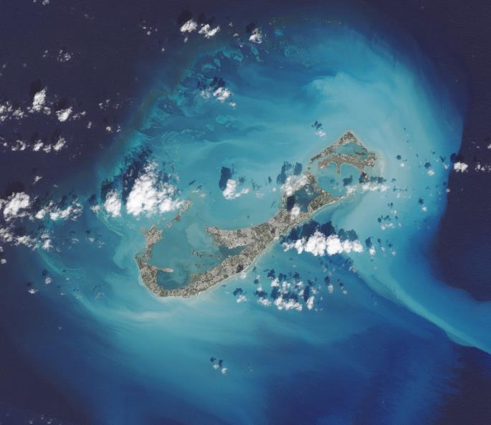
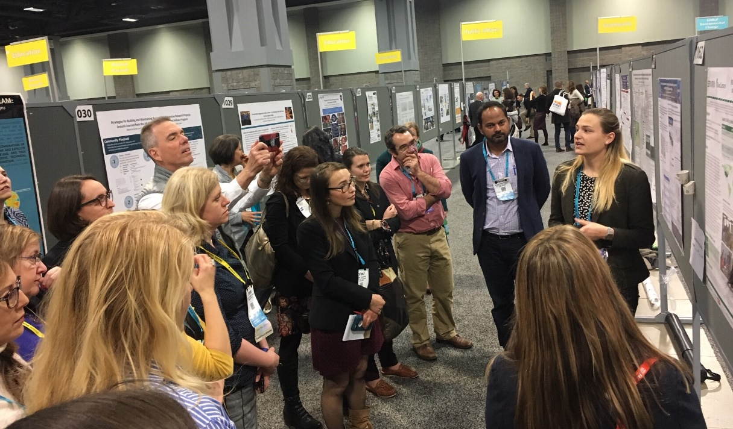
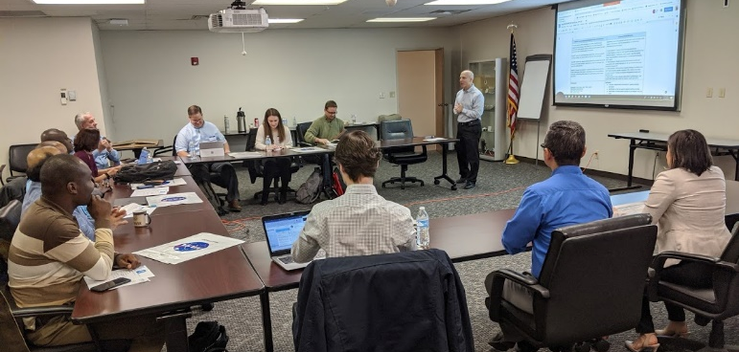
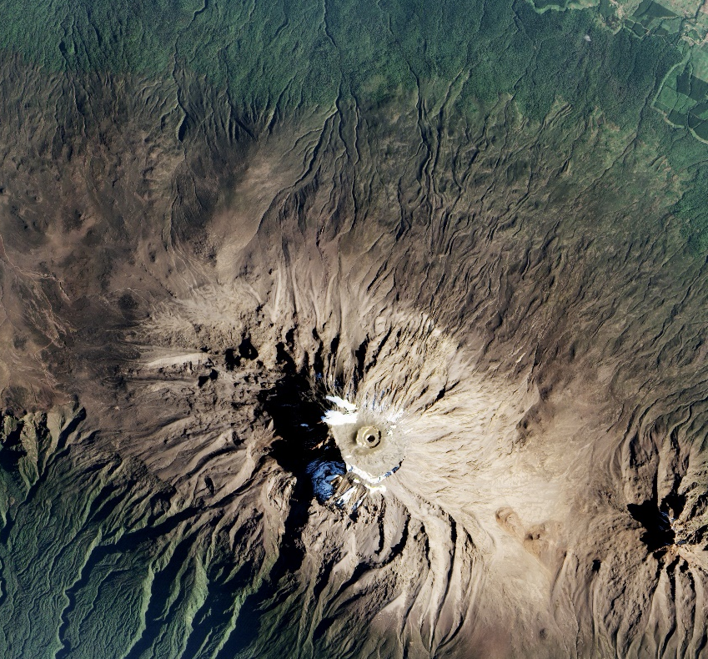

NASA Applied Sciences & Capacity Building Program
November 20, 2020
Notes:
All image credits: NASA
Photos: NASA CBP
EO Imagery:
https://earthobservatory.nasa.gov/images/89605/the-zones-of-Kilimanjaro (bottom right)
https://landsat.visibleearth.nasa.gov/view.php?id=84595 (top left)

Slide 2
NASA & Applied Sciences

Slide 3

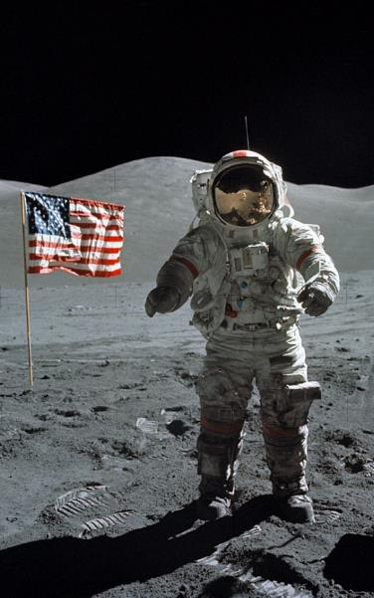
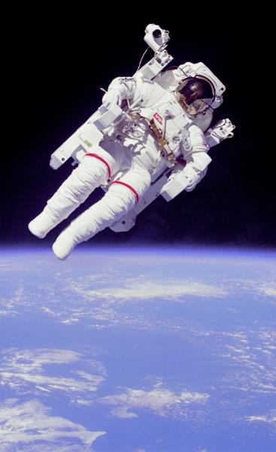

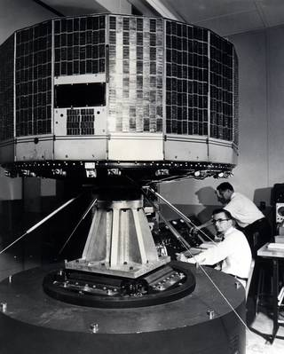
NATIONAL AERONAUTICS AND SPACE ADMINISTRATION
When you think of NASA, what do you picture?
Moon Landing
Astronauts
What about Earth-observing Satellites?
Notes:
All image credits: NASA
https://www.nasa.gov/topics/earth/features/tiros-video.html
https://www.nasa.gov/multimedia/imagegallery/image_feature_559.html

Slide 4
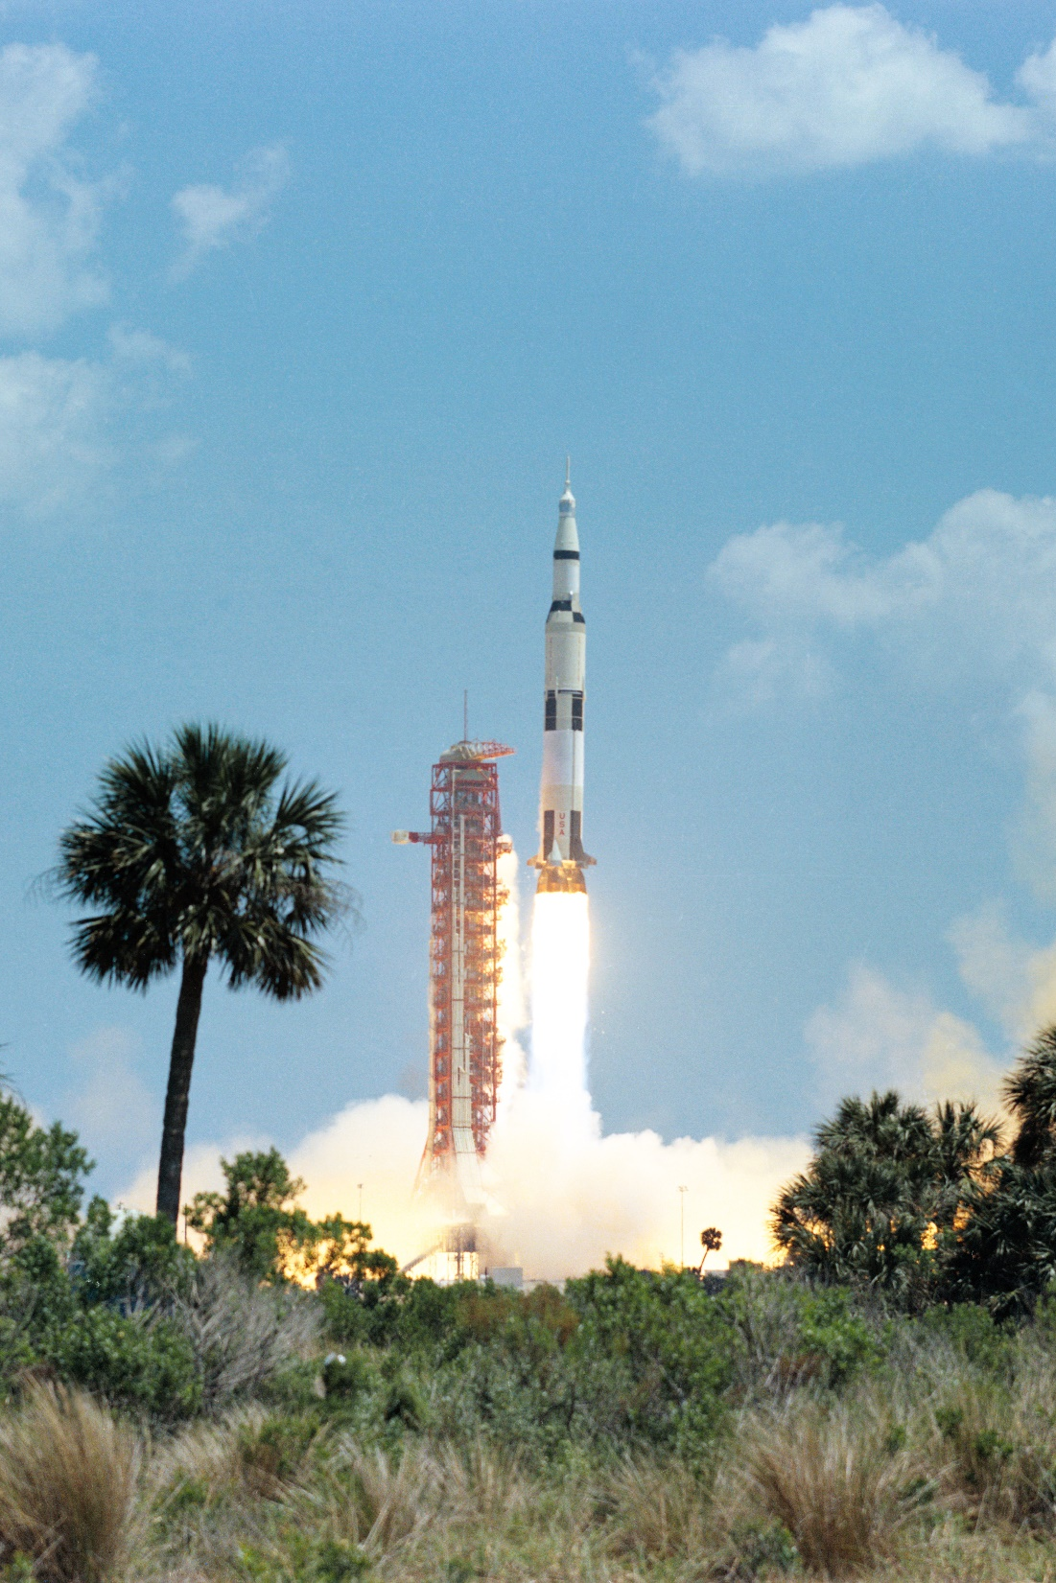
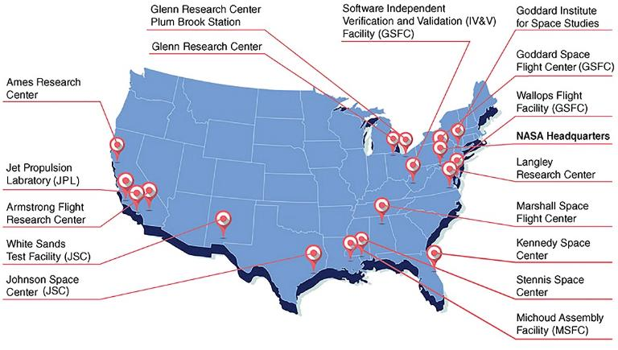
ABOUT NASA
To discover and expand knowledge for the benefit of humanity.
NASA began operations on October 1, 1958
Today, NASA has 10 Centers & 6 facilities around the country, with its headquarters in Washington DC
(GSFC)
Notes:
All image credits: NASA
www.nasa.gov/
https://www.nasa.gov/content/launch-images

Slide 5
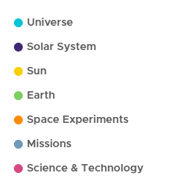
NASA ORGANIZATION
5 Mission Directorates
Science
Human Exploration & Operations
Space Technology
Aeronautics Research
Mission Support
How do planets and life originate?
How does the universe work and what are its origin and destiny?
How and why are Earth’s climate and the environment changing?
How and why does the Sun vary and affect Earth and the rest of the solar system?
Are we alone?
The Science Mission Directorate uses the vantage point of space to achieve a deep scientific understanding of our planet, other planets, solar system bodies, the interplanetary environment, the Sun and its effects on our solar system, and the universe beyond.
Notes:
References:
https://www.nasa.gov/sites/default/files/atoms/files/nasa_organization_chart_august_2020.pdf
https://science.nasa.gov/

Slide 6




Understanding Earth as a system
EARTH SCIENCE DIVISION
The Earth Science Division (ESD), conducts scientific studies to understand the Earth as a system & on all time scales. ESD utilizes NASA’s ability to view the Earth from the unique vantage point of space.
ESD provides uniformly high-quality data covering the planet to support the pursuit of answers to fundamental science questions. There are four lines of business:
Flight
Develops, launches, and operates NASA’s fleet of Earth-observing satellites, instruments, and aircraft. Manages data systems to make the data freely and openly available.
Technology
Tests and demonstrates scientific technologies for future satellite and airborne missions: Instruments, Information Systems, Components, In-Space Validation.
Research & Analysis
Supports research that advances knowledge of the Earth as a system. Six focus areas plus field campaigns, modeling, and scientific computing.
Applied Sciences
Supports innovative and practical uses of Earth observations and scientific knowledge by private and public sectors to inform their planning, decisions, and actions.
Notes:
References:
https://science.nasa.gov/earth-science

Slide 7






APPLIED SCIENCES PROGRAM
Harnessing Earth observations to find solutions to Earth’s greatest challenges.
The Applied Sciences Program helps people across the world use NASA data to solve big problems right here on Earth.
Provides support and funding to help institutions and individuals make better decisions about our environment, food, water, health & safety
Strategically invests in projects and teams that develop innovative and practical uses of Earth observations & lower the barriers to using Earth science information
Enables the early and ongoing involvement of users throughout the lifecycle of Earth science satellite and instrument missions
Supports improved abilities for users to ideate applications, contribute to planning and design, be prepared to use the data after launch, engage with mission scientists, & provide unique feedback to mission teams
Notes:
Reference: https://appliedsciences.nasa.gov/

Slide 8
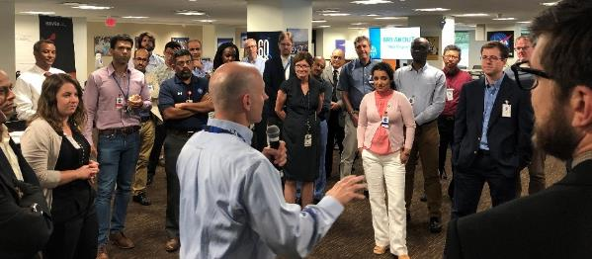
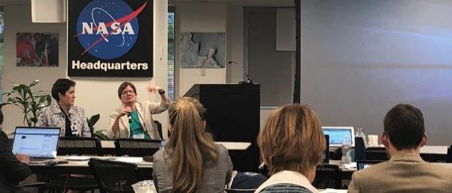
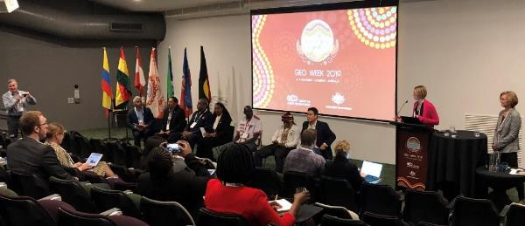
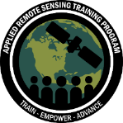


EMPOWERING PEOPLE & COMMUNITIES
Making Earth Data Accessible to All
The Capacity Building Program provides individuals and institutions with workforce development, training activities, and collaborative projects to strengthen understanding of Earth observations and expand their use around the world.
Through our ARSET, DEVELOP and SERVIR programs and our Indigenous Peoples Pilot project, we work with everyone at every level — from first-time users to long-time professional users of Earth observation data.
We work through global networks like CEOS, GEO, and professional societies like AGU, to promote open data access and coordinate capacity building activities focused on users needs.
https://appliedsciences.nasa.gov/what-we-do/capacity-building
Notes:
All Image Credits: NASA CBP
Reference: https://appliedsciences.nasa.gov/what-we-do/capacity-building

Slide 9
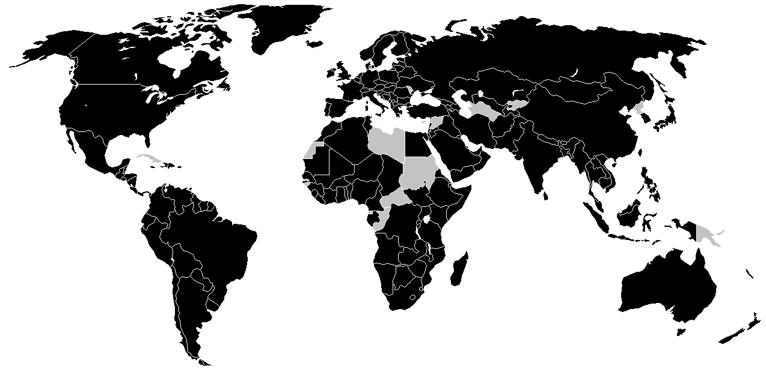
2019 REACH
163 Trainings
71 Co-developed Projects
56 Feasibility Studies
14,445
Individuals
4,556
Institutions
158
Countries
50
U.S. States
&
in
&
through
Tribal (1%)
Local Govt (3%)
Consortium (1%)
State
Govt.
(5%)
Intergovt. (2%)
Private
(Non-Profit)
(13%)
Academia
(38%)
Institution
Sectors
Private
(For-Profit)
(16%)
Federal Govt.
(19%)
countries reached
https://appliedsciences.nasa.gov/join-mission/publications-resources/2019-capacity-building-annual-report
Notes:
References: https://appliedsciences.nasa.gov/join-mission/publications-resources/2019-capacity-building-annual-report

Slide 10
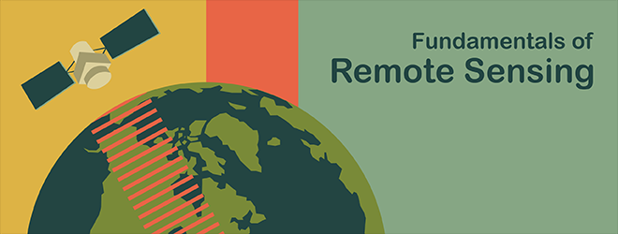
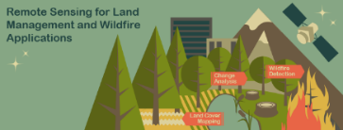

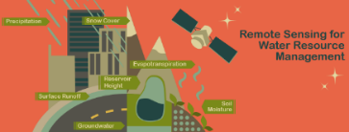
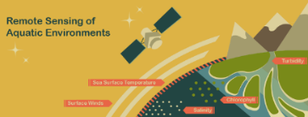
APPLIED REMOTE SENSING TRAINING
ARSET
ARSET empowers the global community through remote-sensing trainings. Through online and in-person trainings, participants learn how to use NASA Earth science data, applications, and models. Participants can then apply these free resources to environmental management and decision support.
With a target audience of policymakers, non-governmental organizations (NGOs), and other applied science professionals, these trainings are open and free for everyone.
Trainings:
Online & in-person
Live & on-demand
Thematic-focused (ex. Water resource management) & satellite-focused (ex. NASA EO fleet)
Awareness → Fundamentals → Introductory → Advanced
One day to three weeks
Notes:
Imagery Credits: NASA ARSET
Reference: https://appliedsciences.nasa.gov/arset

Slide 11
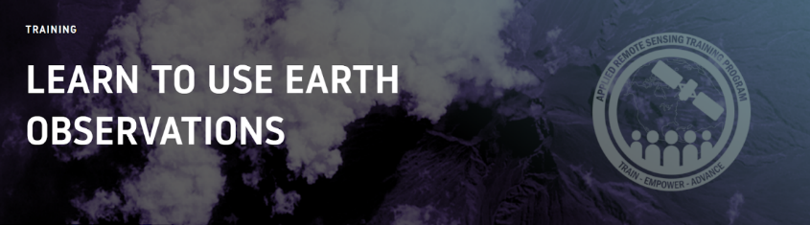
ARSET TRAININGS
https://appliedsciences.nasa.gov/arset
Upcoming ARSET Trainings
Satellite Remote Sensing for Urban Heat Islands
Introduction to NASA’s “Black Marble” Night Lights Data
Relevant ARSET Trainings
Fundamentals of Remote Sensing
An Introduction to Synthetic Aperture Radar
Radar Remote Sensing for Land, Water, & Disasters Applications
Remote Sensing for Disasters Scenarios
Monitoring Urban Floods Using Remote Sensing
NASA Remote Sensing for Flood Monitoring and Management
Monitoring Tropical Storms for Emergency Preparedness
Integrating Remote Sensing into a Water Quality Monitoring Program
Using Earth Observations to Monitor Water Budgets for River Basin Management
An Inside Look at How NASA Measures Air Pollution
Application of Satellite Observations for Air Quality and Health Exposure
Land Cover Classification with Satellite Imagery
Accuracy Assessment of a Land Cover Classification
Notes:
Imagery Credits: NASA ARSET
Reference: https://appliedsciences.nasa.gov/arset

Slide 12
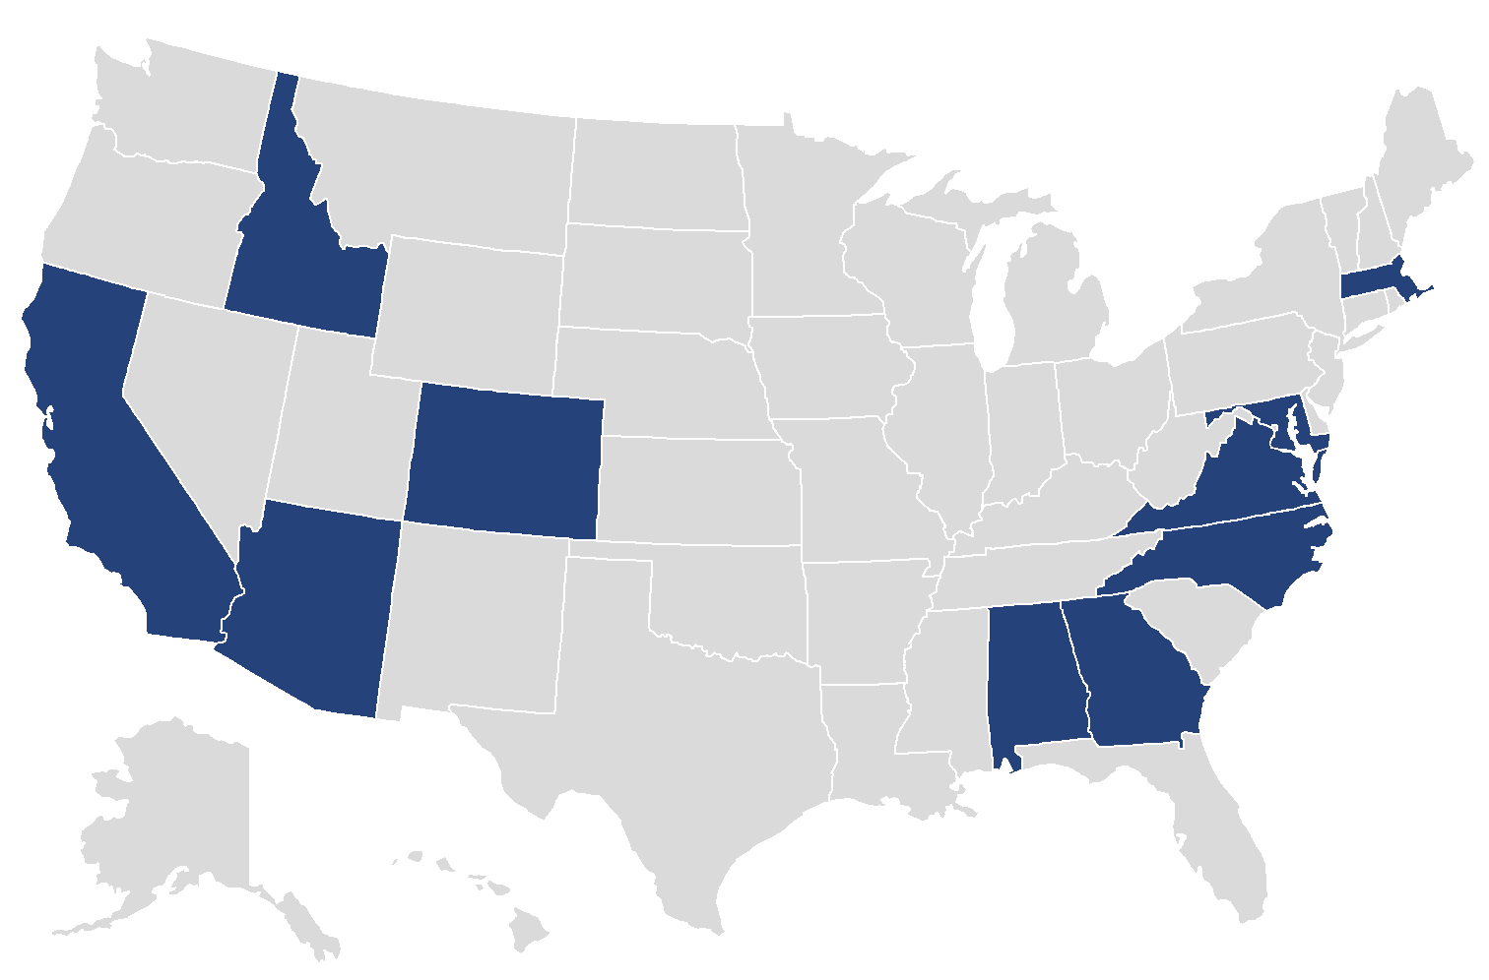

WORKFORCE DEVELOPMENT
DEVELOP has 11 locations across the United States.
DEVELOP
DEVELOP addresses environmental and public policy issues through interdisciplinary research projects that apply the lens of NASA Earth observations to community concerns around the globe. Each feasibility study explores the integration of freely-available NASA Earth observations into partner decision making processes.
Through 10-week feasibility projects, the program builds capacity to use Earth observations in participants (recent graduates, students, and transitioning professionals – anyone 18 and over) and partner organizations (ex. state & local govt., NGOs, etc.). Projects are conducted under the guidance of NASA and partner organization Science Advisors & mentors.
Feasibility Studies:
10 weeks
Local scale
Apply NASA Earth observations
Address partner decision making needs
40-50 feasibility studies are conducted each year during three terms (spring, summer, and fall).
Notes:
Imagery Credits: NASA DEVELOP
Reference: https://develop.larc.nasa.gov/

Slide 13




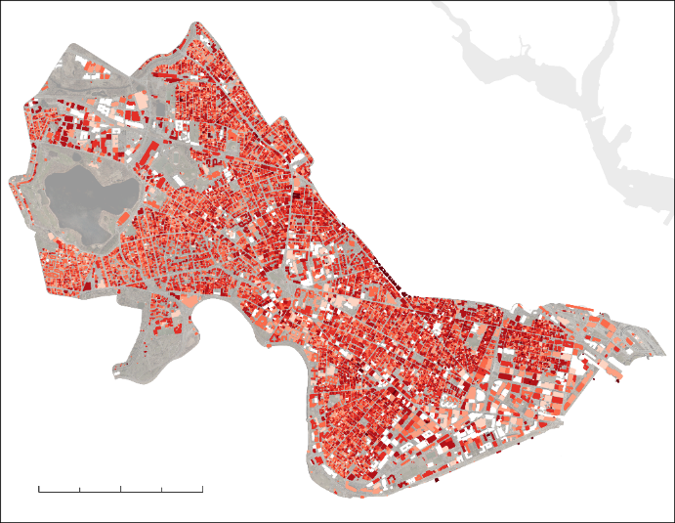
https://develop.larc.nasa.gov/
DEVELOP STUDY EXAMPLE
Useful Links:
Project Archive
Interactive Mapper
YouTube Gallery
GitHub Repository
Opportunities:
Apply to be a participant
Summer Term
Term Dates: 6/7 – 8/13
Application Window: 1/18 – 2/26
For more information about eligibility requirements and logistics, visit: https://develop.larc.nasa.gov/apply.php
Cambridge Urban Development:​ Quantifying Changes in Urban Albedo with NASA Earth Observations to Reduce Urban Heat Island Effect in Cambridge, Massachusetts ​
Urban Heat Island Effect
Temperature
Rural
Suburban
Urban
Suburban
Rural
Partners:
City of Cambridge’s Community Development Department
AGU TEX
Higher Albedo = Reflects More
Lower Albedo = Absorbs More
Albedo
< 1.0
< 0.8
< 0.7
Objectives:
Calculate changes in rooftop albedo using MODIS data
Map temperature “hotspots”
Create an interactive ArcGIS Dashboard
< 0.6
< 0.5
< 0.4
0
1
2 km
< 0.3
Results:
On average, albedo increased by 0.12 across the city, with the majority of positive change in commercial areas. Analysis of mean summer nighttime land surface temperature between 2003 and 2019 revealed a non-significant increase in temperature, although temperature anomaly maps demonstrated that Cambridge was warmer on average than rural areas. These results were incorporated in the interactive Cambridge Urban Heat Dashboard, which allows users to explore temporal trends in albedo.
Notes:
Imagery Credits: NASA DEVELOP
References:
https://develop.larc.nasa.gov/
https://develop.larc.nasa.gov/2020/summer/CambridgeUrbanDev.html

Slide 14
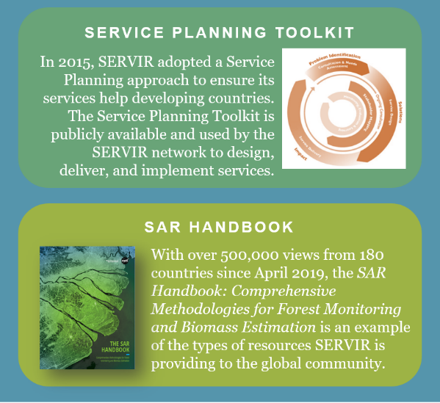

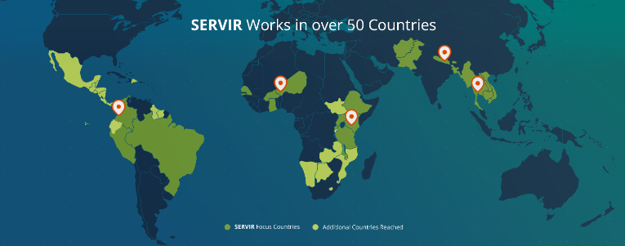
CONNECTING SPACE TO VILLAGE
SERVIR
A joint development initiative of NASA and USAID, SERVIR works in partnership with leading regional organizations world-wide to help developing countries use information provided by Earth observing satellites and geospatial technologies for managing climate risks and land use.
SERVIR empowers decision-makers with tools, products, and services to act locally on climate-sensitive issues such as disasters, agriculture, water, and ecosystems and land use.
Using a service planning approach, SERVIR co-develops geospatial services, tools, data, and training resources.
SERVIR’s Coordination Office is located at NASA Marshall in Huntsville, AL
SERVIR has 5 regional hubs: Amazonia, West Africa, Eastern & Southern Africa, Hindu Kush-Himalaya, and the Lower Mekong
Notes:
Imagery Credits: NASA SERVIR
Reference: https://www.servirglobal.net/

Slide 15
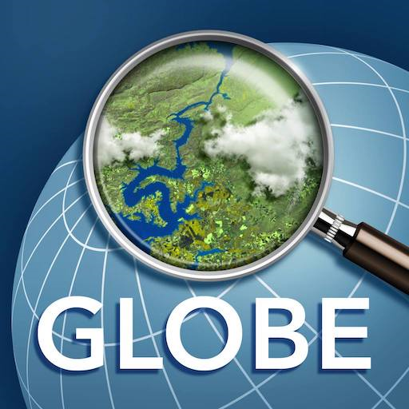
GLOBE
Global Learning & Observations to benefit the Environment Program
The GLOBE Program is an international science and education program, sponsored by NASA, NSF, and the Department of State that provides students and the public worldwide with the opportunity to participate in data collection and the scientific process, and contribute meaningfully to our understanding of the Earth system and global environment.
Provides grade level-appropriate, interdisciplinary activities and investigations about the atmosphere, biosphere, hydrosphere, and soil/pedosphere
Connects students, teachers, scientists, and citizens from different parts of the world to conduct real, hands-on science about their local environment and to put this in a global perspective.
GLOBE Observer is an international network of citizen scientists and scientists working together to learn more about our shared environment and changing climate.
https://www.globe.gov/
Notes:
Image Credit: NASA GLOBE
https://www.globe.gov/en
https://www.nasa.gov/solve/feature/globe
https://observer.globe.gov/

Slide 16
Remote Sensing Fundamentals

Slide 17
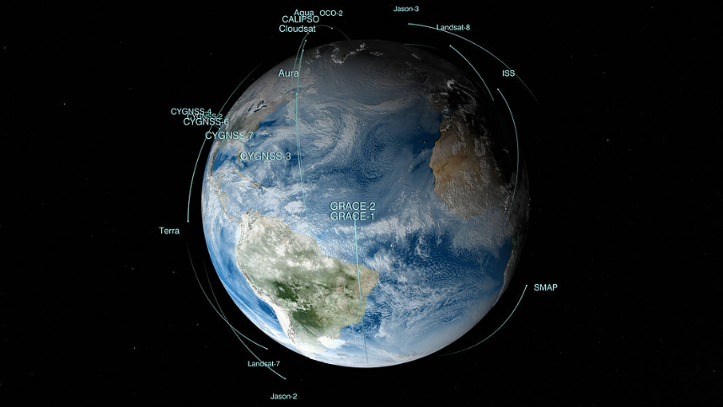
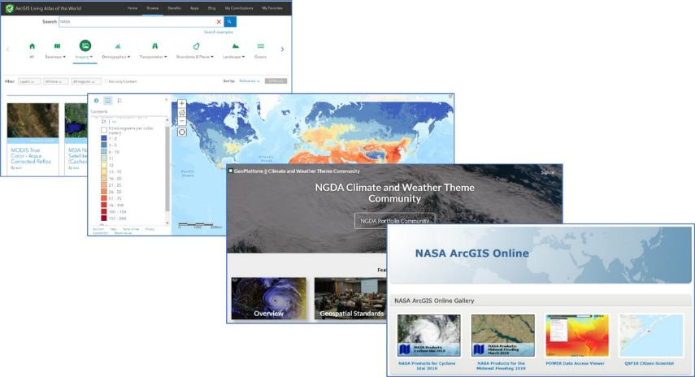
REMOTE SENSING AND GEOSPATIAL ANALYSIS
What is Remote Sensing & Geospatial Analysis?
Remote sensing is the science of identifying, observing, and measuring an object without coming into direct contact with it. Satellites serve as a great vantage point for observing the Earth remotely.
Geospatial analysis is the method of gathering information about certain geographical locations using satellites imagery & data sources to examine change on Earth.
Notes:
Image Credits: NASA
https://www.nasa.gov/multimedia/imagegallery/iotd.html
https://earthdata.nasa.gov/esds/egist
https://earthobservatory.nasa.gov/features/RemoteSensing
https://earthdata.nasa.gov/learn/remote-sensing

Slide 18
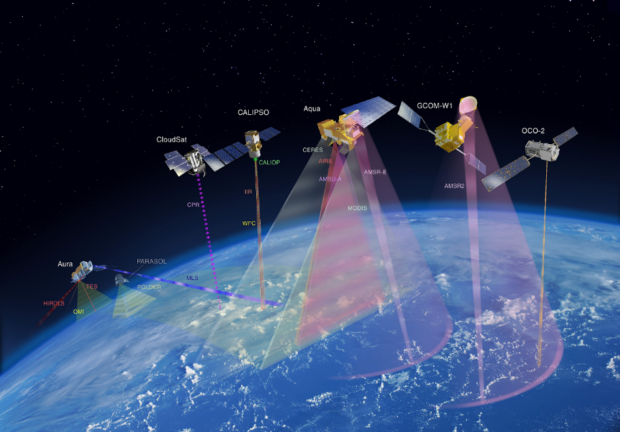
Remote Sensing: BENEFITS
Observe and characterize the Earth's surface from your computer
Collect information over large spatial areas and across time
Monitor and understand change over years
Satellite data can be integrated with in situ measurements for a holistic understanding of our environment
Visualize your results in a multitude of ways through mapping, data plots, heat maps, etc.
NASA Earth observation data are a free and open resource for the world
Benefits of Using Satellite Remote Sensing Data & Geospatial Analysis
Notes:
Image Credit: NASA
https://earthobservatory.nasa.gov/features/RemoteSensing
https://earthdata.nasa.gov/learn/remote-sensing

Slide 19
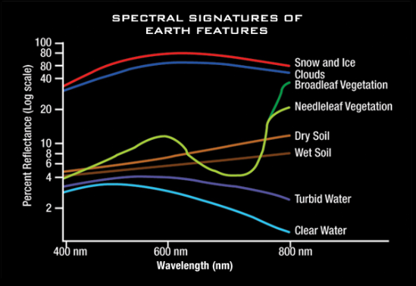
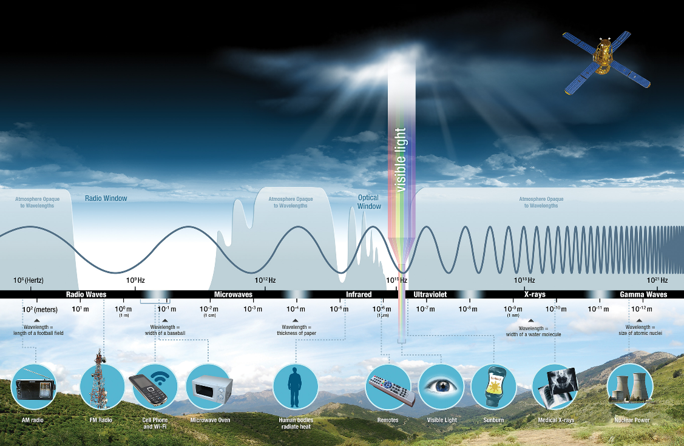
Remote Sensing: ELECTROMAGENETIC SPECTRUM
Electromagnetic energy, produced by the vibration of charged particles, travels in the form of waves through the atmosphere and the vacuum of space
The primary source of the energy observed by satellites, is the sun.
All things on Earth reflect, absorb, or transmit energy, the amount of which varies by wavelength.
Electromagnetic Spectrum
Notes:
Image Credits: NASA
https://earthobservatory.nasa.gov/features/RemoteSensing
https://earthdata.nasa.gov/learn/remote-sensing

Slide 20
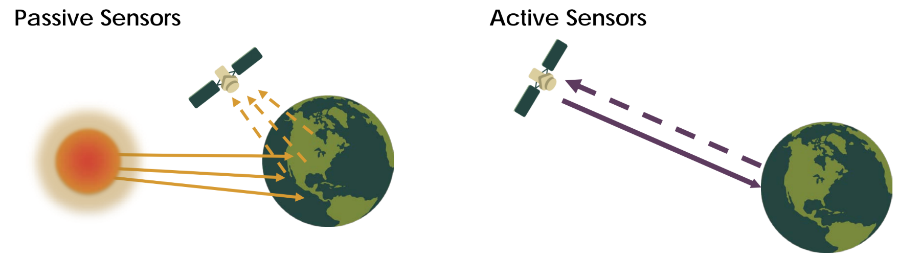
Remote Sensing: SENSORS
Sensors, or instruments, onboard satellites and aircraft use the sun as a source of illumination or provide their own source of illumination, measuring the energy that is reflected back. Sensors that use natural energy from the sun are called passive sensors; those that provide their own source of energy are called active sensors.
Notes:
Image Credit: NASA
https://earthdata.nasa.gov/esds/egist

Slide 21
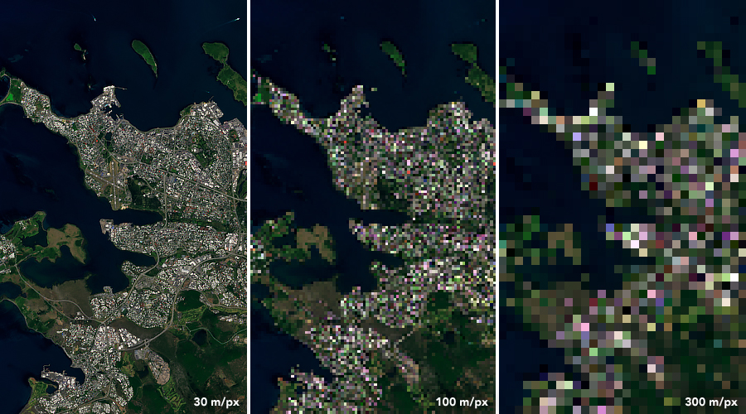
Remote Sensing: RESOLUTION
Resolution plays a role in how data from a sensor can be used. Depending on the satellite’s orbit and sensor design, resolution can vary. There are four types of resolution to consider for any dataset—radiometric, spatial, spectral, and temporal.
Radiometric resolution is the amount of information in each pixel, i.e. the number of bits representing the energy recorded.
Spatial resolution is defined by the size of each pixel within a digital image and the area on the Earth’s surface represented by that pixel.
Spectral resolution is the ability of a sensor to discern finer wavelengths, that is, having more and narrower bands.
Temporal resolution is the time it takes for a satellite to complete an orbit and revisit the same observation area.
Landsat 8 data from July 7, 2019 over Iceland showing varying spatial resolutions.
Notes:
Image Credit: NASA
https://earthdata.nasa.gov/esds/egist

Slide 22
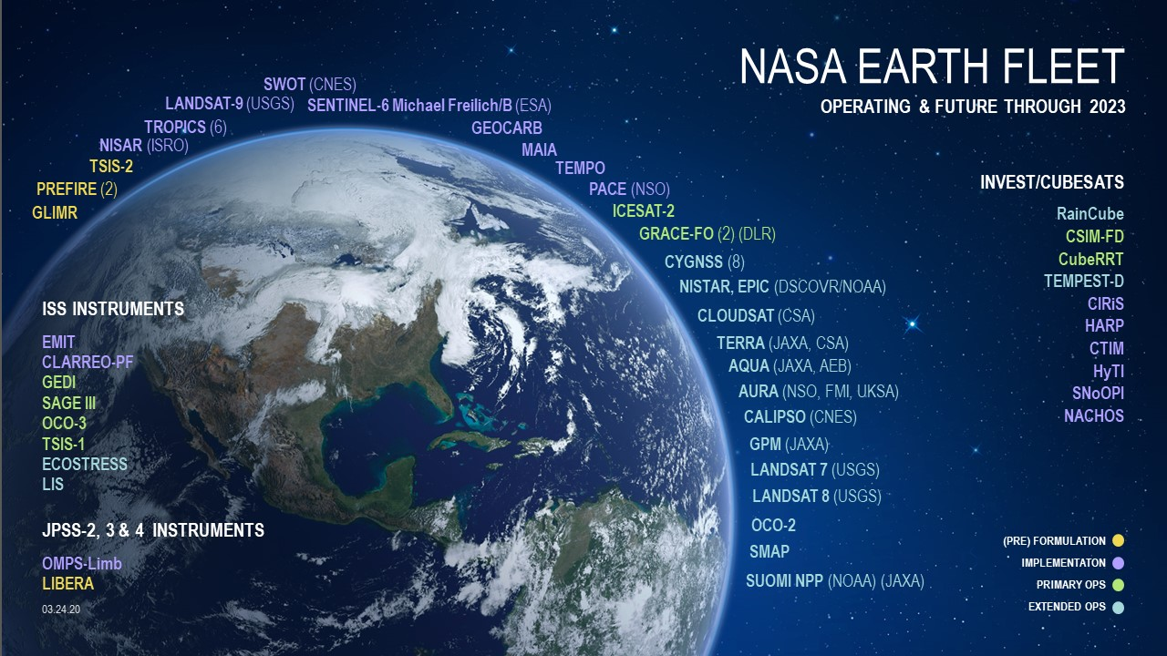
Notes:
Image Credit: NASA
https://science.nasa.gov/earth-science

Slide 23
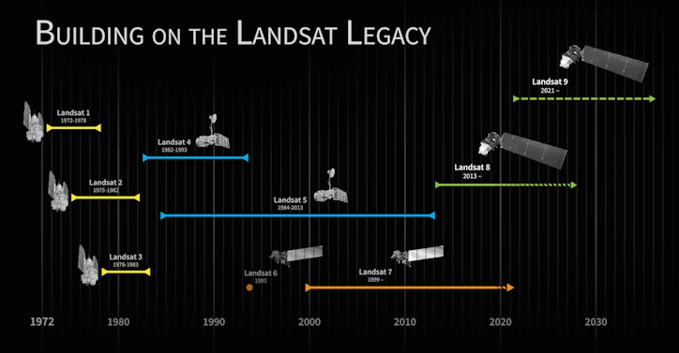
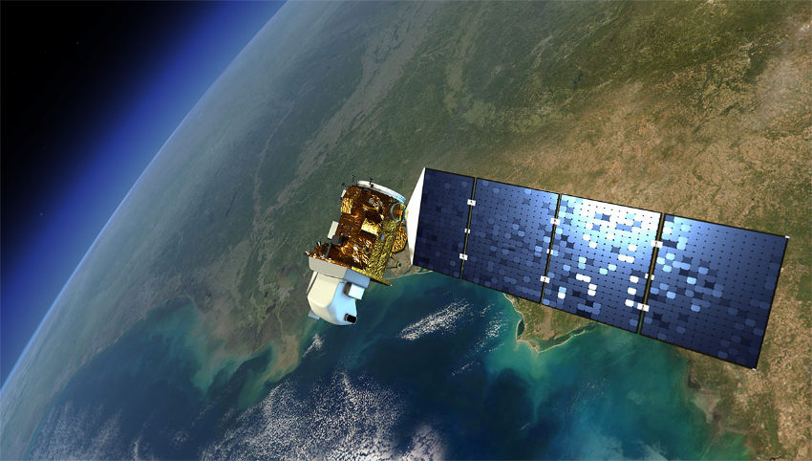
LANDSAT
How can you use Landsat data?
What is Landsat?
The Landsat series of satellites provide the longest continuous space-based record of the Earth's land in existence (1972 to present)
Currently Landsat 7 (launched 1999) and Landsat 8 (launched 2013) are collecting 30m multispectral data of the entire Earth's surface every 16 days
Landsat data informs decisions in many disciplines, especially: human health, agriculture, climate, energy, fire, natural disasters, urban growth, water management, ecosystems and biodiversity, and forest management.
https://landsat.gsfc.nasa.gov/
Notes:
Image Credits: NASA
https://landsat.gsfc.nasa.gov/

Slide 24
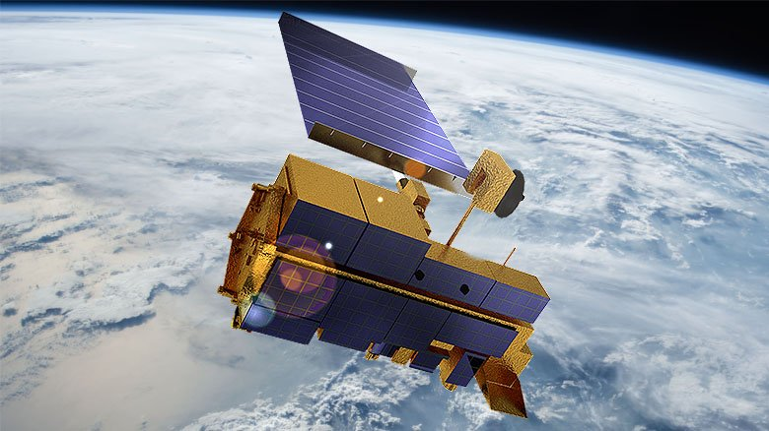
MODIS
How can you use MODIS data?
What is MODIS (Moderate Resolution Imaging Spectroradiometer)?
MODIS collects data supporting four discipline groups: Atmosphere (ex. air quality, clouds), Calibration, Land (ex. snow cover, land surface temperature, vegetation, land cover, albedo, wildfires, evapotranspiration), and Ocean (ex. ocean color).
MODIS instruments are onboard the Terra (launched 1999) and Aqua (launched 2002) satellites
Terra MODIS and Aqua MODIS are viewing the entire Earth's surface every 1 to 2 days
Spatial Resolution: depends on the product, ranging between 250m, 500m, 1km
Temporal resolution: daily, 8-day, 16-day, monthly, quarterly, yearly (2000-present)
Data format: Hierarchal data format- Earth observing format (HDF-EOS)
Spectral Coverage: 36 bands
https://modis.gsfc.nasa.gov/
Notes:
Image Credit: NASA
https://modis.gsfc.nasa.gov/

Slide 25
NASA Data Resources

Slide 26
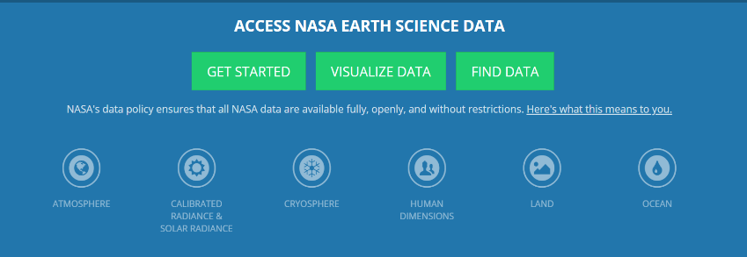
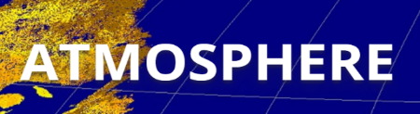
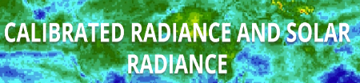


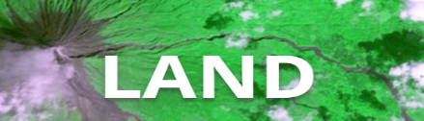
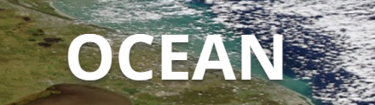
NASA DAACs
(Distributed Active Archive Center)
Where do I find NASA data?
ASDC (ATMOSPHERIC SCIENCE DATA CENTER)
ASF DAAC (Alaska Satellite Facility)
CDDIS (Crustal Dynamics Data Information System)
GES DISC (Goddard Earth Sciences Data and Information Services Center)
GHRC DAAC (Global Hydrology Resource Center)
LAADS DAAC (Level-1 and Atmosphere Archive & Distribution System)
LP DAAC (Land Processes Distributed Active Archive Center)
NSIDC DAAC (National Snow and Ice Data Center)
OB.DAAC (Ocean Biology Processing Group)
ORNL DAAC (Oak Ridge National Laboratory)
PO.DAAC (Physical Oceanography Distributed Active Archive Center)
SEDAC (Socioeconomic Data and Applications Center)
Notes:
Image Credits: NASA
https://earthdata.nasa.gov/eosdis/daacs

Slide 27
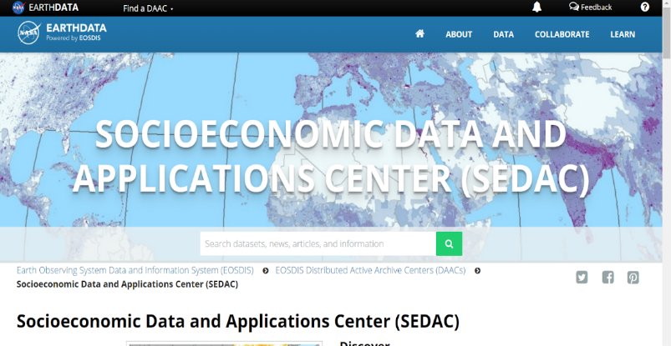
SEDAC
Socioeconomic Data and Applications Center (SEDAC)
One of NASA's data centers within NASA’s Earth Observing System Data and Information System
Focused on human interactions in the environment, SEDAC's mission is to develop and operate applications that support the integration of socioeconomic and Earth science data and to serve as an "Information Gateway" between Earth sciences and social sciences.
SEDAC data and information products and services are designed to help users integrate and apply socioeconomic and Earth science data in their research, educational activities, analysis, and decision making.
SEDAC provides case studies, maps, open-source data, and other visualizations for users to utilize
Focuses on multiple types of environmental challenges from urbanization, poverty, agriculture, floods, and more
https://sedac.ciesin.columbia.edu/
Notes:
Image Credit: NASA
https://sedac.ciesin.columbia.edu/

Slide 28
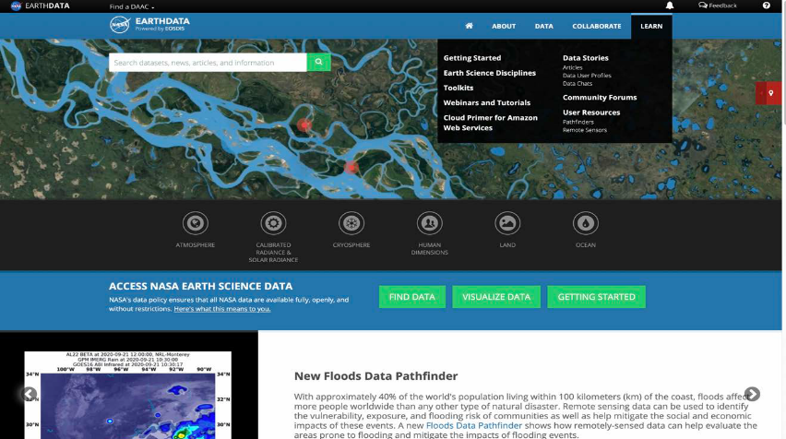
NASA DATA PATHFINDERS
Areas of focus:
Agriculture and Water Resources
Biological Diversity and Ecological Forecasting
COVID-19
Disasters
Geographical Information Systems
Health and Air Quality
Sea Level Change
Water Quality
Wildfires
NASA's Data Pathfinders provide a path for users to understand what datasets are relevant to their environmental issues and needs
Point you to NASA's freely available data
https://earthdata.nasa.gov/learn/pathfinders
Notes:
Image Credit: NASA
https://earthdata.nasa.gov/learn/pathfinders

Slide 29
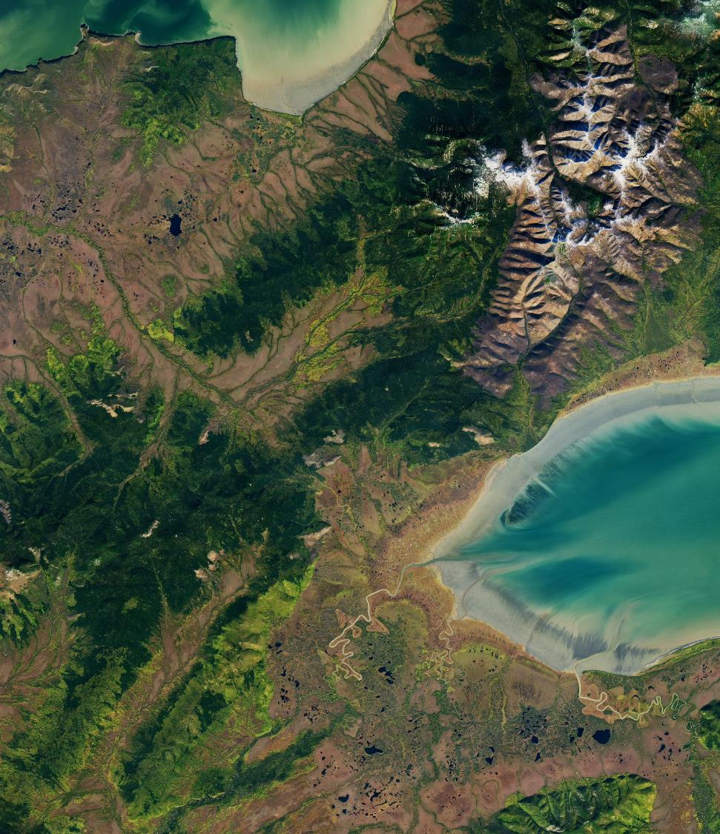
For further information, please visit:
NASA Applied Sciences:
https://appliedsciences.nasa.gov/
Capacity Building Program:
https://appliedsciences.nasa.gov/what-we-do/capacity-building
Notes:
Image Credit: NASA
https://earthobservatory.nasa.gov/images/89981/russias-bay-of-whales

