Slide 1
Using virtual sharding with AWS* S3† to transparently supply missing variables to legacy datasets
AGU Fall 2020
James Gallagher
NASA EED-2 / OPeNDAP
jgallagher@opendap.org
Nathan Potter
NASA EED-2 / OPeNDAP
ndp@opendap.org
Dan Holloway
NASA EED-2 / OPeNDAP
dholloway@opendap.org
*Amazon Web Services
†Simple Storage Service
This work was supported by NASA/GSFC under Raytheon Technologies contract number NNG15HZ39C.
This document does not contain technology or Technical Data controlled under either the U.S. International Traffic in Arms Regulations or the U.S. Export Administration Regulations.

Slide 2
Web Object Store
Large storage capacity – petabytes, …
Unstructured data
Access to objects using HTTP*
No native POSIX† filesystem support
* Hypertext Transfer Protocol
† Portable Operating System Interface

Slide 3
Legacy data
There’s petabytes of legacy data
Even ‘new’ data are effectively ‘legacy’
  Formats/packaging are a decade⁺ old
How can we use these data?
We can use these data efficiently in a web object store (WOS)

Slide 4
Here’s one way
Example: A data file with three variables
HTTP provides a way to read a range of bytes
…aka ‘Range GET’
    Data

Slide 5
Here’s one way
Add metadata describing where each variable resides – both the object and location in the object*
Store the metadata in a separate object
    Data
Metadata
Notes:
* This is important for later…

Slide 6
Here’s one way
    Data
Server or API*
2
Response
1
Metadata
Access by reading metadata and …
Use that to read data
* Application Programming Interface
Notes:
NB: Each metadata entry

Slide 7
We call this ’DMR⁺⁺’
Preserves the original format/structure
Works with any WOS that supports HTTP
  e.g., Google Cloud Storage, Amazon S3
Enables subset-in-place operations
Supports both servers and APIs
* DMR: Dataset Metadata Response

Slide 8
But Servers often do more
Servers often ‘enhance’ legacy data
Adapt old data to new standards
Add missing information
And more…
Can we decouple these operations from access?
Notes:
And more: Modify data types, aggregate separate granules, provide alternate indexing schemes, …

Slide 9
Use case: Add missing data
    Data
Add ‘companion’ data object/file
Reference the new data in metadata for the original data file
Metadata records which object holds which variable
Metadata
    Companion
    data
Notes:
NB: This works because each metadata record includes both the object and location within the object.

Slide 10
Use case: Add missing data
    Data
2
Server or API
Response
Metadata
1
    Companion
    data
3
The server or API reads the added data seamlessly

Slide 11
Summary
Legacy data are here to stay
It is possible to use ‘legacy’ with a Web object store
The DMR⁺⁺ technique supports both Servers and APIs
It supports augmenting data
Those data are accessed transparently
Thank you

Slide 12


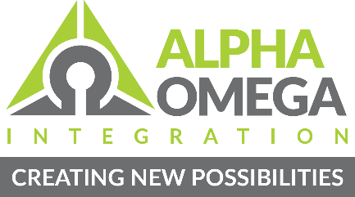



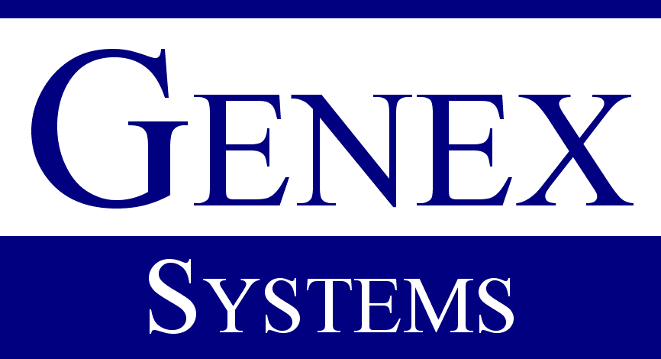









This work was supported by NASA/GSFC under Raytheon Technologies contract number NNG15HZ39C.
in partnership with

