Slide 1

Additive Manufacturing of Electronics for Space Applications
Beth Paquette
NASA Goddard Space Flight Center
  beth.m.paquette@nasa.gov
  301.286.8647

Slide 2
Outline/Agenda
Introduction: Additive Manufacturing Techniques
Next Generation X-Ray Polarimeter
Next Generation Microshutter Array
Future Work
Acknowledgements
Q & A

Slide 3
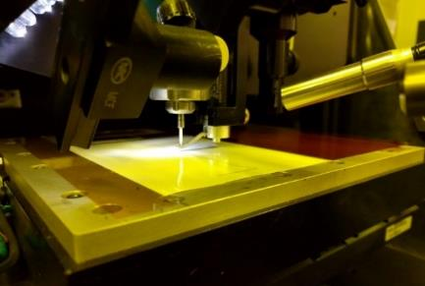
Introduction: Additive Manufacturing Methods
Printed Hybrid Electronics: Deposit conductive and insulating inks onto an existing substrate to create circuits
Aerosol Jet

Slide 4
Why?
Feature sizes down to 10 microns
Variety of substrates – flexible, rigid, 3-dimensional non-planar
Has the potential to reduce mass and volume

Slide 5
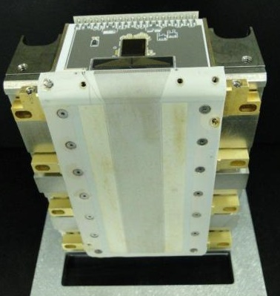
Next Generation X-Ray Polarimeter (NGXP)
ASIC Board
Photoelectron tracks imaged using strip detectors in a gas environment
3 in x 5 in Liquid Crystal Polymer (LCP)
Fan-out area
Traces: 121µm pitch, copper cladding etched
Frame
Original Strip Detector
Notes:
Study sources of X-Rays
Photoelectron tracks imaged using strip detectors in a gas environment
Original strip design: traces at 121-micron pitch, etched into copper cladding on a liquid crystal polymer substrate
The minimum pitch of the strips and the area required to fan the strips in to the pitch of the ASIC readout is limited by the accuracy of the etching, and limits the gas choices and pressure, thus restricting the achievable sensitivity
Reducing the pitch could reduce the Polarimeter design in size, which saves mass, and improves track resolution
A reduction in strip pitch will enable the detector sensitivity to be increased by more than a factor of three and a mission sensitivity increase by more than a factor of ten

Slide 6
NGXP Flexible Prints
Materials:
  Gold and silver inks
  Kapton and Liquid Crystal Polymer (LCP) Substrates
Printer:
  Optomec AJ200
  Pneumatic atomizer for silver ink
  Ultrasonic atomizer for gold ink

Slide 7
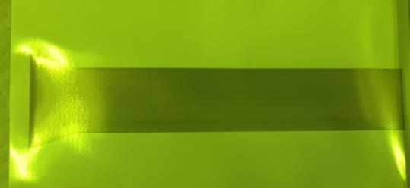
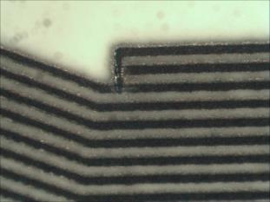
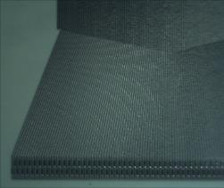
NGXP Flexible Prints
3.5 inches
0.6
inches
120µm pitch
Silver printed on Liquid Crystal Polymer
Traces 60-80µm width

Slide 8
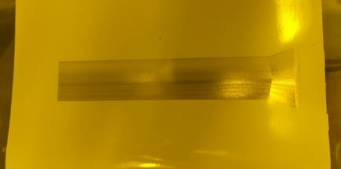
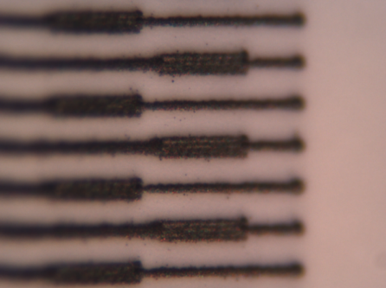
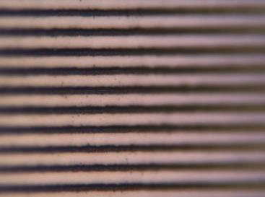
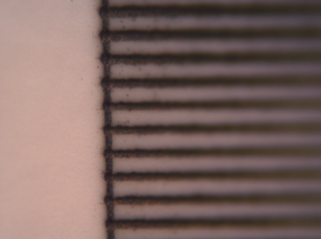
NGXP Flexible Prints
40-80µm width traces
120µm pitch
Silver printed on LCP
Notes:
40µm width increased to 80µm half-way through printing. Settings had to be adjusted to get thinner traces again.

Slide 9
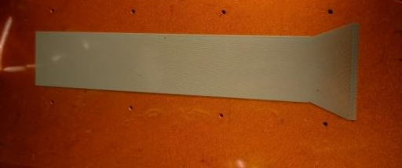
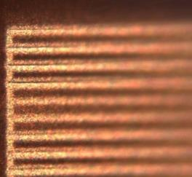
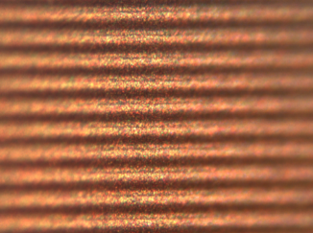
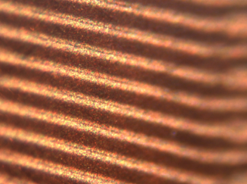
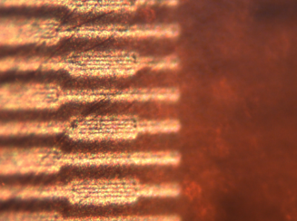
NGXP Flexible Prints
Gold on Kapton
Ultrasonic atomizer
200µm tip
80µm width traces
120µm pitch
Ink appeared dry and powdery. Overspray observed

Slide 10
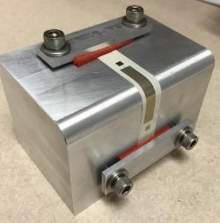

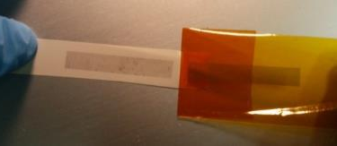

NGXP Flex Mechanical Tests
Tape Testing
Pull directions
Bend Testing
Tensile Testing

Slide 11
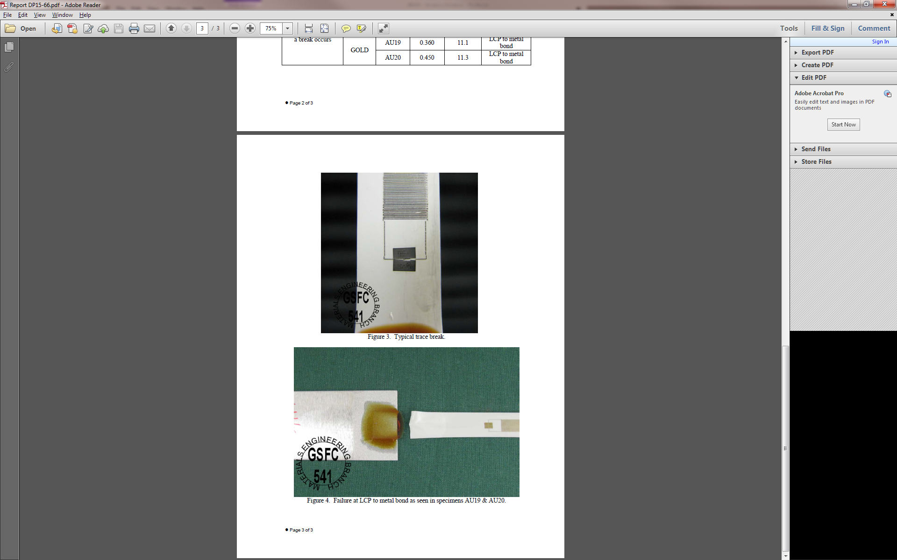

NGXP Flex Mechanical Tests
Tape Tests
Tensile Tests
Trace, bond and LCP breaks observed

Slide 12
NGXP Flex Observations
Printing parameters need to be adjusted over length of print
Results vary between printer operators
Gold ink more cumbersome to use, store
Adhesion of inks to LCP needs improvement

Slide 13
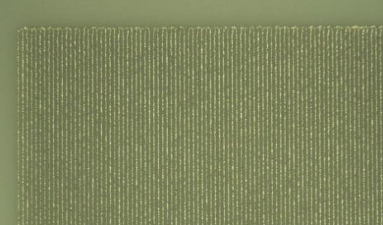
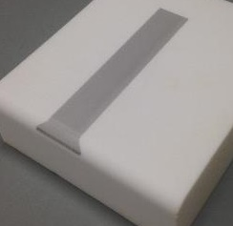
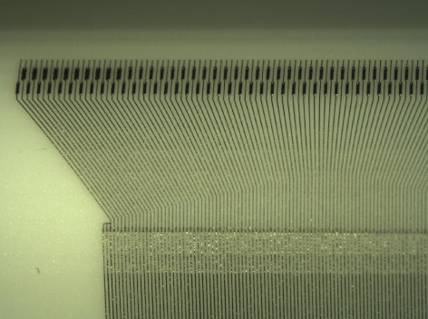
NGXP Rigid Prints
45µm width traces and 120µm pitch
Aerosol Jet Printed Silver Traces on Macor

Slide 14
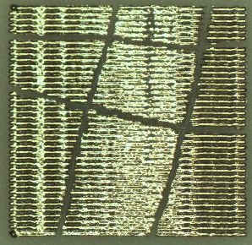
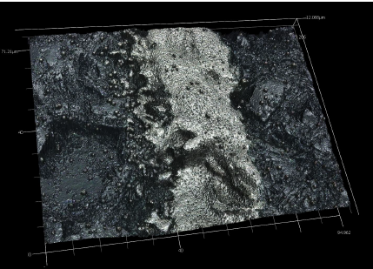
NGXP Rigid Print Tests
Visual and topography imaging
Trace
Substrate
ASTM Adhesion
Class 5B and 4B observed
Traces measured 45.5µm+/-4.4µm

Slide 15
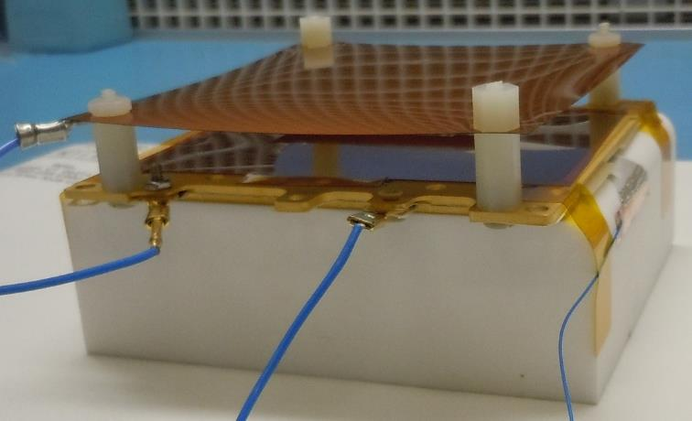
NGXP Rigid Print X-Ray Tests
Electrode layer
X-Rays move parallel to traces
Printed Strip
Charge drifts towards the traces
Strip survived 40+ hours of X-Ray testing

Slide 16
NGXP Rigid Print Observations
Prints on rigid substrates yielded ASTM Class 4B and 5B adhesion (minimal material removed)
Substrate topography may impact trace structure and conductivity
Prints survived X-Ray chamber

Slide 17
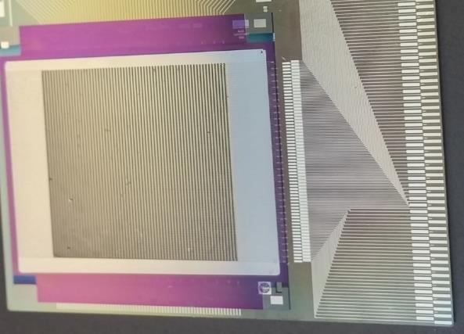
Next Generation Microshutter Arrays (MSA)
High-resolution spectroscopy: Microshutters select many objects in one viewing for simultaneous observation
Microshutter Array
128 pairs of metal pads
Silicon Substrate

Slide 18
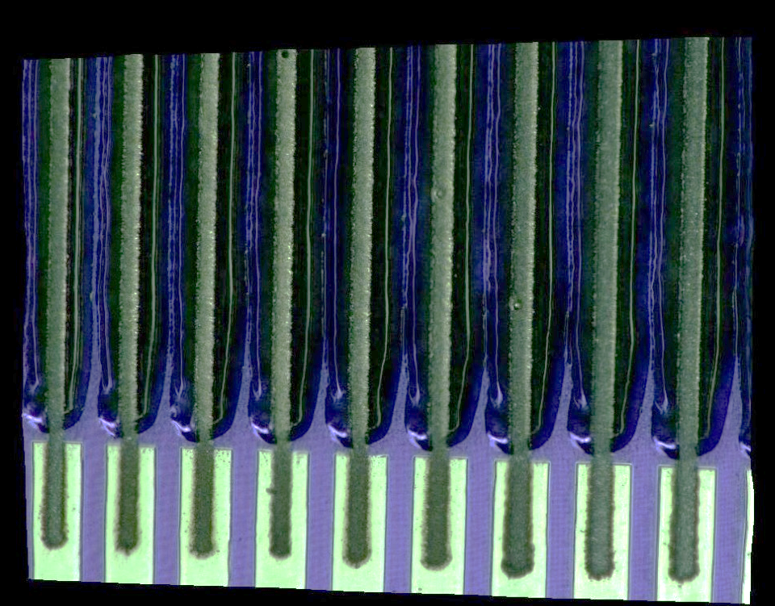
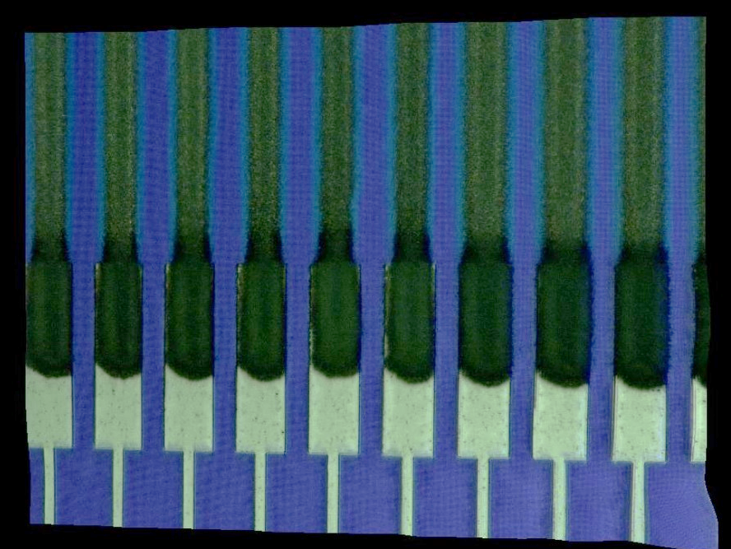
MSA Aerosol Jet (AJ) Test Prints
Printed Silver Lines
Printed Insulator
Metal Pads
Sample without insulator
Sample with insulator
Conductivity tests were successful

Slide 19
MSA AJ Test Prints
Printed Sample on Silicon Squares attached to Wafer
Printed silver lines with 20um width over insulating fillet/”ramp"
Scanning Electron Microscope Images by GSFC

Slide 20
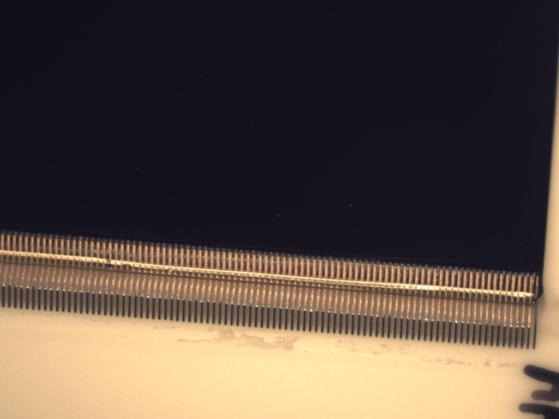
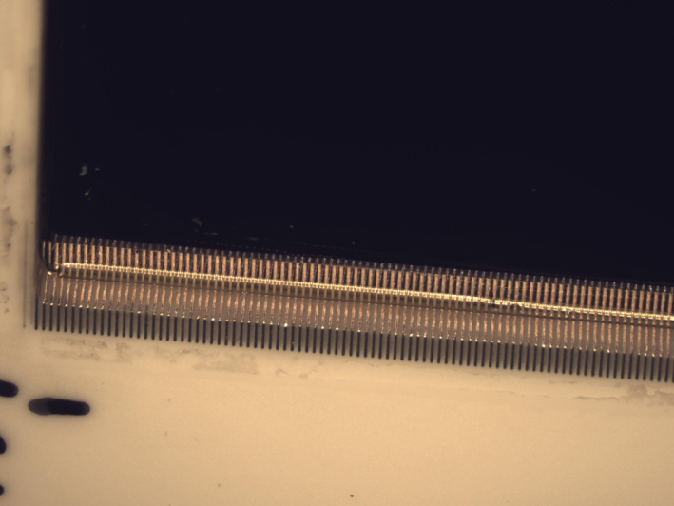
MSA AJ Test Prints
1
130
Left Side
Right Side
Printed silver lines with 25µm width over insulating fillet/”ramp“ [Optomec]
Trace resistivity measured: 10 Ω/mm
Isolation resistance measured greater than 10 GΩ

Slide 21
Future Work
Work with syringe printer and other additive manufacturing methods to produce circuitry
Continue Conductivity and Environmental Testing
Integrate ASIC board design into NGXP
Future applications: Sounding Rocket Demonstration, CubeSat Demonstration

Slide 22
Acknowledgements
Goddard Space Flight Center: Parts, Packaging and Assembly Branch, Meng-Ping Chang, Peng Chen, Kevin Black, Christopher Green, Joe Hill-Kittle, Keith Jahoda, Justin Jones, Mary Li, Eleanya Onuma, Cameron Parvini, Wes Powell, Margaret Samuels, Anna Zajczyk
Justin Bourassa, Mike Renn, Optomec

Slide 23

Thank You!
Contact: beth.m.paquette@nasa.gov

Slide 24
Acronyms
Acronym | Definition
AJ | Aerosol Jet
ASIC | Application Specific Integrated Circuit
ASTM | American Society of Testing and Materials
LCP | Liquid Crystal Polymer
MSA | Microshutter Array
NGXP | Next Generation X-Ray Polarimeter
PEEK | Polyetheretherketone

