Slide 1
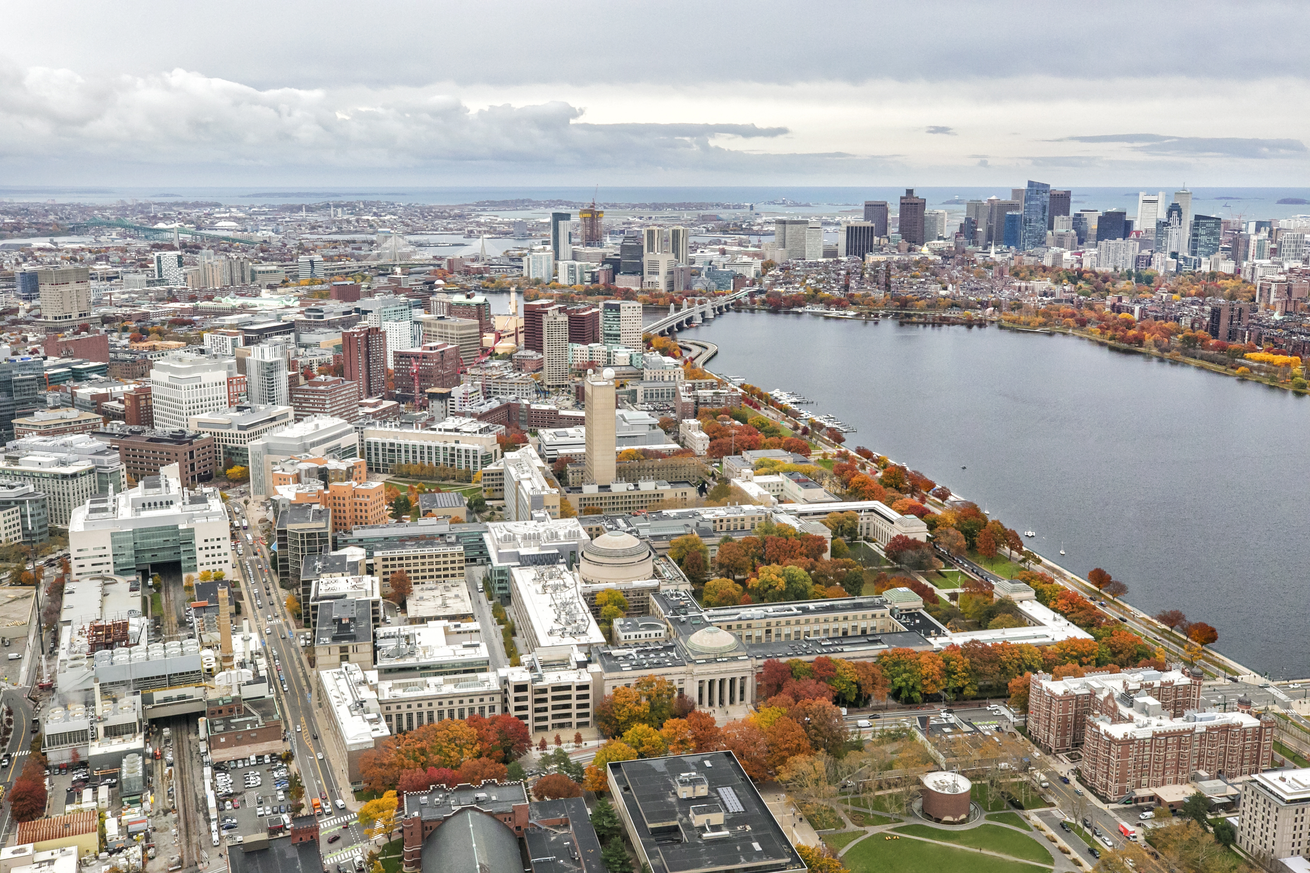






Quantifying Changes in Urban Albedo with NASA Earth Observations to Reduce Urban Heat Island Effect in Cambridge, Massachusetts
Image credit: City of Cambridge
Urban Heat Island Effect
Temperature
Rural
Suburban
Urban
Suburban
Rural
City of Cambridge,
Community Development Department
&
American Geophysical Union’s
Thriving Earth Exchange
Nicole Ramberg-Pihl, Sophie Barrowman,
Liam Bhajan, Olivia Cronin-Golomb, & Celeste Gambino
Notes:
Hello Everyone,
My name is Nicole Ramberg-Pihl and I am excited to share an overview of a project that my teammates and I worked on this past Summer, “Quantifying changes in Urban Albedo with NASA Earth Observations to Reduce Urban Heat Island Effect in Cambridge, Massachusetts.”
UHI Urban Heat Island Effect is a phenomenon where urban environments experience warmer temperatures on average compared to surrounding suburban and rural areas. Temperatures in urban areas can be up to 22 degrees F warmer than surrounding suburban and rural regions – and this effect is often most prominent at night when the surrounding areas cool off and the urban environment remains warmer.
This is what we are depicting with the infographic on the screen before you.
Y axis – Temperature
X axis – Different categories of the built environment – areas where we are both living and working – We have Rural, Suburban, and Urban settings.
********
UHI are attributed to multiple factors including:
The fact that there is a higher density of buildings that trap and release heat
Click for Animation
A lack of trees and vegetation, which are known to provide shade and cooling
Click for Animation
High proportion of low albedo surfaces, such as dark asphalt and roofs
Albedo is a unitless measurement and refers to the proportion of solar radiation that is reflected by a surface. Albedo is important to the study of urban heat islands because low albedo surfaces like dark roofs absorb radiation and emit more heat than high albedo surfaces that reflect radiation away.
********
Elevated temperatures from UHI are associated with increases in heat-related mortalities, increases in energy consumption, air pollution, and impacts to local biodiversity.
And, these impacts can be exacerbated by climate change, and extreme variations in regional temperature – such as heat waves.
By 2030, Cambridge is expected to experience as many as triple the number of days above 90°F per year, along with more heat waves, and overall warmer temperatures due to climate change. Moreover Cambridge consists of over 60 percent impervious surface which as we know can trap heat
*******
The City of Cambridge is a great example of a community that is actively taking steps to increase albedo across the city with hopes that they can lessen the impacts of urban heat. They are even working on a “Climate Change Preparedness and Resilience Plan.”
Our team partnered with the City of Cambridge’s Community Development Department and the American Geophysical Union’s, Thriving Earth Exchange (TEX) to inform ongoing efforts aimed at reducing the impacts of urban heat in the city of Cambridge.
------------------------------Image Information Below ------------------------------
•Image Credit: Summer 2020 MA – Boston Team
•Image Source: Created by Summer 2020 MA-Boston Team Members
•Image Credit: City of Cambridge
•Image Source: Provided by the Partners

Slide 2
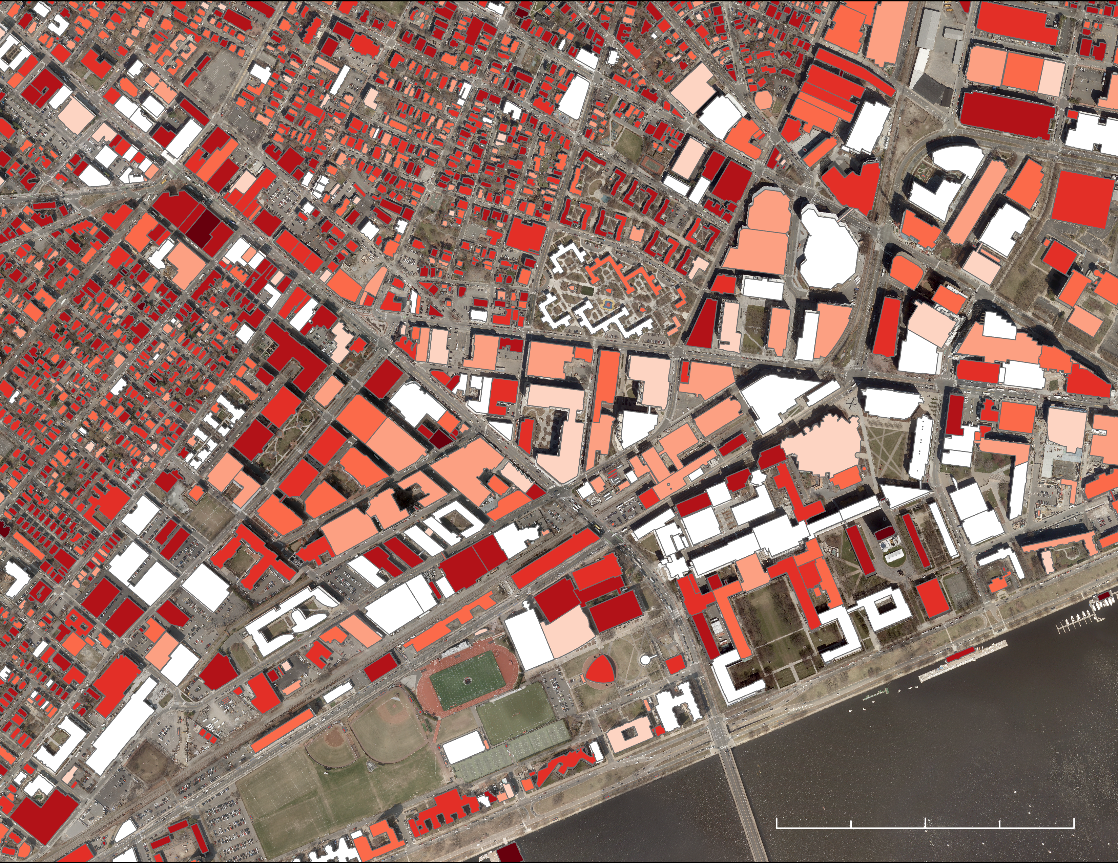
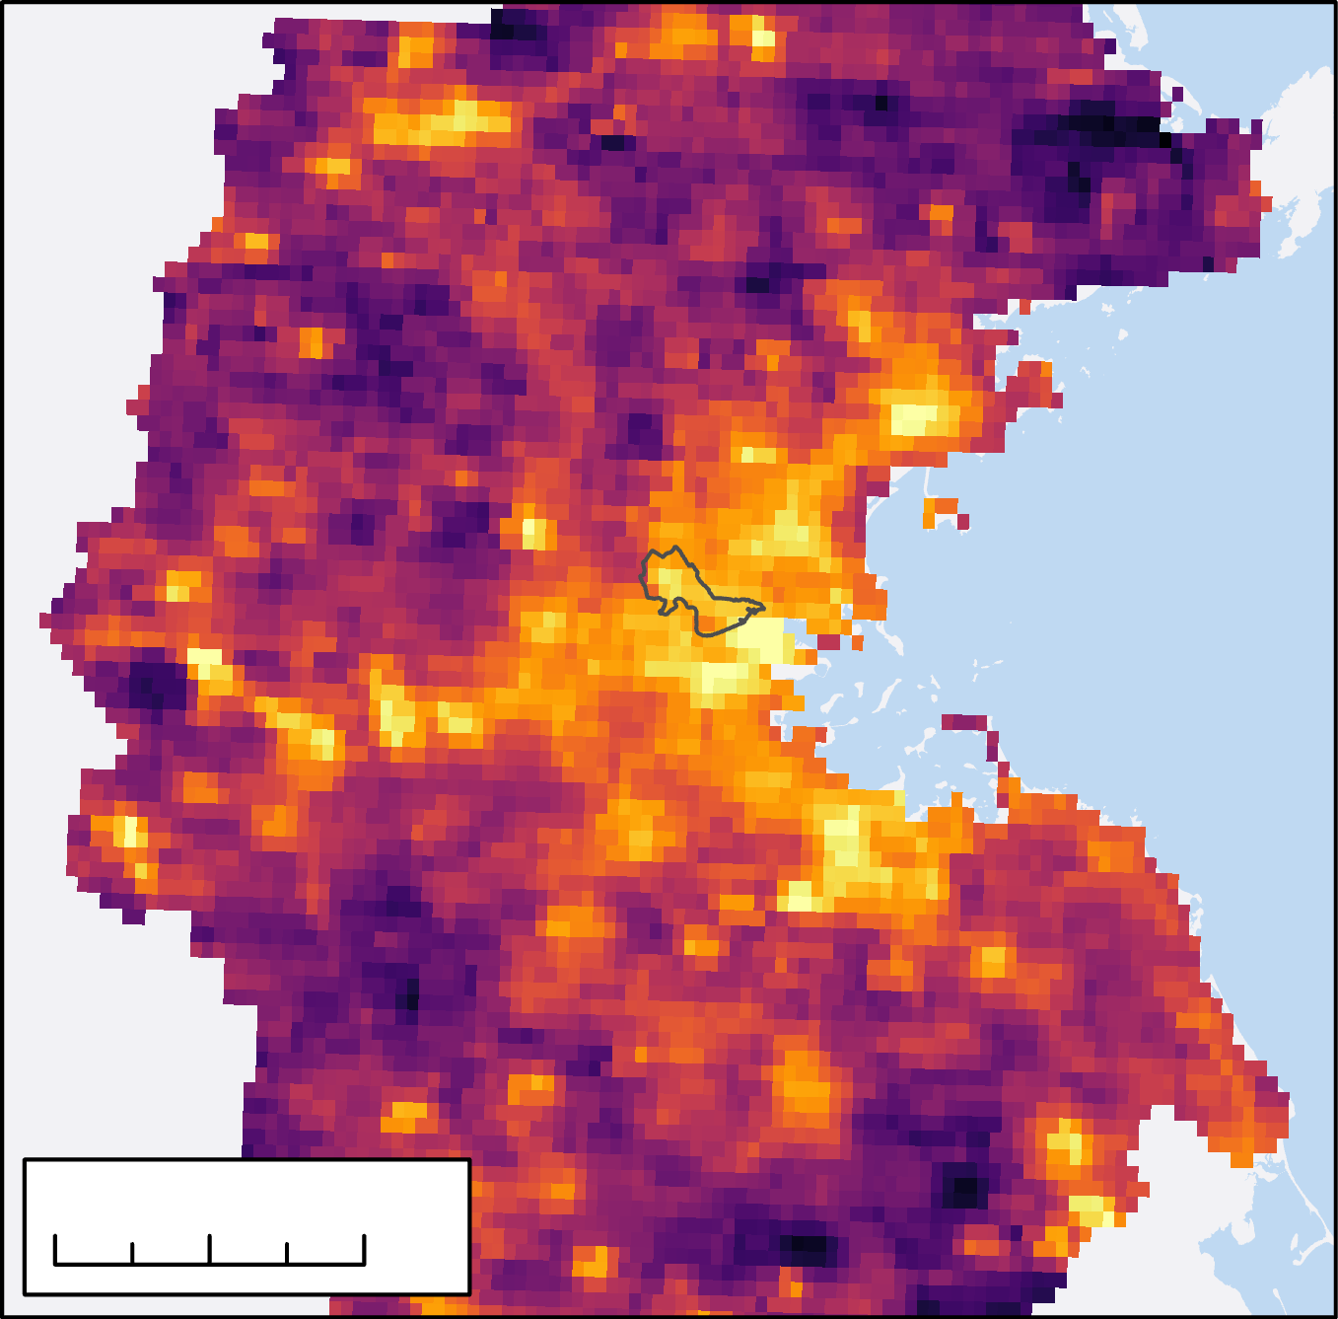
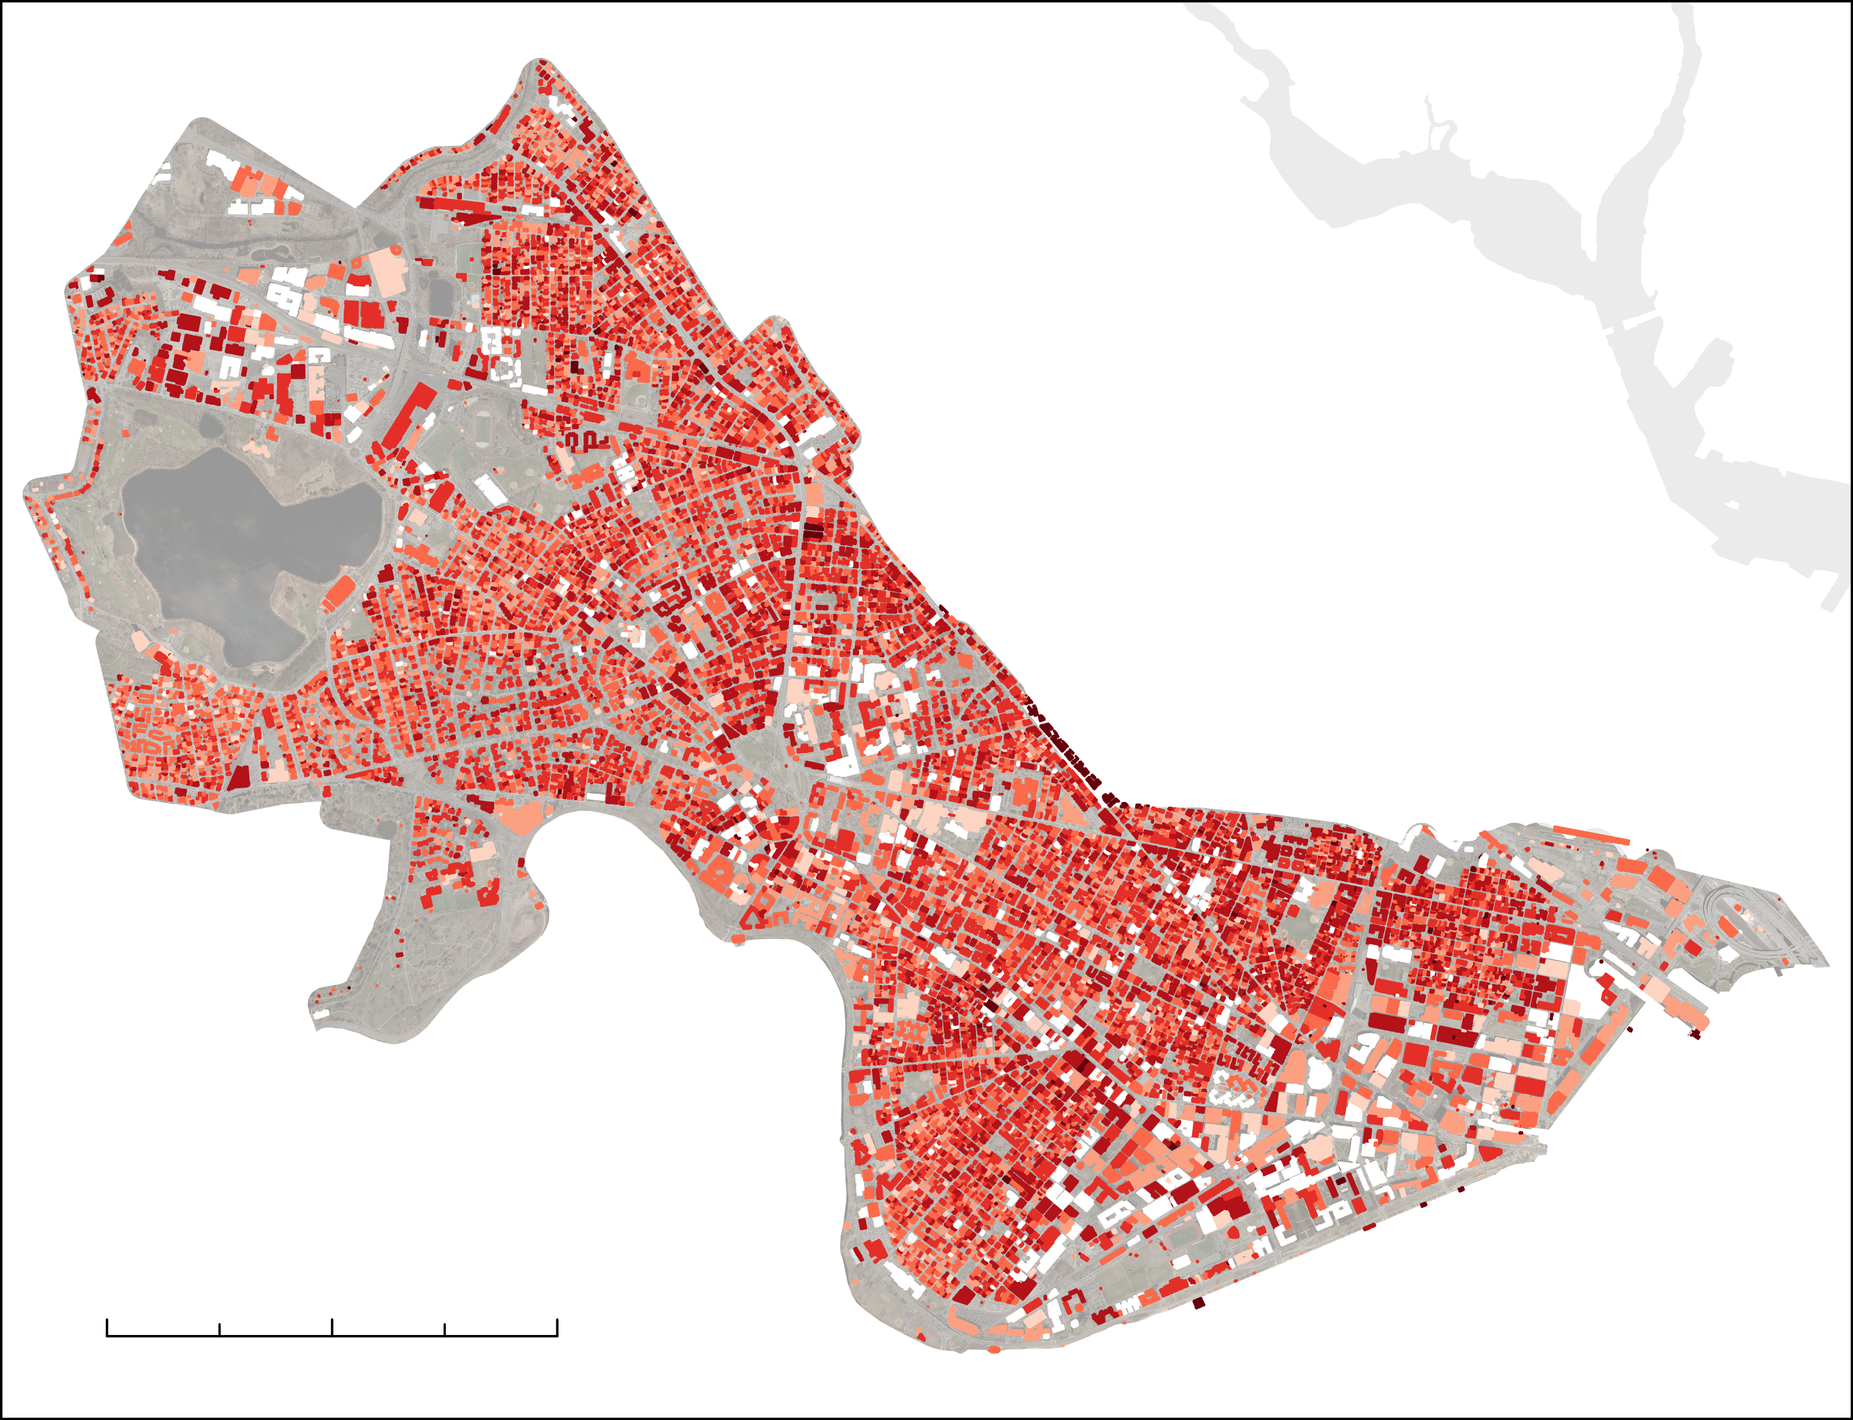
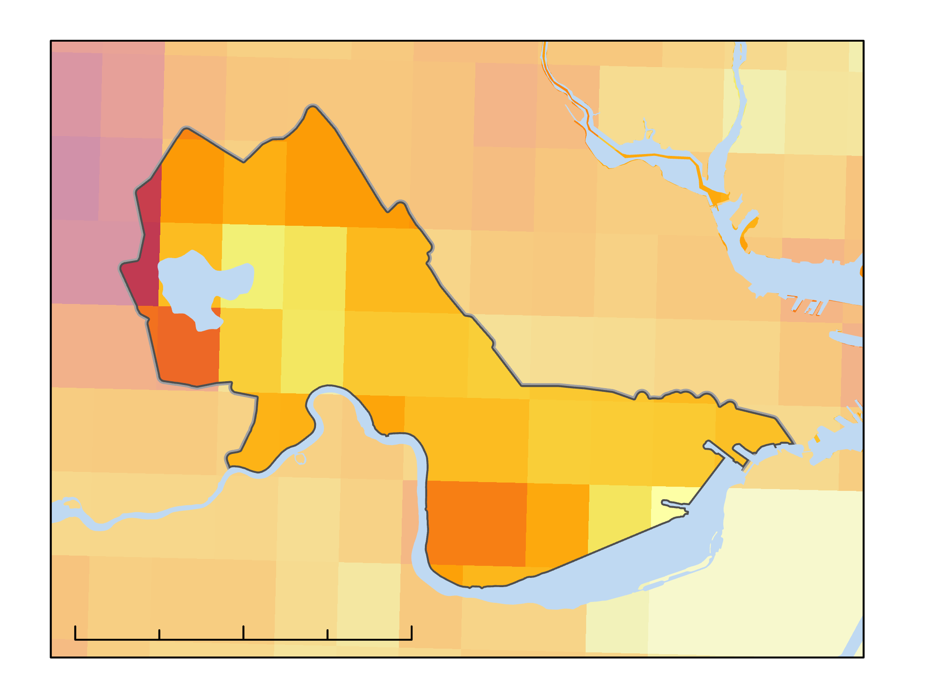

Albedo Has Increased, but Cambridge is Still a ‘Hot spot’
Building Specific Albedo Measurements
Mapping Temperature Anomalies
Temperature
Difference
from the Mean
(60.2°F)
2018
N
2019
Albedo
< 1.0
< 0.8
+6.36
< 0.7
< 0.6
< 0.5
< 0.4
0
2
4 km
< 0.3
0
1
2 km
km 0
0.25
0.5
0
10
20 km
-3.42
Notes:
Using High Resolution Orthoimagery we calculated rooftop albedo and the NASA Earth observation, Aqua MODIS, was used to study nighttime land surface temperature. Nighttime LST was important here because the effect of UHI’s are often most prominent at night.
Albedo Work:
The figure on the left visualizes the results of the albedo calculations applied to 2018 High Resolution Orthoimagery. The dark red buildings represent rooftops with the lowest range in albedo, less than 0.3, and the white buildings represent rooftops with the highest albedo values, greater than 0.8.
I would like to remind you that albedo is measured on a unitless scale between 0 and 1.
Click for Animation:
Here, we enlarged the MIT neighborhood to provide a more detailed view of the results. When we compared the true color imagery with the building specific albedo calculations, we could see that white roofs have a higher albedo value compared to dark roofs.
This example is from 2018, but we calculated rooftop albedo from 2008 – 2018 and found that albedo increased by approximately 0.12 across the city.
Furthermore, we found that the majority of positive change in albedo was found in non-residential areas.
Temperature Anomaly Work:
Next, we have a map of temperature anomalies for the combined months of June, July, and August 2019.
This figure shows the difference in temperature for each pixel from the mean of Eastern Massachusetts – which was 60.2 °F.
Brighter shades of yellow represent positive temperature anomalies, or areas warmer than average, called 'hot spots.’
Darker shades of purple represent negative temperature anomalies, or areas colder than average, called 'cool spots.’
As you can see in the square, Cambridge is characterized by colors that fall on the higher end of the color bar range.
Click for Animation:
This indicates that in 2019, Cambridge was a ‘hotspot’ and experienced warmer nighttime temperatures than rural areas.
Indeed, we found that Cambridge temperature anomalies normalized to a portion of Eastern Massachusetts demonstrated a positive mean temperature difference of 2.89°F between 2004 – 2019. Making Cambridge a ‘Hot spot.’

Slide 3
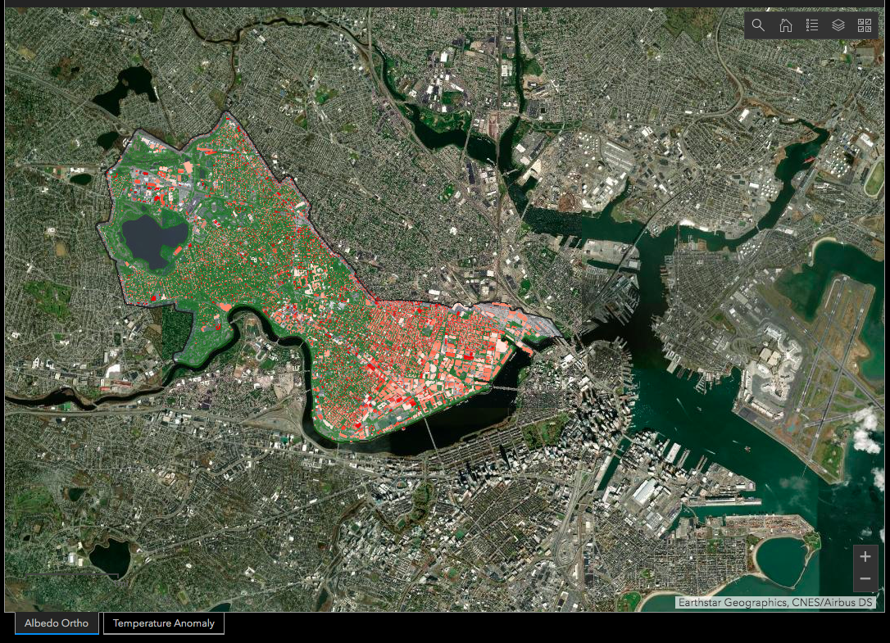

Science to Action: Cambridge Urban Heat Dashboard
Interactive Features
Click on Building
Search Address
Acknowledgements
Dr. Cedric Fichot
Dr. Mehdi Heris
Dr. Kenton Ross
CCDD & TEX
Questions?
nicole.rambergpihl@maine.edu
Notes:
Finally, the results from both rooftop albedo and temperature anomaly calculations were input into a user-friendly ArcGIS Dashboard which will allow our partners and the Cambridge community to interact with our findings. They can explore how albedo and temperature change in relation to other relevant factors, such as tree canopy and impervious surface.
Click for Animation:
The dashboard is interactive, so our partners can either click on a building or look up a specific address to find the albedo of a specific rooftop. We even included a feature so that our partners could assess albedo by neighborhood.
The major benefit here, is that this really serves as a practical tool for our partners. These results will provide our partners at the City of Cambridge with insight into the progress of their Climate Change Preparedness and Resilience Plan and inform future initiatives to aimed at making Cambridge more resilient to the effects of urban heat.
Image Credit: DEVELOP team

Slide 4
Quantifying Changes in Urban Albedo with NASA Earth Observations to Reduce Urban Heat Island Effect in Cambridge, Massachusetts
Nicole Ramberg-Pihl, Sophie Barrowman,
Liam Bhajan, Olivia Cronin-Golomb, & Celeste Gambino
NASA DEVELOP Program – SSAI
SY040-05
Notes:
Hello everyone, my name is Nicole Ramberg-Pihl and this past summer I served as Project Lead for the Cambridge Urban Development project for the NASA DEVELOP National Program. Today I am presenting on behalf of my teammates Sophie Barrowman, Liam Bhajan, and Olivia Cronin-Golomb; as well as our DEVELOP Fellow Celeste Gambino. I am excited to share our work with you, "Quantifying Changes in Urban Albedo with NASA Earth Observations to Reduce Urban Heat Island Effect in Cambridge, Massachusetts.“
The image that you see here is a snapshot from our temperature anomaly work which I will be discussing later in the presentation!

Slide 5




Urban Heat Island Effect (UHI)
Urban environments experience warmer temperatures
compared to surrounding suburban and rural areas
Up to 22°F
WARMER
Temperature
Rural
Suburban
Urban
Suburban
Rural
Notes:
On the previous slide, I mentioned the Urban Heat Island Effect, often simply abbreviated as UHI.
Urban Heat Island Effect (UHI) is a phenomenon where urban environments experience warmer temperatures on average compared to surrounding suburban and rural areas.
This is what we are depicting with the infographic on the screen before you.
Y axis – Temperature
X axis – Different categories of the built environment – areas where we are both living and working - and they range from Rural to Suburban to Urban settings.
CLICK for Animation:
Temperatures in urban areas can be up to 22 degrees F warmer than surrounding suburban and rural regions – and this effect is often most prominent at night when the surrounding areas cool off and the urban environment remains warmer.
------------------------------Image Information Below ------------------------------
•Image Credit: Summer 2020 MA – Boston Team
•Image Source: Created by Summer 2020 MA-Boston Team Members

Slide 6
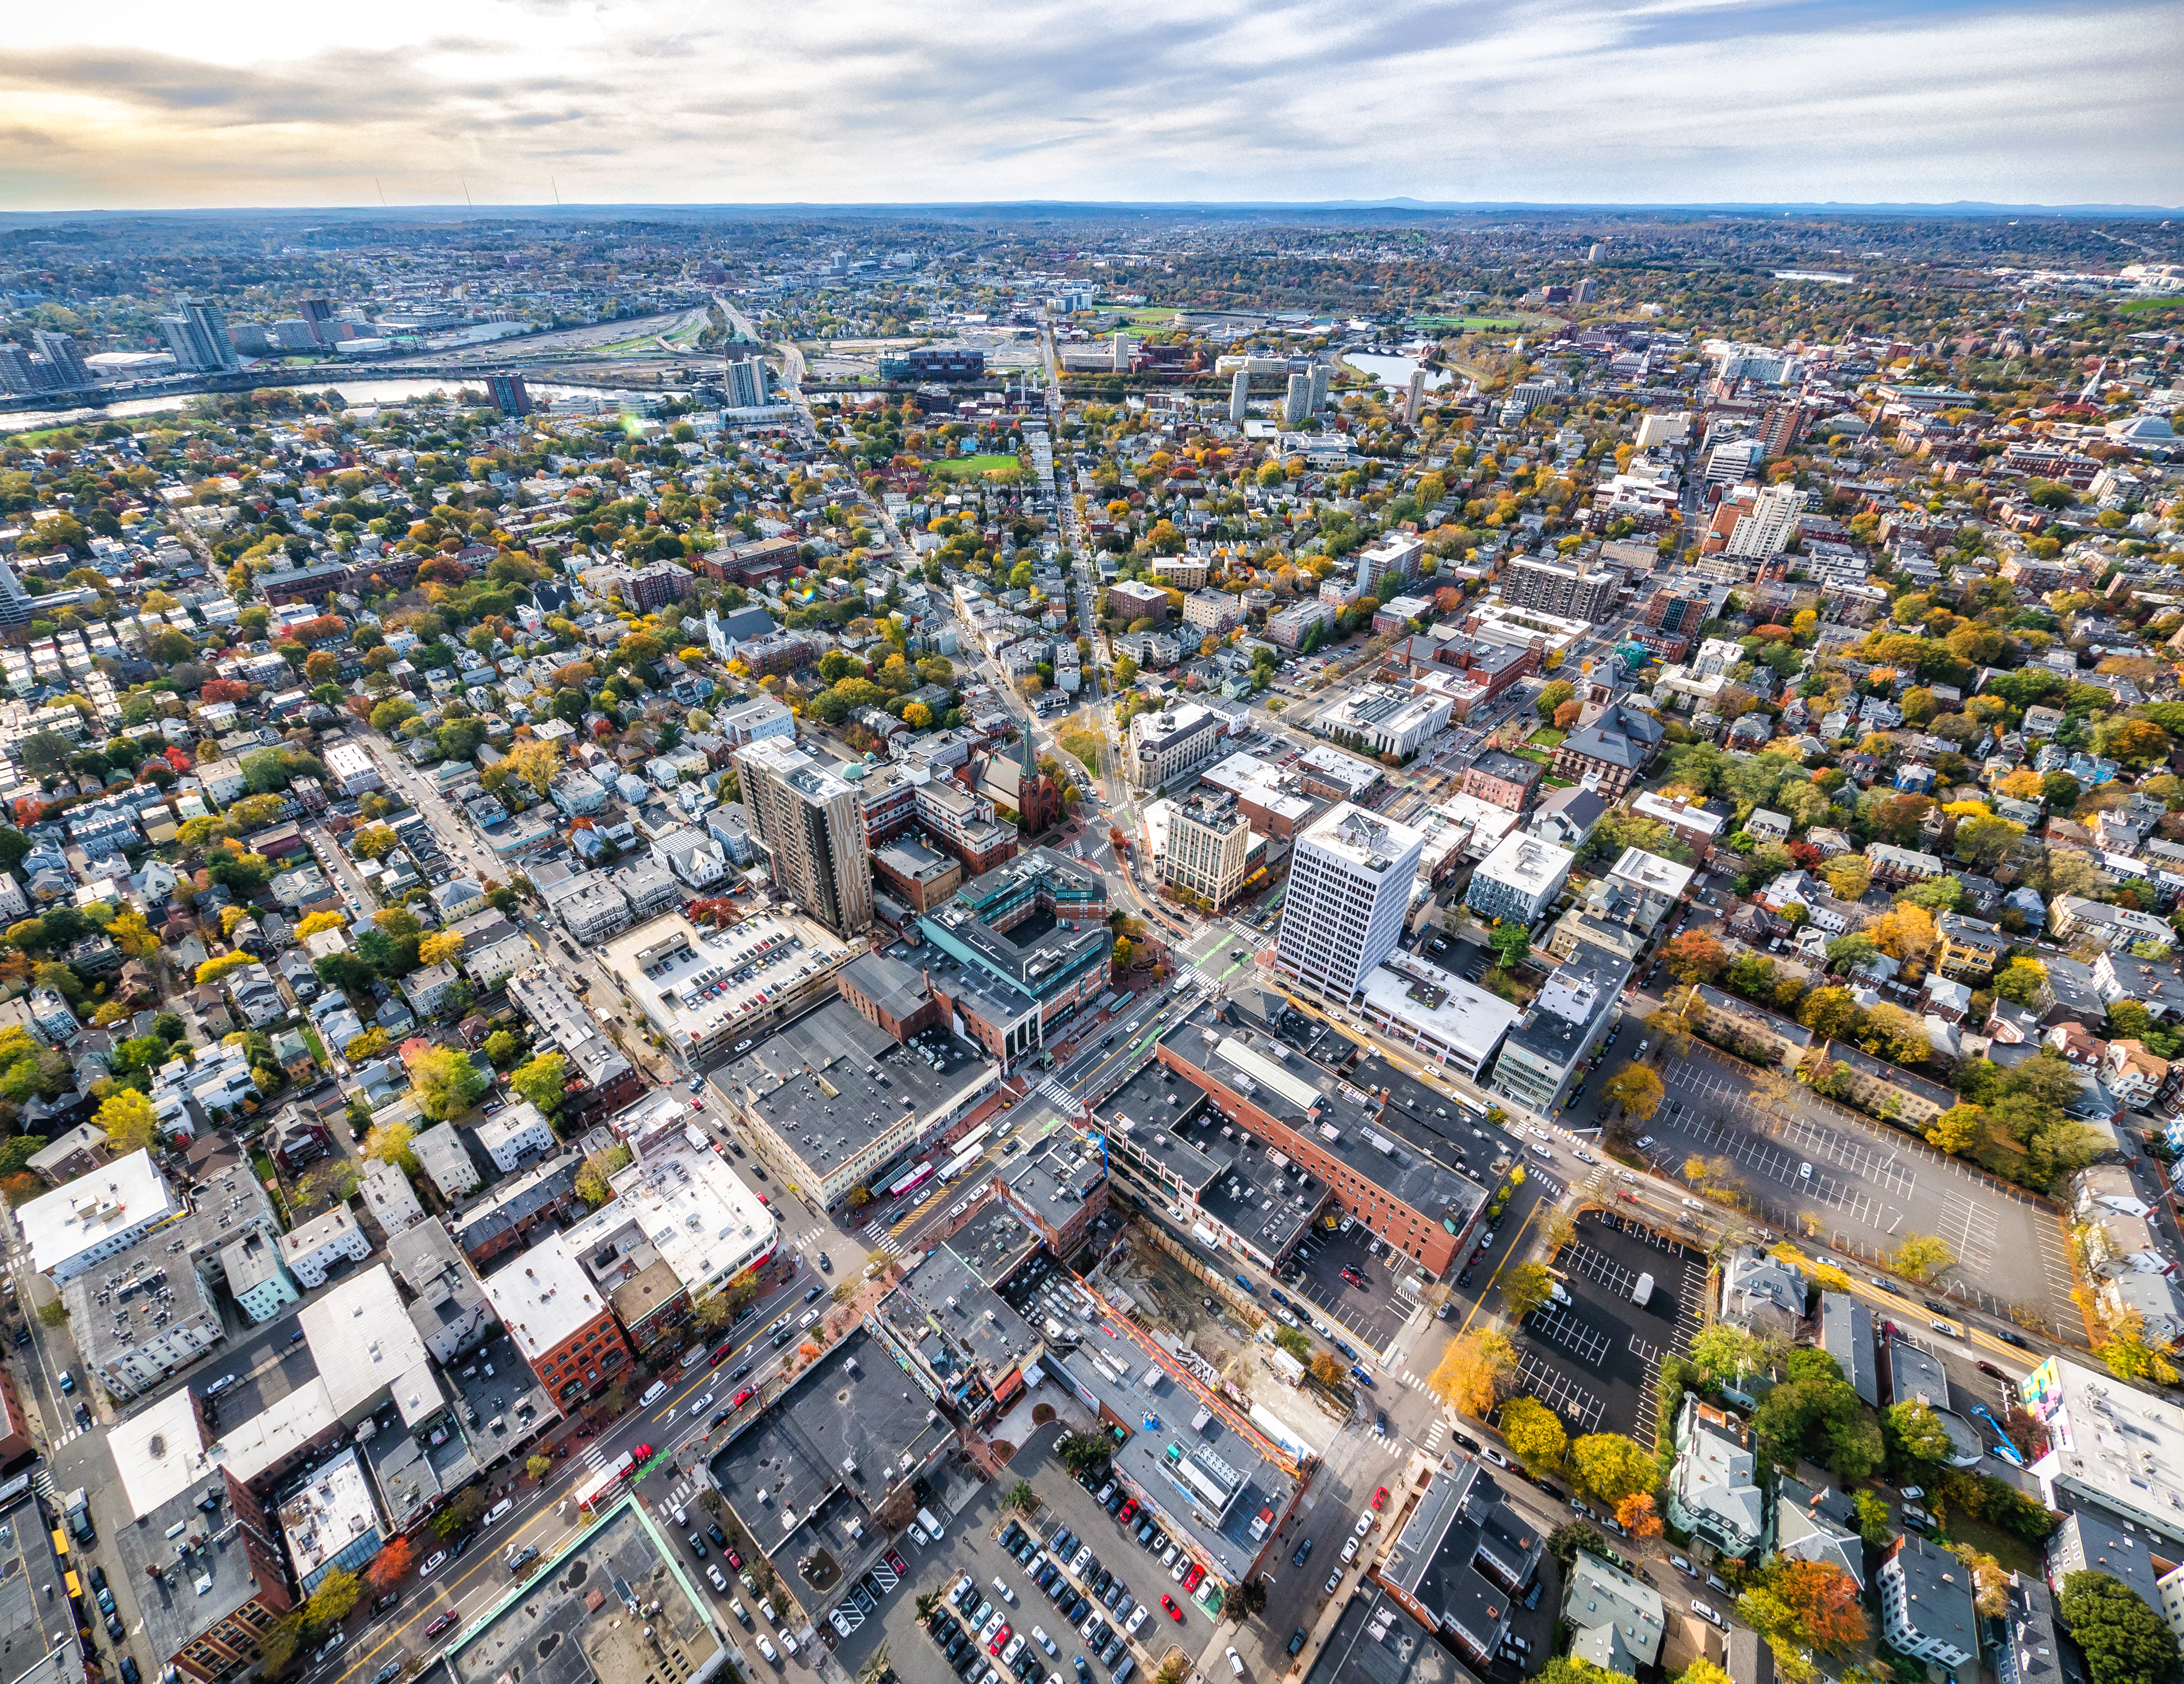
Why Does the UHI Effect Occur?
Lack of
vegetation
High proportion of low albedo surfaces
Image credit: City of Cambridge
Notes:
UHI are attributed to multiple factors including:
The fact that there is a higher density of buildings that trap and release heat
Click for Animation
A lack of trees and vegetation, which are known to provide shade and cooling
Click for Animation
High proportion of low albedo surfaces, such as dark asphalt and roofs
------------------------------Image Information Below ------------------------------
•Image Credit: City of Cambridge
•Image Source: Provided by Partner Organization: City of Cambridge

Slide 7













Low Albedo Surfaces Absorb Radiation
Proportion of incident solar radiation that is reflected by a surface
ABSORBS
REFLECTS
0
0.04
0.06
0.15
0.55
0.80
1
Dark surfaces absorb nearly all sunlight
White surfaces reflect nearly all sunlight
Notes:
Albedo refers to the proportion of incident solar radiation that is reflected by a surface.
Albedo is measured on a unitless scale ranging between 0 and 1, as shown in this figure.
Low albedo materials, such as dark asphalt or traditional roofing materials absorb and trap heat which contributes to the urban heat island effect.
In comparison, light surfaces, such as a white roof, reflect higher amounts of solar radiation and therefore have high albedo.
Mitigation efforts to increase albedo often include painting roofs white or increasing the amount of vegetation in urban areas.
The City of Cambridge is a great example of a community that is actively taking steps to increase albedo across the city with hopes that they can lessen the impacts of urban heat.
Additional Information from Table:
Fresh asphalt – 0.04
Worn asphalt – 0.12
Open ocean – 0.06
Deciduous trees – 0.15
New concrete – 0.55
Fresh snow – 0.80
------------------------------Image Information Below ------------------------------
•Image Credit: Summer 2020 MA – Boston Team
•Image Source: Created by Summer 2020 MA-Boston Team Members

Slide 8
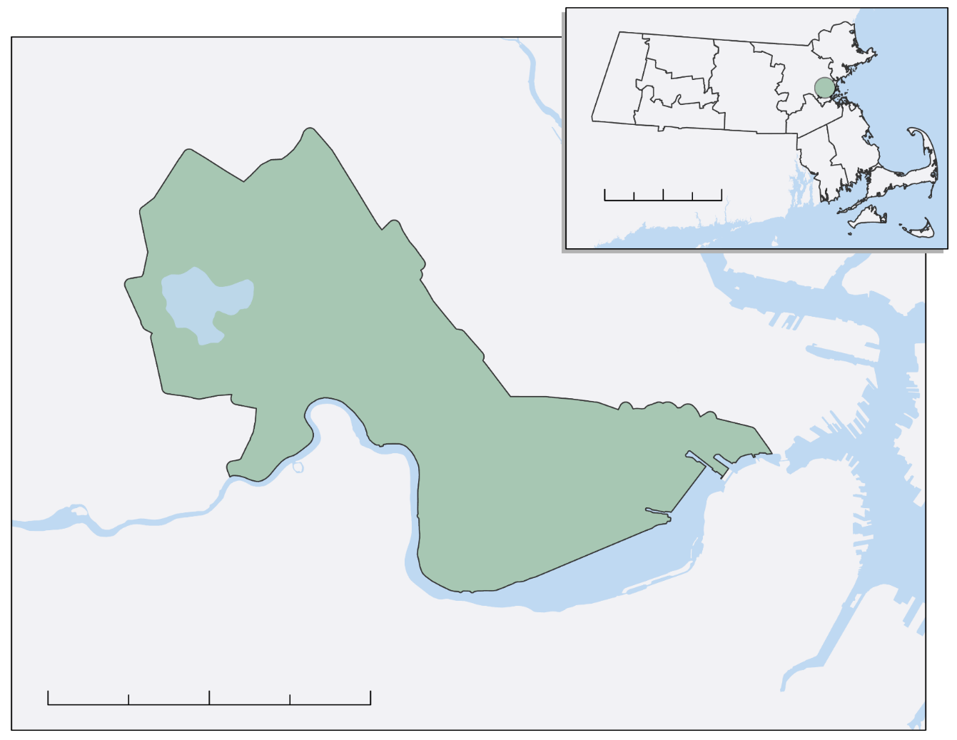

Cambridge, Massachusetts
N
Somerville
0
50
100 km
Cambridge
Study Area
Charles River
Boston
Waterways
0
2
4 km
Image credit: City of Cambridge
City of Cambridge, Community Development Department
&
American Geophysical Union’s Thriving Earth Exchange
Notes:
Our team at DEVELOP partnered with the City of Cambridge’s Community Development Department and the American Geophysical Union’s, Thriving Earth Exchange (TEX) to inform ongoing efforts aimed at reducing the impacts of urban heat in the city of Cambridge.
To provide some context:
Cambridge is part of the greater Boston metropolitan area in the State of Massachusetts, which is located in the Northeastern portion of the United States.
Cambridge spans approximately 7.13 square miles.
According to the 2010 US Census Bureau, Cambridge is home to over 100,000 residents.
On the left we have a study area map showing the city of Cambridge and its position within Massachusetts (inset map). On the right we have an image of the city of Cambridge along the Charles River and on the other side of the river you can see the Boston skyline.
------------------------------Image Information Below ------------------------------
•Image Credit: City of Cambridge
•Image Source: Provided by the Partners

Slide 9
Cause for Concern
Elevated temperatures increase heat-related mortalities, energy consumption, air pollution and impact local biodiversity
Image credit: City of Cambridge
Notes:
It is not surprising that our partners are concerned about Urban Heat Islands and the associated impacts of elevated heat on their community.
Elevated temperatures from UHI are associated with increases in heat-related mortalities, increases in energy consumption, air pollution, and impacts to local biodiversity.
And, these impacts can be exacerbated by climate change, and extreme variations in regional temperature – such as heat waves.
Studies have shown that up to 3 times the amount of heat-related deaths can occur in urban areas compared to surrounding regions during heatwaves.
By 2030, Cambridge is expected to experience as many as triple the number of days above 90°F per year, along with more heat waves, and overall warmer temperatures due to climate change.
Moreover Cambridge consists of over 60 percent impervious surface which, as we know, can trap heat.
------------------------------Image Information Below ------------------------------
•Image Credit: City of Cambridge
•Image Source: https://www.cambridgema.gov/Departments/communitydevelopment (Provided by Partner Organization: City of Cambridge)

Slide 10
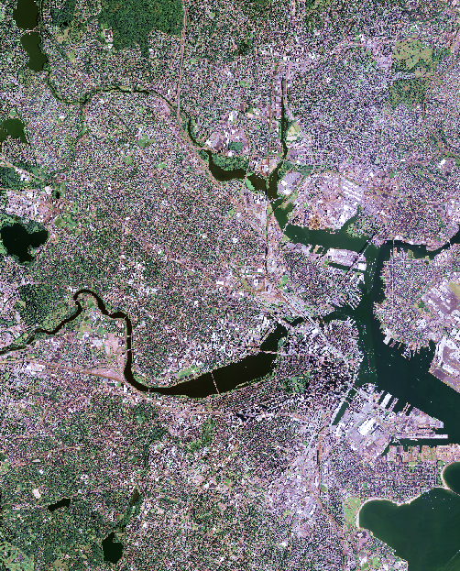
Objectives
Calculate changes in rooftop albedo from 2008 to 2018
Generate a nighttime land surface temperature (LST) record from 2003 to 2019
Map temperature anomalies in Cambridge and surrounding locations from 2004 to 2019
Create an interactive ArcGIS Dashboard to explore spatial and temporal patterns in albedo
Image credit: USDA
Notes:
Working with our partners, we developed a series of objectives that would help to inform ongoing efforts aimed at reducing the impacts of urban heat in the city of Cambridge.
Over a 10-week period between June and August of 2020, our team tackled the following:
We calculated the changes in rooftop albedo in Cambridge from 2008 – 2018.
We generated a nighttime land surface temperature (LST) record from 2003 – 2019.
3. We mapped temperature anomalies or 'hot spots' across Cambridge and surrounding region from 2004 – 2019.
4. Lastly, we created an interactive ArcGIS Dashboard to explore the spatial and temporal patterns of albedo and temperature anomalies across the city.
Note: The differences in the time periods for the objectives is due to data availability.
------------------------------Image Information Below ------------------------------
Base imagery used in Albedo Calculation Example
•Image Credit: USDA
•Image Source: 2014 NAIP Imagery(Downloaded from EarthExplorer)

Slide 11
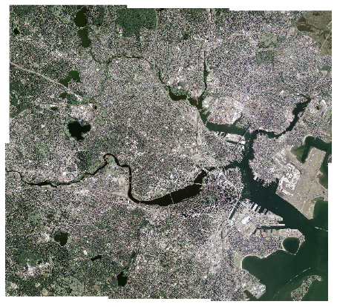
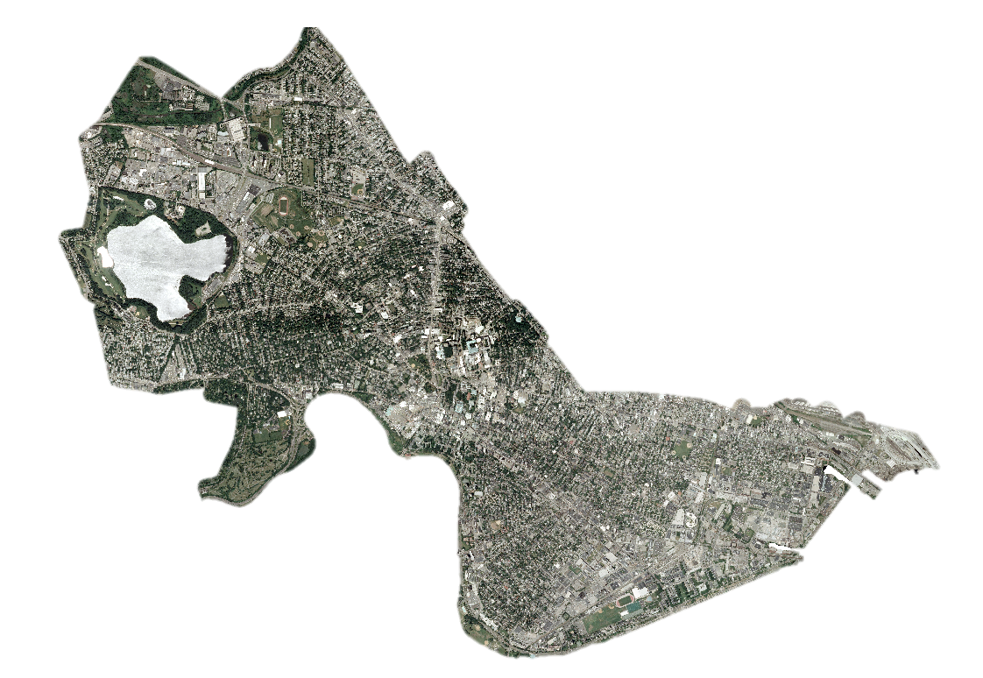

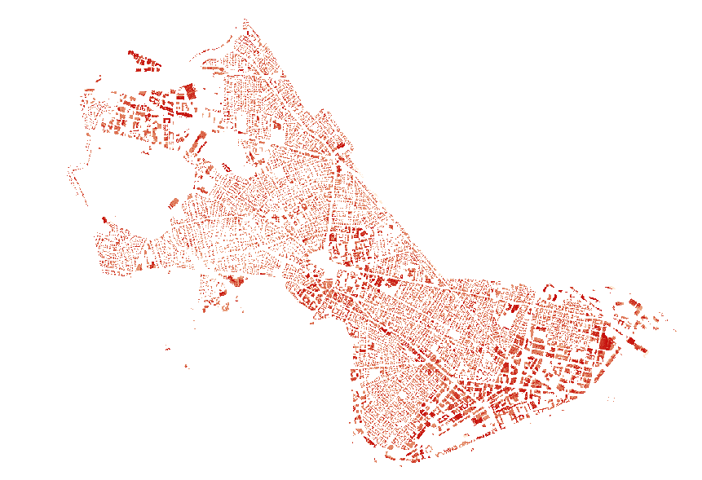

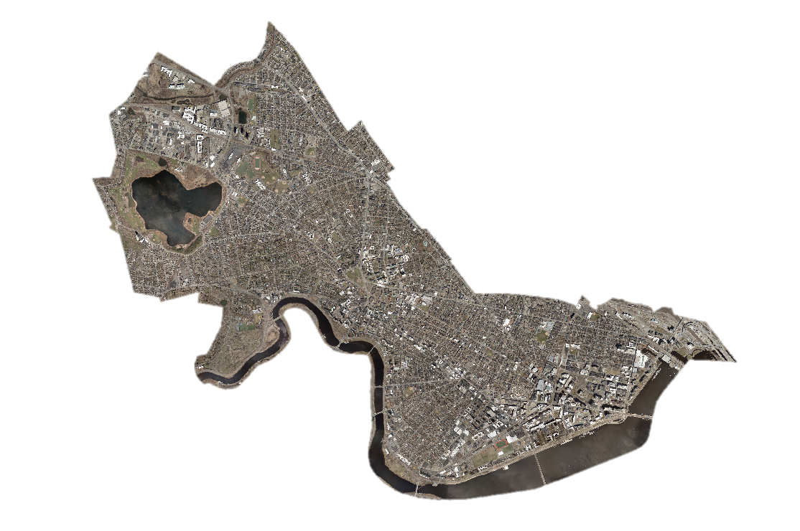

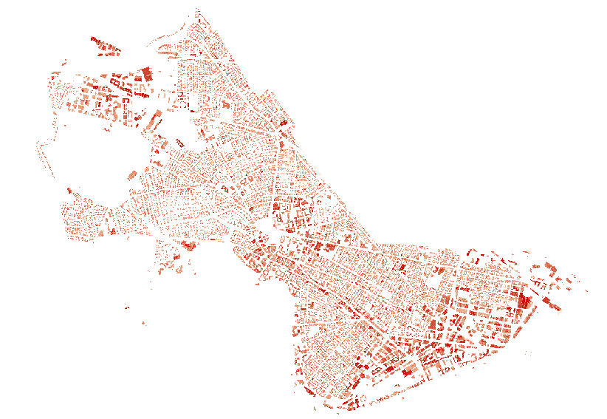
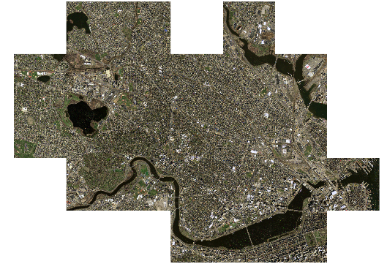
Calculate: Rooftop Albedo
Mosaic and clip
to Cambridge
Run bands through
the equation:
Clip output to
building footprints
Download imagery
Albedo = (0.17∗ B1)−(0.13∗ B2)+(0.33∗ B3)+(0.54∗ B4)
NAIP
2010, 2014, 2018
HRO
2008, 2013, 2018
Notes:
The first component of our project was to calculate rooftop albedo.
In order to do this, we used high resolution aerial imagery.
NAIP (National Agriculture Imagery Program - 1m Resolution)
HRO (High Resolution Orthoimagery – 0.3m resolution)
Both were downloaded from EarthExplorer.
Since we were looking to calculate building specific rooftop albedo, we downloaded NAIP and HRO images that were collected as close as possible to the years when shapefiles with building footprints in Cambridge were created: 2010, 2011, and 2018.
Click for animation:
Each NAIP and HRO image contained red, blue, green, and near infrared bands.
Images were mosaicked together in ArcGIS Pro to make one continuous raster
From there, we clipped and masked the imagery to the extent of Cambridge.
In order to make NAIP and HRO comparable, pixel cells were resized in the HRO to match the spatial resolution of the NAIP imagery.
The four bands in the resulting raster images were exported separately so albedo values could be calculated.
Click for animation:
Rooftop albedo was calculated in Python using code developed by Dr. Mehdi Heris, one of our science advisors. Albedo was calculated for every pixel in the study area using the values from the NAIP and HRO imagery bands in an equation derived from Vanino et al in 2018, which can be seen on the slide.
Click for animation:
The resulting albedo measurements were aggregated based on a unique ID assigned to each building in the city.
Both the median and 80th percentile values of the pixels with the same building IDs were used as final proxies for rooftop albedo.
The median value was used over the mean because it is less sensitive to potential effects of very high and very low albedo measurements.
The 80th percentile value was used to try to account for shadows resulting from the angle of the sun when images were collected, which could result in artificially low albedo.
The final albedo measurements of each building were combined into a table and exported to be used as inputs into the ArcGIS dashboard.
During this process we found that: The HRO was not oversaturated (which we did find with NAIP imagery) and HRO aligned more precisely with building footprints. For these reasons we determined that the HRO results were more accurate for our work and we decided that we would move forward with the HRO results.
**************************************************************************************************
Unabridged Notes For Reference:
Click for animation:
Each NAIP and HRO image contained red, blue, green, and near infrared bands.
Images were mosaicked together in ArcGIS Pro to make one continuous raster which would capture the extent of the study area.
From there, we clipped and masked the mosaicked imagery to the extent of Cambridge.
In order to make them comparable, pixel cells were resized in the HRO to match the spatial resolution of the NAIP imagery.
The four bands in the resulting NAIP and HRO raster images were exported separately so albedo values could be calculated.
Click for animation:
Rooftop albedo was calculated in Python using the preprocessed imagery and the rasterized versions of the building footprint shapefiles. The values of the pixels in the building footprint rasters were unique building IDs created in the original shapefile of the building footprints.
The python code that we used was developed by Dr. Mehdi Harris, one of our science advisors. Albedo was calculated for every pixel in the study area using the values from the NAIP and HRO imagery bands in an equation derived from Vanino et al in 2018, which can be seen on the slide.
Click for animation:
The resulting albedo measurements were aggregated based on the building raster's unique IDs. Both the median and 80th percentile values of the pixels with the same building IDs were used as final proxies for rooftop albedo. The median value was used over the mean because it is less sensitive to potential effects of very high and very low albedo measurements from small objects on rooftops. The 80th percentile value was used to try to account for shadows resulting from the angle of the sun when the images were collected which would result in artificially low albedo. The final albedo measurements of each building were combined into a table and exported to be used as inputs into the ArcGIS dashboard.
------------------------------Image Information Below ------------------------------
Imagery used in NAIP Example
•Image Credit: USDA
•Image Source: 2014 NAIP Imagery (Downloaded from EarthExplorer)
Imagery used in HRO Example
•Image Credit: USGS
•Image Source: High Resolution Orthoimagery (Downloaded from EarthExplorer)

Slide 12
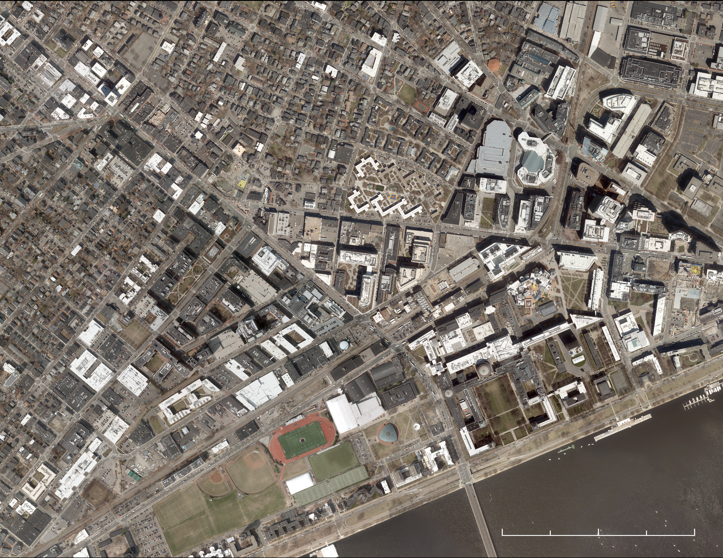
Albedo Increased by 0.12
True Color
2018
N
Albedo
< 1.0
< 0.8
km 0
0.25
< 0.7
km 0
0.25
0.5
< 0.6
< 0.5
< 0.4
< 0.3
0
1
2 km
km 0
0.25
0.5
Notes:
The figure on the left visualizes the results of the albedo calculations applied to 2018 High Resolution Orthoimagery. The dark red buildings represent rooftops with the lowest range in albedo, less than 0.3, and the white buildings represent rooftops with the highest albedo values, greater than 0.8.
I would like to remind you that albedo is measured on a unitless scale between 0 and 1.
On the right, we enlarged the MIT neighborhood to provide a more detailed view of the results. By visually comparing the true color imagery with the building specific albedo calculations, we can see that white roofs have a higher albedo value compared to dark roofs.
This example is from 2018, but we calculated rooftop albedo from 2008 – 2018 and found that albedo increased by approximately 0.12 across the city.
Furthermore, we found that the majority of positive change in albedo was found in non-residential areas.
------------------------------Image Information Below ------------------------------
Base imagery used in Albedo Change Example
•Image Credit: USGS
•Image Source: 2018 High Resolution Orthoimagery (Downloaded from EarthExplorer)

Slide 13
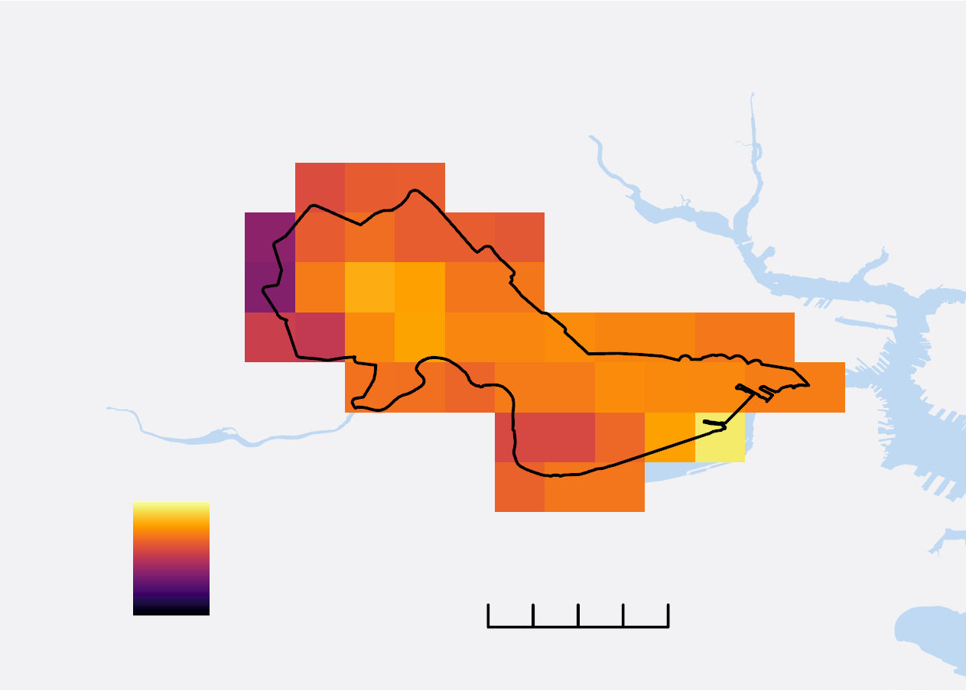

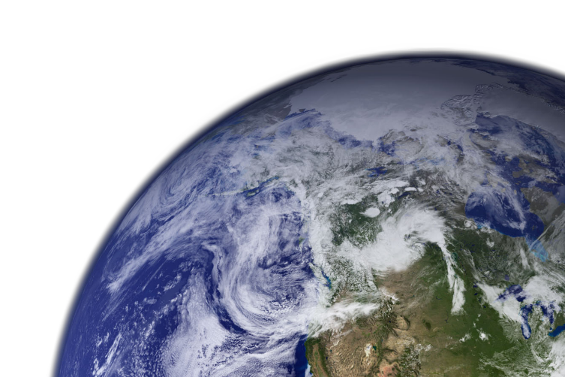
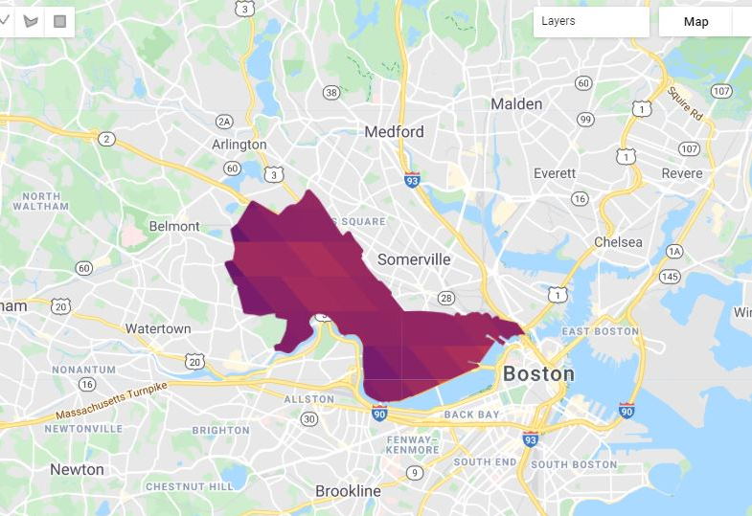

Generate: A Nighttime LST Record
Mask for clouds and pixel with errors
Convert from Kelvin to Fahrenheit
Google Earth Engine
Google Earth Engine
ArcGIS Pro
Aqua MODIS Nighttime LST
Filter summer months (June, July, August) for 2003 to 2019
Visualized in ArcGIS Pro
2019
65 °F
0
4 km
58 °F
Statistical Analysis
Linear Regression conducted in R
Image credit: NASA, Wikimedia
Notes:
The next phase of our project was to construct a nighttime land surface temperature (LST) record for the city of Cambridge.
Aqua MODIS (Moderate Resolution Imaging Spectroradiometer) has a daily nighttime LST product with a 1 km resolution that we accessed through Google Earth Engine.
We gathered data for our study region for the months of June, July, and August, as well as average Summer LST for each year in our study period.
Click for animation:
A mask was created that removed pixels lacking in data due to cloud cover as well as pixels that were plus or minus 3 degrees K from the mean.
And, converted LST from Kelvin to Fahrenheit
Click for animation:
The data was then exported out of Google Earth Engine and visualized using ArcGIS Pro.
Click for animation:
We also ran a linear regression analysis in R to see if nighttime LST changed within our study time period (between 2003 and 2019).
Note: GEE code previously generated by another DEVELOP team and we modified it for our project.
------------------------------Image Information Below ------------------------------
•Image Credit: NASA
•Image Source: http://www.devpedia.developexchange.com/dp/images/b/bf/06_Aqua.png (DEVELOPedia)
•Image Credit: Wikimedia
•Image Source: https://commons.wikimedia.org/wiki/File:Earth_Western_Hemisphere_transparent_background.png
(Public domain)

Slide 14
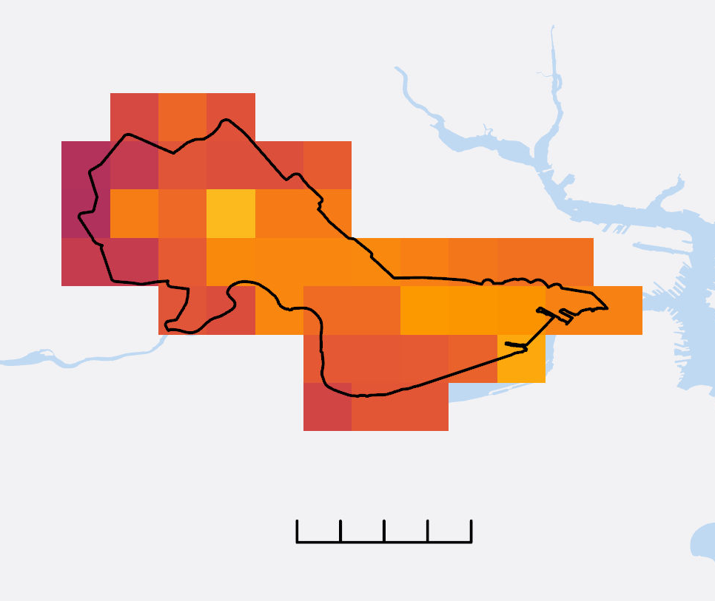
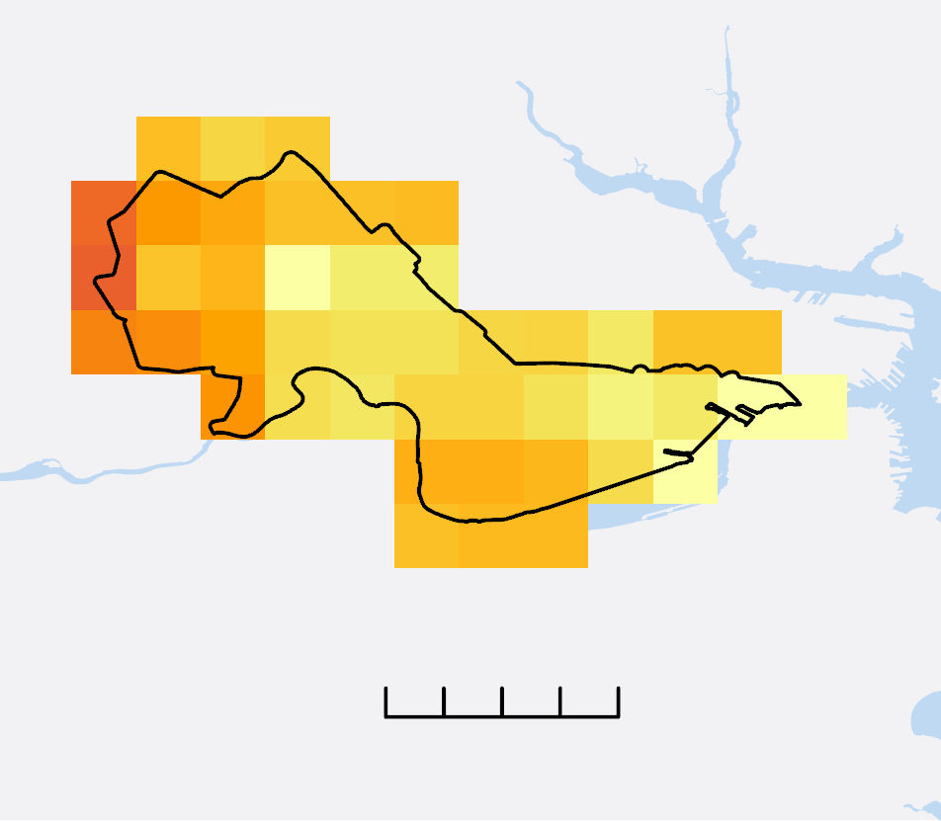



Spatial Patterns in Temperature
Average Summer Nighttime LST
2003
2011
2019
N
0
2
4
km
0
2
4
km
0
2
4
km
Temperature (°F)
58
65
Notes:
This slide shows maps of the average summer nighttime LST in degrees F for 2003, 2011, and 2019.
I would like to draw your attention to the scale bar at the bottom of the slide.
Darker colors represent cooler temperatures while lighter colors represent warmer temperatures.
These images provide a glimpse into how nighttime LST changes both spatially across the landscape and through time.
Note how western Cambridge appears to be cooler than other areas in the city, even when the overall mean in temperature varies from year to year.

Slide 15
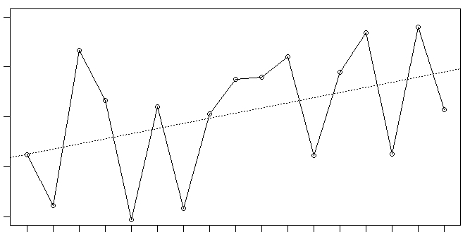
Nonsignificant Increase in Nighttime LST
65
64
Mean Nighttime LST (°F)
63
62
R² = 0.18
P = 0.0869
61
2007
2008
2009
2010
2011
2012
2013
2014
2015
2016
2017
2018
2003
2019
2004
2005
2006
Year
Notes:
Speaking about how mean temperature varies from year to year - This figure shows the mean summer nighttime LST during the study period of 2003 – 2019.
Y axis – Mean Nighttime LST in degrees F.
X axis – Year
Linear regression indicated a nonsignificant increase in temperature.
Click for Animation:
We compared mean summer nighttime LST from 2003-2010 with that of 2011-2019, which revealed an increase of 0.57°F.
This information is useful for our partners to gain a better understanding of how nighttime LST varies both spatially and temporally.

Slide 16
Map: Temperature Anomalies
Retrieve nighttime LST data
Cloud mask and convert from K to °F
Calculate mean temperature for whole area
Subtract mean temp from each pixel
Map 'hot spots' across landscape
Google Earth Engine
Python
ArcGIS Pro
Notes:
The third objective was to map temperature anomalies.
Nighttime LST values were gathered in Google Earth Engine by applying the same methods used to generate the nighttime LST record, except here we averaged temperature for the summer months of June, July, and August between 2004 – 2019.
The nighttime LST imagery was clipped to a subsection of Eastern Massachusetts which allowed us to compare temperatures between Cambridge and the surrounding suburban and rural landscape.
Using Python, we calculated mean nighttime LST for the entire Eastern portion of Massachusetts, which was then subtracted from each pixel in the original image. This created a new raster containing values reflecting the ‘difference from the mean’, or temperature anomalies.
This data was then visualized using ArcGIS Pro.

Slide 17

Positive Mean Temp Difference 2.89°F
Temperature
Difference
from the Mean
(60.2°F)
2019
2019
N
+6.36
0
2
4 km
0
10
20 km
-3.42
Notes:
Here we have a map of temperature anomalies for the combined months of June, July, and August 2019.
This figure shows the difference in temperature for each pixel from the mean of Eastern Massachusetts – which was 60.2 °F.
Brighter shades of yellow represent positive temperature anomalies, or areas warmer than average, called 'hot spots.’
Darker shades of purple represent negative temperature anomalies, or areas colder than average, called 'cool spots.’
As you can see in the image on the right, Cambridge is characterized by colors that fall on the higher end of the color bar range.
This indicates that in 2019, Cambridge was a ‘hotspot’ and experienced warmer nighttime temperatures than rural areas.
Indeed, we found that Cambridge temperature anomalies normalized to a portion of Eastern Massachusetts demonstrated a positive mean temperature difference of 2.89°F between 2004 – 2019.

Slide 18
Cambridge Urban Heat Dashboard
Interactive Features
Click on Building
Search Address
Notes:
The results of these objectives were then built into interactive ArcGIS dashboard.
The Cambridge Urban Heat Dashboard provides a way for our partners to explore spatial and temporal trends in rooftop albedo and temperature anomaly maps.
They can also explore how albedo and temperature change in relation to other relevant factors, such as tree canopy and impervious surface.
Click for Animation:
The dashboard is interactive, so our partners can either click on a building or look up a specific address to find the albedo of a specific rooftop. We even included a feature so that our partners could assess albedo by neighborhood.
The major benefit here, is that this really serves as a tool for our partners as they assess the effectiveness of the steps they have taken in their work to mitigate the impacts associated with urban heat in their community.
------------------------------Image Information Below ------------------------------
•Image Credit: DEVELOP team

Slide 19
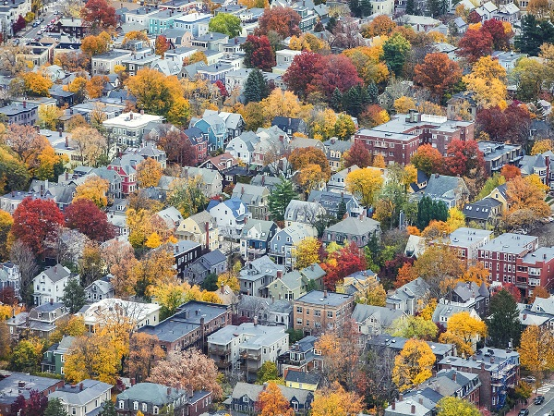
Conclusions
Albedo increased approximately 0.12 across the city from 2008 – 2018
Nonsignificant increase in nighttime LST between 2003 – 2019
Temperature anomaly maps revealed Cambridge’s positive mean temperature difference of 2.89°F between 2004 – 2019
Urban Heat Dashboard provided a practical method for sharing our results
Image credit: City of Cambridge
Notes:
Overall, we found that:
Albedo portion of our work:
The majority of positive change in albedo from 2008 to 2018 was found in non-residential areas, with an average albedo increase of 0.12 across the city.
Nighttime LST Record:
Comparison of mean summer nighttime LST from 2003-2010 and 2011-2019 revealed an increase of 0.57°F, with a nonsignificant increase between 2003-2019.
Temperature Anomalies:
Cambridge is a ‘hot spot.’ Temperature anomalies normalized to a portion of Eastern Massachusetts demonstrated a positive mean temperature difference of 2.89°F between 2004 – 2019.
Urban Heat Dashboard
The urban heat dashboard provided a practical method for sharing our results with our partners. This is an interactive tool that our partners can use to assess the spatial and temporal trends in albedo and temperature anomalies.
Moreover, this project serves as a launching point for future projects focused on albedo and temperature within the community.
------------------------------Image Information Below ------------------------------
•Image Credit: City of Cambridge
•Image Source: Provided by the Partners

Slide 20
The team would like to thank the following people for their support throughout the term:
Our Science Advisors:
  Dr. Cedric Fichot, Boston University
  Dr. Mehdi Heris, University of Colorado
  Dr. Kenton Ross, NASA DEVELOP National Program
Our Partners:
John Bolduc, City of Cambridge, Community Development Department
Drew Kane, City of Cambridge, Community Development Department
Julia Jeanty, American Geophysical Union’s Thriving Earth Exchange
Notes:
This work would not have been possible without the guidance of:
Our Science Advisors: Dr. Cedric Fichot, Dr. Mehdi Heris, and Dr. Kenton Ross
Our Partners:
John Bolduc and Drew Kane from the City of Cambridge, Community Development Department
Julia Jeanty, from the American Geophysical Union's Thriving Earth Exchange

