Slide 1
Liquefied Natural Gas (LNG) as Propellant Fuels; Storage and Transfer Effects
Background, Testing, Data, & Analysis
Adam Swanger/UB-G
November 12, 2020

Slide 2
Background
Project Purpose: Evaluate LNG storage / transfer / operational effects (stratification, weathering, etc.) and mitigations, including Integrated Refrigeration and Storage (IRAS)
Project Scope: Retrofit an existing 400 liter cryogenic vessel with a commercial off-the-shelf Gifford-McMahon cryocooler to create a lab-scale Integrated Refrigeration and Storage (IRAS) system, internal temperature instrumentation, and sample tubes located at different elevations vertically within the liquid. This system can be used to study the behavior of LNG/methane during storage; most notably weathering (i.e. enrichment of non-methane constituents due to preferential boil-off), and stratification of the bulk liquid. Additionally, in-situ liquefaction of natural gas can be performed, along with zero boil-off (ZBO) control and possible densification. ZBO can be evaluated as a means to reduce or eliminate the weathering process.
Partners/Funding: $50K – Spaceport Integration & Services (SI); $100K – CMO
Project Duration: 2017 - 2019

Slide 3
Background Cont.
Project Timeline
  June 2017 – Initial funding from SI
  July 2017 – Cryostat shipped to vendor for retrofit
  August 2018 – Cryostat received from vendor
  September 2018 – Additional funding from CMO
  December 2018 – LN2 boiloff testing on cryostat
  January – October 2019 – Test setup behind Cryogenics Test Laboratoy
  October – December 2019 – Weathering test
Publications
  Poster—Development of a 400 L Integrated Refrigeration and Storage Cryostat for LNG/LCH4 Research, A. Swanger, and W. Notardonato, 27th International Cryogenic Engineering Conference, Oxford, England, (2018)
  Integrated Refrigeration and Storage of LNG for Compositional Stability, Rose, L., Swanger, A. M., Notardonato, W. U., Fesmire, J. E., Gleeson, J., and Carro, R., Advances in Cryogenic Engineering, IOP Conf. Series: Materials Science and Engineering 101 (2019)

Slide 4
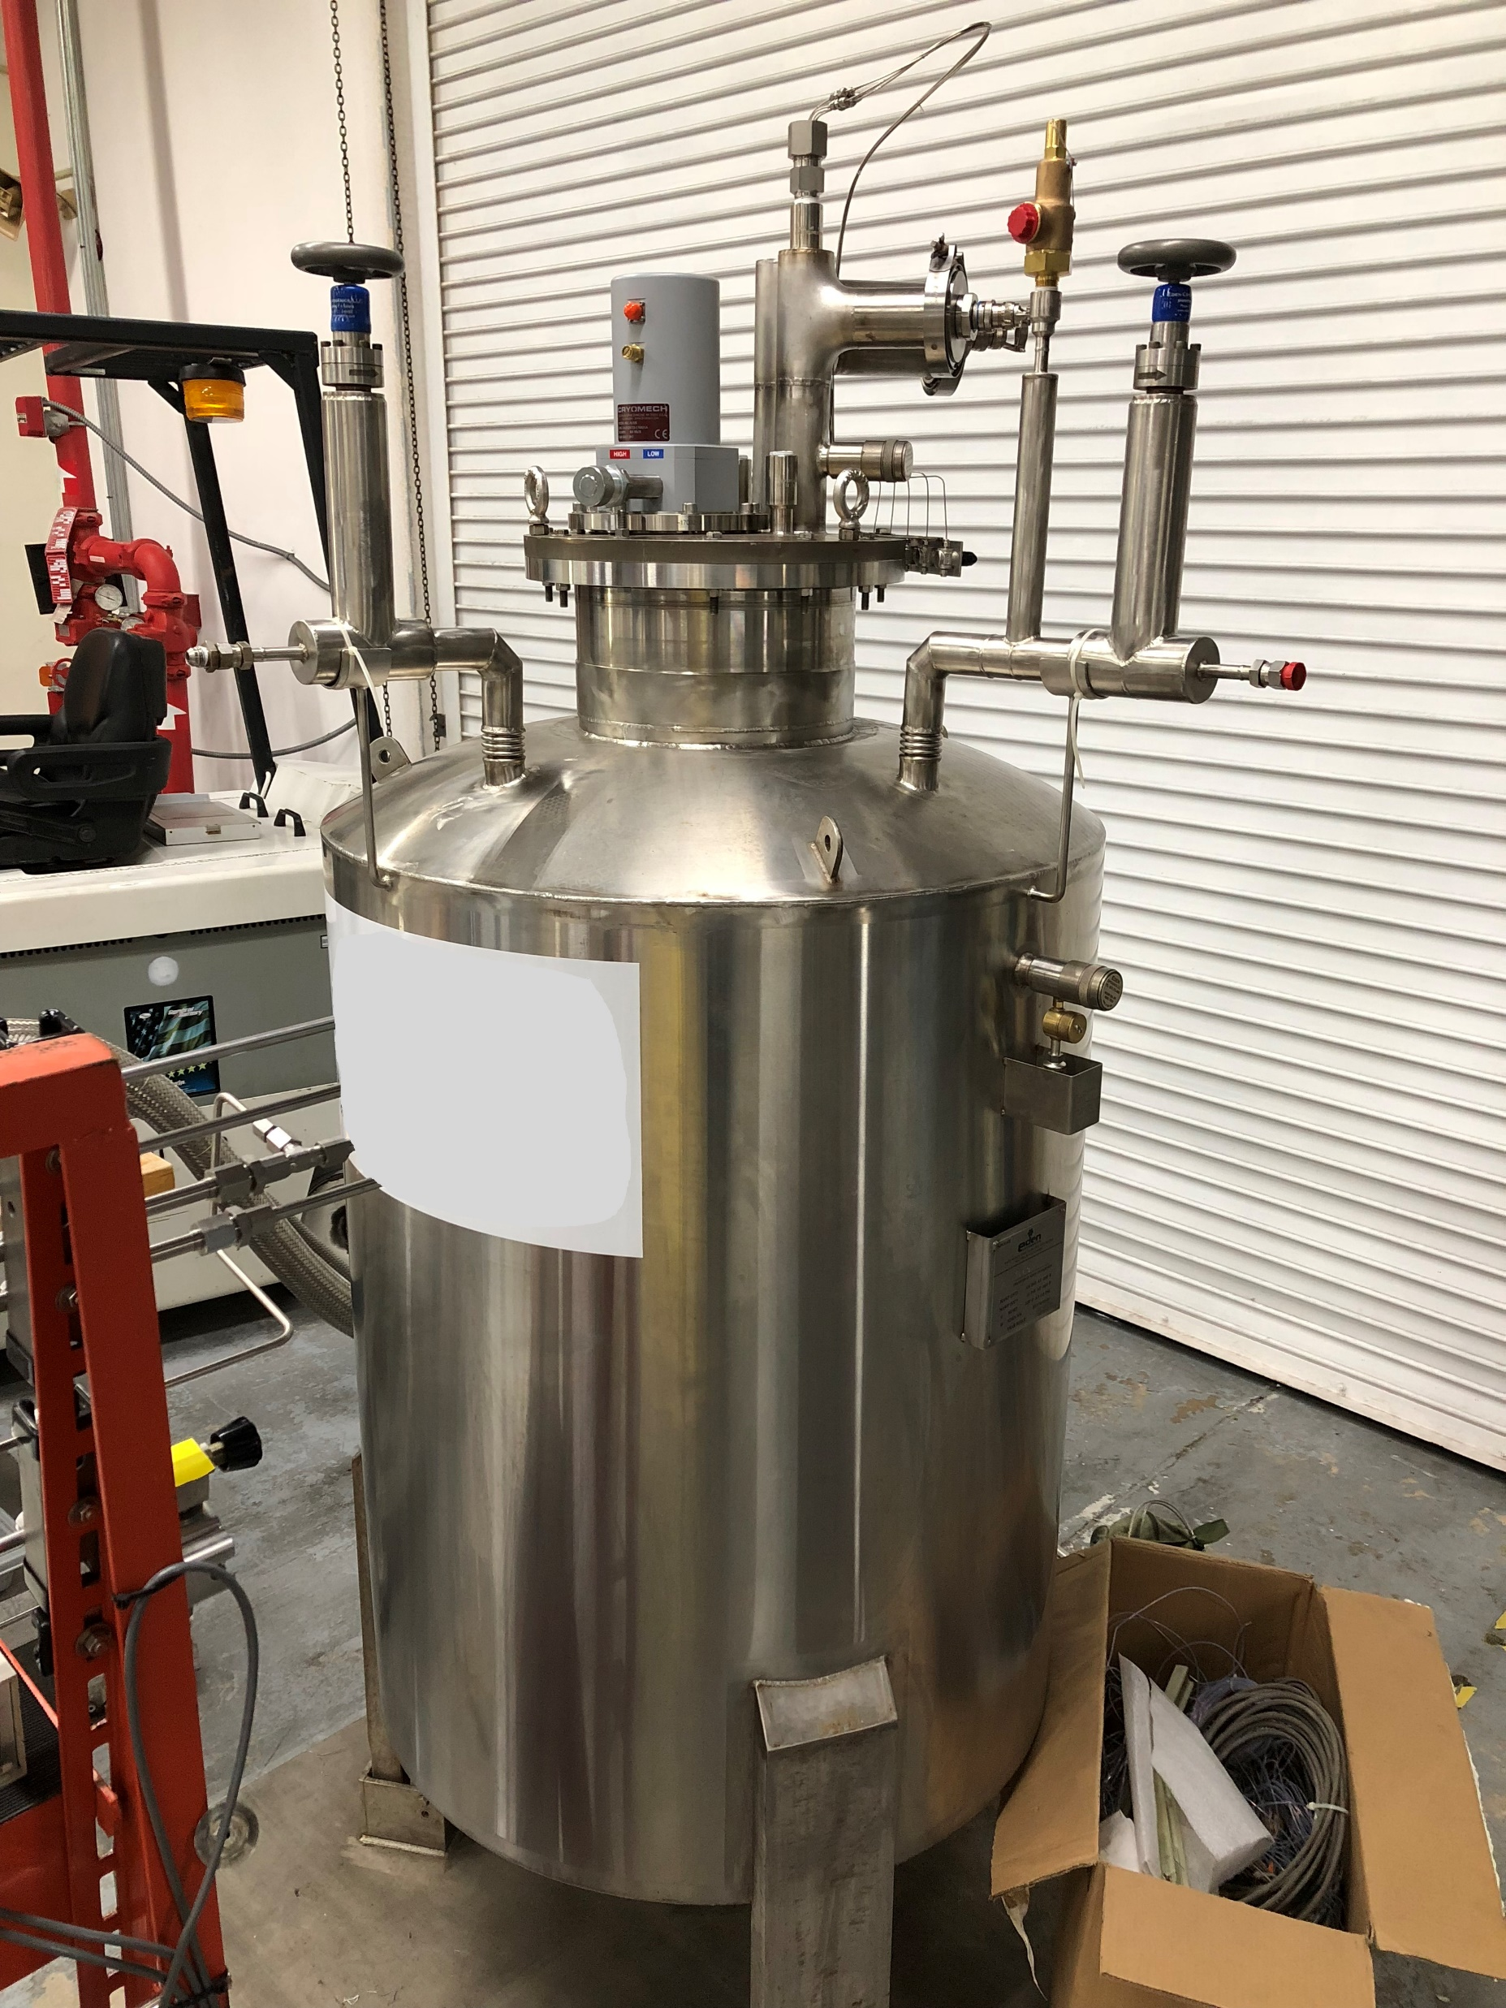
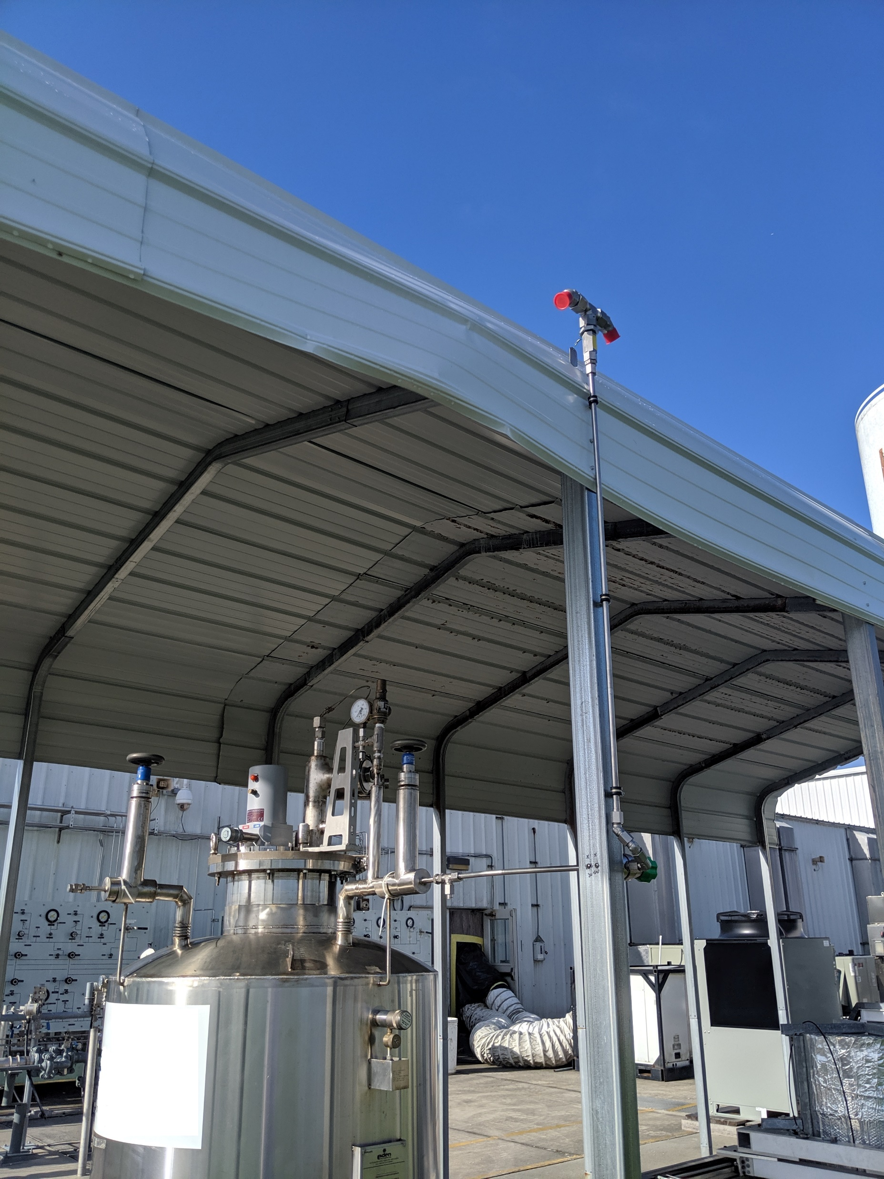
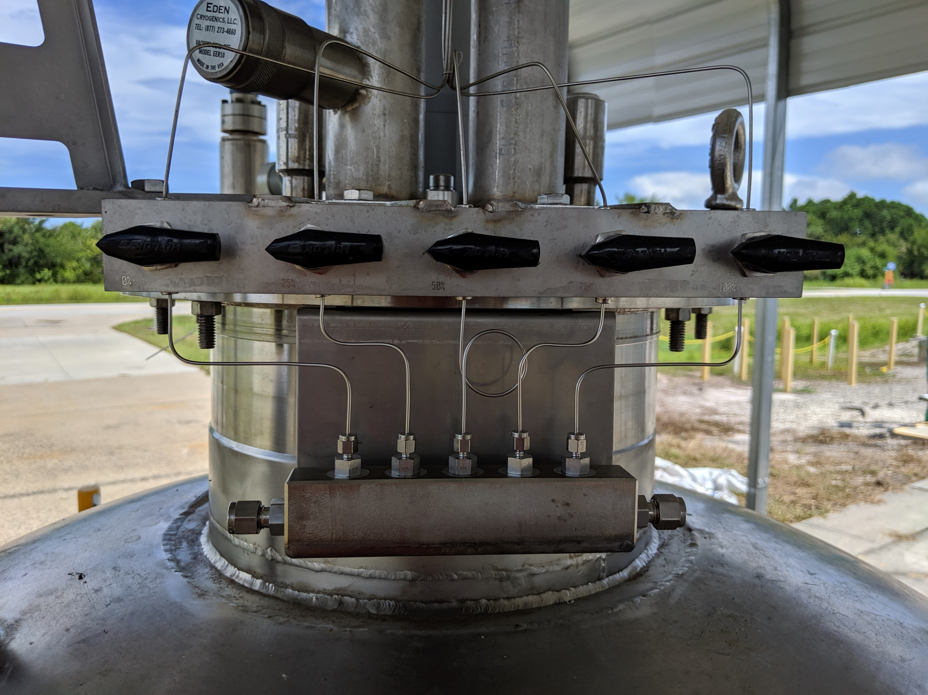
Test Setup—Cryostat
Sample Valves
Cryostat
Vent Stack
Images: Author

Slide 5
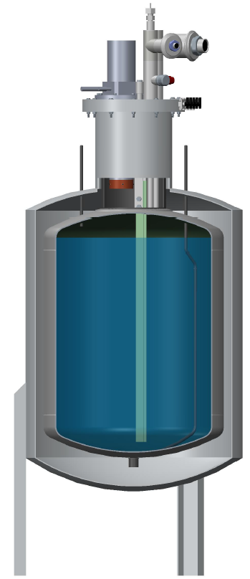
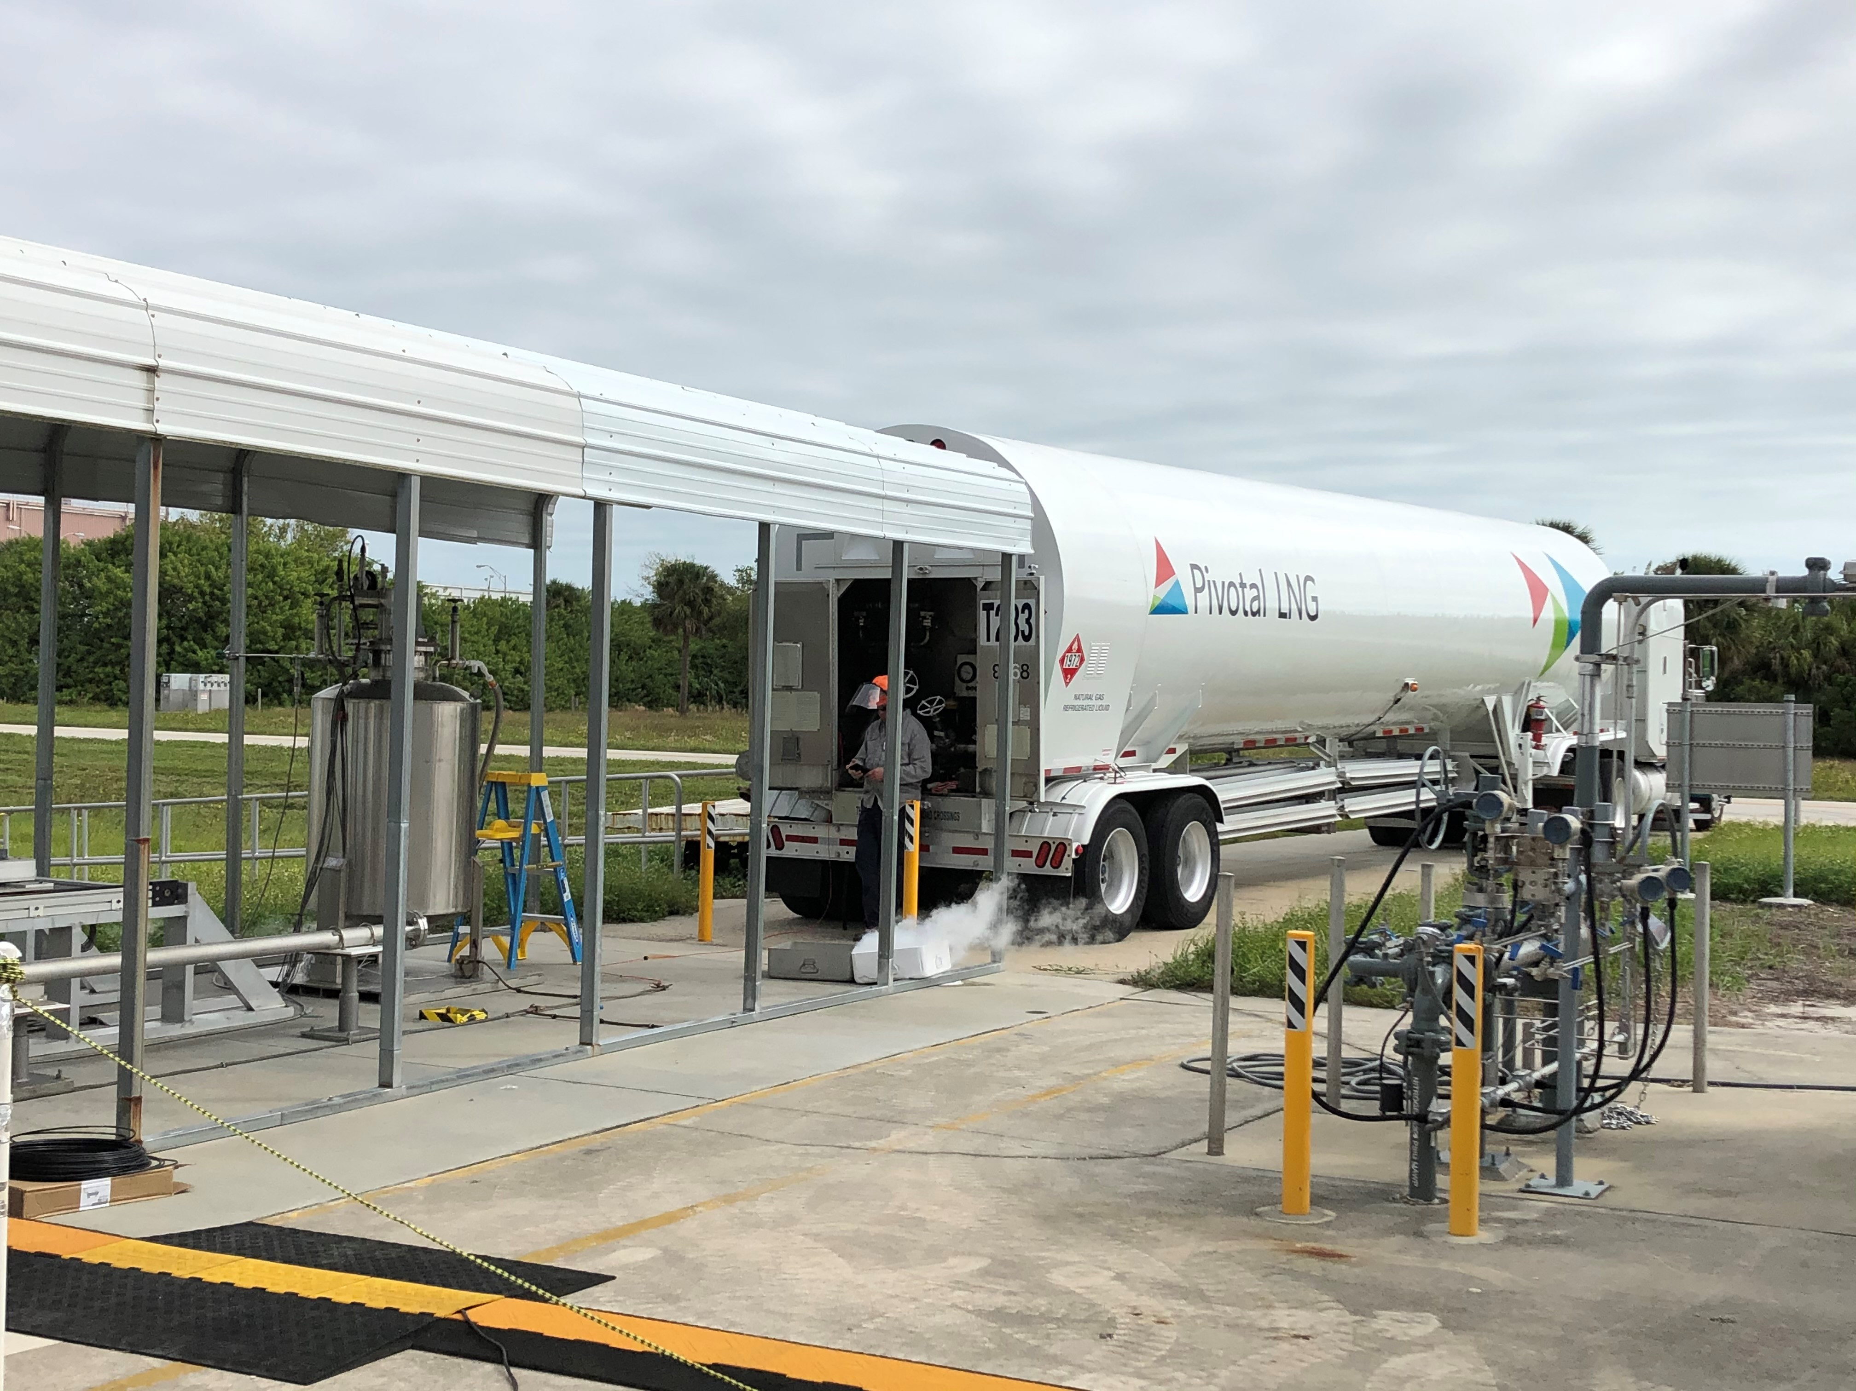
Test Setup—Cryostat
Instrumentation & Sample Tube Feedthrough's
Cryocooler
Sample Tube Valves
Vent Line
Liquid Fill/Drain Line
Vacuum Jacket
Vertical Rake with Temperature Sensors & Sample Tubes
Inner Tank
LNG Delivery
Images: Author

Slide 6
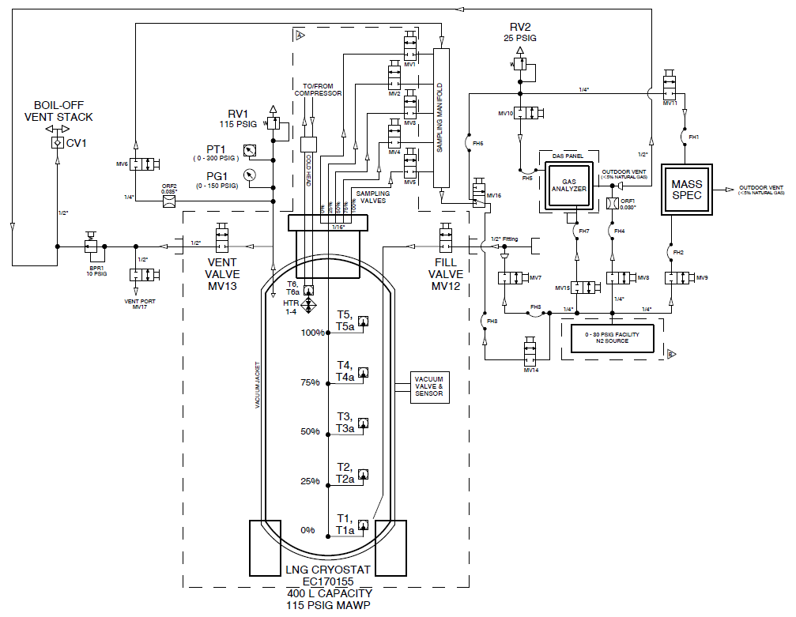
Test Setup—Schematic

Slide 7
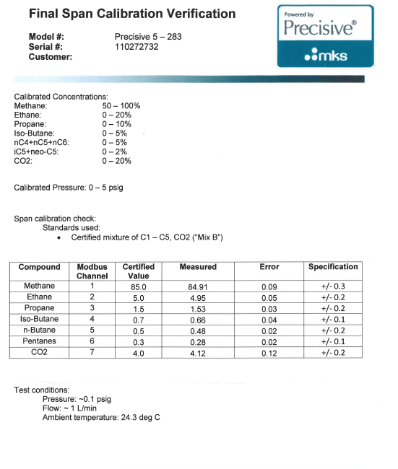
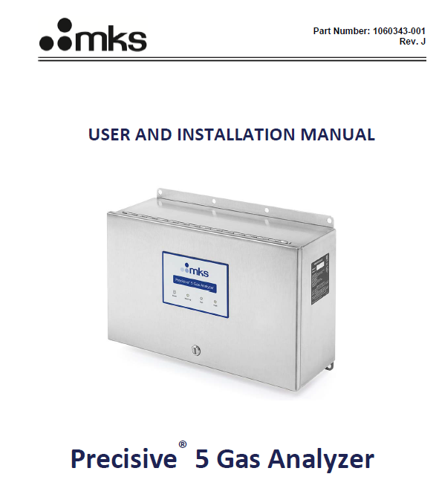
Test Setup—Gas Analyzer

Slide 8
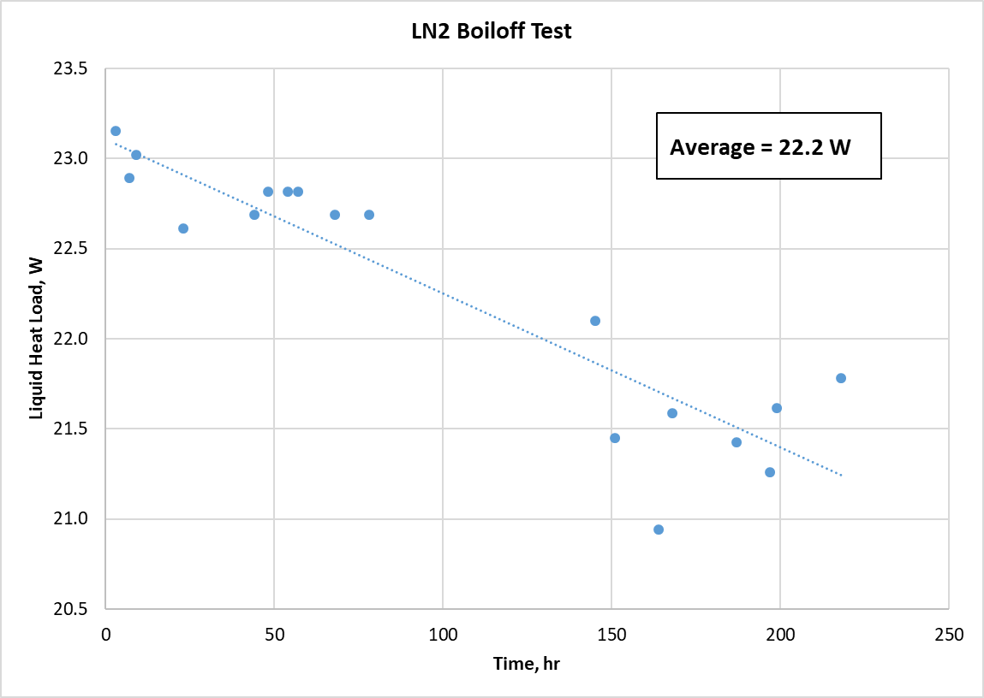
Test Data—LN2 Boiloff

Slide 9
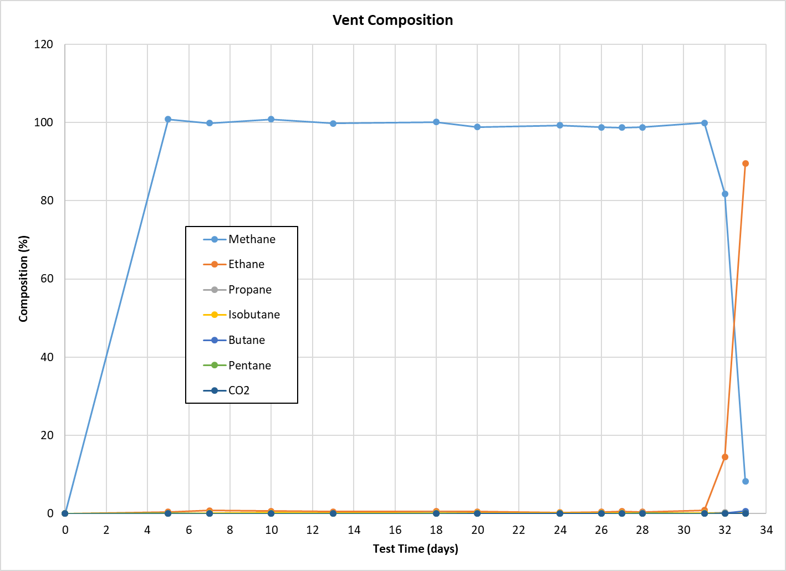
Test Data—Weathering, Vent Gas Composition

Slide 10
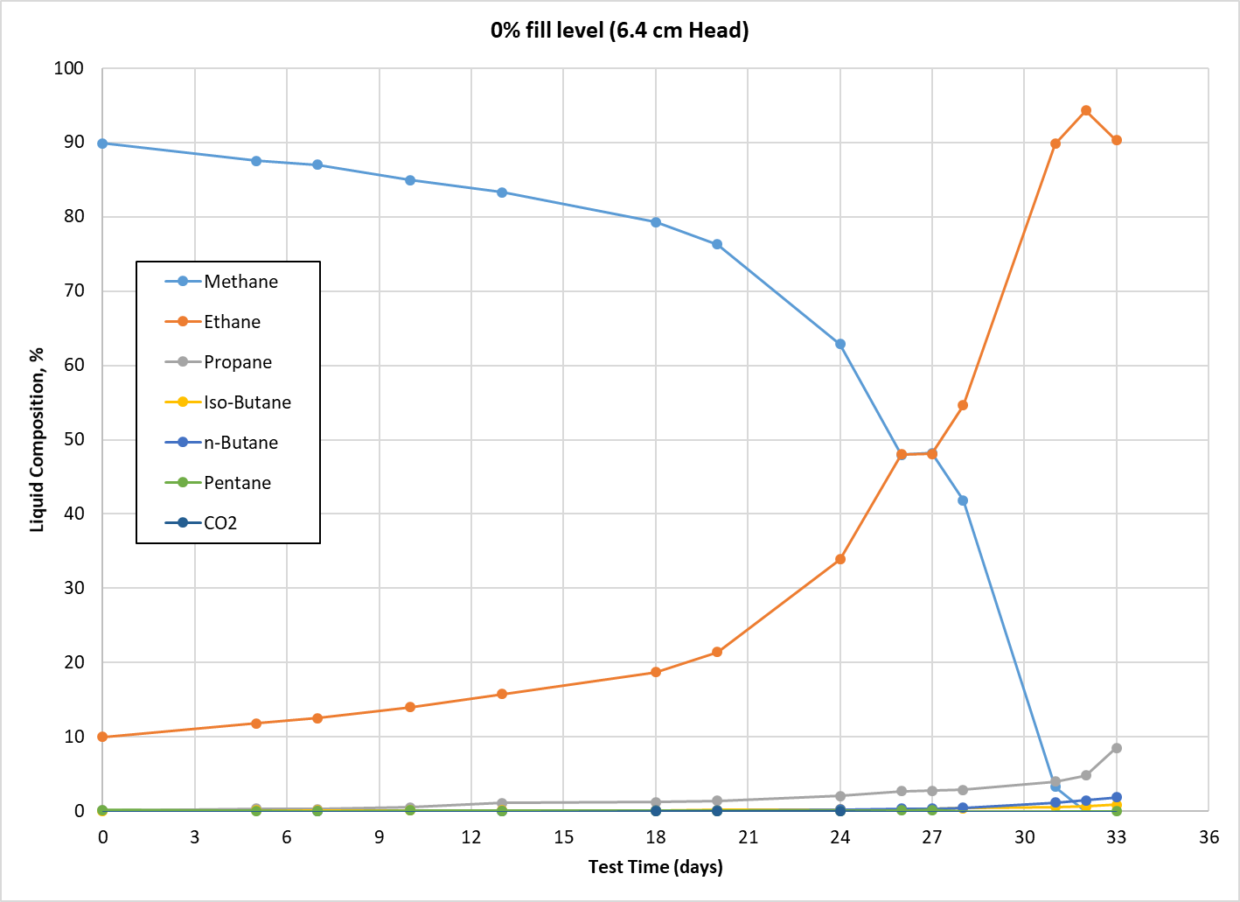
Test Data—Weathering, Liquid Composition

Slide 11
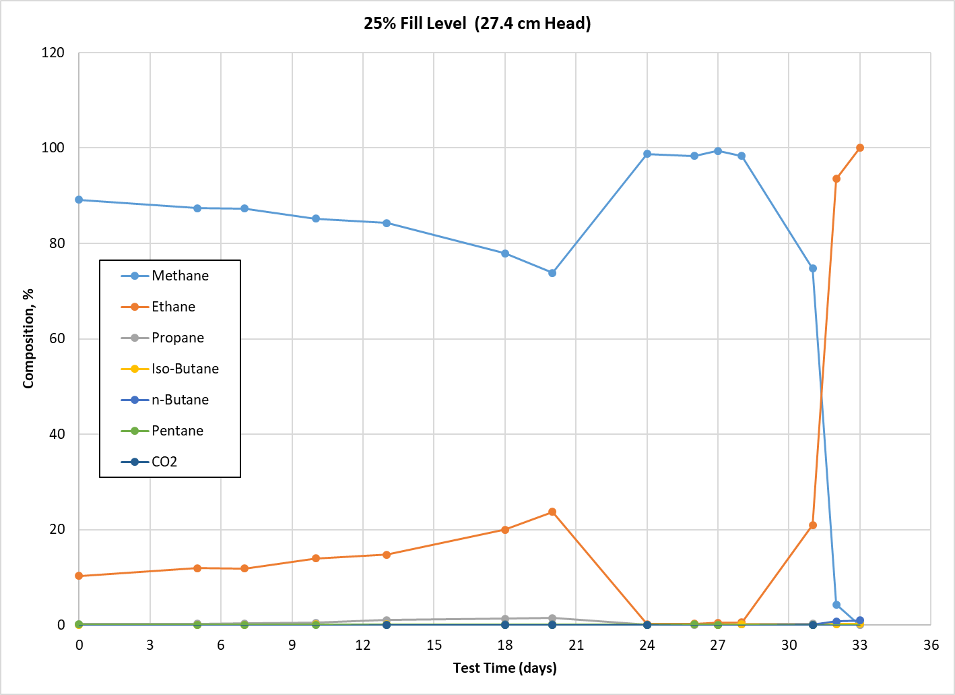
Test Data—Weathering

Slide 12
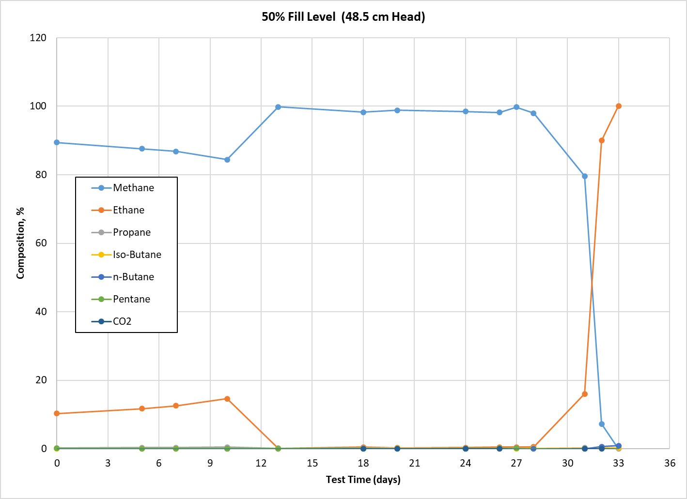
Test Data—Weathering

Slide 13
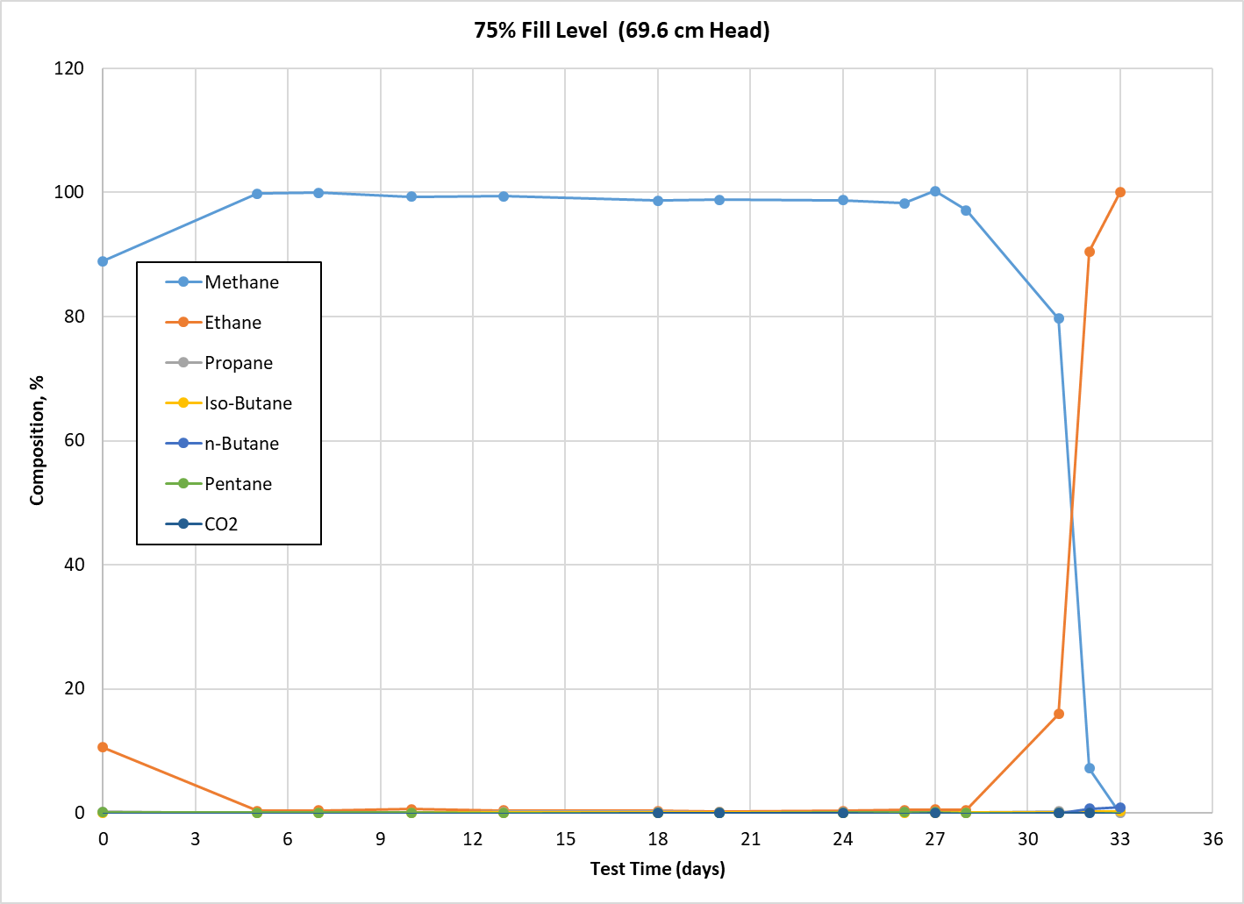
Test Data—Weathering

Slide 14
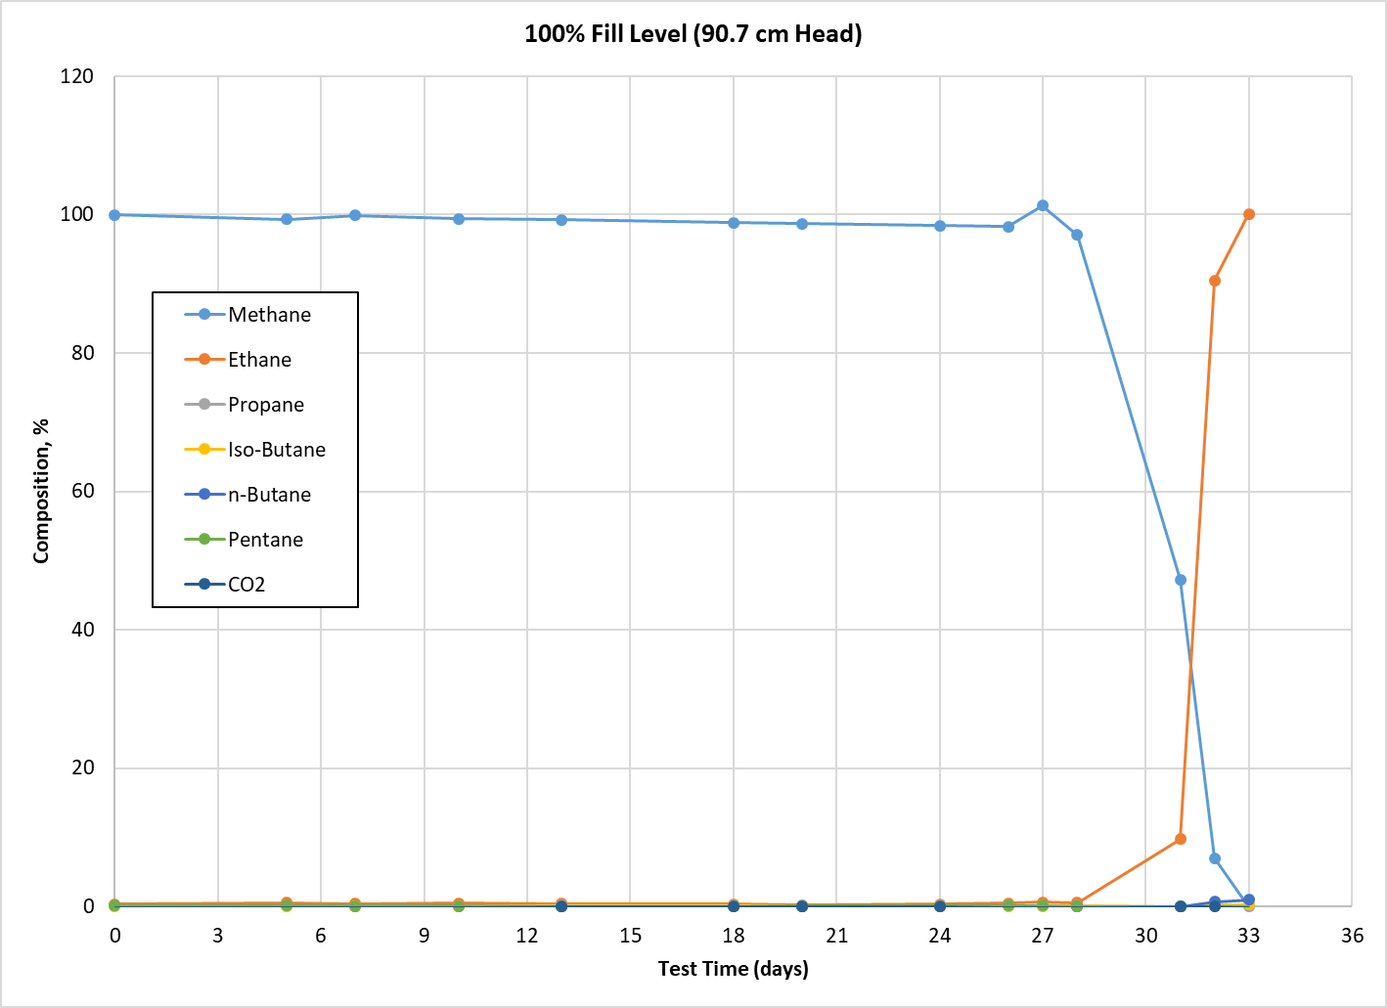
Test Data—Weathering

Slide 15
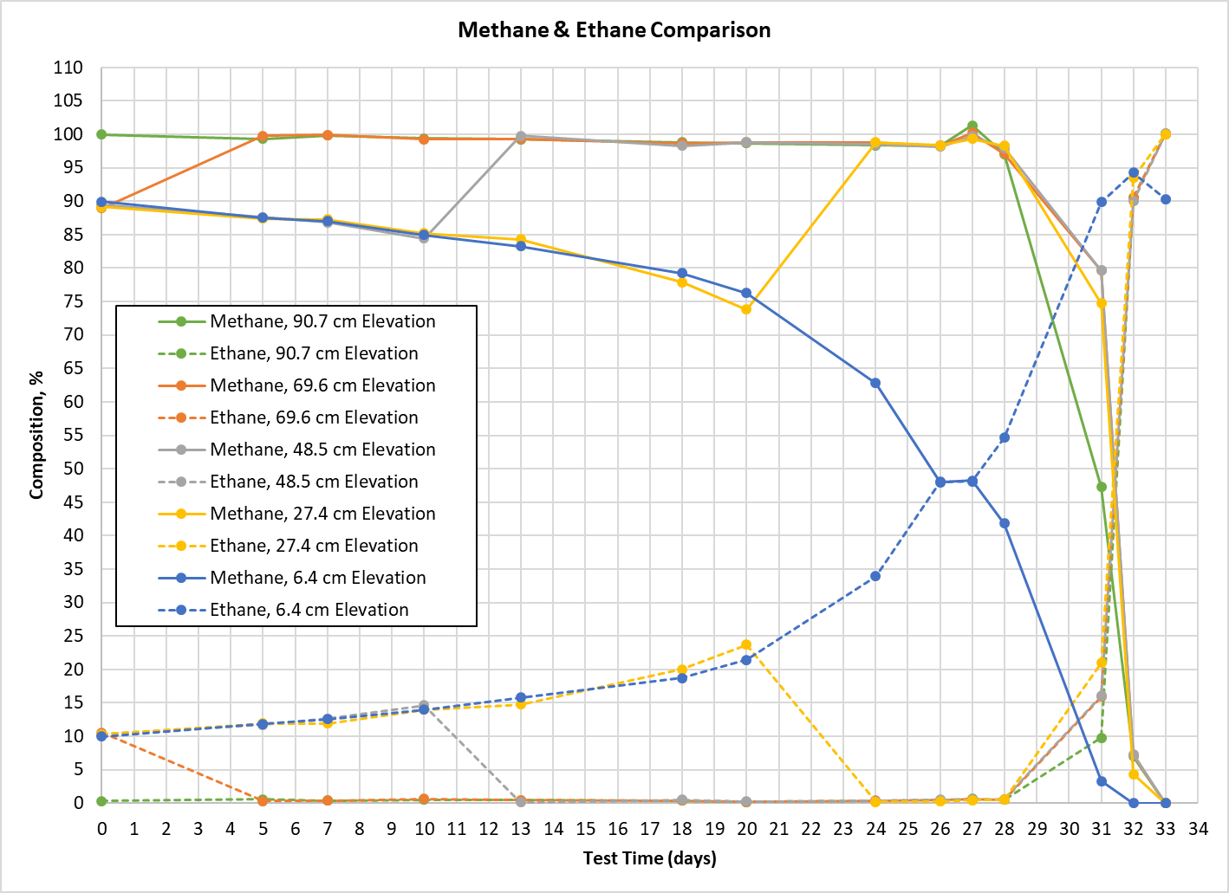
Test Data—Weathering

Slide 16
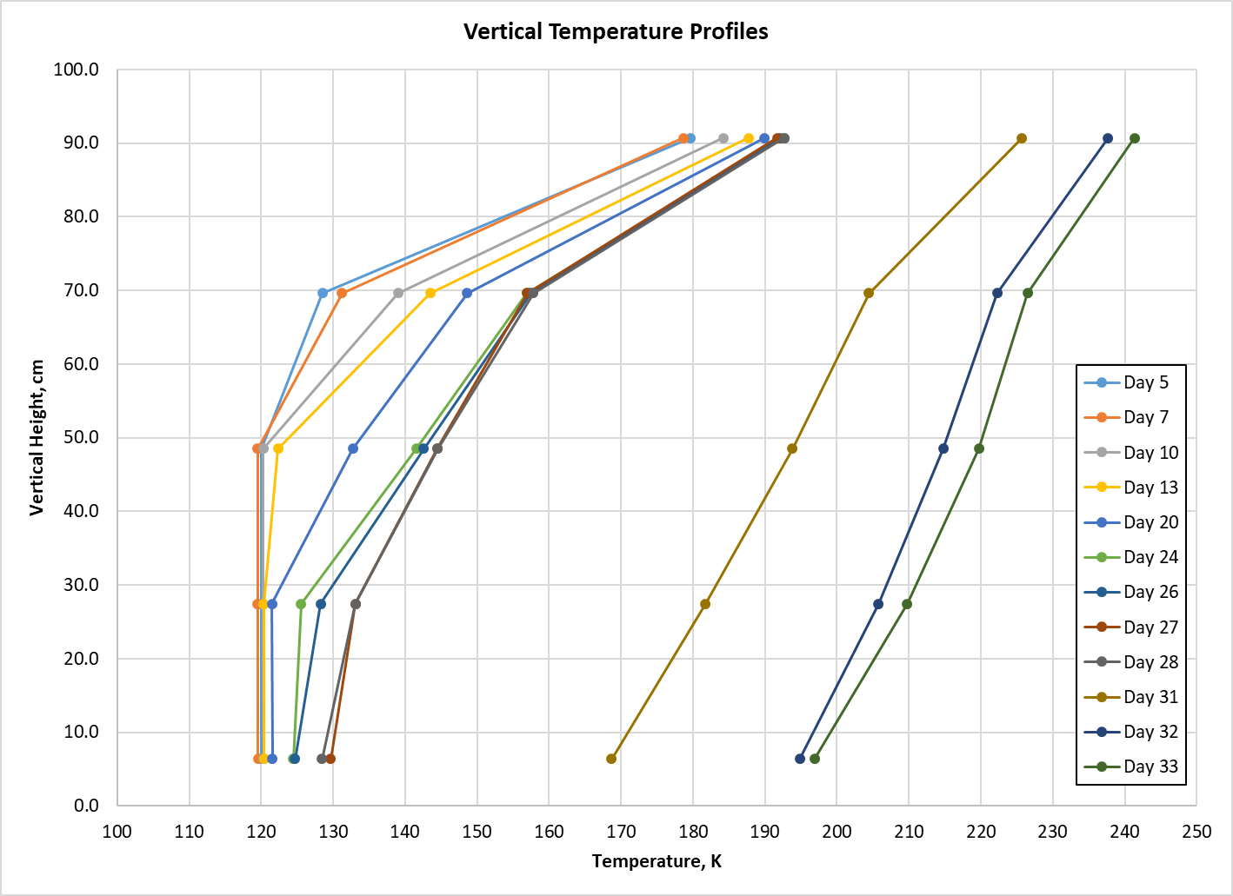
Test Data—Thermal Stratification

Slide 17
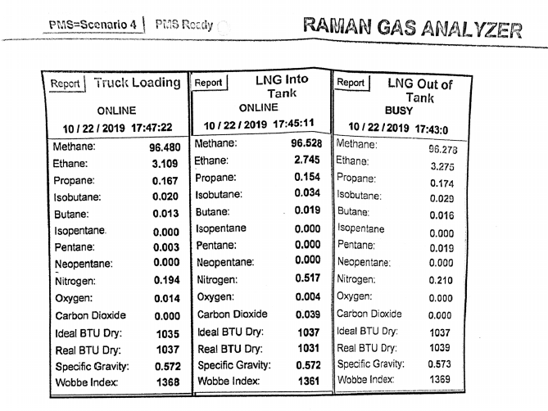
Test Data—LNG Composition Report from Vendor

Slide 18
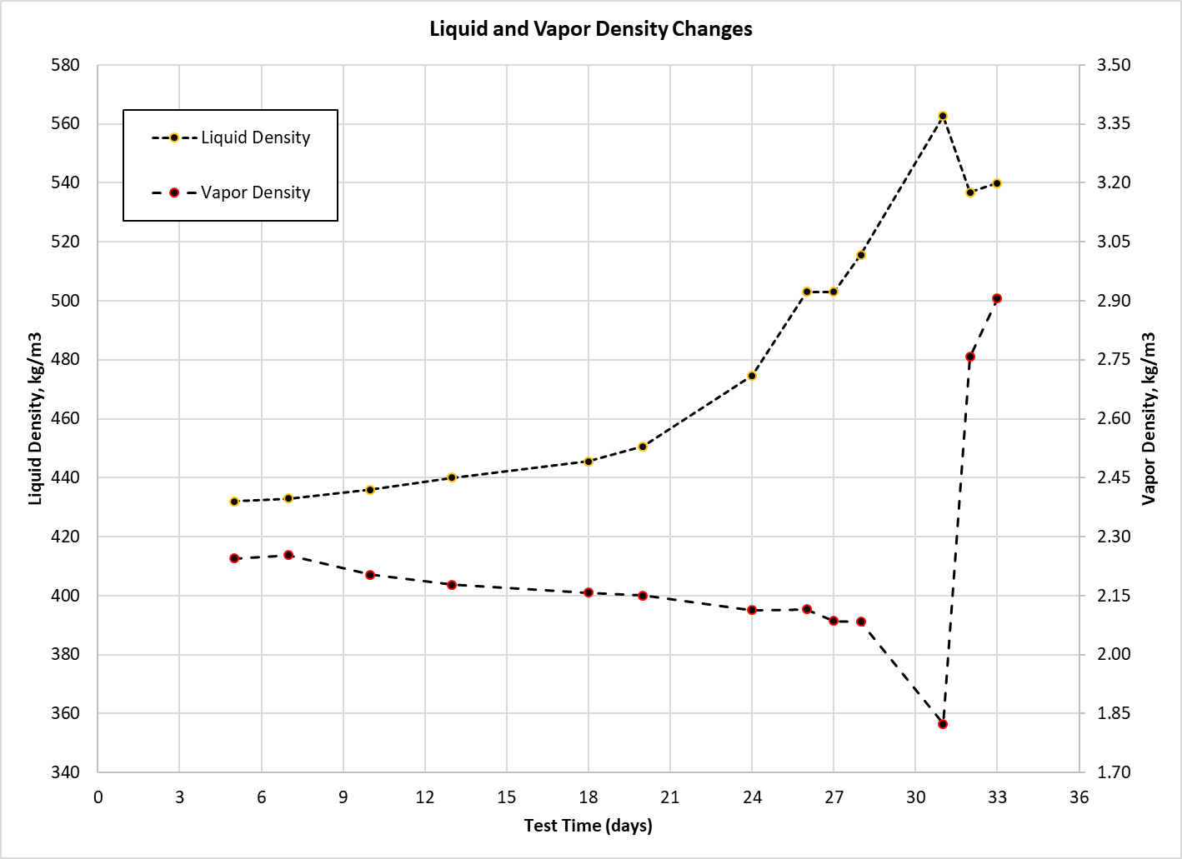
Analysis—Density Variation
Density determined via REFPROP Version 10 using a mass-based mixture of constituents, with percentages from measured values during testing
Liquid density is of a saturated liquid mixture at the test pressure
Vapor density is taken to be the mixture at the 100% fill level (90.7 cm elevation), with an average temperature between the lower- and upper-most sensors.

Slide 19
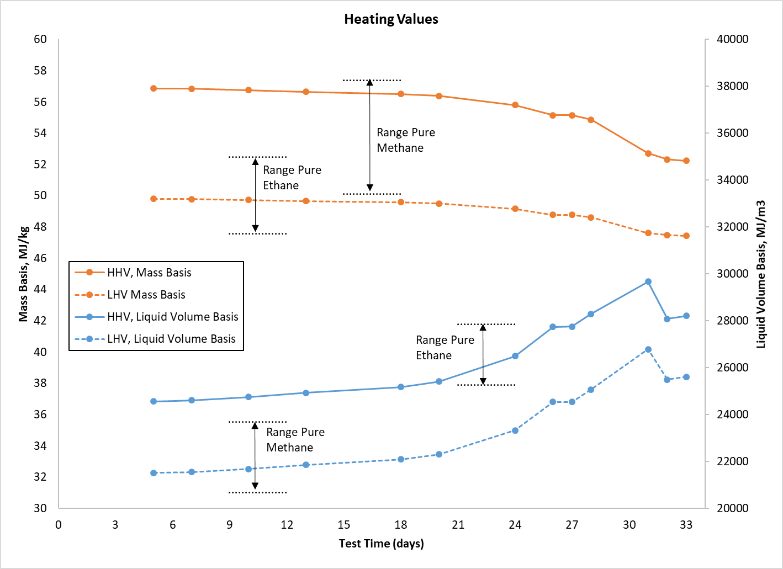
Analysis—Heating Value Variation
Heating values determined via REFPROP Version 10 using a mass-based mixture of constituents, with percentages from measured values during testing
Liquid volume basis values calculated by multiplying the HHV or LHV by the saturated liquid density at the test pressure.

Slide 20
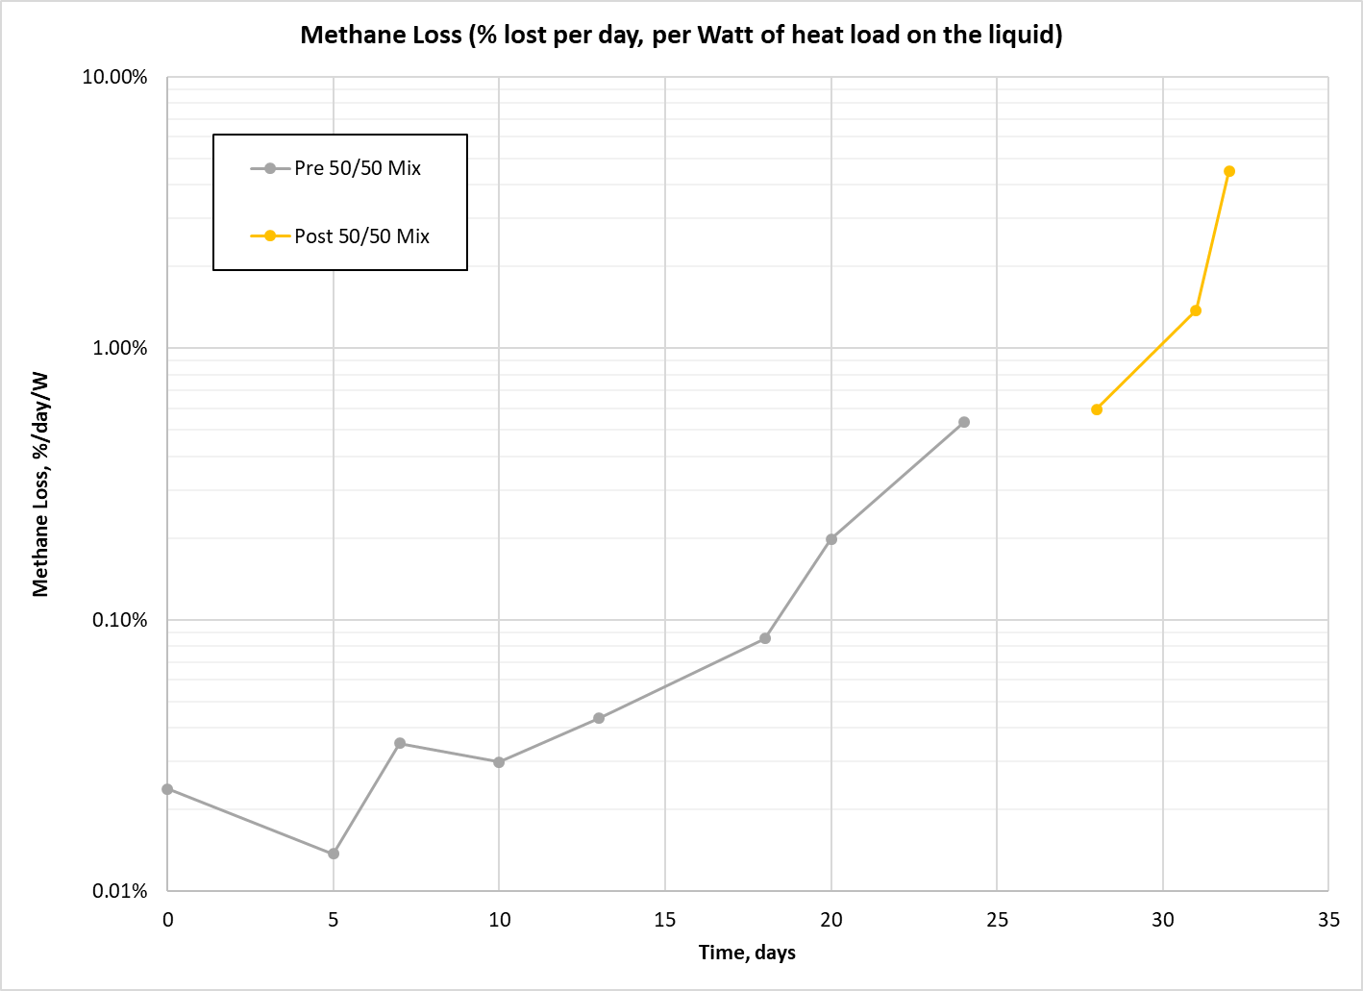
Analysis—Methane Loss

Slide 21
Existing Publications/Presentations
Poster—Development of a 400 L Integrated Refrigeration and Storage Cryostat for LNG/LCH4 Research, 27th International Cryogenic Engineering Conference, Oxford, England, (2018)
Integrated Refrigeration and Storage of LNG for Compositional Stability, Rose, L., Swanger, A. M., Notardonato, W. U., Fesmire, J. E., Gleeson, J., and Carro, R., Advances in Cryogenic Engineering, IOP Conf. Series: Materials Science and Engineering 101 (2019)

