Slide 1
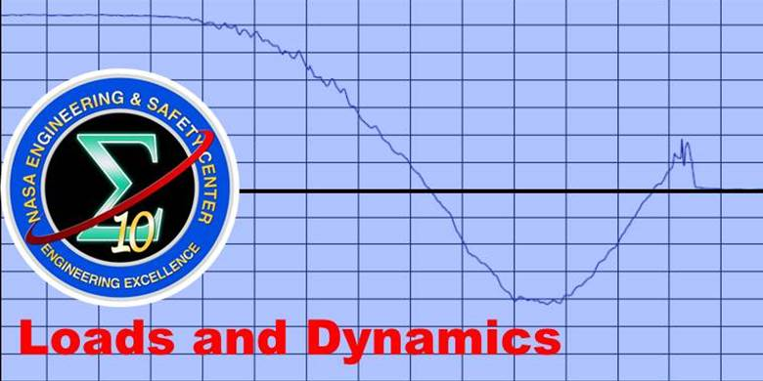
LOADS@NASA
Leading Outstanding Aerospace Loads & Dynamics Solutions
Dr. Dexter Johnson
NASA Technical Fellow – Loads and Dynamics
November 20, 2020
University of Central Florida – Engineering Lecture

Slide 2
Loads & Dynamics
Introduction
NASA’s Mission & Challenges
NASA Engineering and Safety Center
LOADS@NASA
Q&A

Slide 3
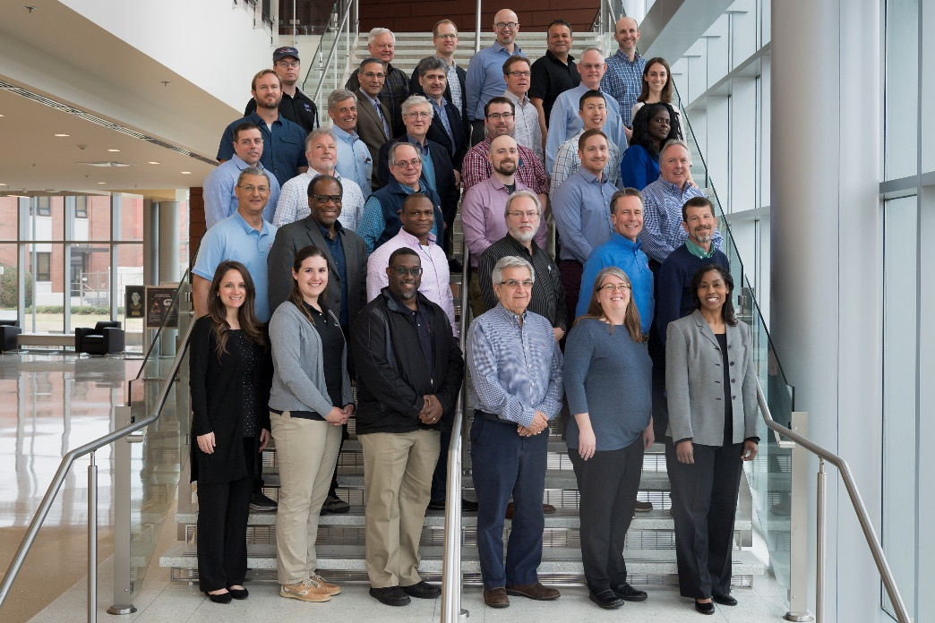
Introduction
Loads and Dynamics is a specialty branch of structural and mechanical engineering that deals with the determination of the vibration response of a structure subjected to dynamic (time varying) forces in its operational environment. It involves the interaction of aerodynamic, dynamic, elastic, damping, inertia, and control forces acting on vehicles and structures. It is a multi-disciplinary analysis, test, and evaluation discipline that interfaces with every aspect of a structural system through its complete lifecycle. It influences every Mission Directorate within NASA and nearly every project.

Slide 4

We Are Going to the Moon
https://www.youtube.com/watch?v=vl6jn-DdafM
Source: “The Artemis Challenge: Another Revolution in Structural Dynamics”, IMAC 38

Slide 5
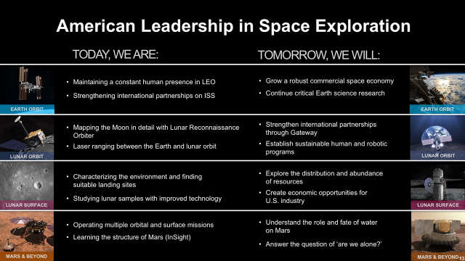
NASA’s Mission & Challenges
Source: “The Artemis Challenge: Another Revolution in Structural Dynamics”, IMAC 38

Slide 6
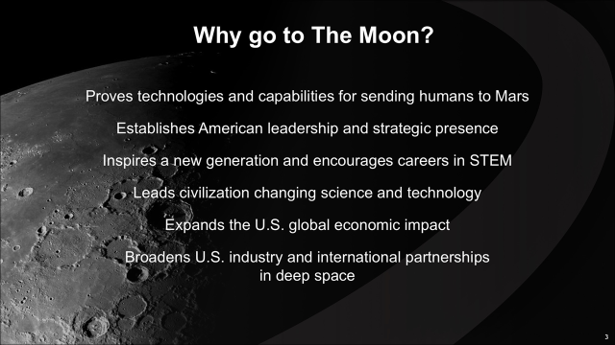
NASA’s Mission & Challenges
Source: “The Artemis Challenge: Another Revolution in Structural Dynamics”, IMAC 38

Slide 7
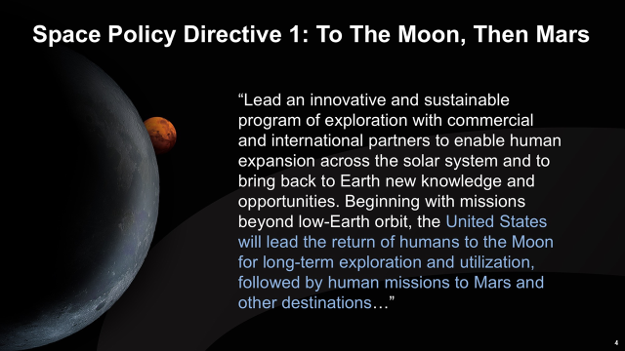
NASA’s Mission & Challenges
Source: “The Artemis Challenge: Another Revolution in Structural Dynamics”, IMAC 38

Slide 8
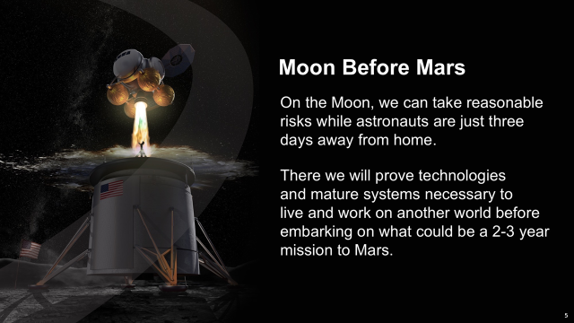
NASA’s Mission & Challenges
Source: “The Artemis Challenge: Another Revolution in Structural Dynamics”, IMAC 38

Slide 9
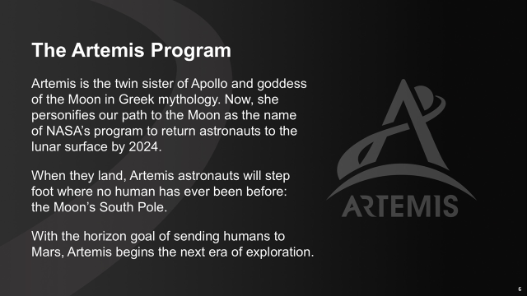
NASA’s Mission & Challenges
Source: “The Artemis Challenge: Another Revolution in Structural Dynamics”, IMAC 38

Slide 10
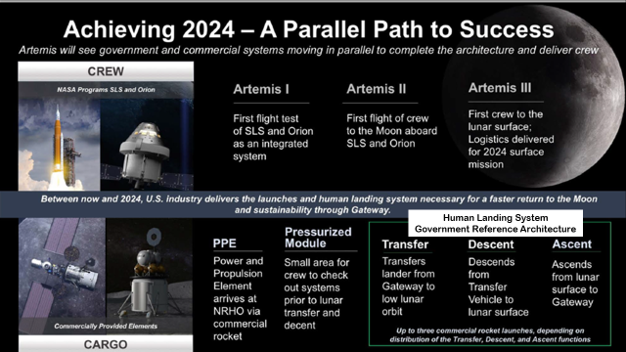
NASA’s Mission & Challenges
Source: “The Artemis Challenge: Another Revolution in Structural Dynamics”, IMAC 38

Slide 11
NASA’s Mission & Challenges
Reference: https://www.youtube.com/watch?v=wJ0ia4M2dxs
Source: “The Artemis Challenge: Another Revolution in Structural Dynamics”, IMAC 38

Slide 12
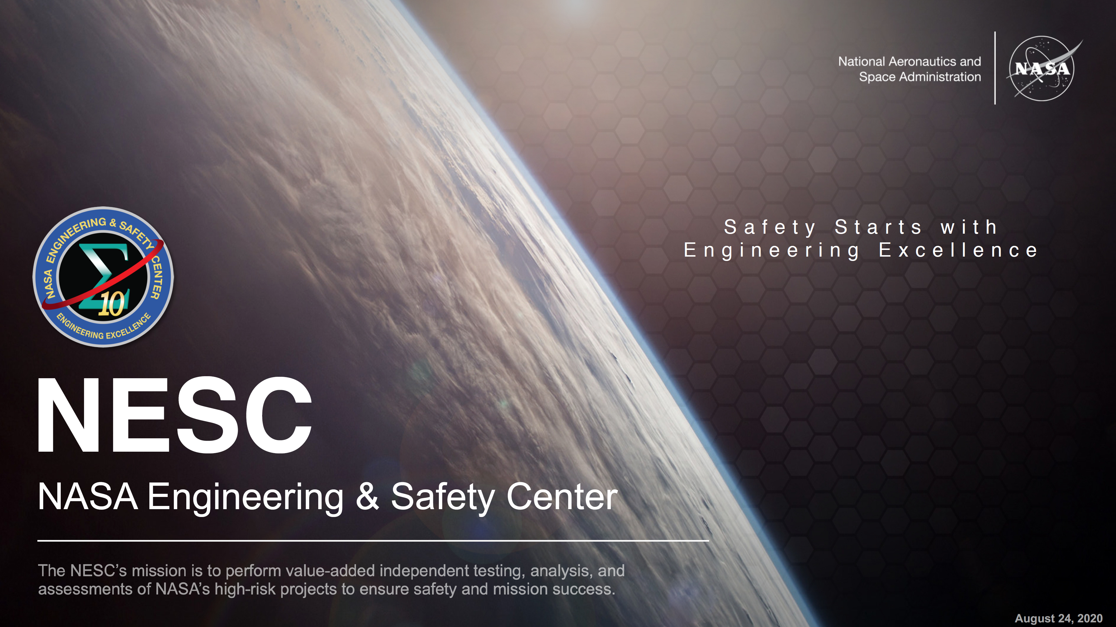
NESC
Source: “NESC Overview-MASTER_8-24-2020.pdf”

Slide 13
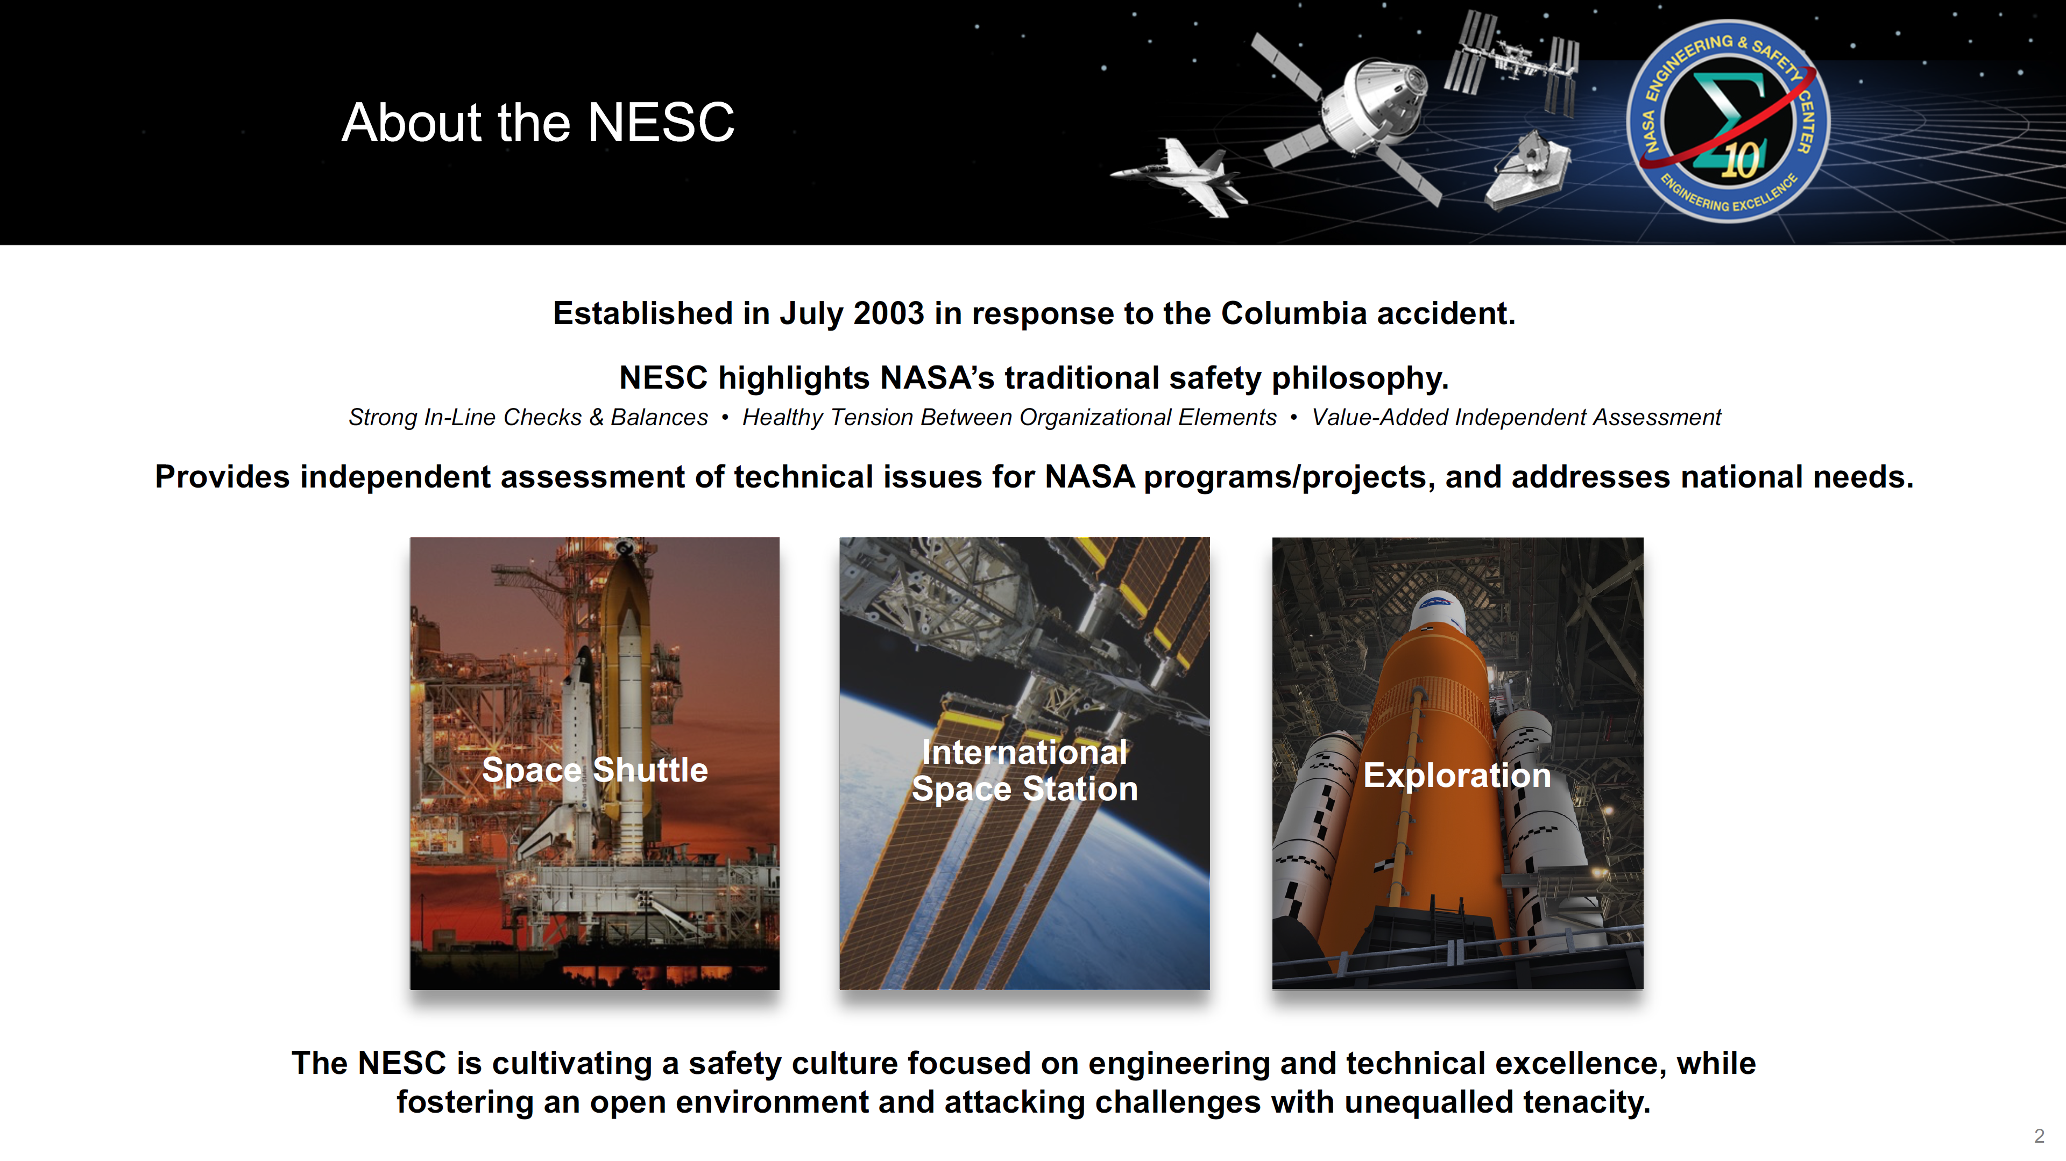
NESC
Source: “NESC Overview-MASTER_8-24-2020.pdf”

Slide 14
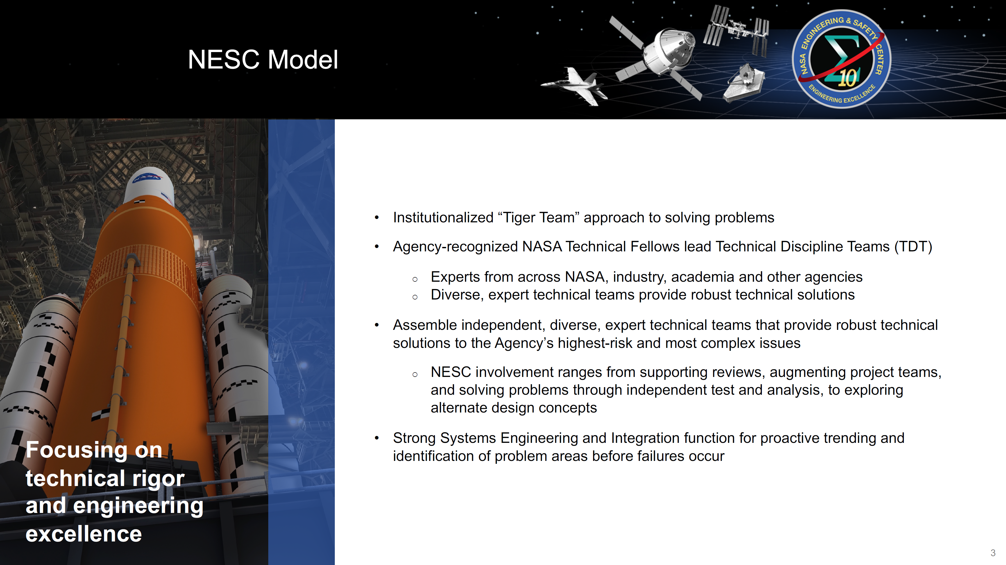
NESC
Source: “NESC Overview-MASTER_8-24-2020.pdf”

Slide 15
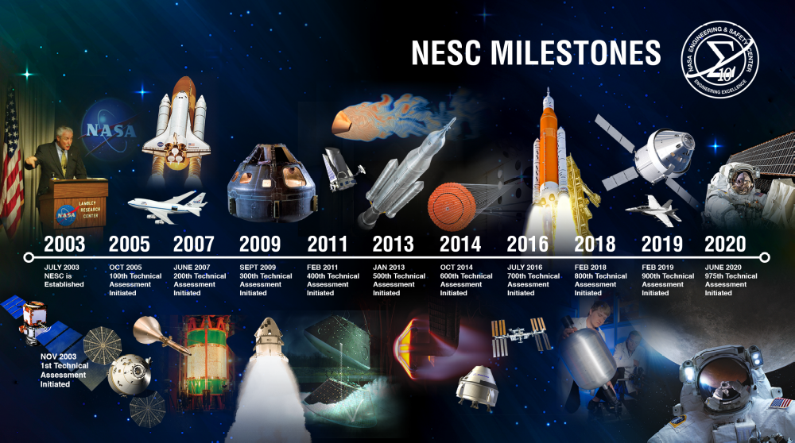
NESC
Source: “NESC Overview-MASTER_8-24-2020.pdf”

Slide 16
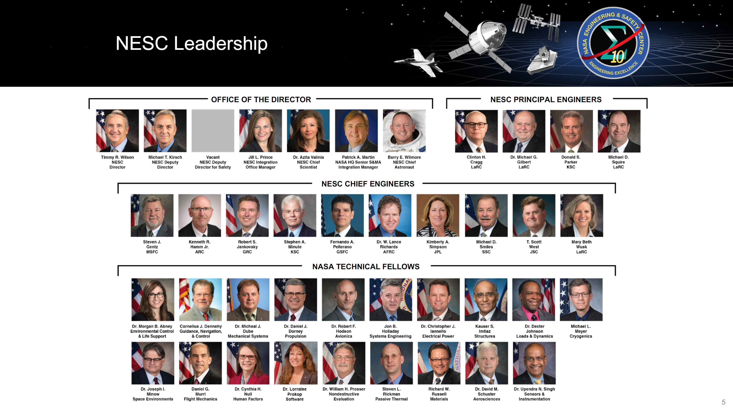
NESC
Source: “NESC Overview-MASTER_8-24-2020.pdf”

Slide 17
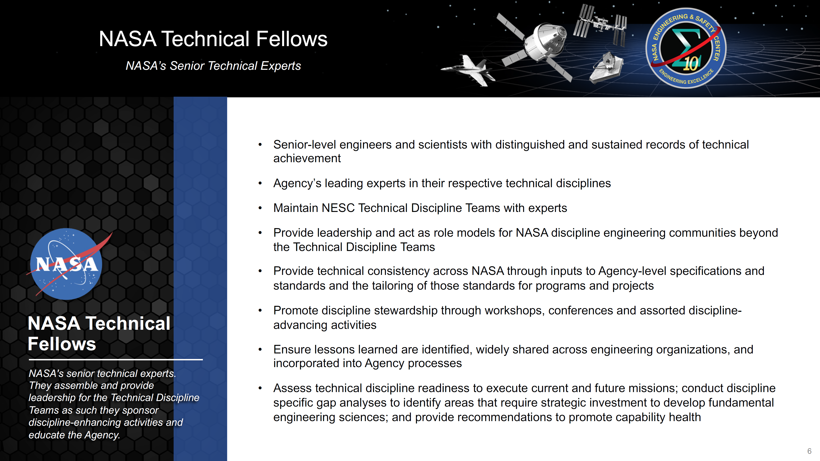
NESC
Source: “NESC Overview-MASTER_8-24-2020.pdf”

Slide 18
LOADS@NASA
Space Technology Mission Directorate TAXONOMY
TX12.5 Structural Dynamics
Loads and Structural Dynamics is a specialty branch of structural and mechanical engineering that deals with the determination of the vibration response of a structure subjected to dynamic (time varying) forces in its operational environment. It involves the interaction of aerodynamic, dynamic, elastic, damping, inertia, and control forces acting on vehicles and structures. Included are response and stability investigations of linear and nonlinear systems using analytical, empirical, and experimental techniques.
Structural dynamics technologies support effective and efficient deterministic and stochastic predictions of the mechanical (global and local static and dynamic) environments and associated structural dynamic behavior for the structural and system capabilities for future aerospace missions. Test technologies and techniques used in the verification and validation of structural and mechanical systems and associated numerical models for critical loads and environments.
TX12.5.1 Loads and Vibration
  Advanced loads and dynamics analysis capabilities with a focus on non-linear modeling and analysis, and uncertainty quantification. Novel vibration control techniques applicable to systems such as on-orbit docking and capture, and advanced aero propulsion systems (e.g., electromagnetic loading of structures for electric aircraft propulsion).
    Example Technologies: Development of Variational Coupled Loads Analysis Techniques, Advanced Fast Coupled Loads Analysis Tools, Enhanced Structural Nonlinear Joint Dynamics Modeling, Turbomachinery Response Analysis Tools
Source: https://www.nasa.gov/sites/default/files/atoms/files/2020_nasa_technology_taxonomy_lowres.pdf

Slide 19
LOADS@NASA
TX12.5 Structural Dynamics
TX12.5.2 Vibroacoustics
  Modeling and analysis techniques for high/mid-frequency range (e.g., Boundary Element Method based techniques)
    Example Technologies: Enhanced Internal Payload Fairing Acoustic Environment Modeling Approaches, Advanced Vibroacoustic Model Correlation Techniques, Structural Damping Integration methods (Active/adaptive strategies to mitigate fatigue, failure, control-structures interactions, structural vibration and acoustics)
TX12.5.3 Shock & Impact
  Enhanced modeling and correlation tools and techniques with test validation
    Example Technologies: Shock Analysis Methods and Tools, Impact Blast and Fragmentation Assessment Tools
TX12.5.4 Test, Tools, and Methods
  Operational modal analysis for large space flight hardware structural systems. Multi-dimensional test techniques.
    Example Technologies: Large Structures Operational Modal Analysis Test Techniques; Smart Dynamic Testing Approaches inclusive of Multi-Input/Multi-Output Techniques
Source: https://www.nasa.gov/sites/default/files/atoms/files/2020_nasa_technology_taxonomy_lowres.pdf

Slide 20
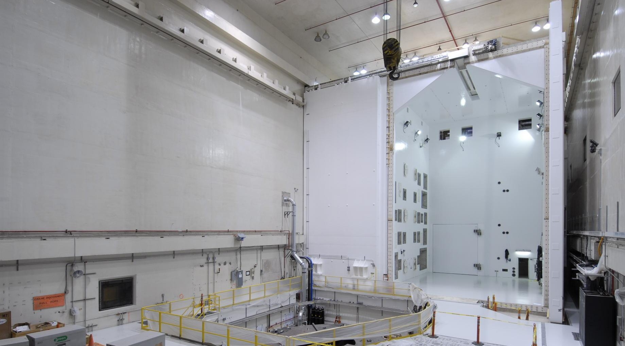
LOADS@NASA
Testing Capabilities
  Reverberant Acoustic Test Facility/ Mechanical Vibration Test Facility in the Space Power Facility at Plum Brook Station, in Sandusky, Ohio
    RATF: Sound pressure levels as high as 161 dB overall have been obtained for the 101,000 cubic foot chamber volume (37.5 feet width x 47.5 feet length x 57 feet height). Thirty six (36) acoustic modulators with dedicated horns are available to produce the unprecedented acoustic power levels over a frequency range of 25 Hz to 10 KHz.
    MVF: Able to accommodate a test article up to 18-feet in diameter, 75-feet in height, and 75,000 lbs in weight. Sine testing up to 1.25-g vertical and 1.0-g horizontally from 5 Hz to 150 Hz can be accomplished, without the need for reconfiguration of the test article between test axes. Additionally, the MVF currently has a 20-ft diameter modal floor capable of supporting fixed base modal testing of the same class spacecraft.
NASA Glenn Research Center’s 101,000 cubic feet reverberant acoustic test facility in Sandusky, Ohio offers unprecedented acoustic power supporting future space missions for both NASA and the commercial space industry.

Slide 21
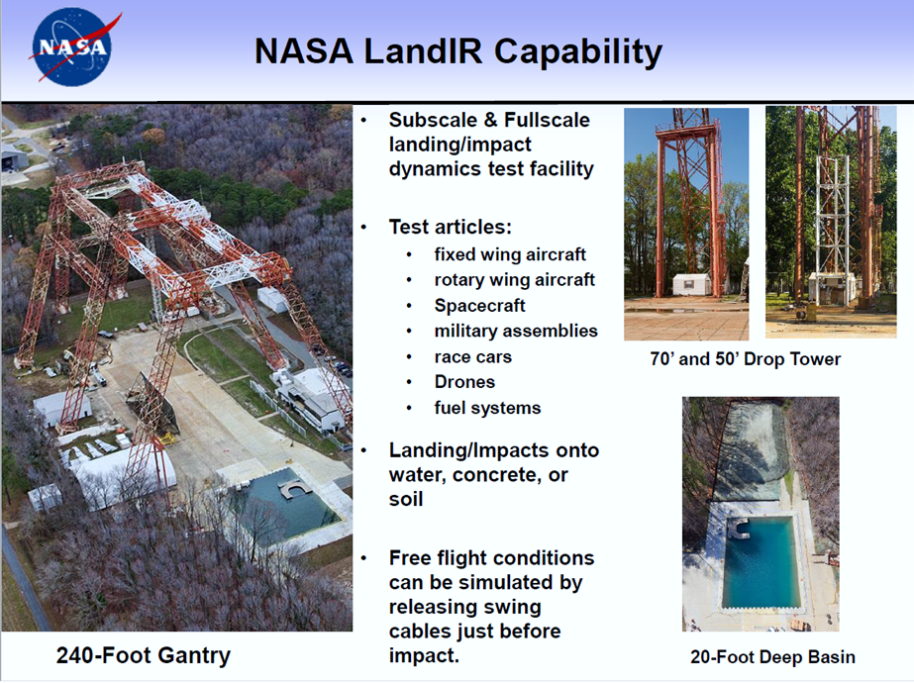

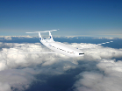

LOADS@NASA
Testing Capabilities
  Landing and Dynamic Impact Research (LanDIR) Facility.
    LanDIR is a unique national asset that provides controlled horizontal and vertical velocity and impact angles for water and land landing scenarios
    LanDIR contributes to the Loads and Dynamics Strategic Vector in several areas including water impact and lander loads verification
    Recent testing has been critical in the validation of non-linear analysis for water and land landing for Orion and Commercial Crew Program partners
    Non-linear modeling/simulation with validation testing at LanDIR is critical for Aeronautics Research Mission Directorate for crashworthiness
RECENT/FUTURE USE
Orion Qual Tests;
Lunar and Mars Landing/Sample Return
2020+
Non-traditional Configurations
2020+
Urban Vertical Lift Airframes
2020+

Slide 22
LOADS@NASA
Relevant NASA Standards and Handbooks
  NASA-STD-5002A, Load Analyses of Spacecraft and Payloads
  NASA-HDBK-7004D, Force Limited Vibration Testing
  NASA-HDBK-7005, Dynamics Environmental Criteria Handbook
  NASA-STD-7003A, Pyroshock Test Criteria Standard
  Program Standards
  Industry Standards

Slide 23
LOADS@NASA
Initiatives
  Smart Dynamic Testing Community of Practice (SDT CoP)
    The L&D discipline within the aerospace community has been challenged with the need to perform structural dynamic testing more effectively and efficiently. Current state-of-the art (SOA) test practices involve performing vibration tests one axis at a time with boundary conditions that are more idealistic than realistic resulting in not fully living up to the motto "test like you fly".
    The L&D TDT has embarked on building on a relatively new SDT CoP. The value added by the SDT CoP will be new test methods that will provide order-of-magnitude enhancements to the technical performance of the tests, with the traditional over-tests and under-tests virtually eliminated. Consequently, the SDT CoP will advance the L&D SDT SOA and will establish a path to enhance NASA aerospace programs and projects.
    Early application involves techniques applied to the Mobile Launcher, Crawler Transport, and Space Launch System (SLS) preparation for upcoming Artemis Mission launches resulting in risk reduction in building block dynamic testing.

Slide 24
LOADS@NASA
Initiatives
  Vibroacoustic Community of Practice (Va CoP)
    The L&D discipline within the aerospace community has been challenged with the need to enhance vibroacoustic prediction and testing more effectively and efficiently.
    This group currently is contained within the NESC Loads and Dynamics Technical Discipline Team and invited guests. They meet monthly via conference calls (if material is available).
    Objective#1: To interchange experiences and lessons learned in VA prediction and test in order to enhance modeling in support of hardware design and testing.
    Objective#2: To interchange experiences in the process of deriving hardware design and testing specifications based on vibroacoustic predictions (generation of component random vibration specs and design limit loads for primary and secondary structure)

Slide 25
LOADS@NASA
Initiatives
  Government, University, and Industry (GUIde) Consortium
    NASA L&D is engaged MSFC and GRC personnel regarding NASA involvement in the GUIde Consortium. The mission of GUIde is to understand and control turbomachinery blade response, as a result, decrease engine development time and cost, increase engine reliability, and provide an international focus on forced response research and enhance technology transfer to industry. The involvement of federal representatives, such as NASA, results in improved communication and collaboration between government and industrial R&D programs.
    Personnel used the opportunity of the annual meeting to hold extensive discussions with the members and researchers on issues of immediate interest to NASA. For example, how to define the population of blade-only natural frequencies for mistuning calculations; and implementation of intentional mistuning to mitigate high response. Finally, establishing relationships with this group of international experts is of great value to NASA in maintaining awareness of the state-of-the-art in turbomachinery structural and fluid dynamic analysis.

Slide 26

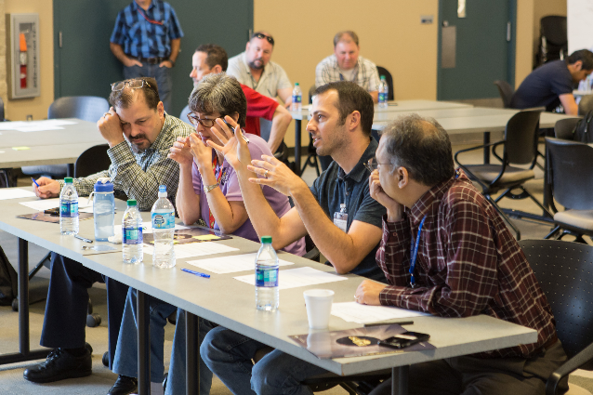
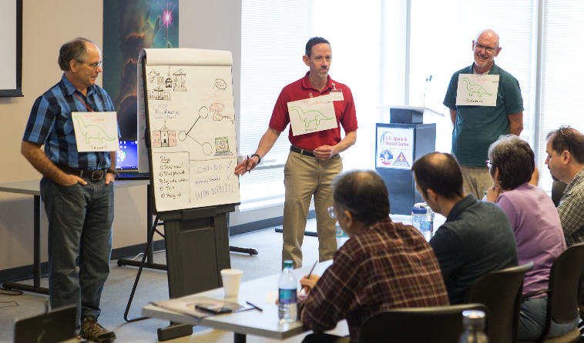
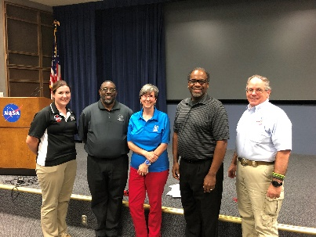
LOADS@NASA
Career
  Structures, Loads, and Mechanical Systems (SLAMS) Early Career Forum (ECF) and CoP
    The ECF is an annual event supported by the NESC Structures, Loads & Dynamics, and Mechanical Systems Technical Discipline Teams (TDTs). The forum provided opportunities for early career engineers (ECEs) across the Agency to showcase their work and develop relationships with peers and mentors to advance the SLaMS fields and develop NASA’s future workforce.
    The Community of Practice participants attend technical and professional development activities throughout the year which involve special presentations, social events, and career enhancement opportunities.
RECENT/FUTURE
Engagement

Slide 27
LOADS@NASA
Cross Discipline Interfaces and Interactions
  Data received from…
    Natural Environments
    Wind, atmosphere, sea surface, ground surface, micrometeoroid and orbital debris (MMOD), …
    Propulsion
    Aerodynamics
    Guidance, Navigation, and Control (GN&C)
    Flight Dynamics
    Structures
    Mechanical Systems (including ordnance and separation systems)
    Thermodynamics
  *Data delivered to…
    GN&C
    Structures
    Mechanical Systems
    Various hardware design groups, including Avionics, ECLSS, Power, etc.
    Crew Health and Safety
    Human Factors Engineering
    Test and Verification
* e.g., structural dynamic models (mode shapes, frequencies, and damping) and load, vibration, acoustic, and shock and impact environments

Slide 28
LOADS@NASA
L&D Mission Readiness - Requirements
ARMD
HEOMD
Advanced Air Vehicles Program
Aerosciences Evaluation and Test Capabilities - Advanced measurement techniques and experimental methods
Advanced Air Transport Technology – Control of flexible structures, flutter suppression, load alleviation, hybrid electric
Advanced Composites - Develop and test-validate advanced computational models under impact loading
Commercial Supersonic Technology – Airframe shape measurement/control for sonic boom attenuation
Hypersonic Technology – Aerothermoelasticity and aerothermoservoelasticity research
Revolutionary Vertical Lift Technology – Rotating machinery, incident tolerant blades
Integrated Aviation Systems Program
Flight Demonstrations and Capabilities – Flight test tool development/validation, FOSS, X-56A Ops, X-57, QueSST/LBFD
ISS Operation to 202X - Operating environments definition for structural assessments
On-orbit loads (ISS and cislunar/GW missions in 2020s)
  Docking , plume, thermal loads; Coupled vehicle dynamic response
Commercial Crew Program
  Alternate standards, IV&V, rapid development
  Test: Qual and acceptance, modal
SLS/MPCV/ESA SM: Prelaunch, liftoff and ascent dynamic loads and environments, model verification
  Support Block 1 certification, Block 1B development
  Complex programs, aborts, end-to-end simulation
  Vibroacoustics, shock
Enabling Development – Moon2Mars, HLS, etc.
Entry and landing loads, stability
  Terrestrial water/ground impact dynamics
  Survivability, reusability

Slide 29
LOADS@NASA
L&D Mission Readiness - Requirements
SMD
STMD
Model validations, loads and environments
  Launch: Acoustic, shock, vibration, modal survey
  On orbit vibration: Jitter
  Class D Payloads: Minimum set of requirements lacking
Validation and Qualification testing
  Random and sine vibration (Force limited tests), Shock, Acoustic, Strength Tests , Modal Surveys (fixed base, base driven, operational), Dynamic Interaction Tests (Jitter)
Kilopower
  Early concepts and planning for taking KRUSTY to Kilopower flight under Game Changing Development
Spacecraft Fire Safety (Saffire)
  Protoflight testing of the 3 units
Advanced Composite Solar Sail System (ACS3)
  Solar Sail Spacecraft Deployment Analysis, Design Concepts, & Testing
  Collaboration with NASA AMES
LOFTID
  Inflatable Decelerator Payload
  Payload Vibration vs. Acoustic Testing considerations

Slide 30
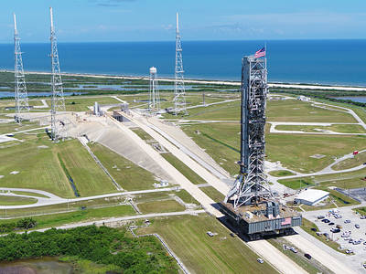
LOADS@NASA
  Advanced Dynamic Testing Development and Demonstration, Modeling and Analysis Methods, and Consensus Guidelines.
    Testing
      Multi-DOF Testing - Impedance-Matched Multi-Axis Testing (IMMAT)
      Operational Modal Analysis
      Fixed Based Correction (FBC) technique
      Enhanced Building Block Approach
    Analysis
      Shock Modelling
      Shock Data
      Vibro-acoustic Modeling
      Nonlinear Joint Analysis
      Uncertainty Quantification
    Guidelines
      Impact and Blast Guidance Development
RECENT/FUTURE
Engagement
The mobile launcher is the ground structure that will be used to assemble, process and launch NASA’s Space Launch System (SLS) rocket and Orion spacecraft from Launch Pad 39B at the agency’s Kennedy Space Center in Florida for missions to deep space destinations, such as the Moon, Mars and beyond.

Slide 31
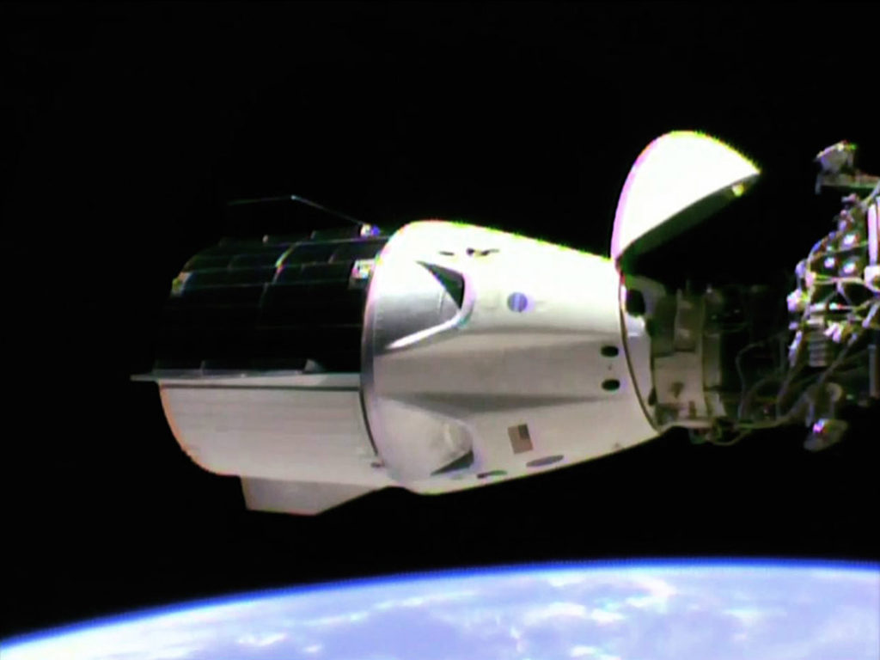
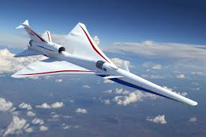
LOADS@NASA
  Future missions will require a refresh and/or development of skills and technologies for:
    In-space
      Proximity-operations/docking/berthing/mated vehicle loads.
      Solar Electric Propulsion mated vehicle loads.
      Lunar lander loads (robotic and human).
      EDL loads (Earth and Mars, Jupiter/Europa, Saturn/Titan).
      Shock environment in vacuum.
      High speed cryogenic turbo-pumps (600kRPM)
    Aeronautics Research
      Impact Dynamics Test and Analysis,
      Advanced Transmissions/Rotorcraft/Drive Systems Test and Analysis
      Turbomachinery
      Electromagnetic Loads & Dynamics Specialty Group
      Hypersonic
      Electrified Aircraft
      X-planes
Source - Space.com: SpaceX's Crew Dragon Docks at Space Station for First Time

Slide 32
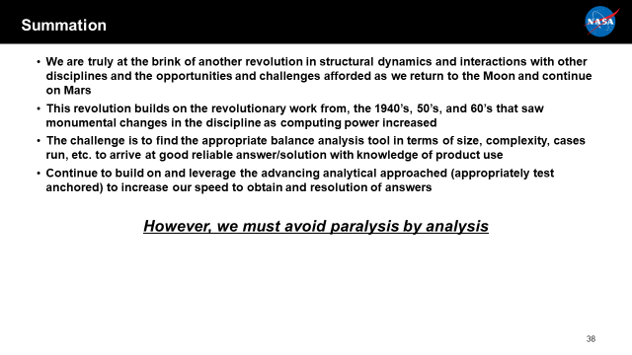
LOADS@NASA
Source: “The Artemis Challenge: Another Revolution in Structural Dynamics”, IMAC 38

Slide 33
LOADS@NASA
Reference: https://www.youtube.com/watch?v=WeA7edXsU40
Source: “The Artemis Challenge: Another Revolution in Structural Dynamics”, IMAC 38

Slide 34
Questions?
Dexter Johnson, Ph.D., NAFP Fellow II, AIAA Associate Fellow
NASA Technical Fellow – Loads and Dynamics
NASA Engineering and Safety Center
NASA Glenn Research Center at Lewis Field
1-216-433-6046 (Voice) / 1-216-977-7545 (Fax) / 1-216-704-8806 (Mobile)
MS 86-8 / 21000 Brookpark Rd. / Brook Park, Ohio 44135
https://nen.nasa.gov/web/lnd
https://www.nasa.gov/offices/nesc/team/Dexter-Johnson-bio.html
"Today is a GREAT day!"

Slide 35
Backup

Slide 36
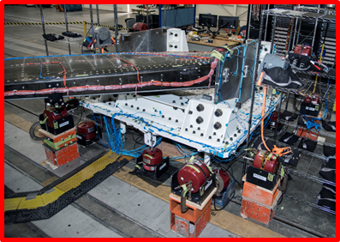
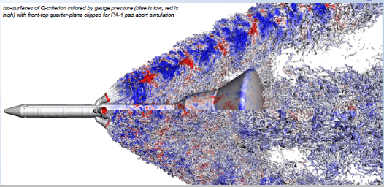
Discipline Strengths/Successes
AFRC
  Passive Aero-elastic Tailored (PAT) Wing Ground Vibration Test (GVT): traditional free-free or rigid boundary condition techniques is a challenge due to the size and mounting locations of the wing. Additional ground fixture investment is costly.
    Utilized fixed based correction (FBC) technique to measure modes from a test article mounted to a dynamically active static test fixture.
    Fixed based modal correction technique used Calibration Research Wing (CReW) as pathfinder to increase confidence in method
ARC
  Launch Abort Vehicle Acoustics (LAVA) team collaborates with Orion L&D team at JSC to help characterize the vibro-acoustic (VA) environment of the Orion LAV for launch and ascent abort (AA) scenarios
    Post-processed acoustics for Pad Abort 1 (PA-1) and obtained excellent agreement with PA-1 flight data given that vehicle was static in sim vs rapidly accelerating and banking in test
    Run simulation with vehicle accelerating and banding to reproduce PA-1 flight test trajectory
    Will inform AA-2 flight test

Slide 37
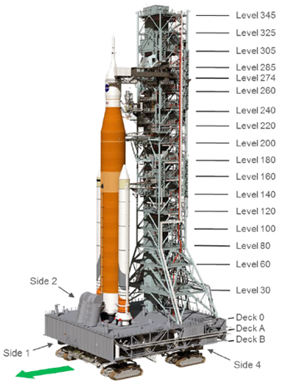
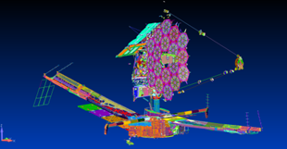
Discipline Strengths/Successes
GRC
  LMD performed an independent assessment of the Mobile Launcher (ML) Only modal test pretest analysis to provide an as-run end-to-end simulation for all three test configurations for target modes up to ~ 7 Hz.
    ML on VAB Support Posts., Crawler Transporter (CT), VAB Support Posts and CT.
    Covered not only accelerometer and shaker layout, but also included generating simulated test time histories for modal extraction to verify shaker forces are sufficient to overcome ambient noise levels.
    359 test DOF on ML and 40 test DOF on CT.
    ML Tower target modes are closely spaced and very in low frequency. CT modes couple with ML modes.
GSFC
  In January 2019, the JWST project completed the acoustics and sine vibration for the spacecraft element (SCE) system flight h/w which included the spacecraft and sunshield components of the JWST observatory. Last April 2018, the project found sunshield membrane cover assembly (MCA) fasteners that had loosened and/or removed during SCE acoustics testing.
    NGAS investigated the fastener design and found that the design was modified so that the fastener did not hit the sunshield membrane but in doing so, insufficient thread engagement occurred. New longer fasteners were incorporated along with bumpers to limit the sunshield membrane motion during mechanical dynamic loading.
    New design reviewed by NGAS and NASA; design qualification included component level mechanical testing. Nearly 1000 fasteners checked and replaced with the new design. Final verification occurred with a 2nd SCE acoustic test January 2019 which showed no issues with the new fastener design.

Slide 38
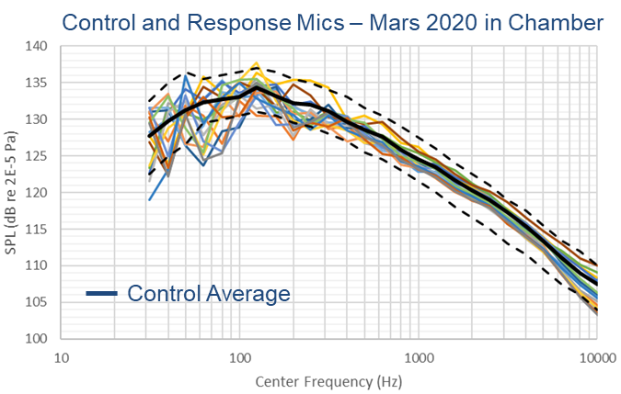
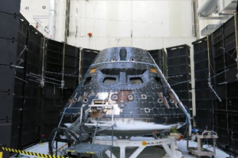
Discipline Strengths/Successes
JPL
  Spacecraft like M2020, Europa Clipper have large size relative to JPL acoustic chamber. There is a need for acoustic field characterization and control microphones locations/numbers optimization.
    Testing with volume simulator used to develop effective test approach for large test articles - contol mic placement strategy and addition of loud speakers to augment high-freq SPLs
    Approach resulted in successful Mars 2020 flight vehicle acoustic test, April 2019 - w/in tolerance, consistent sound filed around vehicle
JSC
  Orion Direct Field Acoustic Test: facing schedule and cost challenges, shipping Orion to the PBS to perform acceptance tests was an undesirable schedule and cost impact to the program
    Used Direct Field Acoustic Test (DFAT) for Acceptance testing instead of the traditional reverberant chamber acoustic test. "Test Chamber" comes to test article
    To address the challenge of having DFAT produce the same level everywhere in the field (direction independent), development tests run in 2015 to verify the acoustic field was adequate for Orion. Lead to updates in # and placement of control mics and controller updates. Test data used to validate prediction tool (Wave6)

Slide 39
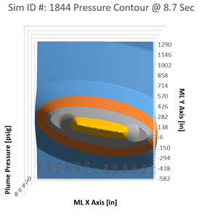
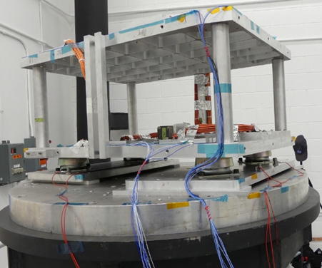
Discipline Strengths/Successes
KSC
  Design and development of ground systems to support a new launch vehicle can be challenging when developing design load requirements. Analysis tools are needed to decipher raw data and document load
    Part I: KSC Engineering Analysis (NE-XY) developed the Flight to Ground Launch Tool (FGLT) which predicts launch blast loads from directing SLS free stream stagnation pressure plumes using the GNC vehicle positon and engine gimbal data. The FGLT is utilized to determine the maximum, mean, and standard deviation pressures down to a 2 ft by 2 ft resolution over the Zero Deck and each level of the Mobile Launcher Tower.
    Part II: SLS Blast And Thermal Environment Load Requirements (K0000345836-SPC) document leverages projected blast pressure statistics output from the FGLT to provide launch environment loads to be used in the design of EGS Ground Support Equipment (GSE), Ground Support Systems (GSS), and Facility systems that will support SLS.
LaRC
  Ascent Abort 2 (AA-2) Flight Test Vehicle instrumentation mounted on isolated pallet designs. Multiple configurations and isolators of representative pallet design mass simulators vibration tested.
  Individual component qual environments derived from test measurements. Initially derived vertical environment specs were severe due to high input environment at pallet interface, poor isolator performance of pallet structural modes and enveloping.
    Evaluated other isolators for better performance through additional testing
    Pallet configs made more flight-like with cabling simulations and shaker interface to structure to better represent the compliance of mounting interface
    Effects of new isolators, cabling simulators and IF compliance identified
    Resulting component qual environments reduced and more representative of flight

Slide 40
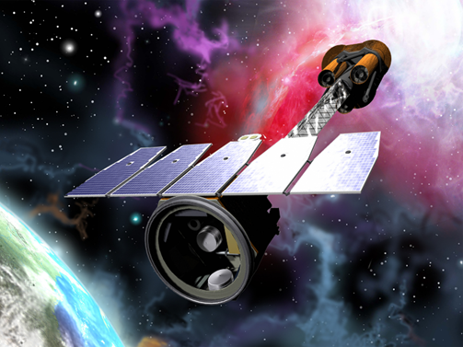
Discipline Strengths/Successes
MSFC
  The Imaging X-Ray Polarimetry Explorer (IXPE) Project needed a method to capture mode shapes and mode frequencies of the mirror shells in the mirror. Shells are too light for accelerometers. Limited space to place the accels
    The MSFC/EV31 team use a photogrammetry technique called Motion Magnification to determine the modes from high speed video
    Both random vibe and sine sweep base excitation from 80-500Hz
    14 modes were captured for the sine sweep excitation, per customer request

