Slide 1
Space Nuclear Propulsion (SNP)
Technology Demonstration Mission (TDM)
NTP Engine System Design
Space Technology Mission Directorate
Technology Demonstration Mission Program
Space Nuclear Propulsion
Tyler Scogin | 9 NOV 2020

Slide 2
Space Nuclear Propulsion (SNP) Overview
Overall Nuclear Thermal Propulsion Strategy:
Develop a subscale nuclear engine that demonstrates a viable Nuclear Thermal Propulsion (NTP) system and is scalable to the Mars mission engine needs. Evolve to Mars engine system as a part of a Mars NP propulsive stage.
  Develop a HALEU solid solution fuel element that can provide reactor exit temperatures > 2700 K (corresponds to > 900s I_{sp}).
  Design a reactor with an eye toward capability to be scaled to a size to support Mars mission engine needs. (Scaling is to be an engineering solution rather than further tech development.)
  Design and develop a subscale engine (Key attribute goals: 10K-15K lbf thrust, 900s I_{sp})
  Determine Demonstration option (either ground test or demonstration flight).
  Identify testing and launch regulatory requirements and mitigate issues.
  Work with Cryogenic Fluid Management (CFM) project to develop passive and active CFM systems to support NTP mission needs.
  Goal is to demonstrate Engine (ground test or flight demonstration) Circa FY2027.
2

Slide 3
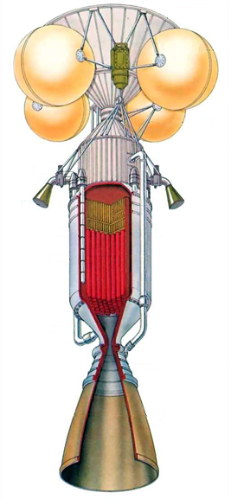
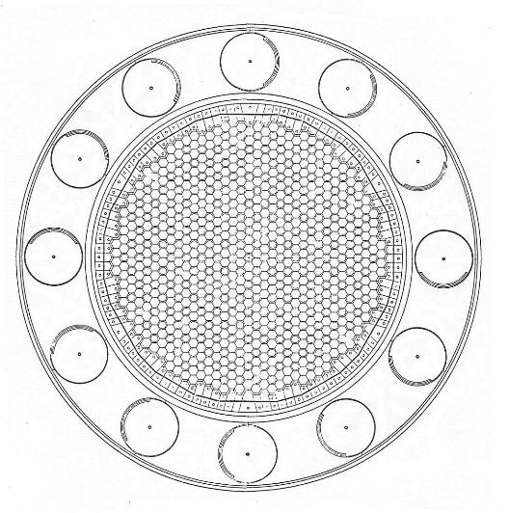
Initial NTP Engine Systems
Base of LH₂ Tank
Cross Section
Helium
Pressurization
Bottles
Structural
Supports
Control Drum
Actuators
Housing for
Turbopumps
Turbopump Exhaust
(Attitude Control)
Radiation Shield
Reactor Reflector
Control Drum
Reactor Core
Pressure Shell
Propellant Bleed
to Turbopump
Propellant Feed Line
Nozzle
Nozzle Extension
Note: Control drums rotate to control reactivity. Portion of circumference covered with neutron absorber and remainder is reflector.

Slide 4
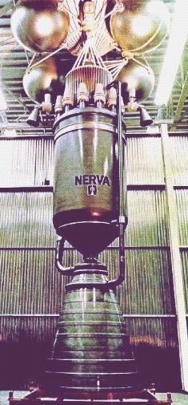
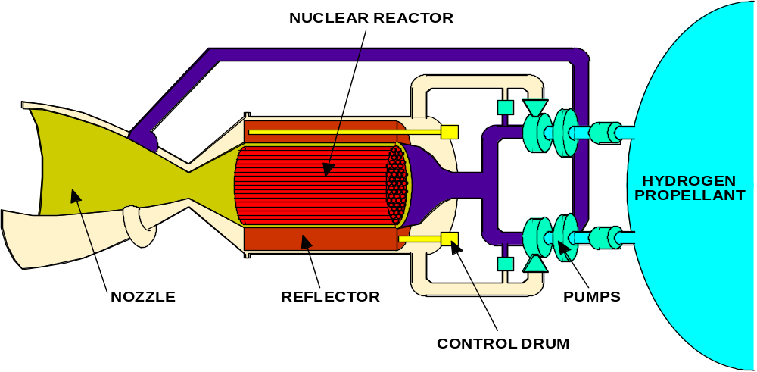
Initial NTP Engine Systems
Propellant heated directly by a nuclear reactor and thermally expanded/accelerated through a nozzle
Low molecular weight propellant – typically Hydrogen
Thrust directly related to thermal power of reactor: 100,000 N ≈ 450 MW_{th} at 900 sec
Specific Impulse directly related to exhaust temperature: 830 - 1000 sec (2300 - 3100K)
Specific Impulse improvement (~2x) over chemical rockets due to lower molecular weight of propellant (exhaust stream of O2/H2 engine actually runs hotter than NTP)
NERVA Nuclear Thermal Rocket Prototype
Major Elements of a Nuclear Thermal Rocket

Slide 5
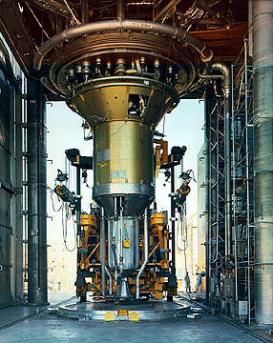
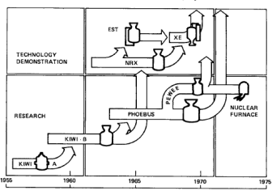
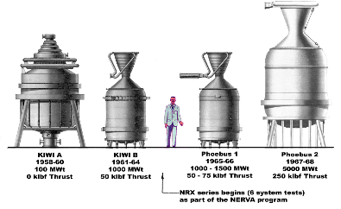
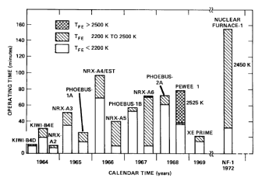
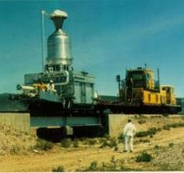
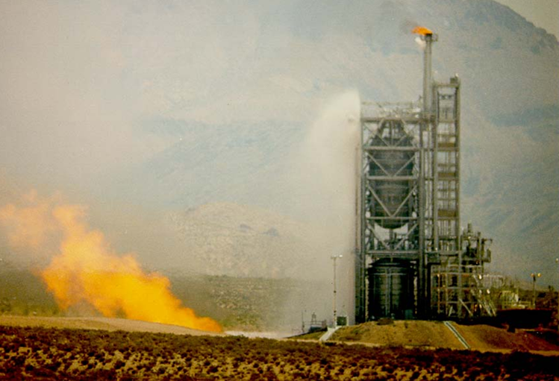
Initial NTP Engine Systems
20 NTP Engines designed, built, and tested during Rover/NERVA (1955-1973)

Slide 6
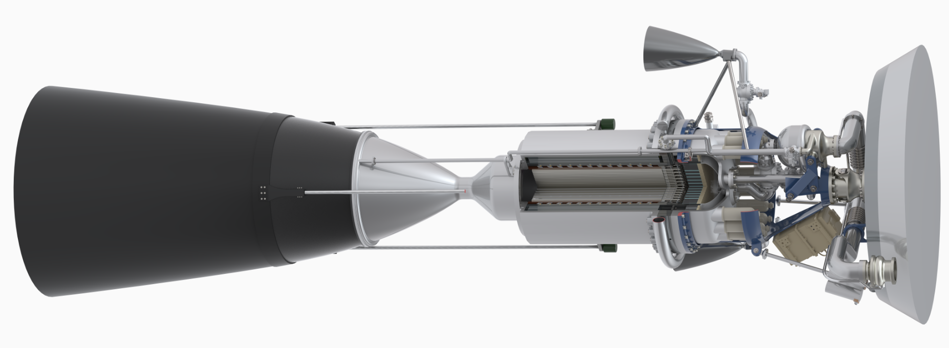
Current NTP Engine Systems
Integrated NTP Engine
Engine controller
Nozzle extension
Reactor Subsystem
Thrust Chamber Assembly
Turbomachinery
NASA’s Nuclear Thermal Propulsion Engine System, for which BWXT provides support for reactor and fuel design and analysis and Aerojet Rocketdyne provides support for engine component design, analysis, and integration.

Slide 7
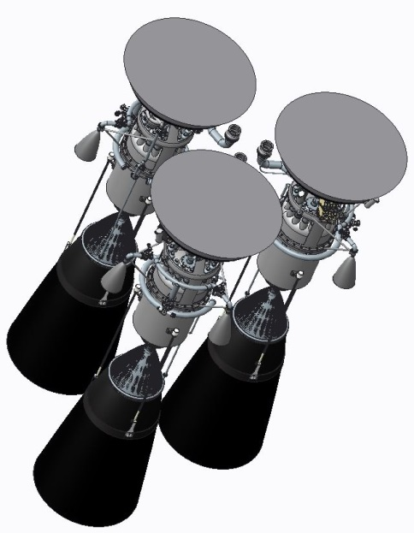
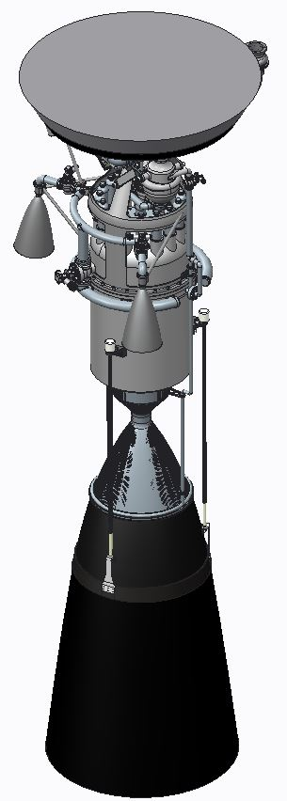
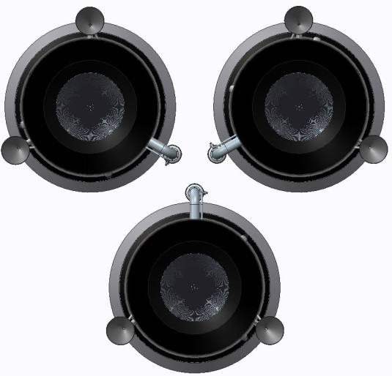
Current NTP Engine Systems
Boost Pump
Chamber Supply Manifold
OMS Shut-off Valve
Moderator Exit Manifold

Slide 8
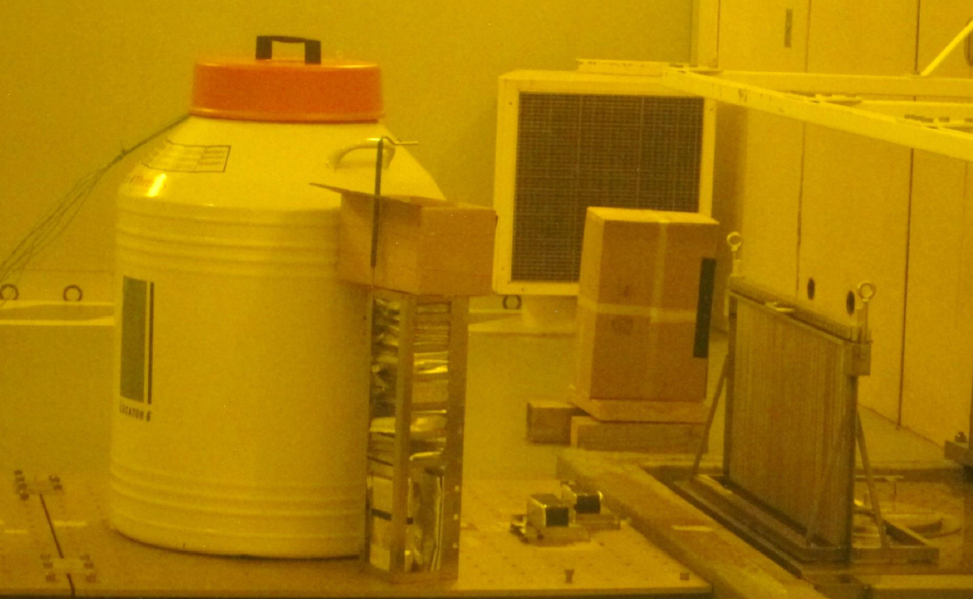
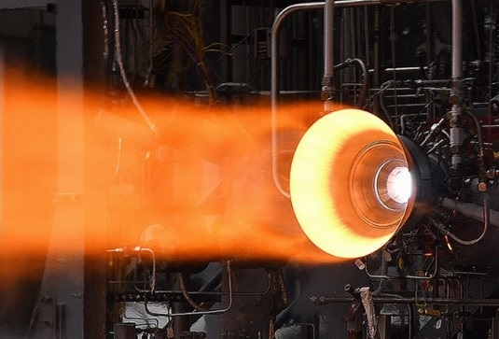
Current NTP Engine Systems
Turbomachinery
  Main and boost turbopumps in development at subscale thrust
  Additive manufacturing (AM) components where advantageous
Engine Valves
  Phase 1: ground component test support valves
  Phase 2: flight valves supporting demonstration method
  Gamma/neutron material irradiation investigations (polymers)
Reactor
  Moderator block core with actuated control drums for reactivity control (power); multiple fuel forms in development
Chamber/nozzle
  Planned AM nickel superalloy and copper superalloy builds using Laser Powder Directed Energy Deposition (LP-DED)
  Hot-fire sea level testing (LOX/LH2) of multiple nozzle materials planned to simulate heat flux at chamber wall
Lines/ducts
  Potential spherical flange for joint misalignment risk reduction
Gamma irradiation at Sandia National Lab
Low-cost Upper Stage Propulsion (LCUSP)
NTP Engine

Slide 9
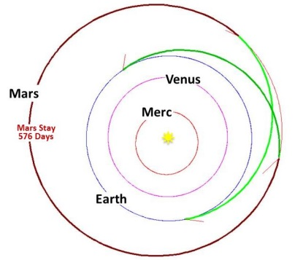
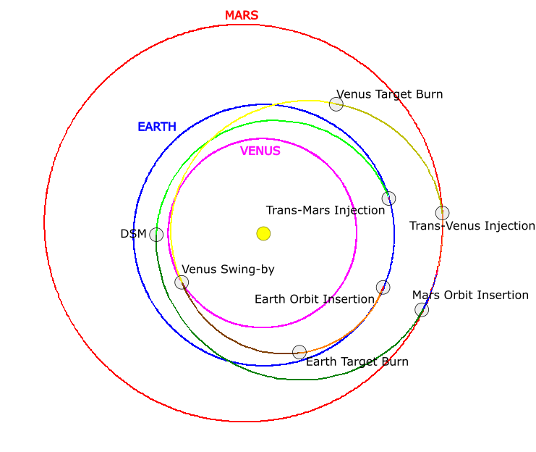
Mars Mission Concepts
Two mission types are being considered:
Conjunction Class (2016 – Early 2019)
Boots on Mars in the mid-2030s
Crew on surface for more than 300 days
Total Crew time off Earth surface <1,100 days (3 years)
  Implies Conjunction Class mission
Cumulative NTP burn time ~ 30 minutes
Opposition Class (Late 2019 – now)
Boots on Mars no later than 2040
No less than 30 days surface stay time
Total Crew time off Earth surface ~2 years or less
  Implies Opposition Class (short-stay) mission
Cumulative NTP burn time ~ 3-4 hours
More difficult (much higher delta-V)
NASA STMD GCD Point-of-Departure NTP Vehicle
NTP Opposition Vehicle
Isp = 900 sec

