Slide 1

Biological and Physical Sciences
Science Opportunities on the Lunar Surface and Gateway
Kevin Sato, Ph.D.
Program Scientist for Exploration
IMSPG 19 November 2020
Notes:
STILL

Slide 2
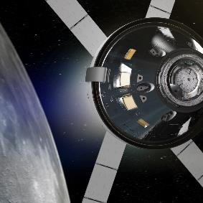
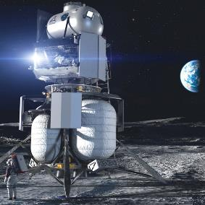
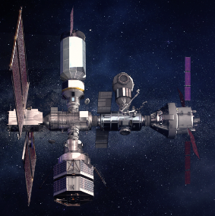
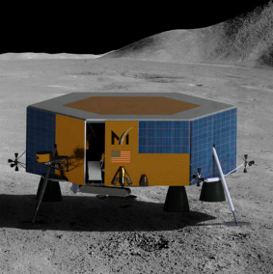
Multiple ways to conduct science in the lunar environment, but only one way to bring it back to Earth
Currently, only Orion Capsule can return science specimens
Each Platform has its own processes and teams for science integration
BPS science are being integrated into all efforts for NASA activities for science beyond LEO
Gateway
  Phase 1 science in review
  15-year science strategy and objectives roadmap – including capabilities/resources
  Space Biology DWG; Astrophysics DWG
  Integrated work with international human health DWG and JSC Crew Health and Performance
BPS Lunar surface science workshops
Artemis Science Definition Team – science objectives; Artemis III science
CLPS Lunar surface science
  PRISM solicitation
  ISS4Mars – ISS Analog working group meetings
  Planetary Protection Roadmap
  Integrated human health roadmap
Orion Capsule
Gateway
• Priority on multi-national
science payloads
Data sharing
BPS
Human Landing
System
Commercial Lunar Payload Services Lander
• Payload housed on lander
• Placed directly on the lunar
surface by a lander capability
• Pre-positioning on the moon
for astronaut access

Slide 3
Lunar Missions

Slide 4
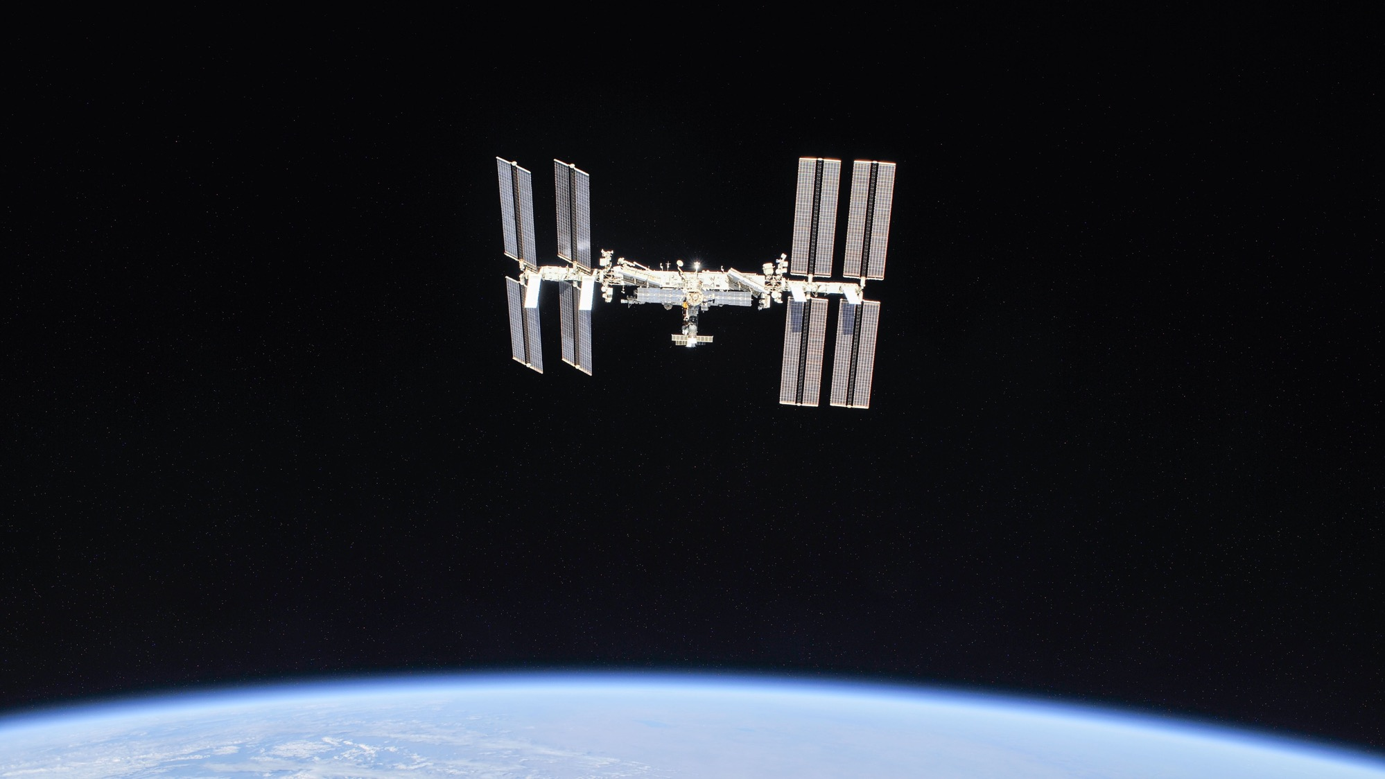

The International Space Station is a microgravity laboratory with an international crew traveling at a speed of 5 miles per second and orbiting Earth every 90 minutes.
A convergence of science, technology and human innovation leads to research breakthroughs and demonstrates new capabilities
not possible on Earth.
Notes:
iss056e201352 (Oct. 4, 2018) --- The International Space Station photographed by Expedition 56 crew members from a Soyuz spacecraft after undocking. NASA astronauts Andrew Feustel and Ricky Arnold and Roscosmos cosmonaut Oleg Artemyev executed a fly around of the orbiting laboratory to take pictures of the station before returning home after spending 197 days in space. The station will celebrate the 20th anniversary of the launch of the first element Zarya in November 2018. Credit: NASA/Roscosmos

Slide 5





The International Space Station is a Testbed for Artemis Missions
Orbiting Earth for nearly 20 years, the space station is the only long-term platform available to validate the technologies, operations, and skills we need to travel farther for longer durations
Life Support Systems
Next Generation
Spacesuits
Advanced Technology
Crew Health
and Performance
Human Research
These capabilities are just a few examples of the necessary technology and strategies being tested on the space station

Slide 6
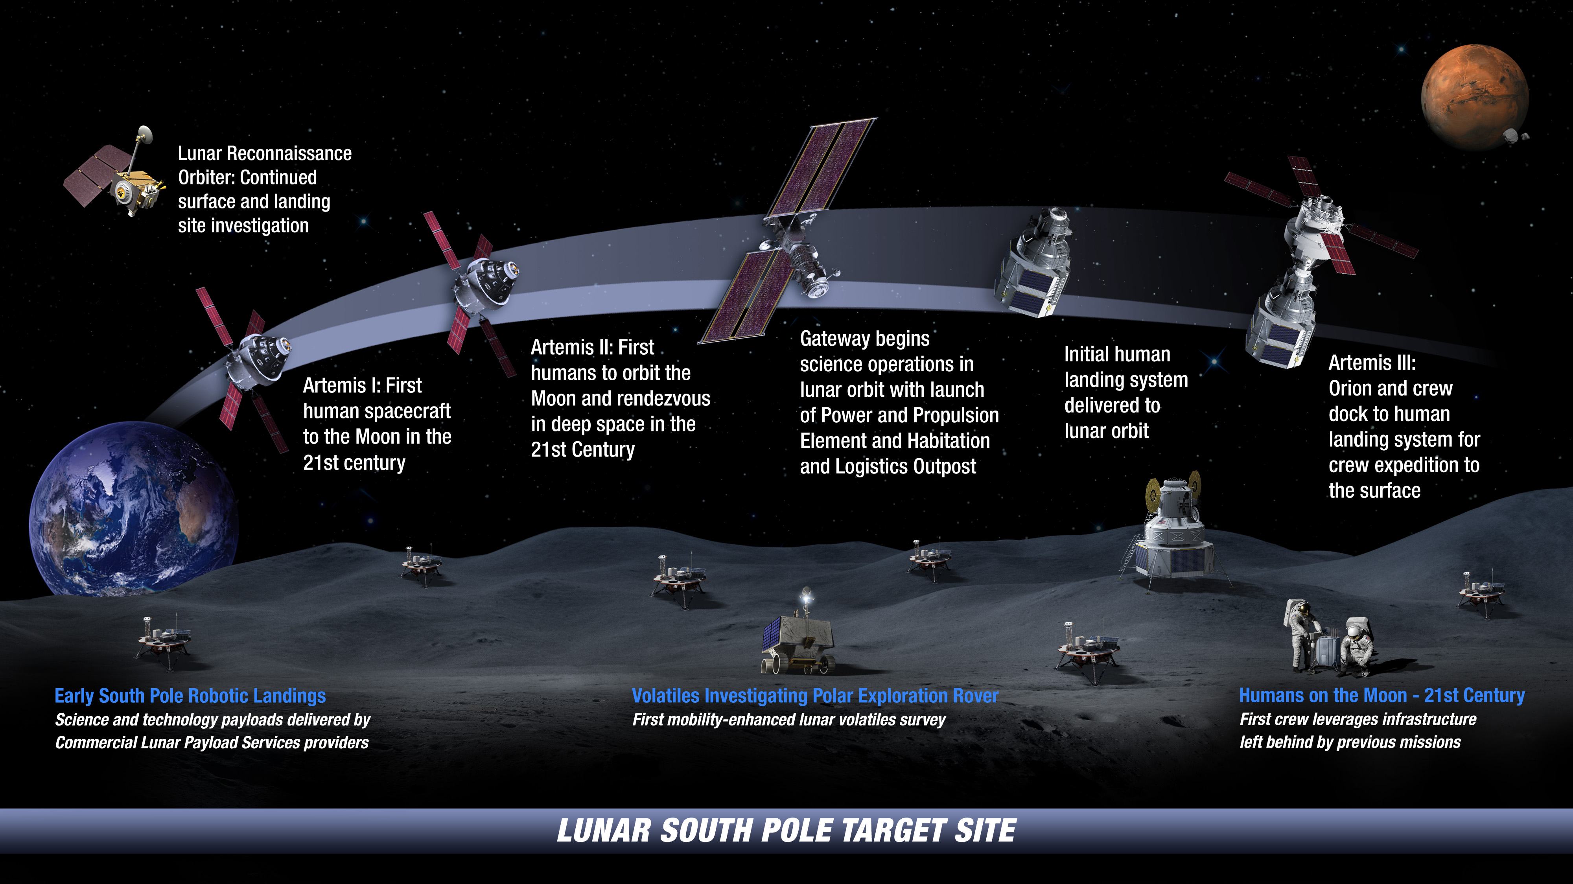

: Landing Humans On the Moon in 2024

Slide 7
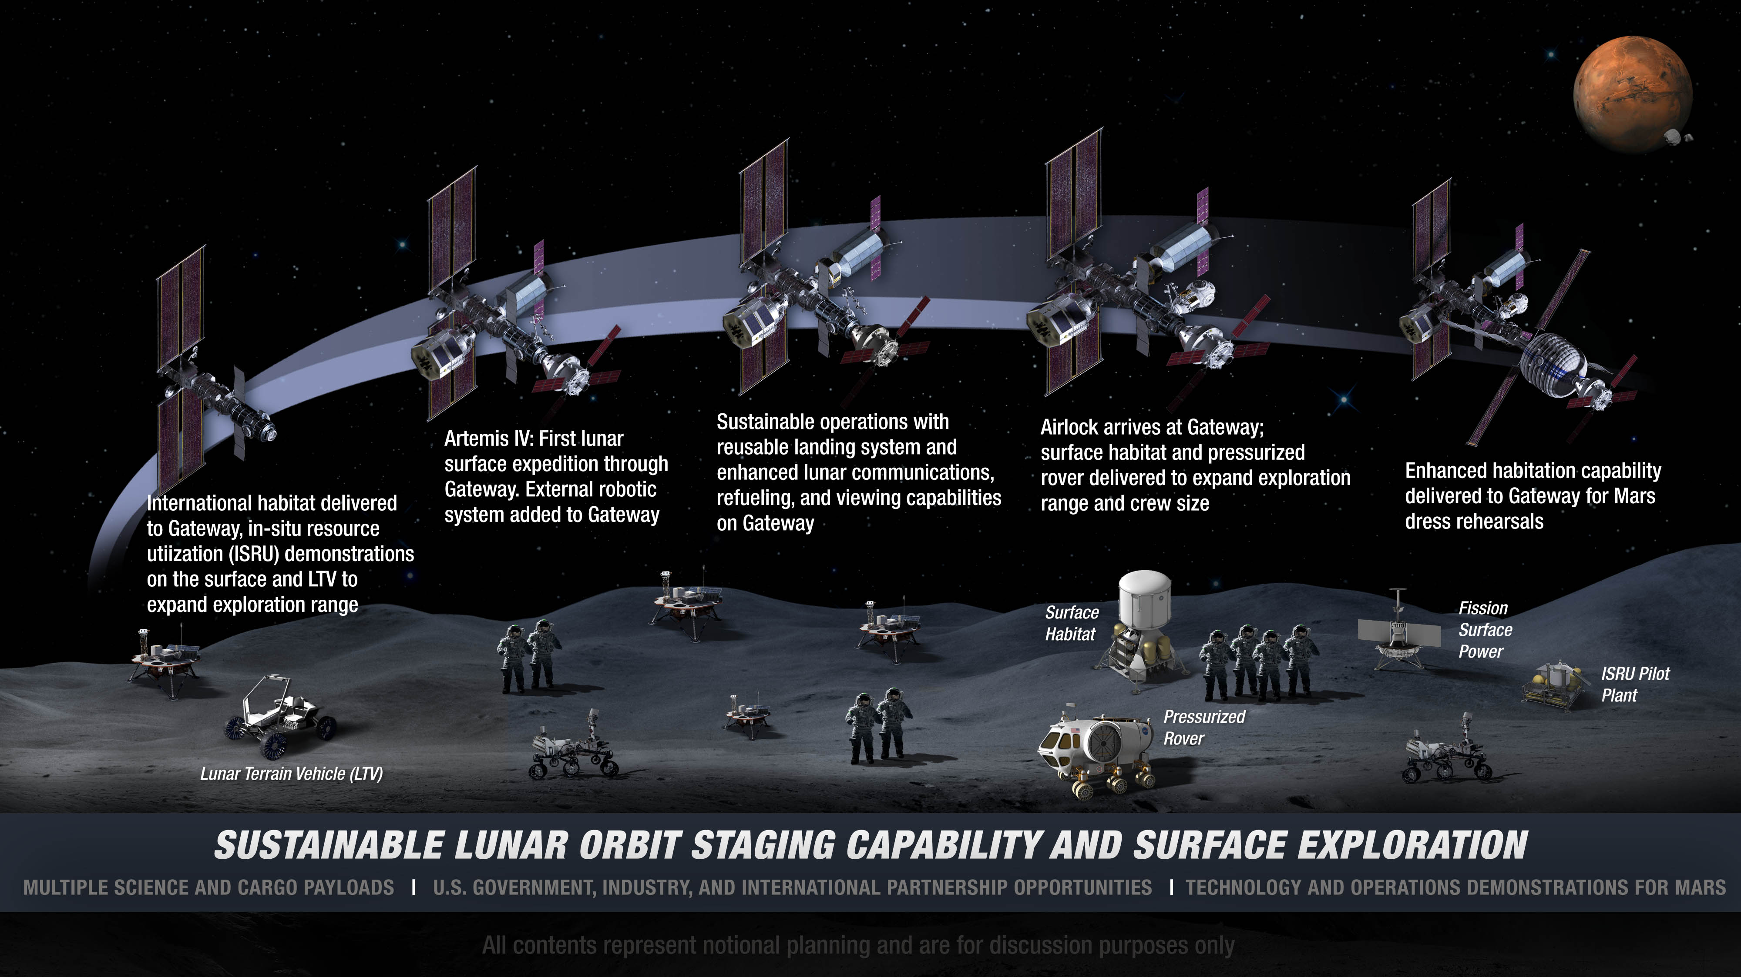
: Extending Lunar Missions to Prepare for Mars

Slide 8
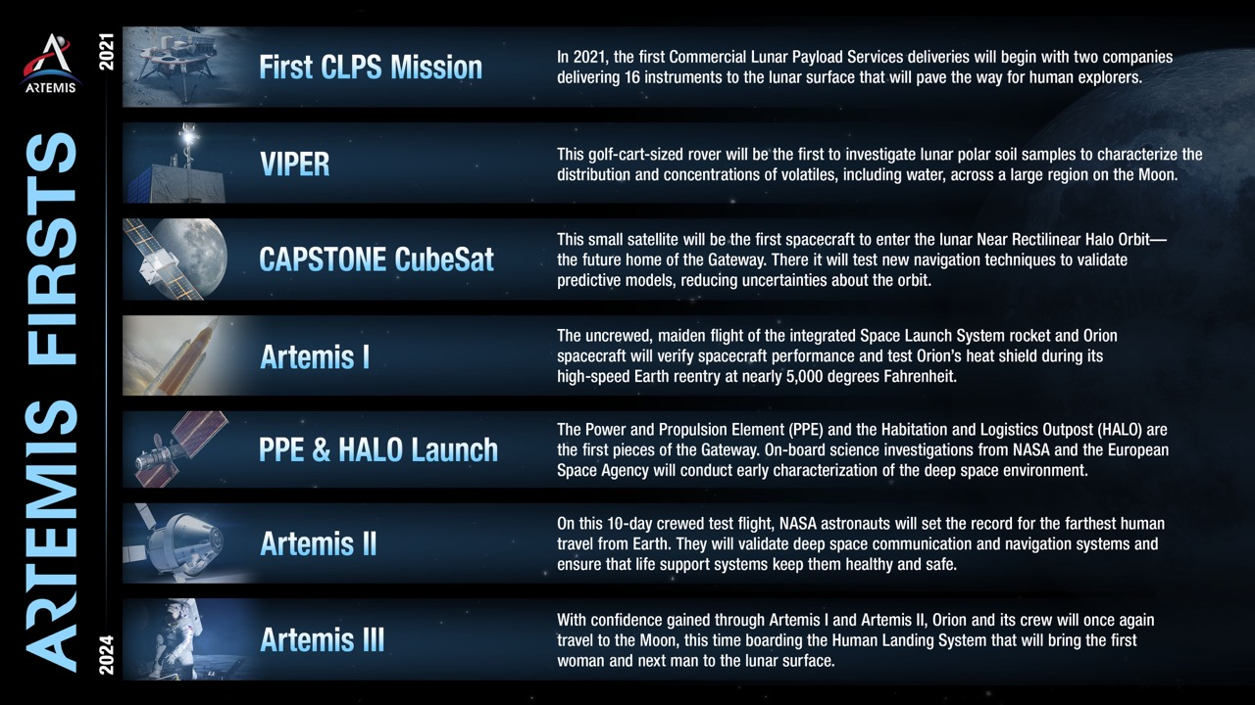

Slide 9
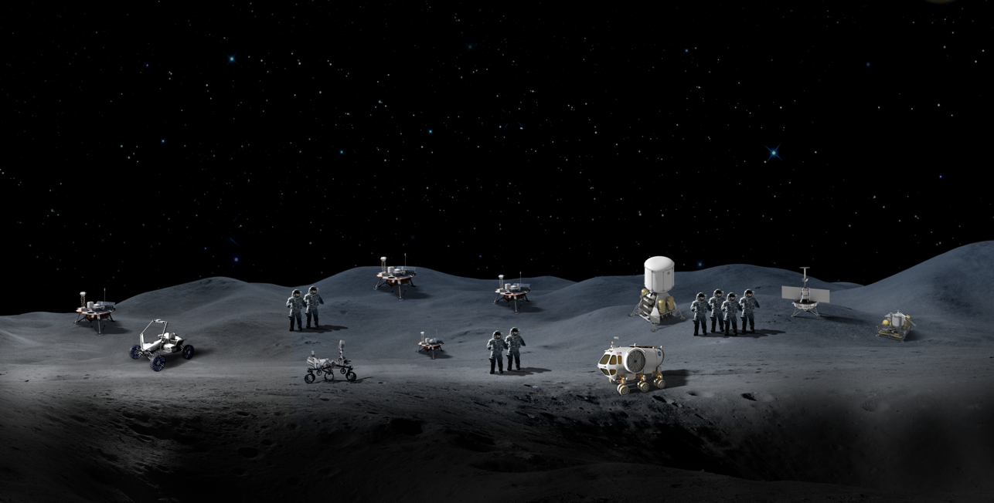


Technology Objectives
The Lunar Surface Innovative Initiative works across industry, academia and government through in-house efforts and public-private partnerships to develop transformative capabilities for lunar surface exploration.
In-situ resource utilization technologies for collecting, processing, storing, and using material found or manufactured on the Moon or other planetary bodies
Surface power technologies that provide the capability for sustainable, continuous power throughout the lunar day and night
Dust mitigation technologies that diminish dust hazards on lunar surface systems such as cameras, solar panels, space suits, and instrumentation
Extreme environment technologies that enable systems to operate throughout the range of lunar surface temperatures
Extreme access technologies that enable humans or robots to efficiently access, navigate, and explore previously inaccessible lunar surface or subsurface areas
Excavation and construction technologies that enable affordable, autonomous manufacturing or construction
Sustainable
Power
Lunar Dust Mitigation
Surface Excavation/Construction
Extreme Access
Extreme Environments
In-Situ Resource Utilization

Slide 10
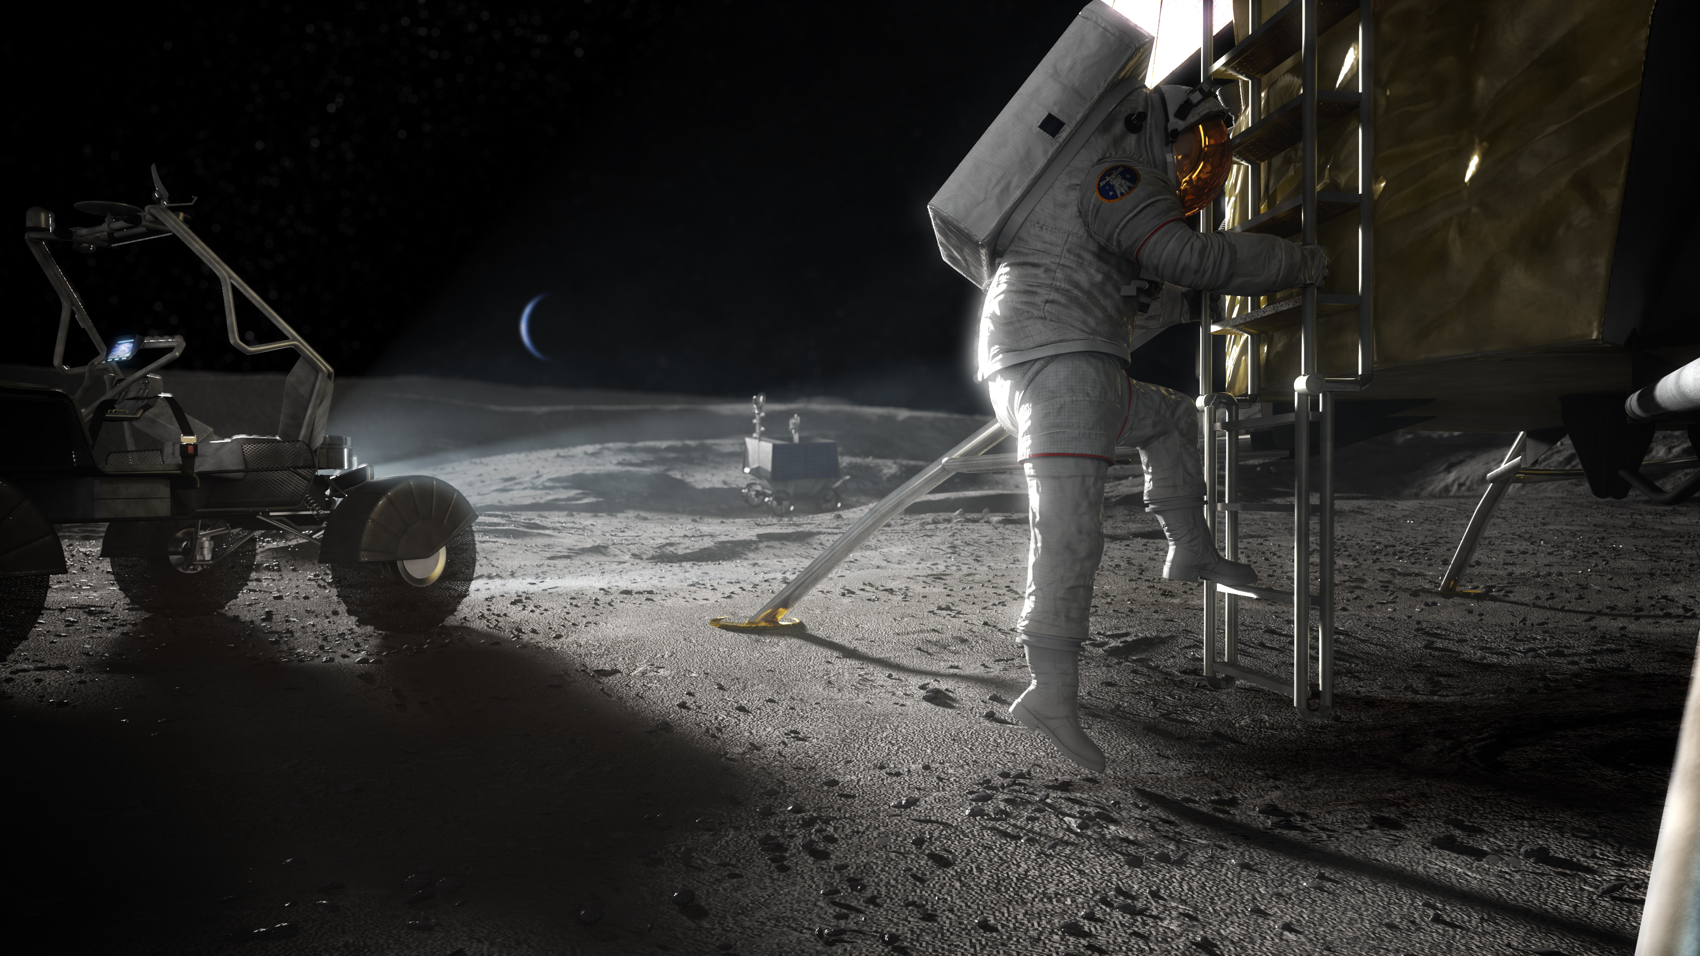
  Gain confidence in planetary human-robotic
  exploration on the Moon before embarking
  on human missions to Mars
  Operate systems on the surface from lunar orbit
  Conduct science experiments
  Prospect for resources
  Return samples to Earth
  Surface power technology demonstrations
  Operate autonomously on another world with
  communications delay
  Establish deep space logistics supply chains
  Immerse in the lunar environment
  Prepare for Mars
What Will We Do On The Moon?
Notes:
Lunar Science
– Establish period of giant planet migration
– Provide absolute chronology for Solar System events
– Understand the lunar water cycle
– Evaluate plasma interactions with the lunar surfaces
– Characterize lunar interior
– Use vantage of lunar farside to view the universe
Understand And Utilize The Special Water Cycle of The Moon
Identify the origin of water
Return samples for representative lunar pristine rocks
Measure in-situ, then obtain samples from polar deposits
Document mobility of volatiles on the Moon with time
Orbital measurements across latitudes at different time-of-day
Long-lived in-situ monitoring
Measure the magnitude of these resources [Are any renewable?]
Global assessment with modern orbital remote sensing
In-situ analyses at poles, pyroclastic deposits, young areas, etc.

Slide 11
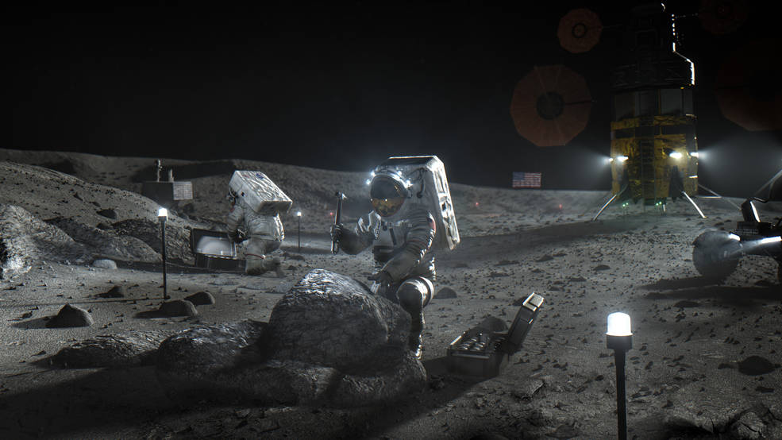
xEVA System: Spacesuits,
Tools, Vehicle Interfaces
Exploration Extravehicular Activity System
Testing suit on ISS in 2023 • In-house build for 2024 lunar mission • xEVA services contracts with U.S. industry for missions beyond 2024
Notes:
Walking on the surface of the moon requires the astronauts to wear a specially designed space suit, the Exploration Extravehicular Mobility Unity (xEMU), to protect against the harsh lunar environment and enable exploration. The new xEMU spacesuit is designed to be worn on the Moon, or another planetary surface. It will provide enhanced mobility for walking and kneeling. The spacesuit connects to the landers for recharging between moonwalks and can be resized to fit each astronaut.

Slide 12
Hazards of Human Spaceflight

Slide 13
Commercial Lunar Payload Services (CLPS)

Slide 14

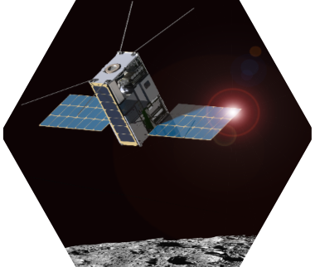
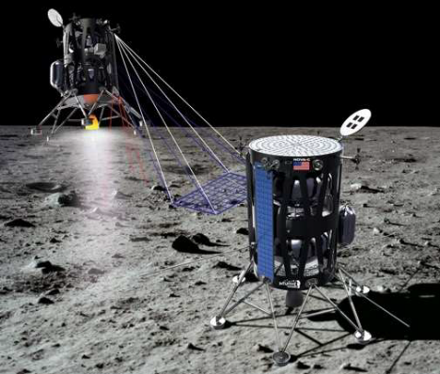
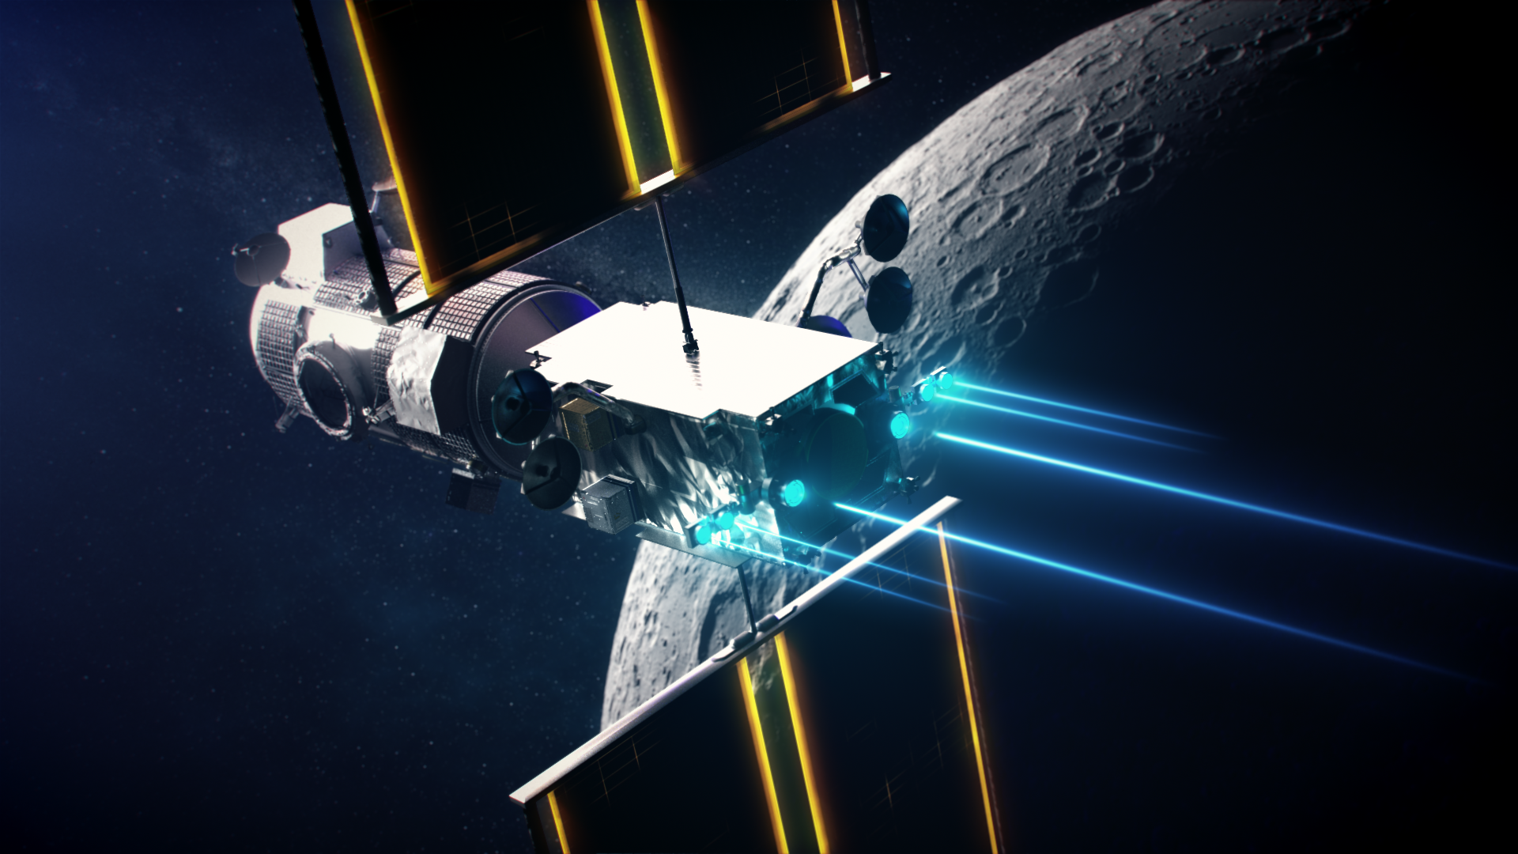
Exploration Science Strategy and Integration Office (ESSIO) formulates & executes an integrated strategy for exploration science
Implementation Strategy
Develop lunar surface science instruments
Use commercial companies to deliver payloads to the Moon
Develop mobility systems to expand and enhance science investigations on the surface
Leverage international partnerships for additional opportunities (e.g., instruments, rovers)
Obtain new scientific data from lunar orbit using smallsats
Use new human exploration systems, such as Gateway and human landing system, to enable science
Lead the science mission planning for humans on the lunar surface
Lunar Discovery & Exploration Program (LDEP)

Slide 15
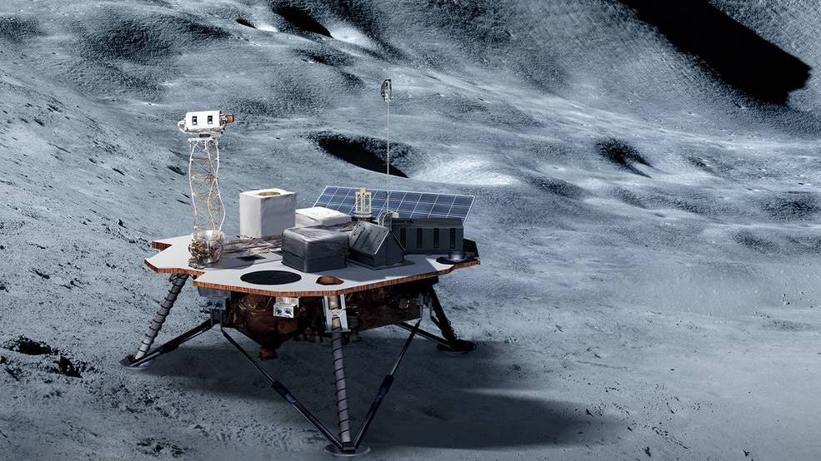
COMMERCIAL LUNAR PAYLOAD SERVICES
14 CLPS providers are currently on contract and eligible to bid on payload deliveries to the Moon
NASA solicits bids from CLPS companies and awards contracts to deliver science, exploration, and technology payloads to the lunar surface
NASA has already awarded four CLPS contracts that will deliver a total of 29 payloads beginning with two landers in 2021, one in 2022, and one in 2023.
NASA is also soliciting payloads and subsequent landers to go to the lunar surface with a cadence of roughly two deliveries per year to characterize the Moon’s surface and enable future human and robotic exploration.

Slide 16
Commercial Lunar Payload Services (CLPS)
Goal: Utilize commercial end-to-end delivery services to enable access to the lunar surface
Deliveries initiated using a Task Order
  Any of the 14 companies on the catalog can respond to a task order
  Expected Task Order cadence of 2 per year
Task order lists what NASA wants delivered, and any constraints
  E.g., landing site, specific needs of instruments
First 4 lunar surface delivery task orders awarded with deliveries commencing in 2021
  2021: Non-polar delivery (Astrobotic and Intuitive
  Machines) – TO 2A & 2B
  2022: Polar delivery (Masten) – TO 19C
  2023: Volatiles Investigating Polar Exploration Rover (VIPER) to Moon’s south polar region (Astrobotic) – TO 20A

Slide 17
CLPS Deliveries & Future Payloads
Payloads and Research Investigations for the Surface of the Moon (PRISM)
PRISM RFI: 238 Responses from the community received
  Catalog of potential instruments
PRISM stage-2 solicitations will state location for each delivery, allowing PIs to propose science optimized for those locations
  High-value ‘location agnostic’ instruments will be called for in PRISM-2
  International contributions to PRISM investigations may be included at up to 30% the total cost of the investigation
  PRISM instruments will feed the manifests for Task Orders for deliveries from late 2023 onwards
  Can be expanded to include orbital payloads
  July 20 community announcement provided a heads-up on the first Stage 2 call and also identified the destinations for the 2 deliveries
    Reiner Gamma magnetic anomaly (lunar swirl)
    Schrödinger farside basin impact melt
  Payloads from other NASA mission directorates are also incorporated into Task Orders

Slide 18
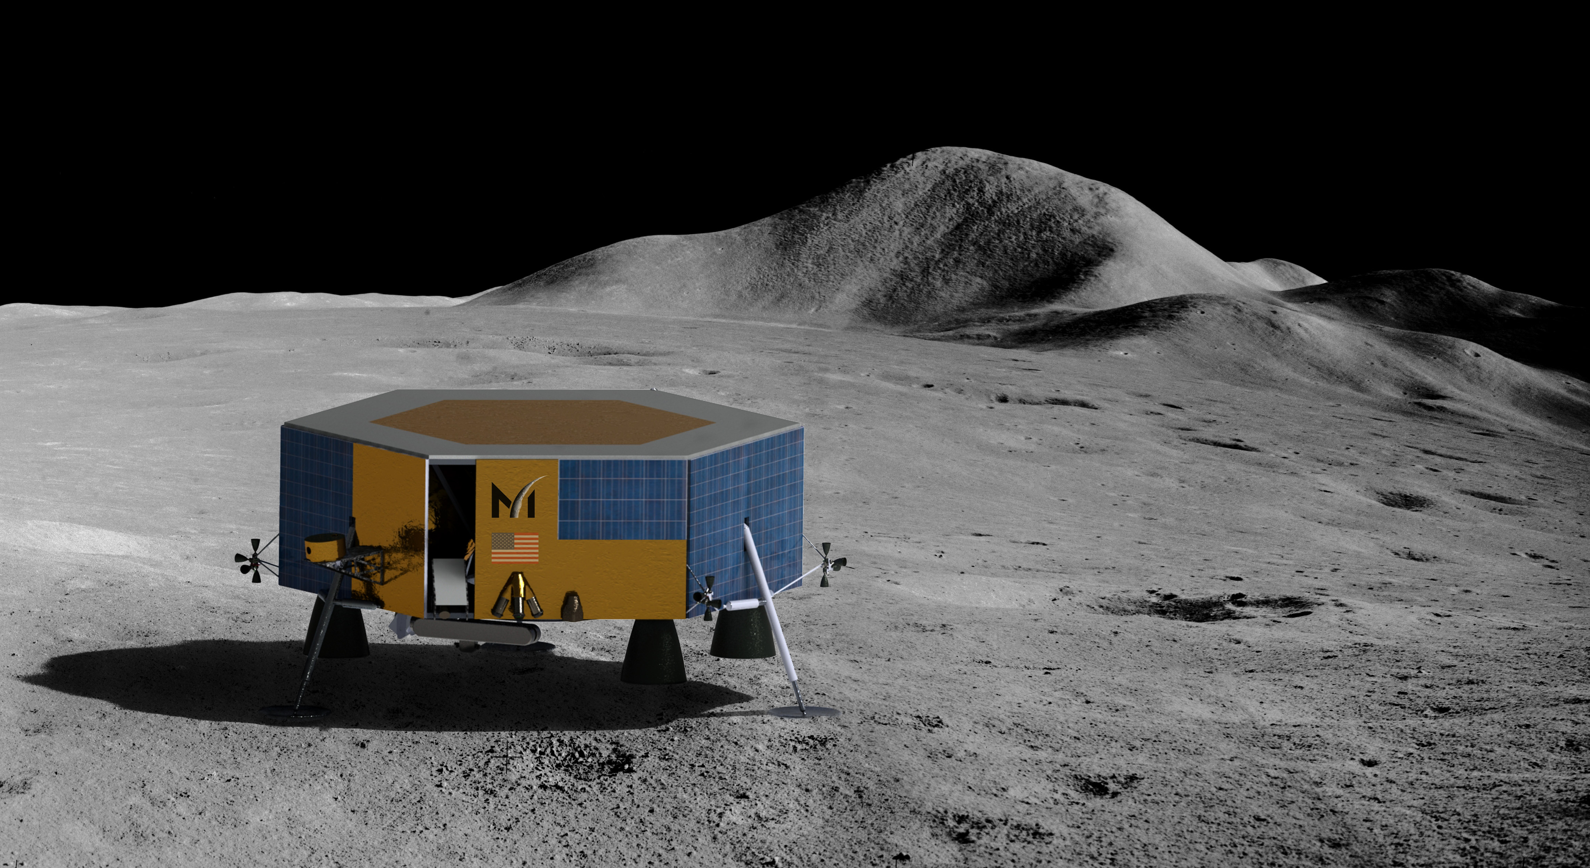
CLPS Payload Science Delivery Concepts
    Deliver science instruments/experiment payloads
      Autonomous execution of the experiments
    Deliver instruments/experiment for pre-positioning on the lunar surface for moonwalker access

Slide 19
Gateway

Slide 20
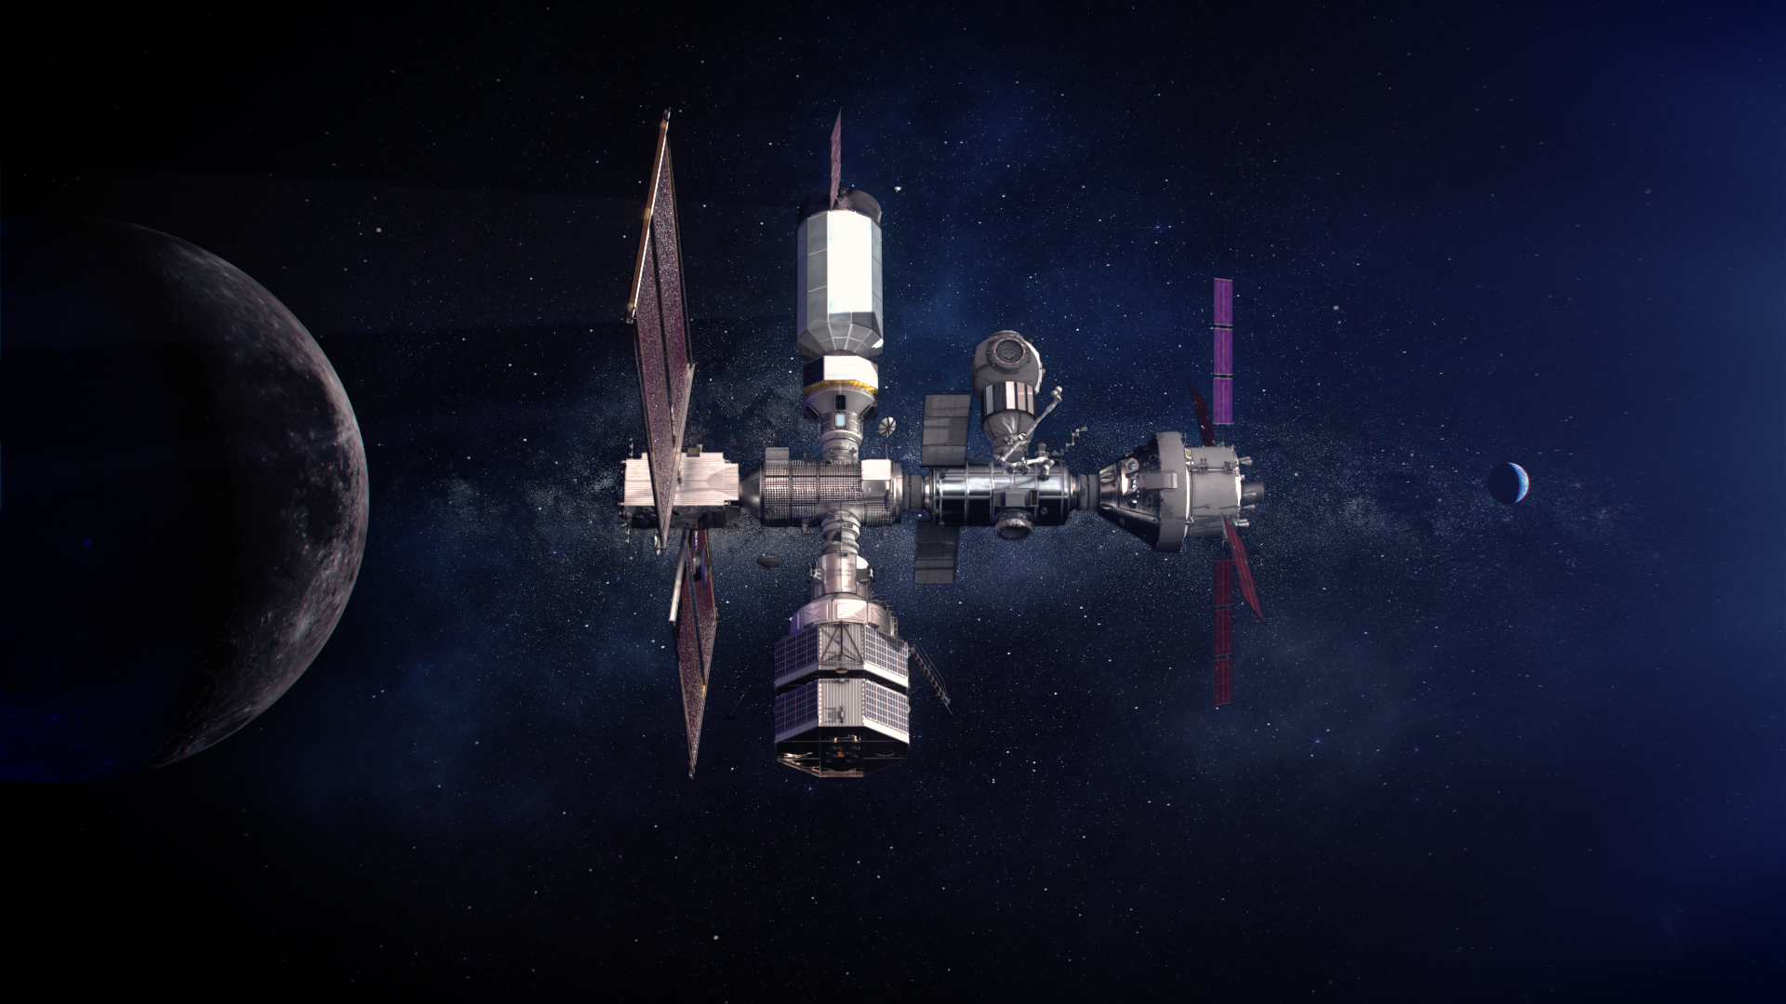




Gateway International Partners
Building on ISS partnerships to expand deep space capabilities
Notes:
MOUs have been released and negotiations underway based on these contributions.
International partners are embedded members within the Gateway team, with membership on Gateway Boards and technical integration embedded at all levels.

Slide 21
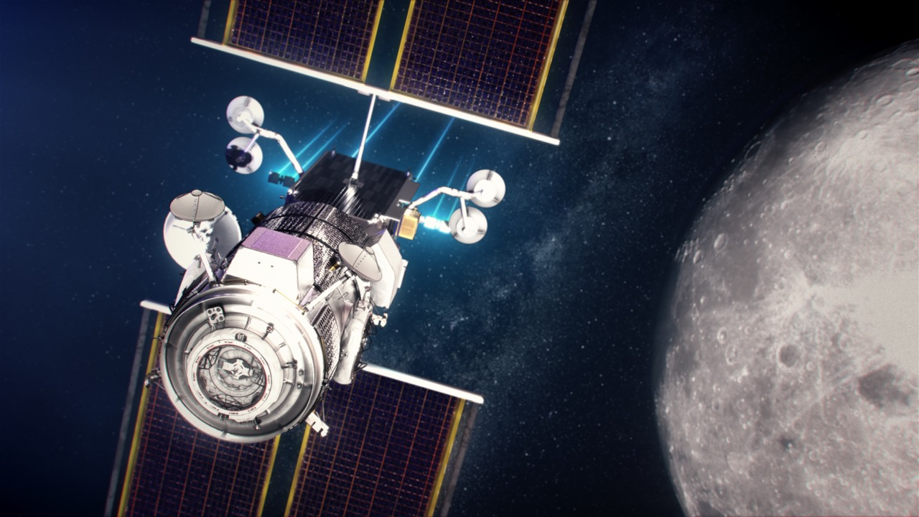
THE GATEWAY
  A platform to establish a
  sustained human presence
  on and around the Moon
  in the next decade
  Will remain in lunar orbit
  enabling access to the
  lunar surface while
  opening the solar system
  to further exploration
  Built by NASA, industry,
  and international partners

Slide 22
Gateway Utilization Coordination Panel
Gateway Program has established the Gateway Utilization Coordination Panel (GUCP) for coordination with Gateway International Partners, in accordance with the MOUs
  Each International Partner has designated a Research Coordinator to put forth their agency’s payload candidates and serve as a member of the GUCP
  Several multilateral research splinters have been set up (e.g., radiation, microbiome)
    HRP using International Space Life Sciences Working Group (ISLSWG) for international forum on human research payload recommendations
Multiple GUCP splinter groups have already been formed to identify short term tactical payloads for initial Gateway elements
  Splinter groups will begin to close out and transition to DWG’s as tactical payload work ends
  Any ongoing work in splinter groups should transition to DWGs where appropriate
DWGs will take the place of splinter groups as payload selection transitions to strategic process

