Slide 1
Space Telescope for Solar System Science
A presentation to the
Small Bodies Decadal Panel
November 18, 2020
HST
JWST
Roman
1990 – mid 2020’s
early 2020’s – late 2020’s
Gap in UV Coverage
mid 2020’s – mid 2030’s
LUVOIR
Cindy L. Young - NASA Langley Research Center
Kunio M. Sayanagi - Hampton University
late 2030’s
Notes:
These are examples of great astrophysics telescopes that will do great science (name one by one).
The Hubble Space Telescope has enabled science that is invaluable to the solar system community, particularly in the ultraviolet wavelengths. As the Hubble space telescope is set to retire sometime this decade, its immediate successors will not be capable of continuing the UV measurement capability, so there will be a gap in UV coverage until LUVOIR becomes operational, which is projected to happen in the late 2030s to early 2040s.
To further illustrate the timeline I mentioned, with the Hubble Space Telescope going offline sometime during this decade, the JWST and Roman will not have UV capabilities, which are critical for studying time-domain phenomena. There will be a gap in UV coverage that is at present projected to span nearly two decades (~15 years) until LUVOIR comes online.
-------------------------------------------------------------
Give some of content of slide 2 in here. Arrow and year #. Add second double arrow to denote UV gap. Label years and UV gap.

Slide 2
Summary
Urgent need: preserve UV observation capabilities
Science
  Time-domain science (high frequency, long-duration)
  New, wide-ranging small bodies surveys
Mission targets
  Cross-disciplinary planetary observations
  A focused science target is also viable
Telescope Architecture options; optimized for:
  Spatial resolution
  Photometric sensitivity
  Balance of both
Concept study objectives
  Survey of technology options
  Point design to demonstrate viable options for the next decade
We advocate to add a solar system space telescope to the NF6 list
The time for a solar system space telescope is NOW!
Notes:
Moreover, the next advances in solar system science to be enabled by space telescope observations should address temporally dynamic phenomena and the need for frequent, long-duration campaigns. The time for a space telescope dedicated to solar system observations is now!
Various technology options are available.

Slide 3
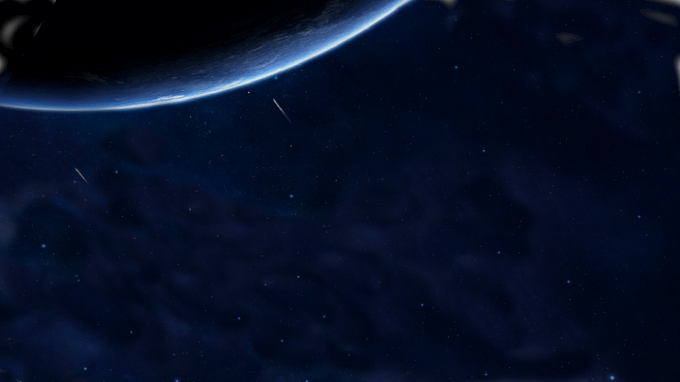
Recommendations by Recent National Academies Reports
Getting Ready for the Next Planetary Science Decadal Survey (2017):
“Synoptic observations of solar system bodies are limited by two factors, the availability of telescope time and resolution. First, while current (e.g., Hubble Space Telescope and Spitzer Space Telescope) and future (e.g., James Webb Space Telescope and Wide-Field Infrared Space Telescope) space observatories are available to the planetary astronomy community and are not resolution constrained, such assets are in great demand for other astronomical studies. Therefore, the availability of telescope time for long-term monitoring of, for example, Titan, Europa, and Io or for surveys is highly limited. Second, the resolution of such observations is primarily dictated by telescope aperture (the larger the aperture the greater the cost of the mission). Hence, studies to determine the potential scientific return of a space telescope dedicated to the monitoring and studies of solar system bodies that can be achieved within the scope of either the Discovery or the New Frontiers programs would benefit the next planetary science decadal survey.
Visions into Voyages for Planetary Sciences in the Decade 2013-2022: A Midterm Review (2018):
NASA should conduct an assessment of the role and value of space-based astronomy, including newly emerging facilities, for planetary science.
This assessment should be finished before the next decadal survey is significantly under way.
NASA Response to the Midterm Review Recommendation:
NASA agrees that it is important to continue to explore the role that space-based astronomy plays in planetary science and will seek community input for an assessment through a mechanism such as a community workshop or study, the planning for which will begin in 2019. Further, NASA recognizes that space-based astronomy has already proven its value for planetary science such as observing the Comet F2 D/1993 Shoemaker-Levy 9 impacts with Jupiter using the HST; discovering approximately fifty of the potentially hazardous asteroids with NEOWISE and characterizing many more with NEOWISE and Spitzer; discovering the New Horizons follow-on target 2014 MU69 in the Kuiper Belt with HST; and assessing the potential hazard to the Mars orbiters posed by Comet C/2013 A1 (Siding Spring) using HST, NEOWISE, Spitzer and Swift.
Notes:
a study has been recommended by recent national academies reports, the most recent the committee on astrobiology and planetary science (CAPS) which made a recommendation to study a large to medium class dedicated space telescope for planetary science, going beyond the discovery-class dedicated telescope endorsed by visions and voyages. Yet, no such studies have been funded to date by NASA.
-----------------------------------------------------------
Past national academies reports that recommended studying a solar system space telescope, and we want the decadal to do that again.

Slide 4
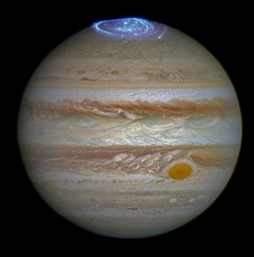
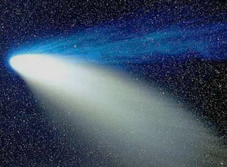
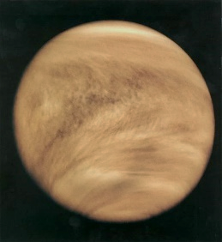
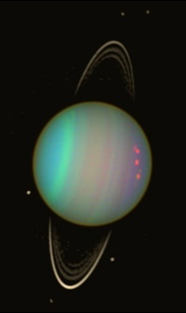
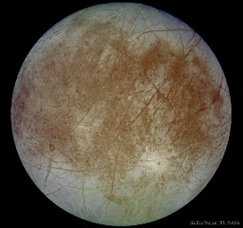
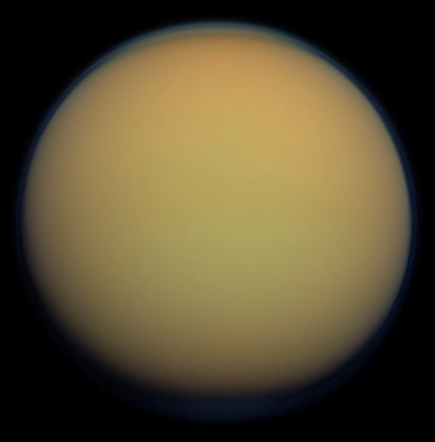
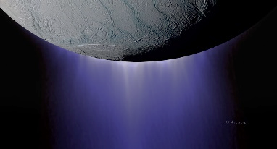
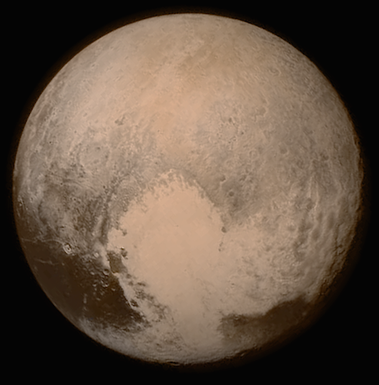
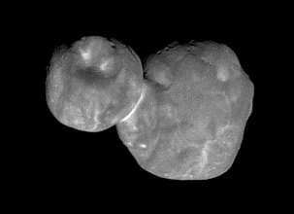
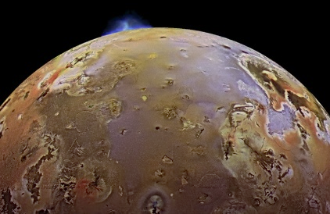
Science Needs
Understand Temporally Dynamic Phenomena
High-Frequency, Long-Duration Campaigns to understand:
Interaction of planetary magnetospheres with the solar wind
Venus and giant planet atmospheric dynamics
Icy satellite geologic activity (e.g., plume searches) and surface evolution
Evolving ring phenomena
Cometary evolution & outgassing asteroids
Understand Origin and Evolution of Small Bodies
Comprehensive Spectral Survey of Solar System Minor Bodies to:
Characterize Surface Properties and Composition
Understand the overall physical properties including:
size, shape, mass, density, porosity, and spin rate.
Notes:
The science that would be enabled by such a telescope addresses critical gaps in the knowledge of temporal phenomena across the solar system…., and would enable a comprehensive spectral survey of solar system minor bodies. Thus, the idea has strong multidisplinary support.
Because we have been invited to speak by the small bodies panel, we want to further highlight the science that can be accomplished in this area.
-----------------------------------------------------------------------------------------------------------------------------------------------------------
Highlight my whitepaper
Maybe use this text with figure on slide 4
Do we want to go historical data on time funded for planetary research on astrophysics assets, or is this too contentious?

Slide 5
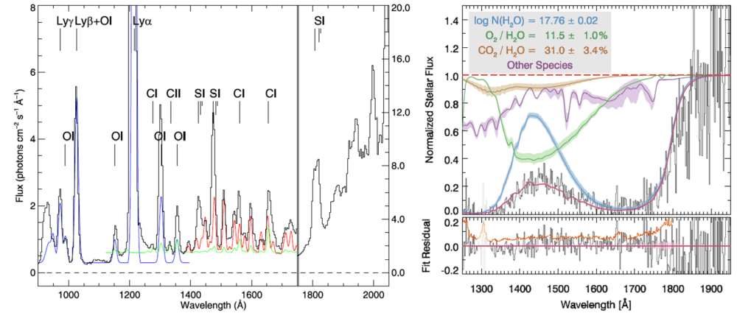
Cometary Evolution, Morphology, and Processes
Priority Questions
How do the coma and nucleus evolve with heliocentric distance (Rh)?
What drives outbursts and their frequency and how often is water ice expelled?
What processes dominate in the coma?
Left: atomic and molecular UV emission can distinguish coma processes such as electron impact (blue, green) and fluorescence (red) [1]
Right: Transmission during stellar occultation can determine associations between species such as O₂ and H₂O, as shown in these examples from Rosetta/Alice data [2].
[1] Feldman et al., 2018 Astronomical Journal.
[2] Keeney et al., 2019 Astronomical Journal.
Notes:
Time-resolved measurements of volatile species address key questions in cometary science and could also characterize new classes of interstellar objects. With the time allotted to planetary observations by a dedicated telescope with sun-shielding ability to study Venus, comes the ability to follow the entire comet life- cycle for several comets, even as they approach perihelion, which will provde an unprecedented understanding of cometary evolution.
Acknowledge that facing a panel of experts; aware more science is possible with a space telescope; here are examples of science.

Slide 6
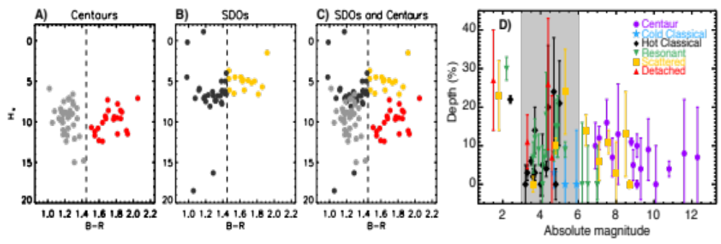
Solar System Minor Body and Irregular Satellite Survey
Priority Questions
What do the compositions/colors of minor bodies/irregular satellites reveal about planetary migration early in solar system history?
What dynamical processes are shaping minor body populations today?
What do the compositions of minor bodies reveal about the radial variations in the solar nebula?
Broadband color data [3] (for (a) Centaurs, (b) Scattered Disk Objects (SDOs), and (c) both overplotted) cannot conclusively validate the dynamically-based hypothesis that Centaurs originate from the SDOs, requiring a spectroscopic sample from each population. (d) The transition region from water-rich to water-poor surfaces is shown in grey, in a plot of water ice feature strength vs. absolute magnitude [4].
[3] Hainaut et al., 2012 Astronomy and Astrophysics.
[4] Barucci et al., 2011 Icarus.
Notes:
with remote spectroscopy in UV, vis, and NiR of Jupiter Trojans, irregular satellites, Centaurs, and Kuiper Belt Objects
Probing the initial composition of the solar nebula and the process of planetary migration with remote spectroscopy in UV, vis, and NiR
Origins of irregular satellites and Jupiter Trojans (was it the Kuiper belt?) Spectral Char across these populations would establish links between current and primordial populations, informing models of giant planet migration
Time allocation of existing facilities does not support; space obs reach high background-limited magnitudes
scattered disk objects in the Kuiper belt interact gravitationally with Neptune and may be the source population of some Centaurs. Thus Centaurs are an opportunity to study KBOs and understand how surfaces evolve as they migrate towards the Sun. UV spectral characterization of Space weathering could like SDO’s to Centaurs
Radial gradients of ice abundances in the solar nebular are suggested as a cause of KBO visible colors.
---------------------------------

Slide 7
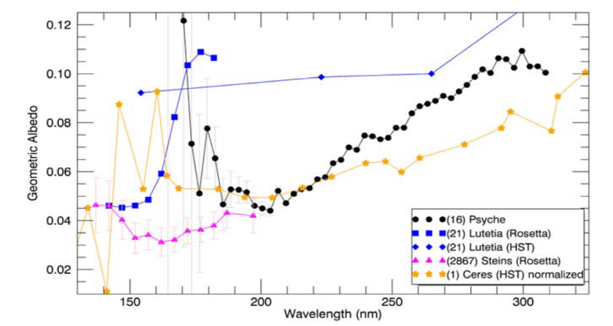
Main Belt and Near-Earth Asteroids
Priority Questions
What are the spectral characteristics of asteroids in the far UV?
Can we constrain surface exposure to space weathering by measuring its effects on asteroids’ UV reflectance spectra?
What is the composition and spatial extent of outgassing produced by active comet-like asteroids?
Left: Comparison of the geometric albedos for Psyche with Rosetta Alice
observations of (2867) Šteins (purple triangles) and (21) Lutetia (blue squares),
HST observations of (21) Lutetia (blue diamonds), and HST STIS observations
of (1) Ceres (orange stars). These are the only four asteroids studied at
wavelengths <220 nm, and their spectra appear very different from one another
at these wavelengths [5].
[5] Becker et al., 2020 Planetary Science Journal.
Notes:
Recent research shows that we are just beginning to understand asteroids better by observing them in the UV.
Only asteroids studied at <220nm, and there spectra are all different from one another at these wavelengths.
UV observations can shed light on present day processes impacting this surfaces, such as space weathering, and can provide information of outgases from active asteroids, what kinds of volitles and can have implications for potential life.
These would be true for near-Earth asteroids as well if we have the tracking capability.
----------------------------------------------------------------------------------------------------
Trade is how fast can we track; not as much of an issue for monolithic; sparse ap have arms that will vibrate and oscillate with tracing quickly; huge problem for membrane.
Have tracking capability for near-Earth asteroids? Include visible range in question 2?

Slide 8
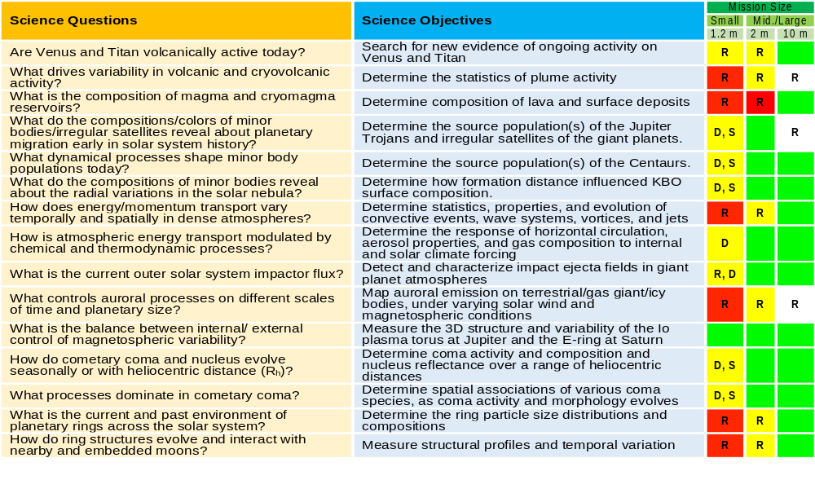
Notes:
As part of PMCS development work, solar system-wide science objectives were defined and we considered 3 telescope aperature sizes that could enable the science. Fully comprised science is denoted in red, partially comprised is in yellow, and fully enabled science is in green. The letters R, D, and S, denote what the restrictions were in terms of resolution, mission duration, and sensitivity. We found that 1.2 m telescope, similar to that proposed in the Discovery class Kuiper proposal led by Jim Bell, saw most science as at least partically compromised, while larger sizes enabled more science goals. 2 m monolith in one launch. 10 m only achieved within New Frontiers cost by distributed aperature able to go in one launch. But, was a proposal dev effort for PMCS, so many more options exist than could be considered. Need a study.
Kunio will now discuss architecture design options more in detail.
“do not say comprised with Jim Bell, say partially accomplished”
-------------------------------------------------------
Example science questions, as worded this is how different class telescopes can address the science. Results of quick survey of science objects
2 m monolithic option satisfies the sensitivity requirement, but not the resolution
Diffraction limit that comes with 10 m aperture, almost everything turns green; lead to revolutionary resolving of small scale structures of temporally dynamic phenomena
Yellow boxes denote high precision requirement for space aperture alignment to do UV observations.
Why specifically is a Kuiper-sized telescope yellow for duration and sensitivity? Which specific science is compromised?

Slide 9

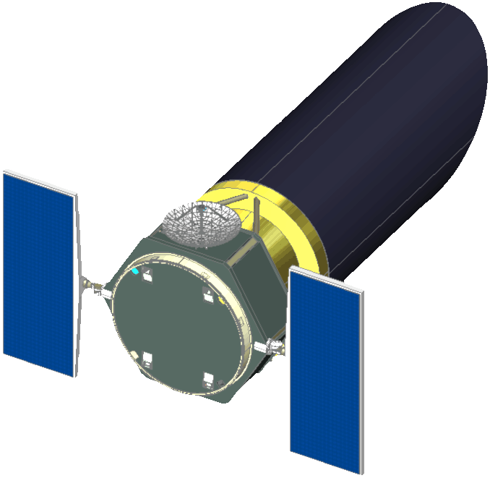
Kuiper Space Telescope Discovery
2015
L2 orbit enables rapid commencement of science observations (L + 30d), and is well above the UV background induced by the Earth’s geocorona

Slide 10
Kuiper Space Telescope Discovery
2015
SMALL BODIES
Determine what connections exist between composition and dynamics/physical location of small bodies and what interactions with the external environment tell us about the formation and evolution of the outer solar system.
SATELLITE SYSTEMS OF THE GIANT PLANETS
Determine the processes and interactions that drive observable spatial and temporal variability of surfaces, atmospheres, and magnetospheres in giant planet satellite systems.
GIANT PLANETS ATMOSPHERES AND MAGNETOSPHERES
Determine the energetics and dynamics of giant planet atmospheres and magnetospheres.
To achieve these objectives, Kuiper acquires observations with cadences and sensitivities that current ground-based and space-based assets have not and cannot be allocated to do.

Slide 11
Optical Tube Assembly (OTA) Design Trade
Optical Design
Filled Aperture Sparse Aperture Interferometer Diffractive Optics
Assembly Approach
Assembled on Ground Deployable Structure In-Space Assembly Any Combination of Above
Measurement Req.
Imaging Resolution Sensitivity Spectral Range Solar Exclusion Zone Note: Spectral Resolution is an instrument parameter, not OTA
Orbit (Affects temporal cadence)
Low-Earth Orbit High-Earth Orbit Earth-Trailing L2
Notes:
THIS NEEDS WORK

Slide 12
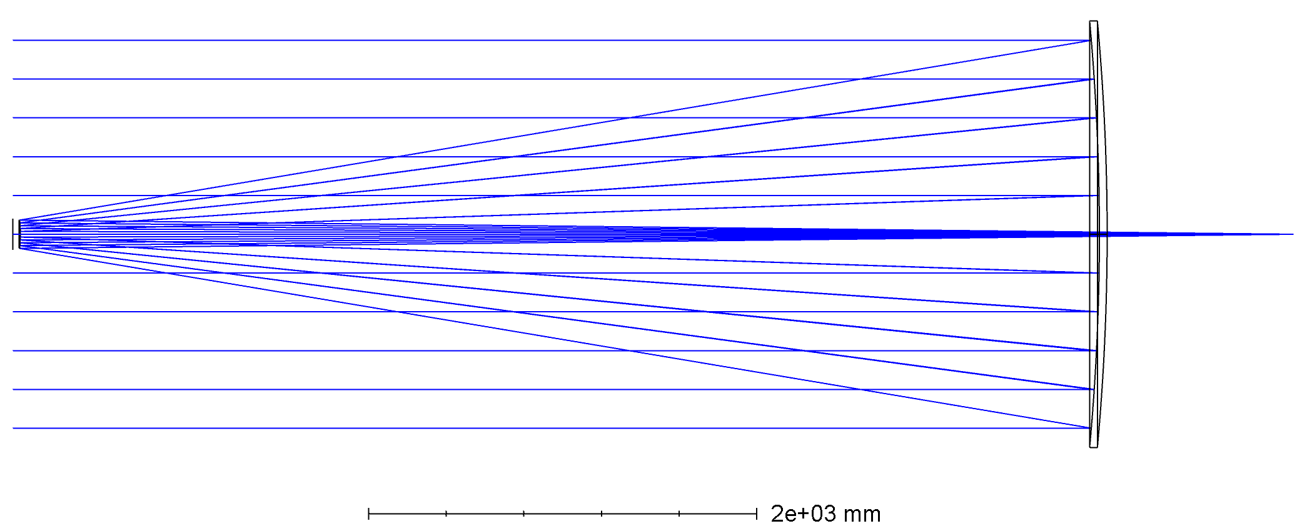
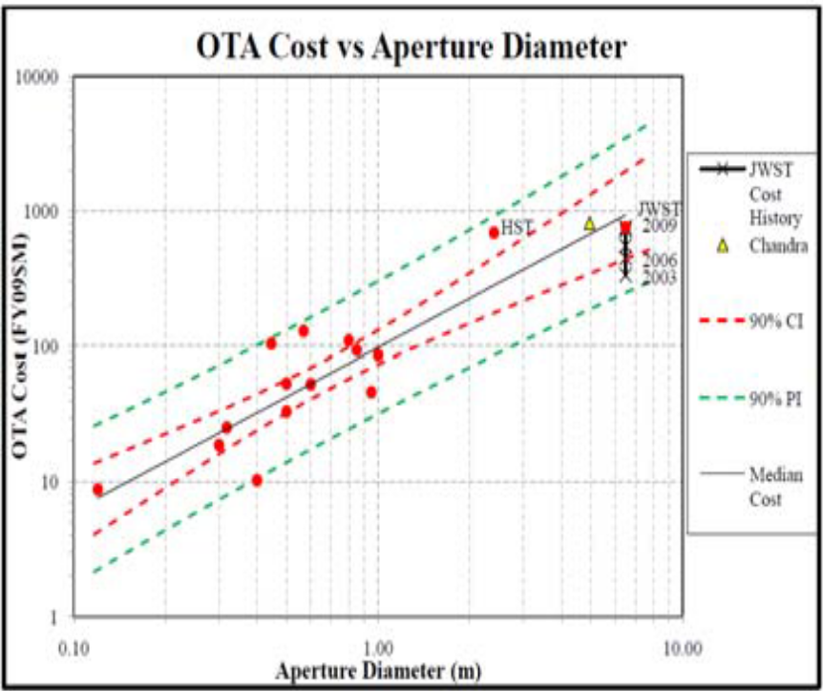
PDX Concept: Filled-Aperture Ground Assembled
Notional PDX Design: Mature Optical Design Approach
Limiting Factor: Launch Fairing
Concept Study Objective:
Determine the biggest filled aperture that can be assembled on ground to be launched within the New Frontiers-class constraints
 | Sensitivity | Diffraction Limit | Instrument FoV
Measurement Performance | Imaging Limiting Mag = 31 Spec. Limiting Mag = 24 | 63 mas at 500 nm | 110 arcsec 4.2 arcsec/mm Plate Scale
Baseline Design | 2-meter circular aperture | 2-meter circular aperture | 58 m Focal Length
Stahl et al. (2017) parametric cost model suggests HST’s OTA could be built for <$1B
Optical Design Tested with Z-max
Parameters | HST | PDX | Atlas V 400 | Atlas V 500 | Delta IV Medium
Length | 13.2 m | 11.0 m | 5.8 m (Extra Extended) | 7.6 m (Medium) | 6.5 m
Diameter | 4.2 m | 3.5 m | 3.8 m | 4.6 m | 3.8 m
Mass | 12,000 kg | 6,900 kg ? | 15,718 kg (LEO) 5,860 kg (GTO) | 18,814 kg (LEO) 6,860 kg (GTO) | 13,140 kg (LEO) 4,490 kg (GTO)
Notes:
Contents are okay, layout needs work

Slide 13
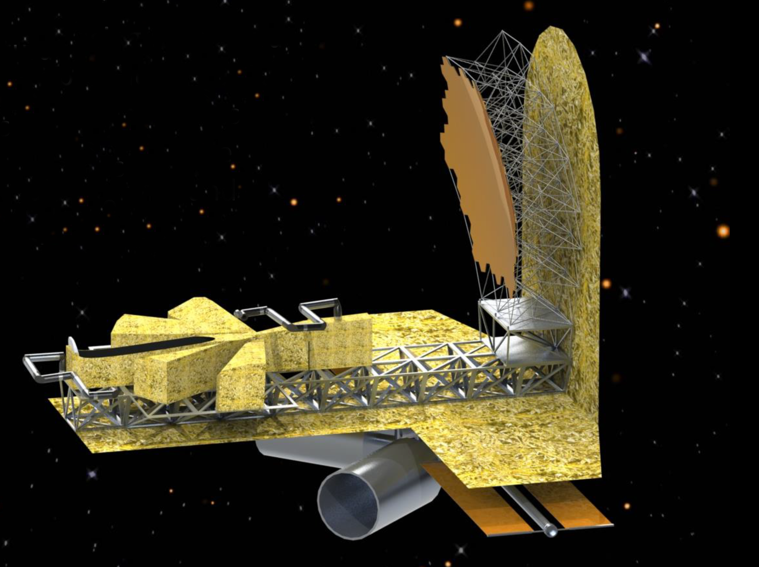
Filled-Aperture in-Space Assembled: iSAT Concept
https://exoplanets.nasa.gov/exep/technology/in-space-assembly/iSAT_study/
Astro2020 iSAT study:
Examined feasibility of a 5, 10, 15 and 20-meter telescope assembled in space
Optimized for sensitivity: Filled Aperture design
Optical surfaces: actively controlled to maintain mirror shape
Solar System Telescope Trade Study Objective:
Use iSAT design as a point of departure
Examine the cost impact of relaxing the mirror shape precision
Determine the Diameter, Imaging Quality vs. Cost
On-going Relevant Project:
Precision Assembled Space Structures (PASS)
Laboratory Demonstration to build a 20-meter parabolic aperture
Robotic Autonomous Assembly
Effort is applicable to future Solar System Telescope
See whitepaper by J. Dorsey
LaRC RAMSES Lab
Robotic Assembly of Modular Space Exploration Systems

Slide 14
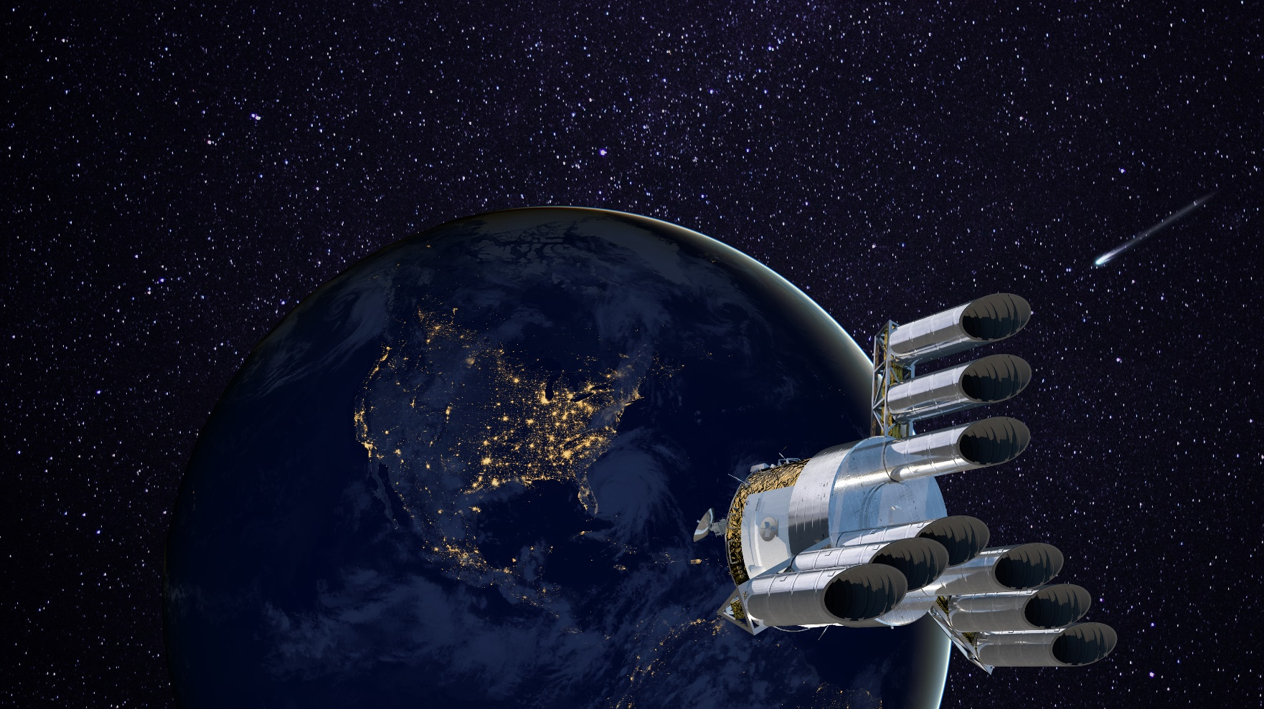
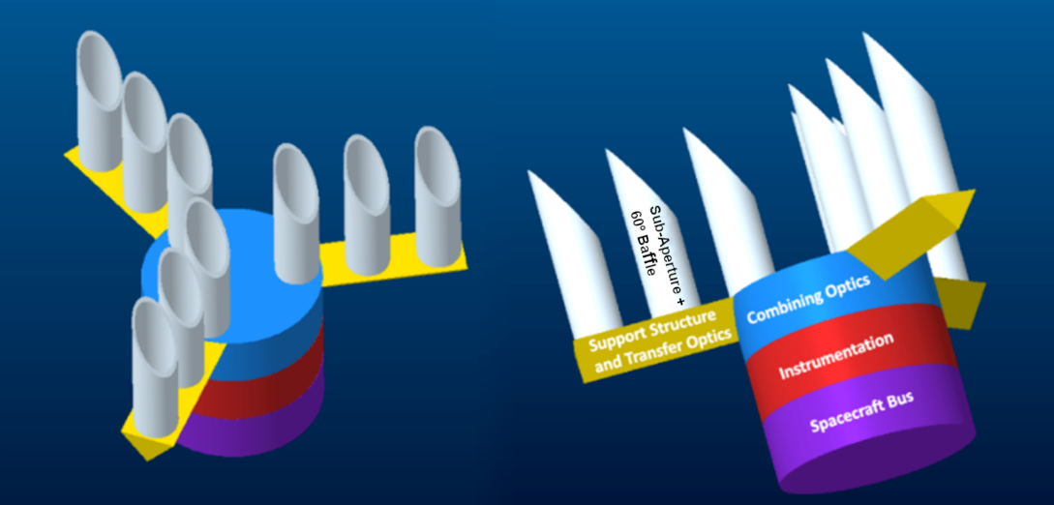
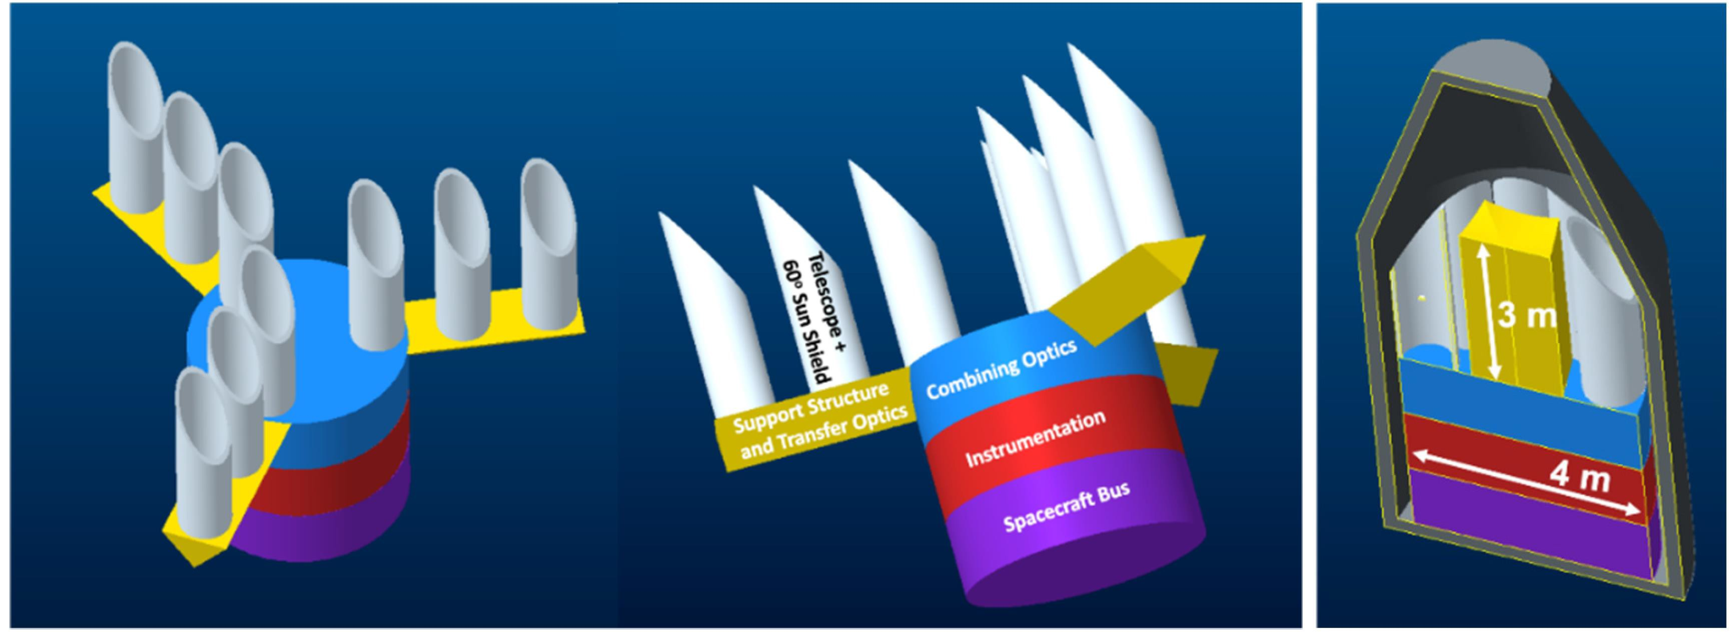
CHARISMA: Caroline Herschel high-Angular Resolution
Imaging & Spectroscopy Multi-Aperture Telescope
Sayanagi et al., 2020 Mission Concept White Paper
Designed to balance sensitivity and resolution
Notional Architecture
~10-meter Effective Aperture
Equivalent of 2-meter circular aperture area
Sparse-Aperture Design
Assembled and/or Deployed in Space
30-deg Solar Exclusion Zone
Create tech heritage for future astrophysics telescopes
Notes:
Tech Demo for Large Future Astrophysics Telescopes --- Aki Response: LUVOIR tech is ready
Can we make the labels legible?

Slide 15
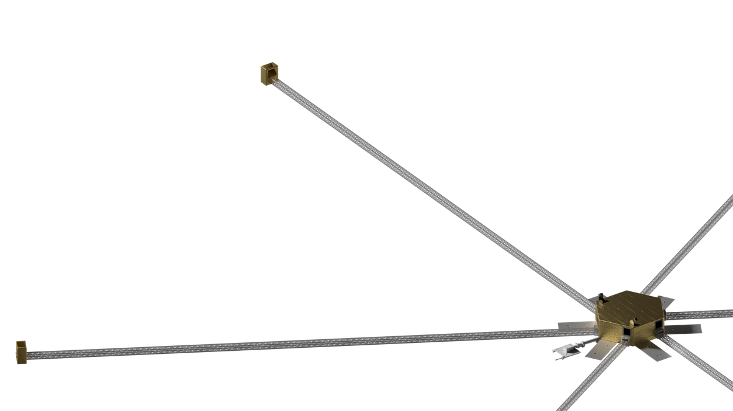
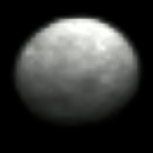
LightBeam:
Optical Interferometer Concept
van Belle et al., 2020 Mission Concept White Paper
Optimized for Imaging Resolution
Flyby-like snapshot imaging at ~10×10 to 100×100 pixels
  Outer planet moons
  Larger (~500+ km) KBOs
  Thousands of >10-100km bodies throughout solar system
Based on existing NASA STMD technology investments & capabilities
  ~100m baseline visible interferometer with 6 x 300mm apertures
  Large s/c structure enabled by in-space manufacturing
  Multiple Made in Space ISS manufacturing units already flying
  First dedicated MIS flight: Archinaut One (2023)
In-Space Assembly/Deployment/Manfacturering of Large Structure = mutual benefit to Astrophysics and Planetary
DAWN at Ceres:
27×27 pix
Notes:
Make sure to say this is a Visible telescope concept
Run quick NSSC database search

Slide 16
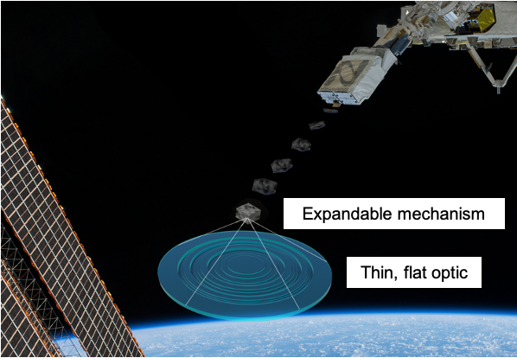
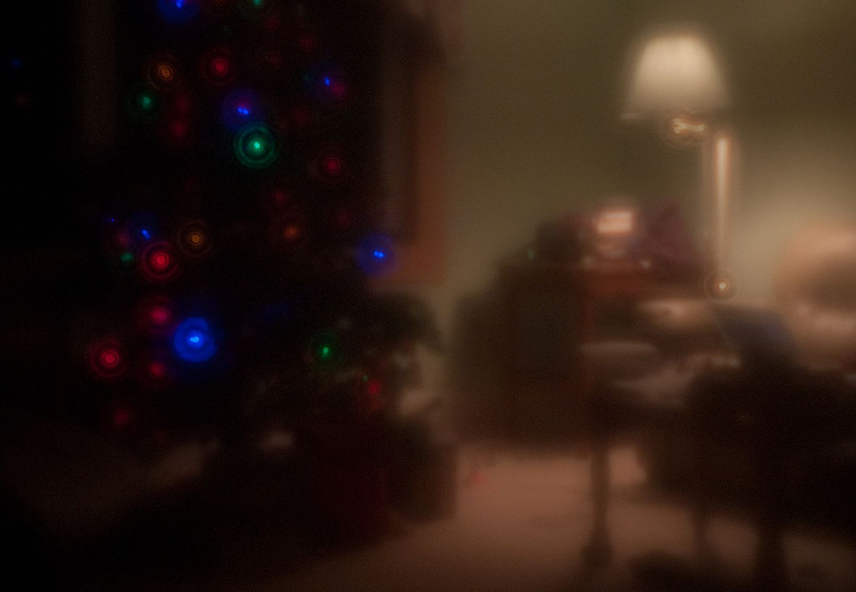
Diffraction Zone Plate Telescope
Under Development at NASA Langley
SPECIES Concept / PI: J. Leckey
Light-weight Membrane Diffraction Zone Plate
90% reduction in system mass compared to traditional optics
40% Optical Throughput
Design optimized for sensitivity (not for image quality)
Currently TRL =2, TRL = 4 expected by 2023
Concept Study Objective
Examine Technology Benefit for Planetary Science
Recommend Development Roadmap
Multi-layer Fresnel Zone Plate LIDAR Concept
Diffraction Zone Plate Image Example
(From Wikipedia)

Slide 17
Relevant Ongoing Activities

Slide 18
Summary
Urgent need: preserve UV observation capabilities
Science
  Time-domain science (high frequency, long-duration)
  New, wide-ranging small bodies surveys
Mission targets
  Cross-disciplinary planetary observations
  A focused science target is also viable
Telescope Architecture options; optimized for:
  Spatial resolution
  Photometric sensitivity
  Balance of both
Concept study objectives
  Survey of technology options
  Point design to demonstrate viable options for the next decade
We advocate to add a solar system space telescope to the NF6 list
The time for a solar system space telescope is NOW!
Notes:
Moreover, the next advances in solar system science to be enabled by space telescope observations should address temporally dynamic phenomena and the need for frequent, long-duration campaigns. The time for a space telescope dedicated to solar system observations is now!
Various technology options are available.

