Slide 1
Space Shuttle Cargo Integration
Coupled Loads Analysis
Lessons Learned
Erica E. Bruno
MRI Technologies, PMP
Joel W. Sills Jr.
National Aerospace and Space Administration (NASA)/ Johnson Space Center, AIAA Associate Fellow
Curtis E. Larsen
Texas Christian University, Professor of Professional Practice, AIAA Associate Fellow
2021 AIAA SciTech Forum, January 11-15 &19-21, 2021

Slide 2
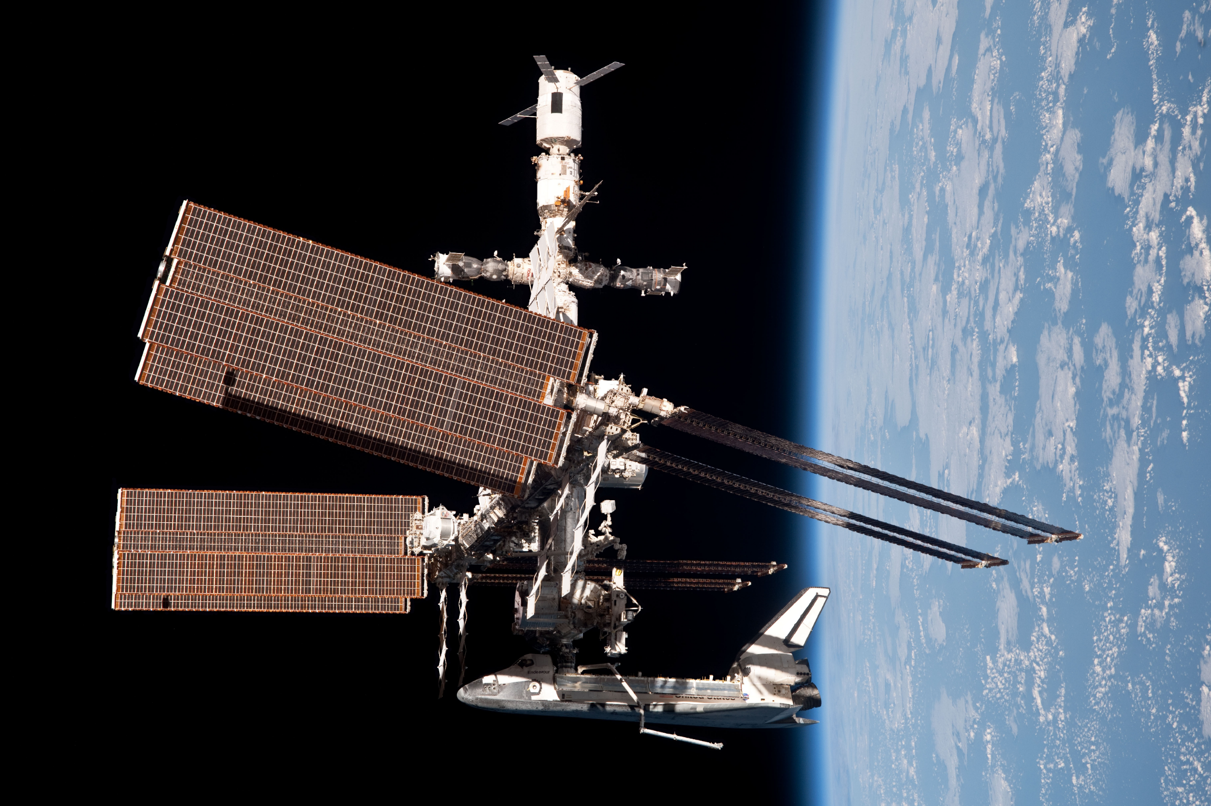
Notes:
When a system experiences a loading environment characterized by rapidly varying forces, such as a rocket launch, a transient analysis is used to analyze the response of the system. The most common transient analysis methodology is the Coupled Loads Analysis (CLA). CLAs are used by the automotive and aerospace industry to analyze cars, trucks, planes, helicopters, spacecraft, etc. The Space Shuttle program used the CLA methodology to assess the compatibility of the payload with the Orbiter and the flight environment. The Space Shuttle Verification Loads Analysis (VLA) was a standardized CLA process that started between ten and thirteen months prior to launch, and included several meetings as well as analysis by both the Space Shuttle Program and the payload developers to verify that the payloads were compatible with the flight loads environment and would not interact negatively with the vehicle. Over the course of the Space Shuttle Program, many improvements were made to the process, which reduced cycle time and improved manifest flexibility. There were several issues which were never fully addressed, but work-arounds were developed to keep the process flowing. The lessons learned included automation of some processes and standardization of others, early assessments, improved documentation and better coordination with all stakeholders in the process. Lessons learned also included the limitations in the current process, and what to do to avoid the same issues in the future.
What the last years of SSP were mostly about…building _the International Space Station! Also known as_ ISS! _This required delivering large modules for assembly on-orbit_
Most of the Space Shuttle flights in the final years carried hardware to the ISS, which consisted of a cargo element carrying smaller payloads, rather than one large payload element; therefore, the term cargo element will be used most often throughout this paper.

Slide 3
Introduction: Space Shuttle Program Verification Loads Analysis (VLA) Process
Standardized transient Coupled Loads Analysis (CLA)
  Structural and clearance compatibility assessment of the payload bay cargo element (CE) complement with the Orbiter and the flight environment
Kick-off @ 10 months prior to launch
Analyses by both the SSP and the CE developers
Final flight structural certification
Completion at T- 2.5 months as input to Flight Readiness Review
Notes:
Over the final ten years of the SSP, nearly 100 Coupled Loads Analyses (CLAs) were conducted as part of the CI Verification Loads Analysis (VLA) process. The VLA provided the flight environment loads that were used for the final assessments of the Orbiter capability and the CE hardware strength and life. The VLA was also the last check to verify adequate clearances between the Orbiter and CEs.
During the course of the VLA process, various issues “arose, ensued and were overcome” by the dedicated engineers and analysts involved with the Space Shuttle and its payloads. This group included those at the National Aeronautics and Space Administration (NASA) Johnson Space Center (JSC), Boeing Space Exploration, United Space Alliance (USA) and Jacobs Engineering as well as all the CE/payload developers and other NASA centers and their support contractors. Some of the issues encountered had a potential to derail the process to verify the hardware for flight (technical issues) and others were significant impacts to the schedule, threatening the launch date. Along the way, VLA process efficiencies and improvements were developed and implemented. This paper addresses these issues and the lessons learned from them.
Quote from the character Jack Sparrow, Pirates of the Caribbean: Dead Man’s Chest

Slide 4
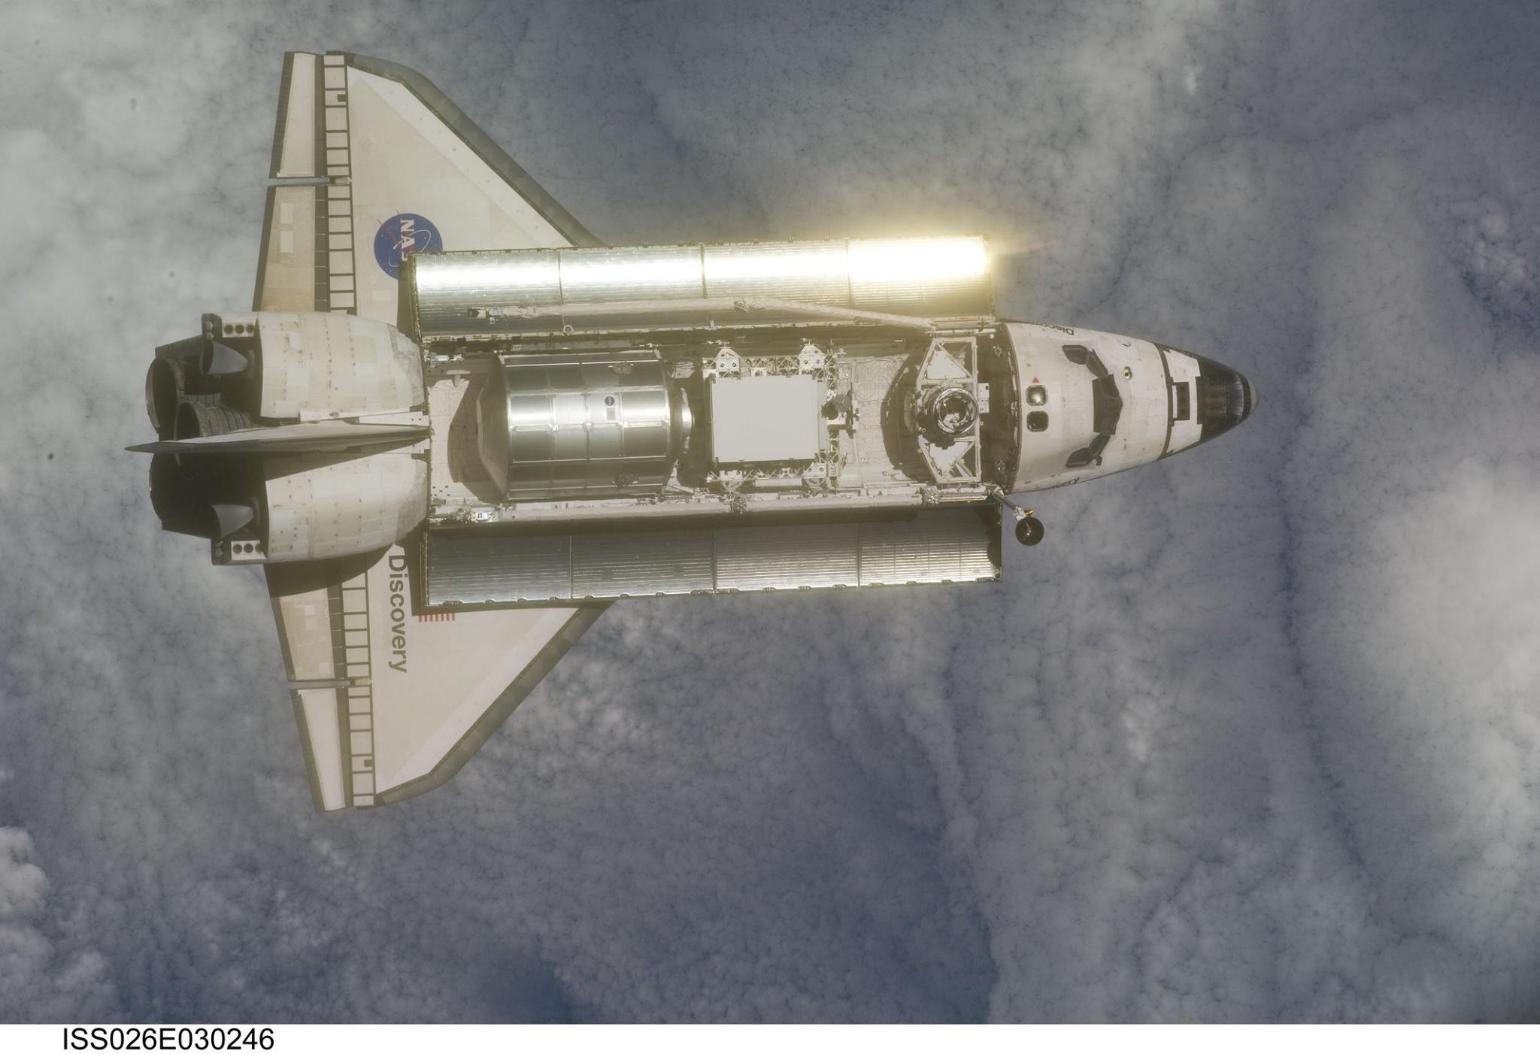
Notes:
Typical ISS mission cargo arrangement. Multiple cross-bay carriers.

Slide 5
SSP VLA Process Improvement Goals
Reduce cycle time by 20%
  Shift start and completion times to the right
  Automate
  Standardize deliveries
Improve manifest flexibility
  Late manifest definition of logistics (both up and down)
  Failure manifesting
  Plan for a second cycle
Notes:
Although the Space Shuttle was unique among space vehicles due to its reusability and return capability as shown in previous slide, it is hoped that these lessons learned will be applicable to new vehicles and programs in the future. These lessons learned cover items from the final ten years of the program, although some go back further. The lessons address issues with the VLA process itself and do not address the dynamic and static math model verifications, which were usually completed by the time the VLA started; however, the impacts of verifications not completed prior to the start of VLA are included.
Cargo integration was given a goal of improving the process to deal with fluid manifests and late additions due to failures. These goals were met by reducing cycle time and improving the flexibility. Some issues were driven by different timelines between the ISS program and the SSP which were not compatible and could not be brought into line with one another. Cycle time reduction was completed over a 4-year period, to test out methods and make corrections along the way without imposing significant impacts on hardware providers or the NASA-side analysis team.

Slide 6
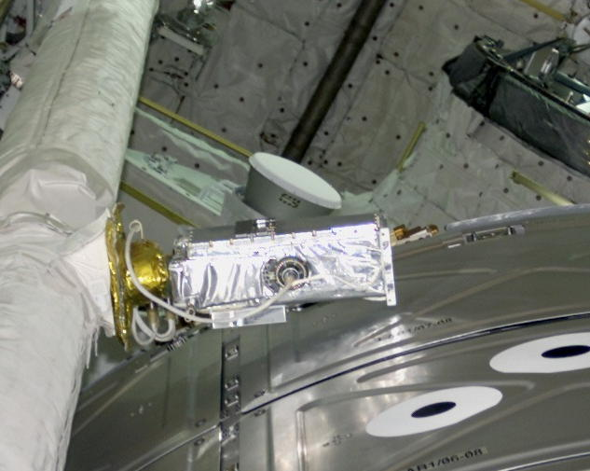
RMS Elbow Camera
US Laboratory
Notes:
A typical issue that needed to be addressed and mitigated/eliminated as much as possible
Clearance issues were noted early in the ISS assembly due to the maximizing of interior habitable space and using as much of the Shuttle Orbiter cargo bay as possible. It was due to issues like the one shown here. For scale, the camera is about 8-10 inches long and the clearance to the module on the right is less than 1 inch. The camera is mounted to a pan-tilt unit which is free to move during launch and ascent, making it highly likely to contact the module and damaging the camera. While an operational envelope was documented, it was only applicable in a narrow range of the payload bay, and only affected the longest of the ISS modules.
Other issues included handrails mounted externally on modules that were not within the defined envelope – again trying to use as much space as possible, but not considering the ramifications of the close clearance items during install and deployment. Even smaller items, such as an Orbital Replacement Unit (ORU) with a “saggy” thermal bag covering it could be a snag hazard during deployment.

Slide 7
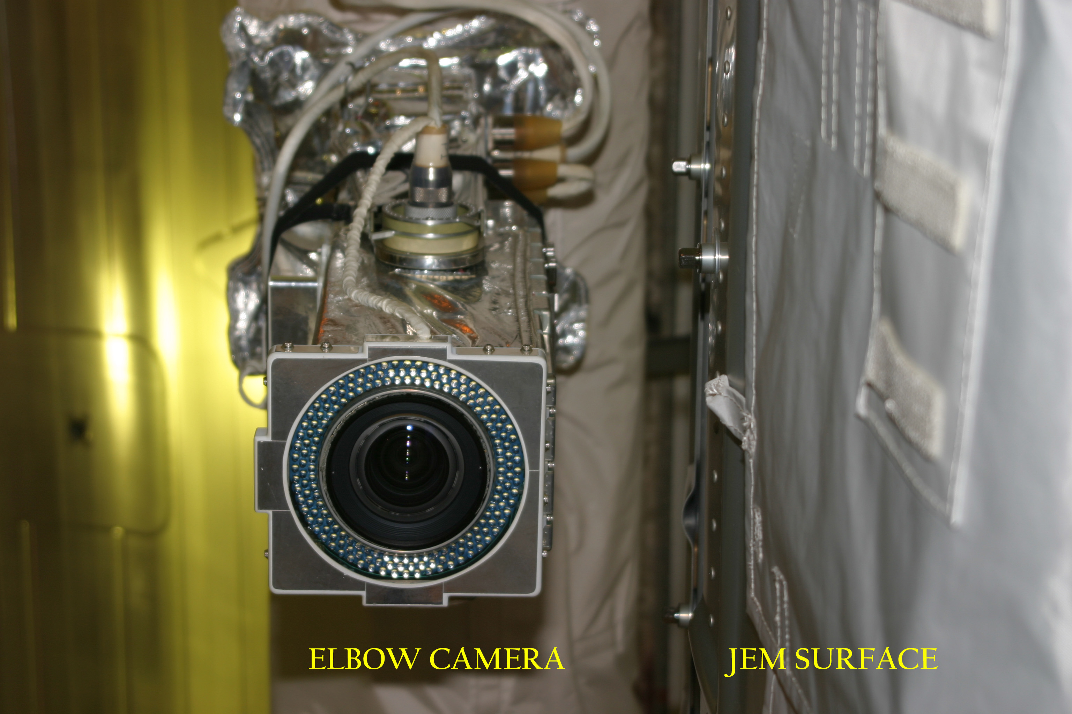
Notes:
Lessons Learned:
Thermal/dynamic envelopes should be defined simply. The more intrusions into the space by the launch vehicle, the more complex the envelope that payload developers must follow. _ and the more likely large payloads may try to design around them!_
Designs of pressurized modules need to account for any additional external hardware volume required outside of the pressure shell when making tradeoffs between the outer mold line and internal volume.
If a payload wishes to maximize their volume to take advantage of every inch of available space, they must be willing to work with the launch vehicle team throughout the design phase to preclude any late (and expensive) hardware re-designs to prevent inadvertent contact.
Document actual clearance requirements, whether no contact or a specific clearance, and distinguish from these the values used to determine when more rigorous clearance assessments are required to verify the requirement is met.
Predicted displacements should be verified through testing, especially if they are deemed critical.

Slide 8
VLA Process Lessons Learned
Lessons learned by SSP:
  Define keep out zones and envelopes in simple terms
  Automate and build databases of needed data up front
  Perform early preliminary (pathfinder) assessments
  Coordinate with all stakeholders and document everything
  Understand limitations of the process
Notes:
EARLY ASSESSMENTS
Lesson Learned:
Pre-determined parameter limits are a great way to reduce assessment time.
If pre-determined parameter limits are not an option, plan for multiple CLAs with the first being the baseline to compare future CLAs against, using an uncertainty factor on the first set of loads to provide margin against later load increases.
Identify ways to address schedule risks due to manifest changes.
AUTOMATION AND STANDARDIZATION
Lessons Learned:
Invest in structural math model improvements as you go.
Automate as many processes as much as possible to improve accuracy and turnaround speed.
Acquire or develop tools suited to the task.
Table 1 Improvements to the Orbiter Model
Remodeling/re-meshing of mid-fuselage
Added heavy mass items under the cargo bay liner
Implemented secondary model updates throughout the vehicle
Revised mid-fuselage stub frames ties to sill longeron
Lessons Learned:
Spend resources up front to build necessary environment databases such that reliance on other group/function deliveries is not required and bottlenecks are mitigated.
If a database is developed, do not lose the capability to regenerate any of the data in the database.
In the absence of a database, automate the generation of environments to allow different group/functions to utilize the software as needed.
DOCUMENTATION AND COORDINATION
Lessons Learned:
CAD models should always be verified against the flight hardware.
All soft goods, especially blankets, should be properly modeled and represented in CAD models to avoid clearance issues and snag hazards.
Use any and all measurement tools available to verify hardware dimensions on both sides of any interface.
Blankets should fit as snugly as possible against hardware to alleviate any issues with blankets shifting due to gravity, acceleration and billowing.
Lessons Learned:
Be specific about items to be delivered with any math model.
Any software used for model processing and CLAs should be as flexible as possible for model formats and coordinate systems.
If a specific unit system is required (input or output), clearly document and communicate that system to all model developers.
Conversion of OTM items between systems of units should be avoided by creating the OTM only after the model units have been converted.
Document as much as possible to make it easy for the CE developer to deliver everything needed the first time, correctly and in the required format.
Provide checklists for both the CE developer and in-house to verify deliveries include all necessary data.
Lessons Learned:
Effective loads relief efforts are only successful with close coordination among all stakeholders. In the case of the SSP, stakeholders included the payload developer, Systems Engineering, Cargo Integration (CI), the United Space Alliance, the NASA Flight Operations and Integration office, and the NASA SSP CI Structure Working Group (SWG).
Communicate often with the payload development organizations regarding potential updates to launch vehicle math models and forcing functions.
Each cargo element must evaluate and show positive margins for the latest Program approved environments. Do not allow, “grandfathering” of previous math models and forcing functions when they are not truly representative of the current environment.
When multiple flights are encountering loading issues, it is time to re-examine the inputs used to generate the loads. Understand the effects of all the parameters in a forcing function and determine which have the most significant impact on payload loads.
UNDERSTAND LIMITATIONS
Lesson Learned:
Spend time understanding the effects of all the parameters in a forcing function and determine which have the most significant impact on payload loads.
Lessons Learned:
Forcing functions should be based on the mission-specific mass properties rather than on a standard set of weight and CG categories (“bins” or tolerance ranges) to allow greater flexibility.
If a database of set cases must be used, the impact of going outside the box should be well understood to determine the allowable tolerance of the system before re-analysis is required.
Lessons Learned:
Understand the limitation of all areas of the vehicle performance affected by mass changes and have them clearly documented, including impacts when violated.
LESSONS FOR THE FUTURE
Lessons Learned:
In-house software requires resources throughout the life of the code to upgrade and test for compatibility as computer systems and operating systems are upgraded.
Tools more heavily based on commercial codes are easier to upgrade and port to other systems.
Investment in the automation of repetitive tasks is well worth the time and money for the payoff in schedule savings when analyses must be repeated.
Rigorous benchmarks/run matrices must be defined and executed to ensure the correct results when software and computer platforms change.
Cooperation and constant coordination among management, analysts, analysis tool providers, operating system providers, and computing platform providers during software or computing platform changes are imperative.
Any tool issues must be diligently tracked and resolved quickly.
Lessons Learned:
Integrated hardware should be weighed at various stages of assembly and piece parts weighed when available integrated hardware cannot be measured.
Mass property verification should be scheduled at various milestones during design and assembly, and the models updated as required to match the actual hardware as much as possible.
Early analysis to expand the tolerance on hardware that will be flown multiple times should be investigated to minimize re-work and increase flexibility (and therefore reducing the amount of real time mission work).
Low margin, light weight designs require more sophisticated and costly analysis efforts than robust structures when it comes to manifest flexibility.
Conduct final verification close to launch to incorporate as many changes as possible and to reduce exposure to additional changes.
Lessons Learned:
Verification cycles are to be used for final verification of a manifest, not for conducting variational analysis.
Define early in the program a “reasonable” limit on the contingency and alternate configurations to be run in the final verification, as some may be needed.
For each payload or manifest, define a plan on how to address additional variations prior to the final verification cycle.
A database of all results obtained is useful to study trending and sensitivity, based on different manifests.
Lessons Learned:
Document all analyses, no matter how small – a short memo may be all that is needed.
Documented analyses allow for peer review, which can catch errors, omissions or question any underlying assumptions used.
For any and all violations of requirements, rationale should include a reference to the analysis done in support of acceptance. This is very helpful when similar issues arise that need to be assessed.
Data specified in the requirements should be traceable to a documented analysis.
Lessons Learned:
Clear roles and responsibilities between the payload provider and the launch authority must be established when a Launch-on-Need ORU is manifested. This is applicable to any late manifest changes.
Issues and late manifest items must be worked jointly between programs which includes complete transparency and sharing of information in a timely fashion.
Readiness of the Launch-on-Need hardware or late manifest items needs to be clearly communicated to determine the open work and a supportable schedule.
A project manager or project lead as the single focal point to both programs is needed to verify data is shared equally and to keep track of what approvals have or have not been given.

Slide 9
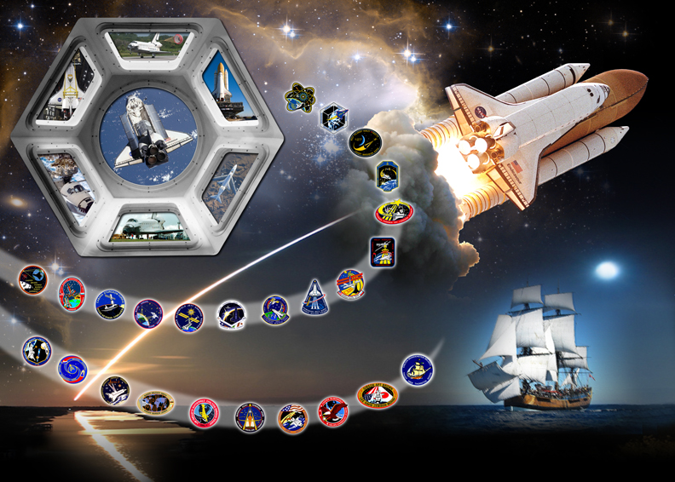
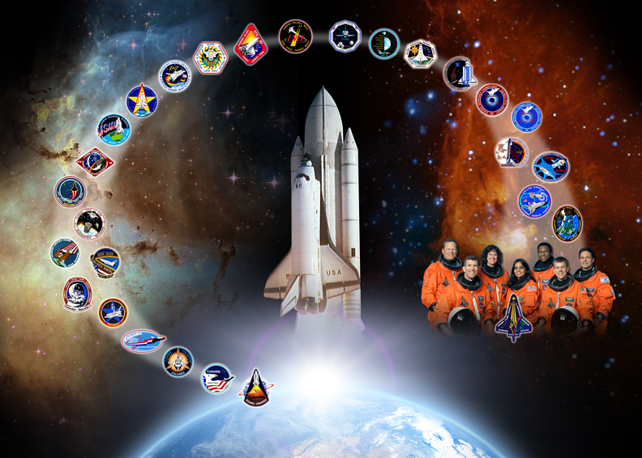
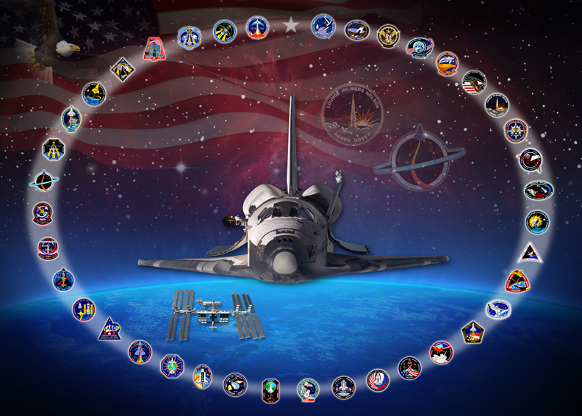
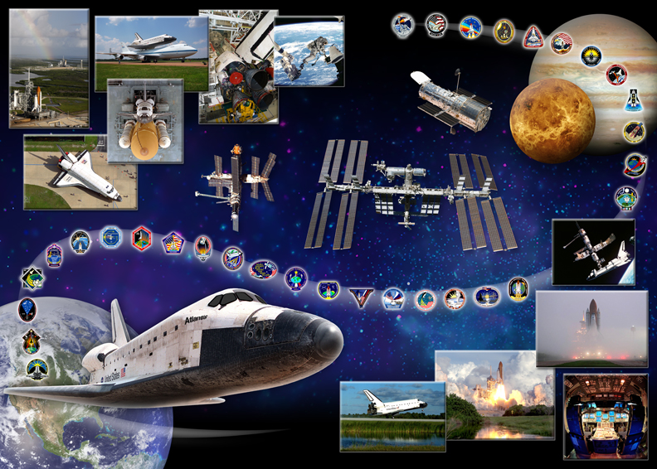
Space Shuttle Program: An American Treasure
Notes:
Dedication
This paper is dedicated in memoriam to Mr. Christopher Rodgers/Boeing Space Exploration, Huntington Beach, CA. Mr. Rodgers’ contributions during the Space Shuttle Program are immeasurable as a colleague, mentor, and a learned practitioner.
Acknowledgments
This set of lessons learned could not have been assembled without the help of those that have been mentors and colleagues to the authors over the years. It is their extensive knowledge of past issues, how things used to be done and the improvements implemented (or not) over the years, which the authors did not wish to be lost at the end of the SSP. These individuals include, but are not limited to: Mr. William Walls/Boeing Space Exploration, Houston, TX; Mr. Nelson Fox/Hamilton Sundstrand Corporation Houston, TX; Mr. Bobby Brown/NASA-JSC (retired); and Mr. Paul Romine/NASA-JSC (retired). Additional help and guidance was provided by Mr. Raymond Nieder/NASA-JSC (retired).

