Slide 1

Usage-Based Discovery of Earth Observations
Earth Science Information Partners Discovery Cluster
Christopher Lynnes, NASA Goddard Space Flight Center*
Margaret Zhu, NASA Goddard Space Flight Center†
Megan Mehta, NASA Goddard Space Flight Center†
Jonathan Blythe, Bureau of Ocean Energy Management
Edward M. Armstrong, NASA Jet Propulsion Laboratory
Elisabeth Huffer, Lingua Logica, LLC
James R. Munroe, Memorial University of Newfoundland
*NASA Civil Servant
†NASA Contractor
‡ United States Geological Survey
Doug Newman, Raytheon†
Christopher Durbin, Raytheon†
Jeff Siarto, Element84†
Mark Reese, Element84†
James Norton, Element84†
Tanja Nicole Williamson, USGS‡ Kentucky Water Science Center
Jessica Burnett, USGS‡ Colorardo Water Science Center Denver
Notes:
Hi, I’m Chris Lynnes, an information systems architect at NASA. I’m going to talk about a collaborative project that we have been working on in the Earth Science Information Partners Federation that we call “Usage-based Discovery”, which is a somewhat novel paradigm for finding Earth Observation datasets. Because we are doing this work in ESIP, we have a number of contributors. I don’t have time to list them all, but I invite you to pause the video and take them all in ☺.
Abstract: Most providers of Earth Observation data enable search via dataset characteristics, (e.g., quantity being measured, instrument, location, and time). However, the Earth Science Information Partners Federation (ESIP) is attempting to improve dataset discovery by capturing information on how datasets are used. At a usage-based discovery hackfest at the July 2020 ESIP Summer Meeting, participants pooled their collective skills to implement a prototype based on the connections between datasets and data usage, which can reveal unanticipated patterns in dataset connectivity that are not apparent through traditional approaches. A survey of natural hazards websites, focusing on hydrology-related hazards such as floods and hydrology datasets such as rainfall, illustrated the difficulty of gleaning which dataset was actually used and how it was accessed. This difficulty highlights the need for greater transparency on dataset usage in website design. An application wireframe for a usage-based discovery database was conceptualized as a tool to help applications data specialists rapidly assemble a fit-for-purpose website as part of a disaster response, where customer feedback was integral to the manner in which the website would be developed and delivered. Capturing connections among datasets and instances of usage, either for research or applications, could help users identify datasets with a proven track record of utility or those that have been supplanted by more accurate and(or) precise representations. It may also help Earth Observation providers maximize returns on investments in data services. Social discovery, i.e, following discovery paths laid down by previous users of the data, could be a critical tool for improving the timeliness and applicability of dataset delivery at times and in circumstances where practitioners don’t have the capacity to evaluate the deluge of datasets that are returned by today’s search tools.

Slide 2
Earth Science Information Partners and Data Discovery
Earth Science Information Partners (ESIP) - https://www.esipfed.org/
ESIP Discovery Cluster - ESIP people interested in making Earth Observation discovery work better
  First: Federated Search (Collection + Granule)
  Then: User Characterization and Relevancy Ranking of Datasets
  Now: Usage-based Discovery
Notes:
ESIP is a federation of government, academic and commercial organizations who get together to address issues related to Earth science data. For many years we have had a cluster—basically an informal working group—addressing issues of data discovery. The Discovery cluster started out working on federated search. After that we worked on issues of relevancy ranking. Relevancy ranking in particular has proven especially thorny for organizations or federations with very large repositories, measured in the thousands of datasets. So recently, we looked at a rather different approach that we call Usage-based Discovery.

Slide 3
Starting Premise...
Users are looking for datasets
to use for a particular purpose
Notes:
The starting premise of Usage Based Discovery is that users are looking for datasets with a particular purpose in mind.

Slide 4

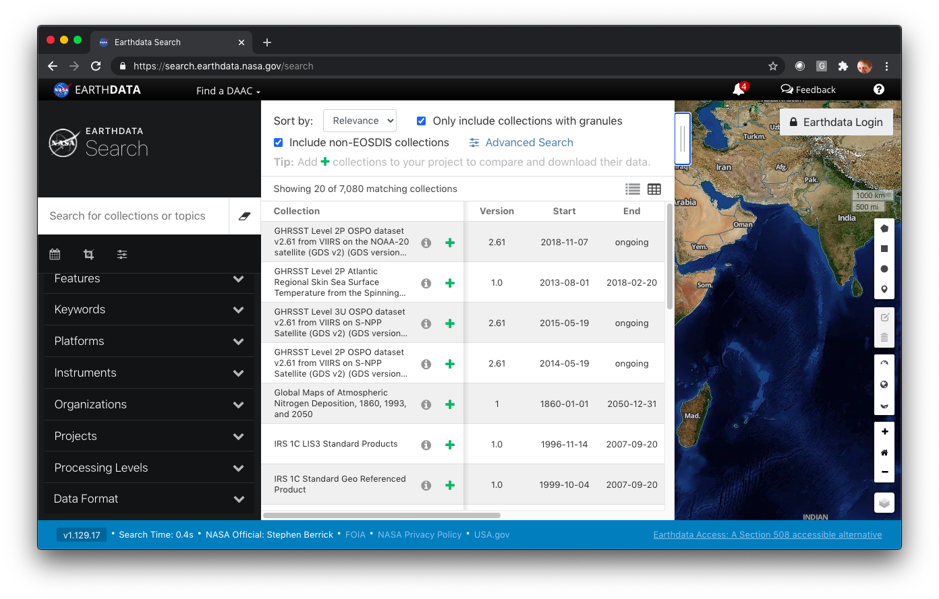



Current discovery interfaces present dataset characteristics
Earthdata Search
Notes:
Image from NASA EOSDIS Earthdata Search
To see how works with the predominant paradigm of most interfaces today, let’s take a look at NASA’s Earthdata Search. We provide you a search interface that allows you to search based on attributes of the datasets, such as a freetext search for terms and/or attributes describing the dataset itself, such as instrument.

Slide 5
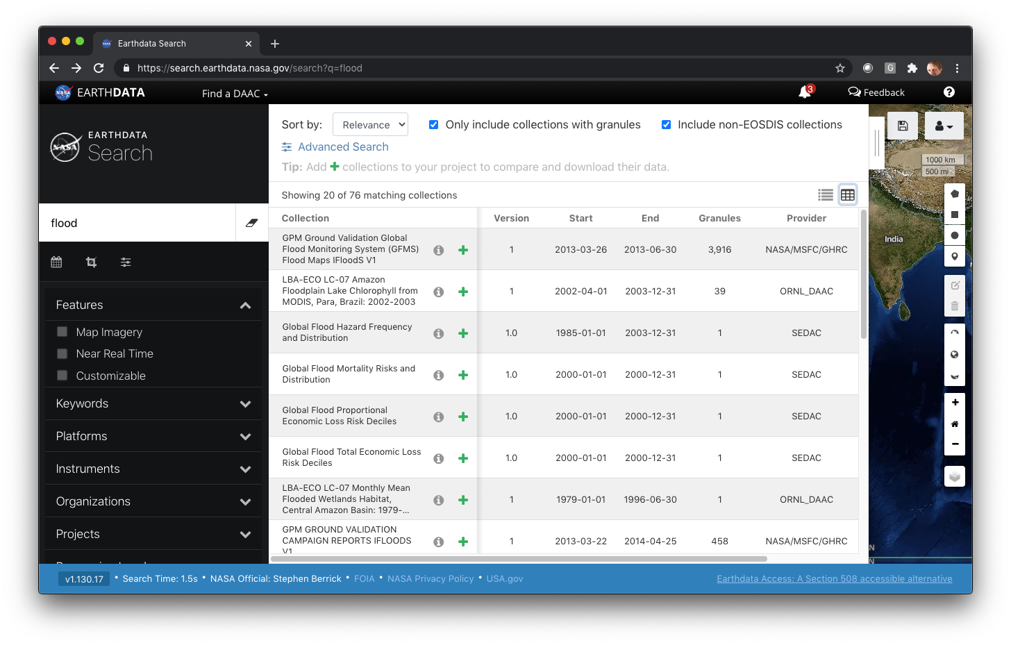


Current discovery interfaces present dataset characteristics
Notes:
Image from NASA EOSDIS Earthdata Search
But let’s say you are looking for data to help you with a flooding-based application, such as flood monitoring or prediction. If you do a keyword search, you are going to get datasets for which “flood” referenced in the description of the dataset. Here we see that searching for flood returns 76 matching collections.

Slide 6
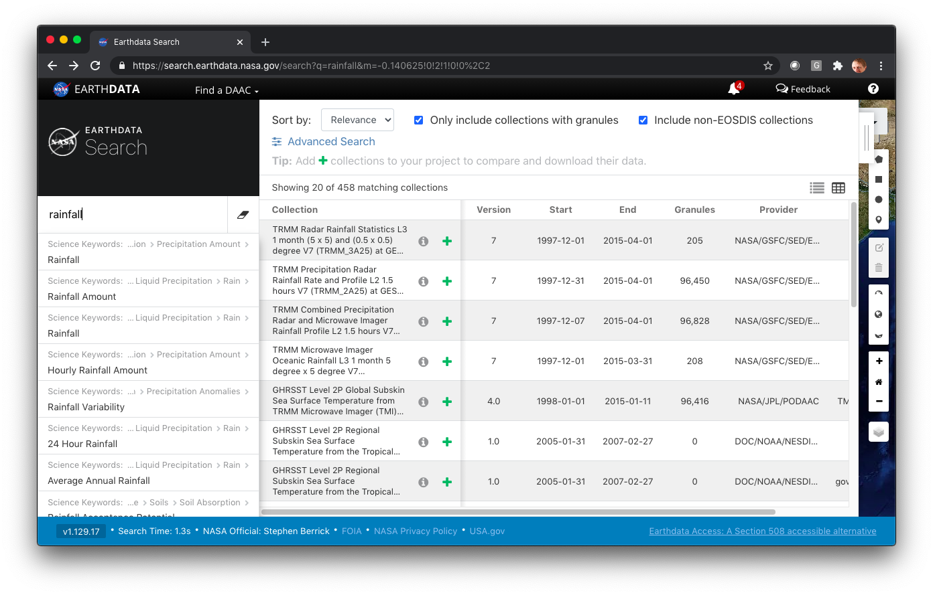
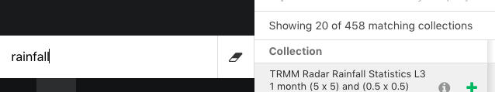

What about Rainfall? Or Soil Moisture?
Notes:
Image from NASA EOSDIS Earthdata Search
But what about other datasets that are relevant to flood applications yet don’t directly measure floods? Rainfall is an obvious one, as is soil moisture, both of which can help predict flooding. We actually have quite a rich set of datasets—over 400 for both these categories--some of which are in fact used by a number of flooding applications.

Slide 7
Are 400+ results too much of a good thing?
OK, what kind of rainfall data do you want for your flood monitoring?
Satellite or rain gauge or merged?
Spatial and temporal resolution?
Spatial and temporal coverage?
Quality?
Latency?
Notes:
But now we have the opposite problem. Out of those 400+ results for rainfall, some of them are probably more useful for flood applications than others. If you are monitoring an active flood, a monthly product is probably too infrequent to be useful, and you also want a low latency.

Slide 8
Let’s try a new paradigm: Usage-based Discovery
“What datasets does <similar flood application> use?”
Notes:
So that brings us to our alternate paradigm of Usage Based Discovery. This is basically a case of looking at which datasets have proven useful to similar applications to the user’s
intended usage.

Slide 9
What is an “Application”?
Application = a practical usage of data
e.g., Landslide Hazard Assessment for Situational Awareness
Notes:
Now in this context, an Application is a practical usage of data, like the Landslide Hazard Assessment for Situational Awareness, also known as LHASA.

Slide 10
What is an “Application”?
Application = a practical usage of data
e.g., Landslide Hazard Assessment for Situational Awareness
NOT a computer program, like Firefox
Notes:
I’m not talking about a computer program, like Firefox.

Slide 11
Let’s try a new paradigm: Usage-based Discovery
“What datasets does <similar flood application> use?”
aka the
“I’ll have what they’re having” paradigm
Notes:
Coming back to our alternate paradigm of Usage Based Discovery. Another way of looking at it is the “I’ll have what they’re having” paradigm.

Slide 12
Let’s try a new paradigm: Usage-based Discovery
“What datasets does <similar flood application> use?”
aka the
“I’ll have what they’re having” paradigm
aka
Social Data Discovery
Notes:
Another way to look at it is Social Data Discovery, where each usage by another application represents a “like”.

Slide 13
Graph relationship from Application to Dataset
Application
Landslide Hazard Assessment Model (LHASA)
Rainfall Dataset
doi:10.5067/GPM/
IMERG/3B-HH/06
uses
Notes:
Those of you familiar with the technologies used in most social tools will have pegged this as a natural for graph database. Here’s an example graph relationship between the LHASA application and a rainfall dataset from the Global Precipitation Mission.

Slide 14
Use Cases → Hackfest
April
May
June
July
User Story Template
Collect User Stories
Collect Dataset-Use Relationships
Hackfest!
Notes:
In ESIP, we have been working for just a few months on this approach, We began by collecting Use Cases in the form of User Stories and then finding some initial dataset-use relationships. These then culminated in a virtual Hackfest in July at the ESIP Summer Meeting.

Slide 15
The Hackfest
Foragers: Go find more relationships between Applications and Datasets
User Experience (UX) Designers: Design mockups showing UX
Coders: Build a proof of concept
Notes:
In the Hackfest , we broke up into three groups. The Foragers set out to find more dataset-usage relationships where the usage was based on Applications. Meanwhile we had a group of User Experience experts working on the UX with some design mockups. And finally, we had coders to build proofs of concept. The overall goal was to see if it was possible to develop one or more working programs using relationships harvested by Foragers.

Slide 16
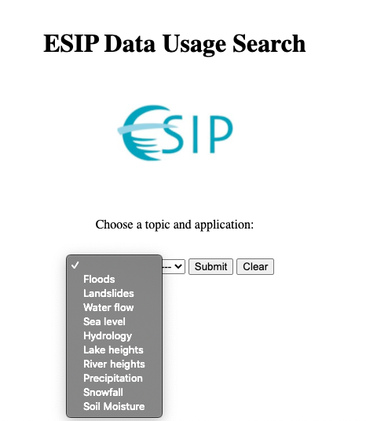
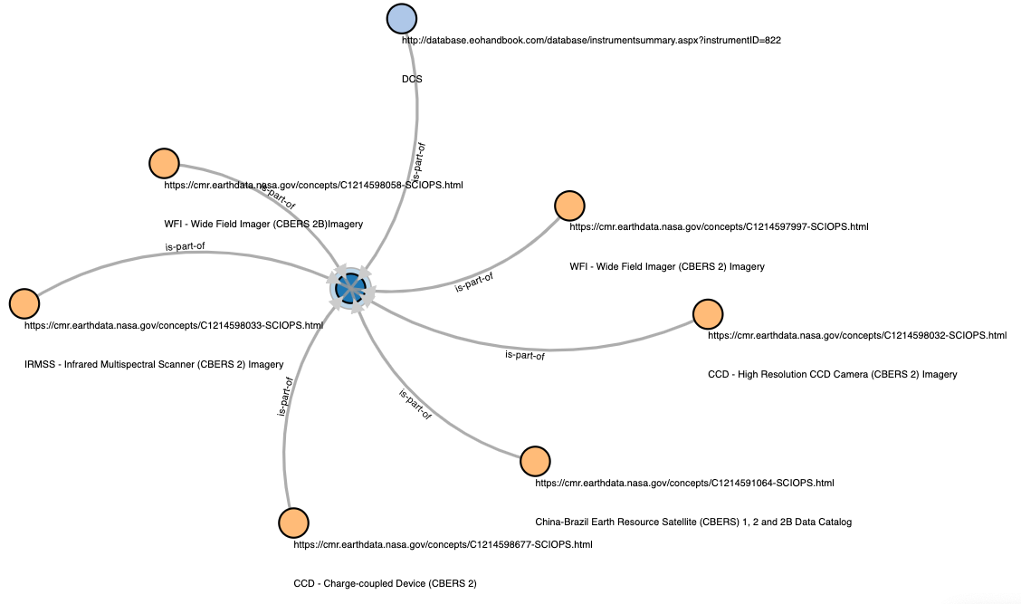
Hackfest Results
Coders: 3 prototypes
2 graph databases
1 ontology
Notes:
Images generated by authors in July 2020
In the Hackfest, the coders produced 3 separate prototypes. Two of them used graph databases, Neo4J and Neptune, and provided a front end for searching or exploring data, with somewhat different looks. A third actually created an ontology from the relationships and imported it into the Top Braid ontology editor.

Slide 17
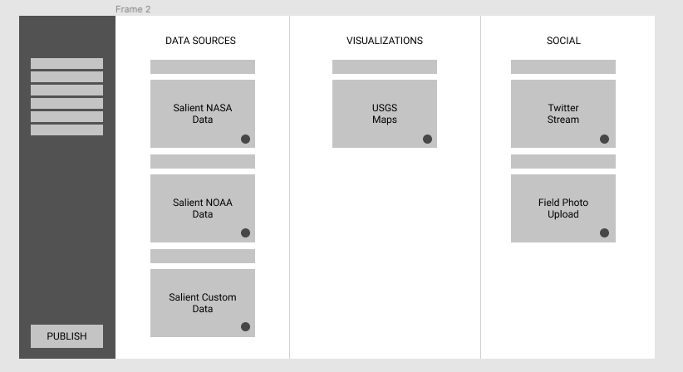
Hackfest Results
Coders: 3 prototypes
2 graph databases
1 ontology
UX Designers:
Focus on data wranglers who put data and applications together for end users
Notes:
Images generated by authors in July 2020
Meanwhile the UX designers came up with a result out of their discussions that was somewhat unexpected, namely that we should maybe focus more on the data wranglers that put an application together for the end users rather than the end users themselves.

Slide 18
Hackfest Results
Coders: 3 prototypes
2 graph databases
1 ontology
UX Designers:
Focus on data wranglers who put data and applications together for end users
Foragers:
Need better data citation practices in Applications!
Notes:
Finally, the foragers had perhaps the most difficult job of all. In the research world, we have been working for some time to get authors to formally cite datasets they use in an article, using unique Digital Object Identifiers or DOI. However, in the Applications world, there is no such convention, so it was often difficult to determine which datasets were used within a given application. Even when some details were provided about the data, the DOI was not usually specified.

Slide 19
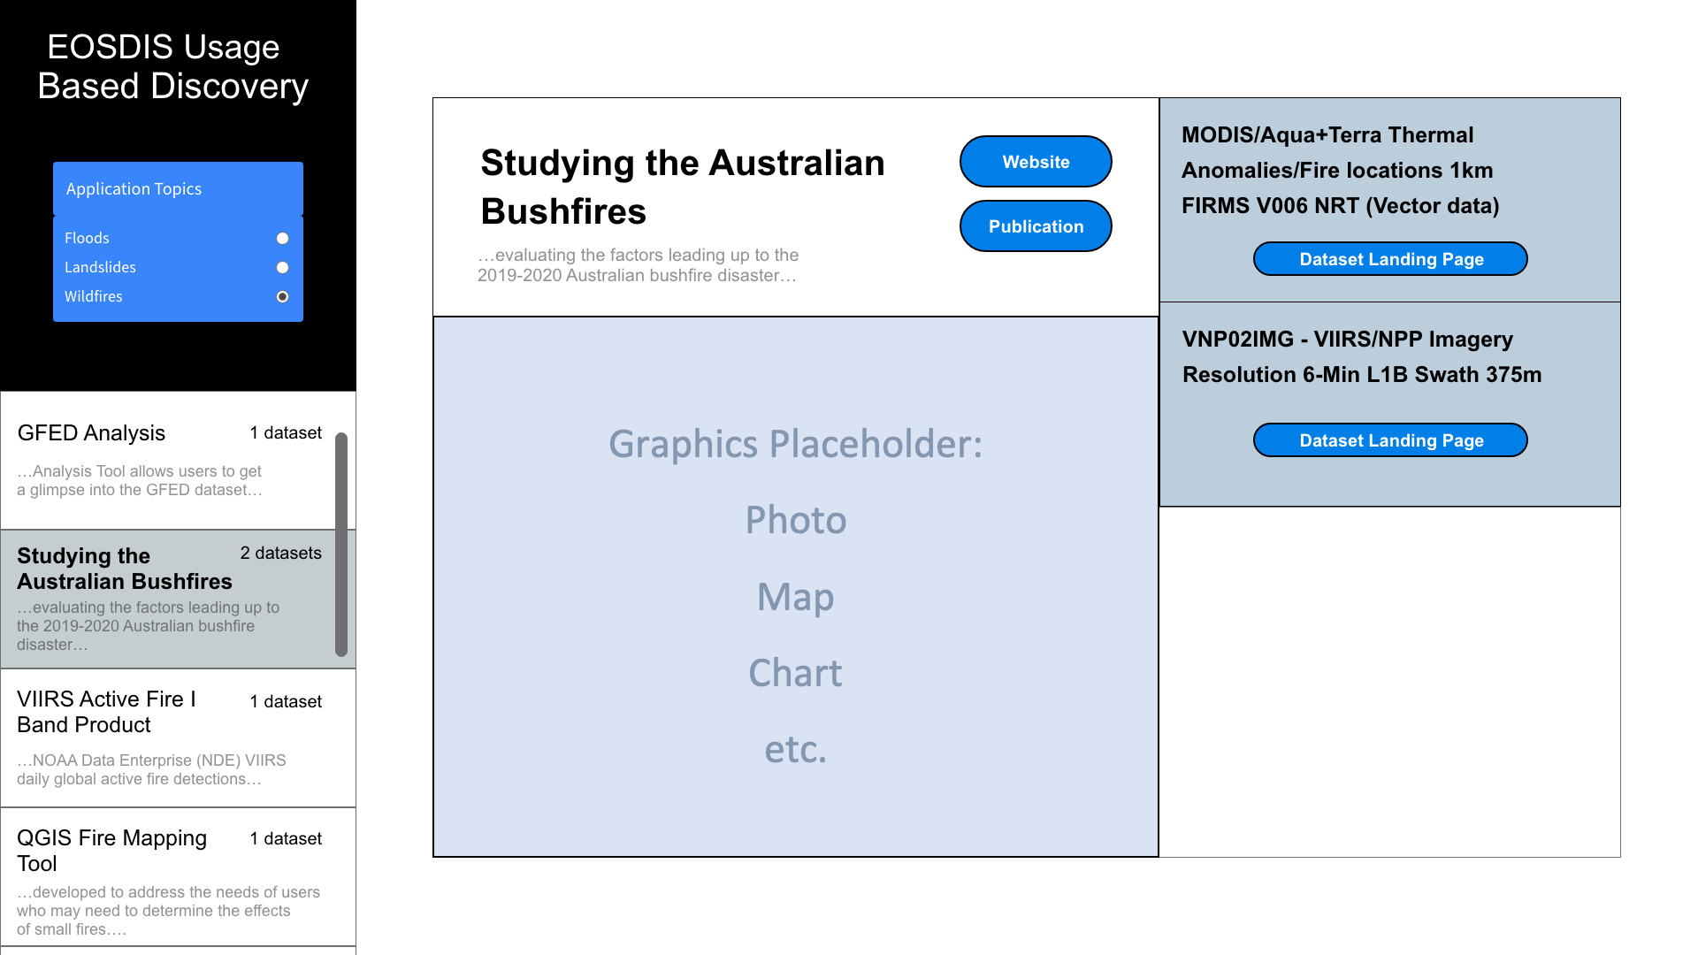
We are now working on a Beta Version
Notes:
Some of the work has continued toward developing a Beta version of a Usage Based Discovery tool. In our latest screen mockup, you can see that we have grouped the applications by topic to narrow things down a bit. When the user selects an application from the left hand column, we show the application information in the center panel, and the datasets that it uses in the right hand column.

Slide 20
Going Forward with Usage Based Discovery...
Automated Harvesting of Relationships
  Degree of automation may vary...
  Could benefit from more consistent citing of datasets by Applications and in science literature
Additional Use Cases
Notes:
And as I mentioned in a previous slide there is a lot of work to be done in harvesting usage-dataset relationships. We have an activity to try to partially automate the harvesting. By the way,this looks like an opportunity to improve how members of the Applications community identify the provenance of their results.
We also continue to define additional use cases. For example, you could see a policy use case, in which one might reverse the quey and ask, how many applications use a particular dataset? This could help get a sense of the impact of the dataset

Slide 21
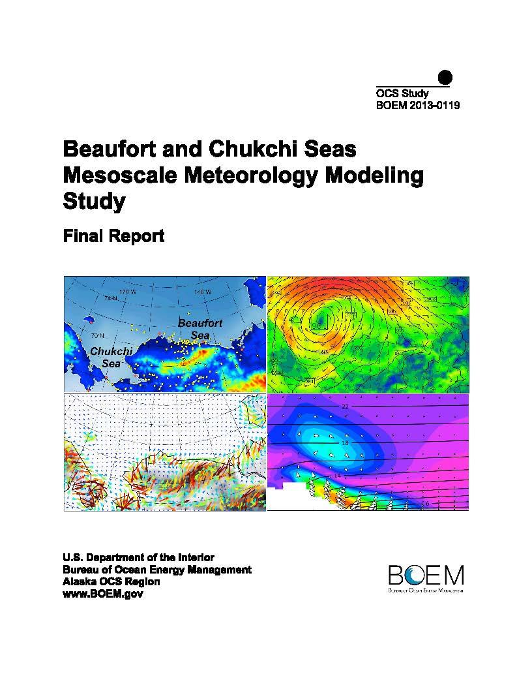
An Alternate Use Case: Provenance for Application Models
Example: BOEM* modeling study
BOEM funded modeling study of mesoscale meteorology in Beaufort and Chukchi Seas.
  https://marinecadastre.gov/espis/#/search/study/23141
Assimilated meteorological data.
Report focused on climatological analysis, which has limited utility.
Model grid: 1hr, 10km, 10m grid.
Time period: 1979 – 2009.
This mesoscale product is an improvement over the global product that BOEM uses to force its oil spill ocean circulation modeling.
*Bureau of Ocean Energy Management
Notes:
Image from BOEM co-author J. Blythe
We are also looking at earth science information products that are intermediate steps in answering applied science information needs. Here is an example from Jonathan Blythe, of the Bureau of Ocean Energy Management. The earth science data are processed into a more digestible format needed to feed the agency application. The scientists creating the information products may not always know the ultimate application of the earth science data they are producing, but they are developing information products that respond to agency requirements for the model output, specifically the model domain and resolution, which they use to create the information product. In this case, BOEM analysts took the meteorological model output produced from this hindcast model to feed the agency’s oil spill trajectory model and inform decision analysis on the oil and gas development leasing in the Arctic Outer Continental Shelf.

Slide 22
Going Even Further in Usage-based Discovery…
Leveraging Semantic Technology
  Application Ontologies
  Schema.org dataset Markup in Application websites
  Text Mining for Knowledge Graphs
Working with Applications clusters
Dataset usage in research articles?
Notes:
The best thing about working within the ESIP framework is the opportunity to work with so many informaticists, including other clusters. We have started talking with people from the ESIP Semantic Cluster about leveraging more semantic technologies, for example. Application ontologies could help users discover the applications closest to their use case. Schema.org markup of datasets in Application websites would help the relationship harvesting process enormously. In addition, some of the text mining techniques used in defining knowledge graphs could be applied to understanding the relationships between datasets and applications.
We are also beginning to engage with more of the Application communities, such as the ESIP Air Quality cluster, to collaborate on cataloguing the datasets used for applications and better understand the applications use cases.
Finally, we are looking at when to begin to include dataset usage in research articles. These have the advantage that the dataset-usage relationships are easier to extract, but have the challenge that research articles are a little more difficult to categorize in a way that is easy for users to navigate.
So, I want to thank you for your attention, and please stay tuned for future developments in the area of Usage-based Discovery.

