Slide 1
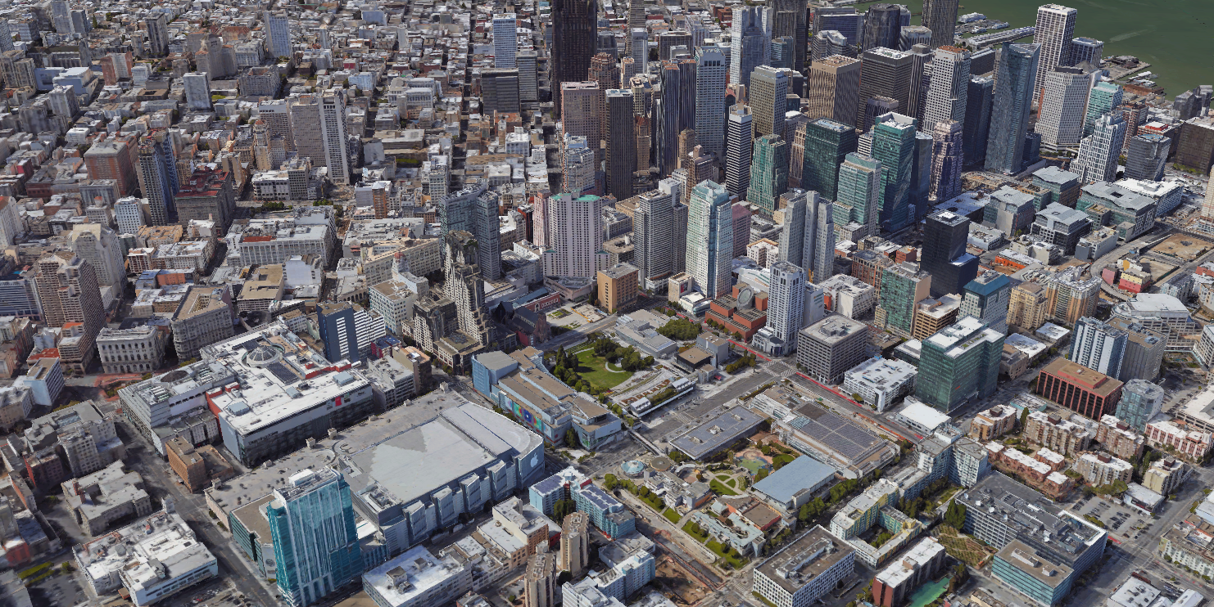
STEReO/SAFE50 : Autonomous sUAS Fireline Detection and Tracking
Joshua Baculi
joshua.e.baculi@nasa.gov
Intelligent Systems Division
NASA Ames Research Center
Moffett Field, CA, USA
Notes:
Hello. My name is Joshua Baculi. I am part of the SAFE50 team here at NASA Ames. We are working on the autonomy side of the STEReO project. If you attended the STEReO Workshop at Ames in February, you may be familiar with some our past autonomy work I presented at the workshop. Here, I will present our research focusing on the autonomous fireline detection and tracking by a sUAS.

Slide 2
Narrative
Operator submits sUAS fireline monitoring operation plan to USS
sUAS executes flight plan searching for active wildfire
sUAS uses onboard autonomy to detect wildfire and plan a trajectory towards it
Using the onboard sensors, the sUAS tracks the fireline by keeping the line centered in the sensor FOV
The fire’s position is calculated by geo-rectifying the relative position to the sUAS
The fire position information is shared with the USS which re-broadcasts the information to relevant parties
Notes:
the wildfire

Slide 3
Objectives
Simulate a fire detection methodology using IR sensors
Real-time detection
Detection from altitudes typically flown by sUAS
Geo-rectification of fire relative to sensor
Simulate a sUAS tracking a detected fire front
Real-time tracking
Complete boundary coverage in single pass
sUAS position used to determine extent of fire
Notes:
The two objectives of this research are the autonomous detection and tracking of a wildfire. Both objectives are tested in simulation, where wildfire, IR sensor, and vehicle are simulated with visualization. Both the detection and tracking are conducted in real-time, meaning the processing is done onboard the vehicle rather than downlinking the IR video capture to a ground station for post-processing.
The IR detection occurs as altitudes typically flown by sUAS and geo-rectifies the fire relative to the sensor onboard the vehicle.
The relative fire location is then fused with the sUAS position to determine the global location of the fire. The complete boundary coverage is done in a single pass such that the vehicle does not have to backtrack to capture the entire fire perimeter.

Slide 4
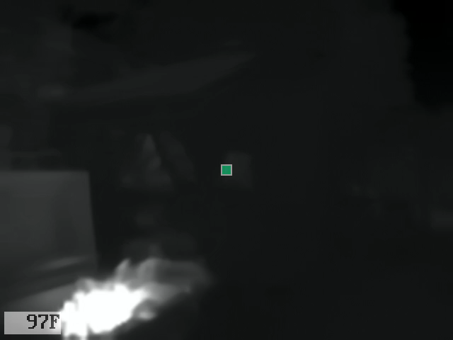

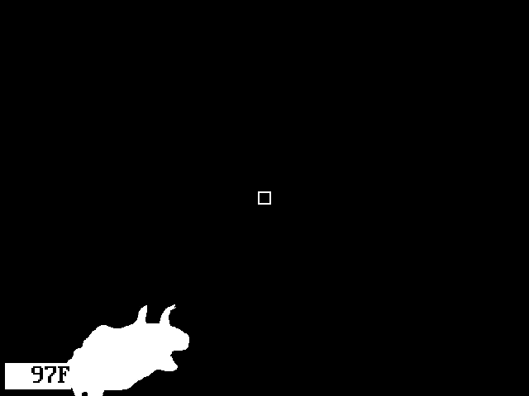

Fire Segmentation
Notes:
On the left is a video capture of a BBQ fire taken by a FLIR Duo R. On the right is the same fire binarized to fire and non-fire pixels. The Duo R saves both the visual camera and TIR video files to an SD card with every capture. I took the raw TIR video file and used MATLAB to test methodologies for binarizing fire and non-fire pixels. I found adaptive binarization methods such as Otsu segmentation to yield problematic results—if no fire was present in the FOV, the Otsu method would binarize whichever pixels were the hottest (e.g. sunlit grass vs shadowed ground). Thus, I found the most consistent method to be a hard set threshold where any pixel above ~390K is binarized to a fire pixel.

Slide 5
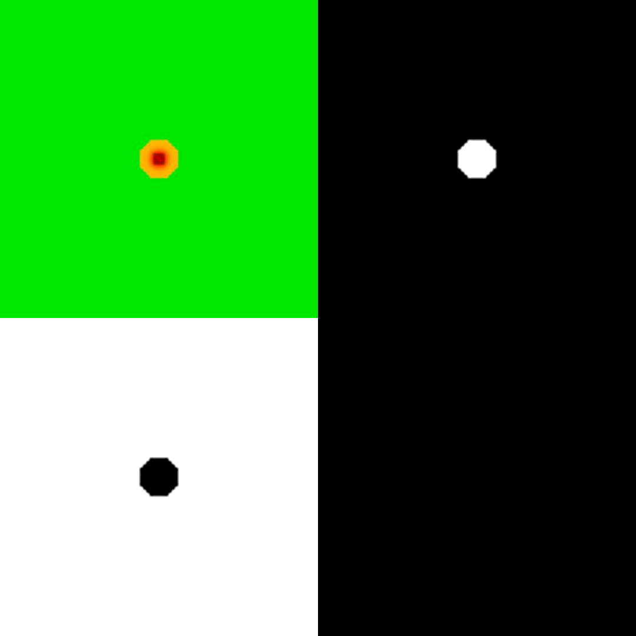
Wildfire Simulation Segmentation
Notes:
Here I demonstrate the binarization methodology on an RGB wildfire simulation. The top left image shows the dynamic wildfire simulation written by a summer intern. The top right shows the binarization of red pixels, the bottom left the binarization of green, and the bottom right the binarization of blue. This shows how fire binarization can be applied to visual spectrum imagery in the simplest case. In the red binarization, only the active fire pixels are binarized whereas the green lumps burning and burned pixels together. Because this is a simple wildfire visualization, there are no blue pixels to binarize. While we can simulate the evolution of a dynamic wildfire, the first steps in our fireline detection and tracking focuses on a static wildfire. Therefore, in our simulation visualization, a single time step instance of the wildfire is overlaid on the terrain, which I will show in the next slide.

Slide 6
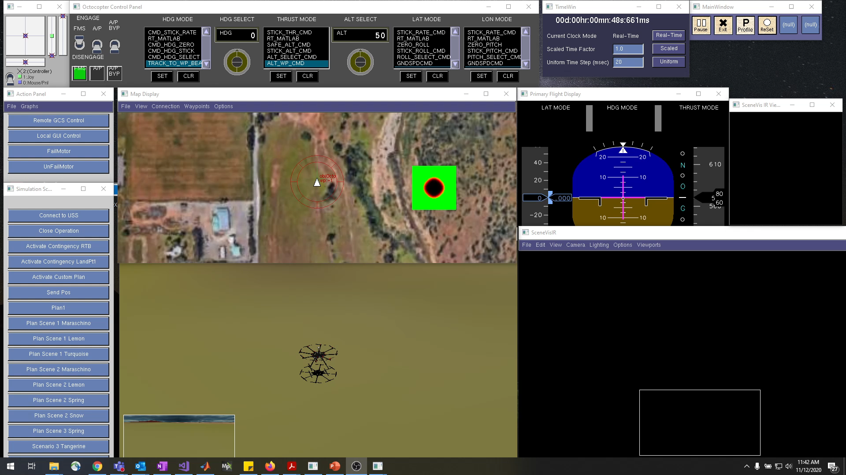
Reflection Simulation
Notes:
Here is the wildfire detection and tracking simulation environment in Reflection. In a real wildfire scenario, the wildfire’s exact location may not be known, so the static wildfire bitmap is overlaid in the Map Display for testing purposes. I start the simulation but selecting the flight plan and then starting the autopilot. The ScenVis environment in the bottom center is shown to give the operator awareness of the simulation environment and does not reflect what the operator may know on the field. The black SceneVIs window on the bottom right simulates the IR camera where only the hot emissivity of a fire would be visible. As the vehicle approaches the wildfire in the Map Display, you can see the wildfire in the viewport box in the IR SceneVis.
As of now, I am working on taking the IR viewport and rendering it as a texture for wildfire segmentation. Following that, I will implement a waypoint scheme to keep the fire boundary centered along the viewport FOV.

Slide 7


Questions?

