Slide 1



Changes in Leafy Green Crop Microbiomes Under Simulated Spaceflight Conditions
A Metagenomics and Transcriptomics Approach
Christina L. Khodadad, Mary E. Hummerick, Anirudha R. Dixit, Cory J. Spern, LaShelle E. Spencer, Aaron B. Curry, Jennifer L. Gooden, Jason A. Fischer – Amentum Services, Inc.
Jonilee A. Polanco, NASA Intern & U. of Alaska
Gretchen J. Maldonado Vazquez, SURA
Matthew W. Romeyn, Gioia D. Massa - NASA, UB

Slide 2
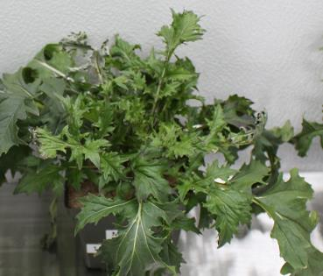
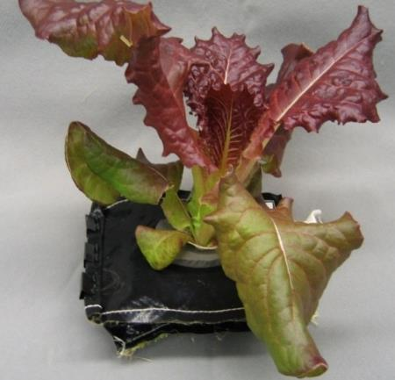
History
Bacterial microbiomes play important roles in plant growth systems
  Nutrient cycling and nutrient flow
  Carbon sequestration
  Protection and defense from plant pathogens
  Plant health, growth and productivity
Provide insight into community development
  Ground & flight differences
  Microgravity influences
  Seed sanitization
Requirements toward a healthy crop
  Safety
  Nutrition

Slide 3
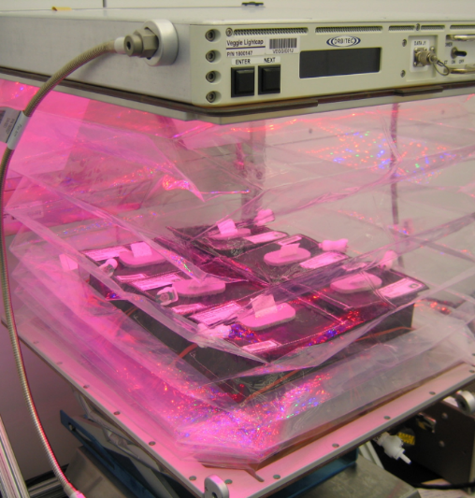
History
NASA has grown and harvested healthy vegetables on ISS
  Red romaine lettuce ‘Outredgeous’ first grown & consumed
Importance in methods used to grow fresh food
  Sterile, soilless substrate with added fertilizer
  Sanitized seeds
Plants and microorganisms may have symbiotic or pathogenic relationships
  Goal was to compare communities and functions

Slide 4
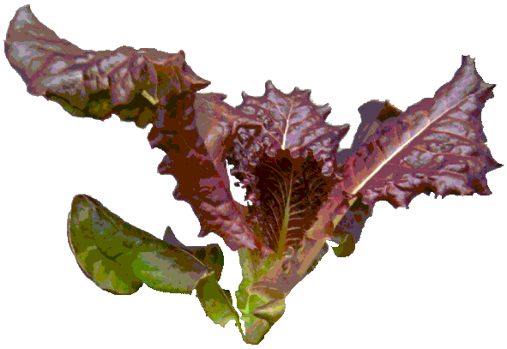
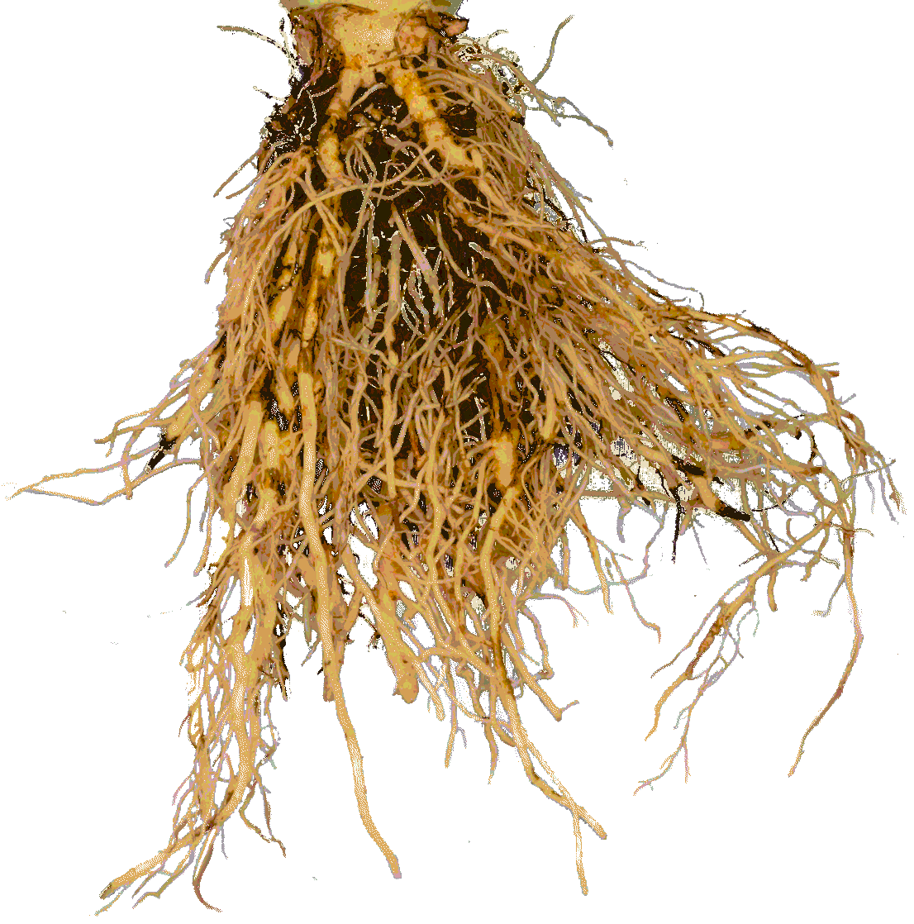
Goals
Compare the microbiome constituents of crops
  Grown under simulated spaceflight environmental conditions
  Grown from sanitized versus unsanitized seeds
  Grown over a time course
Compare functions of microbiomes of crops
  Grown under simulated spaceflight environmental conditions
  Grown from sanitized versus unsanitized seeds
  Grown over a time course
Phyllosphere
Rhizosphere

Slide 5
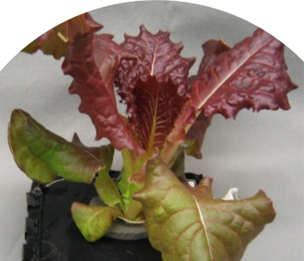
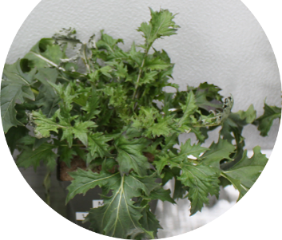
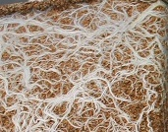

Experimental Design
Two leafy green crops grown from sanitized & unsanitized seeds
  Red romaine lettuce (Lactuca sativa cv ‘Outredgeous’)
  Mizuna mustard (Brassica rapa var japonica)
Mimic ISS growing conditions in Environmental Controlled Chamber
  Temperature 23 °C, 50% RH, CO₂ (3000 ppm)
  Substrate – Greens grade arcillite w/nutricote (7.5 g /L)
  Automatic watering system, DI water
Harvest Root and Leaf tissues from each crop
  Every 7 days to maturity for leafy greens (to 28 DAP)
DNA and RNA Isolation, Library Development, & Sequencing on Illumina MiSeq
16/8

Slide 6
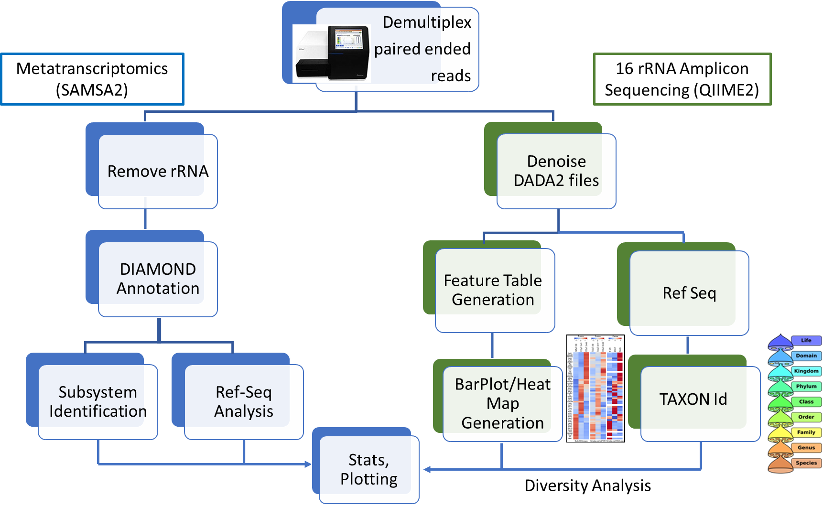
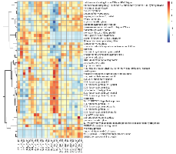
Sequencing Design Diagram-a two method approach

Slide 7
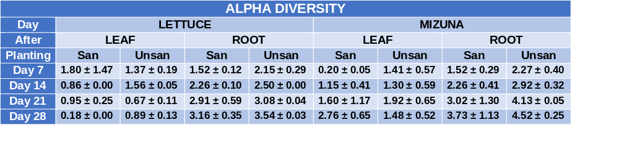
Alpha Diversity - 16S rRNA Lettuce & Mizuna
Alpha diversity higher in root tissue over leaf tissue
Increase in alpha diversity over time with exception of lettuce leaf tissue

Slide 8


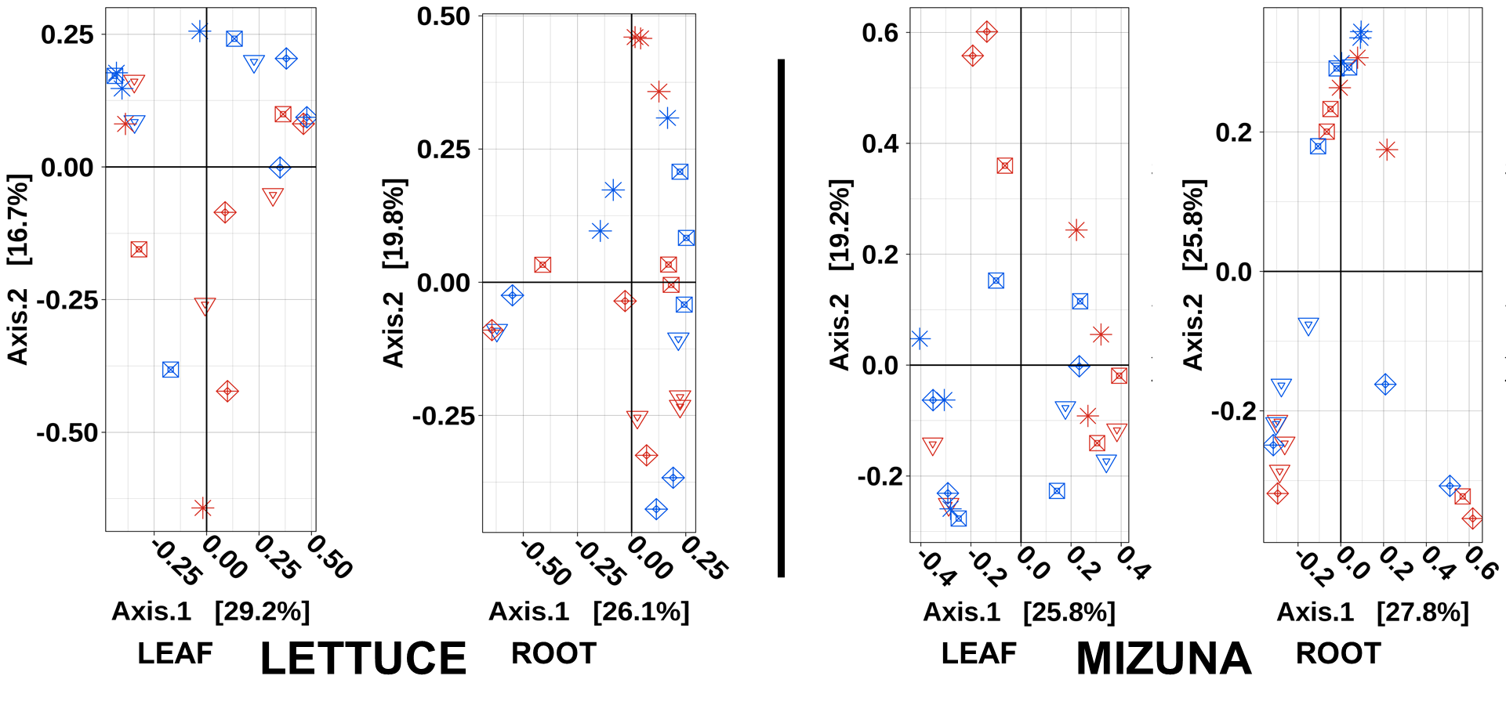
Beta Diversity – 16S rRNA

Slide 9
Abundance Comparison -16S rRNA LETTUCE
ROOT
LEAF

Slide 10
Abundance comparison - 16S rRNA Mizuna
ROOT
LEAF

Slide 11
Differential Abundance Lettuce Leaf P<0.05

Slide 12
Differential Abundance Lettuce Root P<0.05

Slide 13
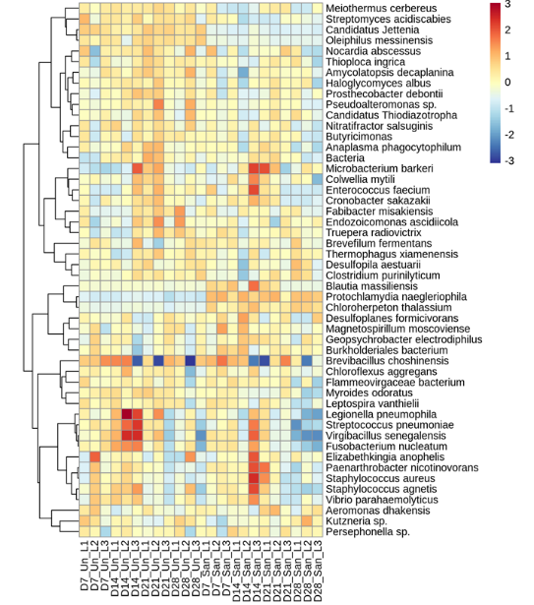
Differential Abundance Mizuna Leaf P<0.05

Slide 14

Differential Abundance Mizuna Root P<0.05

Slide 15
Conclusions
There is variation in alpha diversity with roots having higher diversity than leaf tissue
Beta diversity were more influenced by time rather than the sanitization of the seeds though less than 50% of the variation could be explained by a combination of time and seed treatments
There were similarities in the predominating microbes such as Ralstonia, Pseudomonas and Methylophilis per the 16S rRNA sequencing
Few differences in differentially expressed microbes or functional genes were identified between sanitized and unsanitized seeds.
Time played a more influential role in functional pathway differential abundance

Slide 16

QUESTIONS?
Many thanks to all of my coauthors, each played a major role in the progress of this research
Funded by Biological and Physical Sciences Division (BPS)

