Slide 1
GEOS-Carb III: Delivering mature carbon flux and concentration datasets in support of NASA's Carbon Monitoring System
Presented by Lesley Ott, NASA GSFC

Slide 2
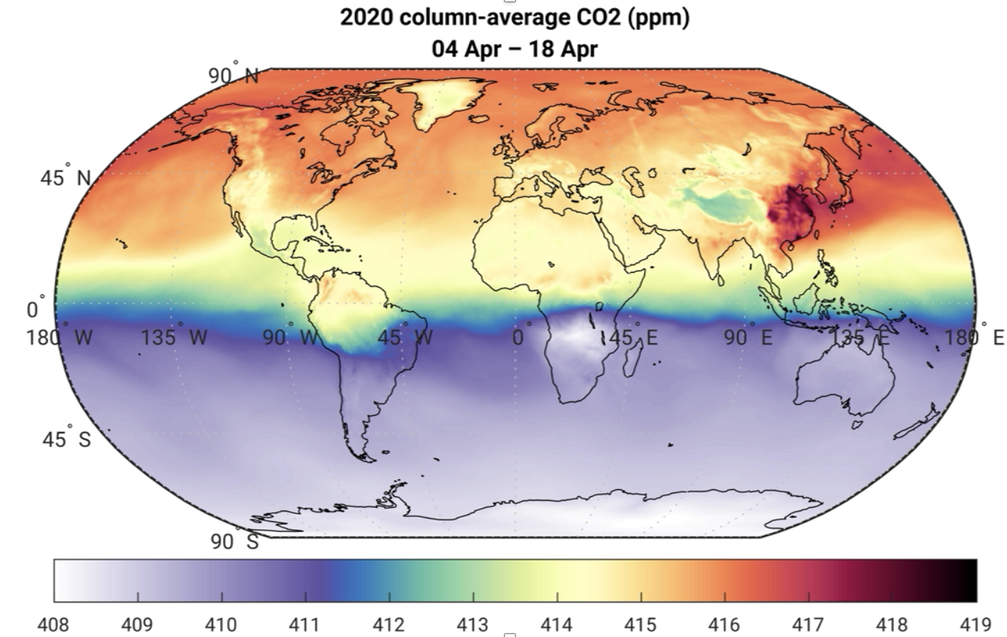
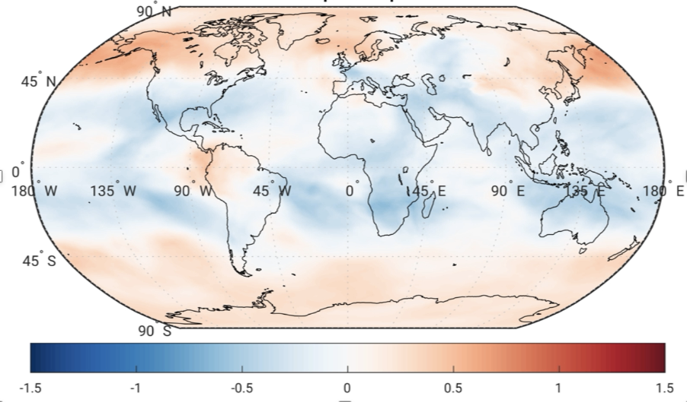
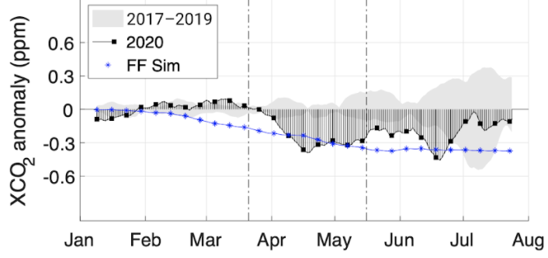
GEOS-Carb Assimilated XCO₂
Results: Analysis of assimilated OCO-2 fields show that reductions in human emissions associated with COVID-19 have a small (0.2-0.5 ppm) but discernible impact on CO₂ concentrations over the world’s largest economies. Decreases are generally consistent with low latency, country-level estimates based on activity data (right).
Synthesis: Working closely with Chatterjee-18 CMS synthesis project (GEOS-Carb PI Dr. Ott is a co-I) and CMS program efforts.
Stakeholders: Working closely with other projects to establish consistency of CMS flux products, engage with global stakeholders. Strong connections with a wide range of science stakeholders. Products currently support NASA and international COVID-19 dashboards.
Field season loss: None; COVID-19 Environmental Impacts: see above
Future directions: Work on COVID-19 demonstrates the importance of low latency land and ocean flux estimates. Also need for improved retrospective baseline for detecting change including more work on uncertainty estimates.
2020 Flux Anomaly – Apr. 9-23
Eval. of Independent Emissions
USA
Weir et al., 2020, submitted

