Slide 1
Middle Atmospheric Science
Observational Imperatives for the Future
Dr. Martin Mlynczak
NASA Langley Research Center
Hampton, Virginia, USA
Dr. Jia Yue
Catholic University/NASA Goddard Spaceflight Center
Greenbelt, Maryland, USA
COSPAR 2021 – Sydney, Australia

Slide 2
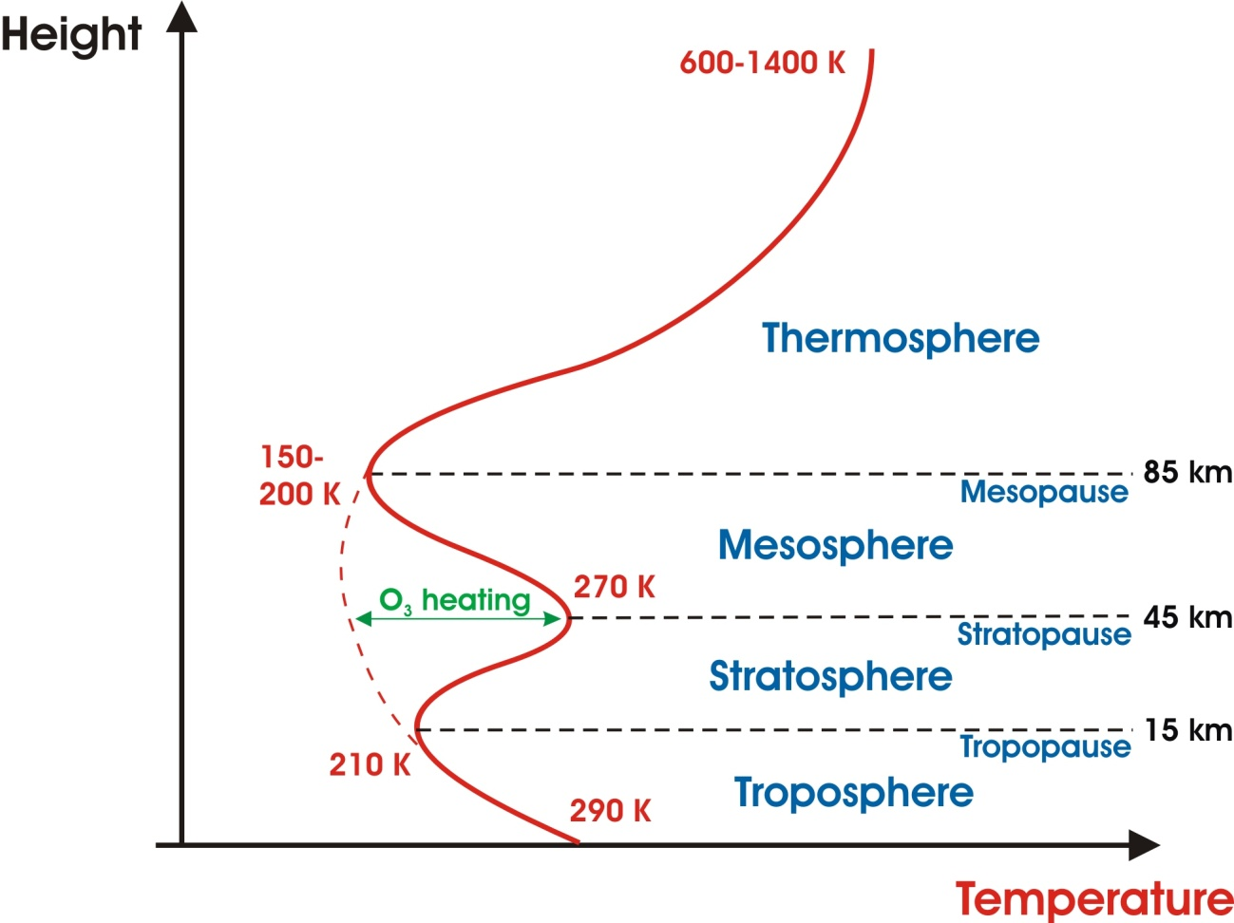
Earth’s Atmospheric Regions
1000 km
100 km
Earth’s Middle Atmosphere
15 km – 135 km

Slide 3
Satellite Observations of the Middle Atmosphere - Status
The past 40 years have been a ‘golden age’ of satellite observations of the middle atmosphere
Beginning with LIMS in 1978 and continuing today with the TIMED, Aura, and ICON missions, middle atmosphere observation from space has been an international endeavor
However, the missions now in orbit are well past their design lives by more than a decade!
Continuous observations exist from 2001 to the present day with some sensors
However, there are no new missions planned or in development
It is virtually certain that there will be a gap (possibly significant) in these crucial observations of our planet’s atmosphere
Climate change near the edge of space has important consequences for the space economy!

Slide 4
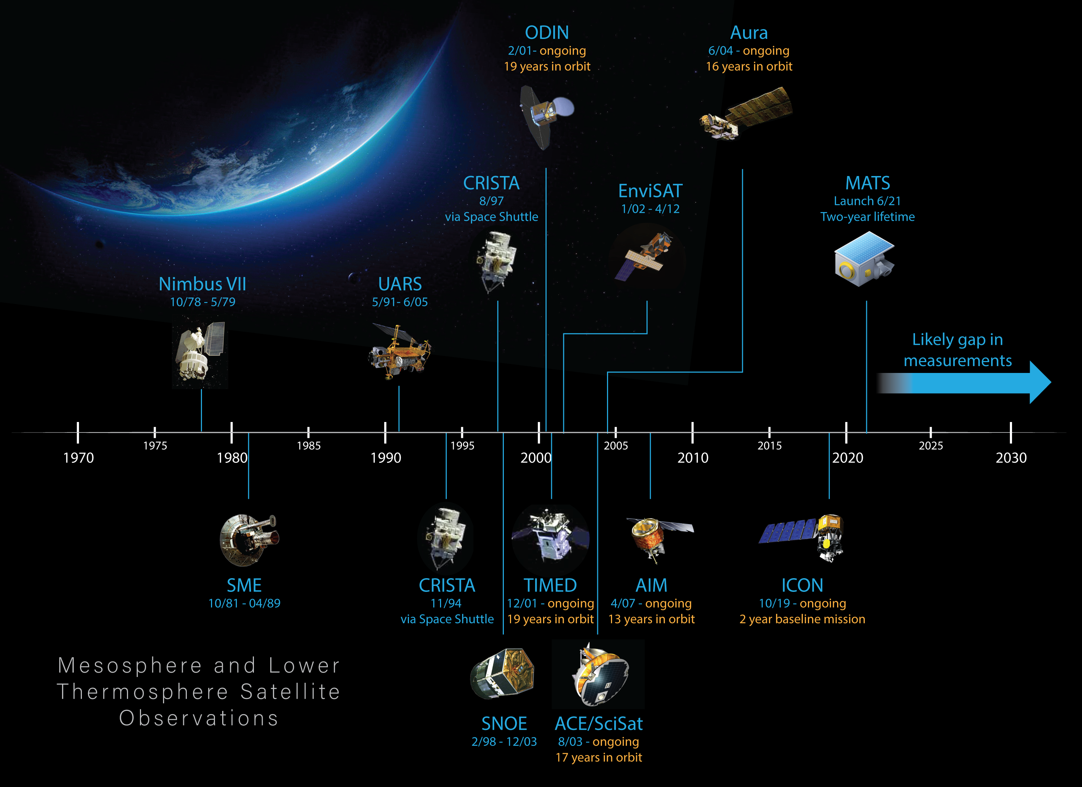

Slide 5
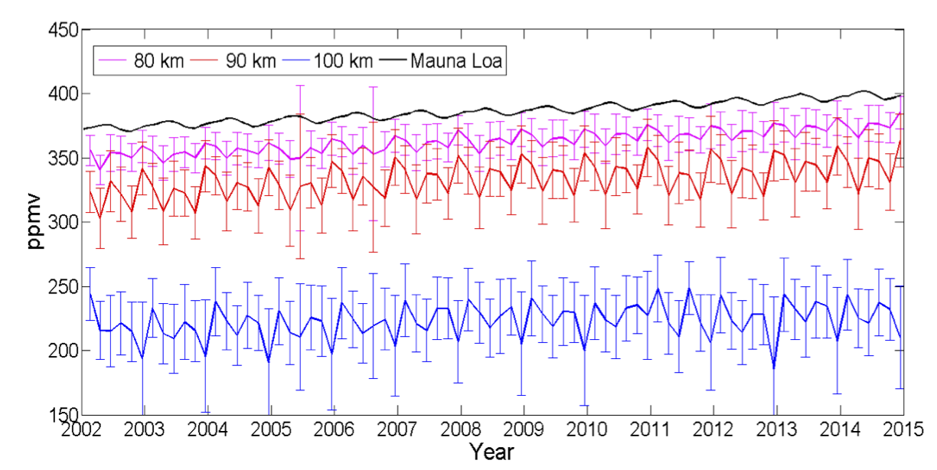
Carbon Dioxide in Earth’s Mesosphere and Lower Thermosphere
Mauna Loa (surface)
80 km
90 km
100 km
Yue et al., GRL, 2015
Measured by the SABER instrument on the TIMED Satellite, M/LT CO₂ trends
are consistent with those measured at Mauna Loa
CO₂ is increasing at the same rate throughout the atmosphere

Slide 6
Summary
There are now more than 40 years of satellite remote sensing data from the stratosphere, mesosphere, and lower thermosphere
Many key results have been discovered – most importantly, the clear evidence of long-term cooling and increasing trends of water vapor and carbon dioxide
A gap in observations is virtually certain in the next ~ 5 years
Critical need to develop new, lower cost, continuous observing capability
New observations, besides middle atmosphere science will enable
  Improved space weather forecasts
  Understanding of coupling between middle atmosphere and thermosphere
  Understanding of effects of long-term change on the middle atmosphere (ozone, water, temperature, etc.)
The effects of middle atmosphere change influence the atmosphere to the
edge of space (~ 1000 km high)

Slide 7
- end of presentation -

