Slide 1
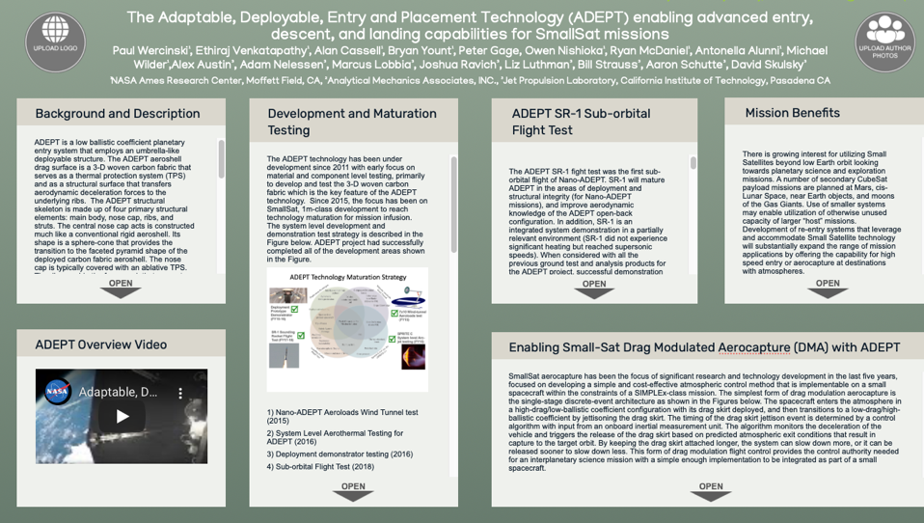
AGU Poster Layout

Slide 2
Background and Description
ADEPT is a low ballistic coefficient planetary entry system that employs an umbrella-like deployable structure. The ADEPT aeroshell drag surface is a 3-D woven carbon fabric that serves as a thermal protection system (TPS) and as a structural surface that transfers aerodynamic deceleration forces to the underlying ribs. The ADEPT structural skeleton is made up of four primary structural elements: main body, nose cap, ribs, and struts. The central nose cap acts is constructed much like a conventional rigid aeroshell. Its shape is a sphere-cone that provides the transition to the faceted pyramid shape of the deployed carbon fabric aeroshell. The nose cap is typically covered with an ablative TPS. The ribs provide the framework that supports the tensioned carbon fabric. The ribs are hinged at their attachment to the nose cap, and are supported via struts at a point along their span that minimizes overall bending. The struts that support the ribs are installed in pairs to carry the aerodynamic loads transmitted from the carbon fabric and ribs back to the main body lower ring. The pairing of struts also provides lateral stability, torsional stability, and improved folding of the ADEPT structure. The aerodynamic surface is formed by tensioning 3D-woven carbon fabric over the ribs of the structural skeleton. High-purity intermediate modulus carbon fiber yarn is used to create a membrane that serves as the structural surface and the thermal barrier. The high temperature capability of the carbon cloth allows it to operate at high temperatures seen during entry (~2000° C). Several of the top layers of the carbon fabric are allowed to oxidize and recede away during the entry heat pulse, but the construction of the 3D woven fabric allows the deployable aeroshell to maintain its structural integrity.

Slide 3
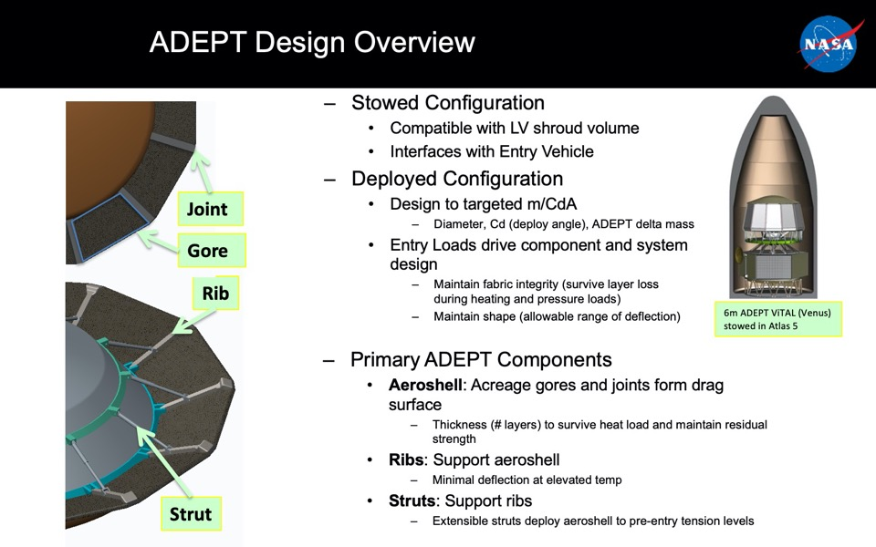

Slide 4
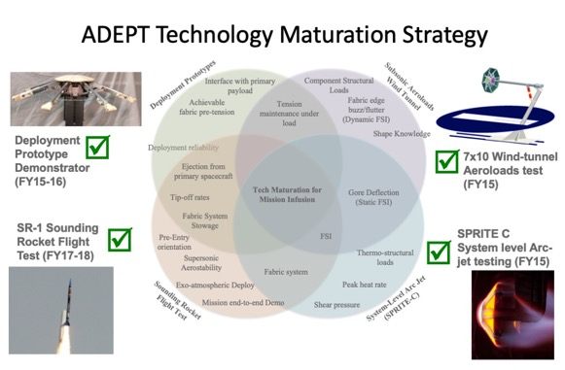
Development and Maturation Testing
The ADEPT technology has been under development since 2011 with early focus on material and component level testing, primarily to develop and test the 3-D woven carbon fabric which is the key feature of the ADEPT technology. Since 2015, the focus has been on SmallSat, 1m-class development to reach technology maturation for mission infusion. The system level development and demonstration test strategy is described in the Figure below. ADEPT project had successfully completed all of the development areas shown in the Figure.

Slide 5
Development and Maturation Testing cont.
1) Nano-ADEPT Aeroloads Wind Tunnel test (2015)
2) System Level Aerothermal Testing for ADEPT (2016)
3) Deployment demonstrator testing (2016)
4) Sub-orbital Flight Test (2018)
The Aeroloads wind tunnel test (2015) was one component of a broader strategy to advance the technology readiness level (TRL) of ADEPT to a maturity level of TRL5. The primary motivation for this wind tunnel test was the generation of deflected shape data as a function of key design parameters for ADEPT missions: aerodynamic load, angle of attack, and the amount of pre-tension put in the fabric prior to atmospheric entry. Testing was completed in May 2015. The test data results are being used to improve structural modeling tools used in the design of ADEPT for multiple mission architectures.
The ADEPT SPRITE-C arcjet test used 4 test articles that were approximately 35cm (14inches) in diameter and were exposed to heating rates and heat loads characteristic of a 1m class ADEPT design reference mission at Mars. Testing took place in September, 2015. Test design allowed for testing at or above the aeroheating environments predicted in flight for the nose TPS, joints (over the ribs), and acreage carbon fabric material. A number of key component features were explored in this test configuration including: rigid nose to carbon fabric transition, fabric joint to rib interface, and trailing edge close-out. The results of the SPRITE-C pathfinder test established the feasibility and thermostructural performance limits for the test article design that encompass the expected environments relevant for Human Mars exploration. The success of this system level aerothermal test methodology will enable more elaborate flight-like designs to be rapidly tested and qualified for aerothermal environments relevant to entries at Mars, Earth, Venus and Titan.
The Deployment Demonstrator testing took place in early 2016 to demonstrate a deployment mechanism for the ADEPT 0.7m configuration that is compatible with the UP Aerospace sounding rocket payload requirements. The testing also served to demonstrate that a spring-based deployment system can be used to adequately pre-tension the 4-layer carbon fabric aeroshell skirt for earth re-entry.

Slide 6
Development and Maturation Testing cont.
1) Nano-ADEPT Aeroloads Wind Tunnel test (2015)
2) System Level Aerothermal Testing for ADEPT (2016)
3) Deployment demonstrator testing (2016)
4) Sub-orbital Flight Test (2018)
The Aeroloads wind tunnel test (2015) was one component of a broader strategy to advance the technology readiness level (TRL) of ADEPT to a maturity level of TRL5. The primary motivation for this wind tunnel test was the generation of deflected shape data as a function of key design parameters for ADEPT missions: aerodynamic load, angle of attack, and the amount of pre-tension put in the fabric prior to atmospheric entry. Testing was completed in May 2015. The test data results are being used to improve structural modeling tools used in the design of ADEPT for multiple mission architectures.
The ADEPT SPRITE-C arcjet test used 4 test articles that were approximately 35cm (14inches) in diameter and were exposed to heating rates and heat loads characteristic of a 1m class ADEPT design reference mission at Mars. Testing took place in September, 2015. Test design allowed for testing at or above the aeroheating environments predicted in flight for the nose TPS, joints (over the ribs), and acreage carbon fabric material. A number of key component features were explored in this test configuration including: rigid nose to carbon fabric transition, fabric joint to rib interface, and trailing edge close-out. The results of the SPRITE-C pathfinder test established the feasibility and thermostructural performance limits for the test article design that encompass the expected environments relevant for Human Mars exploration. The success of this system level aerothermal test methodology will enable more elaborate flight-like designs to be rapidly tested and qualified for aerothermal environments relevant to entries at Mars, Earth, Venus and Titan.
The Deployment Demonstrator testing took place in early 2016 to demonstrate a deployment mechanism for the ADEPT 0.7m configuration that is compatible with the UP Aerospace sounding rocket payload requirements. The testing also served to demonstrate that a spring-based deployment system can be used to adequately pre-tension the 4-layer carbon fabric aeroshell skirt for earth re-entry.

Slide 7
Development and Maturation Testing cont.

Slide 8
ADEPT SR-1 Sub-orbital Flight Test
The ADEPT SR-1 fight test was the first sub-orbital flight of Nano-ADEPT. SR-1 will mature ADEPT in the areas of deployment and structural integrity (for Nano-ADEPT missions), and improve aerodynamic knowledge of the ADEPT open-back configuration. In addition, SR-1 is an integrated system demonstration in a partially relevant environment (SR-1 did not experience significant heating but reached supersonic speeds). When considered with all the previous ground test and analysis products for the ADEPT project, successful demonstration of the SR-1 flight test Key Performance Parameters (KPPs) will support a technology readiness level (TRL) claim of 5 for Nano-ADEPT at the system-level. The KPPs for the ADEPT SR-1 flight experiment are:
1) Exo-atmospheric deployment to the desired entry configuration.
2) Aerodynamic stability without active control of the 1m-class ADEPT deployed flight configuration.
As with any new technology requiring in-space deployment, demonstrating deployment in relevant environments significantly increases the reliability for the design. While ADEPT was only exposed to exo-atmospheric conditions for ~ 40 seconds prior to deployment, the test demonstrated design robustness to the launch environments and verified the deployment initiator timer circuit and rib-tip release functionality. Furthermore, achieving and maintaining the desired deployed shape was critical to the aerodynamic performance. On-board full deployment indicator switch and a video camera were used to confirm KPP-1.
The altitude of apogee determines the total potential energy of the entry vehicle and is correlated to a maximum Mach number experienced during descent. A higher apogee means higher entry velocity and thus higher maximum Mach number. It was a goal to observe the entry vehicle flight dynamics during deceleration from at least Mach 2.8 through Mach 0.8. Mach 2.8 was chosen because flight data from Mars Pathfinder, a 70º sphere-cone with a conical aft body, showed unbounded angle of attack amplitude growth at Mach 2.5 prior to supersonic parachute deployment. The 70° cone angle helps achieve a low ballistic coefficient but has less stability margin than lower cone angle entry configurations. We sought to confirm that ADEPT SR-1 angle of attack oscillations should remain neutrally stable or damped by virtue of its open-back shape and center of gravity location. The open-back configuration was expected to provide some stability benefit over a closed-back design.
A summary of the SR-1 Flight Experiment Success Criteria is listed below:
ADEPT SR-1 Success Criteria (A-F) Assessment
A. ADEPT separates from the sounding rocket prior to apogee
- Pass, confirmed by three independent data sources- AVA IMU, NGIMU, GoPro
B. ADEPT does not re-contact any part of the launch vehicle after separation
- Pass, no evidence of re-contact based upon on-board IMUs and video data provided by LV provider
C. ADEPT reaches an apogee greater than 100 km
- Pass, confirmed by radar tracking and post flight reconstruction
D. ADEPT achieves fully deployed and locked configuration prior to reaching 80 km altitude on descent
- Pass, evidence from GoPro video and LED deployment indicator
E. Obtain video (on-board data recovery after ground impact) of deployed ADEPT to observe fabric response during entry
- Pass, GoPro video was obtained from approximately t=130 to t=501 seconds
F. Obtain data necessary to reconstruct ADEPT 6-DOF descent trajectory between 90 km and 30 km to required accuracy below with 95% confidence from Mach 3.0 while decelerating to ground impact.
a. Mach number: 0.1
b. Total angle of attack: 2 deg (if not tumbling)
c. Axial force coefficient: larger of 5% or 0.005 (if not tumbling)
- Incomplete, ADEPT will be able to reconstruct the descent trajectory, but indications are that the desired level of accuracy will not be met due to the lack of GPS data.

Slide 9
ADEPT SR-1 Sub-orbital Flight Test cont.
A summary of the SR-1 Flight Experiment Success Criteria is listed below:
ADEPT SR-1 Success Criteria (A-F) Assessment
A. ADEPT separates from the sounding rocket prior to apogee
- Pass, confirmed by three independent data sources- AVA IMU, NGIMU, GoPro
B. ADEPT does not re-contact any part of the launch vehicle after separation
- Pass, no evidence of re-contact based upon on-board IMUs and video data provided by LV provider
C. ADEPT reaches an apogee greater than 100 km
- Pass, confirmed by radar tracking and post flight reconstruction
D. ADEPT achieves fully deployed and locked configuration prior to reaching 80 km altitude on descent
- Pass, evidence from GoPro video and LED deployment indicator
E. Obtain video (on-board data recovery after ground impact) of deployed ADEPT to observe fabric response during entry
- Pass, GoPro video was obtained from approximately t=130 to t=501 seconds
F. Obtain data necessary to reconstruct ADEPT 6-DOF descent trajectory between 90 km and 30 km to required accuracy below with 95% confidence from Mach 3.0 while decelerating to ground impact.
  a. Mach number: 0.1
  b. Total angle of attack: 2 deg (if not tumbling)
  c. Axial force coefficient: larger of 5% or 0.005 (if not tumbling)
- Incomplete, ADEPT will be able to reconstruct the descent trajectory, but indications are that the desired level of accuracy will not be met due to the lack of GPS data.

Slide 10
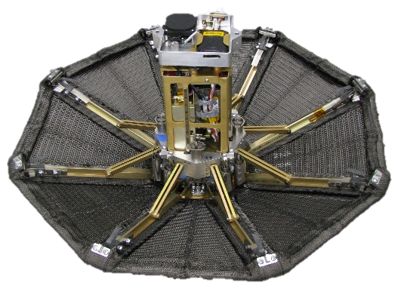
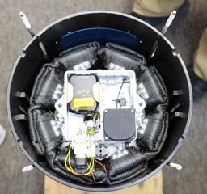
ADEPT SR-1 Sub-orbital Flight Test cont.
Rib tip to Rib tip diameter- 0.70 m
Half cone angle (ribs)- 70 deg
Mass- 11.0 kg (24.3 lb)
β ~ 20 kg/m²
Xcg/D= 0.15
Aft Deck & Late Access Connectors
Instrumentation | Data/Function
AVA | Accelerometers, Rate Gyros, Magnetometer, GPS Tracking
NGIMU | Accelerometers, Rate Gyros, IMU Board Temp Sensors
LED Indicator Board | System Health Indicator Status
GoPro Video | 1080p, 60 fps video
C-Band Transponder | WSMR Radar Tracking
SPOT Trace | GPS Recovery Tracker
Separation Sensors | Power-on signal for deployment timer, C-Band & GoPro
Deployment Switch | Indicates full deployment
Rails
Rib Release Deck
Push-off Springs
Electrical Power System
Moving Ring
First-Stage Springs
Struts
Rib
Tips
SR-1 Stowed in LV
Stowed Diameter 0.24 m
Ribs
Four-Layer 3D Woven Carbon Fabric
Retention Cord Loops
Second-Stage Springs
DeploymentLatches
Impact Attenuation Foam
10

Slide 11
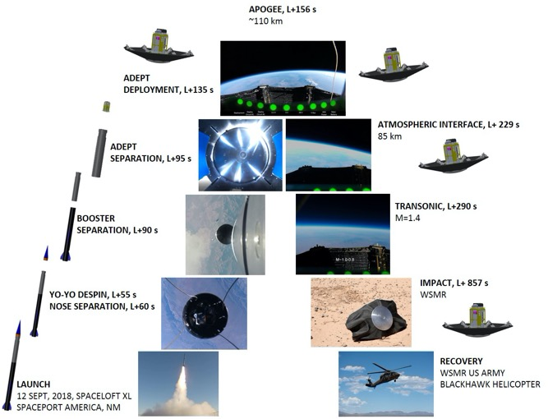
ADEPT SR-1 Sub-orbital Flight Test cont.

Slide 12
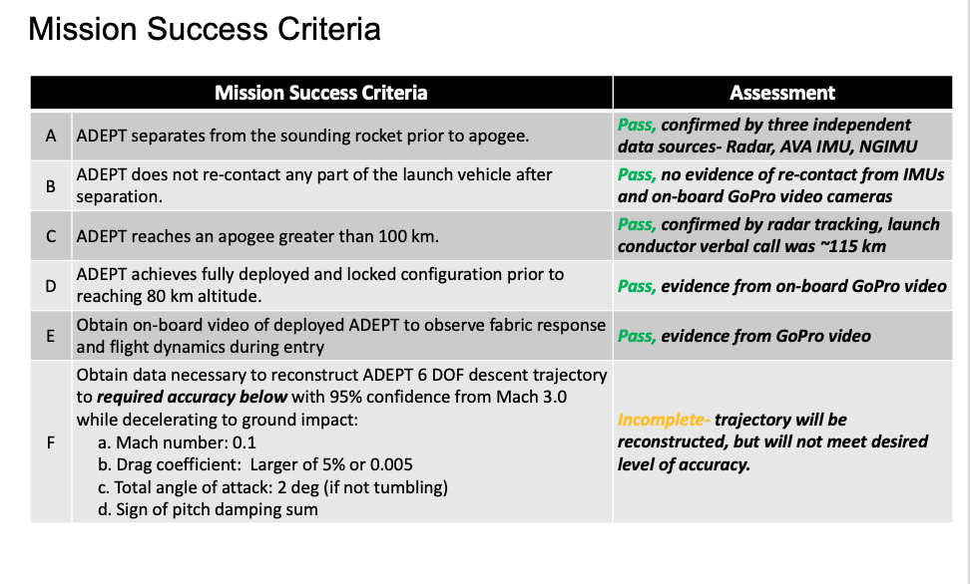
ADEPT SR-1 Sub-orbital Flight Test cont.

Slide 13
Mission Benefits
There is growing interest for utilizing Small Satellites beyond low Earth orbit looking towards planetary science and exploration missions. A number of secondary CubeSat payload missions are planned at Mars, cis-Lunar Space, near Earth objects, and moons of the Gas Giants. Use of smaller systems may enable utilization of otherwise unused capacity of larger “host” missions. Development of re-entry systems that leverage and accommodate Small Satellite technology will substantially expand the range of mission applications by offering the capability for high speed entry or aerocapture at destinations with atmospheres.
The ADEPT hypersonic deployable decelerator offers benefits over traditional rigid aeroshells including volume, mass and payload form factor. The Adaptive Deployable Entry and Placement Technology (ADEPT) offers such a delivery capability for Small Sat or CubeSat orbiter(s), in-situ elements, or landers. The ADEPT system can package with off the shelf CubeSat deployment systems (1U-16U) to offer a delivery capability for a single CubeSat or constellations. Furthermore, ADEPT can deliver the same science payload to a destination with a stowed diameter a factor of 3-4 times smaller than an equivalent rigid aeroshell, alleviating volumetric constraints on the secondary payload accommodation or primary carrier spacecraft bus. The Figure below shows the stowable volume savings of 3x-4x over a rigid heatshield entry vehicle carrying the same payload. The ADEPT architecture has been studied over a wide range of scales and for various planetary destinations.

Slide 14
Mission Benefits cont.

Slide 15
Enabling Small-Sat Drag Modulated Aerocapture (DMA) with ADEPT
SmallSat aerocapture has been the focus of significant research and technology development in the last five years, focused on developing a simple and cost-effective atmospheric control method that is implementable on a small spacecraft within the constraints of a SIMPLEx-class mission. The simplest form of drag modulation aerocapture is the single-stage discrete-event architecture as shown in the Figures below. The spacecraft enters the atmosphere in a high-drag/low-ballistic coefficient configuration with its drag skirt deployed, and then transitions to a low-drag/high-ballistic coefficient by jettisoning the drag skirt. The timing of the drag skirt jettison event is determined by a control algorithm with input from an onboard inertial measurement unit. The algorithm monitors the deceleration of the vehicle and triggers the release of the drag skirt based on predicted atmospheric exit conditions that result in capture to the target orbit. By keeping the drag skirt attached longer, the system can slow down more, or it can be released sooner to slow down less. This form of drag modulation flight control provides the control authority needed for an interplanetary science mission with a simple enough implementation to be integrated as part of a small spacecraft.
The deployable drag skirt technology is the Adaptable, Deployable Entry and Placement Technology (ADEPT). ADEPT employs an umbrella-like deployable structure with a “skin” that is a 3-D woven carbon fabric to serve as a thermal protection system (TPS) and as a structural surface that transfers aerodynamic deceleration forces to the underlying ribs. The ADEPT structure is folded during launch and then deployed prior to atmospheric entry, enabling the entire flight system to be packaged into an ESPA compatible volume which meets SIMPLEx launch and configuration constraints. The ADEPT system is uniquely capable as it can tolerate the high heating environment at Venus. ADEPT benefits from significant recent development, culminating in a successful suborbital flight test which demonstrated key aspects of the technology, including the ability to deploy in space and withstand aerodynamic loading during reentry. This has given a comprehensive understanding of the aerocapture flight system and requirements, with the next step to prepare for technology demonstration and mission infusion to enable small satellite orbiter missions across the solar system.
Ref: Austin, A. et al., “SmallSat Aerocapture: Breaking the Rocket Equation to Enable a New Class of Planetary Missions”, 70th International Astronautical Congress, 21-25 October 2019.

Slide 16
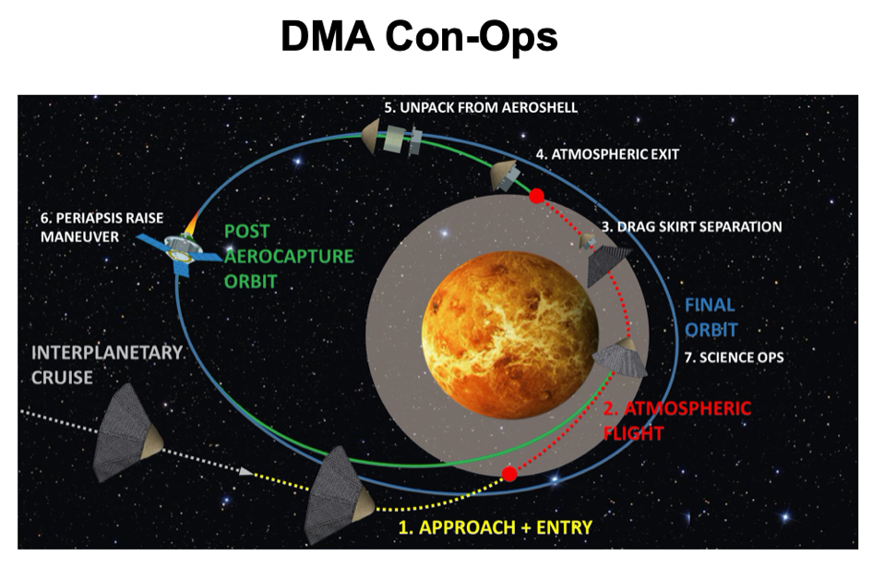

Slide 17
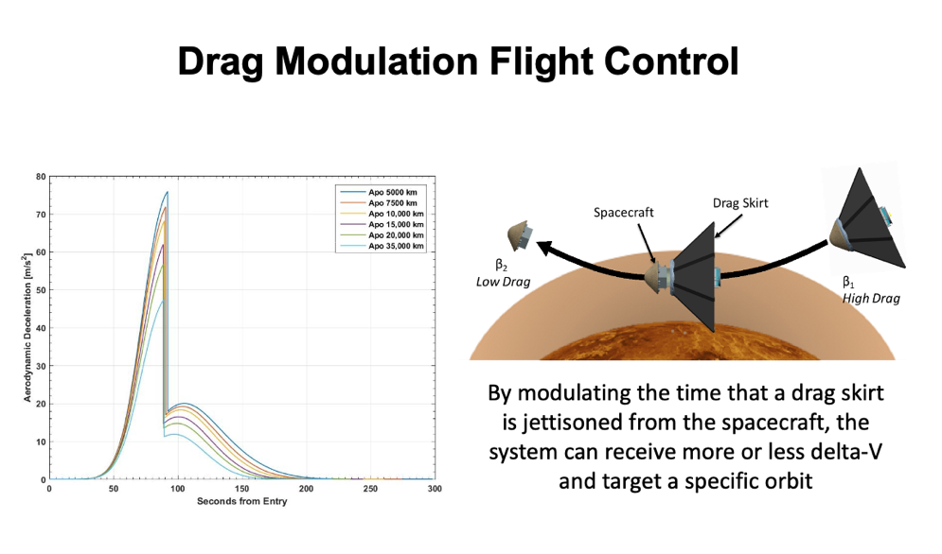

Slide 18
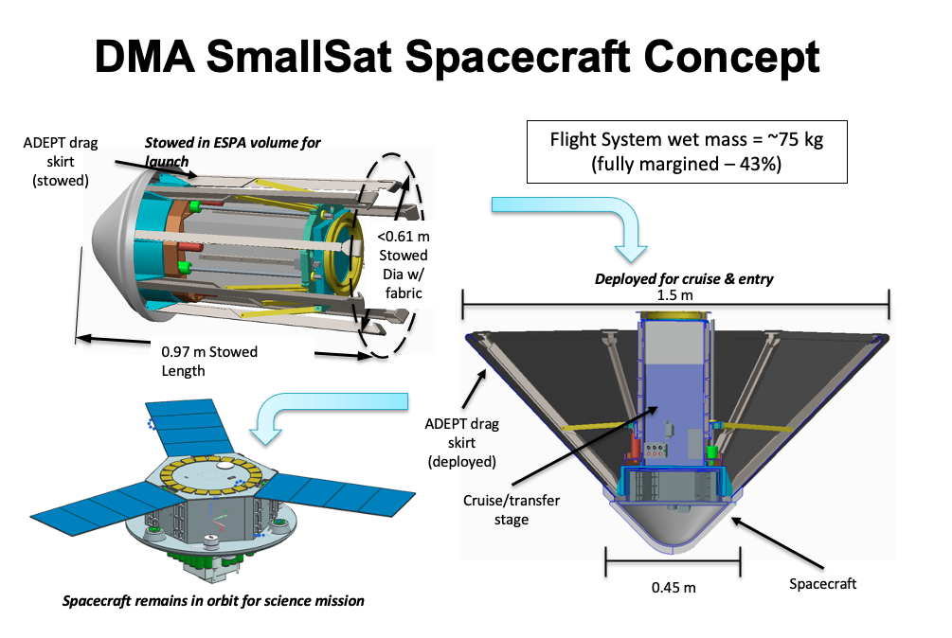

Slide 19
ADEPT Overview Video
https://www.youtube.com/watch?v=fYVNd06A_T8&feature=emb_title

