Slide 1
Configurable Model I/O through
ExtData and History Gridded Components
Tom Clune, 610.1
Ben Auer, 610.1/SSAI
Atanas Trayanov, 610.1/SSAI
Weiyuan Jiang, 610.1/SSAI
William Jamieson, 610.1/SSAI

Slide 2
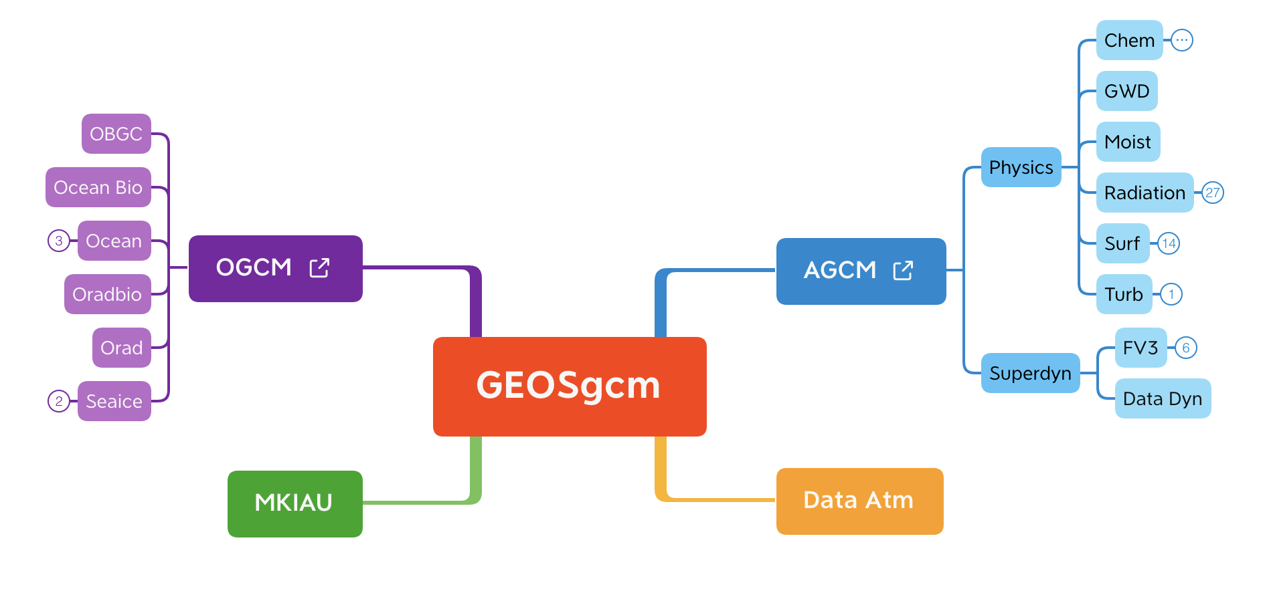
What is MAPL
MAPL: a usability layer on top of ESMF to simplify the creation and use of ESMF gridded components in a hierarchical architecture
  Easy specification of import, export, and internal states
  Easy addition of child components
  Default implementation for checkpoint/restart.
  Framework standard gridded components:
    History – run time configurable output
    ExtData - configurable input – imports of last resort
    Cap – drives hierarchy; manages History+ExtData
  Wrap user-specified ESMF entry points to
    Manage instantiation of fields, esp. field connections
    Profile (time and memory)
    Insert couplers (when needed)
  Enforce conventions
Similar motivations have led to NUOPC but unfortunately the details diverged.

Slide 3
NUOPC vs MAPL
NUOPC
MAPL
MAPL Cap
AGCM
OGCM
ExtData
GCM
History
Mediator
AGCM
OGCM
MAPL Generic Services

Slide 4
ExtData
Attempts to satisfy any unresolved imports at the Cap level
Configuration file -- one-line per quantity (see next slide)
Automatically maintains time bracket containing current model time
Source ESMF grid is automatically* determined from file metadata
  Currently supported grids: LatLon, CubedSphere, and ???
Data are read into an ESMF Field
Data then regridded to the grid of the unresolved import
  ESMF RouteHandle is automatically constructed
  Supports regridding of tangent vectors (U; V)
  Can skip regridding for identical grids
*Only knows about some grid type; but is extensible.

Slide 5
1 2 3 4 5 6 7 8 9 10
U ‘m/s’ N N 0 none none U winds_%y4%m2%d2_%h2z.nc4
BIOMASS 'kg m-2 s-1’ N Y %y4-%m2-%d2t00:00:00 none 0.25 biomass biomass_file _%y4%m2%d2.nc4
BIOCLIMS 'kg m-2 s-1’ 2005 Y 0 none 0.25 biomass biomass_file _%y4%m2%d2.nc4
DUST_SRC NA N Y - none none du_src gocart.dust_source.v5a.x1152_y721.nc
Import name – name of field delivered to ExtData this rules applies to
Units – unused entry
Climatology – treat as a climatology. Can also use single year of a mutli-year dataset (N, Y, year)
Regridding – regridding method to use available options bilinear (N), conservative(Y), voting (V)
Refresh template – update frequency: once, every timestep, interval, or relative to the last eval.
Offset – offset applied to field (for example 2.0) or none
Scaling – scaling applied to field (for example 2.0) or none
File variable – name of the variable in the file to use
File template – grads style file template or /dev/null:constant to set the field to a constant
File reference time/frequency YYYY-MM-DDThh:mm:ssPYYYY-MM-DDThh:mm:ss
  Needed if this cannot be “guessed” from the file template. If not provided frequency assumed to be rightmost token, relative to initial clock time.

Slide 6
History
Can output any Field from the export state of any component in the hierarchy
Output files are grouped into “collections”
  List of quantities
  Output grid
  Output frequency, averaging, …
Also supports
  Time averaging
  Vector regridding

Slide 7
VERSION: 1
EXPID: TEST_split4d
EXPDSC: TEST_split4d
EXPSRC: GEOSgcm-v10.12.3
COLLECTIONS: 'geosgcm_prog'
::
GRID_LABELS: PC48x25-DC
::
PC48x25-DC.GRID_TYPE: LatLon
PC48x25-DC.IM_WORLD: 48
PC48x25-DC.JM_WORLD: 25
PC48x25-DC.POLE: PC
PC48x25-DC.DATELINE: DC
PC48x25-DC.LM: 72
geosgcm_prog.template: '%y4%m2%d2_%h2%n2z.nc4',
geosgcm_prog.archive: '%c/Y%y4',
geosgcm_prog.format: 'CFIO',
geosgcm_prog.frequency: 060000,
geosgcm_prog.grid_label: PC48x25-DC
geosgcm_prog.vscale: 100.0,
geosgcm_prog.vunit: 'hPa',
geosgcm_prog.vvars: 'log(PLE)', 'DYN',
geosgcm_prog.levels: 1000 975 950 925 900 875 850 825 800
775 750 725 700 650 600 550 500 450
400 350 300 250 200 150 100 70 50
40 30 20 10 7 5 4 3 2
1 0.7 0.5 0.4 0.3 0.2 0.1 0.07 0.05
0.04 0.03 0.02,
geosgcm_prog.fields: 'PHIS' , 'AGCM' ,
'U;V' , 'DYN' ,
'T' , 'DYN' ,
'PS' , 'DYN' ,
'Q' , 'MOIST' , 'QV' ,
::

Slide 8
Client-Server File I/O
Disk access for History and ExtData is through an asynchronous client server
  Extensible set of file formats, but only NetCDF4 currently implemented.
Server layer can run on application PETs or on a separate partition of MPI processes
  ESMF not used except for splitting the VM
ExtData manages a single Client
  Corresponding Server runs on same set of processes as the application
History manages a list of clients
  Workaround for BIG-small-BIG-small pattern in real configurations
  New Server subclass being developed that we hope will allow a single client

Slide 9
Future Plans
Refactor ExtData and History
  Considerable progress has been made on ExtData
Convert to YAML configuration files
Become NUOPC compliant
  Major redesign of MAPL underway
Replace I/O server mechanism with NUOPC concurrent execution (PI Rocky Dunlap)

Slide 10
Questions

