Slide 1

EVAA RTA Research Update
Expandable Variable Autonomy Architecture (EVAA)
& HQ-90 Reference Implementation
Mark Skoog
Principal Investigator for Autonomy
NASA / Armstrong Flight Research Center

Slide 2
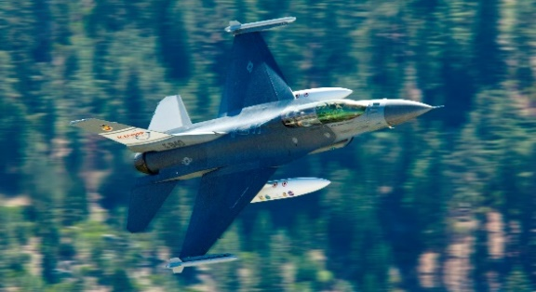

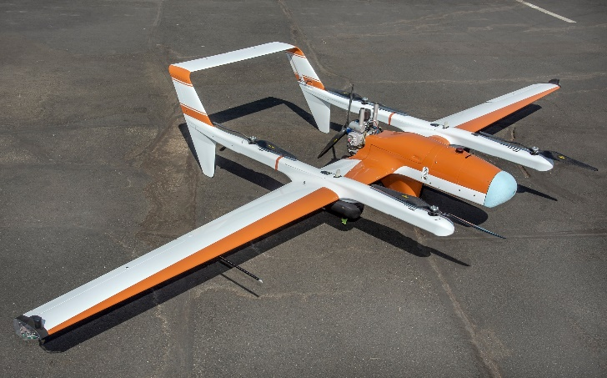
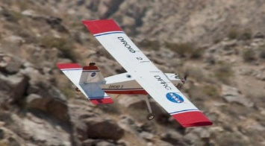
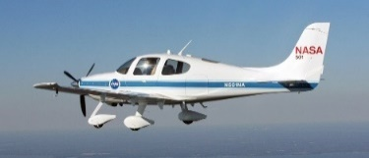
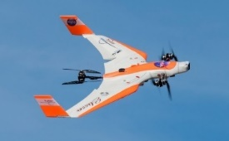

Resilient Autonomy
Technology & Airworthiness Development & Transition
Performance Based Certification
NASA
UAM
F-16 Auto GCAS & ACAS
ASTM International
Resilient Autonomy
AvSP
1st Industry Standard
Joint Capability Technology Demonstration
Industry
UTM & SASO
Autonomy
Safety
Standards
Drone Package Delivery
USAF
F-16 & F-35
USAF
Future Attack UAS
DoD
Army
Future Vertical-Lift & UAS
2018 Collier
Reference Implementation Development
Notes:
Resilient Autonomy research has two primary thrusts:
Performance Based Certification
Reference Implementation Development
Performance based certification is focused on the aggregate safety of the system as opposed to the more common prescriptive certification which looks at each individual component for safety. Performance base certification is a relatively new approach to certification being used for Part 23 aircraft. Resilient Autonomy is expanding on its former standards development with the FAA and ASTM International that culminated in the publishing of the first industry standard for safely bounding complex behavior in UAVs. This standard is based on a software architecture that leverages run-time assurance (RTA). This work is being done through a tight collaboration with the FAA.
A reference implementation of the software architecture is being developed that highly leverages RTA. This architecture is being integrated onto a UAV and evaluated for airworthiness as a means of validating the use of RTA as a means of compliance to the above certification approach being developed. This reference implementation leverages decades of work that went into the development of the F-16 automatic ground collision avoidance system (Auto GCAS).

Slide 3
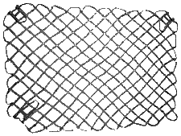
The Challenge of Autonomy
Complex or Untrusted
System
Verification & Certification of a Complex System
A Possible Solution – Run-Time Assurance (RTA)
Deterministic
Safety Net
Notes:
Certification of autonomy is considered very challenging, if not impossible, using conventional methods such as DO-178. The problem being with such a complex system, you can’t guarantee that the system can’t get to a state from which there are possible bad outcomes.
Our project posed the question,
“What if you could stretch a safety net across just the bad outcomes? And, you only certified that safety net, not trying to certify the complex system? That safety net could be made less complex (or more deterministic) and thus much easier to certify.”
This concept is part of an approach called run-time assurance or RTA.

Slide 4
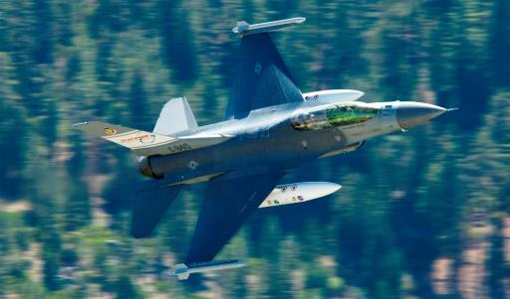
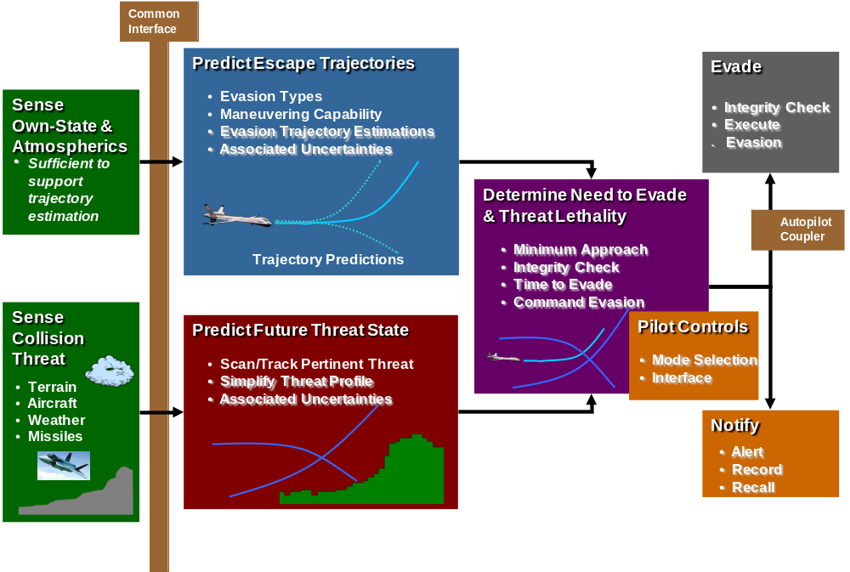

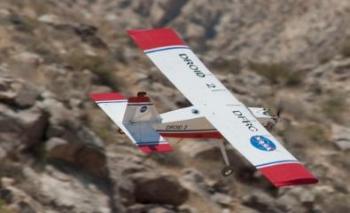

Ground Collision Avoidance System
(GCAS)
Notes:
Auto GCAS basically stretches this safety net across the ground, preventing the aircraft from crossing to the bad outcome of ground impact. Our previous research has shown that one basic architecture can be easily adapted to a wide variety of aircraft.

Slide 5


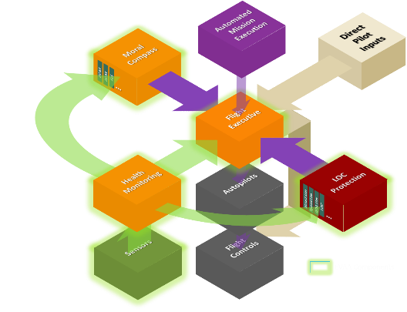
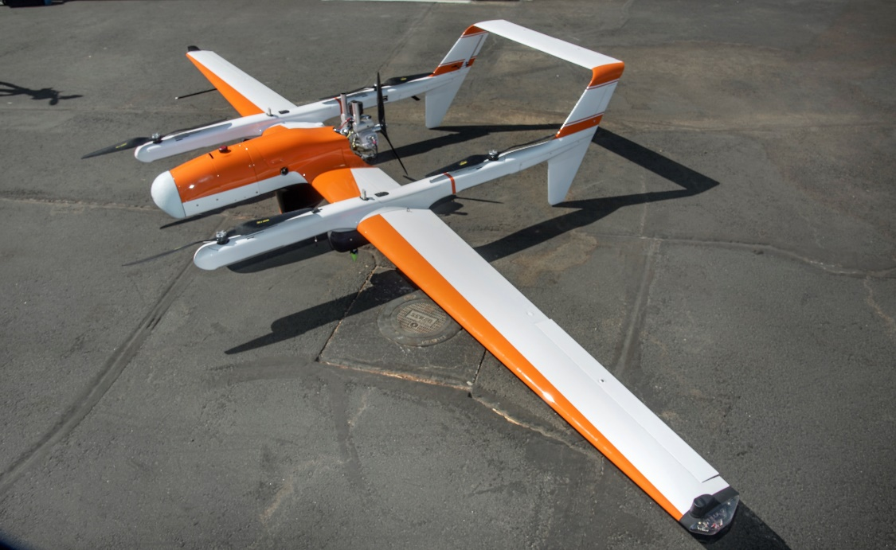

Multi-Monitor RTA (MM-RTA) with Risk-Based Decision Making
EVAA
Expandable Variable-Autonomy Architecture
Notes:
What if you developed a software framework of multiple safety nets, each protecting the aircraft from the various hazards it may encounter in flight? In the RTA vernacular these safety nets are called monitors.. Although not previously considered in RTA research, this sort of framework would contain multiple monitors, each focused on a separate category of flight hazard.
Our reference implementation is a multi-monitor RTA (MM-RTA) framework and the monitor control/switching is controlled with risk-based decision making. We call this reference implementation of an MM-RTA, the expandable variable-autonomy architecture or EVAA (pronounced Eva) for short.

Slide 6
Traditional RTA Framework
https://www.astm.org/Standards/F3269.htm
This illustration represents what is in the published industry standard
Publish Oct 2017
Safety Monitor
RTA Input Manager
RTA
Switch
Sensors
Untrusted System
Sensors
Vehicle Management System
Sensors
Sensors
Legend
RTA Trusted Functions
Untrusted Controllers
Recovery
Controllers
Baseline Aircraft
Recovery
Controllers
Recovery
Controllers
Sensors
Notes:
Shown is the RTA framework covered in the ASTM standard. The orange boxes are the certified safety net wrapping around the untrusted or complex system. The switch is controlled by the monitor. Under normal circumstances, the untrusted system is allowed to send commands to the flight controls of the aircraft. If the monitor determines that the boundary is about to breeched, control is switched from the untrusted system and gives it to a trusted controller. When breech of the boundary is no longer imminent, control is returned to the untrusted controller.
For Auto GCAS, the pilot is the untrusted system and Auto GCAS is the monitor, evaluating if the aircraft is in imminent breech of the safety boundary (hitting the ground).

Slide 7
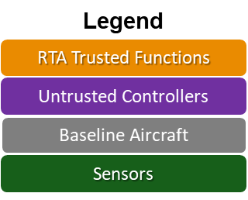
Multi-Monitor RTA (MM-RTA) Framework
One monitor to protect against all hazards is similarly a complex system
We partition the monitors into separate functions & govern their selection through a risk-based switch (the Moral Compass)
Safety/Behavioral
Monitor
Safety/Behavioral
Monitor
Safety/Behavioral
Monitor
EVAA Phase 1 : 2017
Maneuver Request
Consequence
Moral Compass
RTA Integrity Manager
RTA
Switch
Sensors
Untrusted System
Recovery Controller
Autopilot
Sensors
Vehicle Management System
Sensors
Sensors
Notes:
Shown is the RTA framework covered in the ASTM standard. The orange boxes are the certified safety net wrapping around the untrusted or complex system. The switch is controlled by the monitor. Under normal circumstances, the untrusted system is allowed to send commands to the flight controls of the aircraft. If the monitor determines that the boundary is about to breeched, control is switched from the untrusted system and gives it to a trusted controller. When breech of the boundary is no longer imminent, control is returned to the untrusted controller.
For Auto GCAS, the pilot is the untrusted system and Auto GCAS is the monitor, evaluating if the aircraft is in imminent breech of the safety boundary (hitting the ground).

Slide 8
EVAA Phase 2 : Current Work
Expandable Variable-Autonomy Architecture
RTA Network
EVAA Phase 2 : 2020-21
Resilient Autonomy JCTD
Safety/Behavioral
Monitor
In-flight emergencies are coordinated through an additional RTA switch
This switch feeds into the Moral Compass so safety monitors can still protect
Safety/Behavioral
Monitor
Safety/Behavioral
Monitor
Maneuver Request
Consequence
Moral Compass
RTA Integrity Manager
Untrusted System
RTA
Switch
Sensors
Recovery Controller
Autopilot
Sensors
Vehicle Management System
Sensors
Sensors
Emergency Mode
Consequence
RTA
Switch
Emergency Functions
Notes:
Shown is the RTA framework covered in the ASTM standard. The orange boxes are the certified safety net wrapping around the untrusted or complex system. The switch is controlled by the monitor. Under normal circumstances, the untrusted system is allowed to send commands to the flight controls of the aircraft. If the monitor determines that the boundary is about to breeched, control is switched from the untrusted system and gives it to a trusted controller. When breech of the boundary is no longer imminent, control is returned to the untrusted controller.
For Auto GCAS, the pilot is the untrusted system and Auto GCAS is the monitor, evaluating if the aircraft is in imminent breech of the safety boundary (hitting the ground).

Slide 9
Functional Deconstruction of Piloting
Piloting
Aviate
Navigate
Communicate
A/C Control
Plan Mission
Interpret mission
objectives
Aircraft Controlling Entity
Stability
Pilot in control
Structural limits
Company operations center
Flightpath control
Path finding
Etc.
Stall
AI
Etc.
Observe Airmanship Rules
EVAA
A/C Safety
Follow Mission Plan
Agents in Near Vicinity
Well clear
Pilot commands
Nearby aircraft
Minimum flight levels
Waypoint following
Launch & recovery operator
Airspace boundaries
Intelligent routing
Others?
Etc.
Etc.
Contingency Management
Tactical
Coordinate Mission with other Agents
Airspace Control Authority
Air Traffic
Formation flying
ATM
Ground
Interactive re-routing
UTM
Obstacles
Surveillance/tracking
Etc.
Birds
Etc.
Strategic
Action in one category can initiate other functional processes
Onboard failures
Weather
Notes:
With EVAA (an MM-RTA), we determine what monitors are needed by deconstructing the responsibilities of piloting. We begin with the three commonly known categories: aviate, navigate and communicate. We further break these down until we reach the fundamental functional categories that we can develop specific monitors for. EVAA addresses the piloting responsibilities under aviate that do not fall under aircraft control. The Resilient Autonomy project is developing monitors for most, though not all of these responsibilities.

Slide 10
Resilient Autonomy
Project Goals & Status

Slide 11
RA JCTD Proposal
What is the need?
  Effectively & affordably counter threat networks (CTN)
    Extend current capability which is limited to 35nm & 5k for Due Regard
What is it?
  Airworthy, Safe, Scalable Autonomy Framework for an Airborne Agent that can react to unanticipated events and situations
What will the project do? - The Reference Implementations
  Develop a Government Owned System that can be Adapted to any Vehicle and allow Link-less & Multi-Aircraft to One Operator Capability DoD-wide
  Develop and Evaluate an Airworthy System for the HQ-90 UAS that will allow beyond line-of-sight (BLOS) operations in Domestic and International Airspace
Operational value to the warfighter:
  Greatly increased mission capability, flexibility and reactivity
  Significant support cost reductions of UAS performing DoD ISR missions
    Eliminate need for AWACS mission support
    Eliminate need for continuous operator oversight of vehicle, can continue mission with lost link
    Greatly reduce crew support & training needs
    Enables multi-vehicle to single operator
    System can be easily be tailored to evolving mission requirements
Notes:
Resilient Autonomy is developing two things:
A software architecture that can be adapted to any vehicle
That architecture adapted to an HQ-90
The software architecture is envisioned to be used by many users wishing to adapt it to a vehicle other than an HQ-90 UAV. The HQ-90 adaptation can be used for a wide array of missions/ConOps. US SOUTHERN COMMAND is looking to use it for drug interdiction missions over the Gulf of Mexico and Eastern Pacific.

Slide 12
The EVAA Reference Implementation
(Expandable Variable-Autonomy Architecture) v2
Vehicle Unique Elements
RTA Network
Helper Functions
Safety Monitors
Airmanship & Tactical Contingencies
Map Manager
Geo-Fence
Maneuver type & Consequence
Well Clear
Trajectory Manager
Obstacle Spacing
Moral Compass
…
Select Highest Consequence
Consequence Calculator
Switch Controller
Autopilot engagement & capture values
iACAS
Maneuver type
Flight Management System
Capture values
Input data & associated uncertainty
iGCAS
Command Coupler
Autopilot
Integrity Manager
Sensors
Maneuver
Selection
Sensor Coupler
System Health
Sensors
Self-Health Checks
Sensors
Dynamic Consistency Checks
Sensors
Emergency Re-Plan & Consequence
Outer Loop Integrity Verifier
Switch
Controller
Intent Manager
Derived Data
Contingency Functions
Strategic Contingencies
In-Flight Re-Planner
FLS
Geo-Recovery
Mission Guidance and Consequence
Voice
Sound
Lighting
GCS
VComm
FltMngmnt
…
Re-Route
Selection
AI/Guidance/Pilot
Untrusted Guidance Commands
& Priority

Slide 13

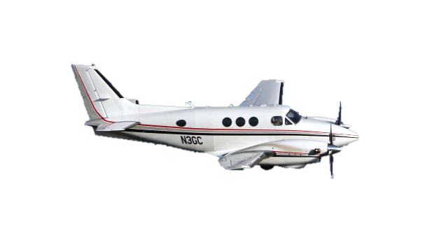
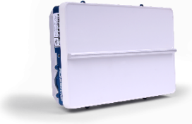

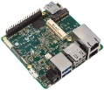

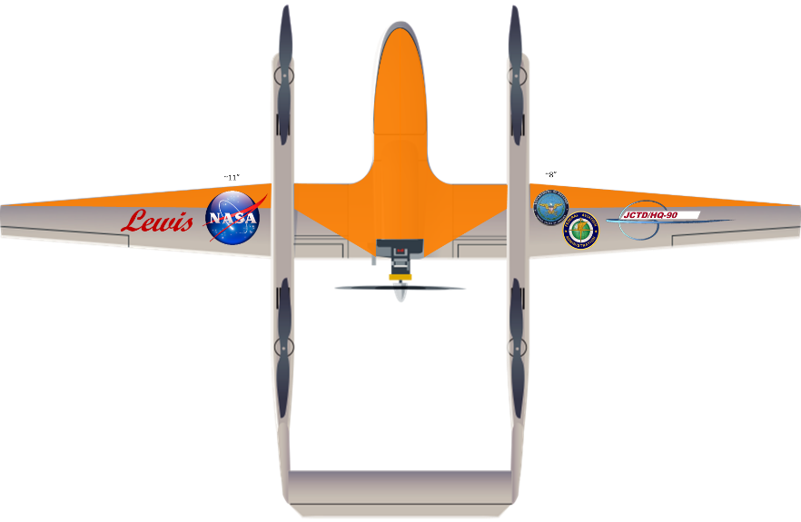

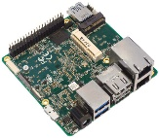
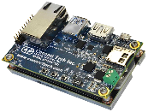
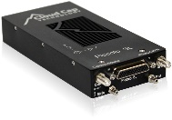
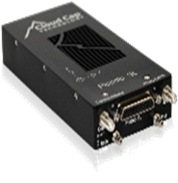
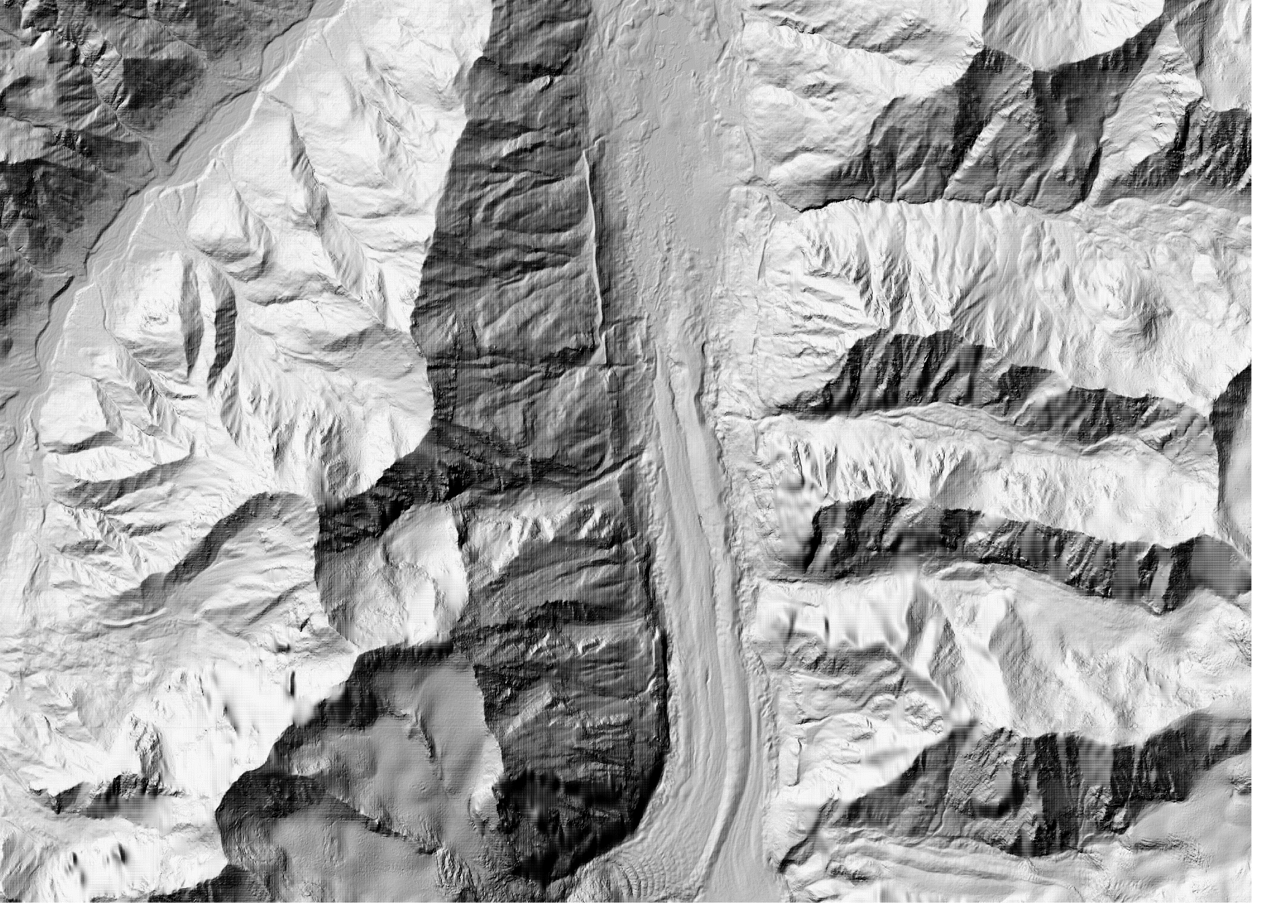

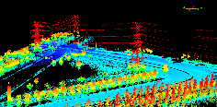



The HQ-90/EVAA Reference Implementation
Cooperative & Non-Cooperative Targets
Air Traffic Detection
Aircraft
Echodyne Radar
Aircraft Control
SARA Acoustic
ADS-B
Navigation
HQ-90C
Image Referenced Navigation
Visual Inertial
Odometry
GPS
INS
EVAA Autonomy
Ground/Obstacle/Risk Detection
Terrain
Obstacles
117 Lbs. Max Gross Takeoff Weight
14’ 8” Wingspan
11 pounds of Payload
Up to 15 Hours Endurance
Risk
Landing
Autopilot
Digital Maps
Notes:
EVAA is hosted on an Up2 processor. A wide variety of sensors feed the monitors within EVAA and the EVAA commands are sent to a Piccolo 2 autopilot used by the HQ-90. Although a wide variety and spectrum of sensors are used, the Resilient Autonomy project is really about the software that makes up EVAA.

Slide 14
Whitney Portal
X-Plane Cessna 172SP

Slide 15
iACAS/GA

Slide 16

EVAA Tech Transition
Early Out-of-Cycle Beta Release
Who
  160th SOAR
    MQ-1ER Integration
    Noel Khan is the transition Lead
      Has been imbedded in the RA software team since before JCTD start
  Skyborg
    Brian Krumheuer is the transition Lead
      Has been imbedded in the RA software team for a number of months
  FAA
    General aviation flight test project
  US Army PM UAS
    Evaluation in consideration for inclusion upcoming platform development
    Future Vertical Lift
    Future UAS Programs
  A-10 Program
    Evaluation to replace current GPWS
What
  Full hardware and software list for a working simulation
  EVAA Software
  Simulation Interface Software
  Analysis Software
How
  NASA Software Release
  Interagency Software Use Agreement
When
  This fall
  Status:
    Basic software documentation completed
    Additional software design documentation completed
    Software V&V completed
    Software Use Agreements in Work

Slide 17
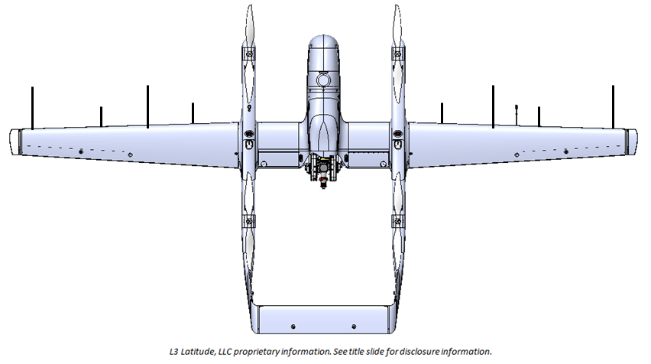
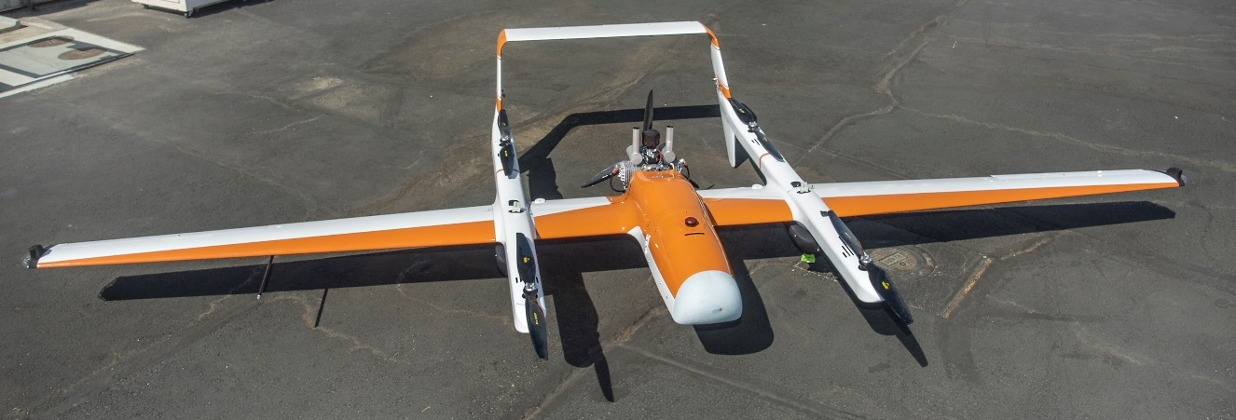
HQ-90 Ref. Imp. Status
Ship 1 – Lewis
  Built with JCTD unique hardware installed & integrated
    Does not include Amazon Prime Air vision sensor
  Baseline acceptance & acoustic characterization flights flown
  Arrived at Armstrong 30 Sep
  Aircraft personnel on site prepping for functional check flights
Ship 2 – Clark
  Aircraft build beginning
    Will include Amazon Prime Air sensor if project collaboration is successful
    Lewis to be retrofitted at Armstrong following Clark readiness to begin flight test
  Arrives at Armstrong in November

Slide 18
Airworthiness Status
Project Specific Certification Plan for EVAA/General Aviation
  First critical step in certification
  Addresses multiple levels of automation
    Pilot cuing only
    Various level of automated maneuvering
  Shows how accepted certification practices can be used to certify autonomy
  Completed on time
Project Specific Certification Plan for EVAA/HQ-90
  Builds on GA approach
  Will address multiple ConOps
    US SOUTHCOM ISR mission
    Long-range low-altitude rural mission within national airspace
    Long-range medium-altitude rural mission within national airspace
  Currently under development
    Scheduled completion at end of project

Slide 19
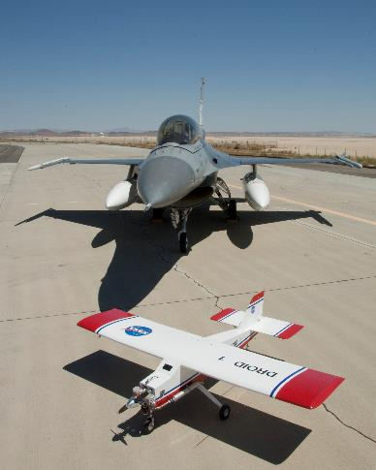

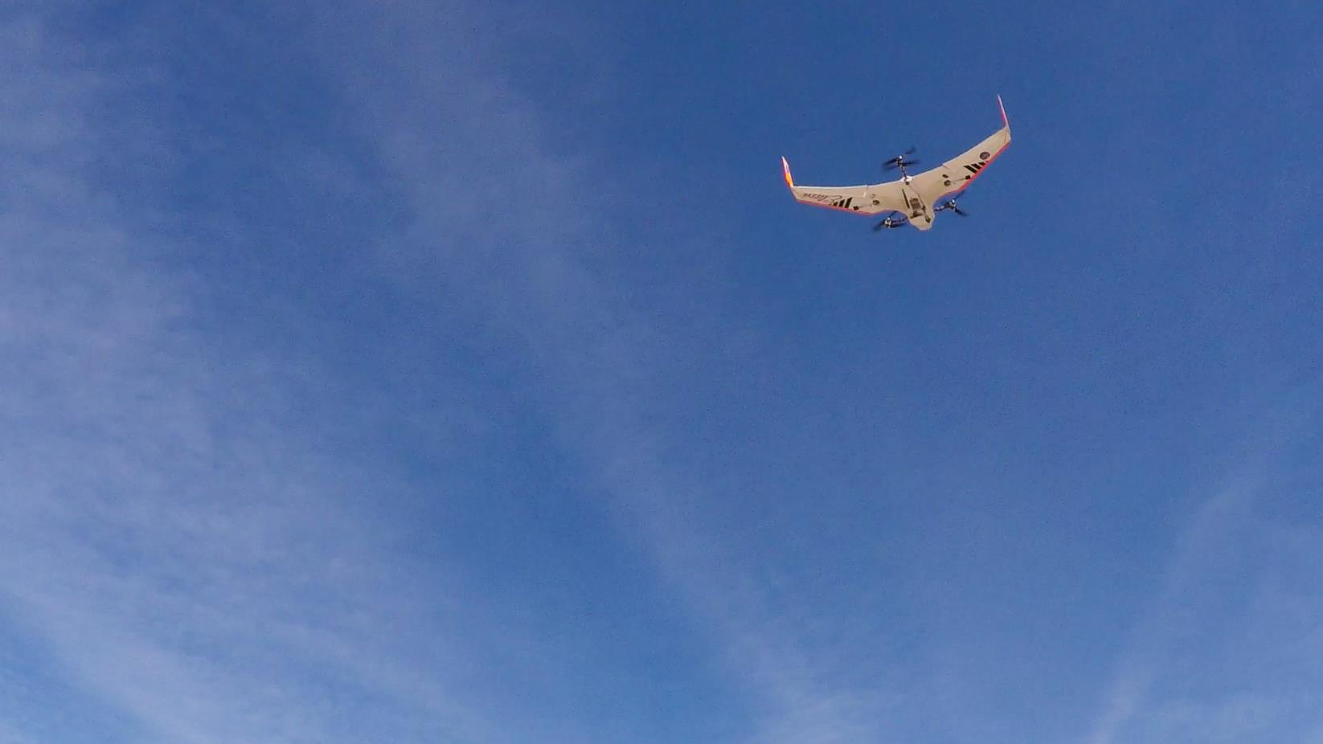
Questions

Slide 20
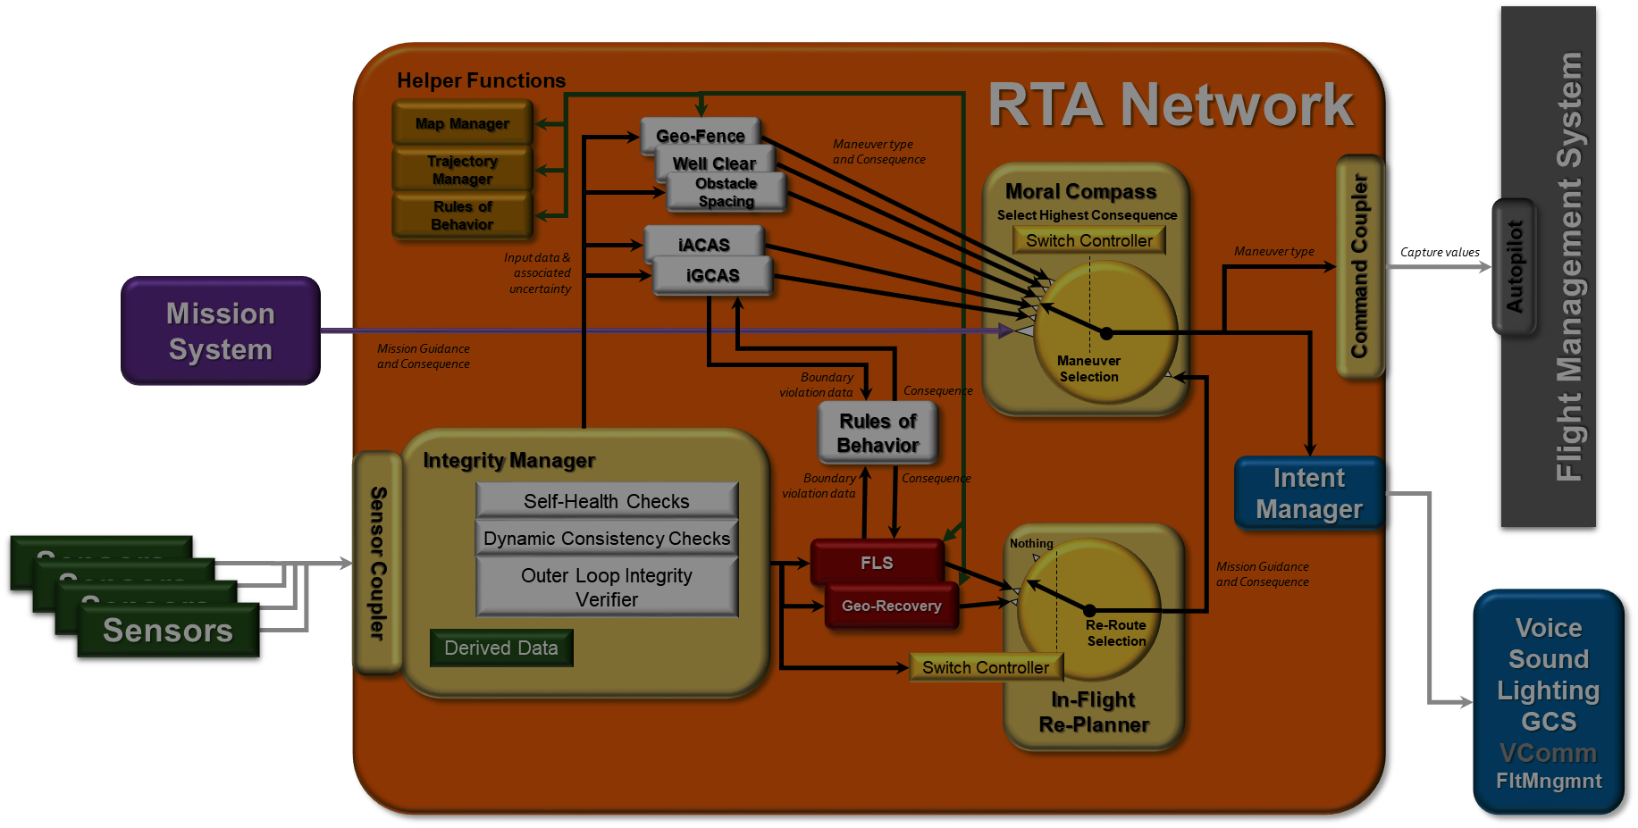
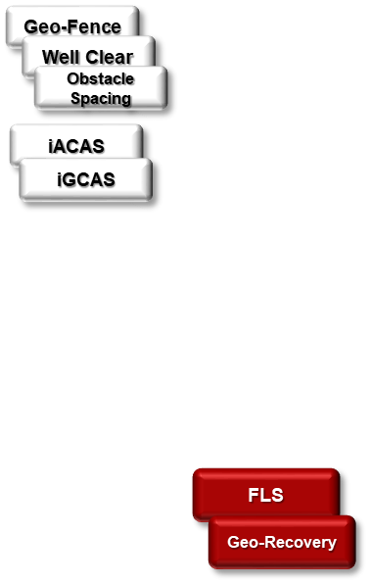
The Algorithms
Monitors & Emergency Re-planners

Slide 21
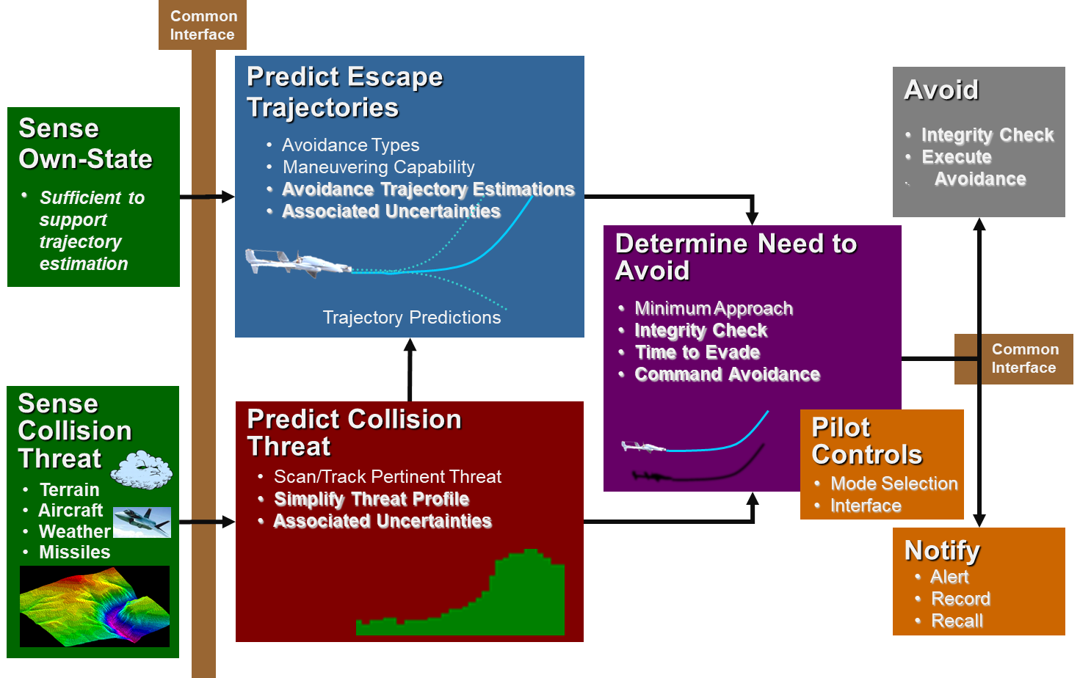

Algorithms
4 Categories of EVAA Algorithms
  Tactical monitors for stationary collision threats
  Tactical monitors for moving collision threats
  Strategic algorithms for re-planning some portion of the mission
  Integrity Monitors for triggering mission re-planning
General Description of Tactical Monitors
  Sense
    Sensor Coupler
    Own State
      Nav Data
      Air Data
    Collision Threat
      Terrain
      Obstacles
      Aircraft
      Etc.
  Evaluate
    Predict Escape Trajectories
      Trajectory Manager
      Any number of maneuvers
    Predict Future Collision Threat
    Determine Need to Avoid
  Act
    Execute Avoidance
      Command Coupler
      Autopilot
Tactical Monitor Common Algorithm Framework

Slide 22
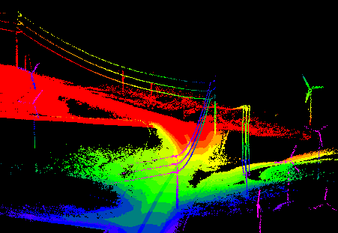




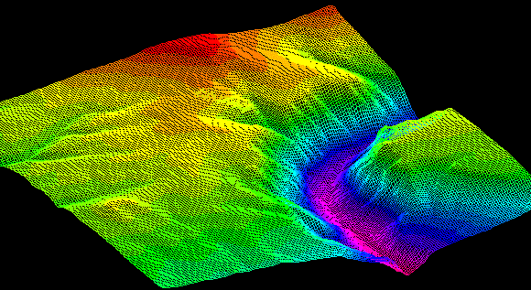
iGCAS
Improved Ground Collision Avoidance System
Trajectory Manager
Map Manager

Slide 23
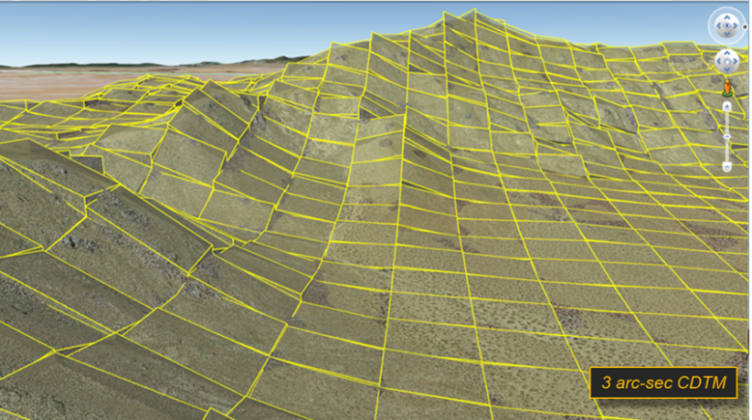
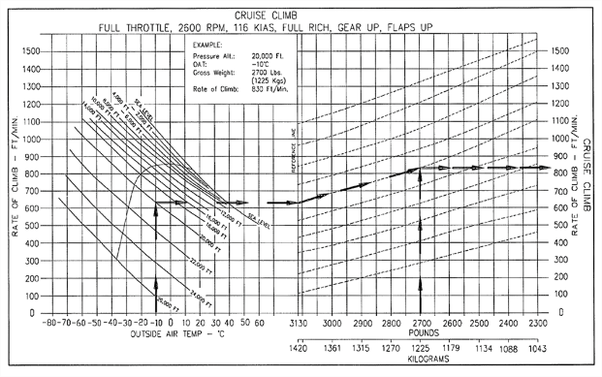
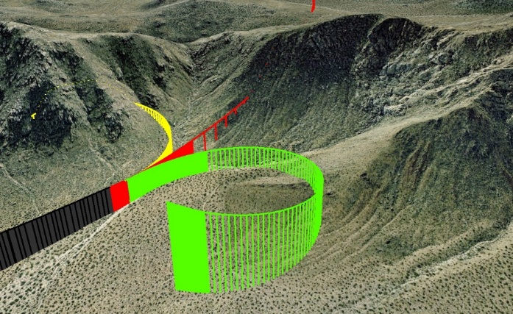
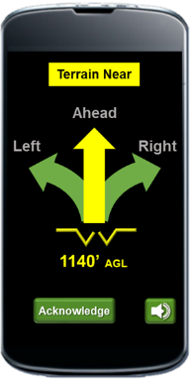
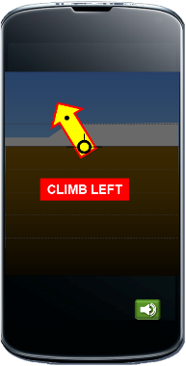
iGCAS
Design
Software Structure
  Easily adjusts to new aircraft performance
  Easily adjusts to evolving requirements
Higher Fidelity Terrain Maps
  NASA-unique terrain encoding with ~2,000:1 file size reduction
  81x finer resolution than F-16/F-35 1/3rd AS (10m)
  Obstacle map 1/9th AS (3m)
  In-flight switchable acceptable landing map
More Accurate Aircraft Performance Modeling
  Easily tuned to specific aircraft/autopilot flight dynamics
  Performance can switch in-flight with aircraft configuration changes
Multiple Avoidance Options Evaluated
  Normal = left, straight & right climbs at max climb rate of aircraft
  No-Climb = Bush pilot mode for scud-running under weather
New Advanced Features
  Activation suppression on landing
  Leeward ridgeline downdraft protection
Avoidance Director Cuing
System Status
Fully mechanized
Included in latest release
ICD, Documentation included with release
Computational Agility enabling beneficial emergent behavior during hard landings

Slide 24
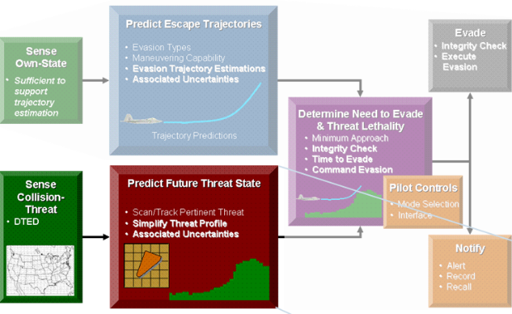
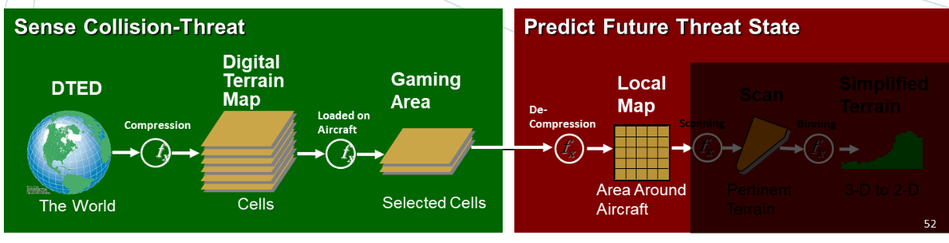
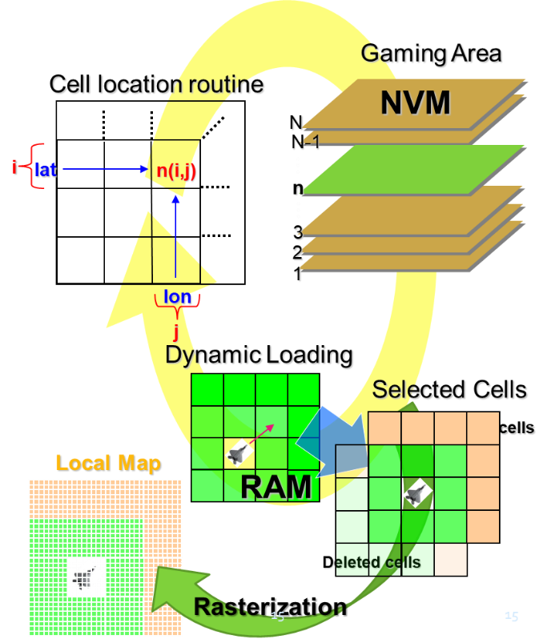
Map Manager
Design
Purpose
  Provide common interface method for data bases
Basic Concepts
  Manage any number of data base products
  Access data in non-volatile memory
  Store subset of data in RAM
    Update this Local Map with data surrounding the aircraft position as the aircraft moves
  Provide a standard set of interface calls for monitors to access data for their use
Capability
  Supports a wide variety of resolutions
  Supports a multiple formats
System Status
Multi-Resolution & Multi-Format terrain data supported
Raster Obstacle data supported at resolution as low as 1/9th arc-sec
Multiple landing data bases supported
Can switch landing data base in-flight
Risk data base will be added as part of Spiral 2 to support FLS and Rules of Behavior

Slide 25
Trajectory Manager
Design
Purpose
  Prefict the future flight path trajectory of various maneuvers
Basic Concepts
  Kinematic modeling: F = Ma
  3 control loops modeled
    Climb rate
    Roll rate
    Speed
Capability
  Models an extremely wide variety of potential escape maneuvers
  Supports low-speed, climb-limited aircraft
    <300 KCAS
    <3,000 FPM climb rate
System Status
Fully functional in current release
Developing tuning guide for users
Developing generic PID auto-tuning mechanization

Slide 26
iGCAS/GA

Slide 27



iACAS
Improved Air Collision Avoidance System
Trajectory Manager

Slide 28
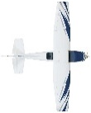


iACAS
Design
Purpose
  Avoid midair collisions and request an aggressive escape maneuver
    “Don’t scrape paint”

Slide 29
iACAS
Design
Purpose
  Avoid midair collisions and request an aggressive escape maneuver
    “Don’t scrape paint”
Basic Concepts
  Generates multiple Escape Trajectory Options
  Evaluates Separation of Each
  Waits Until Last Maneuver can Barely Avoid to Request that Maneuver
    Do nearly everything you can with the maneuverability of the aircraft to avoid collision
Uncertainty

Slide 30
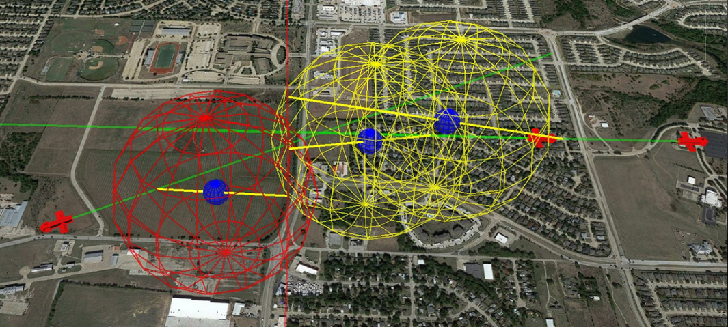
iACAS
Design
Purpose
  Avoid midair collisions and request an aggressive escape maneuver
Basic Concepts
  Generates multiple Escape Trajectory Options
  Evaluates Separation of Each
  Waits Until Last Maneuver can Barely Avoid to Request that Maneuver
Capability
  Any Number of Intruder Aircraft
  Any Type and Number of Avoidance Options
    We are currently using 7 avoidance options
    Maneuvers are aggressive & the same or similar to those used by iGCAS
    Maneuver profiles are generated by the Trajectory Manager
  Easily Tailors to Aircraft Dynamics
  Additional DAA Sensors Easily Added
    ADS-B
    Echodyne Radar 1 to 2 km (only detects aircraft @±60ºAz
    Sara Acoustic Sensor 2 to 10 km (only detects propeller aircraft to include helicopters)
Uncertainty
System Status
Initial mechanization completed & running within EVAA
The current focus of our software development

Slide 31
iACAS/GA

Slide 32


Well Clear
Observing Airmanship Rules
Trajectory Manager

Slide 33
Well Clear
Design
Larger
Separation
Bubbles
Purpose
  Observe appropriate airmanship behavior
Basic Concepts
  Detune iACAS
    Larger separation
    Less aggressive maneuvers
      Less bank angle used
      Will increase bank angle used if still not maintaining appropriate separation
    Favor horizontal maneuvers over vertical
      Will coordinate appropriate maneuvers with FAA
Capability
  Acts before iACAS if intruder is sensed early enough
Larger
Separation
Bubbles
System Status
Spiral 2 work
Beginning coordination of maneuvers with FAA
Less Aggressive Maneuvers
Medium Bank
Low Bank
Higher Bank

Slide 34



Obstacle Spacing

Slide 35

Obstacle Spacing
Design
Larger
Separation
Bubbles
Purpose
  Observe appropriate airmanship behavior near structures
Basic Concepts
  Detune iGCAS
    Larger horizontal separation distances
    Less aggressive maneuvers
      Less bank angle used
      Will increase bank angle used if still not maintaining appropriate separation
    Favor horizontal maneuvers over vertical
      Will coordinate appropriate maneuvers with FAA
Capability
  Acts before iGCAS if obstacle is sensed early enough
Larger
Separation
Bubbles
System Status
Spiral 2 work
Beginning coordination of maneuvers with FAA
Less Aggressive Maneuvers

Slide 36
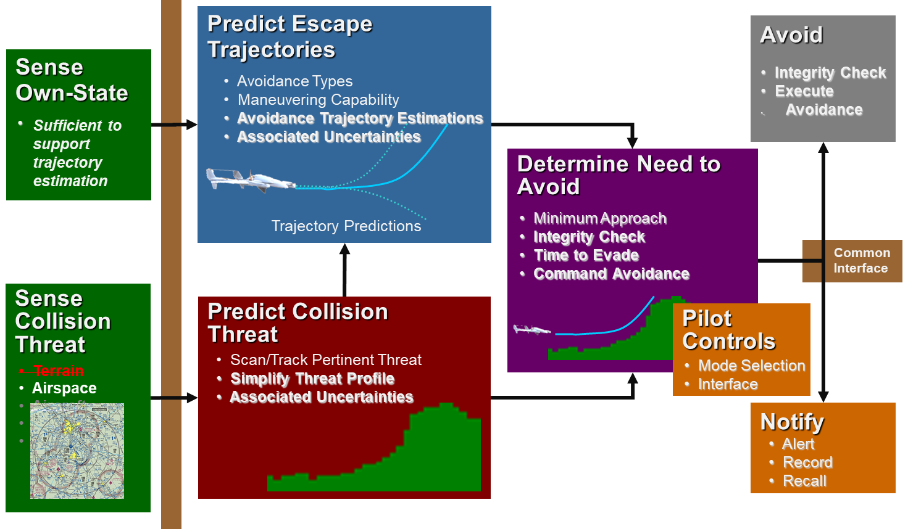



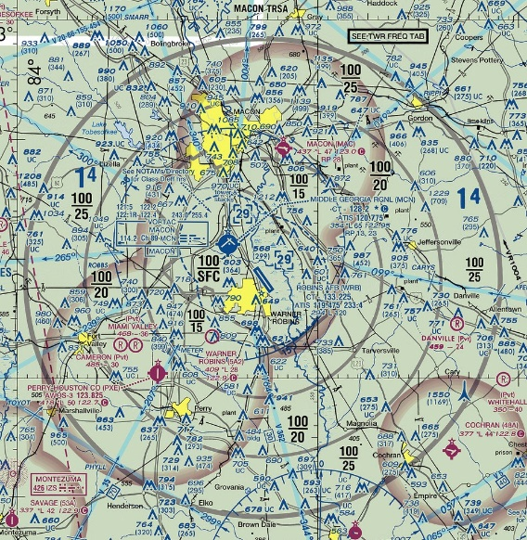
Geo-Fence
Airspace & Other Restricted Boundaries
Map Manager
Trajectory Manager

Slide 37

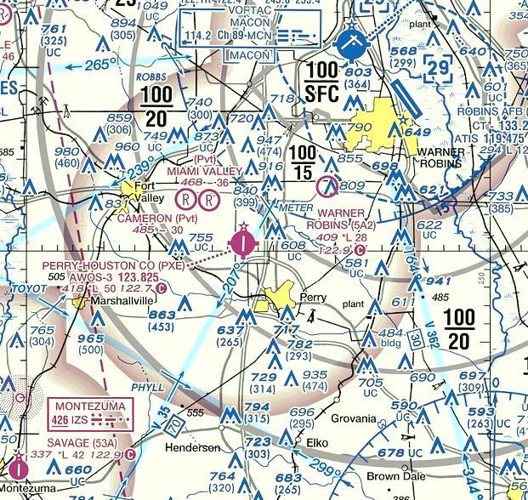


Geo-Fence
Design
Purpose
  Observe appropriate airmanship behavior by staying out of restricted airspace
Basic Concepts
  Repurpose iGCAS by substituting airspace boundaries for terrain and obstacles
    MSL & AGL floor values
    MSL & AGL ceiling values
    Airspace boundaries equivalent to obstacle walls
  Boundaries will be stored as separate data base
    Loaded as part of pre-flight
Capability
  Pulls up to avoid floor penetration
  Pushes over to avoid ceiling breech
  Maneuvers horizontally to avoid wall boundaries
System Status
An extremely similar version of this flew on our previous program
Ready to add a modified instance of iGCAS as part of Spiral 2 work

Slide 38
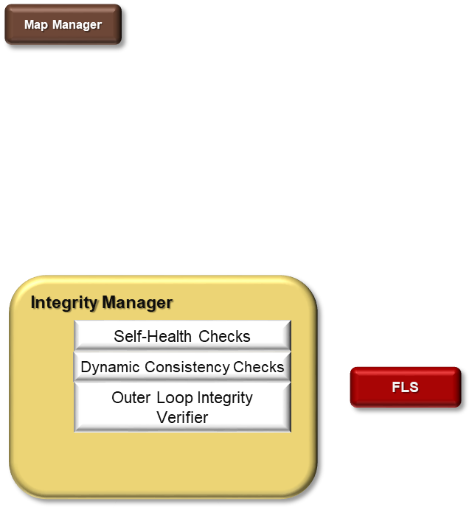


FLS
Forced Landing System
Integrity Manager
Map Manager

Slide 39
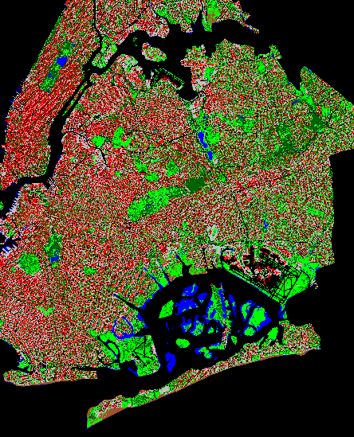

FLS
Design
Risk map of New York city
Purpose
  Generate a flight plan for an emergency landing when contingencies arise that compromise safely continuing the remaining mission
Basic Concepts
  Integrity Management
    Identifies the need for an emergency landing
    Identifies constraints for and how soon the aircraft must land
  FLS
    Computes the reachable landing areas
    Requests risk data from the Map Manager
      Provides the lowest risk location for each reachable area
    Sends the landing location to the flight control system and requests landing initiation
Capability
  Risk map allows significant flexibility
    Currently configured to generate landing risk from LiDAR data
      Terrain slope & small obstructions
      Road/highway data from available vector maps
      Population data
  FLS leverages the inherent landing capability of the Piccolo
Land here
Search areas
Land in X sec
Lowest risk landing location
Search area
Emergency Flight Path
Command Location
Current Flight Path
X sec ahead
Lowest risk landing location
Current Flight Path
System Status
FLS has been developed over previous programs & flown on a similar UAV
We have initial software to automatically generate risk maps
We currently expanding this auto-generate software capability
Emergency Flight Path

Slide 40
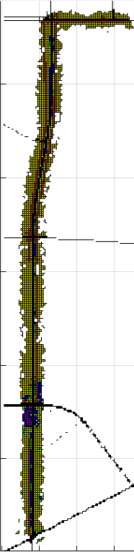
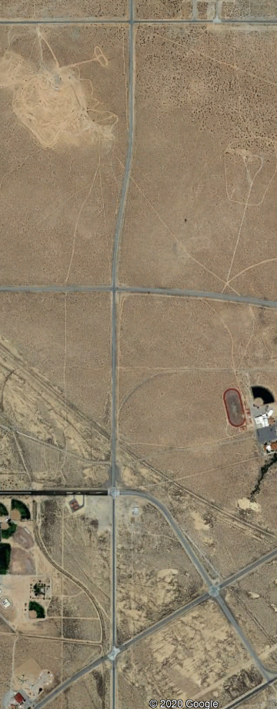
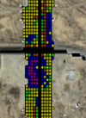
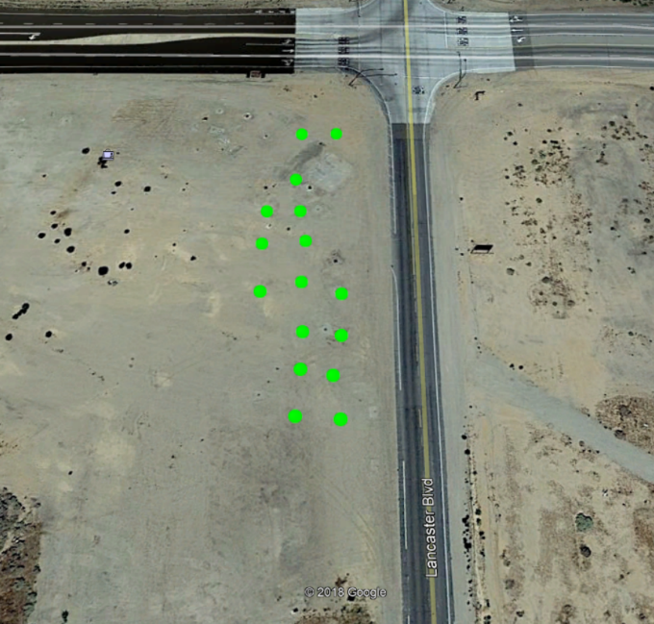
Example of Landing Risk Generation
Landing risk map
Road vector data
Area on Edwards AFB

