Slide 1
Visualizations to Aid Decision-Making in the ACCP Value Framework
Christopher A. Jones, Marie L. Ivanco, Shaun A. Deacon
Space Mission Analysis Branch, NASA Langley Research Center

Slide 2
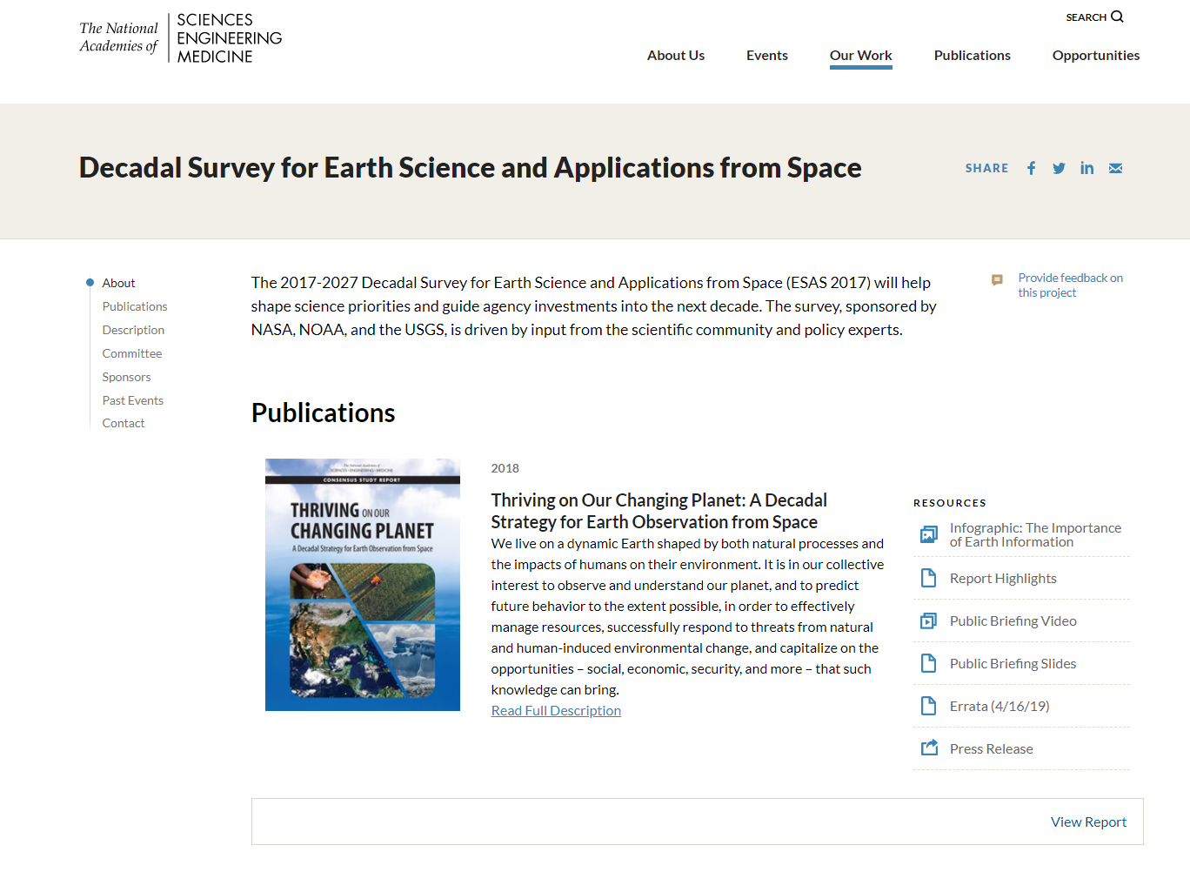
2017 Earth Science Decadal Survey
Released in January 2018. Effort started in 2015 with study panels and a steering committee.
Published by the National Academy of Sciences
Objective of ESAS 2017 is:
  “to generate recommendations for the environmental monitoring and Earth science and applications communities for an integrated and sustainable approach to the conduct of the U.S. government’s civilian space-based Earth-system science programs.”
ESAS 2017 recommended 22 Targeted Observables:
  290 Community RFI responses
  35 Science and Applications Questions
  103 Science and Applications Objectives, organized in tiers (Most Important, Very Important, Important)
  22 Targeted Observables, with suggested measurement approaches
https://www.nationalacademies.org/our-work-decadal-survey-for-earth-science-and-applications-from-space

Slide 3
The Aerosols, Clouds, Convection, and Precipitation Study
The Aerosols, Clouds, Convection, and Precipitation study was tasked with defining and evaluating candidate observing system concepts. A Value Framework was developed to enable scientists and engineers across multiple NASA centers, academia, and international partners to collaborate on the study team.
A structured, traceable, and transparent approach to be responsive to a complex decision landscape:
A holistic approach that informs the decision-making process:
    Comprehensive examination of all elements of the decision space to enable trade-offs (science, applications, programmatic factors, cost, and risk)
    Common terminology to enable productive conversations across a large, diverse group
    Data-driven, consistent evaluations augmented by structured expert judgement
    Independent team that facilitates but does not provide input into the assessment
8 science objectives
27 applications
Multiple programmatic considerations
Lidars
Polarimeters
Radiometers
Radars
Spectrometers
Cameras
Multi-Objective Decision
Many Alternatives
Mission-level Trades
2 Science Communities
Many Stakeholders
Aerosols
CCP
Different communities and priorities, leveraging synergies
Integrated Value Analysis
6 NASA Centers
4 International Partners
Academia

Slide 4
Guiding Principles of Visualization Design
Relevance
Visualizations should be helpful in supporting conversations; if they are not used by the intended audience, they have failed.
Balance
Visualizations should be tailored to an appropriate level of fidelity, which depends on the information that is needed by the intended audience to do their job successfully.
Focus
Visualizations should have a simple and clear purpose that decomposes complexity by isolating and focusing on individual dimensions of a conversation.

Slide 5
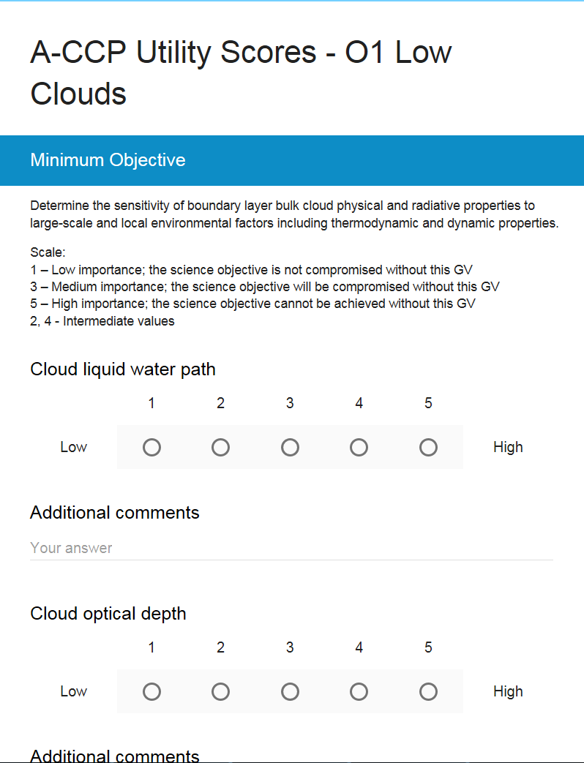
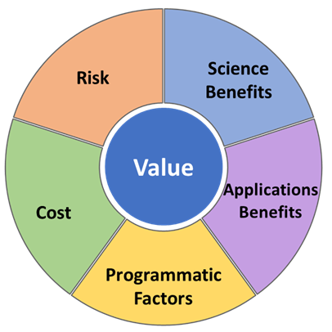
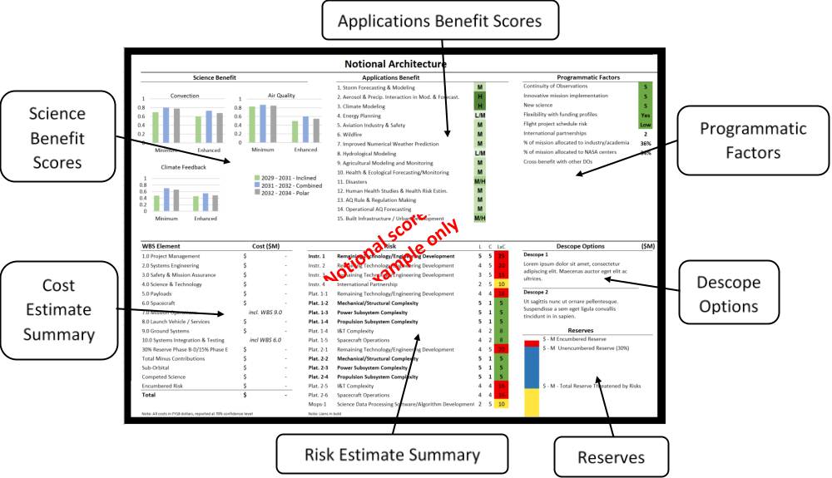
Three Functions of Visualizations in ACCP VF
Structuring communications
Facilitating elicitation and aggregation of data
Summarizing complex information

Slide 6
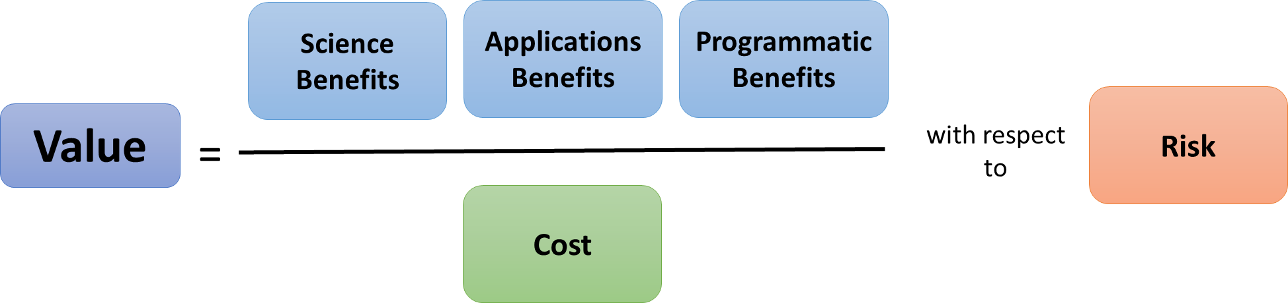
Structuring Communications
Relevance
Focus

Slide 7
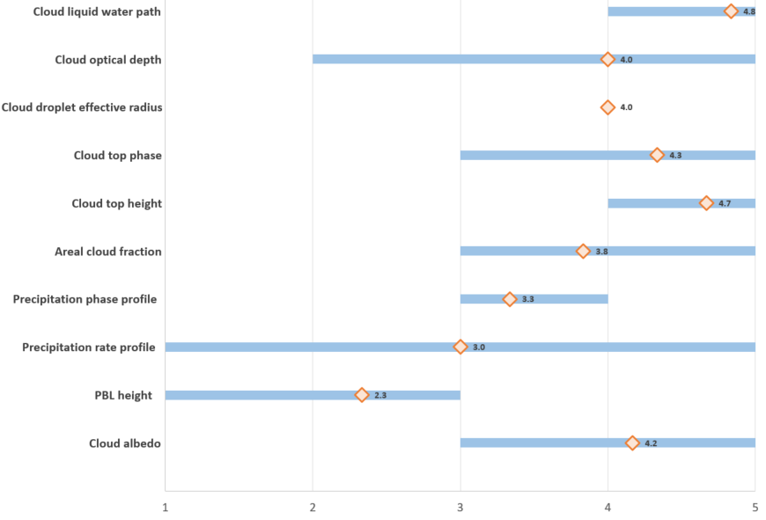
Facilitating Elicitation and Aggregation of Data
Balance
Focus

Slide 8
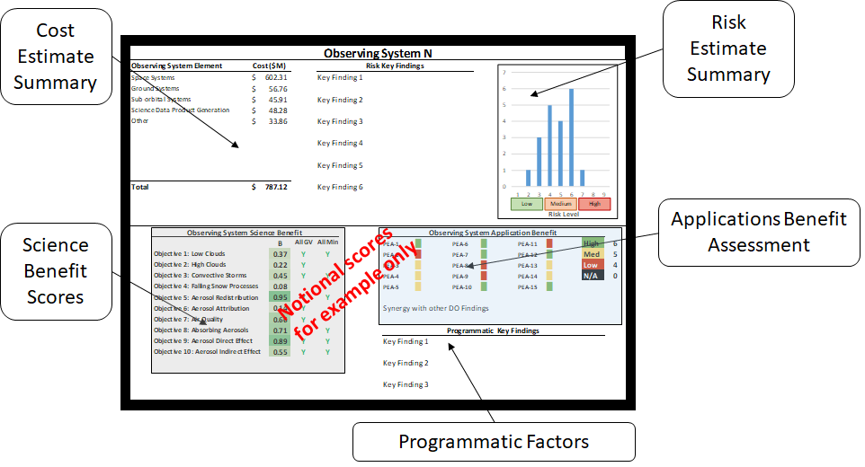
Summarizing Complex Information—Initial
Relevance
Balance
Focus

Slide 9
Summarizing Complex Information—Current
Relevance
Balance
Focus

Slide 10
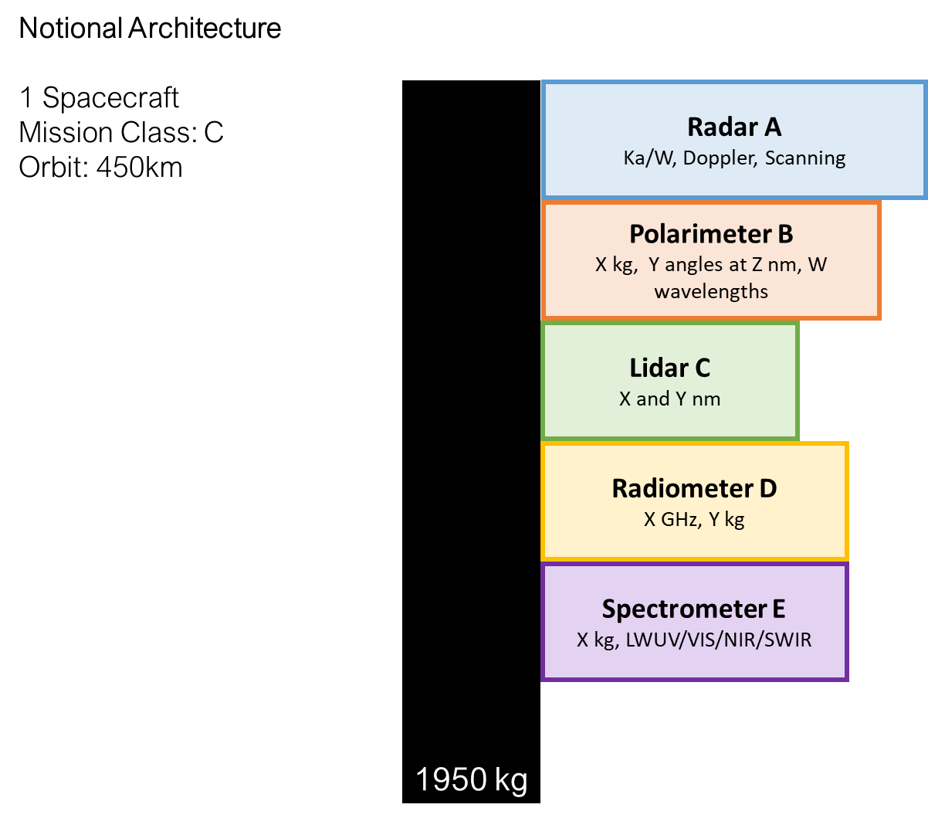
Another Key Lesson—Speed vs Perfection
Relevance
Balance

Slide 11
Summary
Relevance
Visualizations should be helpful in supporting conversations; if they are not used by the intended audience, they have failed.
Balance
Visualizations should be tailored to an appropriate level of fidelity, which depends on the information that is needed by the intended audience to do their job successfully.
Focus
Visualizations should have a simple and clear purpose that decomposes complexity by isolating and focusing on individual dimensions of a conversation.
Structuring communications
Facilitating elicitation and aggregation of data
Summarizing complex information

