Slide 1









December 2
Machine Learning and Climate Resilience, SERVIR
Tim Mayer, NASA SERVIR Hindu Kush Himalaya Regional Science and Coordination Lead
Notes:
Slide 1
• Hello and Thank You,
• I am Tim Mayer the SERVIR Regional Science Coordination Lead for the Hindu Kush Himalaya Hub
• And I am pleased to provide an Overview and highlight of SERVIR activities in Asia
• -
• Next Slide

Slide 2

SERVIR Overview
3

Slide 3
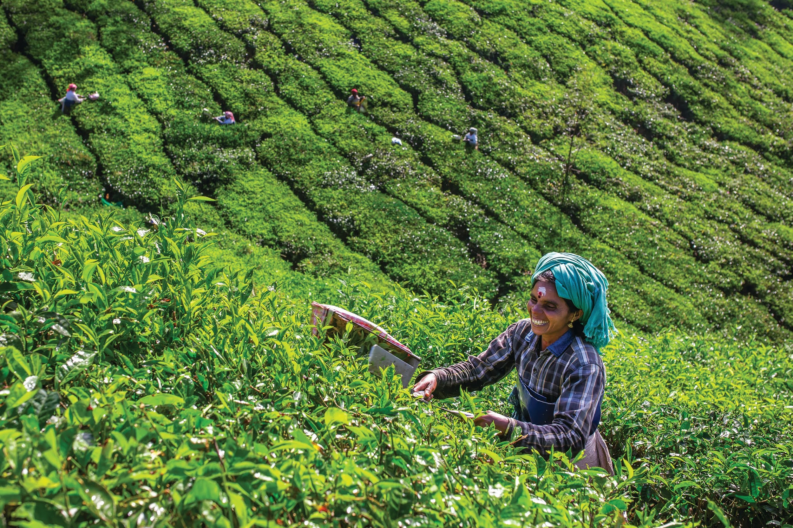
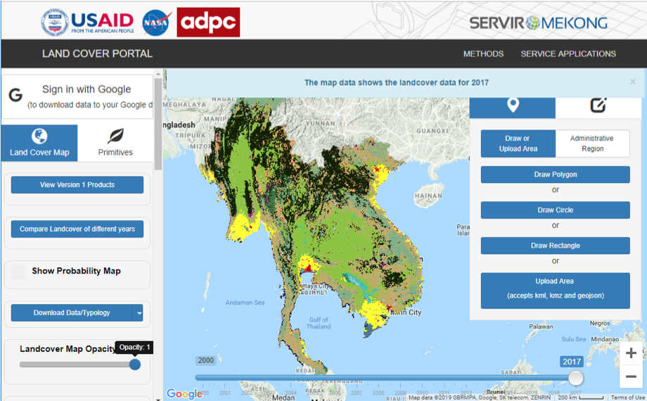
Countries Around the World Need Satellite Data
PROBLEM
Complex challenges occur in data-scarce environments
Most countries lack the capacity to use satellite data and geospatial technologies to manage resources and risk
APPROACH
Build regional capacity at a global scale in the spirit of self-reliance
Ensure needs-driven and collaborative solutions for impact, buy-in, and sustainability
Leverage U.S. leadership in science and technology
Notes:
Image Credit: Public Photo on the SERVIR Service Catalog website
Photos obtained from the public SERVIR website,

Slide 4

Linking Science to End User Needs

Slide 5




Thematic Areas
  Agriculture and Food Security
  Water and Water Related Disasters
  Land Use and Ecosystems
  Weather and Climate

Slide 6


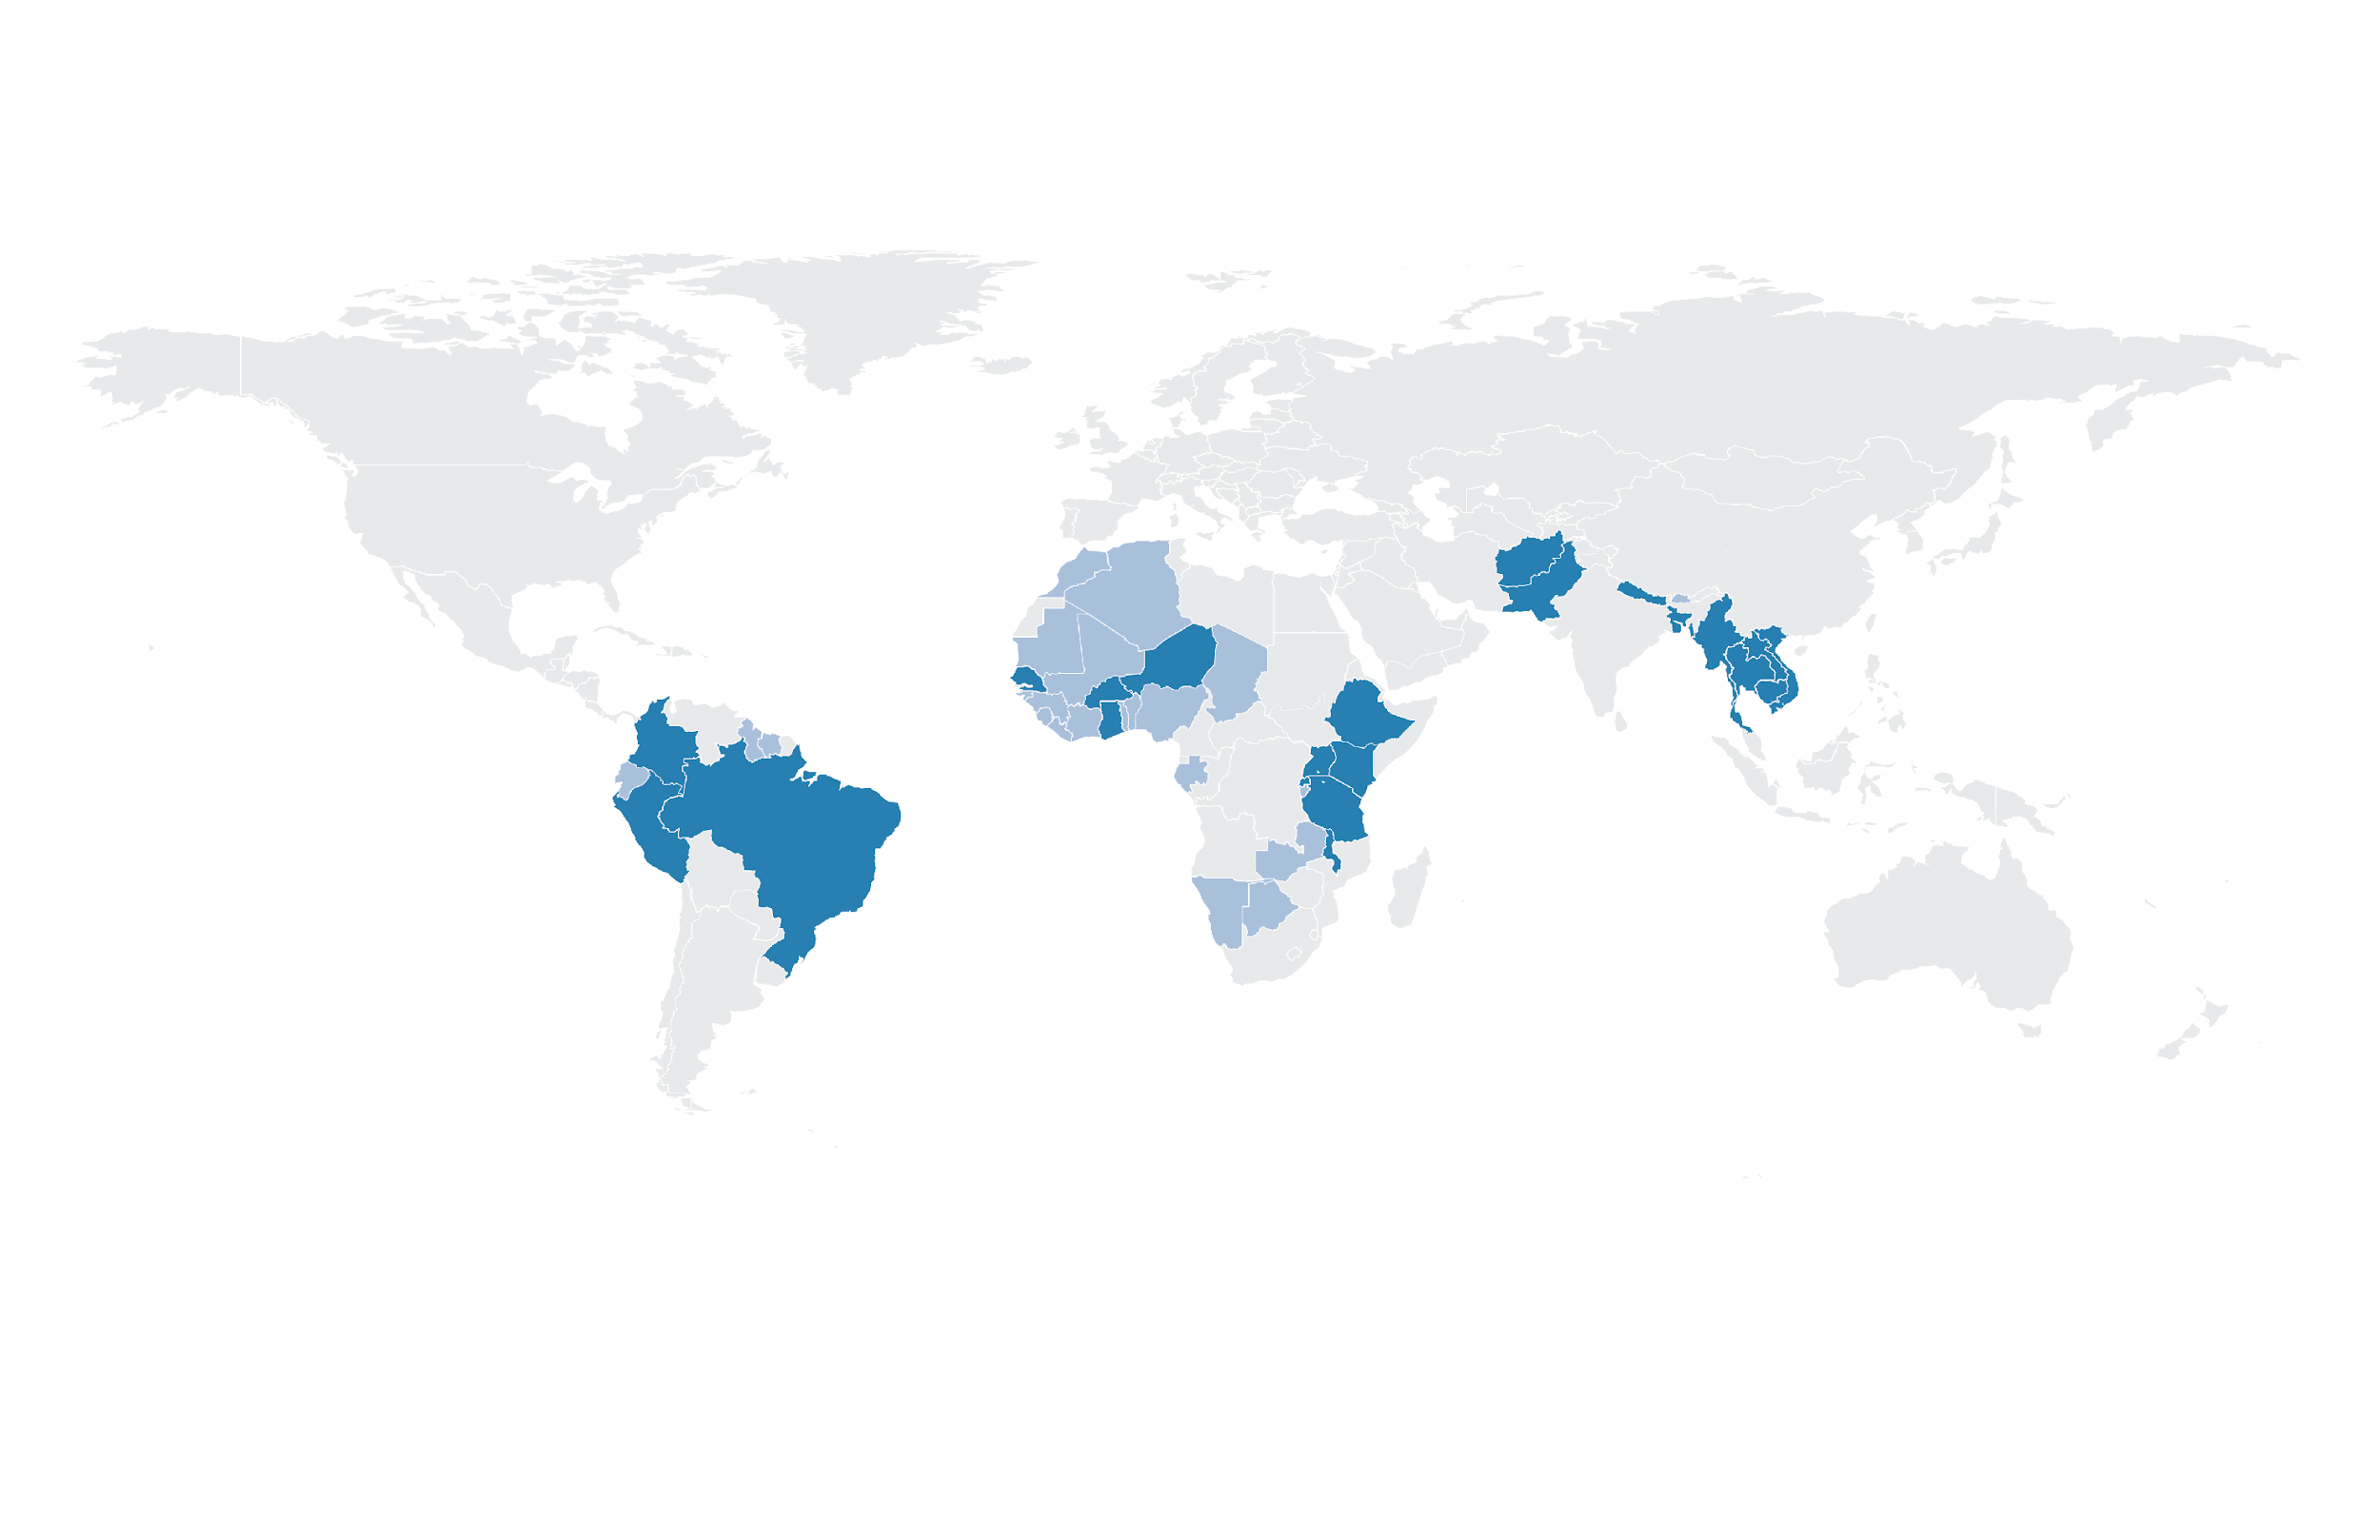
SERVIR Focuses on Asia, Africa, & the Americas
SERVIR Science Coordination Office
NASA MSFC
SERVIR Hindu Kush Himalaya
ICIMOD
USAID Washington
NASA Headquarters
SERVIR Amazonia
CIAT
SERVIR Eastern & Southern Africa
RCMRD
SERVIR Mekong
ADPC
SERVIR West Africa
AGRHYMET
Focus Countries
Additional Reach
Notes:
---SERVIR is a joint initiative between NASA and the U.S. Agency for International DEVELOPMENT.
• We currently have activities in more than 50 Countries; ----We Collaborate with more than 250 institutions
• Specifically we have five hubs across the globe.
• With 2 locations in Africa, First in West Africa located at AGRHYMET, Next the Eastern and Southern Africa hub at RCMRD in Kenya
• The Newest hub: Amazonia located in Cali Columbia at the International Center for Tropical Agriculture (CIAT)
• And finally two hubs in ASIA: The Hindu Kush Himalaya--- or HKH--- and Mekong hubs
• -
• All the SERVIR folks you have heard from over this past week are from the Science Coordination Office located at the Marshall Space Flight Center;
• But we, all of SERVIR, are a vast network of individuals working to serve the communities comprising our regions

Slide 7
Services: SERVIR services meet needs in Africa
Eastern & Southern Africa
Drought monitoring and assessments
Frost monitoring
Streamflow and flood forecasting
Land cover mapping
Climate vulnerability, impacts, and assessment
Crop area estimation
West Africa
Surface water body mapping
Ground water monitoring and modeling
Charcoal production monitoring
Locust infestation monitoring
Monitoring of artisanal mining (Galamsey) in Ghana
Support for commune-level development planning in Burkina Faso
Niamey, Niger
CILSS/AGRHYMET HQ
Nairobi, Kenya
RCMRD HQ

Slide 8
Services: SERVIR services meet needs in the Americas
Amazonia
Detection of Illegal gold mining
Fire forecasting and mapping
Monitoring of mangroves
Monitoring of zero deforestation value chains using active remote sensing
Monitoring ecosystem services
Deforestation monitoring and reporting in Ecuador
Biodiversity monitoring
Use of Synthetic Aperture Radar (SAR) to monitor forest degradation
Cali, Colombia
CIAT HQ

Slide 9
Services: SERVIR services meet needs in Asia
Hindu-Kush Himalaya
Crop area estimation
Regional drought monitoring and outlook system
Regional land cover monitoring system
Forest monitoring, and biomass estimation
Early warning information on floods and other high-impact weather events
Mekong
Enhancing drought resilience and crop yield security
Supporting improved riparian and flash flood forecasting
Improving regional land cover monitoring
Supporting transboundary water resource planning and management
Supporting management of the agriculture, forestry, and other land use through air quality monitoring
Developing a protected area alerts system for Cambodia
Data monitoring and evaluation dashboard for landscape improvement in Cambodia
Kathmandu, Nepal
ICIMOD HQ
Bangkok, Thailand
ADPC HQ

Slide 10









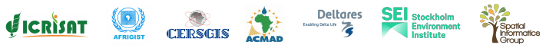



Who is SERVIR?
Private sector collaborators:
Poverty reduction and resilience
Data-dependent issues in data-scarce places
International field presence
Research collaborators: Over 20 US universities and research centers through the Applied Sciences Team
USG collaborators: NOAA, USGS, USFS
Intergovernmental, NGO collaborators: Food and Agriculture Organization, World Food Programme, Red Cross, Mercy Corps
University collaborators: ITC, university networks in region
30+ Earth observing satellite missions, free & open data policies
Major research portfolio
Societal benefit from space
Regional Hub Host Institutions:
Hub Consortium Members:

Slide 11

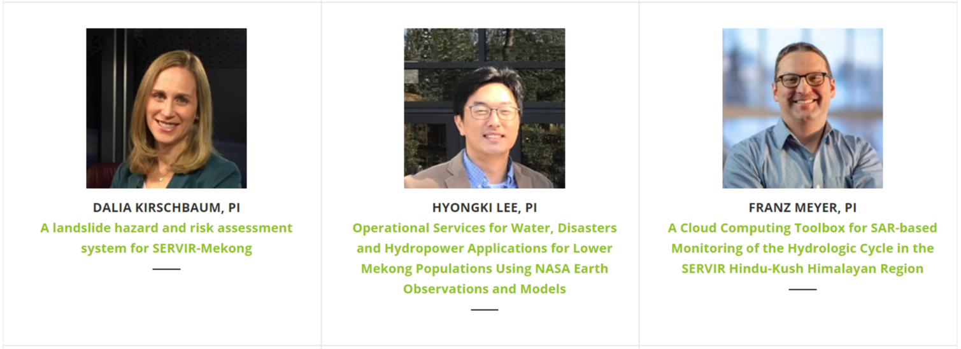
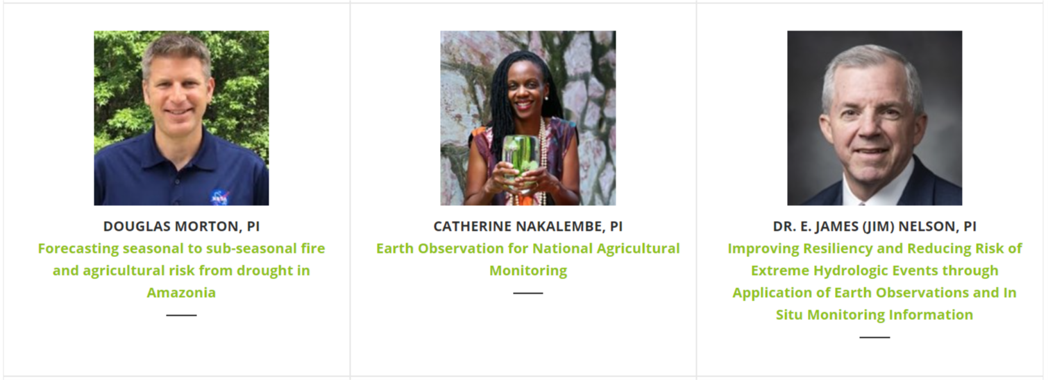
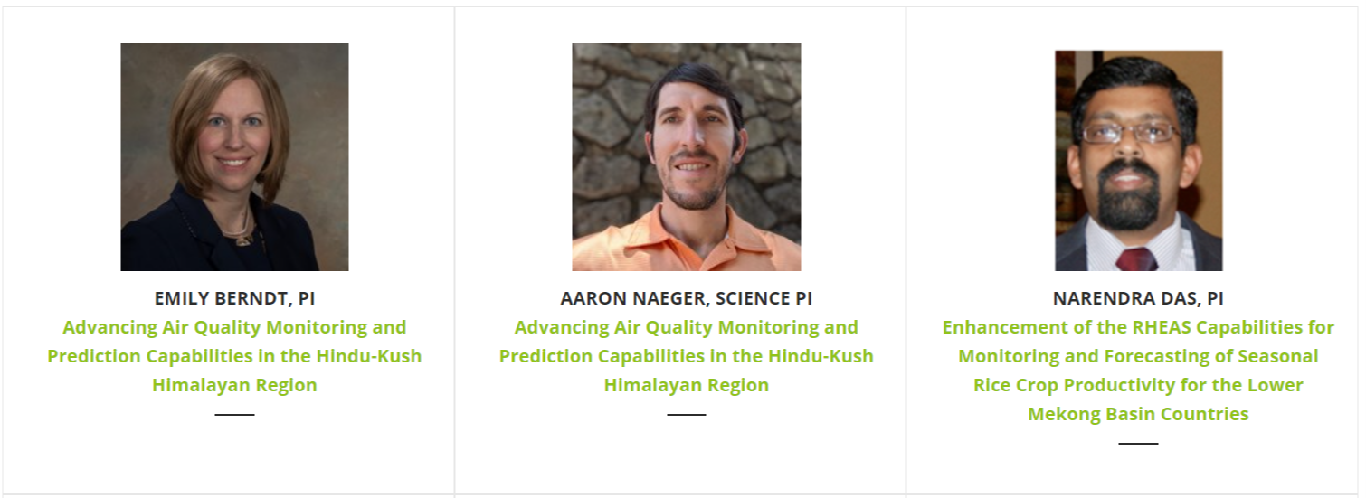
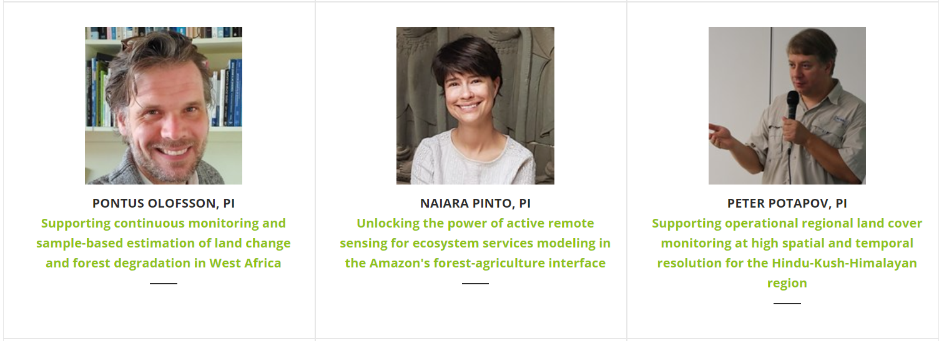
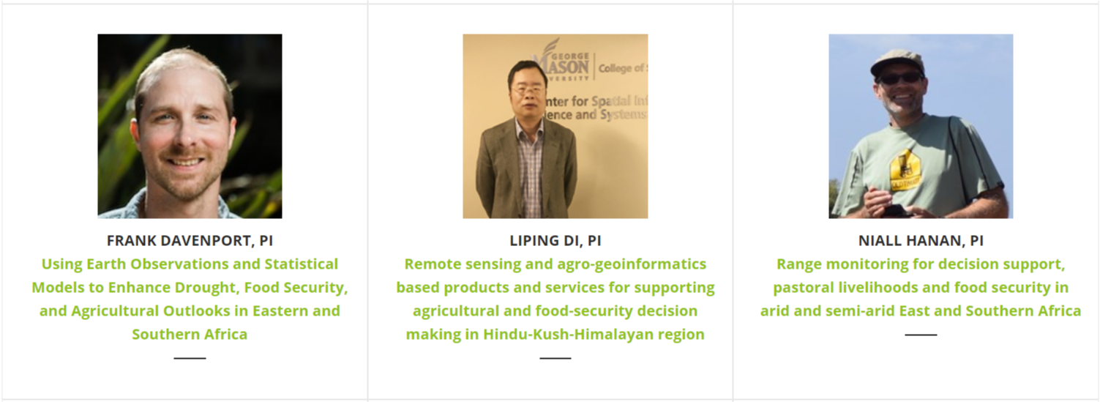
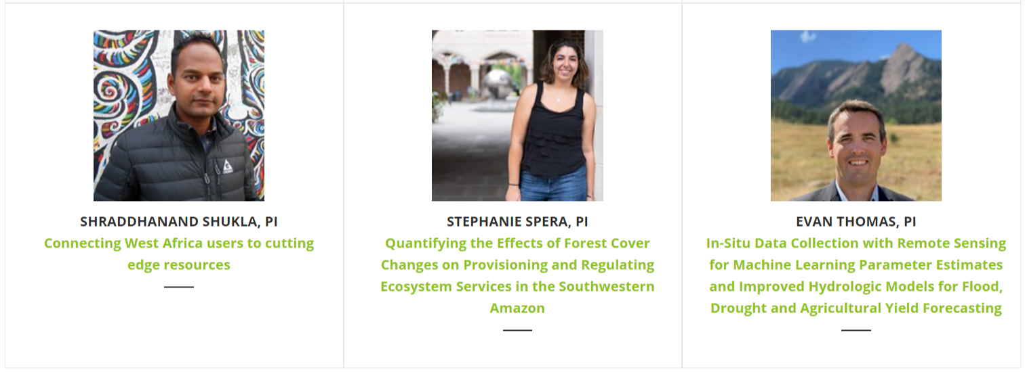
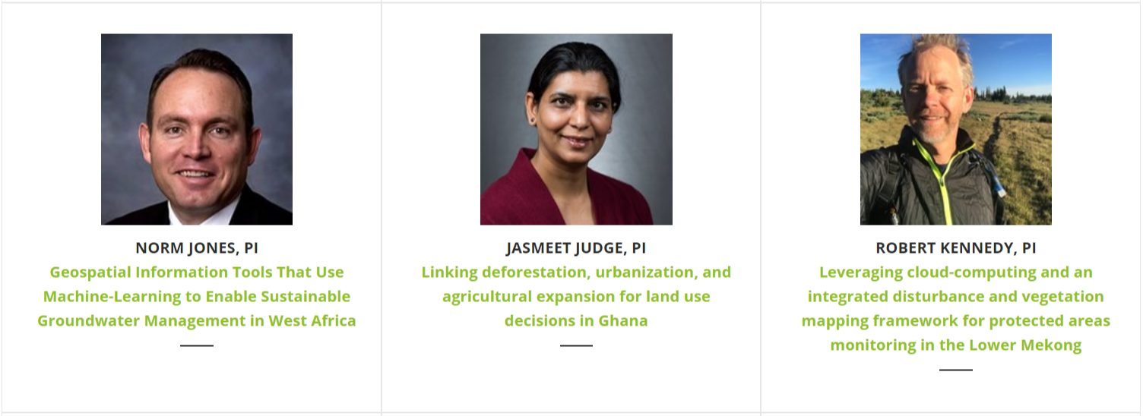
SERVIR Applied Sciences Team
Notes:
Image Credit: SERVIR Global (public photos on the SERVIR Global website)
Photos obtained from the public SERVIR website,
View the https://www.servirglobal.net/SERVIR-AST publications and science integrated into services

Slide 12
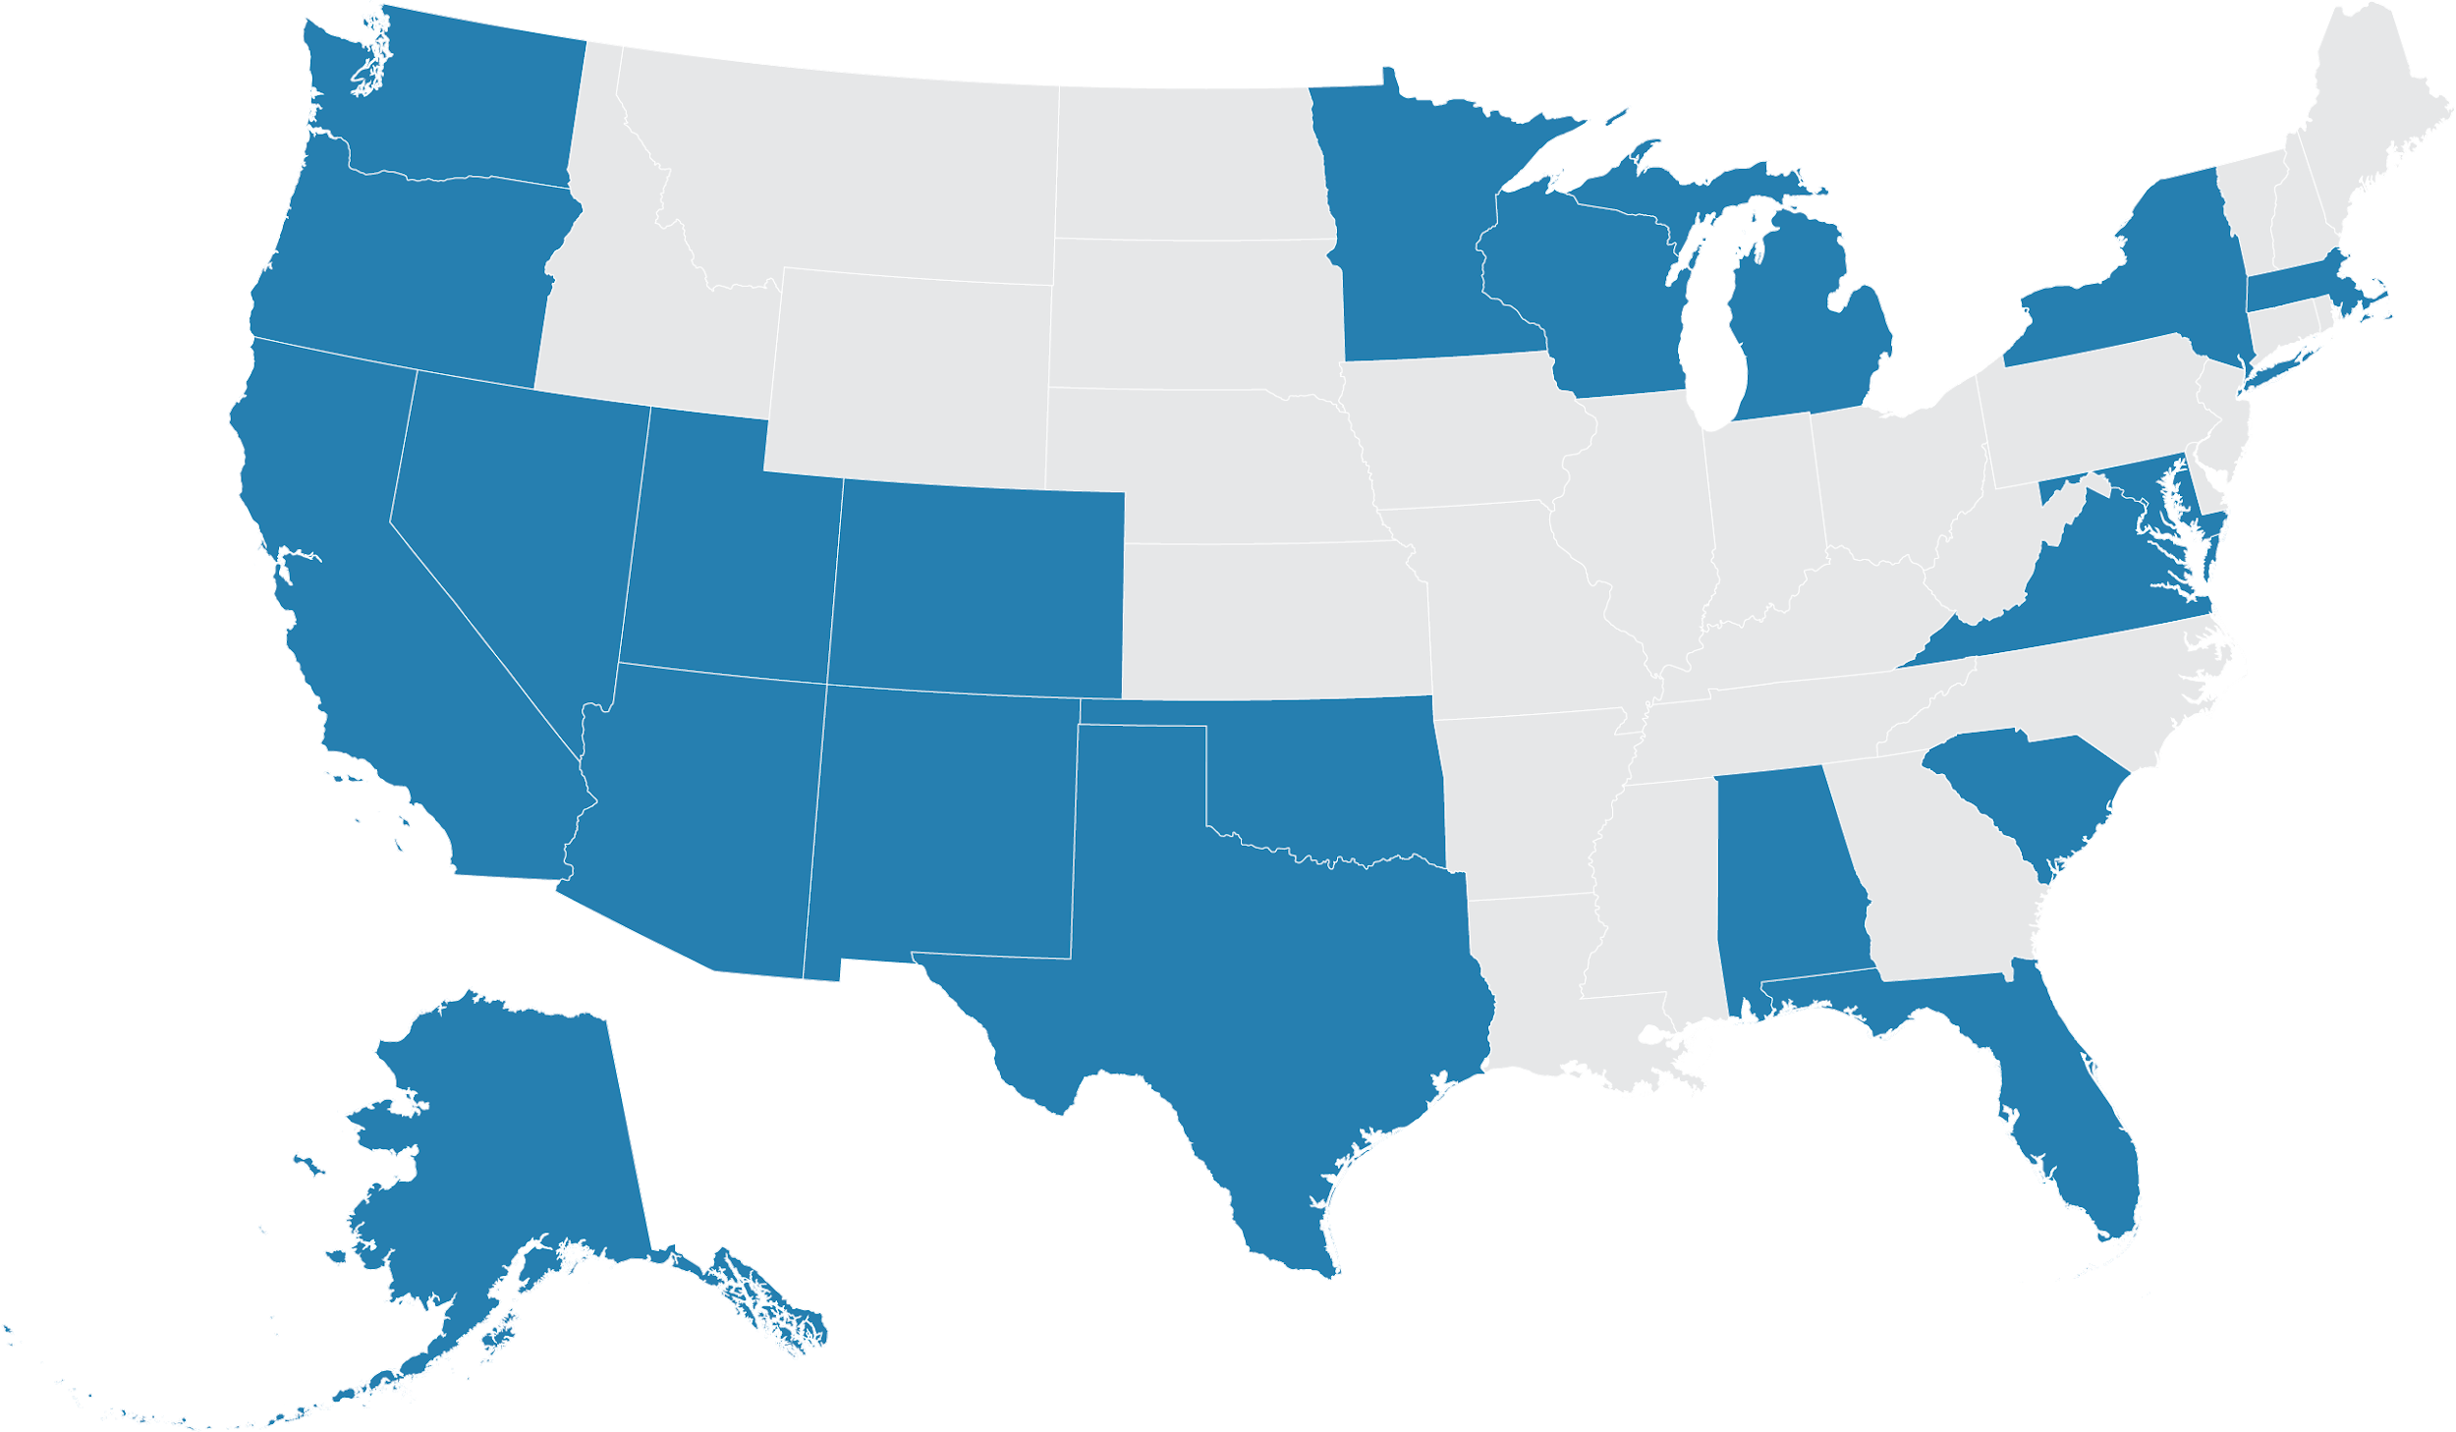
SERVIR Capitalizes on US Scientific Leadership
Brigham Young University
US Forest Service, Rocky Mountain Research Station
US Geological Survey, Salt Lake City
Maxar Technologies
Univ. of Colorado, Boulder
University of Wisconsin, Madison
Columbia University
International Research Institute for Climate and Society
Lamont Doherty Earth Observatory
University of Minnesota
Michigan State University
Amazon
University of Washington
Boston University
Clark University
Earth Big Data
Univ. of Massachusetts, Amherst
Woods Hole Research Center
Oregon State University
US Forest Service, PNW Research Station
Desert Research Institute
Johns Hopkins University
NASA Goddard Space Flight Center
University of Maryland
Univ. of Maryland, Baltimore County
Univ. of Maryland, College Park
USRA, Columbia
Columbus Technologies
ESRI
Google
Mapbox
NASA Jet Propulsion Laboratory
Spatial Informatics Group, LLC
University Of California, Los Angeles
University Of California, Santa Barbara
University of California, Berkeley
University of California, Irvine
University of San Francisco
DevSeed
Resources For The Future, Inc.
World Wildlife Fund
George Mason University
US Agency for International Development
USGS, Eastern Geographic Science Center
University of Richmond
Geospatial Collaborative LLC
Alaska Satellite Facility
University of Alaska Fairbanks
New Mexico State University
University of South Carolina
IFDC
NASA Marshall Space Flight Center
NASA SPoRT Center/ENSCO
Universities Space Research Association
University of Alabama in Huntsville
University of Florida, Gainesville
US research collaborators &
private sector partners
University Of Houston
Texas Agricultural Experiment Station
NOAA/National Severe Storms Laboratory
University of Oklahoma, Norman
10

Slide 13
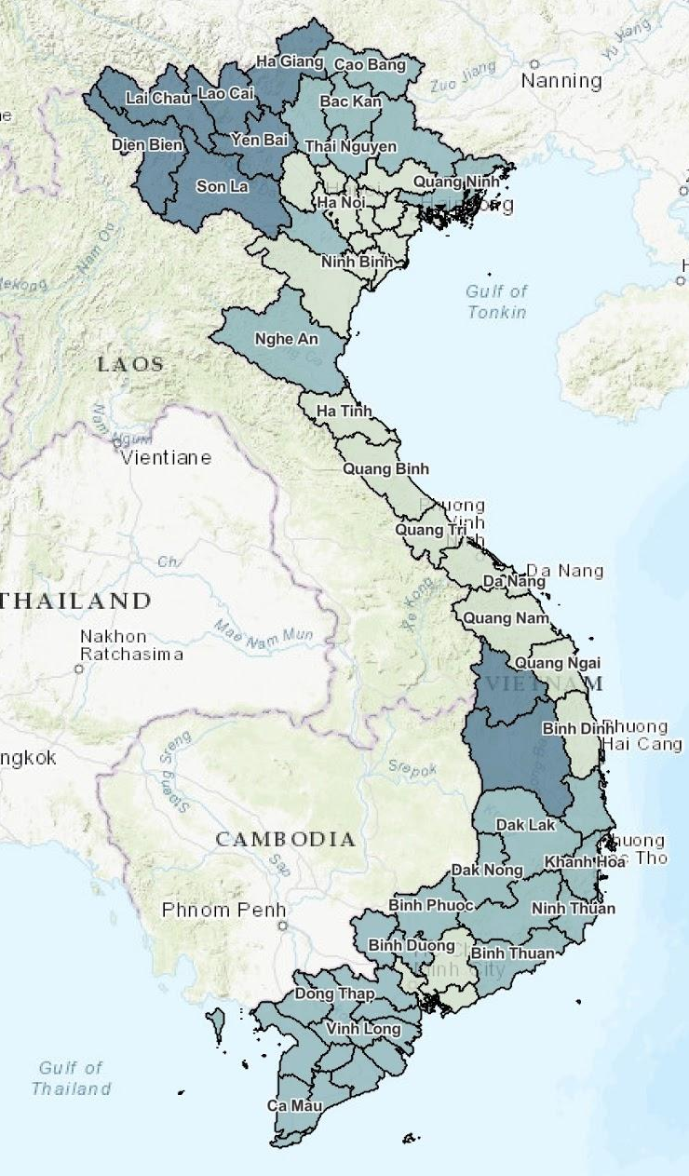
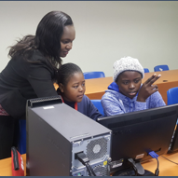


Capacity & Services: Gender Integration and Action
41% of people trained in 2019 identify as female
Building women leaders and gender champions in SERVIR
Empowering women and girls to explore STEM fields
Integrating gender considerations in service planning
Using remote sensing and GIS to address development issues that are inclusive of underrepresented groups
SERVIR-Mekong Vietnam Gender Inequality Index (GEII) serves gender differentiated data, giving insight into service design and delivery.
Grant awarded to build mentorship programs, expand GEII, and update the Service Planning Toolkit
18
Notes:
Image Credit: Public Photo on the SERVIR Service Catalog website
Photos obtained from the public SERVIR website,

Slide 14

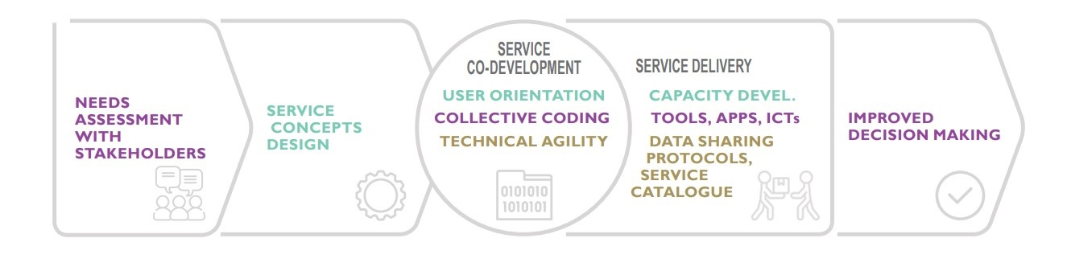

Slide 15
Applied Machine Learning:
-
Regional Land Cover Monitoring Service
Notes:
How democratizing AI for disaster response can build local to global climate resilience?

Slide 16
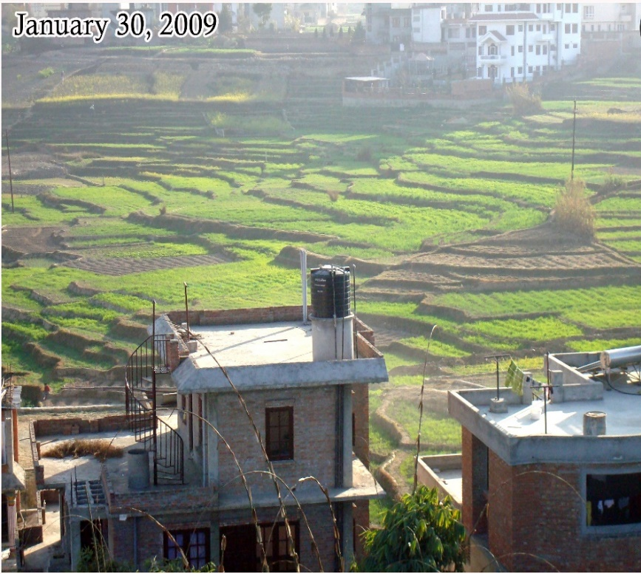


Regional land cover monitoring service
The Hindu Kush Himalaya and Lower Mekong Regions have experienced dramatic and rapid land cover change in recent years.
SERVIR Hub organizations build the capacity of end users through service Co-Development.
SERVIR Hub organizations build the capacity of end users through service Co-Development.
Notes:
Image Credit Kabir Uddin SERVIR HKH and SAR handbook
The Hindu Kush Himalaya and Lower Mekong Regions have experienced dramatic and rapid land cover change in recent years.
For instance in Myanmar, a shared HKH and Mekong focus country, the United Nations Food and Agriculture Organization (FAO) Forest Resource Assessment (FRA) reports, Myanmar's forest cover drastically declined from 58% in 1990 to 43% in 2015.
To meet the need for effective land cover and especially forest monitoring essential for the United Nations Framework Convention on Climate Change (UNFCCC), both SERVIR-HKH and SERVIR-Mekong co-developed along with [National Forest Departments and government groups: Nepal Forest Research and Training Center; Afghanistan Ministry of Agriculture Irrigation and Livestock; Bangladesh Forest Department]. Spatial Informatics Group, USFS, OneMap Myanmar and University of Maryland the Regional Land Cover Monitoring System (RLCMS)

Slide 17
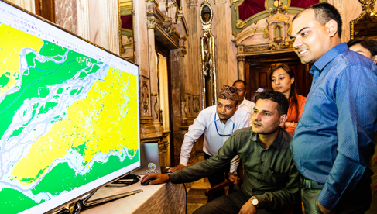
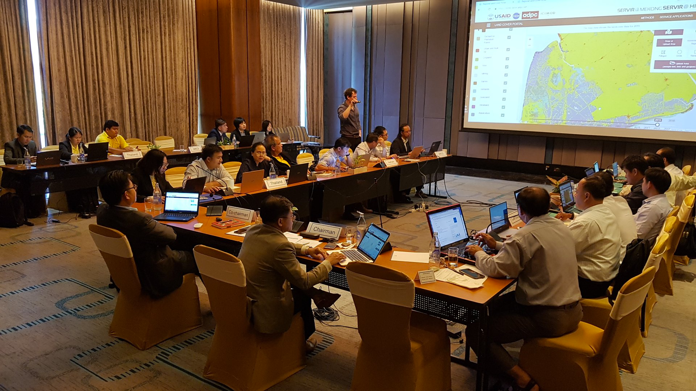
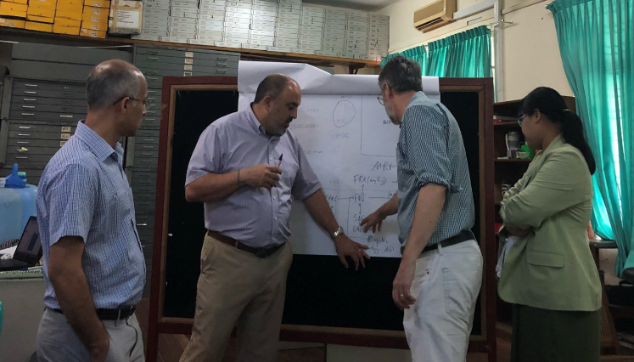
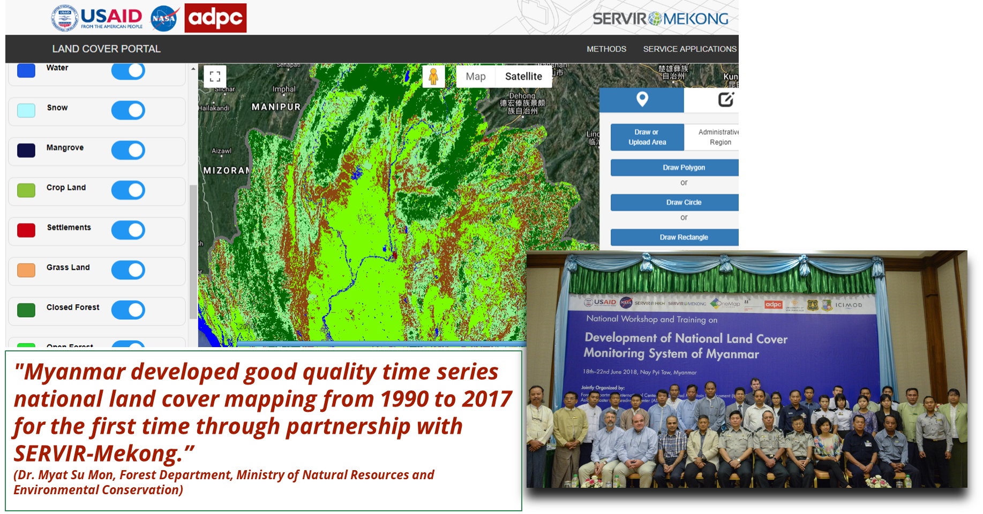
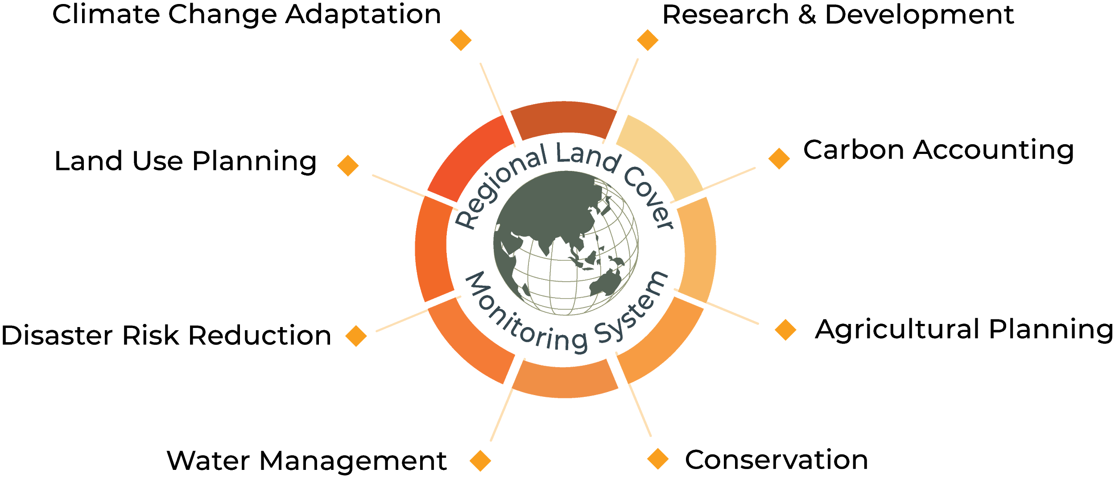
Regional land cover monitoring service
RLCMS is a web-based tool being developed using cloud-based technology to produce land cover maps on a yearly basis
Notes:
Image Credit: SERVIR Service Catalog SERVIR, Global Website, Amanda Markert, Lee Ellenburg, and Kabir Uddin
Photos obtained from the public SERVIR website,
To meet the need for effective land cover and especially forest monitoring essential for the United Nations Framework Convention on Climate Change (UNFCCC), both SERVIR-HKH and SERVIR-Mekong co-developed along with [National Forest Departments and government groups: Nepal Forest Research and Training Center; Afghanistan Ministry of Agriculture Irrigation and Livestock; Bangladesh Forest Department]. Spatial Informatics Group, USFS, OneMap Myanmar and University of Maryland the Regional Land Cover Monitoring System (RLCMS)

Slide 18
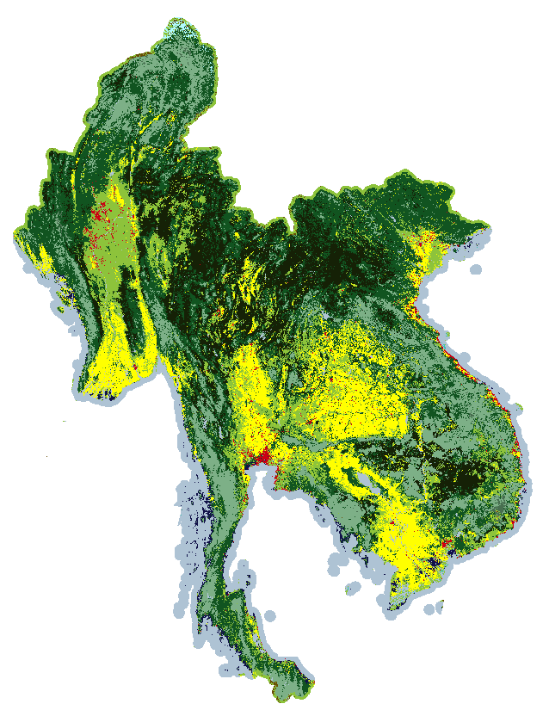
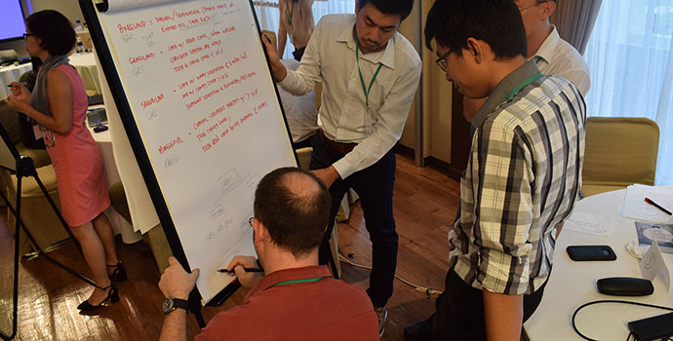
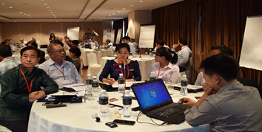
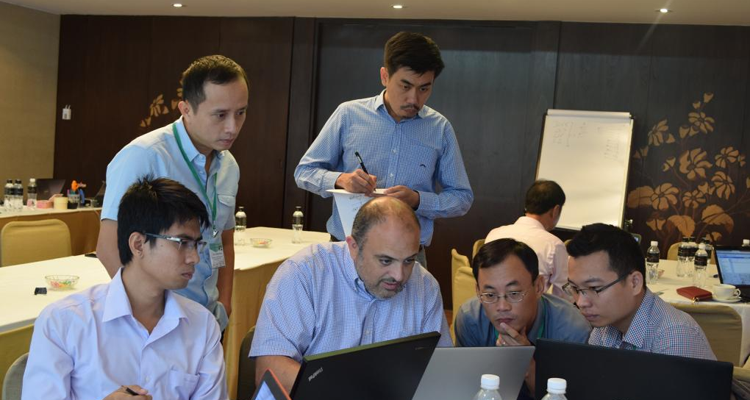
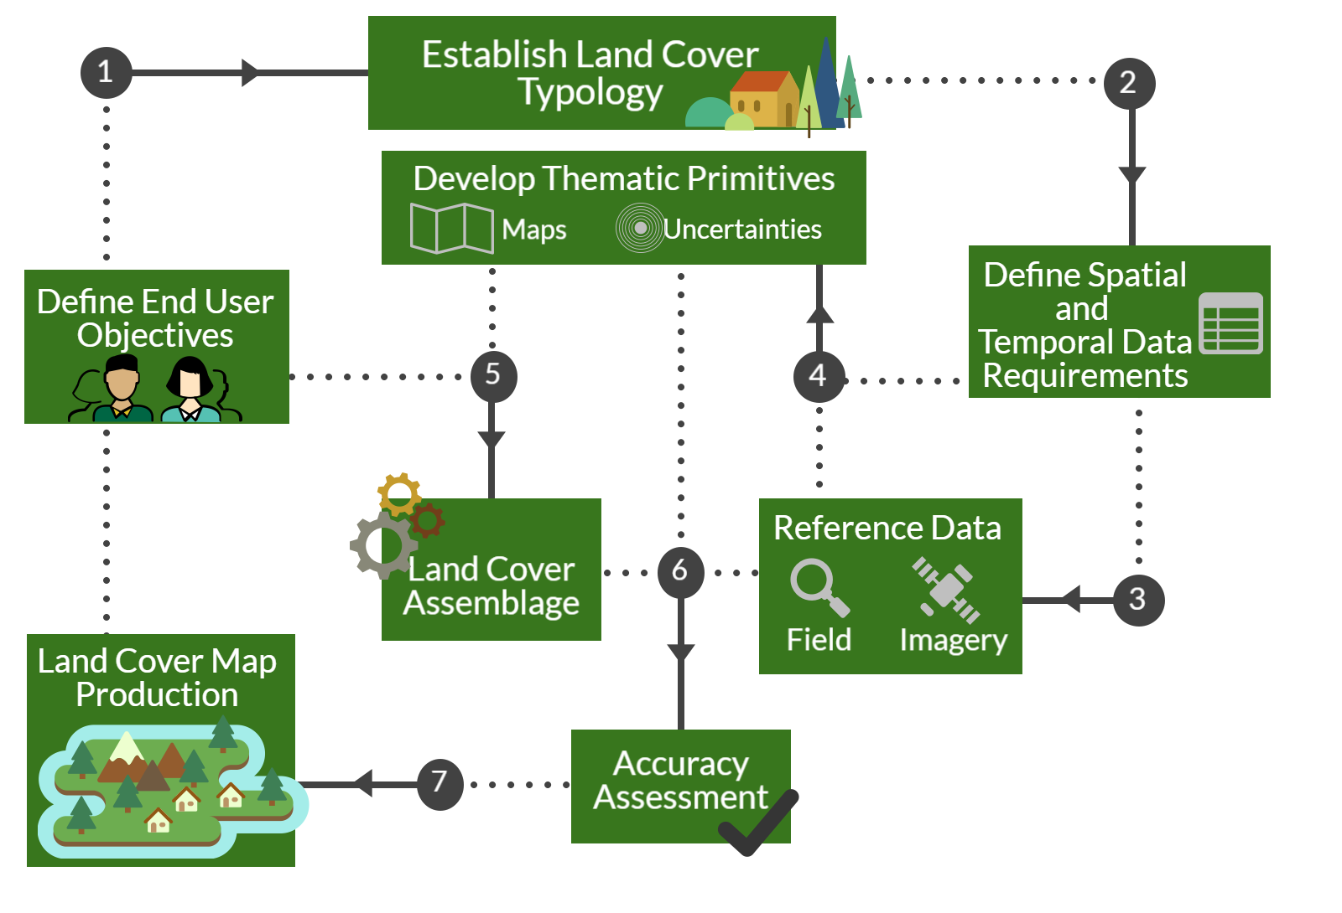
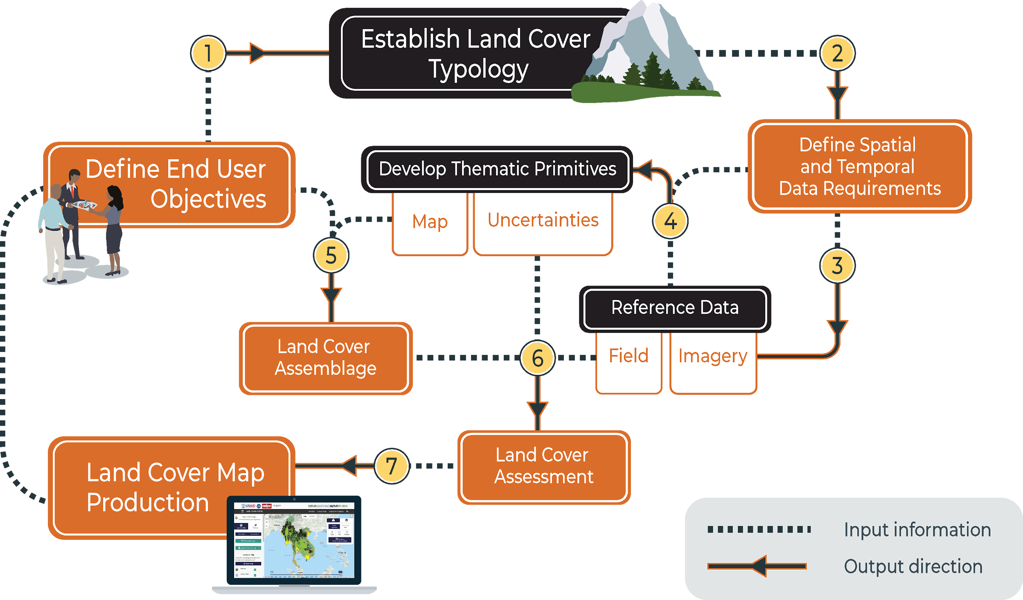
Regional land cover monitoring service
Notes:
Image Credit: Amanda Markert, Lee Ellenburg, Kabir Uddin, David Saah, and SERVIR Service Catalog
Regional Land Cover Mapping System (RLCMS) is important foundation for an array of regional services
Within RLCMS framework, highlighting orange is Reference Field Data which was obtained with the Collect Earth Online (CEO) System

Slide 19
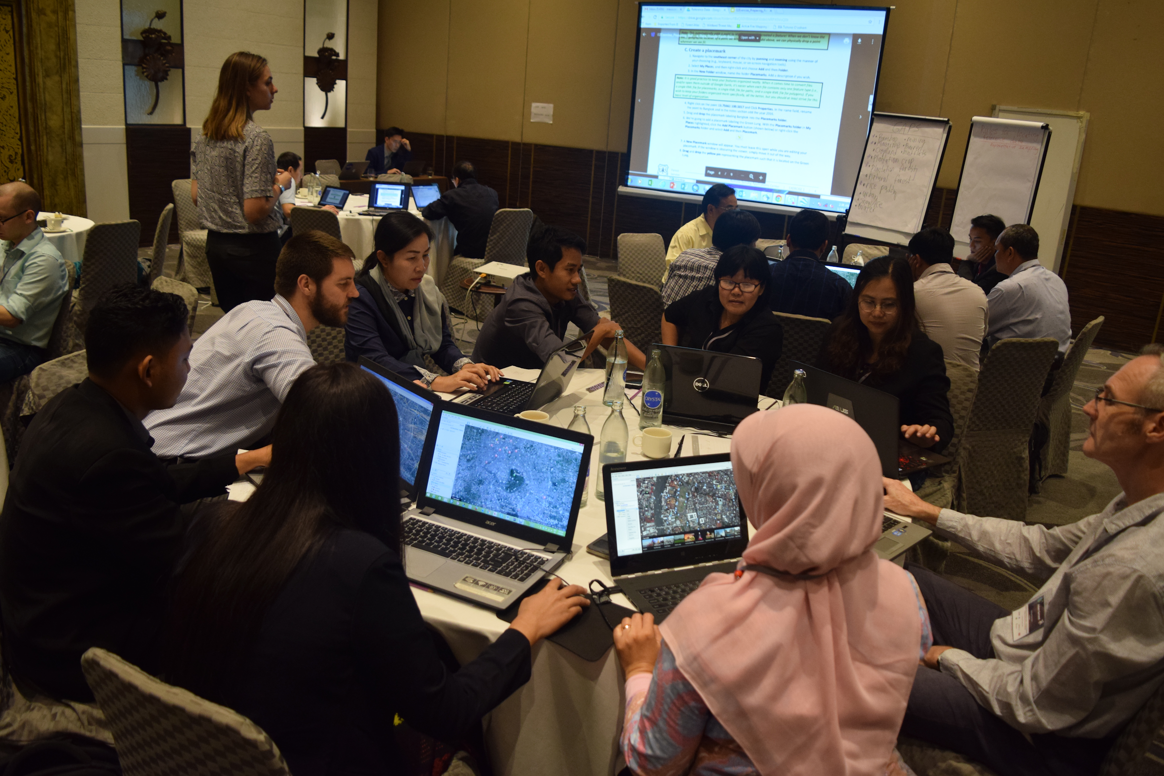
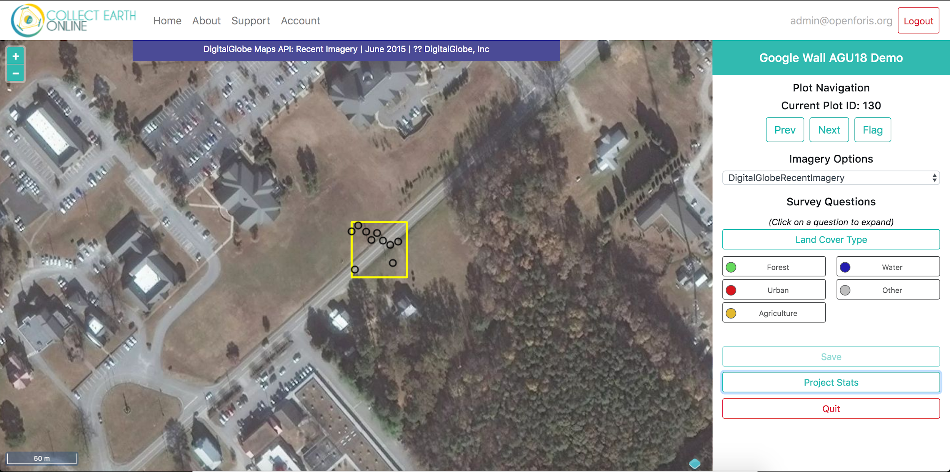
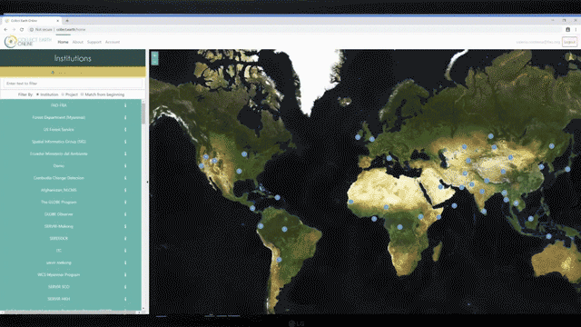
Collect Earth Online (CEO)
CEO is an open source platform for global data collection essential for forest monitoring and reporting
Notes:
Image Credit: Amanda Markert, Lee Ellenburg, Kabir Uddin, David Saah, and SERVIR Service Catalog
Photos obtained from the public SERVIR website
Introduced in December 2018, CEO is an open-source, online platform that uses satellite data to quickly generate reference data for land cover classification analyses.
The UN’s Food and Agriculture Organization (FAO) has selected CEO as the primary tool for the 2020 Global Forest Resources Assessment (FRA), to be conducted in approximately 190 countries. The first use of CEO will occur in India in March 2019.
CEO offers a paradigm shift from current methods. Users generate reference data through online analyses of satellite measurements, thus significantly reducing the requirement to collect data in the field.
CEO was developed by SERVIR, in partnership with FAO, the Google Earth Engine Team, and the USG SilvaCarbon Program.

Slide 20

SERVIR
TensorFlow Working Group
Notes:
Image Credit: GDJ
Free for Commercial use no attribution required

Slide 21
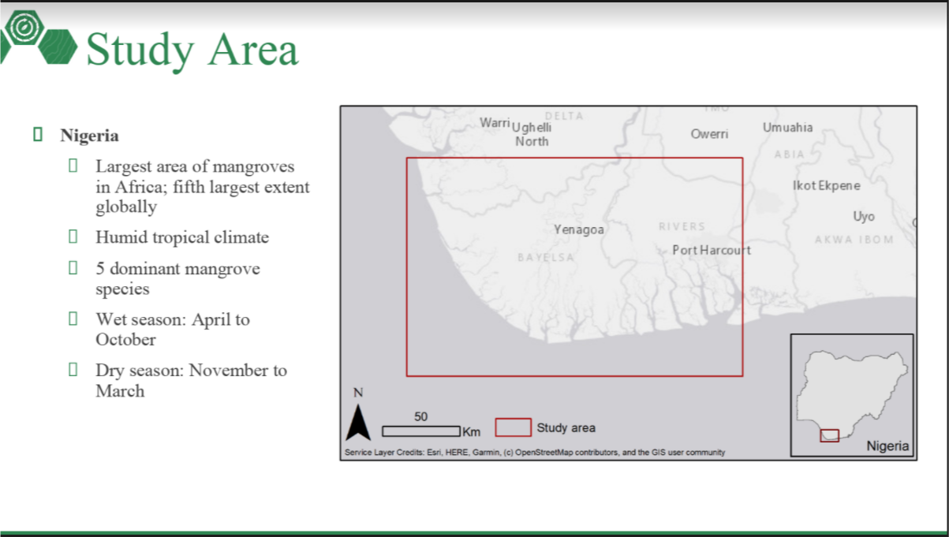
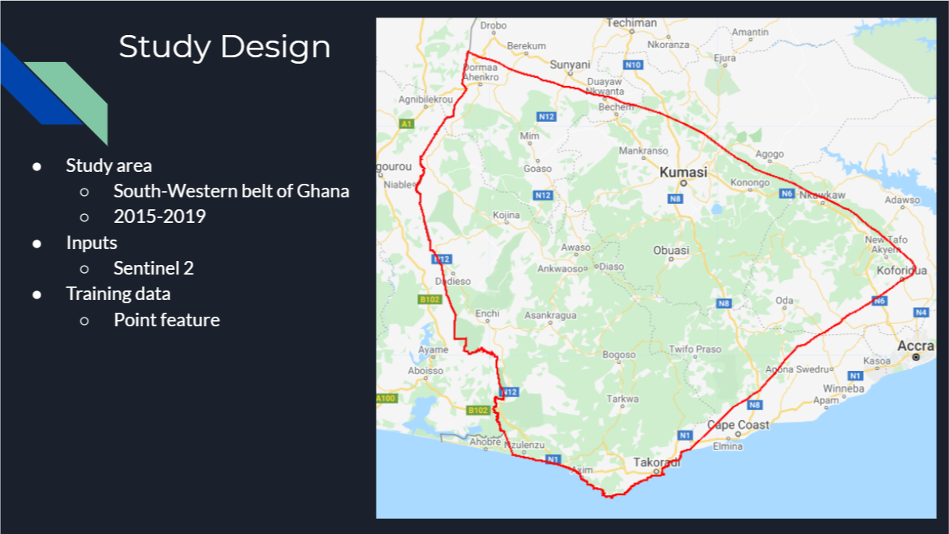
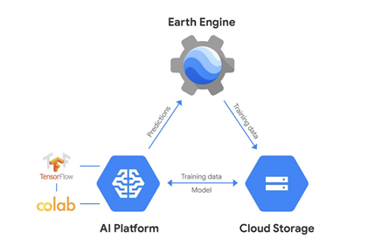
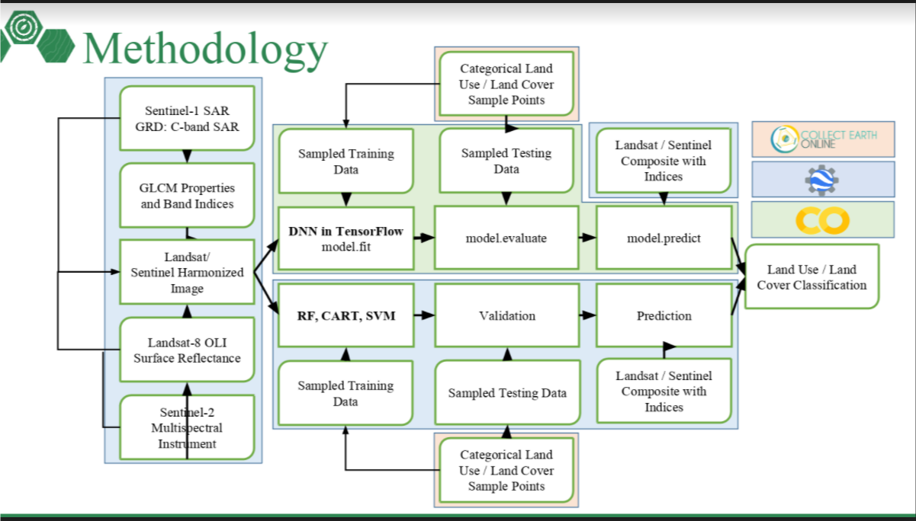
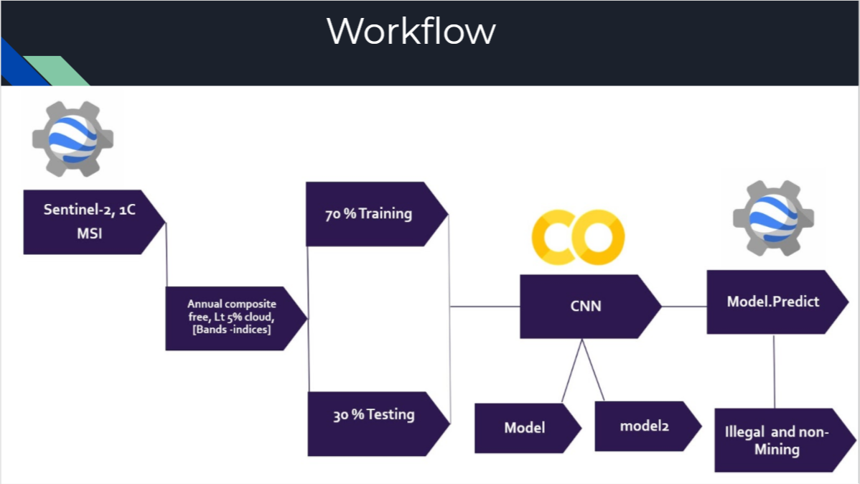
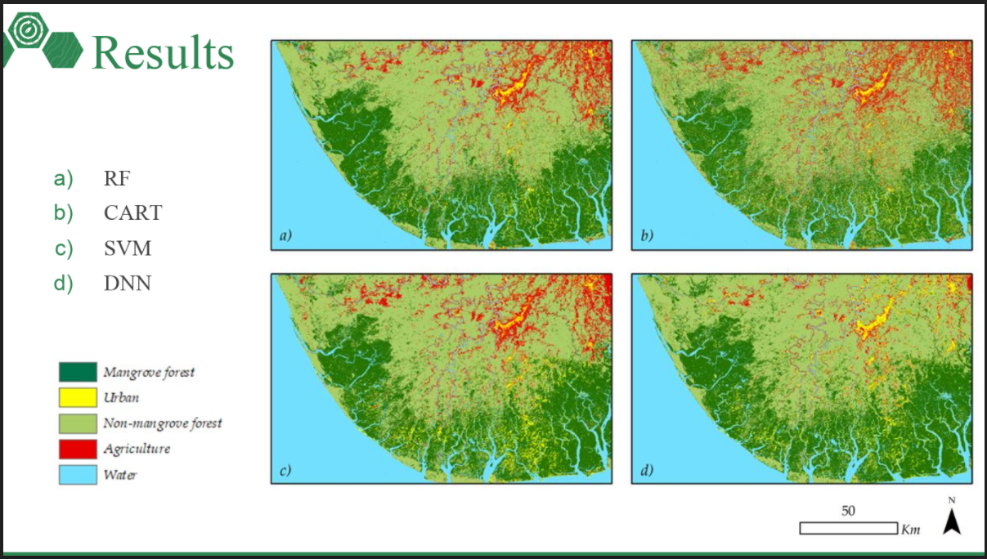
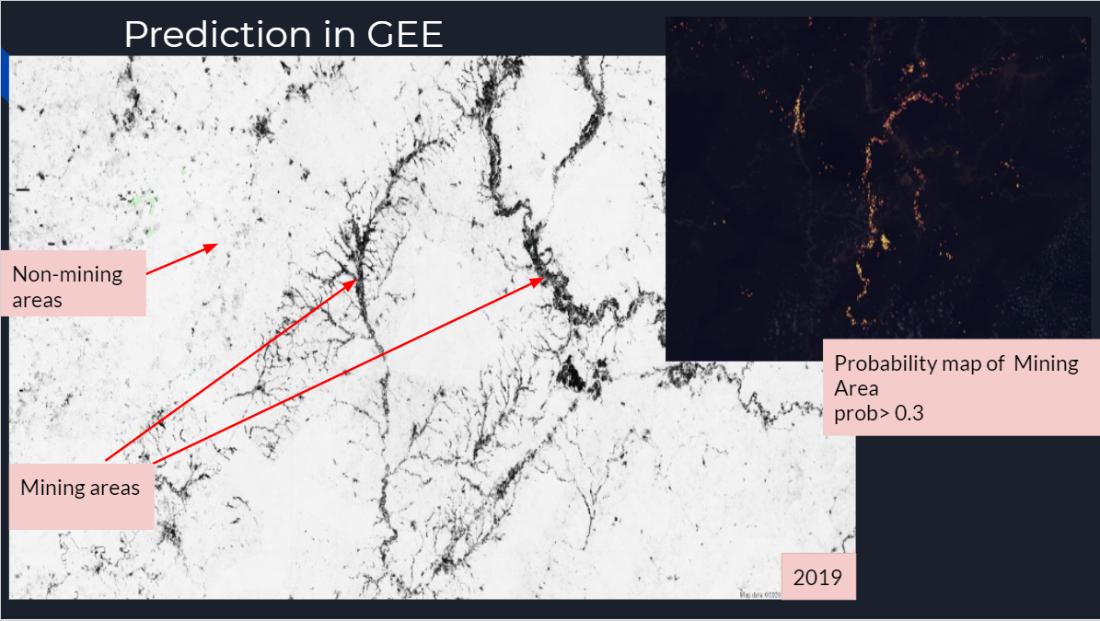
SERVIR TensorFlow Working Group Examples
Notes:
Image Credit: Katie Strattman; Modou Mbaye, Abena Asare-Ansah

Slide 22
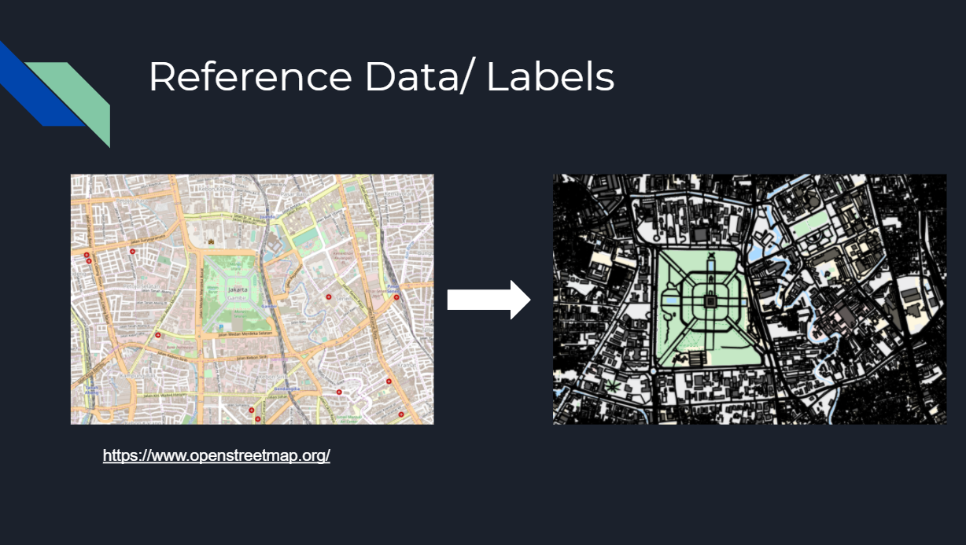
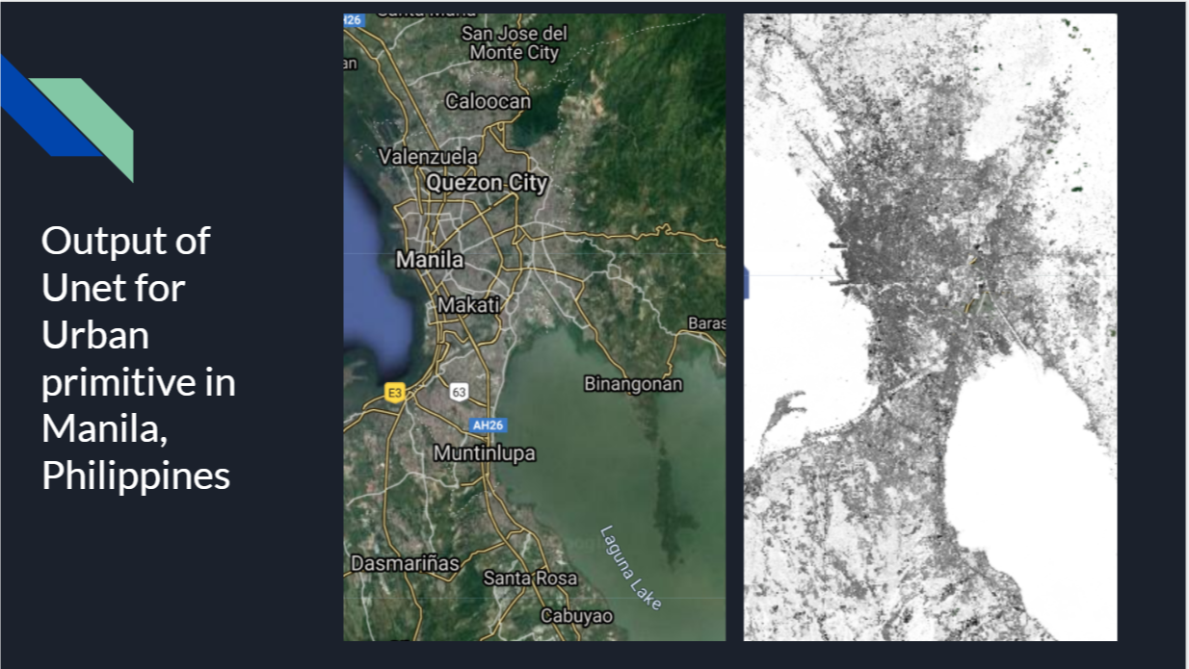
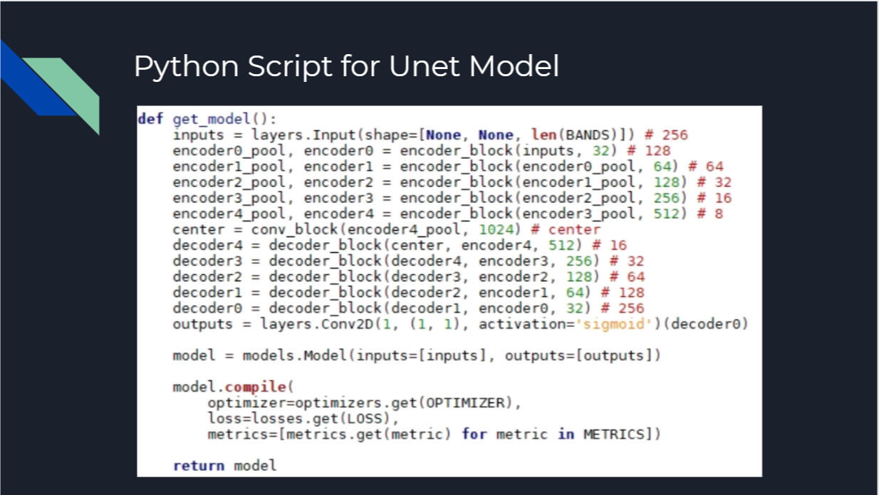
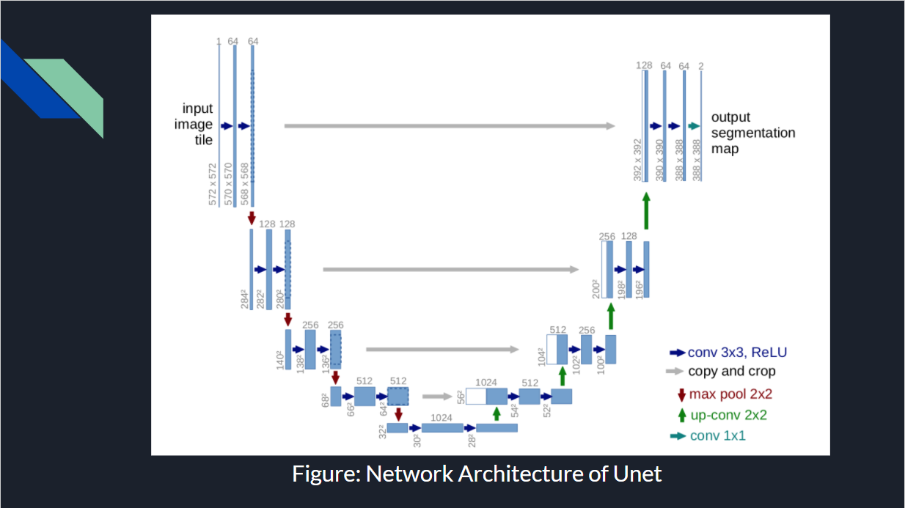
SERVIR TensorFlow Working Group Examples
Notes:
Image Credit: Ate Poortinga, Nyein Soe Thwal at SERVIR Mekong

Slide 23

SERVIR TensorFlow Working Group
Goal of the TensorFlow Working Group is to create a community of practice, share methodologies, and build capacity to leverage ML and AI
-
Contact me to join
Notes:
Image Credit: geralt Free for commerical use , no attribution required
https://pixabay.com/illustrations/personal-collective-hexagon-group-3285993/
-
We are looking for presenters and collaborators in our community of practice

Slide 24
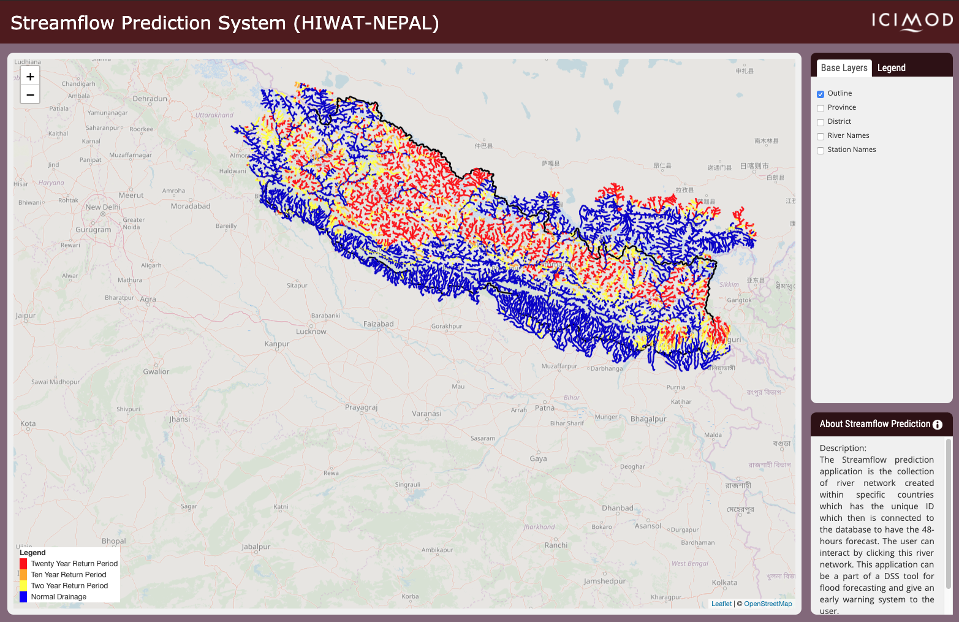
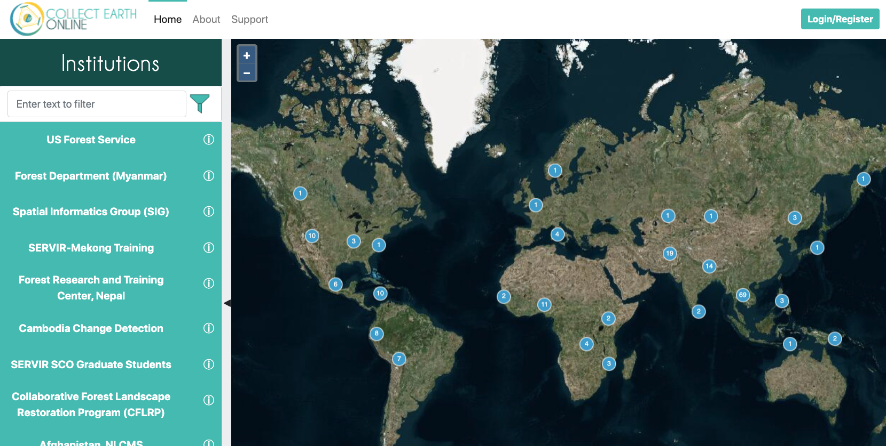

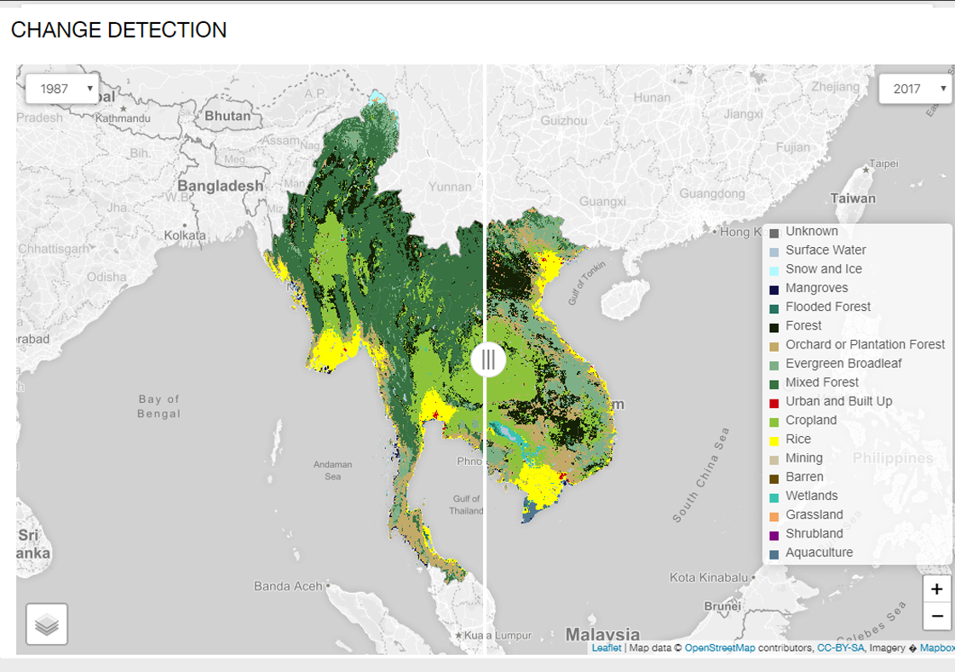
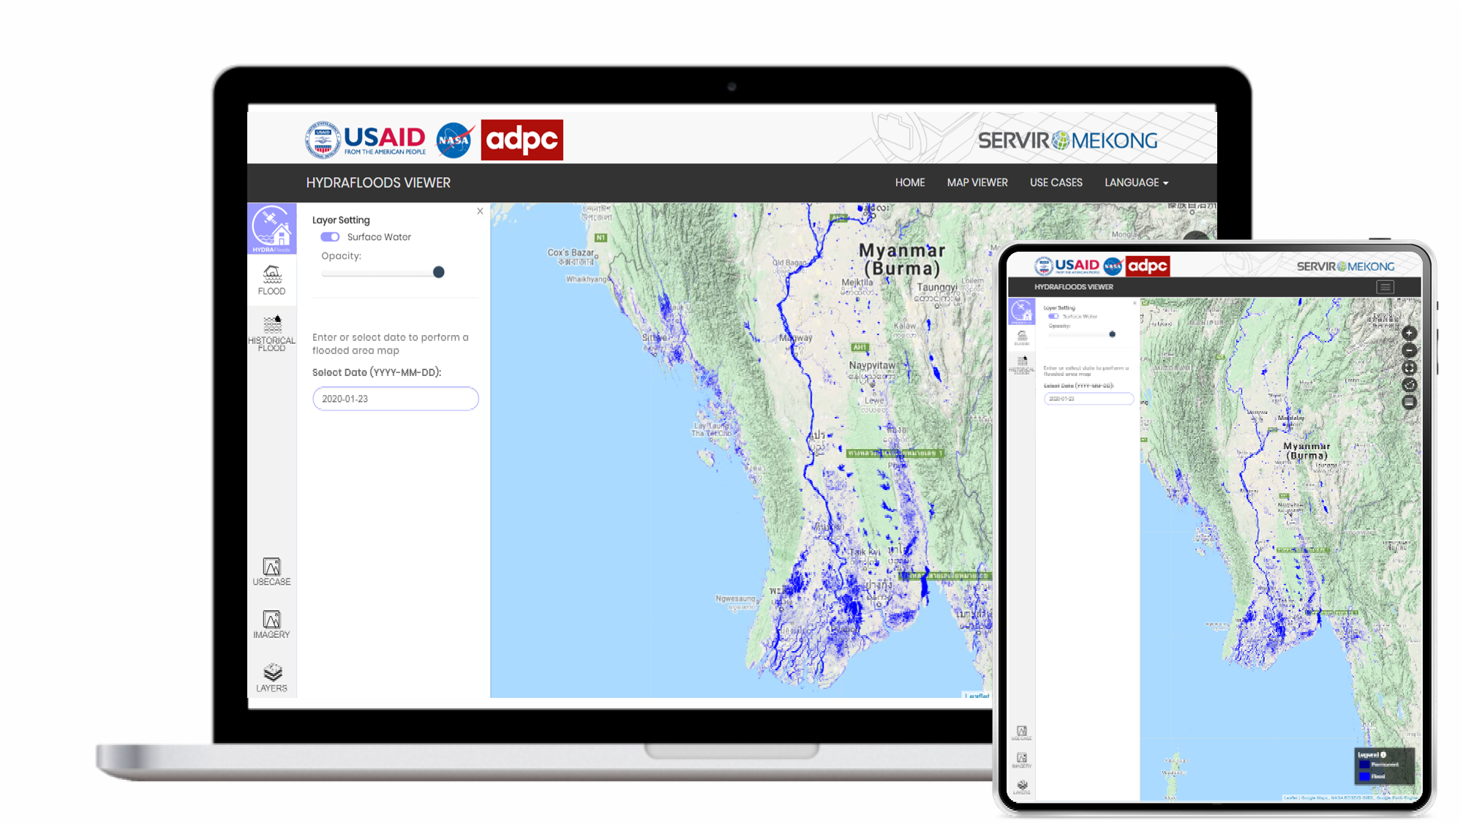
Services: Scaling, Replicating, and Exchanging across the SERVIR Global Network
Streamflow Prediction Tool
Hydrologic forecast system supports official flood bulletins in Nepal, scaled to Americas, Africa, and Asia through GEOGLOWS
Collect Earth Online (CEO)
Used in Forest Resource Assessments worldwide and to collect reference data across thematic areas
HydraFloods
Country-to-country replication from Myanmar to Cambodia to prioritize food assistance in the face of floods via WFP
RLCMS
Further adoption of Regional Land Cover Monitoring System (RLCMS) at regional and national levels

Slide 25
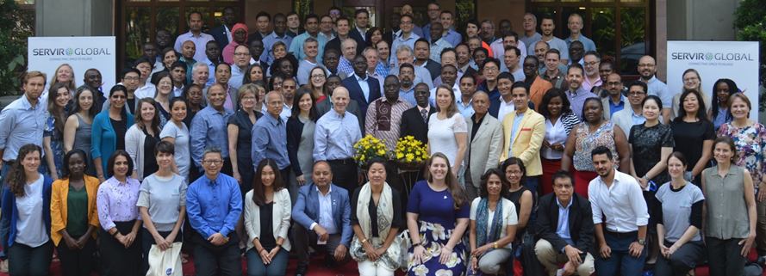
Capacity: Power & Depth of the SERVIR Network
2020 SERVIR Annual Global Exchange, Siem Reap, Cambodia
Notes:
Image Credit: Public Photo on the SERVIR global website
Photos obtained from the public SERVIR website,

Slide 26

Thank You.
Tim Mayer, NASA SERVIR Hindu Kush Himalaya Regional Science and Coordination Lead
For further questions, please contact: timothy.j.mayer@nasa.gov
Notes:
Photo Credit: Tim Mayer

Slide 27

Notes:
Image Credit: Public Photo on the SERVIR global website
Photos obtained from the public SERVIR website,

Slide 28
Acknowledgements
Any opinions, findings, and conclusions or recommendations expressed in this material are those of the authors and do not necessarily reflect the views of the National Aeronautics and Space Administration (NASA). Any mention of commercial product, service, or activity in this material does not constitute NASA endorsement. This material is based upon work supported by NASA through Co-operative agreement number: NNM11AA01A Task no.: 2.4.4
The authors would like to acknowledge the Earth System Science Center at the University of Alabama in Huntsville, the SERVIR Science Coordination Office, the NASA Applied Sciences Program, NASA Capacity Building Program, SERVIR-Eastern and Southern Africa at the Regional Center for Mapping of Resources for Development (RCMRD) in Nairobi. SERVIR-Hindu Kush Himalayan (HKH) at the International Centre for Integrated Mountain Development (ICIMOD) in Kathmandu, Nepal. SERVIR-Mekong at the Asian Disaster Preparedness Center (ADPC) in Bangkok Thailand, and the consortium partners include Spatial Informatics Group (SIG), Deltares, and Stockholm Environment Institute (SEI).. SERVIR- West Africa at the Agriculture, Hydrology and Meteorology Regional Centre (AGRHYMET) in Niamey, Niger, along with their consortium of regional technical partners, including CSE and CERSGIS. SERVIR-Amazonia at the International Center for Tropical Agriculture (CIAT) in Cali, Columbia and the consortium partners include ACCA and IMAFLORA. Additionally, information and photos were provided and used with their permission by the various SERVIR hub points of contact who are actively engaged in the partnership in their respective regions and countries.

Slide 29
Applied Machine Learning:
-
Supporting Near Real-Time Flood Monitoring in Myanmar
Notes:
How democratizing AI for disaster response can build local to global climate resilience?

Slide 30

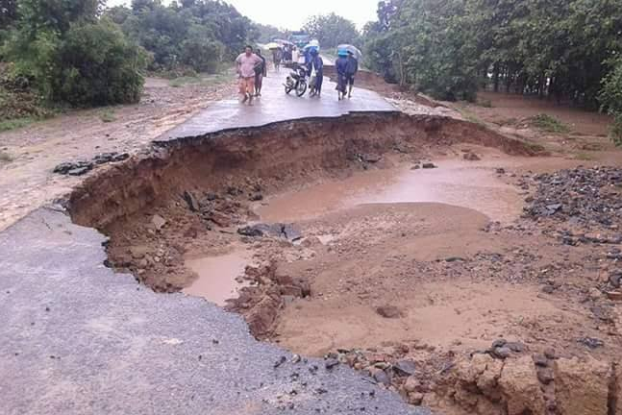
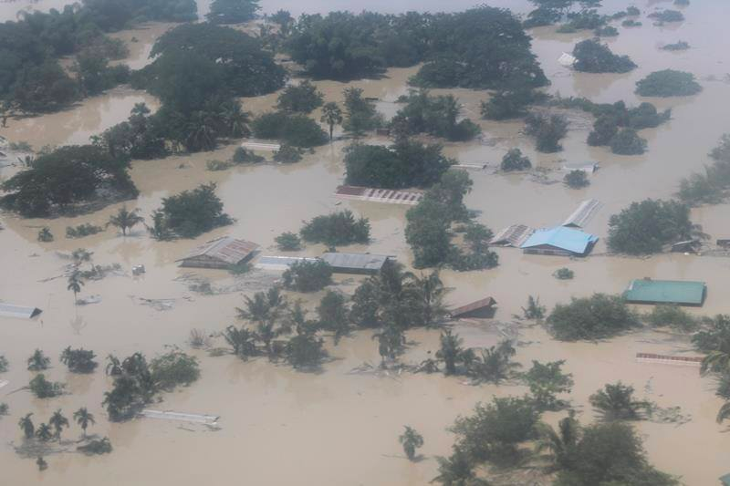
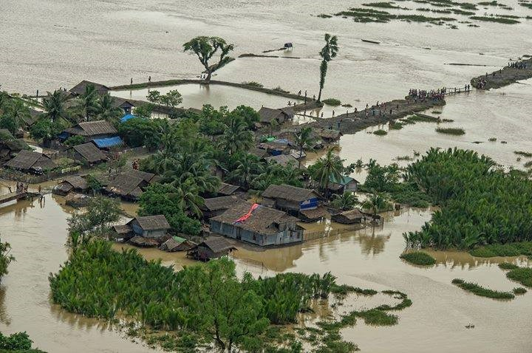
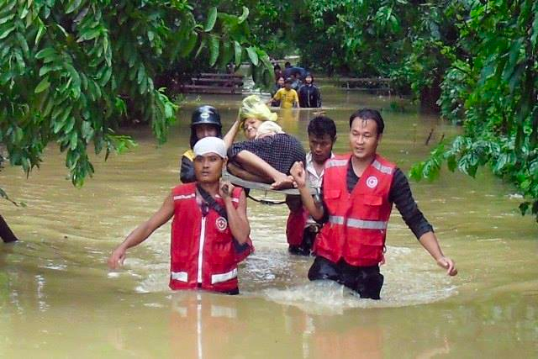
Supporting Near Real-Time Flood Monitoring in Myanmar
Myanmar is greatly affected due to monsoon rains and tropical cyclones
Co-Development of geospatial tools is a mechanism for preparedness and capacity building.
Notes:
Image Credit: Amanda Markert and SERVIR Service Catalog
Photos obtained from the public SERVIR website
Monsoon rains and tropical cyclones cause recurrent floods in Myanmar.
There exists a direct need to monitor and disseminate information regarding inundated areas in near real-time to allow emergency response operations and support relief activities by national and international organizations.
To meet the need of rapid flood monitoring map products SERVIR- Mekong, Spatial Informatics Group, Deltares, Stockholm Environment Institute Co-Developed with OneMap Myanmar, Myanmar Department of Disaster Management (DDM), Department of Meteorology and Hydrology (DHM) The HYDrologic Remote sensing Analysis for Floods (HYDRAFloods) system

Slide 31







Hydrological Remote Sensing Analysis of Floods (HYDRAFloods)
Edge detection
Notes:
Image Credit: Kel Markert
Sentinel 1: hydrafloods.Sentinel1
Sentinel 2: hydrafloods.Sentinel2
Landsat 8: hydrafloods.Landsat8
Landsat 7: hydrafloods.Landsat7
VIIRS: hydrafloods.Viirs
MODIS: hydrafloods.Modis
-
Lee Sigma: hydrafloods.lee_sigma (Lee et al., 2008)
Gamma Map: hydrafloods.gamma_map (Beauchemin et al., 1995)
Refined Lee: hydrafloods.refined_lee (Lee, 1981)
-
Edge Otsu: hydrafloods.edge_otsu (Donchyts et al., 2016; Markert et al., 2020)
Bmax Otsu: hydrafloods.bmax_otsu (Cao et al.,2019; Markert et al., 2020)
KMeans Extent: hydrafloods.kmeans_extent (Chang et al., 2020)

Slide 32


Hydrological Remote Sensing Analysis of Floods (HYDRAFloods)
HYDRAFloods is a web-based multiple satellite tool that generate daily flood water maps.
Flooding Event
Date: July 2019
Location: Myitkyina,Myanmar
Notes:
Image Credit: Amanda Markert and Kel Markert
Service
HYDRAFloods system, a web-based (Hydraviewer) tool that leverages the most recently available remotely sensed data acquired by multiple satellite platforms and Data fusion techniques to generate daily flood water maps.
The HYDRAFloods tool employs the most recently available optical, active- and passive- microwave remote sensing data from the MODIS, VIIRS, ATMS, Sentinel 1, Sentinel 2, and Landsat 5,7,8 sensors to generate flood maps enabling more timely, in-depth analysis, and monitoring of flood events.

Slide 33

Hydrological Remote Sensing Analysis of Floods Viewer (HYDRAViewer)
Notes:
How democratizing AI for disaster response can build local to global climate resilience?

