Slide 1
Empowering Commercialization with
New Technologies and Capabilities
By LaNetra Tate

Slide 2
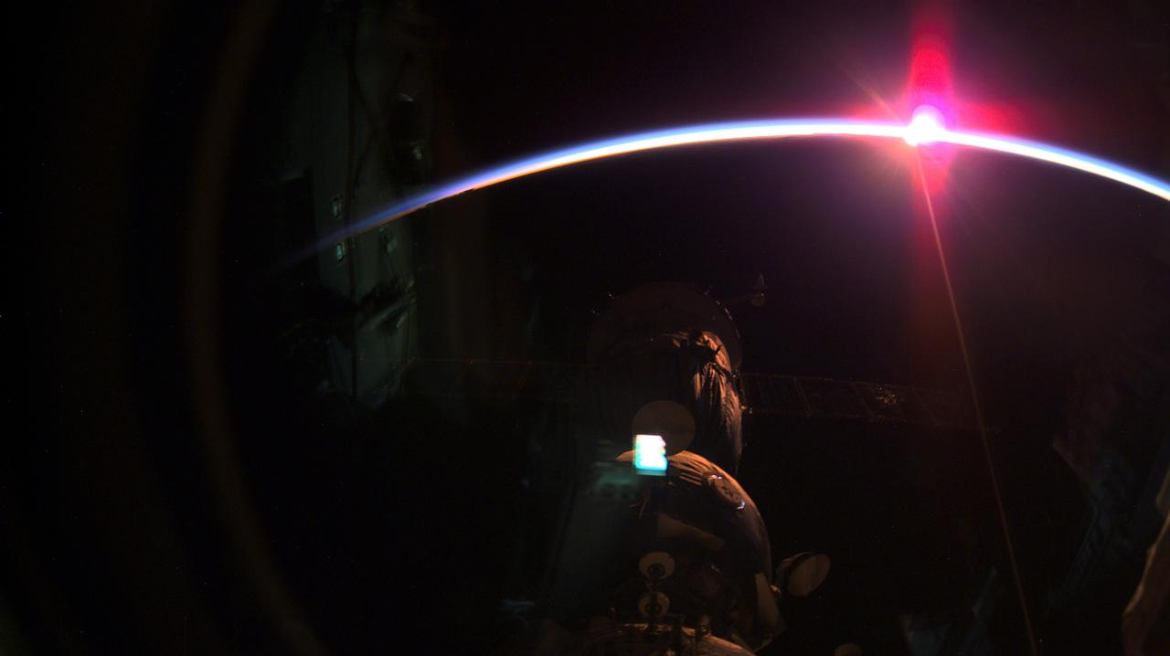
Enhancing Capabilities
Most NASA missions use radio frequency communications to send data to and from spacecraft. Radio waves have been used in space communications since the beginning of space exploration and have a proven track record of success.
However, as space missions generate and collect more data, the need for enhanced communications capabilities becomes paramount. Optical communications is one of these critical enhancements.
Optical communications can benefit large satellites and small satellites.

Slide 3
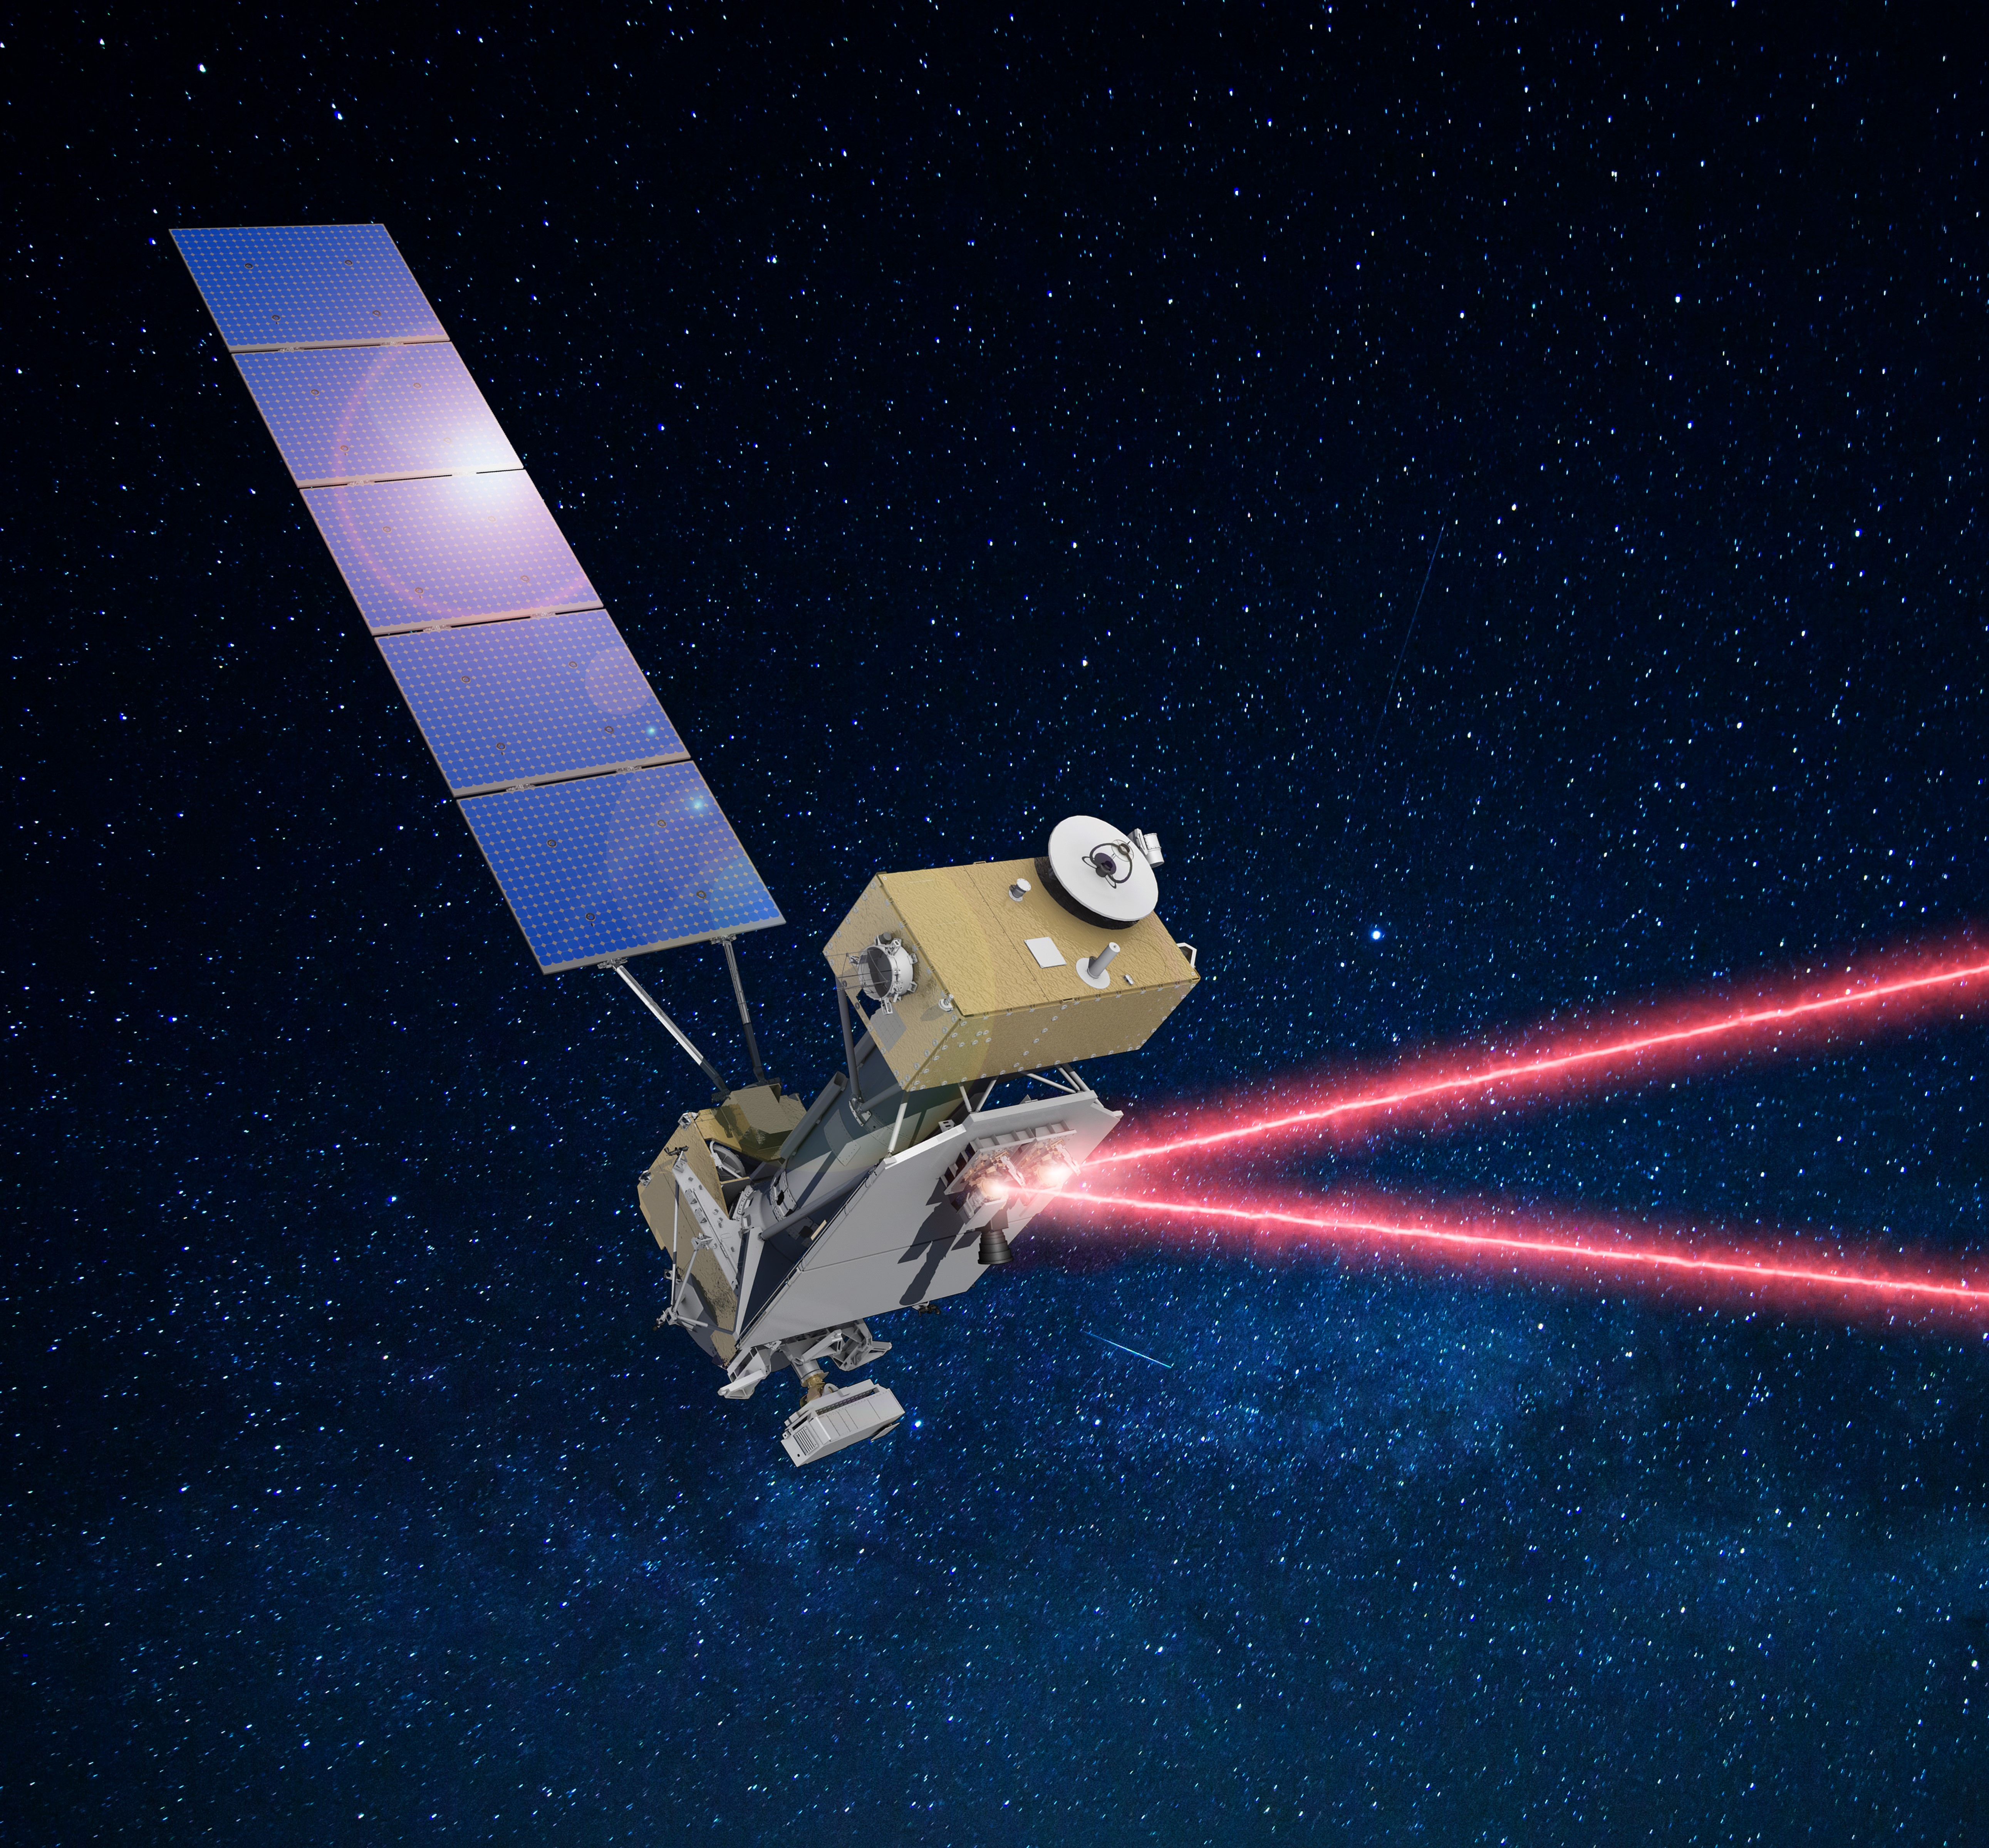

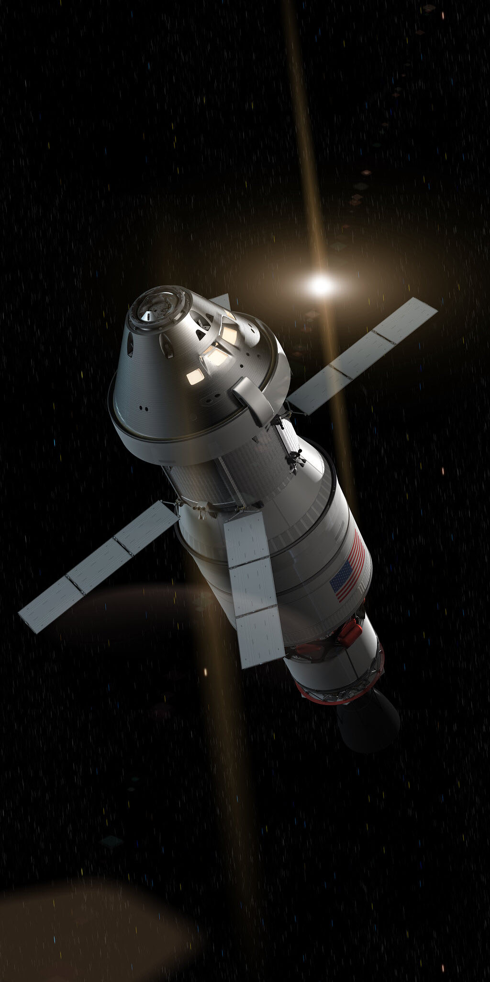
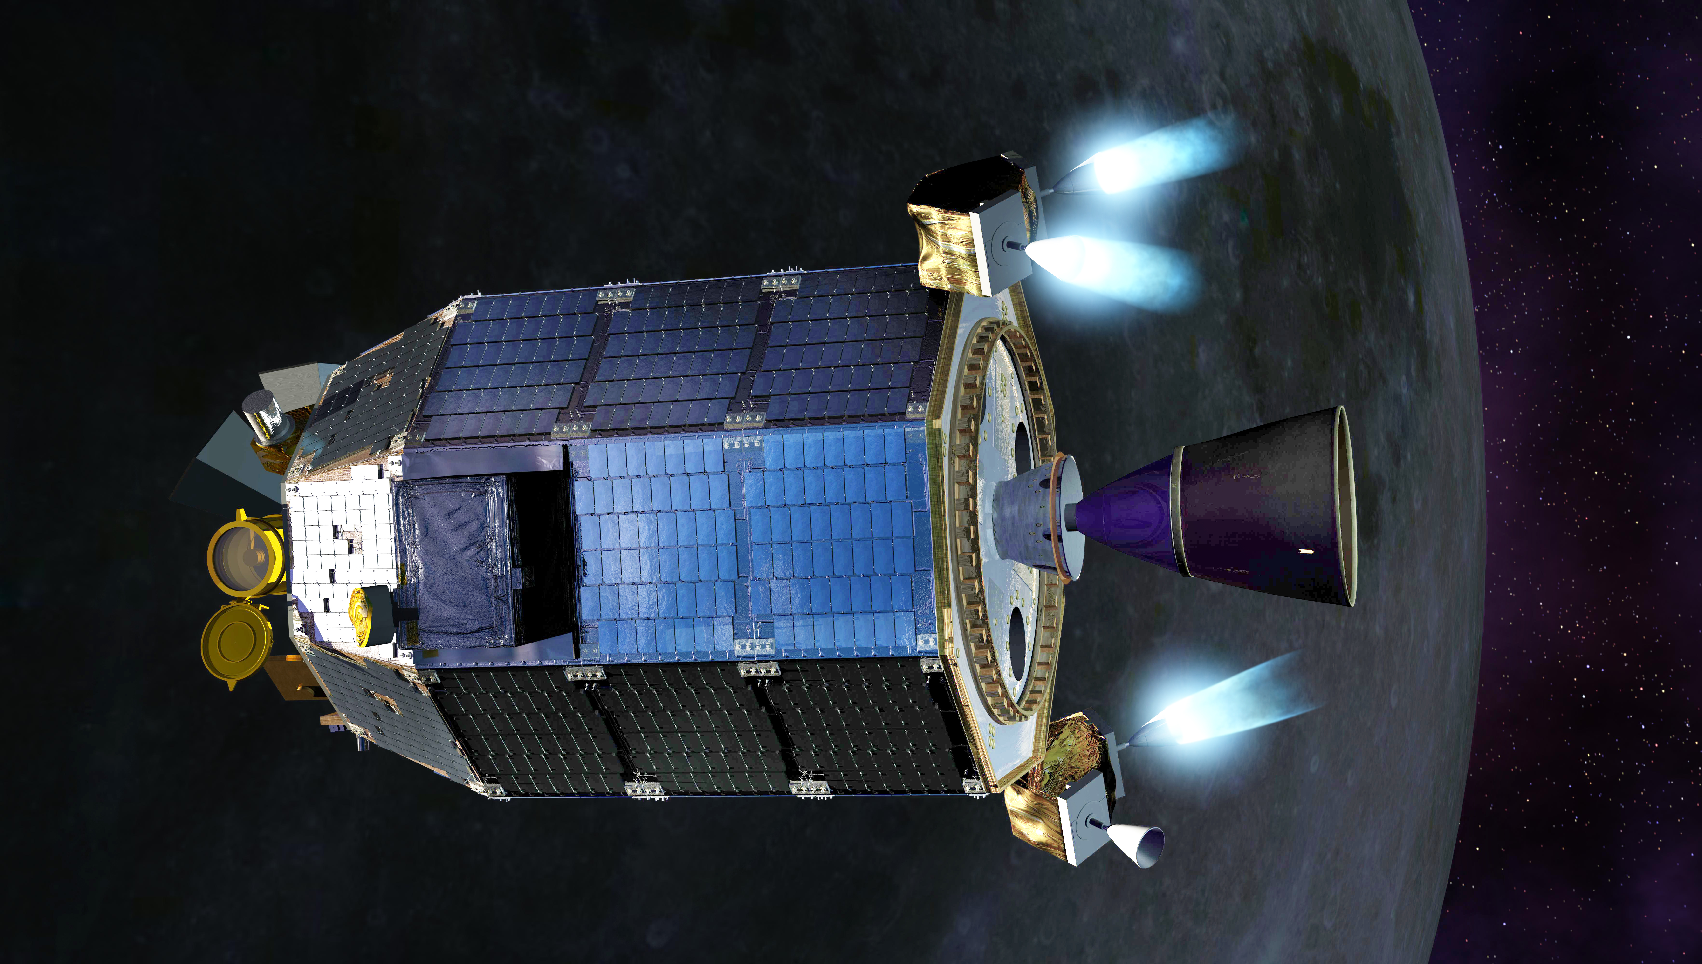
LLCD
LCRD
ILLUMA-T
O2O
Optical Communications
Optical communications use infrared light rather than radio waves as a means to transmit data.
NASA is developing optical communications to increase data capabilities for missions. With optical communications supplementing radio, missions will have unprecedented flexibility.
Missions collect data and then beam this data down over lasers to ground stations on Earth. This data is then forwarded to scientists and researchers, who analyze the data and make discoveries about Earth or deep space.

Slide 4
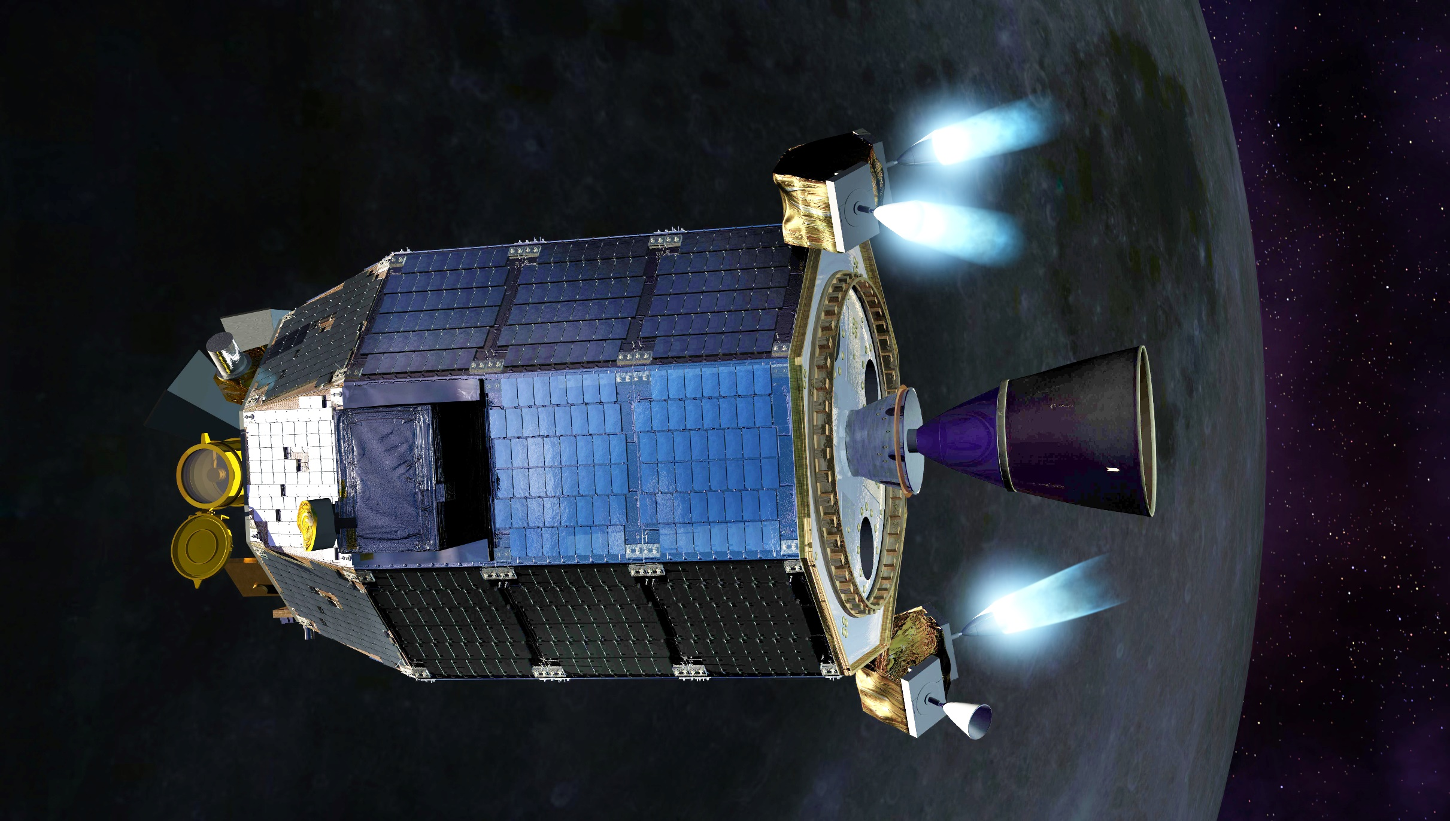
The Benefits
Optical communications provides bandwidth increases of 10 to 100 times more than radio frequency systems. Allowing missions to send more data at once.
Optical systems provide decreased size, weight, and power requirements. A smaller size means more room for science instruments. Less weight means a less expensive launch. Less power means less drain on the spacecraft’s batteries.
With optical communications supplementing radio, missions will have unparalleled communications capabilities.

Slide 5

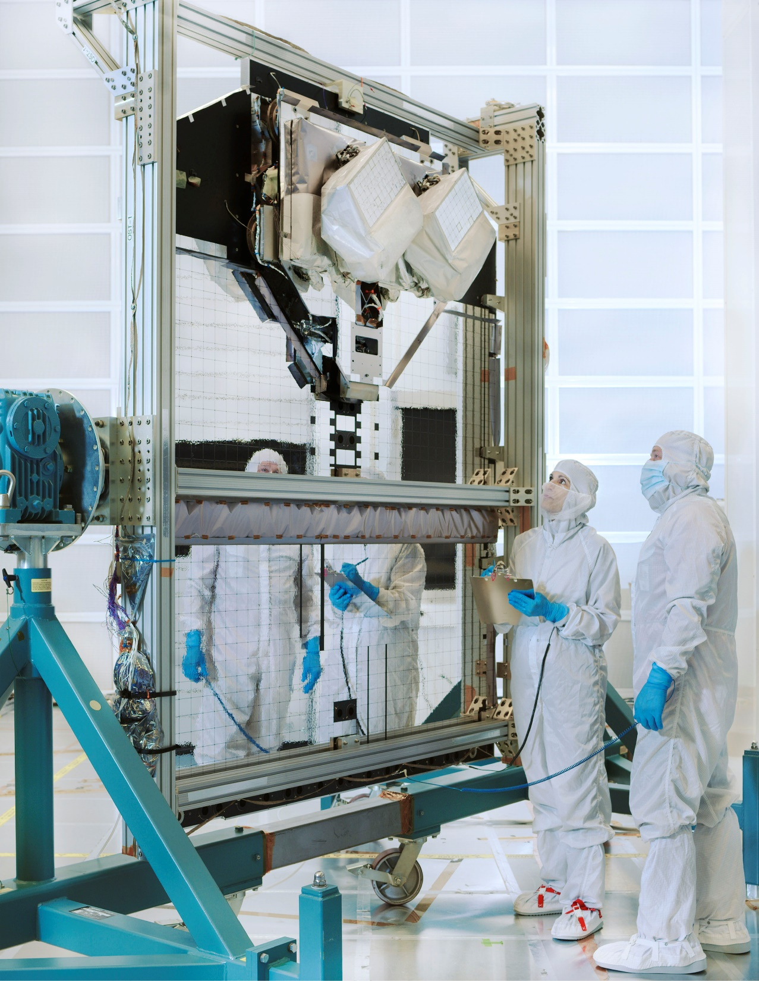
Laser Communications
Relay Demonstration (LCRD)
LCRD is launching in 2021 and will be NASA’s first end-to-end, bidirectional optical communications relay.
As a technology demonstration mission, after on-orbit check out, LCRD will spend two years demonstrating its capabilities with a variety of experiments.
  These experiments will help test optical communications functionality and demonstrate how it can meet the aerospace industry’s growing need for higher data rates.
In July 2020, LCRD was integrated with its host spacecraft, the U.S. Space Force’s Space Test Program Satellite 6 (STPSat-6).

Slide 6
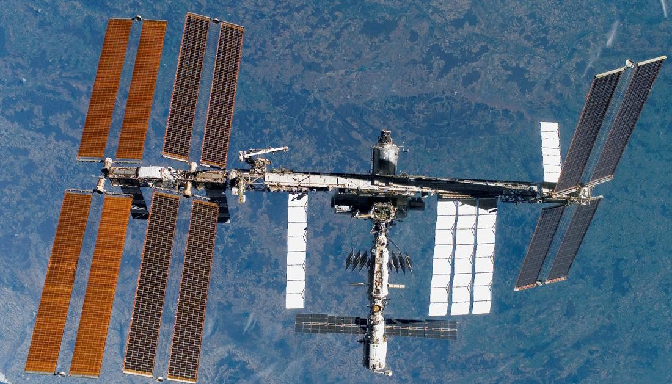
Integrated LCRD Low-Earth Orbit User Modem and Amplifier Terminal (ILLUMA-T)
The ILLUMA-T payload will be hosted on the International Space Station.
The terminal will receive high-resolution science data from experiments and instruments onboard the space station and then transfer this data to LCRD, which will then transmit it to a ground station.
ILLUMA-T is launching in 2021 and will be LCRD’ first operational user.
The payload is currently in its build phase at both Goddard Space Flight Center and the Massachusetts Institute of Technology - Lincoln Laboratory.

Slide 7
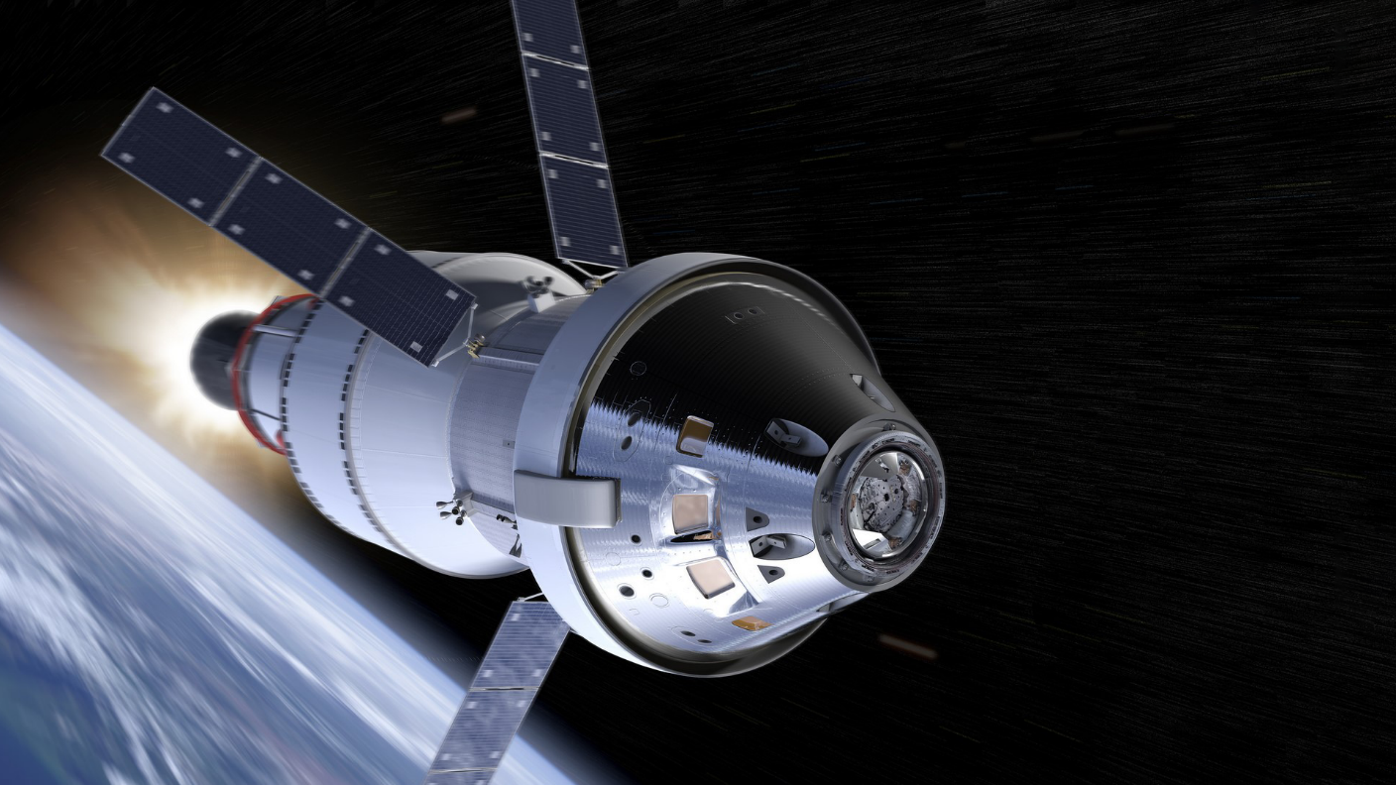
Orion Artemis II Optical Communications System (O2O)
The Orion Artemis II Optical Communications System (O2O) is an optical terminal going on NASA’s Artemis II mission in 2023.
O2O will allow the astronauts traveling to the lunar region to send back high-definition photos and videos, enabling increased discovery.
O2O is currently being developed at the Massachusetts Institute of Technology –Lincoln Laboratory, one of our essential partners in many optical communications missions.

Slide 8

Drivers for Change
The market has reached a maturity to enable 100% commercialization of direct-to-Earth radio frequency communications services.
The Office of Management and Budget (OMB) has required SCaN commercialize Earth proximity networks. ESC was challenged to respond.
SCaN will continue to manage geosynchronous orbit (GEO) relay operations until TDRS fly-out. SCaN will continue to assess market viability for commercial space relay services.
An efficiency can be found by establishing a single point for service fulfillment for user missions to increase value to our customers.
Opportunity to simplify SCaN’s network architecture for both users and commercial participants.
This reduces confusion for customers and vendors, creating a single point of access for communication services with the user community and critical stakeholders.
Notes:
NEN and SN were already commercialized, but external stakeholders require a difference implementation
The move to commercialization will increase work/revenue transfer to private sector; support growth of the U.S. space industry
Consolidate procurement of vendor services
Reduce costs for GOCO support; this is efficiency for our assets and other OGA services
Leveraging modern capabilities
This effort will free up resources to focus on new technologies (noble work)
This drive us to change from a link service provider to a network service provider

Slide 9

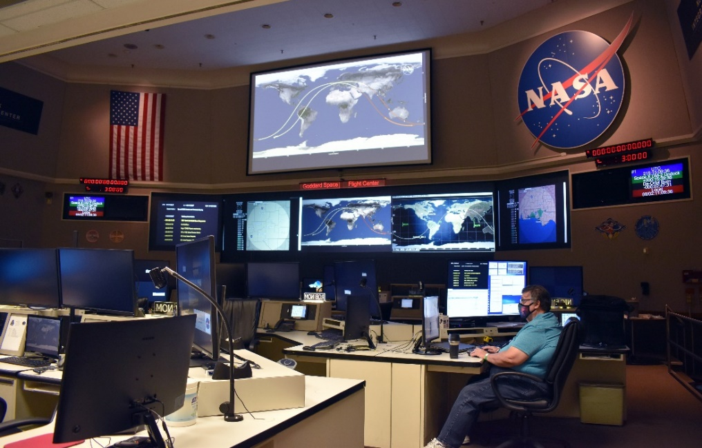
The Near Space Network (NSN) Project
The NSN project is a service fulfillment organization that connects customer missions to essential communications and navigation services. NSN enables the transmission of science and exploration data from space to mission operations centers.
Onboarding Customer Missions
User Interface Management (Agreements, ICDs)
Missions/Providers Technical Pairing (Link Budgets, I&T Planning, Verification, Validation)
Full Lifecycle Support
Onboarding Providers
Procurement / Acquisition
Integration, Capabilities Validation
Monitoring service contracts
Operations
[Near Space Operations Control Center]
Mission Service Management (Service Orchestration)
Service Execution (End-to-End Networking, Data Services)
Critical Ops (Launch Support)
Notes:
As the one-stop-shop for all near space service needs, the NSN will provide support to CIS with resources for Pre-Phase A analysis and will then manage the relationship
For current missions and those already in development, they will be directly transitioned to the NSN to continue with their assignment mission managers. They will not see a difference but the support they receive will be more unified and continue into operations.
This is being done by… onboarding customer missions… onboarding providers… and working with our operations model to…

Slide 10

A Single Point of Contact
As a single point of contact, the Near Space Network alleviates the need for mission teams to research and find the most effective communications services on their own. In this way, mission teams can rely on the expertise of Goddard’s communications and navigation community.
Before NSN
After NSN
User Mission
SN
User Mission
ACCESS
User Mission
NEN
User Mission
NSN
Other Govt SLP
Commercial
User Mission
Commercial
User Mission
Commercial
User Mission
Commercial

Slide 11







Understanding the Domain
Near Space: the volume of space from the Earth’s surface to 2,000,000 kilometers.
  Earth Proximity Region: subset of near space; volume from Earth’s surface to GEO (36,000 km)
Deep Space: volume of space starting at 2,000,000 km from Earth’s surface and proceeding out into the solar system and beyond.
Deep Space
Earth Proximity
Near Space
Notes:
This can be a touchy subject and an area where we have a user community conflict with the DSN as they start to manage customer support at ___. We know this and it will take all of us communicating a consistent message for these definitions.
Collaborate with JPL from GEO to 2M km.

Slide 12
Commercialization, Innovation, and Synergies Office
The CIS office will broadcast the communications and navigation services available, sharing capabilities, connecting commercial vendors with opportunities, and assessing the viability of new providers.
Goals:
Identify opportunities
Nurture diverse relationships
Implement collaborative solutions
Enable and enhance capabilities and technologies
Foster synergistic relationships
Accelerate infusion opportunities
Collaborate with private industry, other government agencies, and international partners
Virtual Roadshows
Virtual Roadshows
GSFC Comm and Nav Forum
Tech Pitch Competition
Tech Pitch Competition
New and Enabling Technology Forum
Jul
Aug
Sep
Oct
Nov
Dec
Jan
Feb
Mar
Apr
May
Jun
Jul
Aug
Sep
Oct
Nov
Dec
2020
2021
DTE RFI Submitted
and Reviewed
SCaN
Town Hall
Lunar RFI Submissions
Reviewed
SCaN Industry Engagement Event
SCaN Industry
Engagement Event

Slide 13
Empowering Commercialization
By increasing industry providers and enhancing technologies, we will enable broad spectrum mapping of provider capabilities with diverse and unique user needs.
The CIS office and NSN will work with NASA’s Space Communications and Navigation (SCaN) program office and industry to mature technologies and capabilities
    Interoperability
    Optical communications
    Real-time access of newly-discovered phenomena
    The use of SmallSats to enable a diverse missions
    Ground site diversity (RF, optical, wide band)
    Machine Learning/Automation

Slide 14
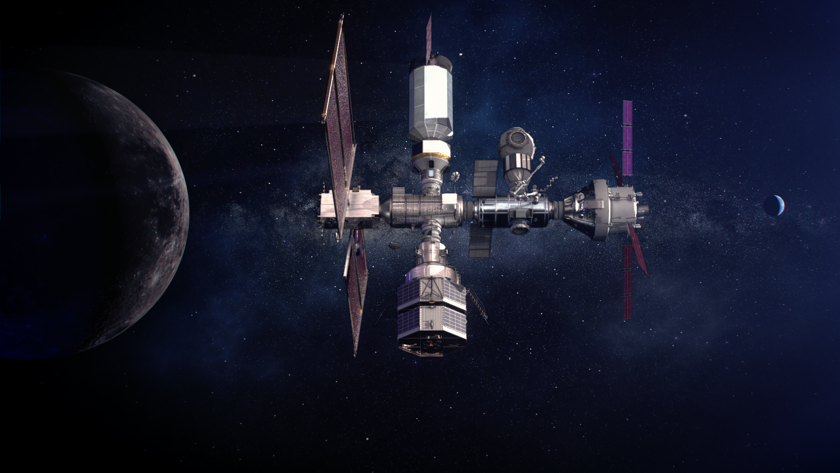
Future Exploration
As NASA journeys to the Moon, Mars and beyond, missions will need enhanced communications capabilities. Rising to the challenge, optical communications will infuse NASA networks with the capabilities we need to explore further.
NASA is currently investigating possible future missions to have optical terminals on. These terminals will work in tandem with the radio frequency communications systems.
CIS will foster relationships with industry to further advance technologies and capabilities like optical communications.

Slide 15
Points of Contact
Dr. Jason Mitchell
Director
SCaN Advanced Communications and Navigation Technology Division
Email: jason.w.mitchell@nasa.gov
Dr. LaNetra Tate
Chief
Commercialization, Innovation, and Synergies Office
Email: lanetra.c.tate@nasa.gov
Vir Thanvi
Project Manager
Near Space Network Project
Email: vir.thanvi@nasa.gov
Glenn Jackson
Project Manager
LCRD and ILLUMA-T
Email: glenn.b.jackson@nasa.gov
Betsy Park
Project Manager
O2O
Email: elizabeth.a.park@nasa.gov
Websites:
https://esc.gsfc.nasa.gov/projects/CIS
https://esc.gsfc.nasa.gov/projects/ACCESS
https://esc.gsfc.nasa.gov/projects/NSN
https://esc.gsfc.nasa.gov/projects/LCRD
https://esc.gsfc.nasa.gov/projects/LEMNOS

