Slide 1
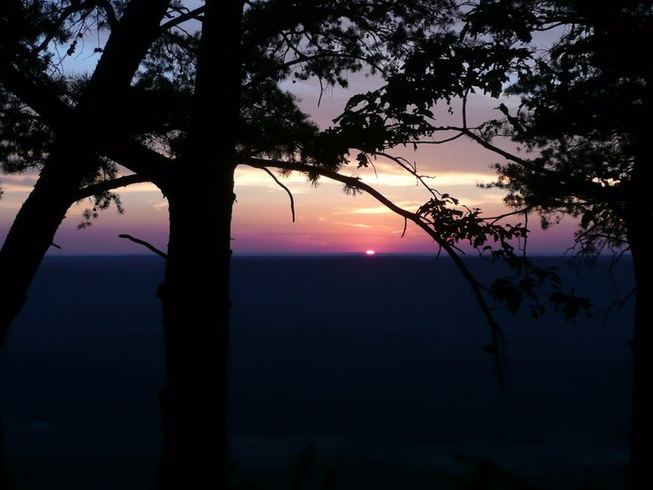
A Comparison of Evaluation Techniques for in-School Programs vs.
Adult-Oriented Planetarium Programs
ED053-08
Mitzi Adams, Heliophysicist and Elizabeth Bero, Gifted Specialist
NASA/MSFC and Horizon Elementary School
Hunstville and Madison, Alabama

Slide 2
The Issue: Relying on Adults to Self Report Interests and Educational Outcomes in
an Informal Educational Setting Results In an Incomplete Assessment of “Success”
of the Presentation.
Problem: Survey response from adults in informal settings is low.
Problem: Without the incentive of grades, response from school children
is also low (from one data point 50%).
Problem: Covid issues have impacted the ability to gather data from formal groups and informal groups.

Slide 3
What are We Comparing?
We compare results from presentations that were surveyed twice, pre and post,
with those surveyed once at the end of the presentation.
The intent was also to compare results of surveys given during classroom settings
with those given after hours or to adults in informal settings. But…Covid…

Slide 4
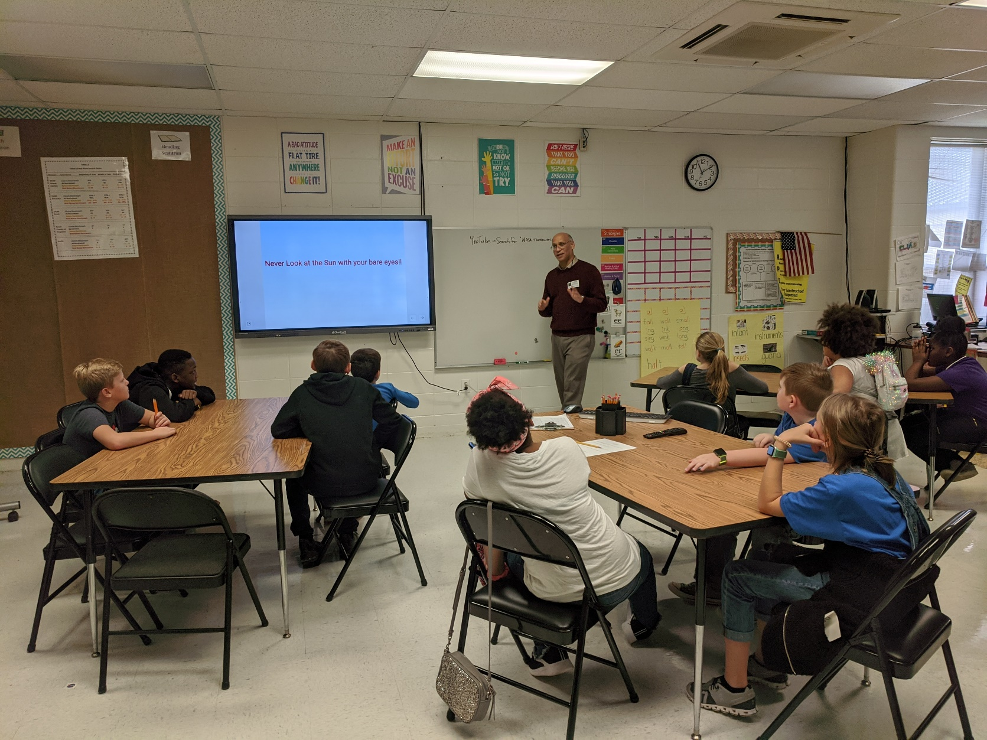
Example Survey Questions:
On a scale from 1 to 10, please
rate your interest in astronomy
and space science.
1 is not very interested,
10 is very interested
Pre-average: 6.1,
Post-average: 8.0
Is a sunspot cooler than its
surroundings? (Yes, No)
Pre: 11 Yes, 26 No
Post: 24 Yes, 12 No
Totals: 27 Pre, 36 Post
Dr. Alphonse Sterling (NASA/MSFC) speaks
about the Sun to Monrovia Elementary
Students for their STEM night.

Slide 5
Problems for After-School Hours Programming:
In informal settings, some students leave early or arrive late.
Attention is not as focused as in formal settings.
Students arrive without writing utensils.

Slide 6
Is There a Better Way to Assess Learning and Interest in Informal Settings?

Slide 7
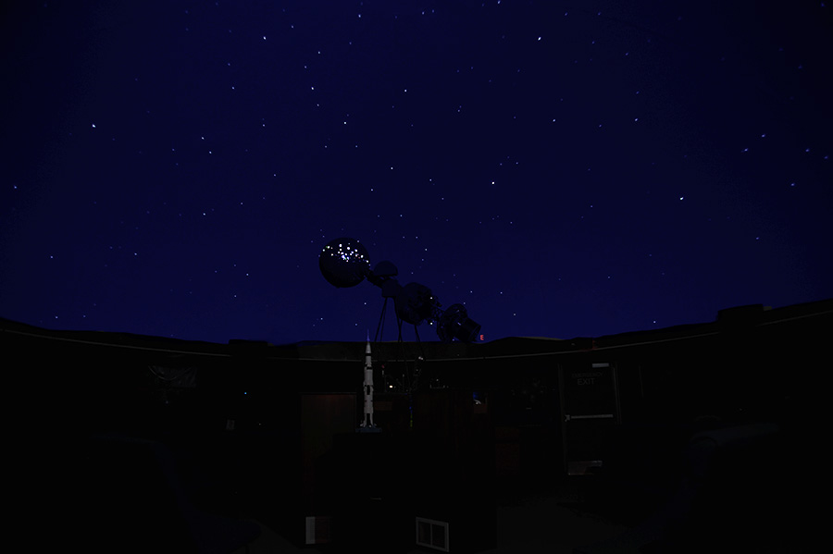
In the Planetarium: There are no tables and often no desks, so paper assessments
are difficult, so we have tried the electronic option via QR code along with
“bribes”, such as solar lenticulars or solar-system trading cards.
From Oct 21, 2020
at
Von Braun
Astronomical Society (VBAS)
Huntsville, AL
120 in audience
61 viewed survey
24 started survey
24 completed survey
Please rate your interest in
astronomy and space science
before the presentation
1 = Not interested
10 = Very interested
Average 8.62
Please rate your interest in astronomy and space science after the presentation.
Average 8.92

Slide 8
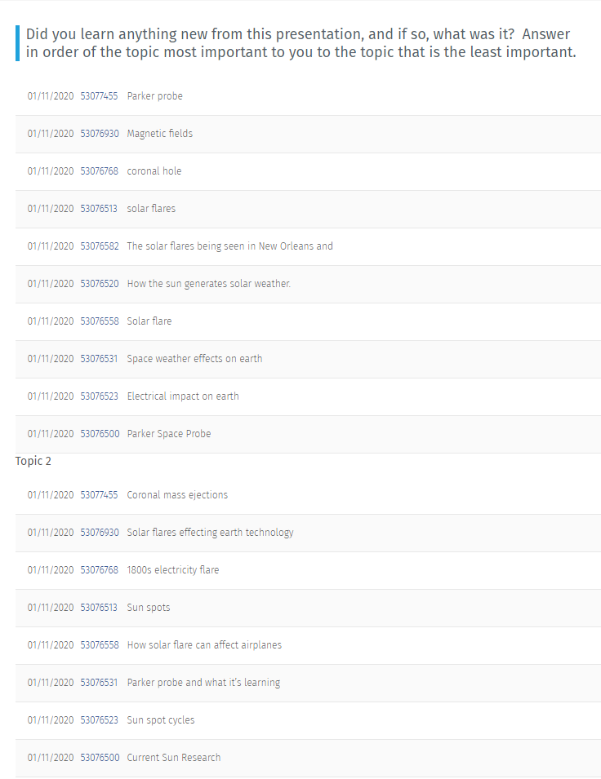
Survey Tools:
Online Surveys
190 in audience
51 viewed survey
24 started survey
21 completed survey
From Jan 11, 2020
at
Fernbank
Science Center (FSC)
Atlanta, Georgia
Interest in Space
Science Before:
8.1
Interest in Space
Science After:
8.7

Slide 9
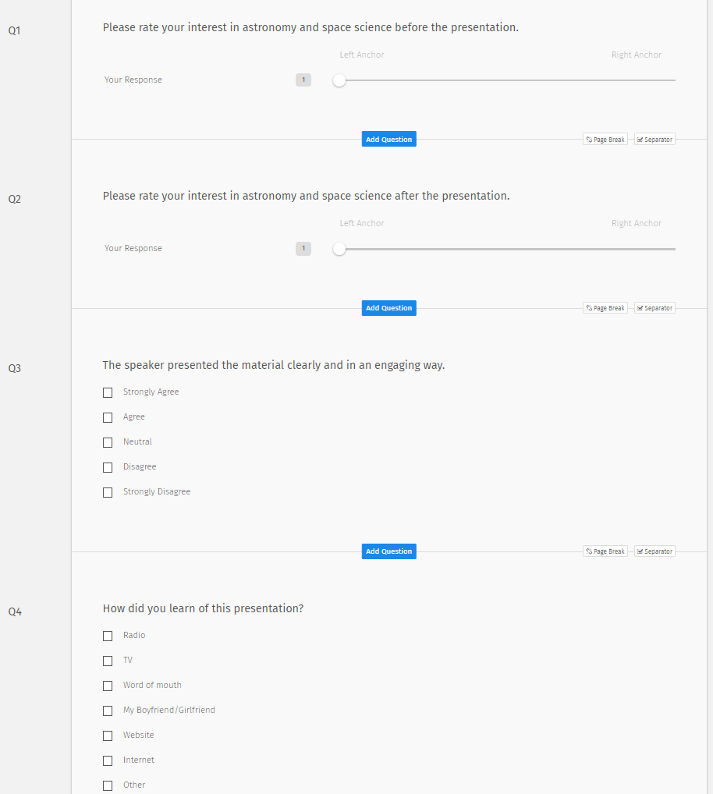
Individual Responses Can Be Examined.
Example:
Did you learn anything new from this
Presentation, and if so, what was it?
Answer in order of the topic most
Important to you.
Parker probe
Coronal mass ejections
Solar Storms

Slide 10
Problems for Planetarium Programming:
In informal settings, some participants arrive late and/or leave early.
In informal settings, there may be no access to writing utensils or hard
surfaces for writing.
In informal settings, the electronic option may get responses, but only
if assessments are completed on site.
In informal settings, attention is not as focused as in formal settings.

Slide 11
Problems for Planetarium Programming:
In informal settings, the electronic option works best, but may be
limited to those who have electronics, biasing against older or
economically-disadvantaged populations.
In informal settings involving volunteers,
reminders about assessments may be forgotten.

Slide 12
Example Result from After School Presentation Compared to the
General Public in the Planetarium:
Using Only One Survey:
VBAS Space Science Interest Pre: 8.6
VBAS Space Science Interest Post: 8.9
(out of 24 respondents)
Using Pre and Post Surveys:
On a scale from 1 to 10, please
rate your interest in astronomy
and space science.
1 is not very interested,
10 is very interested
Pre-average: 6.1,
Post-average: 8.0
Total Respondents:
27 Pre, 36 Post
FSC Space Science Interest Pre: 8.1
FSC Space Science Interest Post: 8.7
(out of 21 respondents)

Slide 13
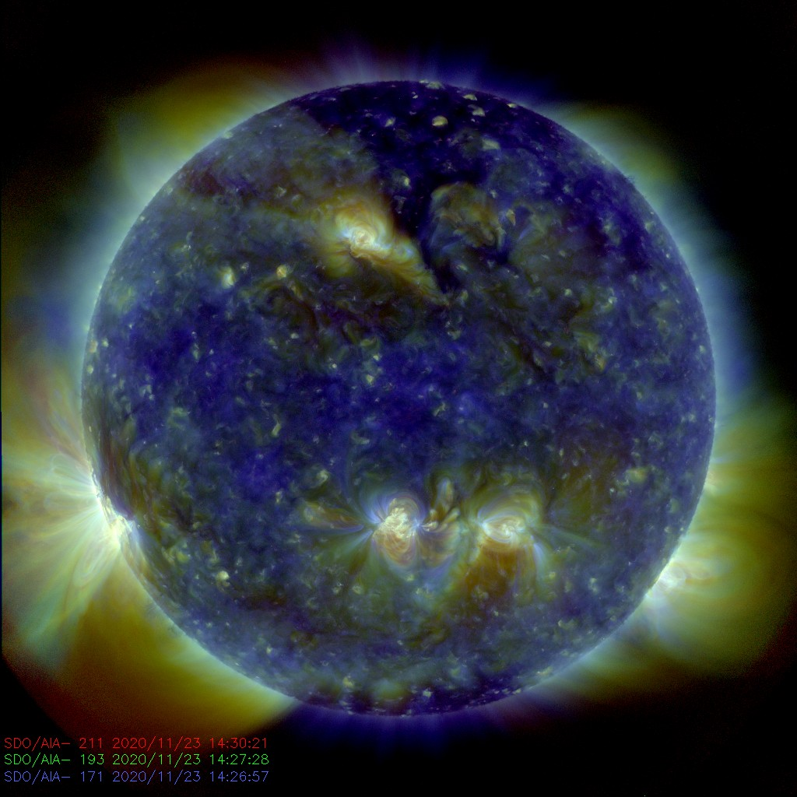
Summary and Work for the Future
There is a larger gain in interest in
the after-school group.
Is this real or due to survey differences;
that is, giving both pre- and
post-surveys to the after-school
groups vs. presenting only one
survey to the planetarium group,
post presentation?
Future work will compare interest and content-knowledge gains between informal groups and formal in-school groups, using identical survey tools.

