Slide 1

Flood Pilot Update
Committee on Earth Observation Satellites
Guy Schumann, Remote Sensing Solutions
Andrew Molthan, NASA Marshall
Mitch Goldberg, NOAA/NESDIS
David Borges, NASA Langley
CEOS WG Disasters Meeting #15
25 November 2020

Slide 2
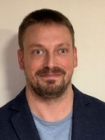

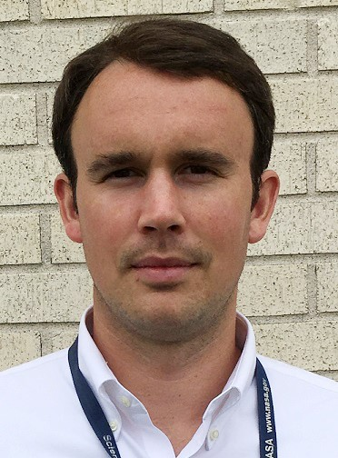
Co-Leads and Introductions
Dr. Guy Schumann, Remote Sensing Solutions
  Principal Scientist at Remote Sensing Solutions Inc. Researches flood risk, from local to global scale, using flood modeling, prediction and remote sensing
Dr. Mitch Goldberg, NOAA/NESDIS
  NOAA/NESDIS Chief Scientist; led the NESDIS Satellite Proving Ground to improve NOAA services
Dr. Andrew Molthan, Marshall Space Flight Center
  Research Meteorologist at NASA Marshall, collaborates with NASA’s Disasters Program to help the disasters community use NASA data and tools
Dave Borges, NASA Langley
  CEOS WGDisasters Secretariat, Flood Pilot Co-Lead and GEO DRR WG Co-Chair supports flood related efforts across the GEO and CEOS communities.

Slide 3
Pilot Goals
Objective A
  Solicit input from CEOS partnering agencies and participants on current and upcoming efforts to map water and flood extent from diversity of LEO/GEO and SAR contributions
Objective B
  Capture underlying requirements and future needs to sustain and improve upon these capabilities.
Objective C
  Explore ideal combination of LEO/GEO/SAR flood mapping outputs, using representative regional events of interest to partners.
  Develop and document best practices for combining and sharing flood information from multiple platforms with diversity in sensor, spatial/temporal resolution, etc.

Slide 4
Highlights Since Last Meeting
WGDisasters Flood Pilot Meeting -- October
  Continued discussions about their proposed cases of interest
WGDisasters Flood Pilot Virtual Workshop – November
  Participants gathered for a 3-hour meeting to discuss:
    Status of the CEOS Interoperability Lab, to learn how cloud resources can provide a common space for collaboration
    Additional progress and preliminary data requests from teams who are interested in obtaining new information from CEOS partnering agencies
Upcoming Plans
  Call with CONAE to discuss availability and status of SAOCOM data relevant to pilot efforts
  Call with Pilot partners to finalize data requests for submission to CEOS data team

Slide 5
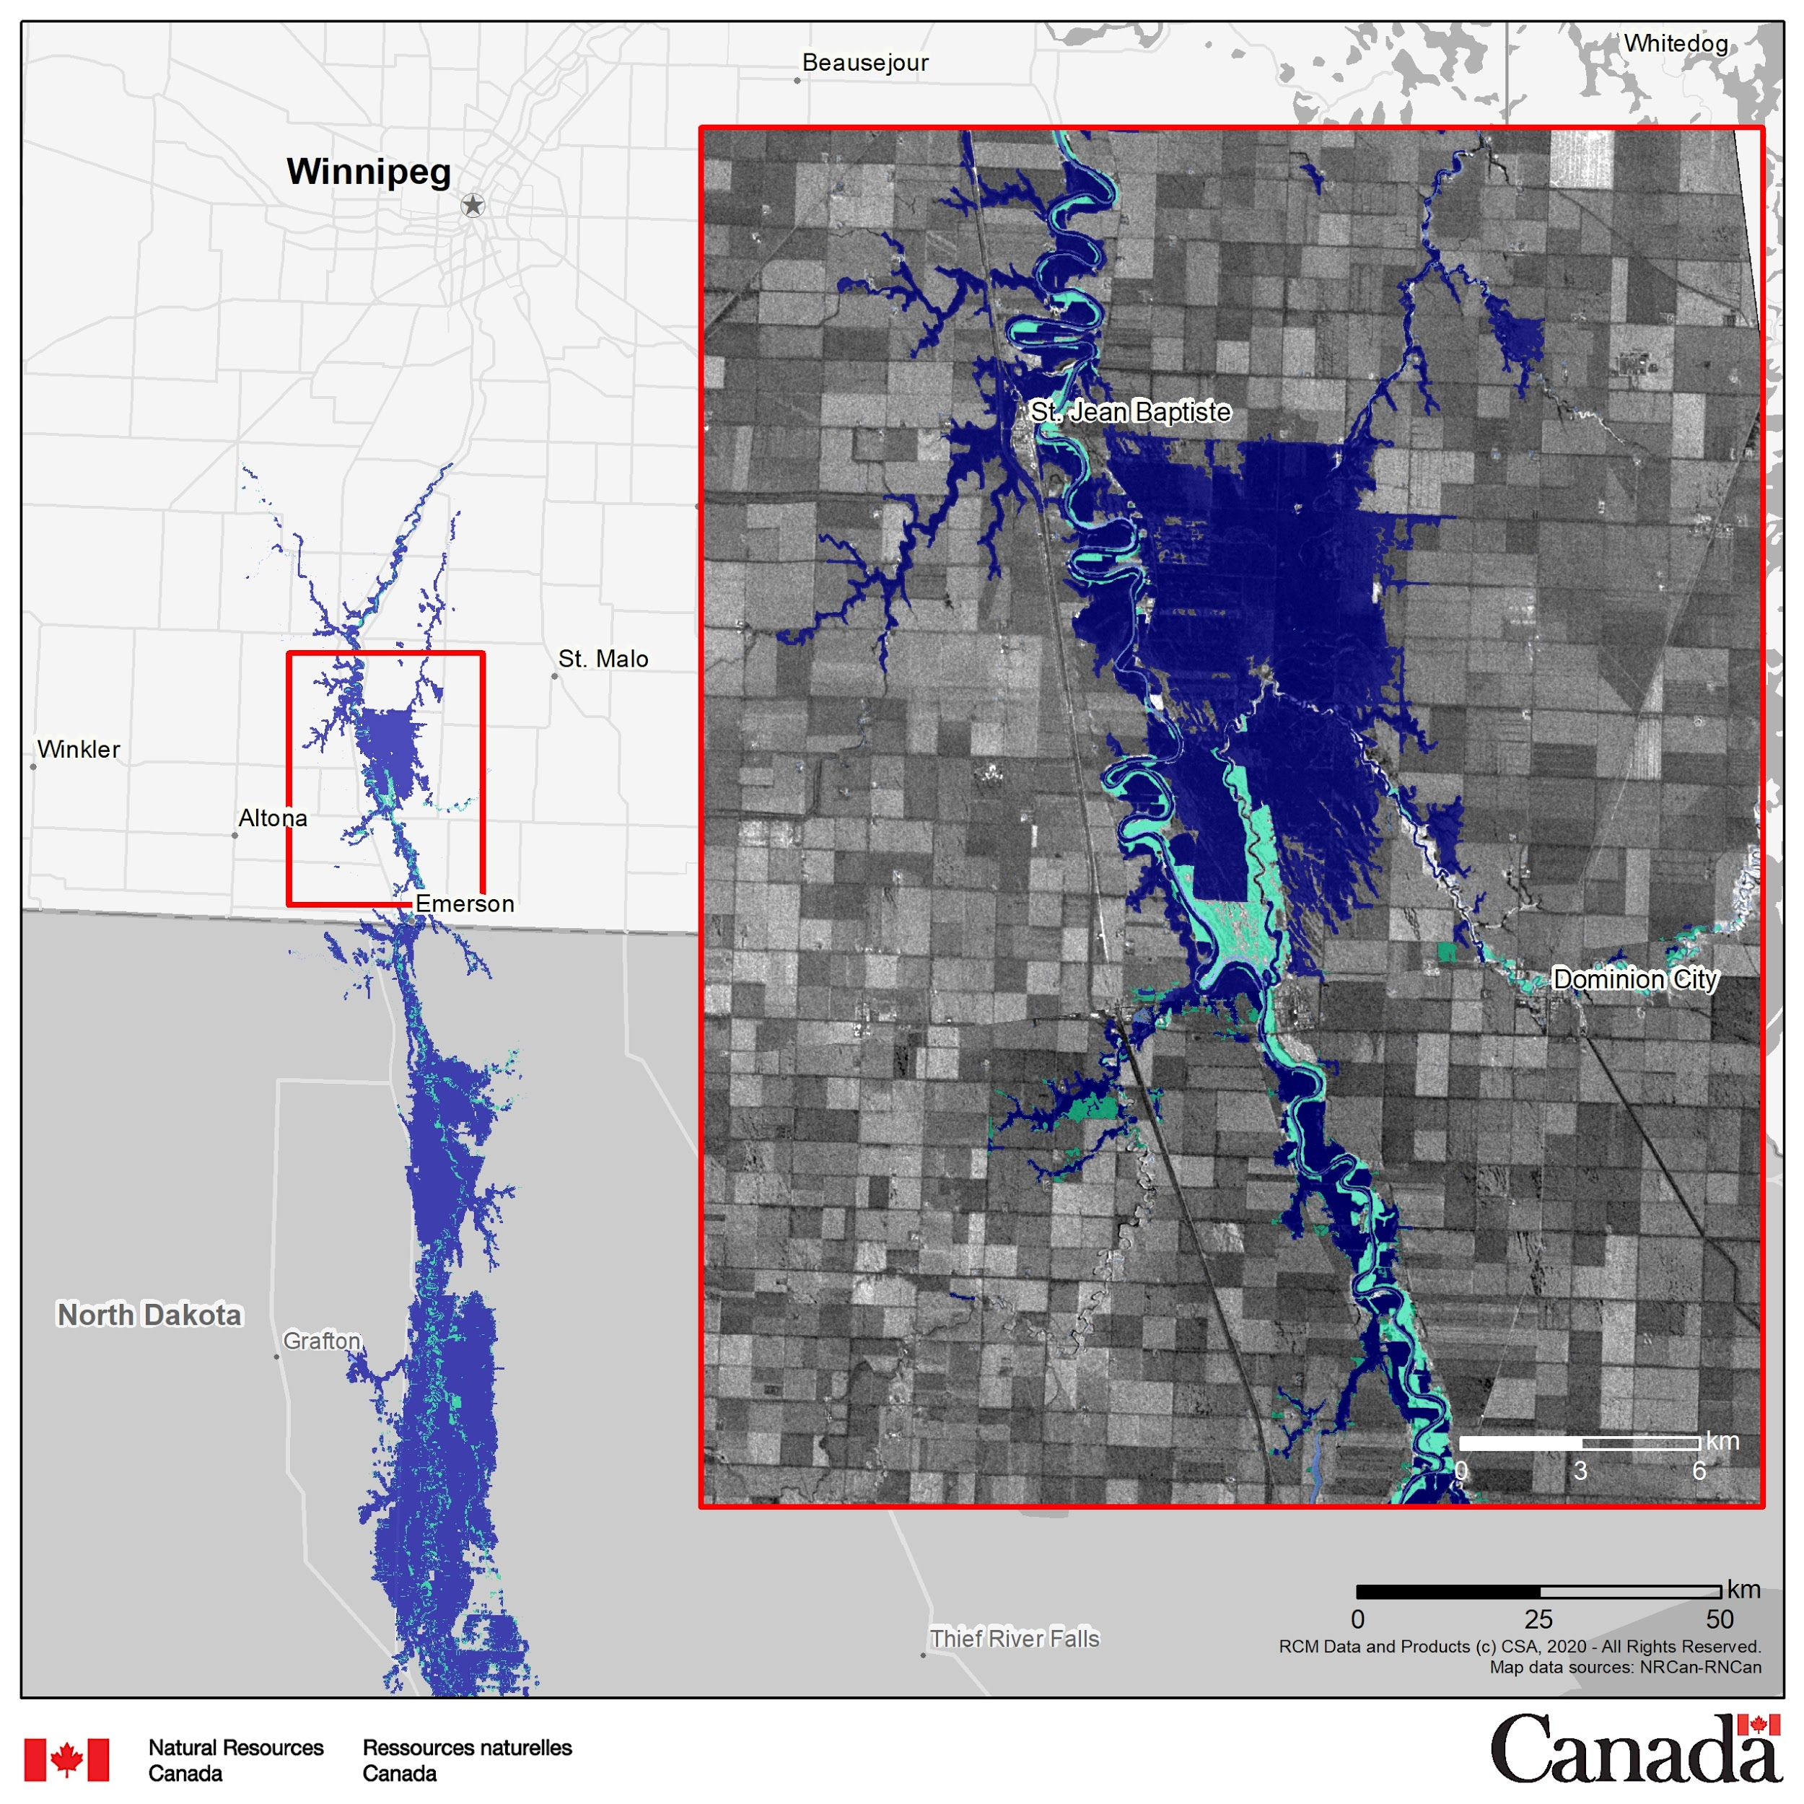
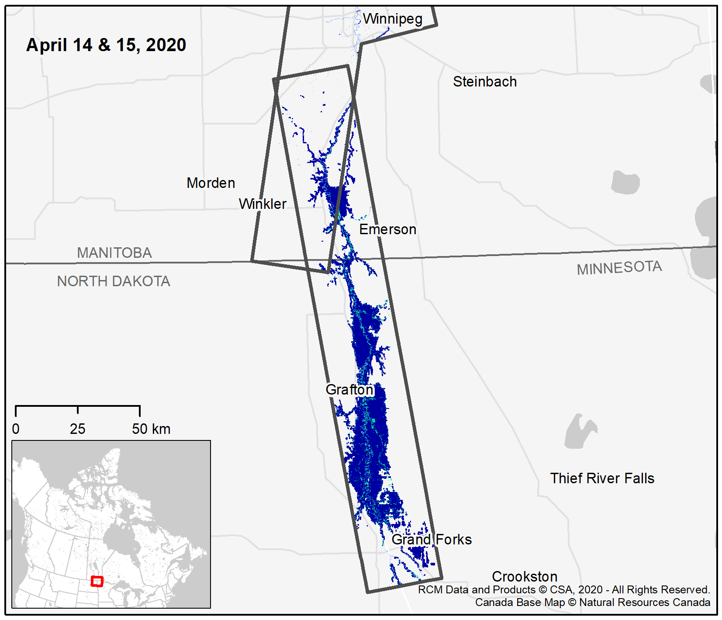
Pilot Highlight: Red River of the North
From the Natural Resources Canada/Red River of the North team:
77 RCM scenes used to create 20 flood maps between April 14th and May 10th
Preliminary plans on algorithm sharing for community use and development

Slide 6
Example of Data Plan
Red River of the North Team / NRCan have demonstrated their need and goals for multi-platform and partner data supporting analysis in the 2020 event and year
Peak Flood
2020
Apr
May
Legend:
Apr 7
Apr 10
Apr 14
Apr 19
Apr 23
Apr 27
Apr 30
May 3
May 5
May 9
Stripmap 5m Dual-Pol
Stripmap 5m & 30m Compact-Pol
Standard & Ultra-fine
Fine Quad Wide
Interferometric Wide
Multispectral L1C
LC08 L1TP
PlanetScope 3m Multispectral
VIIRS
GOES
RCM
n=26 (77 frames)
RSAT-2
n=6 (9 frames)
Apr 11
Apr 18
Apr 21
Apr 25
Apr 28
May 8
Sentinel-1
n=4 (8 frames)
Apr 11
Apr 16
Apr 28
May 10
Sentinel-2
n=7 (11 frames)
Apr 10
Apr 15
Apr 17
Apr 22
Apr 27
Apr 30
May 10
Landsat-8
n=3
Apr 17
Apr 24
May 10
Planet
n=5 (17 frames)
Apr 15
Apr 17
Apr 22
May 6
Cloud-free data TBD
VIIRS
n=34
Apr 7
Apr 10
Apr 13
Apr 16
Apr 19
Apr 22
Apr 25
Apr 28
May 1
May 4
May 7
May 10
GOES
n=34
Apr 7
Apr 10
Apr 13
Apr 16
Apr 19
Apr 22
Apr 25
Apr 28
May 1
May 4
May 7
May 10
WGDisasters Pilot Team need: Develop a similar plan for all teams and case study participants to help guide collection requests. Focus of December activities.

Slide 7
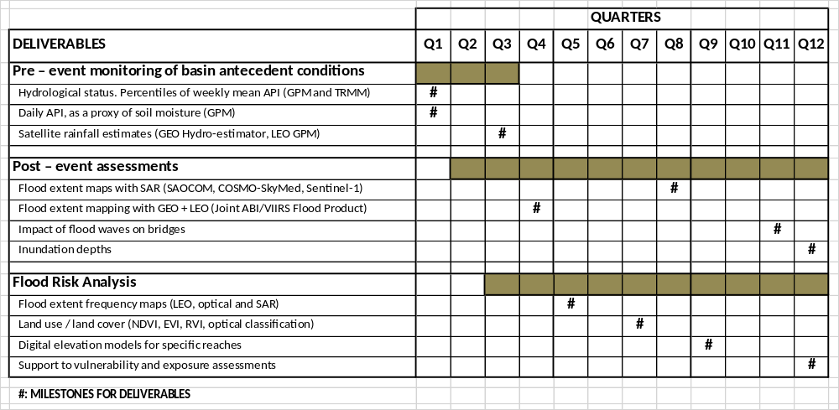
Pilot Highlight: Pilcomayo and Bermejo
CONAE-led team for Pilcomayo and Bermejo Transboundary Basins area of interest continues progress in line with expected contributions. Data requests submitted.
Progress of these products in good agreement with Gantt chart

Slide 8
Implementation Plan Endorsement
Our CEOS WGDisasters Flood Pilot Implementation Plan was endorsed during the 2020 Plenary
Key Milestones:
  2020-21
    Begin regional studies; collect data; establish relationships
  2021-22
    Provide derived products to users for feedback and explore refinement of monitoring strategies. Initial evaluation of pilot results to GFP and international conferences.
  2022+
    Develop reports from users on derived products, best practices, and evaluate results from study sites. Explore whether broader EO strategies can be developed.

Slide 9
Upcoming Activities
Flood Pilot Team is working with partners to schedule the following:
  TBD December, meet with CONAE to understand current data holdings available for SAOCOM missions.
  TBD December, meet with pilot teams via email and virtual follow-up to finalize plans for data needs.
    WGDisasters Data Coordination Team (DCT)
    Action to regional case study leads to examine data needs and inventory for work with the DCT for provision and sharing.
  Data Access / Platform Contributions
    Briefing from and discussion with Interoperability Lab agreed to look for including WGDisasters Flood Pilot participants to help test and evaluate in early 2021.

Slide 10
Backups

Slide 11
Pearl River Basin – Urban, Coastal Flooding
Late August 2018
The Pearl River Basin experiences heavy rainfall from coastal storms (cyclones, typhoons) and heavy interior rainfall events
Events have included Typhoon Rumbia and other major storms in the region
Expected Outcomes
                Leverage imagery from Chinese optical remote sensing satellites
                GF4, HJ, ZY, each providing resolutions of 5-30 m and multispectral bands of VIS-MWIR
                Explore benefits of using GF3, a multi-polarized C-band SAR sensor offering resolutions of 5-50 m
NASA MODIS via Worldview
Status and Level of Effort
Data Needs, Challenges, and Risks
                Leads: Chinese Academy of Sciences (CAS)
                Regions of interest and some preliminary events have been identified in 2018, may also be able to use most recent flooding event in 2020.
                Collaborations with other data partners on any available in situ data for validation, imagery collections through partners and/or the Charter
                Expecting heavy use of Chinese / China Academy of Space Technology assets for optical and including SAR imaging capabilities

Slide 12
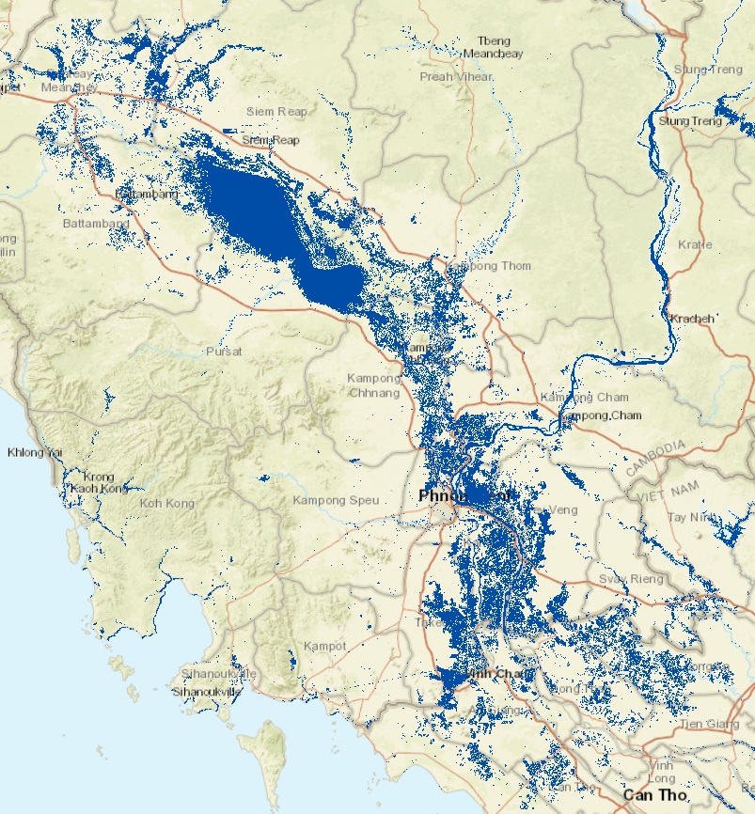
Myanmar – Automated Flood Detections
2019 Monsoon Season
Expected Outcomes
Seeking to understand flood risk at large scales and establish risk profiles via satellite archive.
Strengthen emergency response efforts.
                Partner with the World Bank to enhance use of satellite-derived information in the disaster risk financing sector for SE Asia
                Strengthen emergency response through parametric insurance modeling that looks to expedite pay-out based upon clear and transparent rule sets
                Use multi-temporal SAR and other complementary images to improve water mapping
Status and Level of Effort
Data Needs, Challenges, and Risks
                Leads: Luxembourg Institute of Science and Technology (LIST)
                Past work has examined mapping the extent of permanent water bodies, separating permanent water from flood extent, and relating flood events to impacts via population and other human settlement information
                Adapting InSAR coherence imagery to improve the performance of flood detections in urban areas and the urban-suburban-rural interfaces, also for regions with extensive vegetation
                Increased sampling rate of imagery over the region through a multi-sensor approach (e.g. incorporate Radarsat-2, Sentinel, others) as well as combined radar and optical data
                Explore additional L-band wavelengths to improve detections within vegetated regions and to prep for ESA’s ROSE-L mission

Slide 13
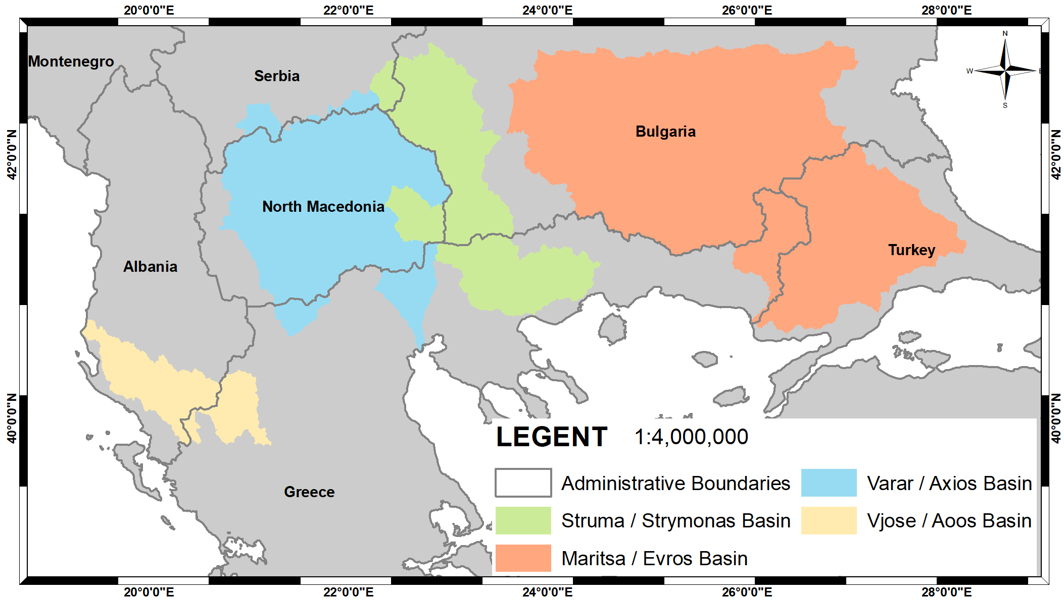
South Balkan Basins -- Transboundary
Late August 2018
Expected Outcomes
Major basins spanning political boundaries benefit from routine Earth observations and flood mapping
                Improved integration of LEO, GEO and SAR with an emphasis on water and flood mapping in these transboundary basins
                Capture underlying physical processes and causes contributing to major regional flood events.
                Demonstrate operational utility of EO specific to hazards and risks in the region
Status and Level of Effort
Data Needs, Challenges, and Risks
                Leads: Harokopio University (Greece) Earth Observation Team (HUA EO Team)
                Previous work in the region has examined SAR analysis and multi-temporal approaches to extract features of interest
                Multi-temporal optical and SAR images, SAR amplitude imagery to assist with mapping of permanent water versus floods.
                Interferometric coherence based upon SAR (InSAR) and additional polarimetry processing, wavelength diversity.

