Slide 1

Monitoring
From Requirements to Autonomous Flight
Swee Balachandran³, Esther Conrad¹, Aaron Dutle¹, Dimitra Giannakopoulou², Alwyn Goodloe¹, Anastasia Mavridou^{2,4}, César Muñoz¹, Ivan Perez³, Laura Titlolo³
¹NASA Langley Research Center
²NASA Ames Research Center
³National Institute of Aerospace
⁴KBR, Inc.

Slide 2
Why Runtime Monitors?
Verification is hard
Large, complex system built of diverse components.
Components may not be designed with formal verification in mind.
Runtime Monitors are flexible
Monitor and alert for unexpected events, instead of verify they don’t happen.
Easier to add new monitors than verify new properties.
Can allow for integration of untrusted components (when Simplexed)
The project is a research demonstration of monitors as an alternate/additional means to assure safety.

Slide 3
Goal: Simple, accurate, integrated monitors
Write or select requirements in a natural(ish) language.
Create (automatically!) safe monitors in software.
Integrate them into an autonomous flight system.

Slide 4


Goal: Simple, accurate, integrated monitors
Write or select requirements in a natural(ish) language.
Create (automatically!) safe monitors in software.
Integrate them into an autonomous flight system.

Slide 5
Project Workflow
ICAROUS-specific requirements
FRET translation to Copilot
Monitor integration
ICAROUS

Slide 6
Tool Descriptions
ICAROUS-specific requirements
FRET translation to Copilot
Monitor integration
ICAROUS

Slide 7
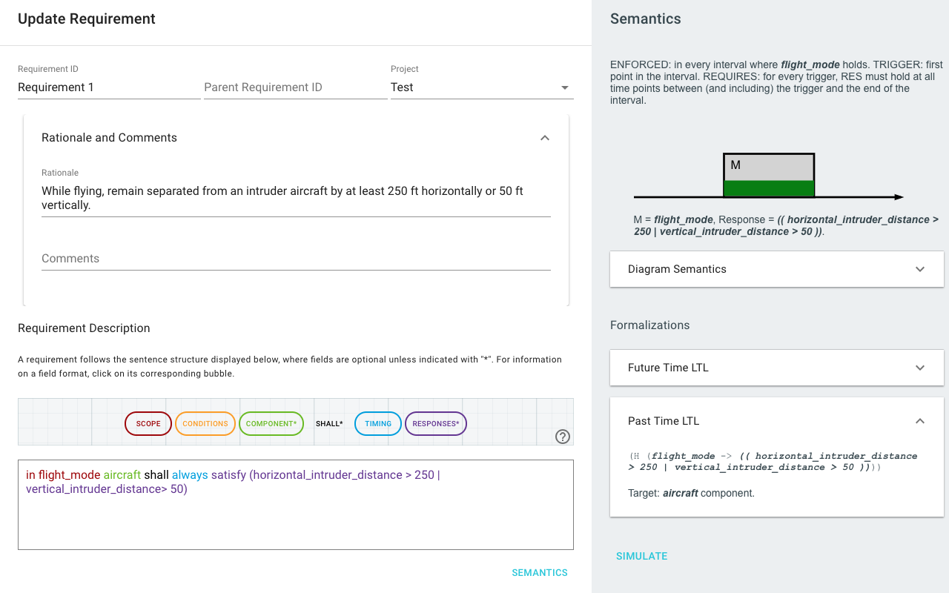
For more details, see the FRET website: https://github.com/NASA-SW-VnV/fret

Slide 8
Copilot
Runtime verification language & framework that produces hard real time C99 code.
For details, see the Copilot website: https://copilot-language.github.io/ and the NASA Technical Manual 2020–220587 "Copilot 3".
Copilot Compiler
C99 implementation
C compiler
Object file
Copilot Specification
(eDSL)

Slide 9
Copilot ICAROUS Monitor Example
elevation :: Stream Double elevation = extern ”elevation” Nothing
−− Estimate derivative by delaying the elevation
climbrate :: Stream Double climbrate = elevation − ([0] ++ elevation)
falling :: Stream Bool
falling = climbrate < (−6)
−− Specification that defines triggers based on streams
spec :: Spec spec = do
trigger ”falling” falling [arg counter, arg climbrate]
trigger ”not fallen” (alwaysBeen (not falling)) [] -- PTLTL
Defined as a global variable in a CFS application in C
Defined as a function in a CFS application in C

Slide 10
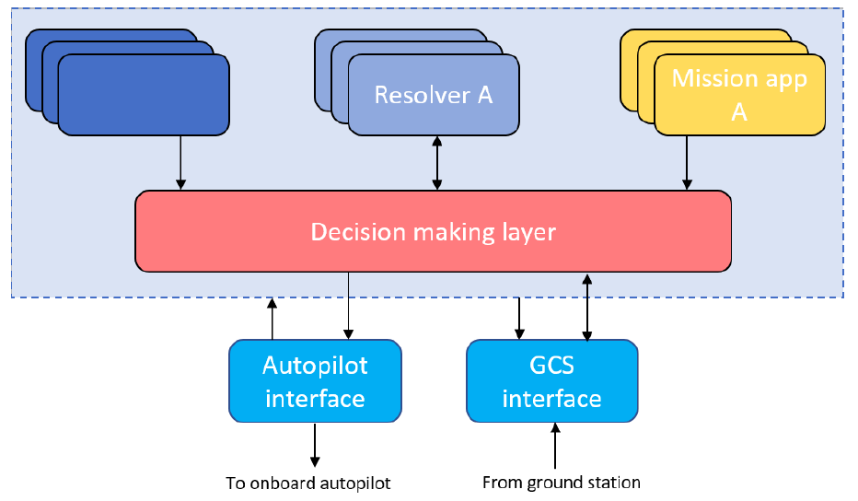
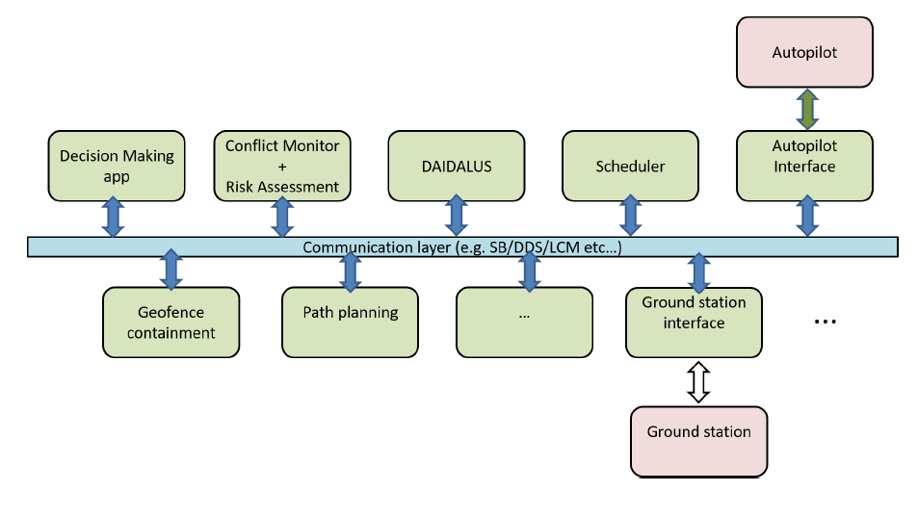
Architecturally:
Separate software modules, with extensibility
Some included modules have formal verification
Publish -- Subscribe communication
Built on NASA-pedigreed core Flight System platform
Detector A
Functionally:
Mission applications maintain and achieve goals
Detectors anticipate upcoming problems
Resolvers avoid problems discovered by detectors
Decision making layer negotiates and communicates
For more details, see the ICAROUS website: https://github.com/nasa/icarous

Slide 11
Integration
ICAROUS-specific requirements
FRET translation to Copilot
Monitor integration
ICAROUS

Slide 12
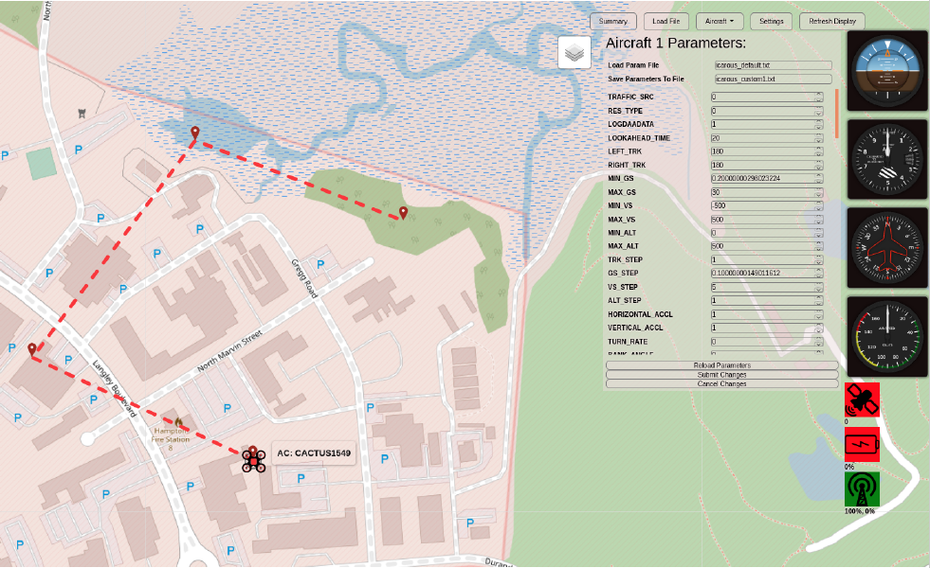
ICAROUS-specific requirements
Monitors:
Collision Avoidance
250 ft
Horiz
Enabled
50 ft
Vert
Geofence Standoff
25 ft
Enabled
Path Deviation
100 ft
Disabled
Custom Monitor
Generate Monitors
Cancel Changes
Current ICAROUS interface to set waypoints, geofences, change parameters
“Monitors” pane concept

Slide 13
ICAROUS-specific requirements: Current Issues
FRET allows arbitrary variable names in specification
Restrict the interface to only see or allow systems/signals available
Requires cataloging of available ICAROUS-published signals
Tablet interface is used post-installation of ICAROUS
Generating, compiling, and installing C on-board sUAS is tricky
Custom requirements require full FRET and Copilot
Parametric template monitors from the interface?
Current Copilot doesn’t support parametric C code
Properties concerning all traffic, all geofences
"Spawning” monitors is a bad idea with limited resources.

Slide 14
FRET translation to Copilot
OGMA is a tool that translates temporal expressions into Copilot monitors.
FRET
Copilot
Monitor
C99 implementation
C compiler
Object file
OGMA
Copilot
Lustre

Slide 15
FRET translation to Copilot
OGMA is a tool that translates temporal expressions into Copilot monitors.
FRET
Copilot
Monitor
C99 implementation
C compiler
Object file
OGMA
Copilot
Lustre

Slide 16
Monitor Integration
Developing a “Runtime Verification” module for ICAROUS
Receives data requirements for monitors at start, subscribes accordingly
Provides data to the Copilot generated monitors
Monitors have no feed-back into ICAROUS functions (no side-effects)
Violation alerts are raised to the operator/logged
Copilot Generated Monitors
Monitors
Module
Firewall
Violation Alert

Slide 17
Current Project status
ICAROUS requirements/interface:
Catalog ICAROUS signals
Develop user interface for templates and custom requirements
Overcome generating monitors post-installation
FRET to Copilot translation:
Fret output accepted by Ogma
Ogma creates Copilot monitor
Monitor Integration:
Prototype monitors module created

Slide 18
Tangents, Future work
PVS Specification of the syntax and semantics of FRETish.
Proving equivalence of FRET evaluation on traces with LTL translations.
Future: Check conformance of the generated monitor with the original requirement?
By construction? (Likely very difficult)
Verify on a per-monitor basis after generation? (Easier perhaps)
Future: Use RV in a Simplex architecture for ICAROUS.
Use modular architecture to cut off ICAROUS interaction when untrusted component causes violation.

