Slide 1
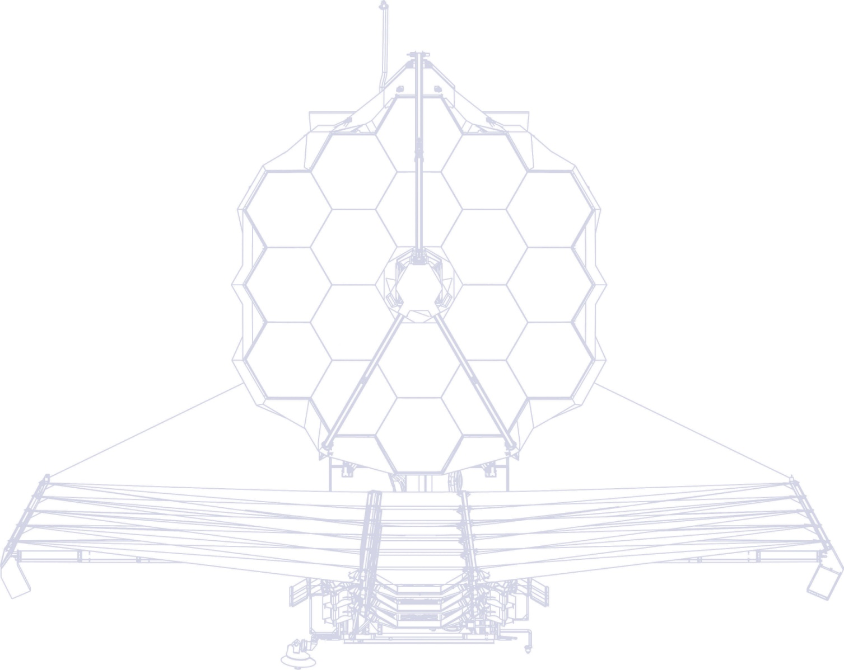
Commissioning The James Webb Space Telescope Observatory
Paper 11443-23
Author(s): Lee D. Feinberg, NASA Goddard Space Flight Center (GSFC; United States);
Carl Starr, NASA GSFC (United States); Carl Reis, ATA Aerospace, LLC (United States); Keith Parrish, Randy A. Kimble, Michael W. McElwain, NASA GSFC (United States); J. Scott Knight, Ball Aerospace (United States); Marshall D. Perrin, Space Telescope Science Institute (United States); Shaun Thomson, NASA GSFC (United States)

Slide 2
Overall Commissioning Timeline
Thermal Slew and Stability Characterization
Sunshield and Other Spacecraft Deployments
Final Cooler Transition
Ready for Science
Solar Array and Comm
Spacecraft Commissioning
Day
80
OTE Commissioning
SI Commissioning
Day 40
Day 120
Day 180
Telescope Deployments
Mirror
Deployments
Launch
Wavefront Sensing and Control
NIRCam, NIRISS, FGS On

Slide 3
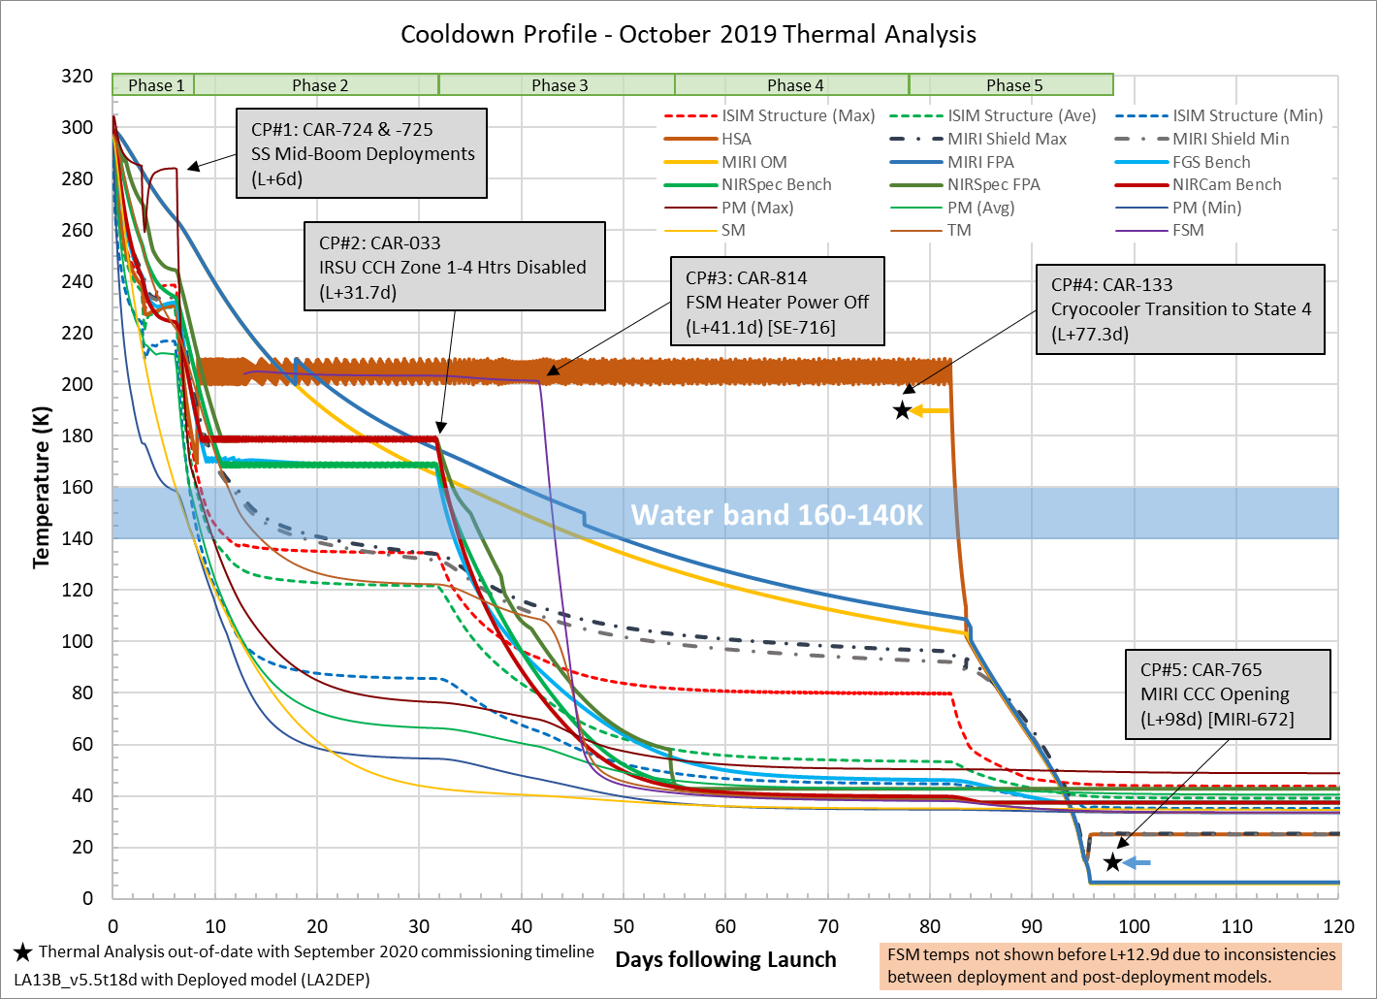
Nominal Cooldown Profile

Slide 4
Water-Ice Measurement Philosophy
A key consideration as the observatory cools down is to make sure that outgassing water does not form ice on optical surfaces
  Key is to carefully control surfaces <140-160K while water is outgassing
Secondary Mirror - A lot of work has been done to assure that outgassing from heaters near motors can get ice on the Secondary Mirror
    Both by design – control of venting
    And by early heater outgassing while secondary mirror is warm
Fine Steering Mirror – Fine Steering Mirror has a heater that will stay on until we are confident it is safe to begin cooling from a moisture perspective
  Have developed observing programs to take series of NIRCam and NIRSpec spectroscopic measurements when each reaches operational temp
    Each observation analyzed for the equivalent width (EW) of the 3.1 μm water-ice feature

Slide 5
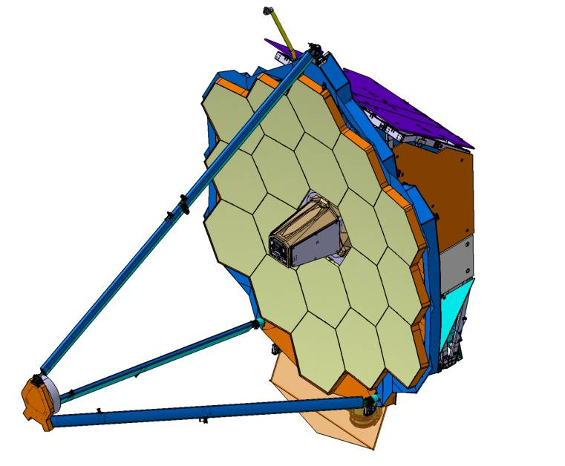
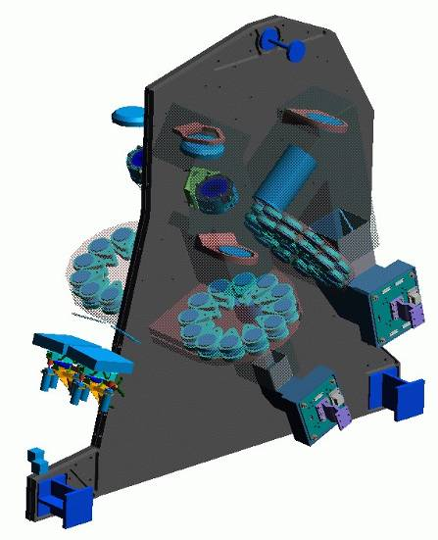
OTE Alignment Via Image Based WFS&C
NIRCam Pupil and Filter Wheels
In NIRCam pupil and filter wheels:
  DHS Filter (F.W.)
  0 deg and 60 deg DHS (P.W.)
  +8 wave weak lens (P.W.)
  -8 wave weak lens (P.W.)
  +4 wave weak lens (F.W.)
Downlink Eng. Data and NIRCam Images
PMSA: 7 DOF Adjustments
SMA: 6 DOF Adjustments
Uplink NIRCam commands and OTE mirror commands
Ground Segment (S&OC)
Green boxes indicate the components of the WFS&C subsystem
WFS&C Software Subsystem (incl. Executive)
Mirror Control Software
WFS&C Analysis Software

Slide 6
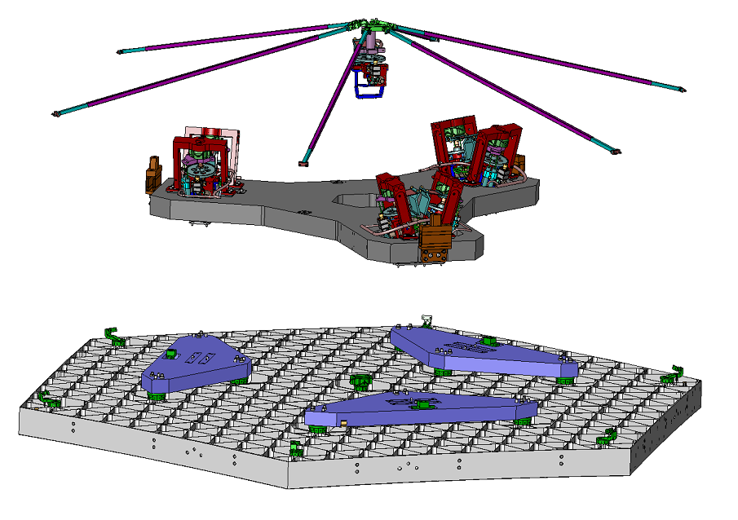
Primary Mirror Segment Assembly (PMSA) Design Description
Radius of Curvature
Actuator
Radius of Curvature
Strongback Struts
Bipod Actuator (3 Places)
Hexapod Assembly
(Housed on Beryllium Delta Frame)
PMBSS Mount
(3 places)
Mirror Substrate

Slide 7
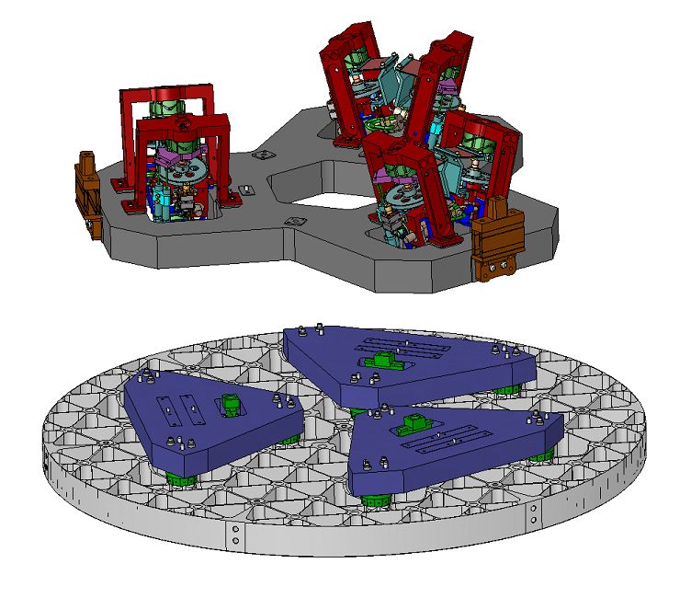
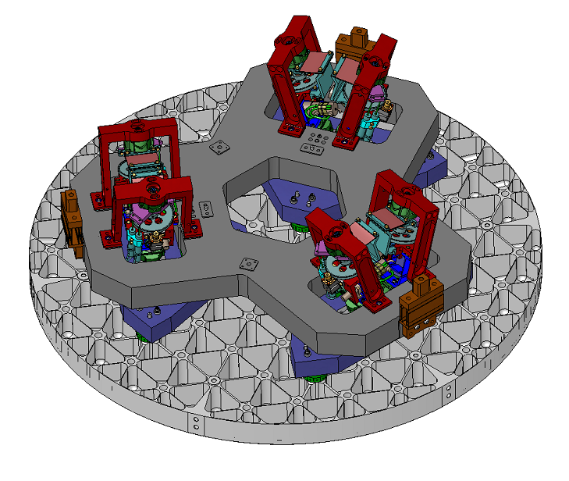
Secondary Mirror Assembly Design Description
Bipod Actuator
(3 PL)
Beryllium
Delta-Frame
Hexapod
Assembly
Beryllium
Substrate
Actuators have coarse and fine mode of operation
Thermistors, LVDT’s on both sides of actuators, resolvers on A side only
Hexapod actuators are snubbed for launch
Hexapod deploys off snubber 12.5mm to nominal locations

Slide 8
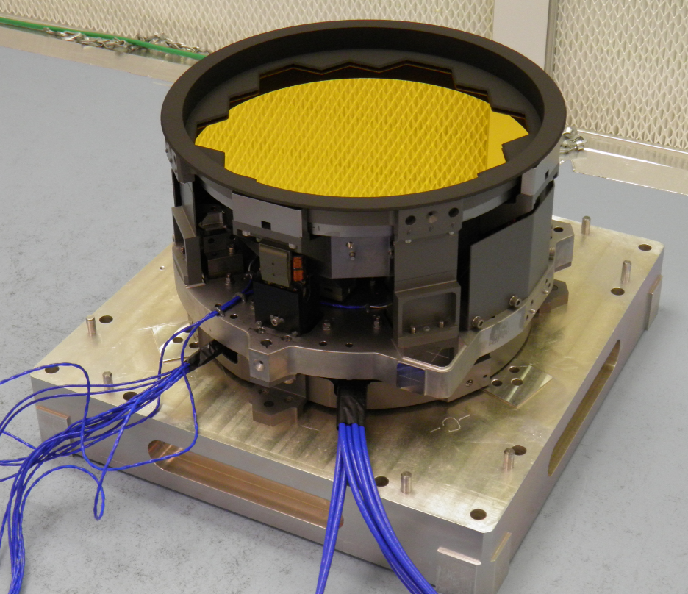
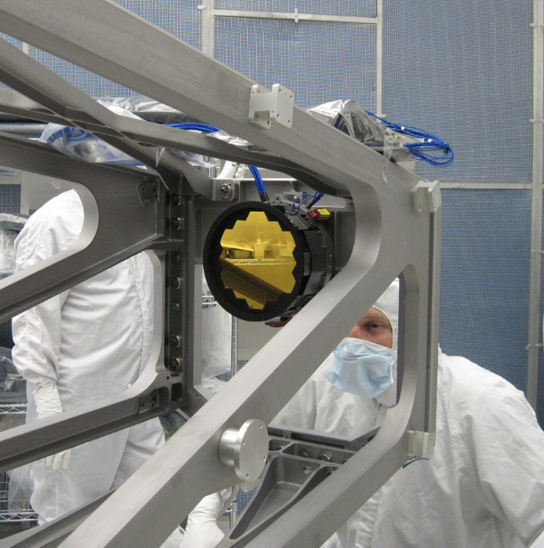
Fine Steering Mirror Design Description
Fine Steering Mirror (FSM)
  Flat optic mounted to fixed base via a tip-tilt flexure
  Differential Impedance Transducer Position Sensors used as feedback to control voice coil actuators
    Provides line of sight steering in two orthogonal axes
  Decontamination Heater to maintain temperature above ISIM during cooldown

Slide 9
Wavefront Sensing and Control Goal
Wavefront Sensing and Control is the sensing, control and algorithms that align the OTE mirrors
(PM Segments, SM) together, and align the OTE relative to the science instruments in ISIM
The goal is to take a post deployed telescope with wing and secondary mirror misalignments and align it to meet image quality requirements
  The image quality for JWST is specified by the Strehl Ratio which can be equated to a total WFE that has allocations that are the driver for WFSC
    MR-110: Strehl Ratio of 0.8 at 2 µm wavelength (NIRCam)
      Equivalent to 150 nm rms WFE
    MR-116: Strehl Ratio of 0.8 at 5.6 µm wavelength (MIRI)
      Equivalent to 420 nm rms WFE
    MR-228: Error Budget flow down to OTE allocates 131 nm rms WFE over the fields of view of NIRCam, NIRSpec, and MIRI
The WFSC alignment affects the Strehl Ratio through the Wave Front Error (WFE)
  The allocation to WFE is divided into:
    The very small design residual for a perfectly aligned and fabricated optics
    Errors in the alignment of the optical elements relative to each other
      Including alignment of Science Instruments to OTE
    Errors in the fabrication of the WFE of optical elements
  Alignments also affect Radiometric Sensitivity through potential vignetting and stray light
    A key driver here is that the image of the primary can move around at the Fine Steering Mask and we need to assure that we do not vignette the mask as we align the telescope

Slide 10
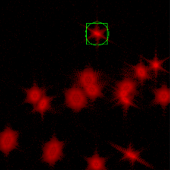
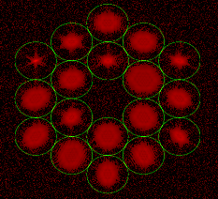
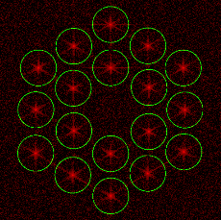
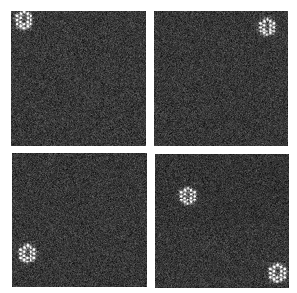
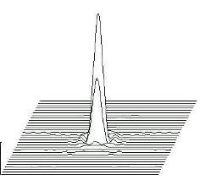
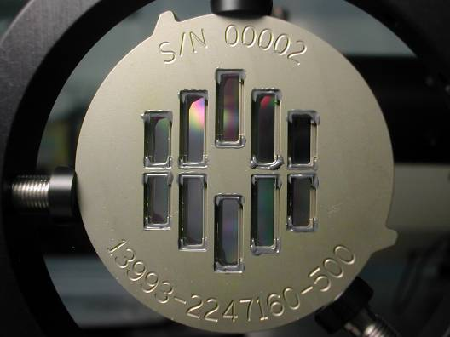
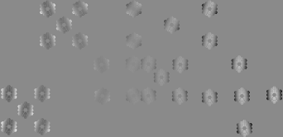

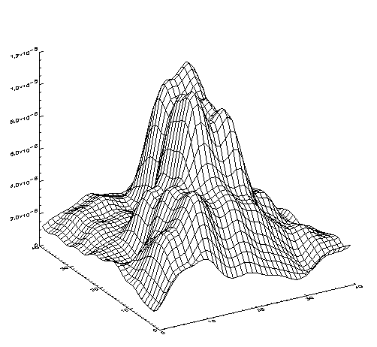
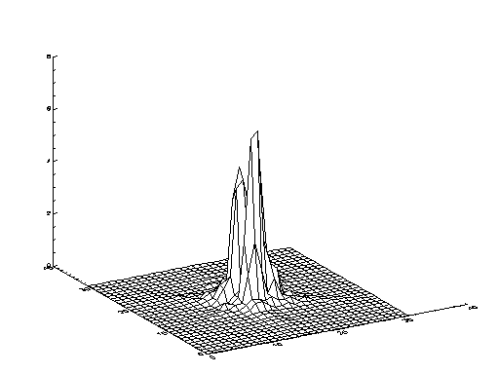
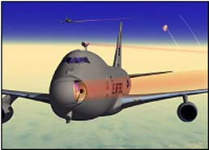
High Level WFSC Commissioning Process
OTE Deployment / First Light (Image Mosaic)
SM Focus Sweep
Segment Identification
NIRCam First Light
After Segment-Image Array
Segment-Image Array
After Global Alignment
Global Alignment
DHS (20 edges)
Commissioning
Image Stacking
After Image Stacking
After Coarse Phasing
Coarse Phasing (DHS)
Coarse Multi-Field
Single Field Fine Phasing
After SF Fine Phasing
Pupil Imaging
Multi-Field Fine Phasing
Wavefront Monitoring & Maintenance

Slide 11
WFS&C Operational Architecture
S&OC/Software
  Software to align & maintain the OTE
    WFS&C Executive
    WFS&C Analysis Software
    Mirror Control Software
3.
1.
2.
OTE Mirror Actuation
  PMSA/SMA adjustment
  Hexapod actuators
  Mirror position telemetry
  WFE Alignment
ISIM Imagery
  NIRCam Optics/Functionality for WFS
    Bandpass filters
    DHS for coarse phasing PM
    3 weak lenses for focus diversity
    DFS (backup for DHS)
  Imagery as needed from other SI’s
    Internal focus mechanisms
    MIRI pupil Imaging
LOS Stability for WFS&C
  LOS stability using only ACS
  FGS use during WFS&C Commissioning
  FGS use during nominal operations
4.

Slide 12
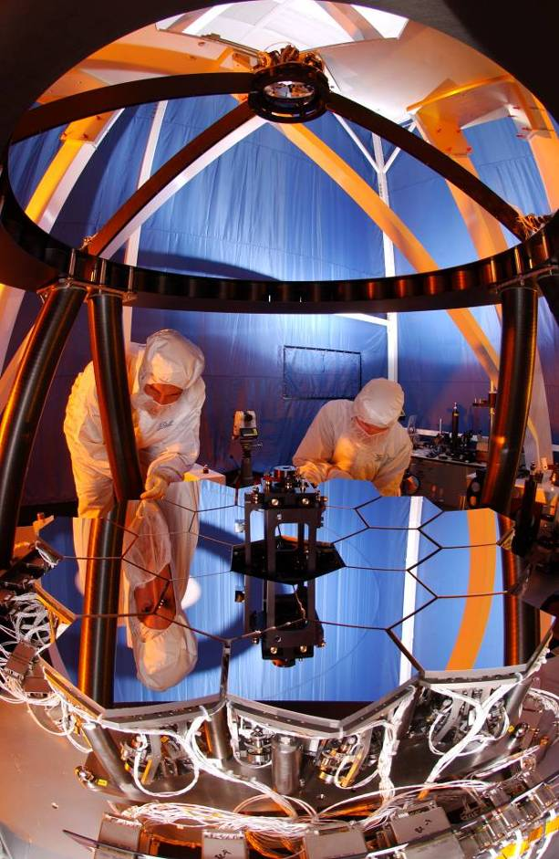
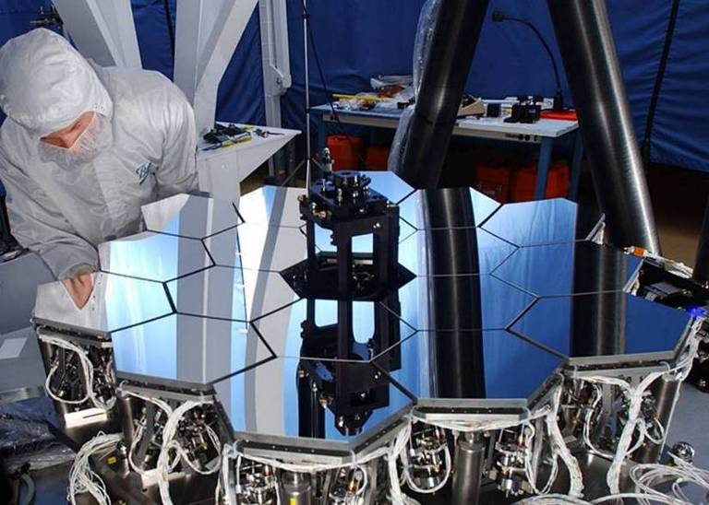
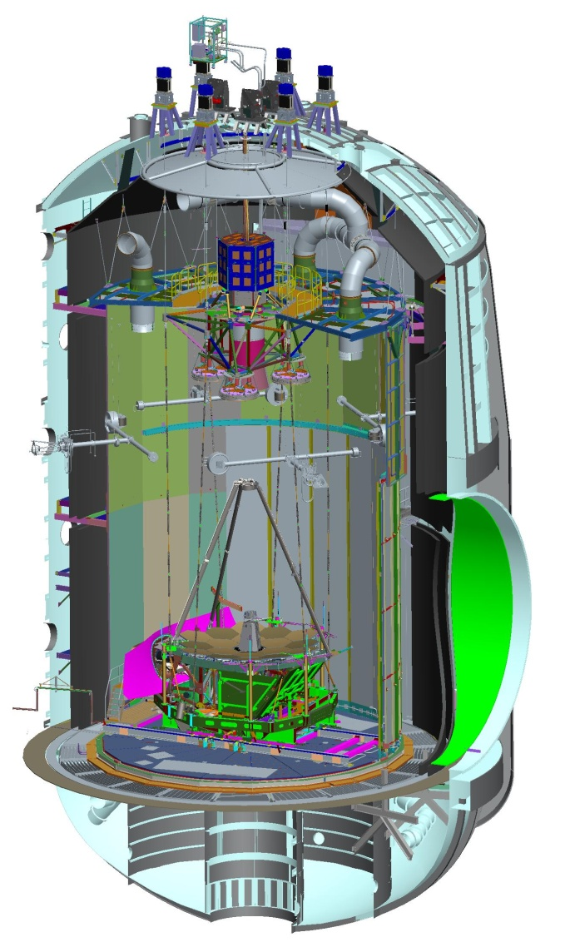
How WFSC Was Validated and Tested
WFSC Testbed Telescope is a 1/6th scale, fully functional model of the JWST telescope with performance traceable to JWST (TMA, 18 7-dof segments, etc.).
TBT primary use was in validation of Flight Algorithms and software
  We were able to validate algorithms to the limits of the environment, close to flight requirements
  Allowed us to build confidence in the Integrated Telescope Model (ITM) that was then used to verify the flight software and algorithms
  TBT has been realigned and is near ready for use in training and contingency work
JSC cryotesting allowed us to test key algorithms end to end with operations using the full telescope and science instruments
  Coarse phasing, fine phasing demo
  Global alignment demo
  Used OSS scripts, end to end

Slide 13
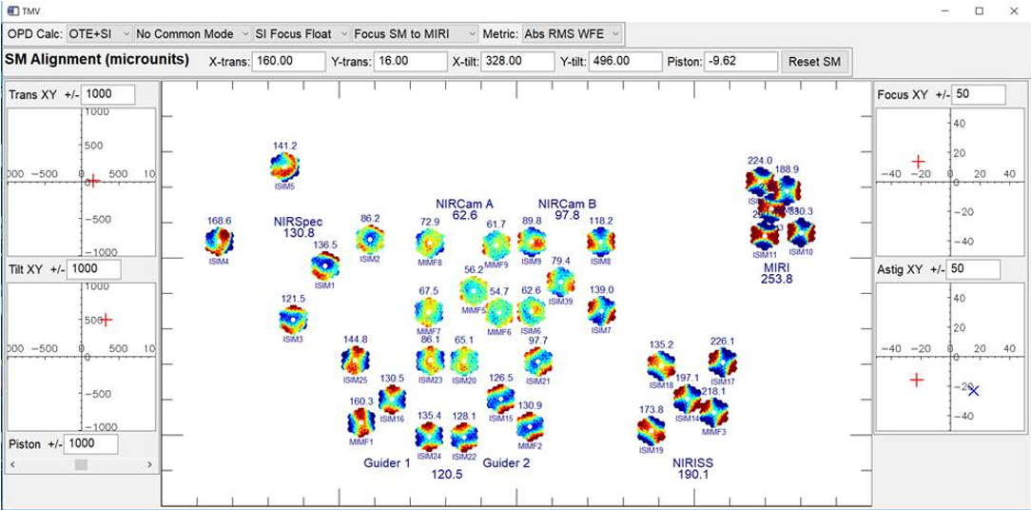
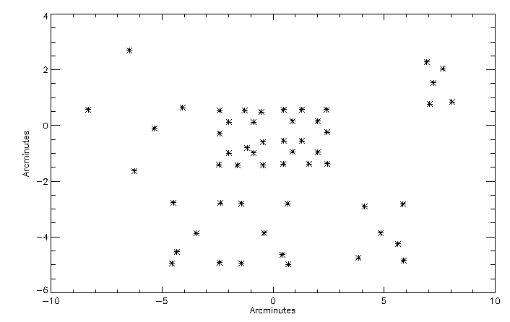
Multi-Instrument Multi-Field Alignment
Early in the program, we recognized that certain Primary Mirror alignments could look like a misaligned secondary mirror at a single field point creating an ambiguity (degeneracy)
  Key is that the primary mirror shape does not vary with field (it is at a pupil) but a misaligned secondary creates field dependent aberrations
To address this, we recognized that using field points in each SI over the field would allow us to break this degeneracy
We developed the MIMF algorithm to address this degeneracy and carefully calibrated SIs at key field points used in this algorithm
Realigning the secondary can be time consuming (several days to a week) so we carefully evaluate if it is needed each iteration working closely with the Science Community
SI Calibration Points
Simulation of Degeneracy

Slide 14
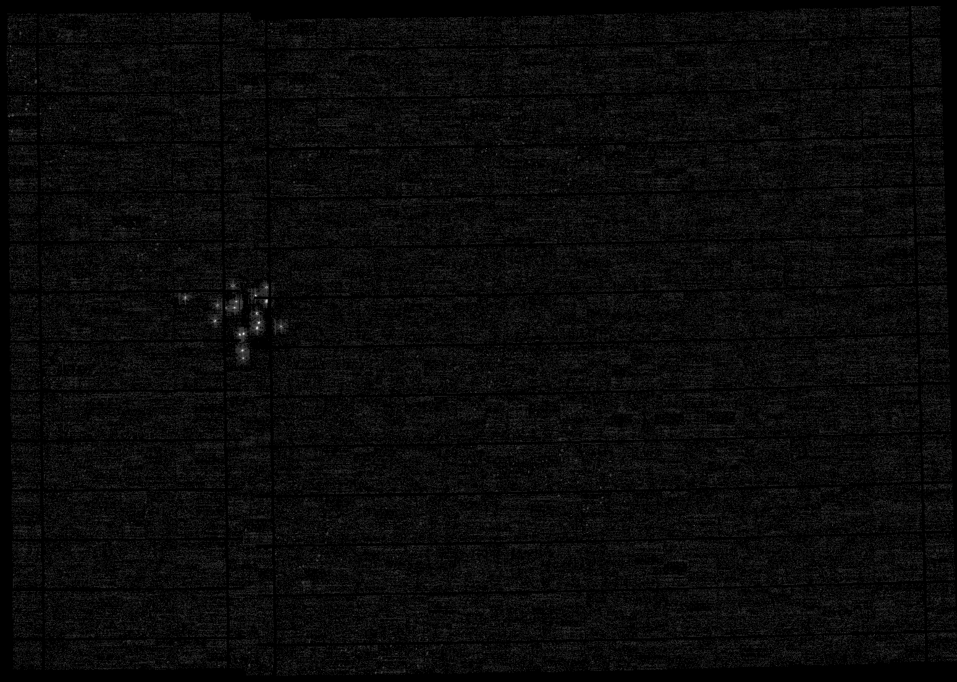
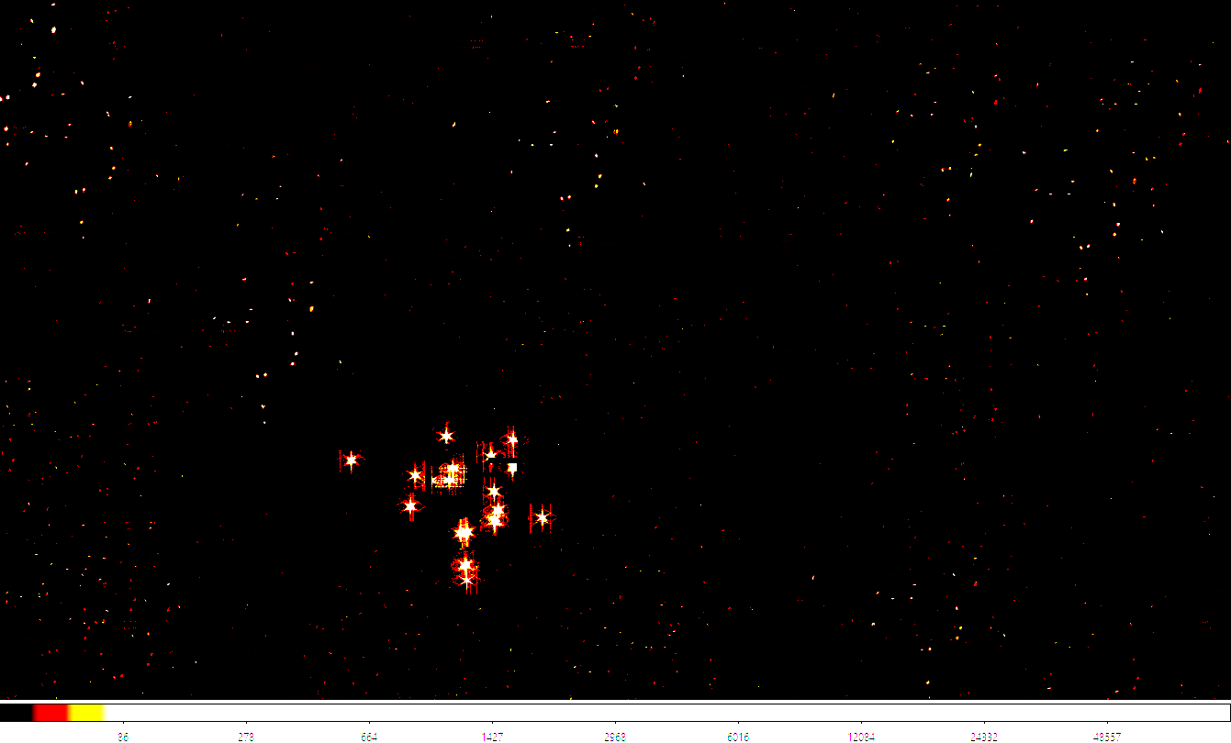
Initial Boresight Offset
Baseline plan to establish initial boresight:
Slew to a bright isolated star
Execute a large mosaic observation
Add additional observations as needed until 18 spots are seen
Plan for nominal 40x40 arcmin swath that happens incrementally (can end early)
Geometric centroid of spots yields boresight location
Contingency Approach if initial boresight error exceeds requirements:
We have several options ranging from increasing the field size to using a bright globular cluster to pattern recognition.
MIRaGe mosaic from Team Practice 4
Scan pattern overlaps left-right; leaves small gaps between NIRCam SCA’s, but gaps are smaller than expected size of initial defocused segment PSFs

Slide 15
Guiding During WFSC
One of the key risks we have carefully managed for Wavefront Sensing and Control is Guiding. Requires integrated functionality of FGS, FSM, and ACS.
Unusual PSFs (single segments, aberrated, defocused) make guiding more challenging, and require use of special setups developed for this purpose.
Guiding is first used in flight during initial Line of Sight checkout, immediately before OTE Global Alignment. This is guiding off one segment which has a larger Point Spread Function.
The WFSC and Guiding teams have worked closely together for many years to assure guiding can be implemented smoothly
  OTE WFSC has provided Point Spread Functions that simulate guiding at the various stages of WFSC, including realistic variations
  On top of our simulations, during JSC cryotesting we closed the guiding loop using a highly aberrated half pass source
In addition to all of these efforts, the team has looked at the case where guiding is not initially working and has shown that we can get all the way to Fine Phasing

Slide 16
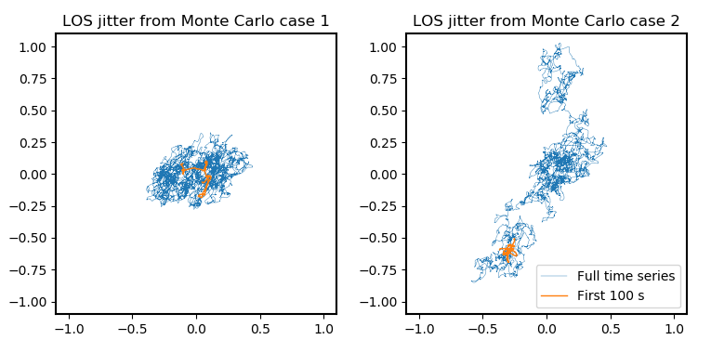
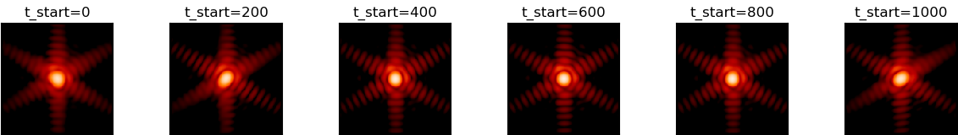
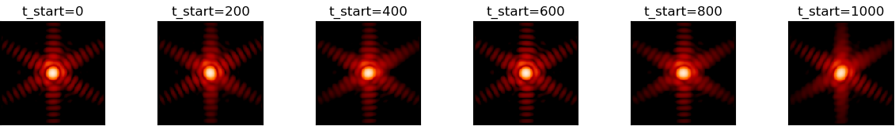
Contingency: Closed Loop Guiding Not Working
Recent sims of observatory pointing in ACS coarse mode
(i.e. without closed loop guiding) predict jitter+drift < 0.25 arcsec for exposure times < 100 s.
Based on this expectation of coarse pointing, we could execute commissioning activities without guiding until
Fine Phasing 1
arcsec
Monte-Carlo simulations over 2-hour period.
Case 1
Case 2

Slide 17
Thermal Stability Activity Plan
After the telescope is aligned over the full field, it will continue to cool to its operational temperatures.
The optical next step will be to assess the thermal stability of the observatory:
Thermally stabilize at hot attitude
Assess instrument electronics cyclic wavefront or other short timescale drifts and establish warm stable baseline performance for pointing stability and WFE stability.
Slew to cold attitude
    Assess frill/primary mirror, telescope wavefront drifts and pointing stability over 14 days.
Slew back to hot attitude
Verify consistency with prior hot to cold pointing stability
All thermal stability measurements take ~4.6 days over a 20 day time period

Slide 18
Science Instrument Commissioning
Science Instrument (SI) commissioning brings the science modes to readiness for use in scientific observations
This process involves obtaining suitable preliminary calibrations and executing operational demonstrations to ensure that we know how to take science-quality data
  This will involve assessments of the contributors to sensitivity (throughput, image quality, backgrounds, detector noise) as well as the astrometric calibrations necessary to put targets in slits or centered on coronagraphic spots, etc.
  Operational demonstrations will include target acquisition, dithers, mosaics
The SI’s are commissioned mode by mode, not SI by SI
  For example, no reason to hold up on “point and shoot” imaging observations because of an issue with the coronagraphic target acquisition algorithm
SI commissioning will flow seamlessly into Cycle 1 observing
  The commissioning observations will have exercised the same planning tools and data pipelines that will be used by all observers

Slide 19
Conclusion
Preparations for JWST commissioning are going well
Once power and communications are established, the first phase of commissioning includes the large deployments of the sunshield, tower, and wings
The second phase is the mirror deployments and telescope alignment.
  Begins with mirror deployments
  Wavefront Sensing and Control through an aligned telescope
Final phase is Science Instrument Calibration
Optical commissioning uses WaveFront Sensing and Control (WFSC) algorithms that have been extensively tested and optimized
The Guider and NIRCAM instruments will be used to support WFSC
Once in space, it will be several months before we have confidence the telescope meets all optical requirements but we will build confidence as we go through WFSC

