Slide 1




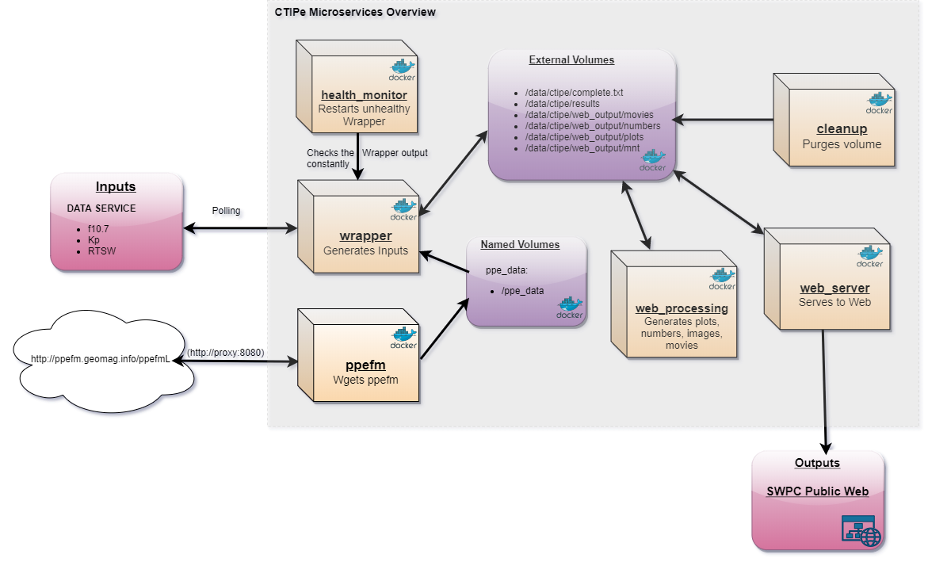
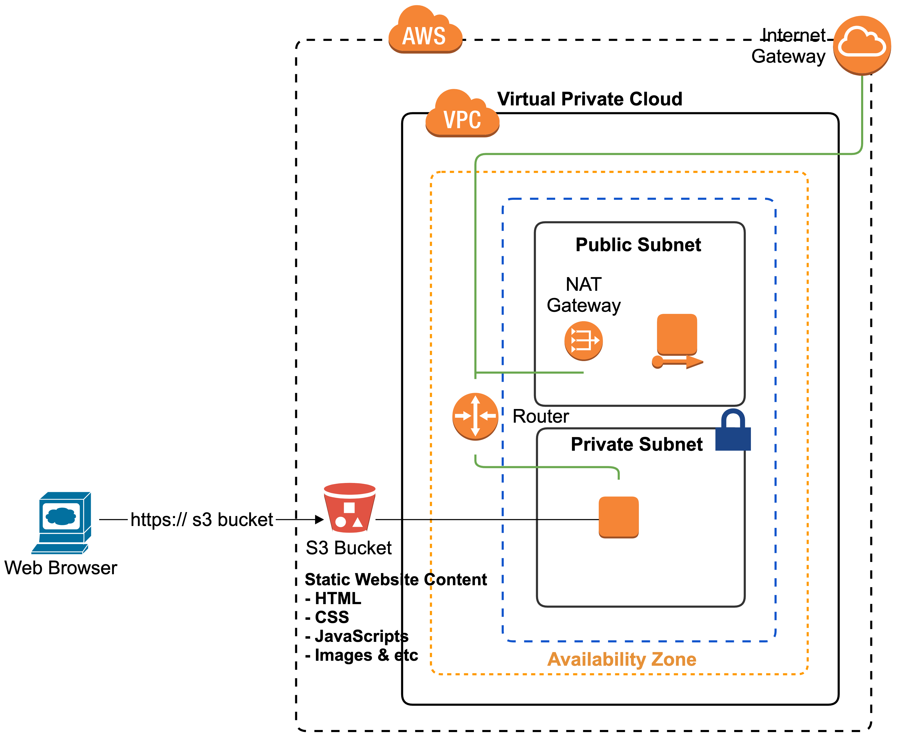

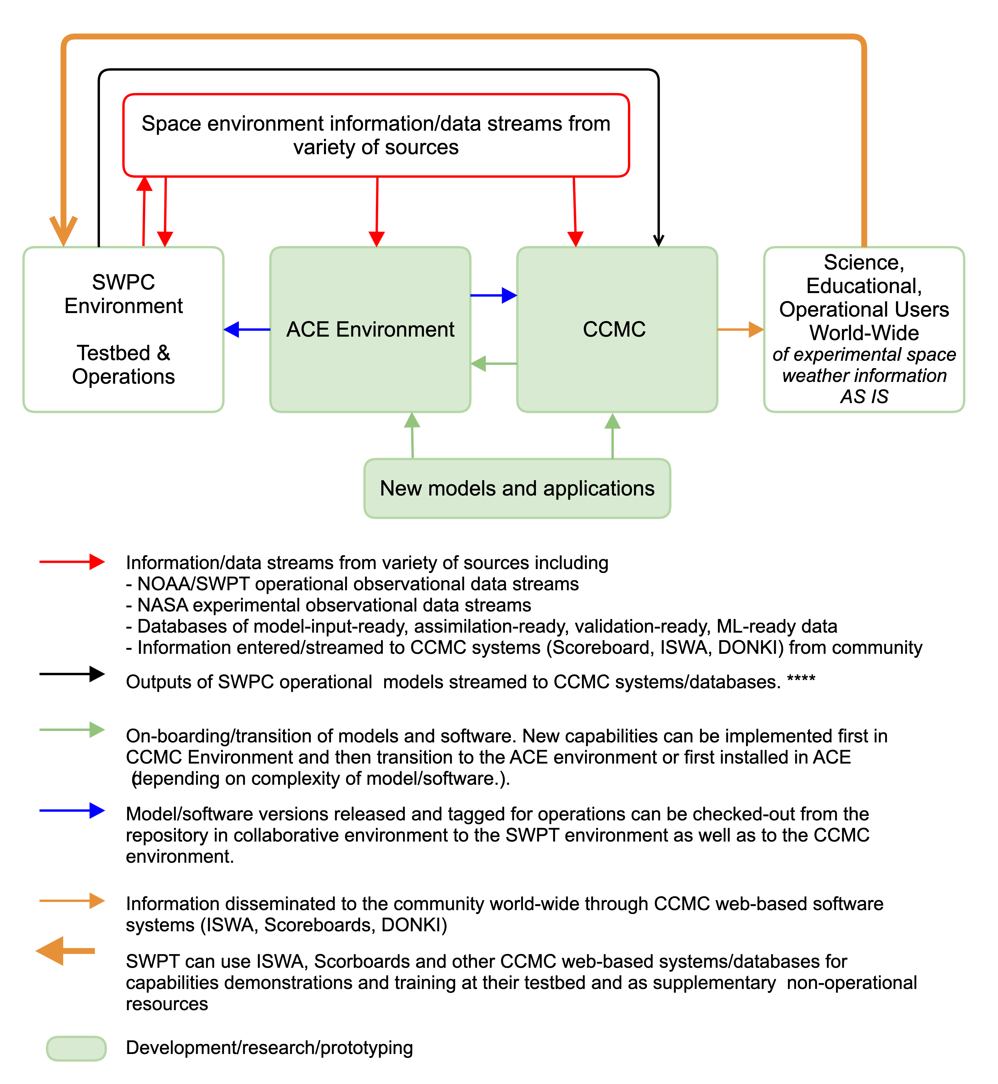
Building Collaborative Proving Grounds for R2O2R – NASA/CCMC –
NOAA/Space Weather Prediction Testbed (SWPT) Partnership
T. Tsui[1], M. Cash[2], C. C. Didigu[1], R. Dodani[2], M. England[2], B. Gordon[2], S. Hill[2], M. Husler[2], M. Kuznetsova[1],
C. Lauer[2], L. Mays[1], C. Wallace[2], C. Wiegand[1], J. Yue[1]
[1] NASA Goddard Space Flight Center, [2] NOAA Space Weather Prediction Testbed
Summary
A Research-to-Operations Operations-to-Research (R2O2R) environment in the Amazon Web Services (AWS) cloud was successfully implemented.
Effectively transitioned a containerized Coupled Thermosphere Ionosphere Plasmasphere Electrodynamics (CTIPe) model from operations to research through the R2O2R environment.
Using AWS cloud services promoted secure and convenient collaboration between operations and research teams.
Using Docker containers, as well as version control with GitLab, enabled rapid portability between operational and research systems.
Areas for improvement were identified and will be used to enhance this and future proving grounds.
Following best practices and standards was vital in ensuring a successful and repeatable outcome.
Overview and Architecture of the ACE Environment
The ACE environment consists of an AWS virtual network (VPC), subnets, and gateways. The environment was initially set up to mirror the operational environment as closely as possible. Deviation was introduced to secure AWS services or to take advantage of AWS services. The deployment process for ACE environment includes:
Virtual Private Cloud (VPC) was configured with public and private subnets, the appropriate network address translation (NAT), and internet gateways and route tables for inbound and outbound traffic. Servers within the private subnet, which do not have a route to the internet, will not have access to the internet.
Deployed a bastion host, with a public Elastic IP address, for secure access to other servers in the subnets. The bastion host is configured for inbound Secure Shell (SSH) access.
Launched a server for the SWPT-CCMC effort in the private subnet.
Configured Elastic Compute Cloud (EC2) security group for inbound access control. Ports are limited, allowing only the necessary access to hosts.
Created and configured a Simple Storage Service (S3) bucket to display model-derived images via a static website. The configuration includes enabling website hosting, setting permissions, and creating and uploading the index document (for example, index.html).
Installed L3Harris IDL floating license server on the instance. As of July 2020, AWS License Manager is unable to manage IDL license.
What We Did and Progress Made
CTIPe, a serial model, was chosen as the first model to be transitioned via the ACE collaborative environment. A containerized version of CTIPe, running in operations, was installed and tested on AWS. A continuous assessment of the model was iteratively performed during testing in order to identify improvements to the security, maintainability, reliability, and portability of the entire system in accordance with previously established criteria. As improvements were identified, they would then be implemented in operations, and finally the improved system would be re-installed in the collaborative environment for further assessment.
After several iterations of implementing improvements to the system to meet established criteria, the system was transitioned from AWS to a CCMC production server.
The system comprised Docker containers for the CTIPe model, IDL, real-time run scripts, post-processing software to produce images from model results, and a static website on AWS S3 displaying observation data and the derived images. The data and images were updated after every real-time run and stored in an AWS S3 bucket to be retrieved and displayed on the website. Source code for the entire system was stored in GitLab repositories and kept up to date.
In 2016 and 2019, Executive Orders were signed by the President to prepare the Nation for Space Weather Events. At the forefront of being able to achieve this goal is the necessity to accelerate and enhance R2O2R. To drive this initiative, the Space Weather R2O2R Framework, initially led by NOAA and NASA, was developed. At the very center of the framework is the Space Weather Proving Grounds effort that will allow various institutions to collaborate, share, and advance their space weather modeling and simulation capabilities. The first of these Proving Grounds is the Architecture for Collaborative Evaluation (ACE) environment shared between the Community Coordinated Modeling Center (CCMC) at NASA and the Space Weather Prediction Testbed (SWPT) at NOAA. Since 2019, the ACE environment has been set up on the AWS cloud where it utilizes AWS cloud services and Docker containerization technology.
Design Goals
To enhance operational-grade models and software.
To demonstrate that research-grade models and software are ready to be transitioned into operational settings.
Initially set up to mirror SWPC operational environment as closely as possible.
R2O2R Software Transition and Data Flow at ACE
CTIPe Docker Microservices
Lessons Learned
AWS offers many storage options. S3 is the ideal solution for most cases. It is the cheapest solution; you pay what you use. With Elastic Block Store (EBS), you pay what you have allocated, regardless of how much you use.
In the environment, multi-factor authentication (MFA) was enabled for each user. Because MFA requires human interaction, we encountered permissions issues when accessing the S3 bucket from the EC2 instance during runtime. To solve this problem, we used AWS Identity & Access Management (IAM) roles for authentication.
In general, using IAM roles instead of IAM users was preferred for EC2 because IAM user access keys are in plaintext, and the returned temporary Security Token Service (STS) credential expires. IAM roles will also take care of the S3 permissions and key rotation for you automatically.
Initially, we tried to mount S3 as a file system, known as S3fs. However, the performance of S3fs was a showstopper. We tried s3fs-fuse and goofys but both these s3fs libraries would unmount the S3 bucket whenever CTIPe issued a write. We believe they are unable to keep up with the model input and output rate. In the end, CTIPe was configured to write to device storage; the AWS Command Line Interface (CLI) would then be used to push/sync the data to S3.
Another issue we encountered was with the permissions/ownership of the directory and files created by CTIPe. The original CTIPe containers created files with a hardcoded UID and GID of 1003. On the server/instance that we were using, the user had a different UID/GID and was unable to write to the S3 mount. To solve this, the Docker container was modified to accept any UID/GID during build time, which provides system flexibility.
We employed best practices for container, model/software, and AWS common services while developing the ACE environment and software.
Architecture for Collaborative Evaluation (ACE)
environment
Future Plans
We plan to:
Continue adding more operational and/or research containerized serial models to ACE while employing the best practices that we have identified.
Continue to evaluate ACE environment for R2O2R framework.
Enhance current ACE environment with AWS Parallel Cluster for parallel models.
If opportunity presents, add parallel model to ACE.
Evaluate GitLab Container Registry for improved portability.
Explore container orchestration with Kubernetes.

