Slide 1
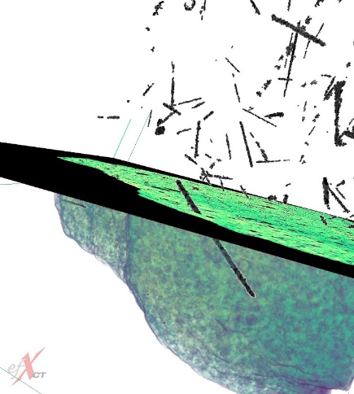
X-ray Computed Tomography for Space: Applications and Implications for Future Exploration
Justin S. Jones, Ph.D.
  NDE Lead and Subject Matter Expert
  NASA Goddard Space Flight Center
  justin.s.jones@nasa.gov
Collaborators: Dr. James B. Garvin/GSFC Chief Scientist, Ryan Kent/GSFC, Nathan Smith/GSFC, Dr. Jenny Sietins/ARL
North Star Imaging: “NDT Talks” Webinar
Thursday, December 10, 2020

Slide 2
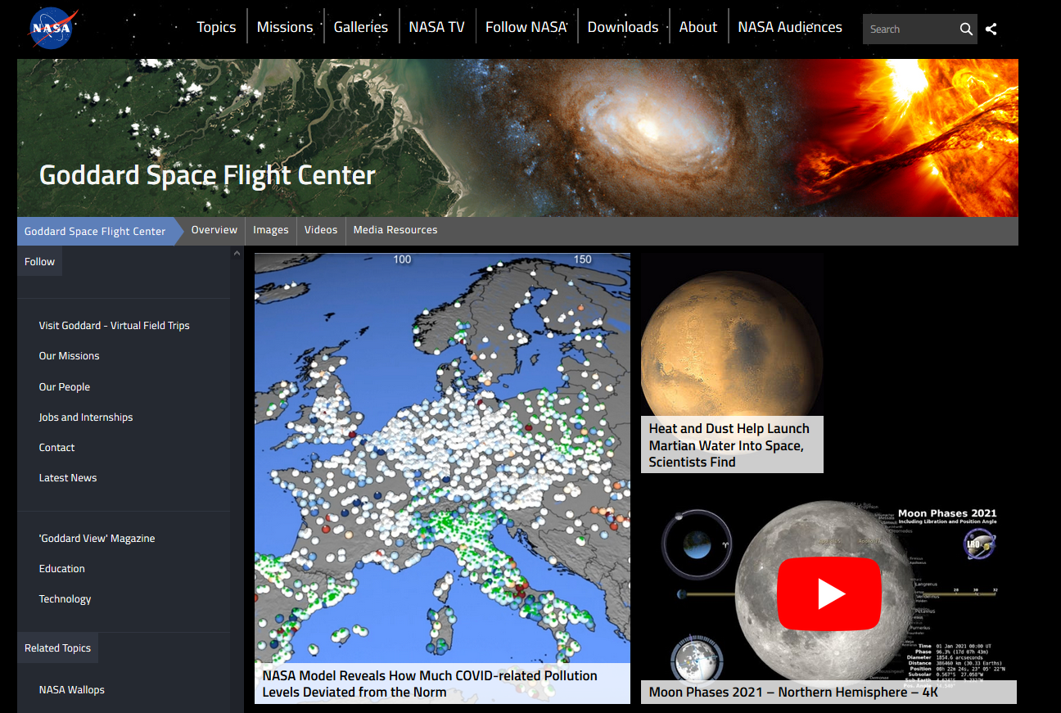
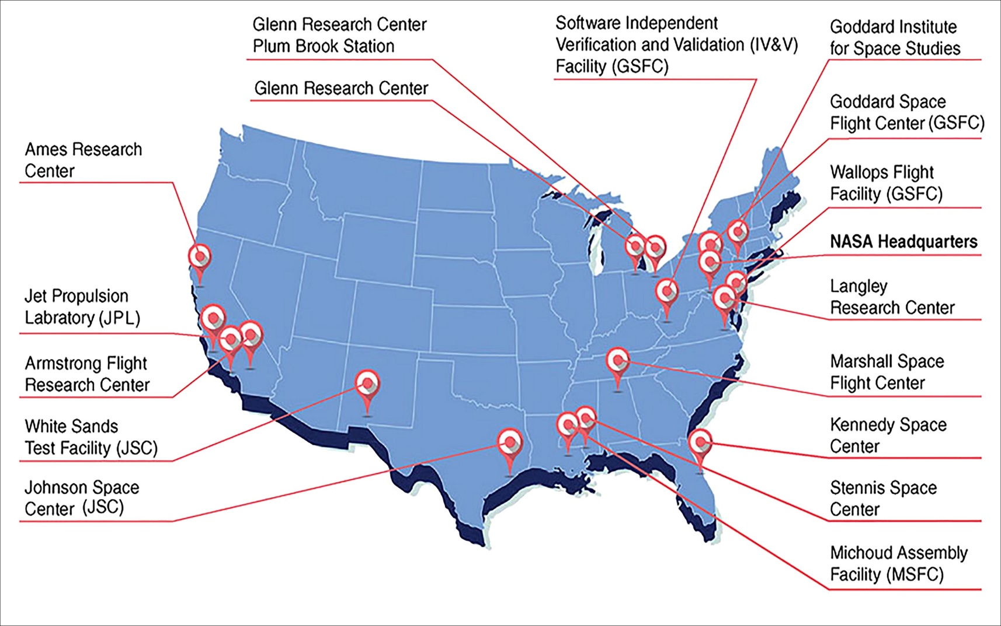
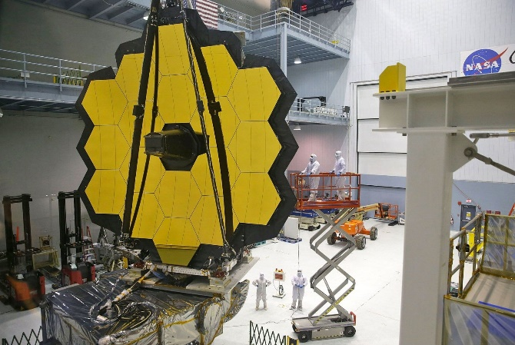
Quick Intro to NASA Goddard
https://www.nasa.gov/centers/goddard/about/index.html

Slide 3
Non-Destructive Evaluation (NDE) at GSFC
Radiography
  X-ray Computed Tomography system
    North Star Imaging X5000 custom system
      Source: Yxlon, model FXE-225.99, 225 kVp, Dual-Head Micro-focus
      1st Detector: Dexela 7529 CMOS panel w/75 µm pitch, 3888 x 3072 pixel resolution
      2nd Detector: Varex XRD 1611xP CMOS panel w/100 µm pitch, 4096 x 4096 pixel resolution
      7-axis part manipulation capability
      Secondary Super Fast Reconstruction and Analysis Workstation
  Real Time X-ray system
    Source: Xray Worx XWT-225-CT micro-focus directional x-ray tube, 225 kVp
    Detector: Varian PaxScan 2520V, Am. Si panel w/127 µm pitch, 1516 x 1900 pixel resolution
    5-axis part manipulation capability
Infrared Thermography
  TWI EchoTherm lite flash IR system
    Hensel Tria 6000 Flash Packs and Lamps
    FLIR SC8200 detector w/ 18µm pitch, 1024 x 1024 resolution, 3-5µm spectral range
Ultrasound
  TecScan TS-1000 3 axis immersion system
  Olympus Epoch 1000i portable/handheld system, Phased Array Equipped
  NDT Systems Raptor/StringScan portable/handheld C-scan system
Fluorescent Penetrant
  Methods: A, C, D
Eddy Current
  Zetec MIZ-21B portable system
Dimensional Tools:
  Digital Image Correlation, GOM Aramis 5M
  Laser Confocal Microscope: Keyence VK-x250
  3D EDOF Microscope: Keyence VHX-5000
  Handheld Structured Light Scanner: Creaform GoScan20
*New Equipment

Slide 4
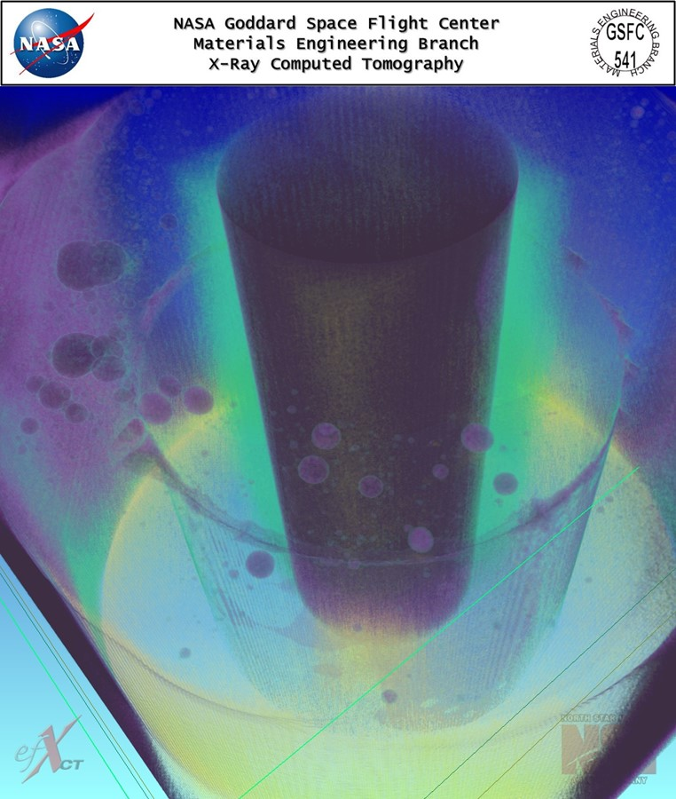
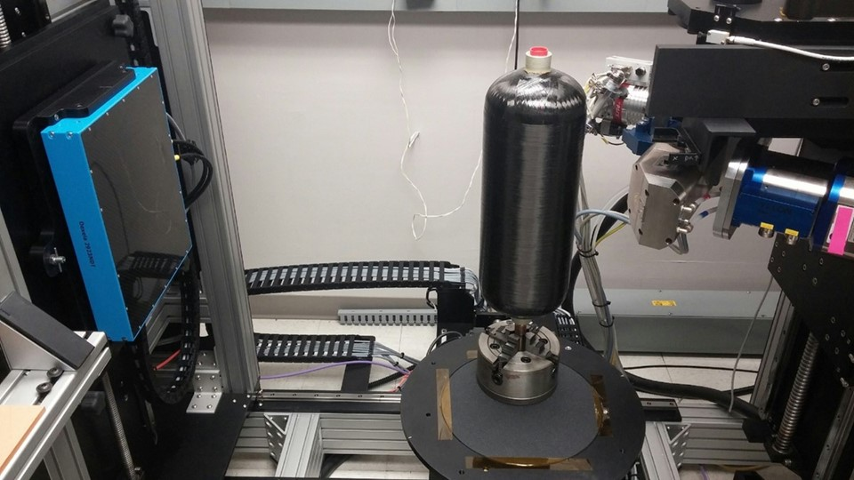
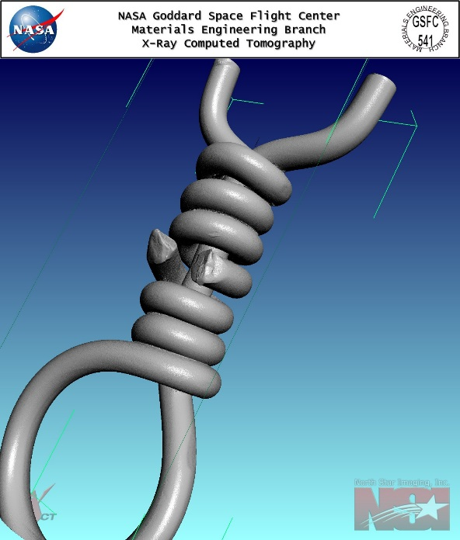
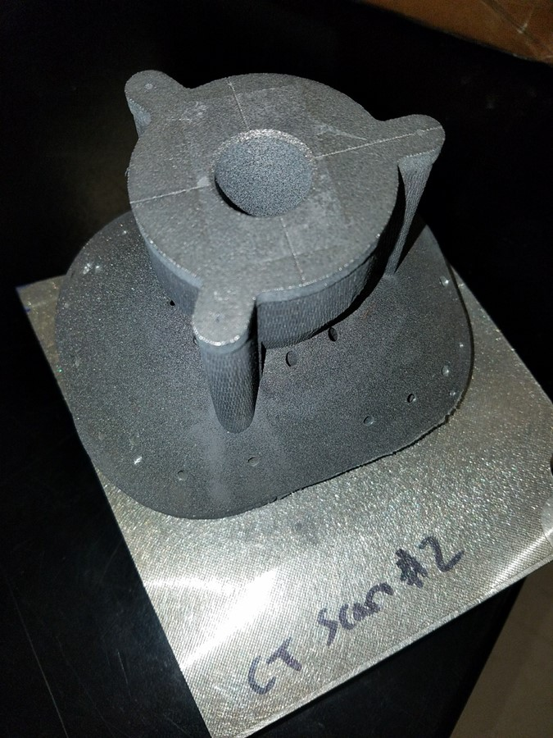
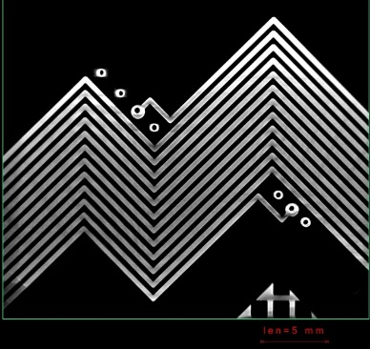
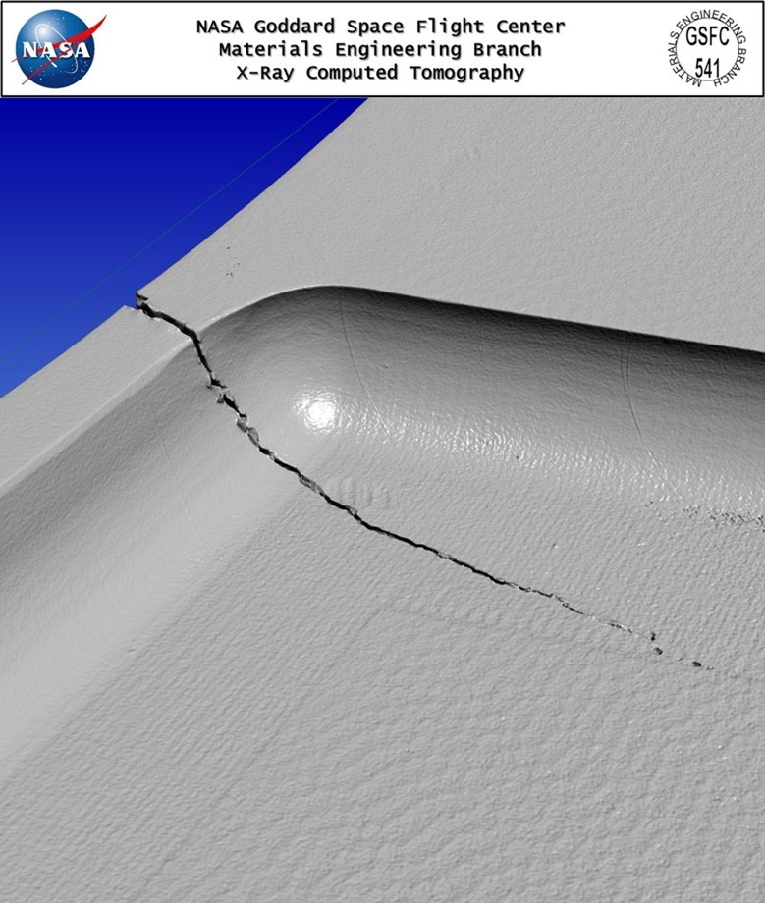
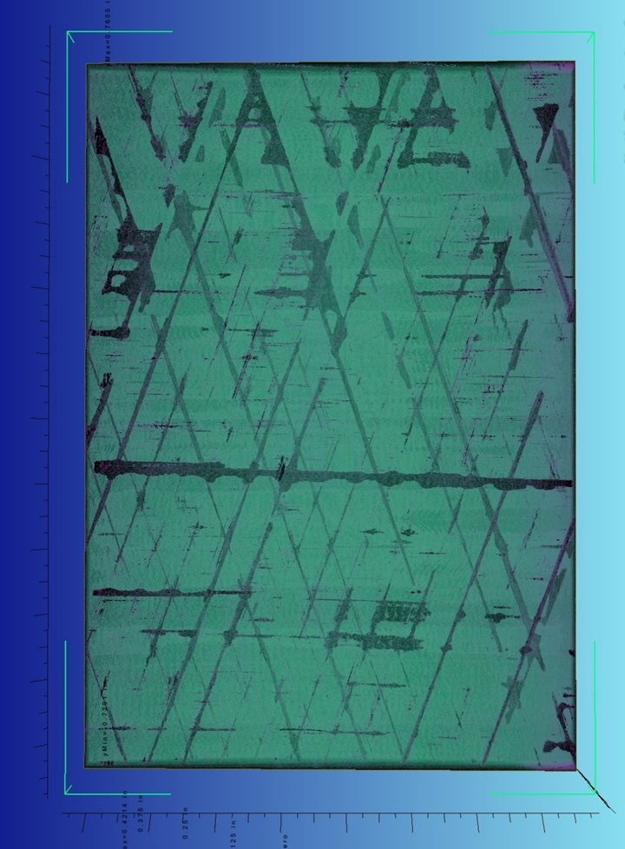
Breakdown of GSFC NDE Activities, by Type
GSFC Project Support
Provide inspection support to several active flight project/program offices: including James Webb Space Telescope, Roman Space Telescope, PACE, and many others
Typically Short Duration (few days/weeks typically)

Slide 5
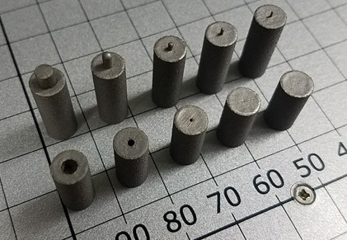
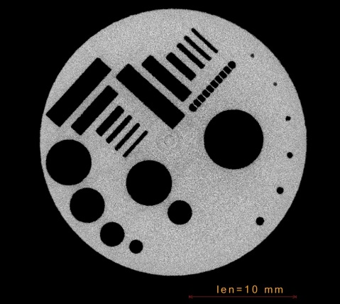
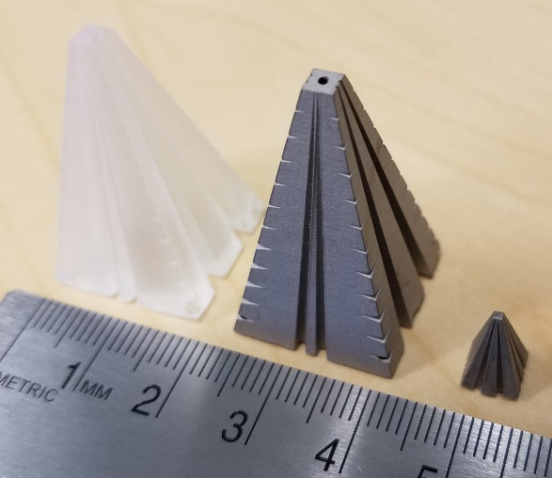
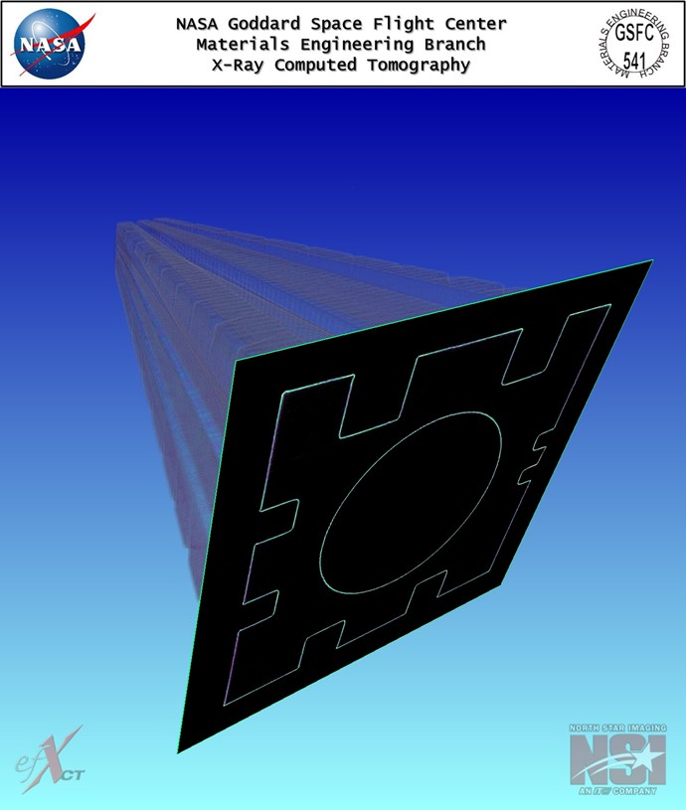
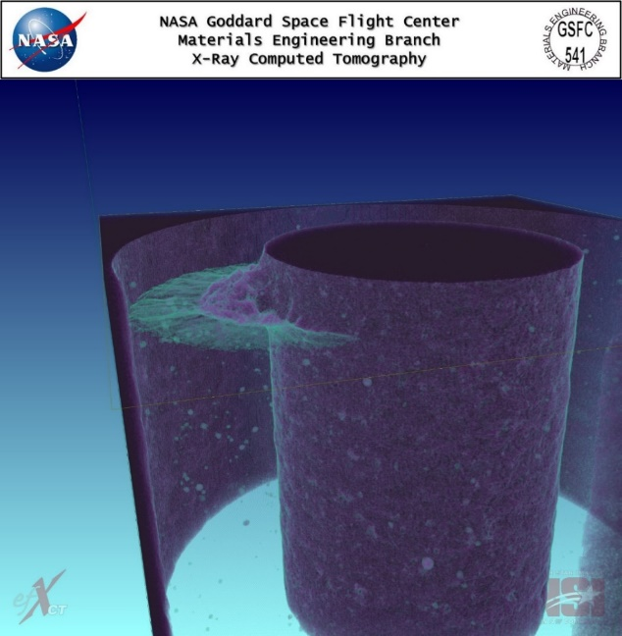
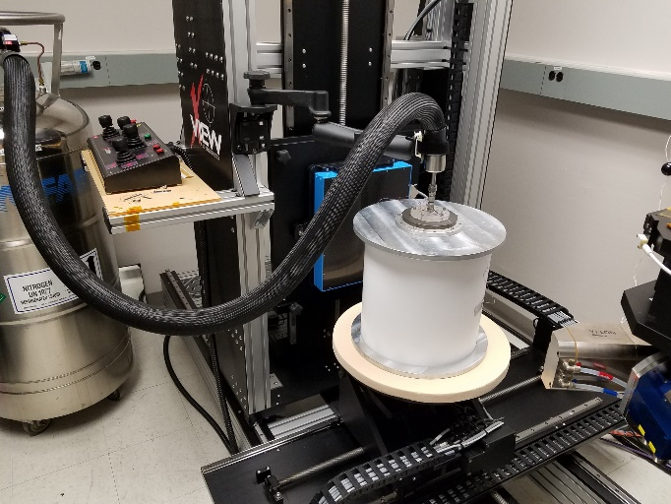
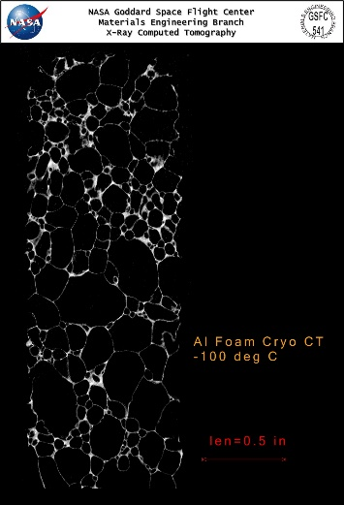
Breakdown of GSFC NDE Activities, by Type
OSMA/NESC Efforts
NDE Dependence on Additive Manufacturing Material Parameters
Development of X-Ray Computed Tomography Performance Standards using Additive Manufacturing
Cryogenic CT Scan System
Portable X-ray Source Miniaturization
COPV Damage Assessment
Radiometric Parameters for Tube and Pressure Vessel Systems
Emergency Project Support

Slide 6
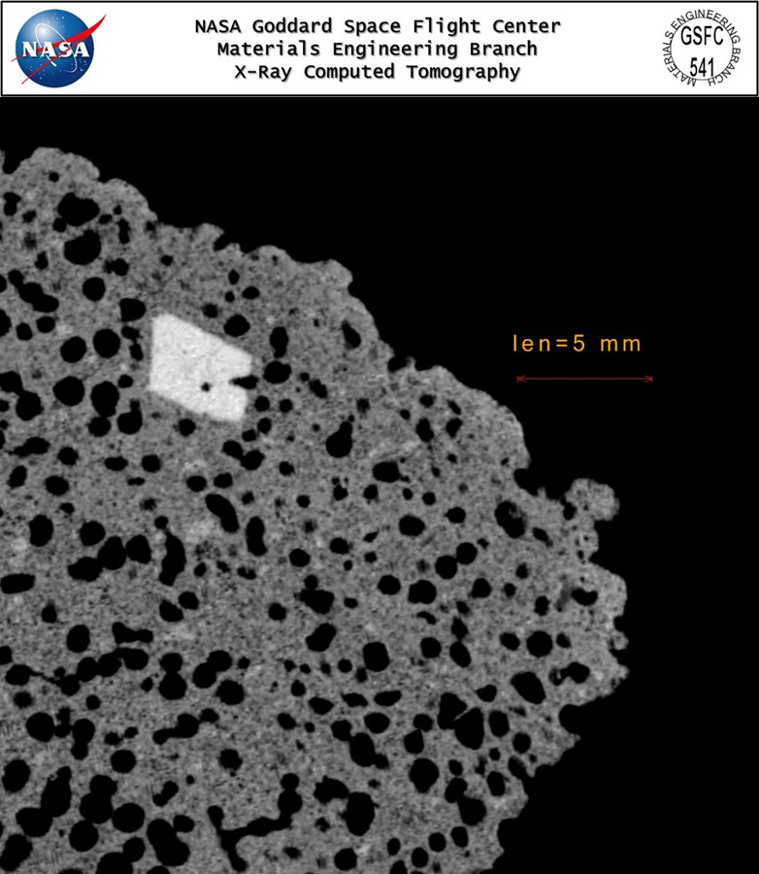
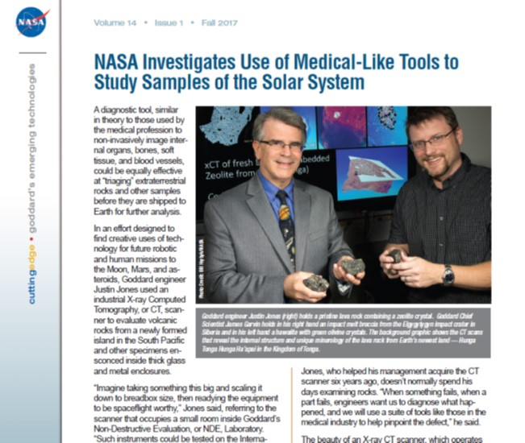
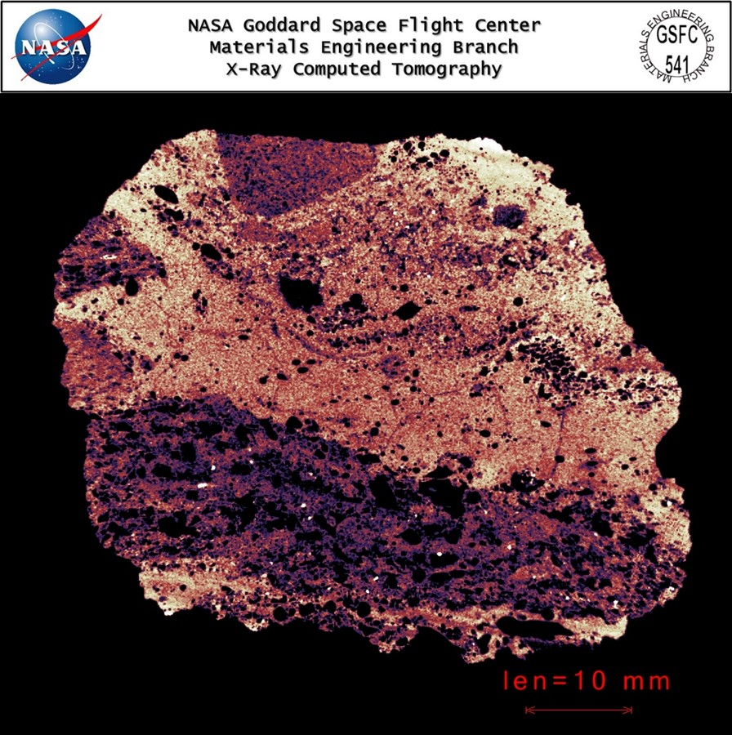
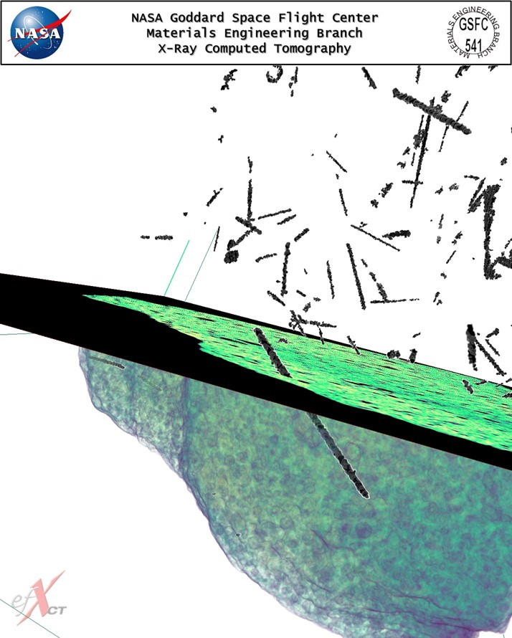
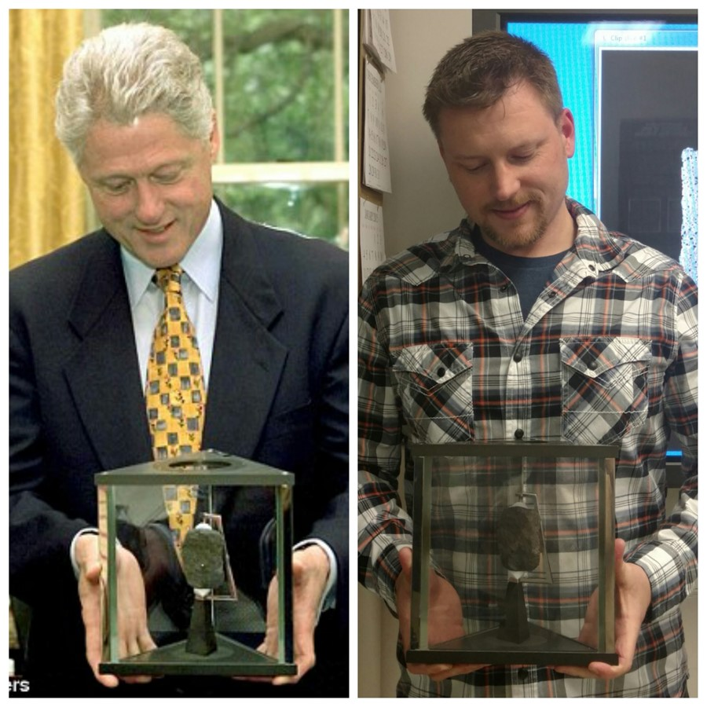
Breakdown of GSFC NDE Activities, by Type
GSFC Science Support
Investigating merits of CT for extraterrestrial sample return applications (Lunar, Martian, asteroid samples)
Base-lining system parameters to ultimately build a CT System for In-Space Use

Slide 7
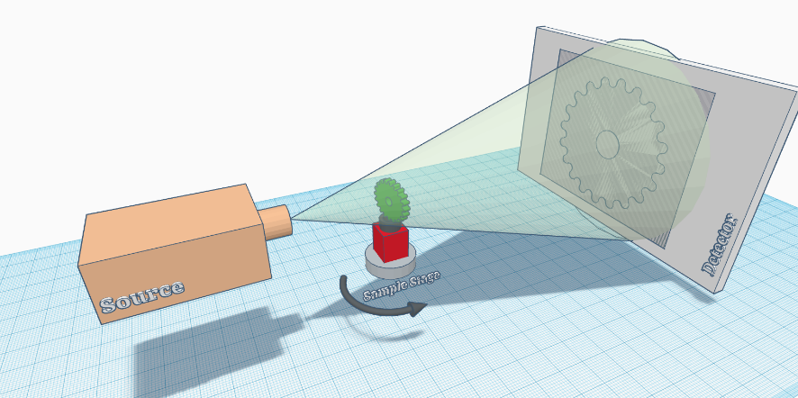
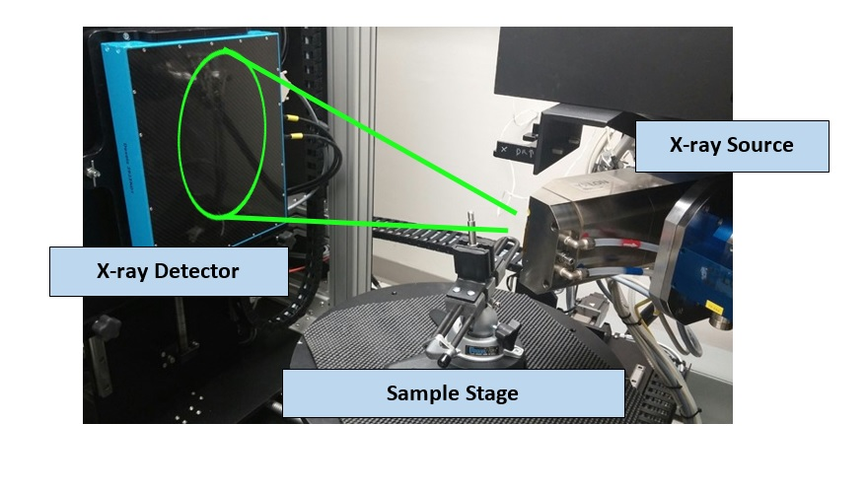
Background on X-ray CT
X-ray Cone Beam Computed Tomography (CT) is used to create 3D, volumetric images of samples/parts
  Raw data consists of a series of 2D x-ray images, or radiographs, taken at different angle views, known as projections.
  Similar to medical CT scan, but for industrial CT, the sample rotates as opposed to a rotating x-ray gantry.
  Radiographs are processed into a 3D volume with commercial software through a process called reconstruction (e.g. Feldkamp back-projection or similar method).
  Volume data consists of generally 12- to 16-bit grey scale data (14 for our study) distributed through the volume as voxels (volume pixels).

Slide 8
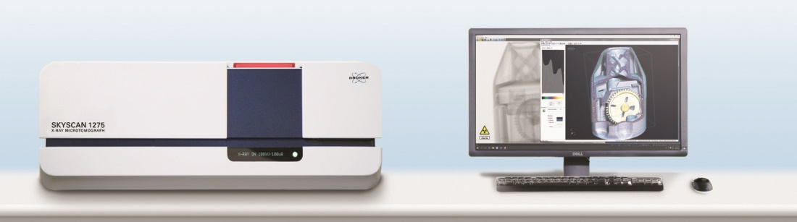
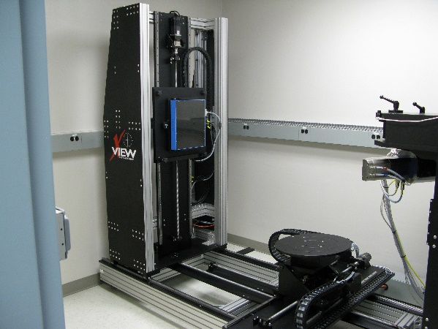
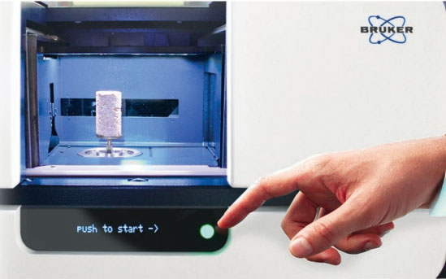
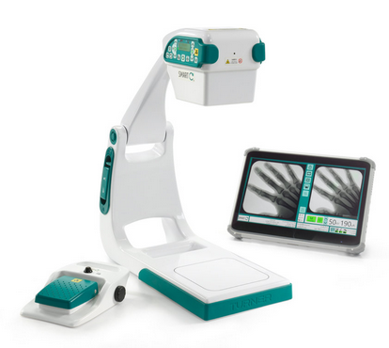
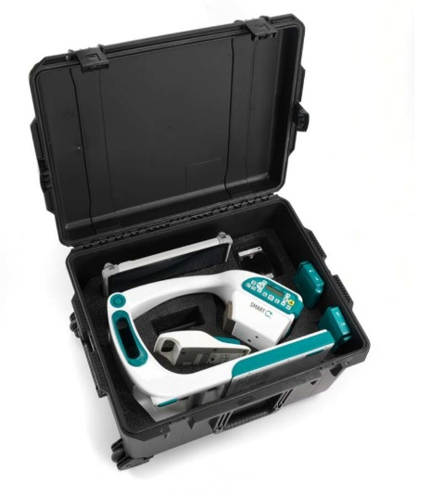
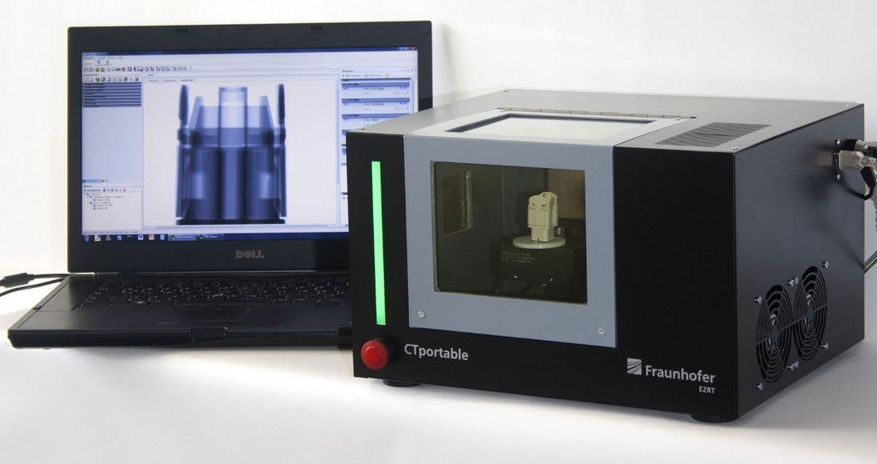
CT Form Factors and Sizing for Space
Industrial Scale: GSFC Code 541 CT System--North Star Imaging X5000 (possibly the size of future permanent Lunar habitat system)
Desktop Scale: Bruker CT (similar size to what might work for ISS)
Non-traditional, foldable, compact form factor: Turner Imaging Systems Smart-CTM Flouroscopy System
(not a CT system, but could be with some robotic assistance…)
Laptop Scale: Fraunhofer CT (similar size to what might work for Mars)

Slide 9
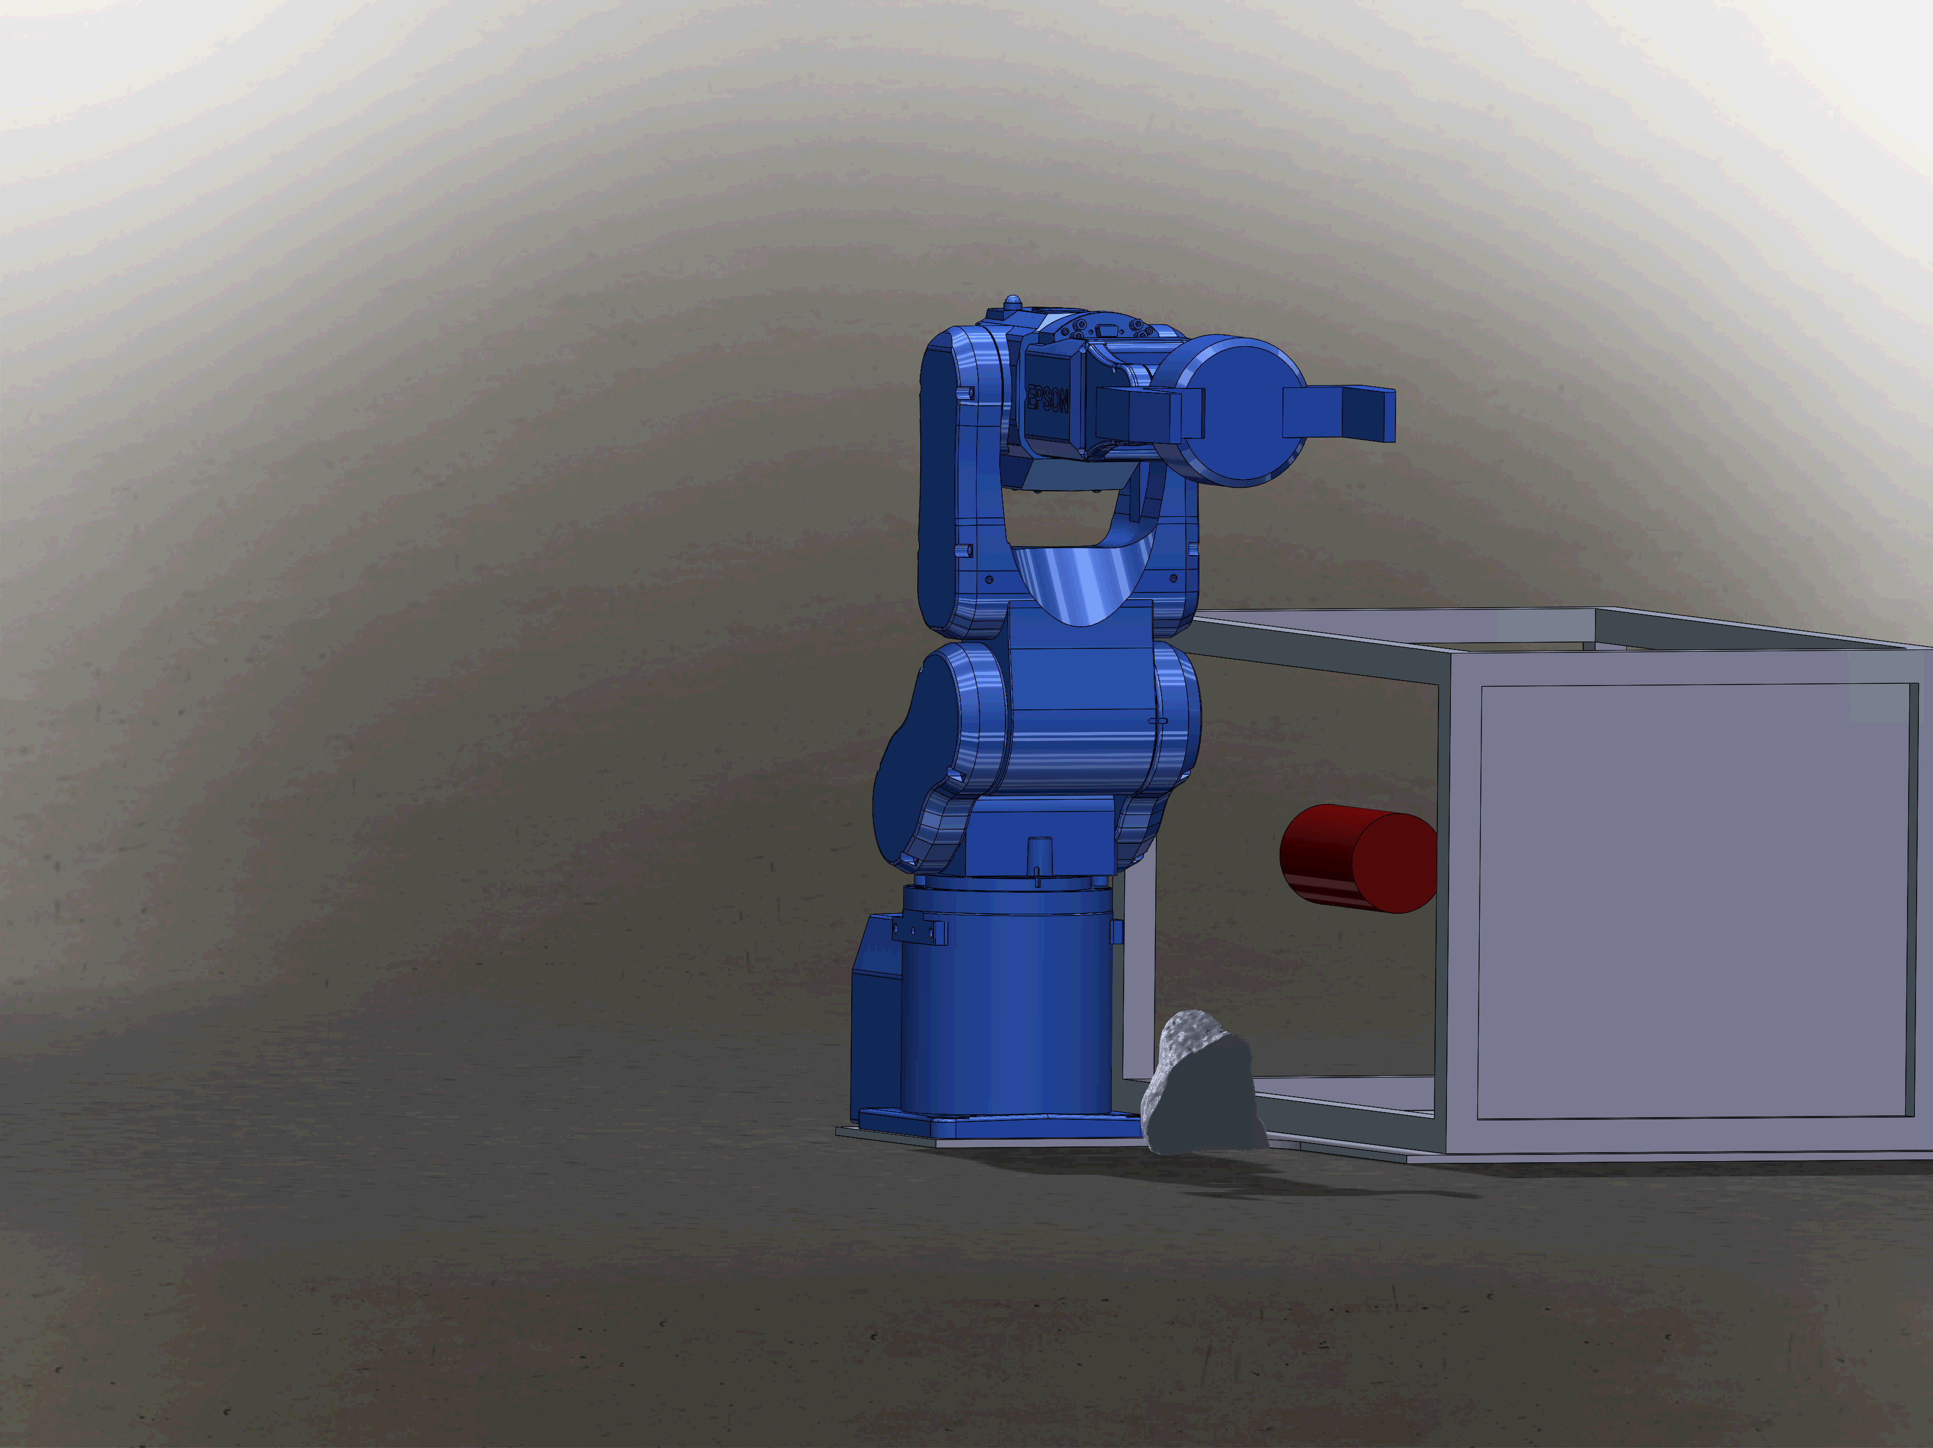
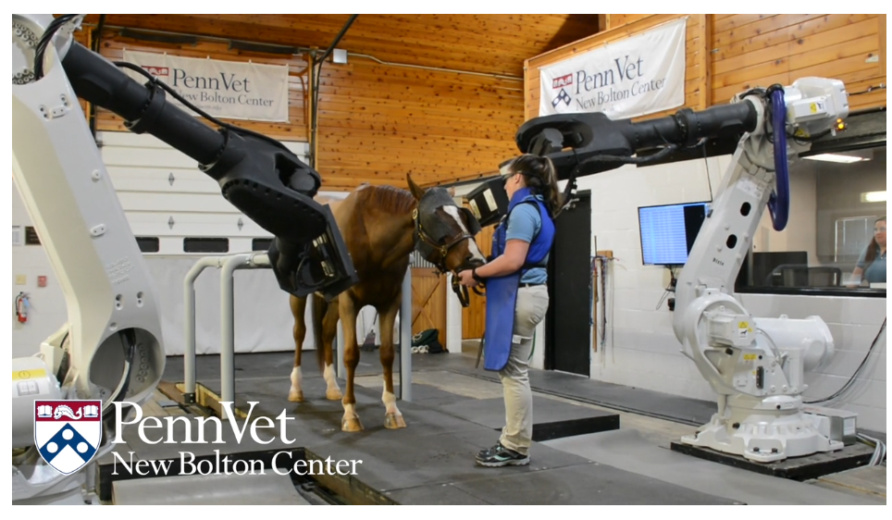
Forward-Thinking Concepts…(RoboCT)
Sometime in the near future, on some other world…
Tandem Robotic CT
https://www.vet.upenn.edu/veterinary-hospitals/NBC-hospital/news-events/patient-stories/new-bolton-center-story/innovating-diagnostics-for-equine-arthritis

Slide 10
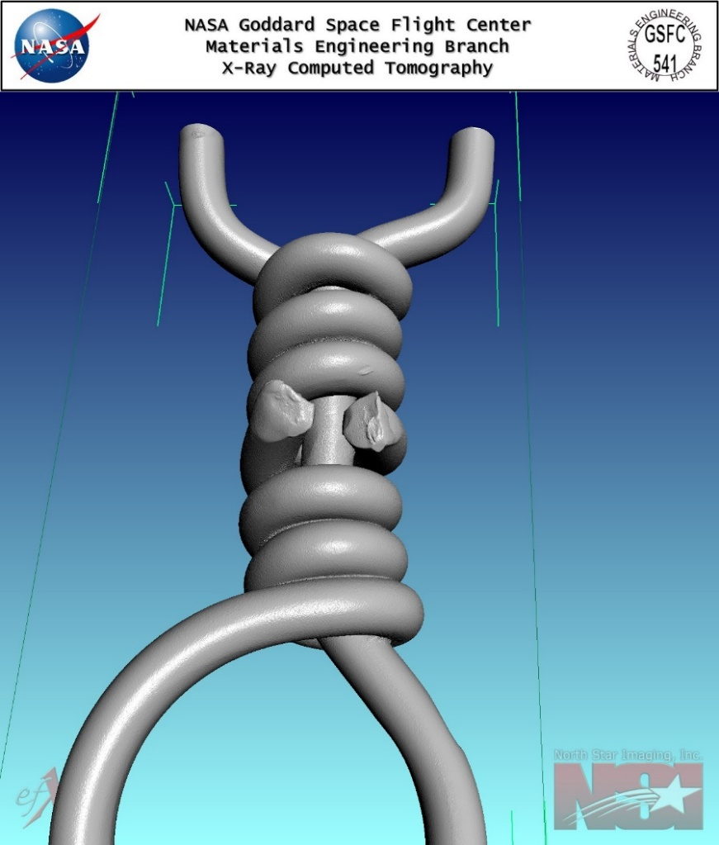
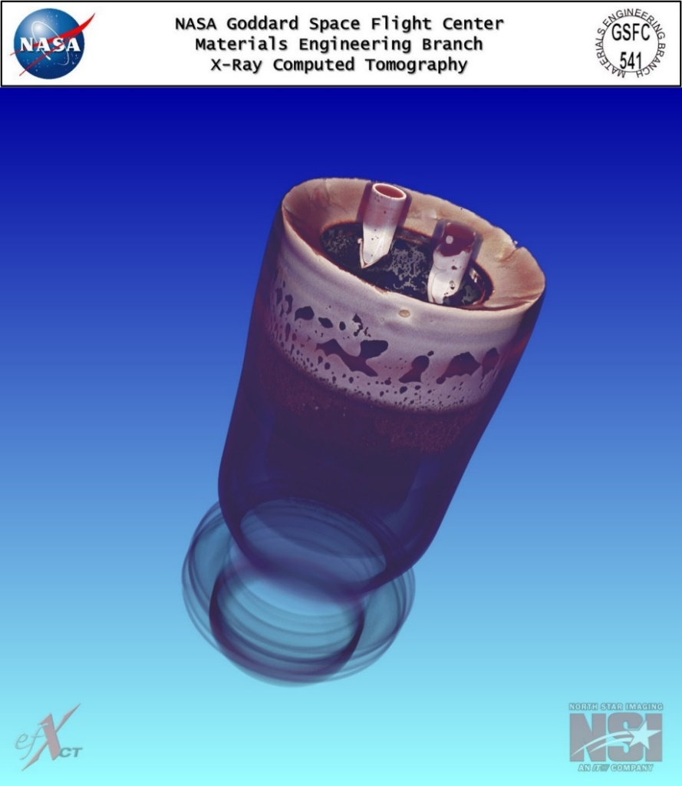
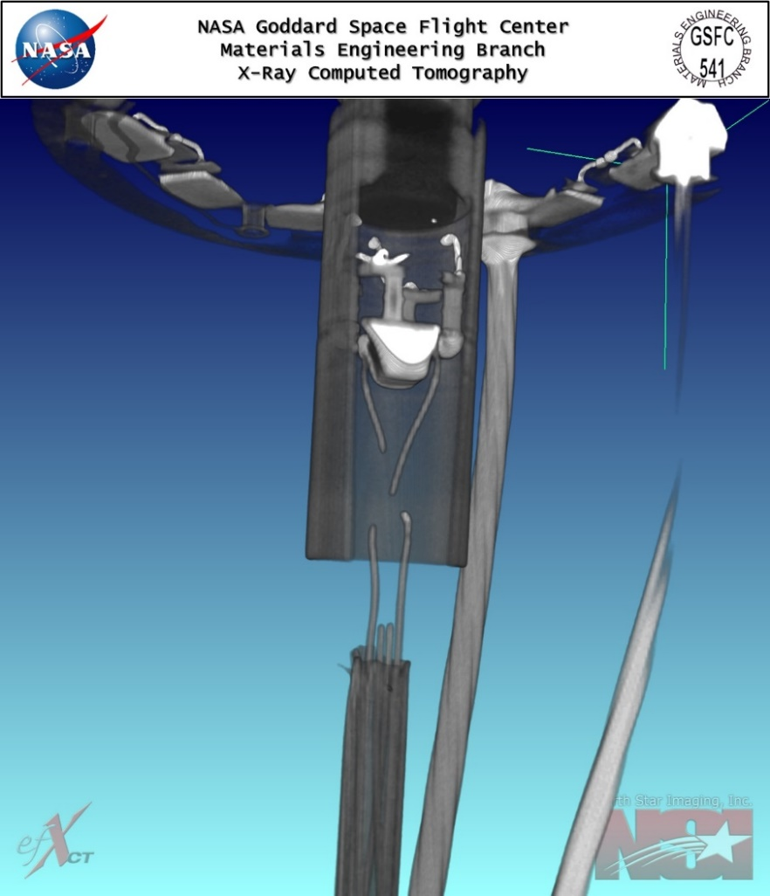
Motivation…Engineering
Quality Assurance (QA) for Flight Hardware
Deployment release mechanism wire assembly
Pyrotechnic bellows actuator braze joint
Articulating borescope camera failure

Slide 11

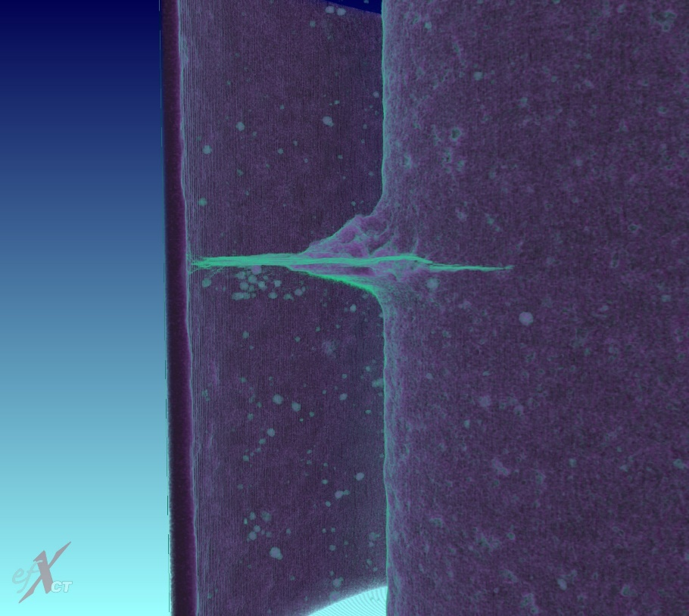
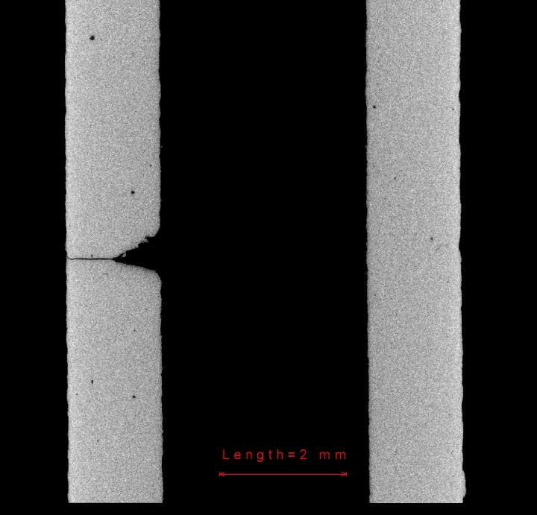
Motivation…Engineering
Additive Manufacturing (AM) Parts and In-Space Manufacturing (ISM)
This AM part was fatigued such that a crack was grown from a starter notch and allowed to penetrate to the outer wall. Our goal here is to create scores of these with varying degrees of surface roughness and varied internal microstructure, then see how those two process variables affect NDE signal response. The two images in the upper left were created by inverting the image contrast such that the bulk material is clear while pores and surfaces of the crack are revealed.

Slide 12
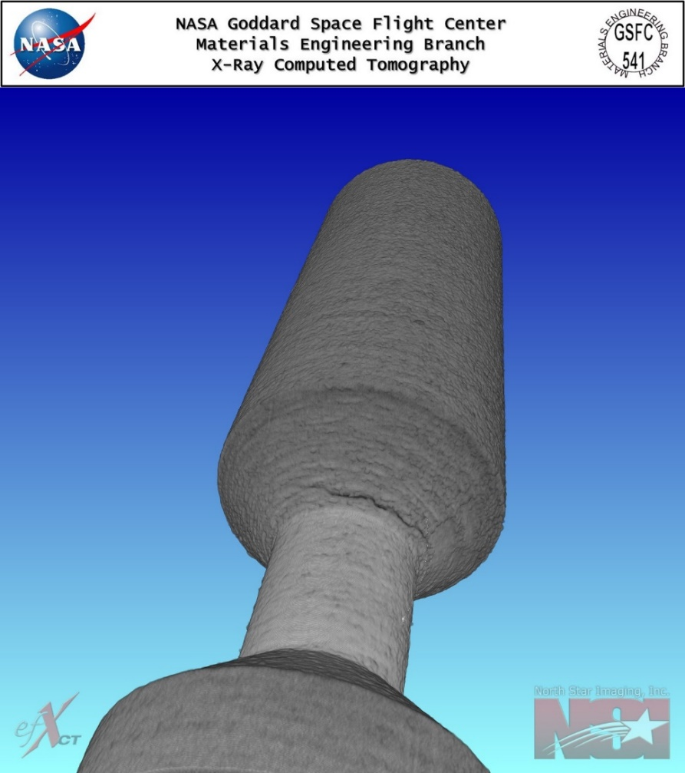
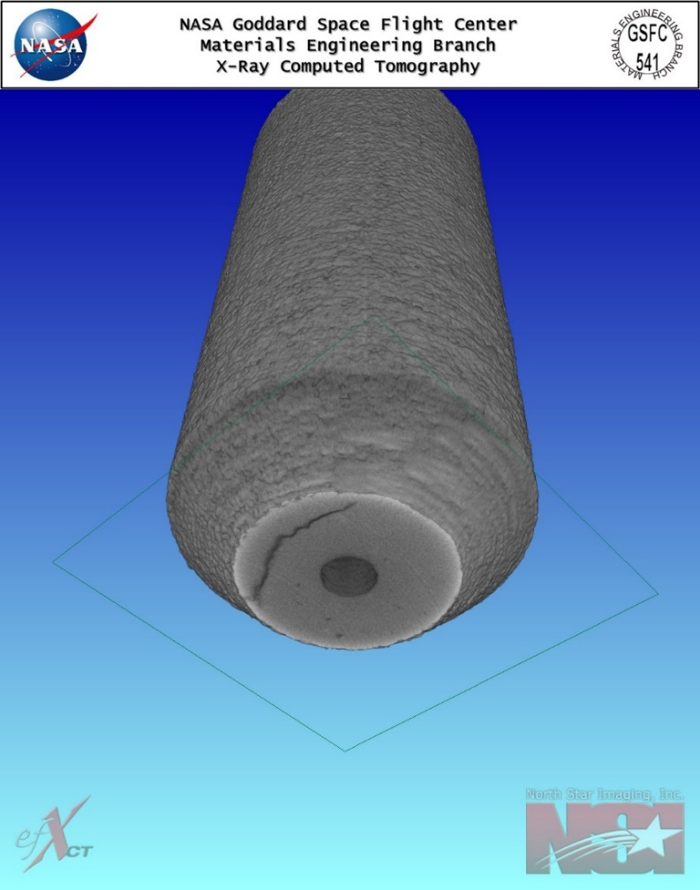
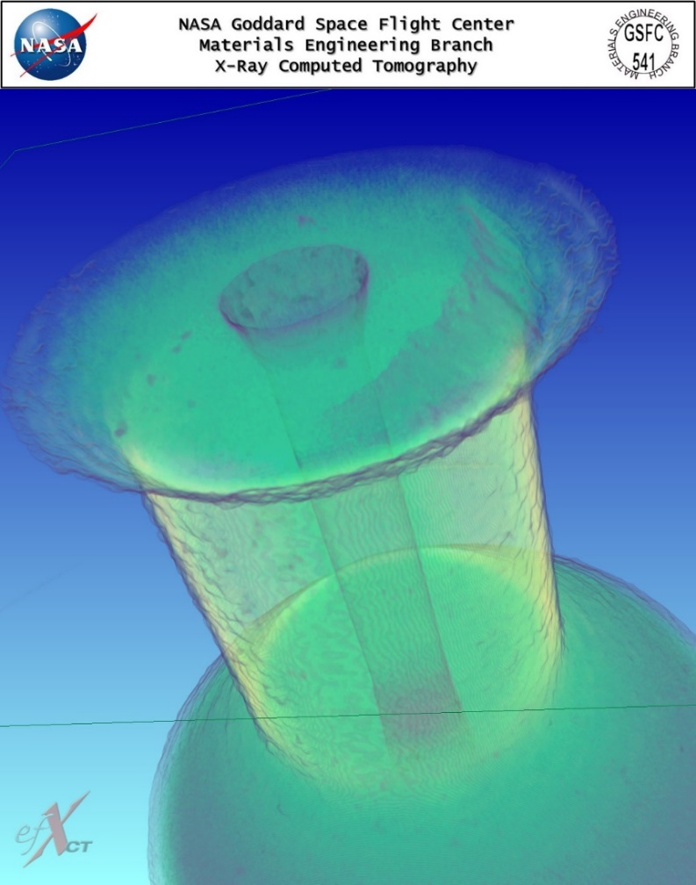
Motivation…Engineering
Additive Manufacturing (AM) Parts and In-Space Manufacturing (ISM)
Ti6Al4V AM flow device with clearly defined crack that breaks the surface. This crack occurred during fabrication—likely stress relief. The interesting thing is that from the surface, this crack is completely hidden from view both to the eye and also under microscope due to the inherent surface roughness from fabrication. Without CT, cracks like these could easily be missed.

Slide 13
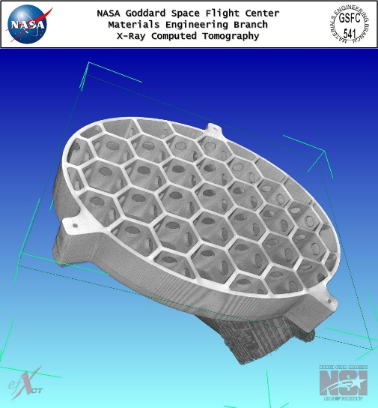
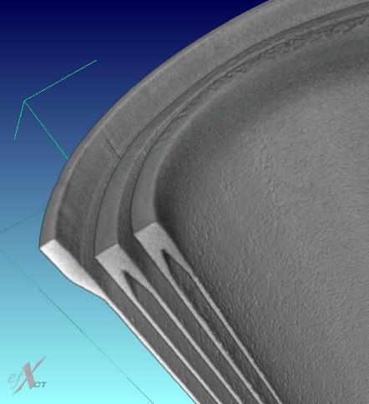
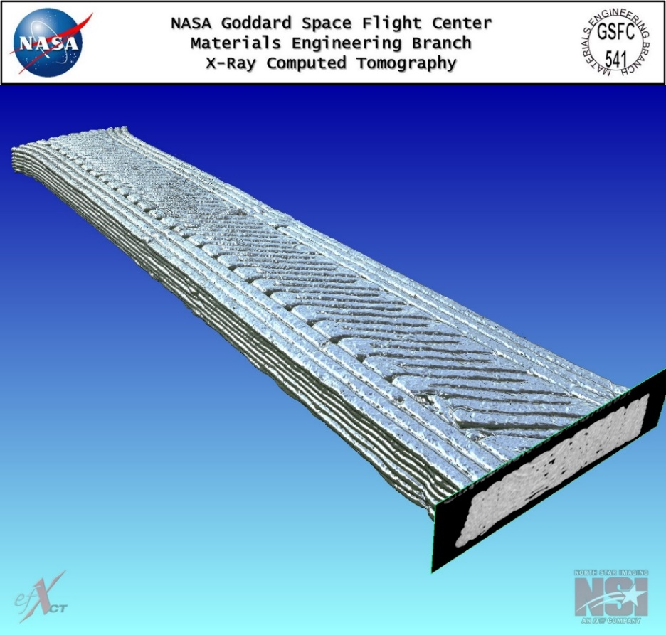
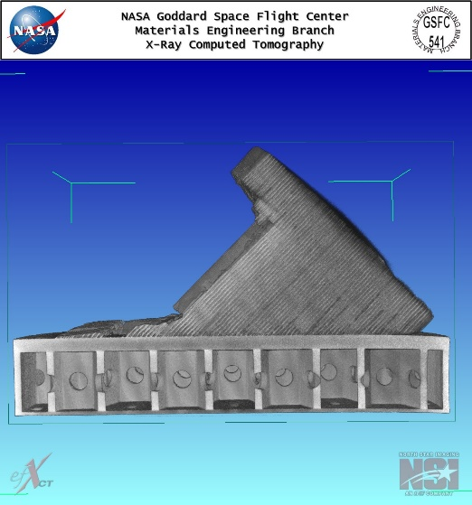
Motivation…Engineering
Additive Manufacturing (AM) Parts and In-Space Manufacturing (ISM)
3D printed prototype “re-entrant tube” concept
3D printed dog bone part (with surface rendering)
3D printed prototype mirror back-shell

Slide 14
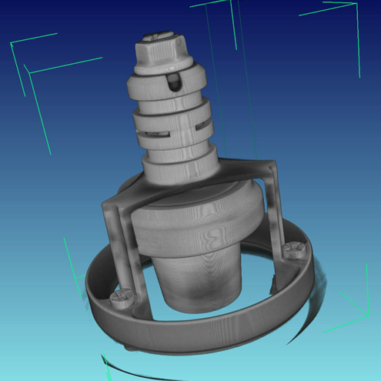

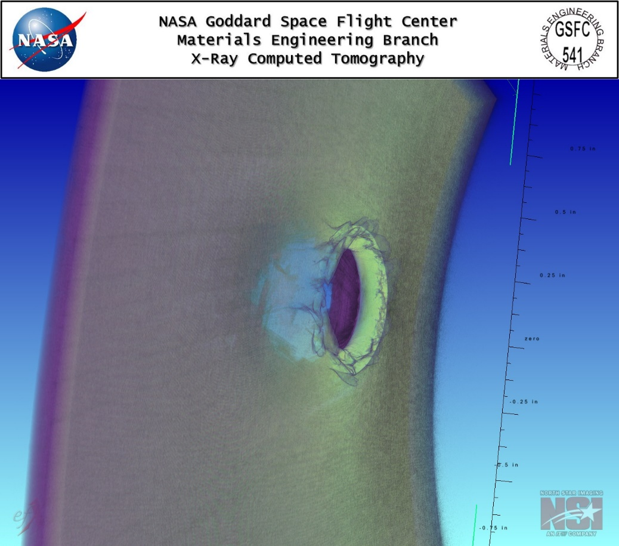
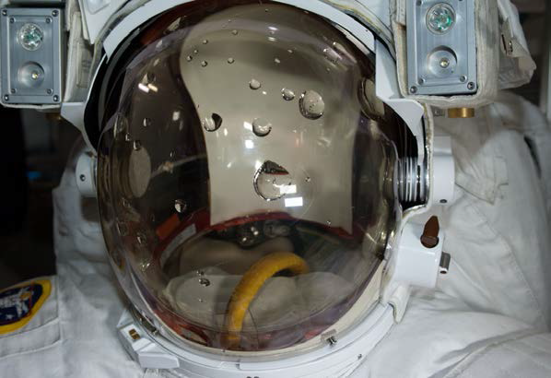
Motivation…Safety/Mission Assurance
Structural Damage Detection and Human Safety
International Space Station (ISS) Extravehicular Activity (EVA) 23 Suit Water Intrusion High Visibility Close Call (HVCC) Mishap Investigation
ISS type Composite Overwrap Pressure Vessel (COPV) impact damage assessment

Slide 15
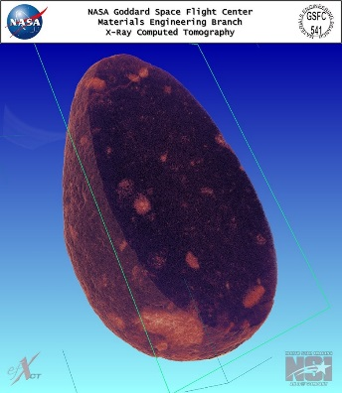
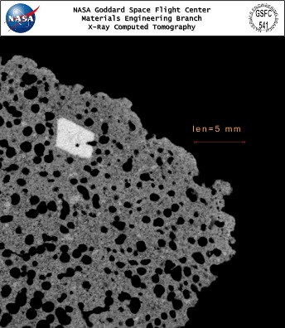







Motivation…Earth Geology
Ultra Mafic Icelandic Basalt
Surtsey Volcanic Basalt
Olivine Basalt
ZhamanshiniteTektite
Elgygytgyn Breccia
N
K
H
Hunga Tonga Hunga Ha’apai; Newest Landmass on Earth (P.I. J. Garvin)
HTHH_Sample N, Reefrock
HTHH_Sample K, Lava
HTHH_Sample H, 1Pumice

Slide 16









Complimentary Tools Showcase: HTHH volcanic island sample, multi-method analysis
X-ray CT of HTHH Sample K (Tonga Lava) revealed fascinating cluster of high absorbers (black), possibly a zeolite
Volumetric triangulation using CT data used to guide destructive cross-section of the sample to expose the feature.
X-ray
Optical
Electron
SEM/EDS
Corresponding field of view images, showing putative zeolite feature: from Left to Right (Cross-sectioned x-ray CT, EDOF optical micrograph, Surface SEM, inset SEM/EDS of single high absorber, layered SEM/EDS).
High density particles in x-ray align with amber colored crystals in optical image and Fe, Ti phase in SEM EDS. Background is Al dominant with Mg grains.
GFIC FY17 Year End Review (P.I. Jones, with J. Garvin and R. Kent): 11/16/2017
Red=Fe, Ti; Blue = Al; Green=Mg

Slide 17









Motivation…Beyond Earth…
A collection of recent CT scans of Lunar and Martian samples (Jones, Garvin, Kent, Sietins)

Slide 18




Motivation…Return to the Moon (SPD-1)
Exploration and In Space Resource Utilization (ISRU)
GSFC x-ray Computed Tomography (CT) system (NSI X-5000) showing inspection of the lunar display sample 10057.3 and the newly discovered large grained ilmenite (FeTiO₃) crystals

Slide 19




Motivation…Return to the Moon (SPD-1)
Apollo 11 return sample 10057.3, very high titanium (VHT) basalt with very large grained interspersed ilmenite crystals

Slide 20




Motivation…Return to the Moon (SPD-1)
Exploration and In Space Resource Utilization (ISRU)
Apollo 16 impact melt glass fragment from sample 60095, with tiny interior metal vugs

Slide 21


Motivation…Return to the Moon (SPD-1)
Exploration and In Space Resource Utilization (ISRU)
Apollo 16 impact melt glass fragment, (8mm wide) showing highly absorbing metal-filled vesicles, or “vugs”. Close up scan is of a partially exposed 300 micron wide vug. Left image is from 225 kV micro-focus system (GSFC); right image is from nano-focus Zeiss Xradia system (Army Research Lab; J. Sietins), visualized using NSI software (J. Jones).

Slide 22

Motivation…Return to the Moon (SPD-1)
Apollo 16 return sample 60095: CT Video of metal-filled vesicle, or “VUG”
Scan data from Zeiss Xradia Versa system (Army Research Lab; J. Sietins), visualized using CTVox

Slide 23





Complimentary Tools Showcase: Lunar Impact Glass “Vug” Survey with xCT, LCM and SEM
Nano-focus xCT (Zeiss Xradia Versa (ARL/Sietins and GSFC/Jones)
Scanning Electron Microscopy (GSFC/R. Kent)
Scanning Electron Microscopy (GSFC/R. Kent)
Green=Fe, Ni rich
Laser Confocal Microscopy (GSFC/Jones)
Nano-focus xCT (Zeiss Xradia Versa (ARL/Sietins)
The “Brainy Vug”: 300 micron metal filled vesicle within Apollo lunar return sample 60095.

Slide 24


Motivation…Return to the Moon (SPD-1)
Micro-meteorite impact damage assessment
Apollo 16 sample 60095 zap pit and interior metal vugs

Slide 25




Complimentary Tools Showcase: Lunar Impact Glass “Zap Pit” Survey with xCT, followed by LCM
Apollo 16 sample 60095 with “zap pit”: Left images show nano-focus CT (ARL/Xradia Versa/J. Sietins) and Right images show laser confocal microscopy (J. Jones)

Slide 26



Motivation…Mars
Martian meteorites compliments of the Dr. Jay Piatek Collection
MSR mission and future Sample Return
Ultra rare “Black Beauty” Martian meteorite showing interior “blueberries” that contain high percent OH-bearing minerals
Martian Nakhlite NWA 10153 w/ large interior crystals (not visible outside)

Slide 27

Motivation…(Mars Video)
Martian meteorites compliments of the Dr. Jay Piatek Collection
Martian “Black Beauty”
NWA 7034 Video

Slide 28
Technology Drivers
In-space 3D inspection impacts
  Science Triage (rocks, assays, drill cores)
  In-Space Manufacturing (e.g. Made In Space, Inc., FabLab)
  In-Situ Resource Utilization (ISRU)
  Engineering QA (flaw detection in parts)
  Human Safety (impact damage detection, protective gear)
From 2020 NASA Technology Taxonomy:
  Primary Technical Area: TX 12.4.5 (Non-Destructive Evaluation and Sensors)
  Secondary Technical Area: TX 12.3.4 (Reliability, Life Assessment, and Health Monitoring)
  Additional Technical Area: TX 12.4.1 (Manufacturing Processes (in particular Additive Manufacturing))
  Additional Technical Area: TX 8.3.3 (Sample Handling)

Slide 29
X-ray CT will be a key part of the future of In-Space Inspection.
So where do we go from here?

Slide 30

Recent Efforts at GSFC
Over past 3-4 years, we have been doing Early Concept Development and Trade Studies to assess Feasibility for CT in Space
All efforts thus far suggest no insurmountable technological challenges (now budget challenges…that’s a different story!)
Systems Assessed thus far
  Source and Detector Trade Studies
  Geometric Constraints and Optimization
  Systems Integration
  Radiometry
  Electrical
  Science Data Processing
  Mechanical Systems
  Mechanisms
  Thermal Loads
  Launch/Environment Loads/Vibration
  Radiation Transfer and Shielding

Slide 31


Critical Near Term Goals
Solidify funding and continue to communicate the need for CT in space to decision makers
Sustain momentum from early concept studies to build functional prototype and be ready for upcoming funding opportunities
Work with GSFC leadership and other Centers to push for early technology demonstration (possibly ISS) in next 5 years, in support of ARTEMIS/GATEWAY and Moon to Mars directives
Potential Proving Ground: ISS or Gateway

Slide 32

Long Term Outlook…
Extended Pathways for CT in Space Utilization:
ISS concept as first demonstration of xCT in space for NDE applied to AM samples, planetary samples, and inspection
From ISS to the Moon via Gateway or Artemis crewed missions as a fast, in situ NDE tool
Autonomous mini-CT system for CLPS Landers/Rovers for in situ small sample assessments
From the Moon to Mars, for in situ sample assessment on 2030’s era mobile labs associated with materials for extant life detection, in context for cryogenic drill core sample return
Beyond the ISS-Moon-Mars is Europa and other ocean worlds – fast surveys of samples
Ultimately, the autonomous “commodity style” system with scalable range of applications
White Paper Submitted to the National Academy of Sciences Planetary Sciences and Astrobiology Decadal Survey

Slide 33

The Long and Winding Road!

Slide 34

Questions/Discussion
Acknowledgments:
Our Hosts: North Star Imaging, in particular Brett Muehlhauser and Rocky Buencamino
Goddard Fellows Innovative Challenge (GFIC)
NASA Center Innovation Fund (CIF)
NASA Office of Safety and Mission Assurance NDE Development Program (OSMA NDE)
NASA Engineering and Safety Center (NESC)
GSFC Instrument Development Lab (IDL)
Dr. Jay Piatek, Dr. C. Agee, and the J. Piatek Collection
NASA MSFC, In-Space Manufacturing Group
GSFC Interns: A. Watson-Jones, J. Harwerth, S. Santoro, N. Lutes
Army Research Lab NDE Group (J. Sietins, W. Green, T. Walter, J. Sun)

