Slide 1
This material is a work of the U.S. Government and is not subject to copyright protection in the United States.
Space Launch System Liftoff and Separation Dynamics Analysis Tool Chain
Ben Burger
NASA/MSFC/EV42/ESSCA/DCI
2021 AIAA SciTech Forum
January 14, 2021
Co-Authors: Carole Addona, Benjamin Diedrich, William J. Harlin, Peter McDonough, Zachary Muscha, Ray Sells, Daniel Tyler

Slide 2
Outline
Problem Description
Liftoff and Separation Dynamics Analysis Tool Chain
SLS Liftoff Analysis Data Products
SLS Booster Separation Analysis Data Products
Broader Applications of the Tool Chain

Slide 3
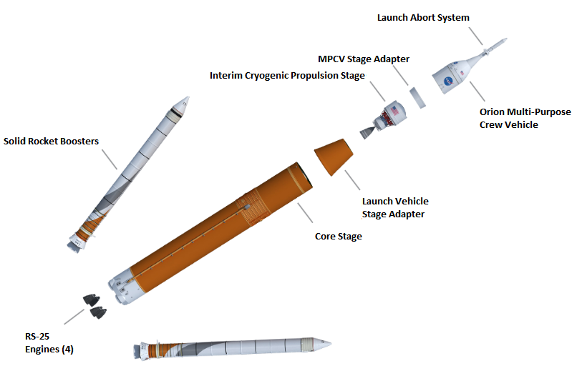
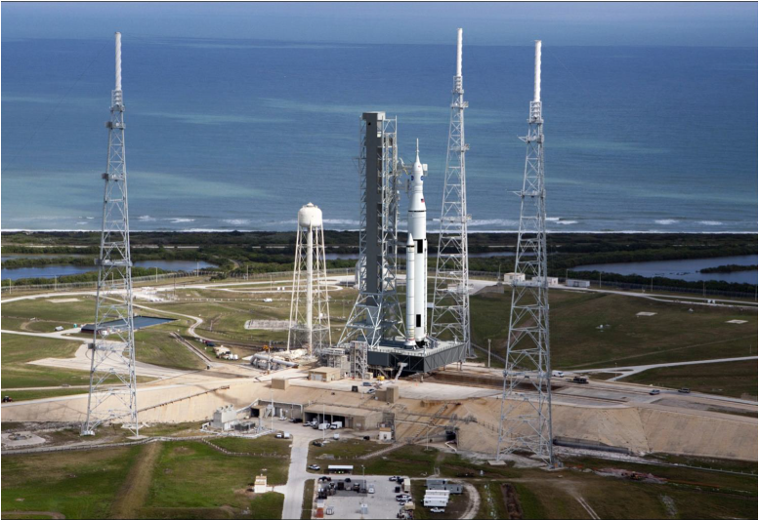
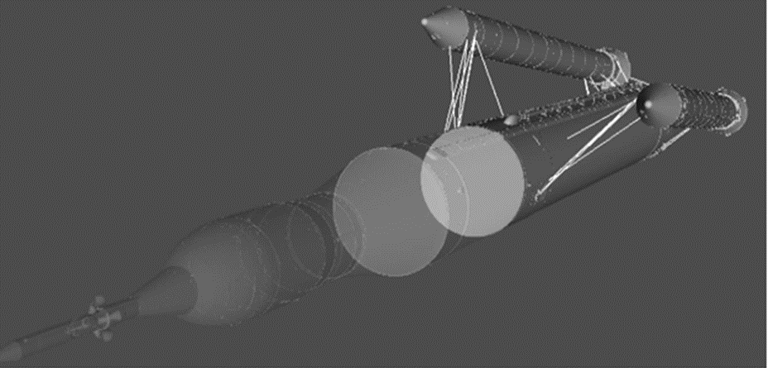
Problem Description
The SLS Liftoff and Separation Dynamics Team is responsible for simulating and analyzing the SLS liftoff and separation events, which is needed to:
  Ensure no recontact between the vehicle/ground structures and the separating vehicle components during staging events
  Inform launch commit criteria, such as ground wind speed placards
  Set flight software separation timing logic parameters and potential tower fly-away maneuvers
  Certify the vehicle for flight
For the SLS Block-1 crew configuration, the team is responsible for the liftoff and booster separation events, primarily using Monte Carlo analysis with a high-fidelity simulation.
A flexible approach with an emphasis on analysis automation is needed for the rapid, iterative design analysis cycle process to quickly address issues and pursue alternatives.

Slide 4
Liftoff and Separation Dynamics Analysis Tool Chain
A Model-View-Controller (MVC) wrapper approach consisting of several open-source tools tied together with scripting languages evolved into the tool chain.
  Model:
    TREETOPS: Generic multi-body dynamics simulation tool.
    CLVTOPS: Wrapper around TREETOPS which includes vehicle and SLS specific input models, including the GN&C Flight Software code.
  View:
    Minimum Distance Tool: Post-processing tool that uses CAD models along with CLVTOPS simulation state outputs to calculate clearances (or minimum distances) during the liftoff and separation events.
    TREE3D: Python tool developed with the Visualization Toolkit (VTK) used to animate the simulation results using CAD models.
    Python (NumPy, Matplotlib) and MATLAB post-processing scripts: Used to create plots and tables of key simulation outputs.
CLVTOPS Tool Chain
Post-Processing (Python, TREE3D, Minimum Distance Tool, MATLAB)
view
Runtime Scripting (Python, bash shell)
controller
CLVTOPS
model
TREETOPS
  Controller:
    Python and bash shell scripts: Used to organize input data, execute the CLVTOPS simulation in either nominal or Monte Carlo mode, organize the output data, configure and run the Minimum Distance Tool, create TREE3D input files, and call the various post-processing scripts.

Slide 5
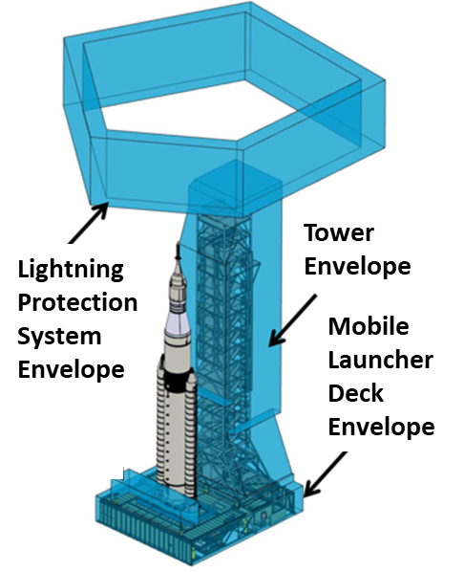
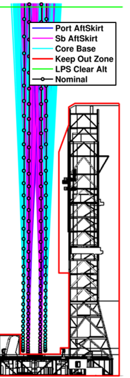
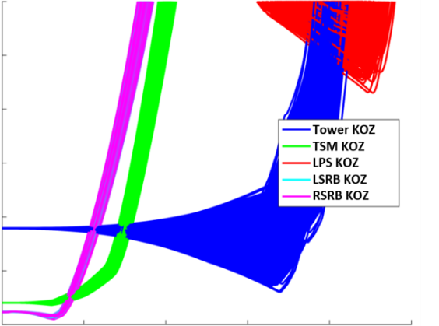
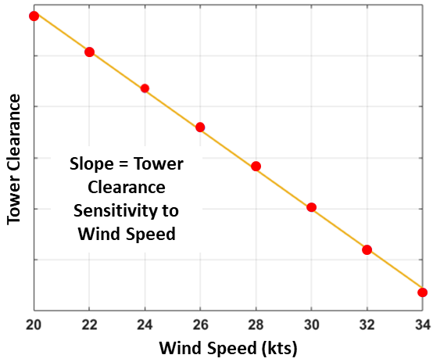
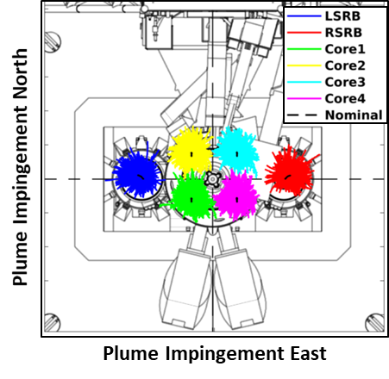
SLS Liftoff Analysis Data Products
The primary metric of the liftoff analysis is the clearance between the vehicle and keep-out-zone envelopes of the ground system hardware.
Monte Carlo analysis is performed where vehicle and environment input models are dispersed and the resulting clearances are calculated.
Correlation analysis is performed to quantify the effects of input models.
Other key data products include the vehicle actuator control activity and the thrust plume impingement on the ground structures.
Keep-Out-Zone Envelopes
SLS Drift
Dispersed Clearances
Clearance Sensitivity to Wind
Plume Impingement
Minimum Distance
Time
All data products shown herein are representative and do not portray any SLS design qualities or performance.

Slide 6
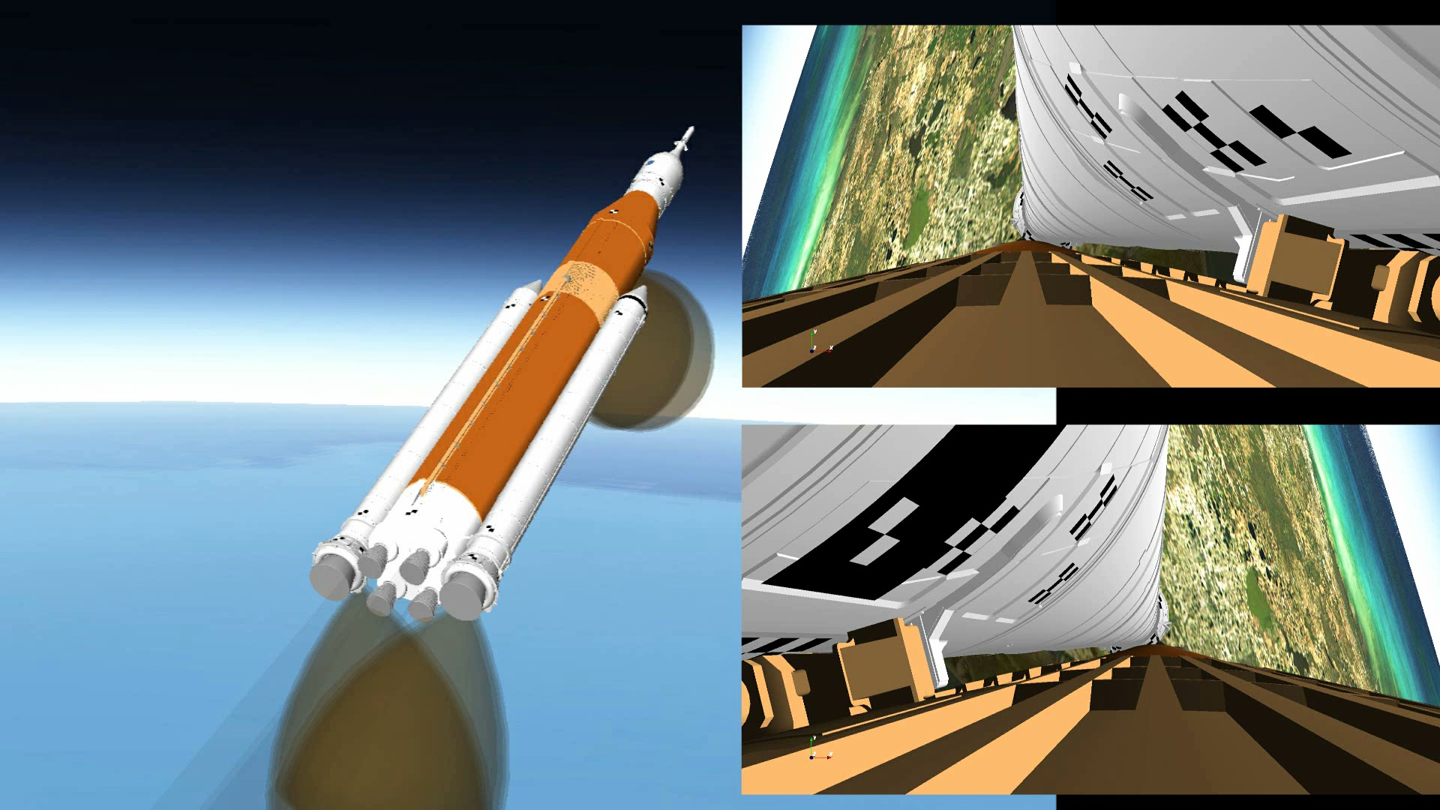
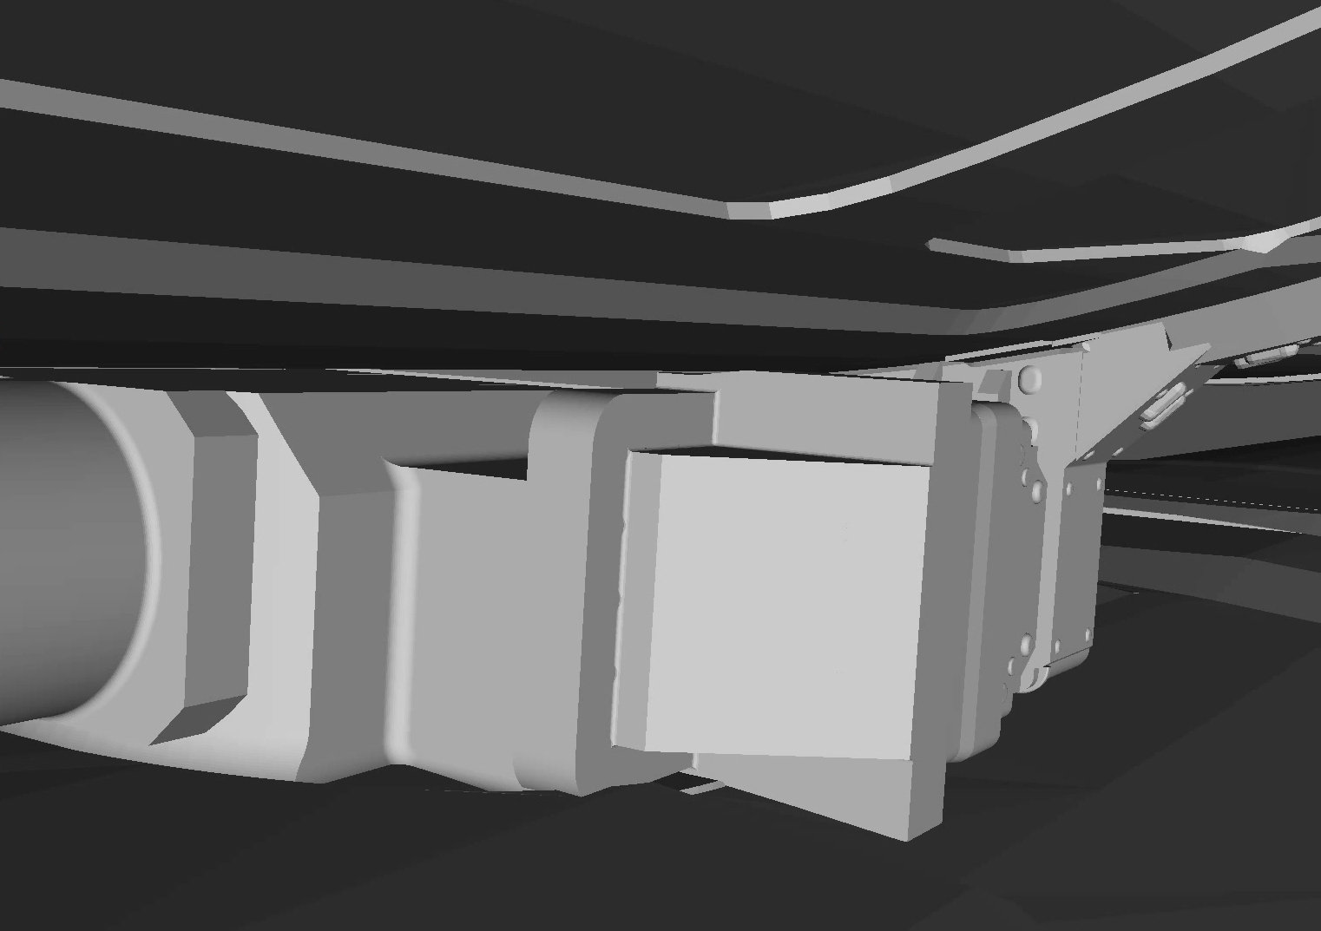
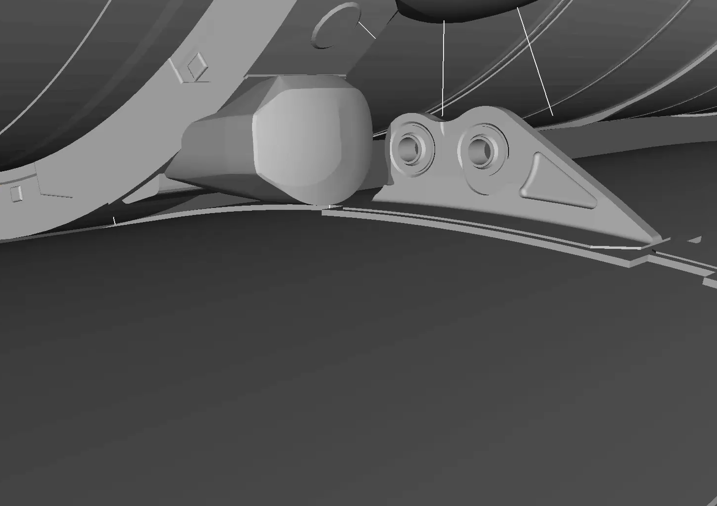
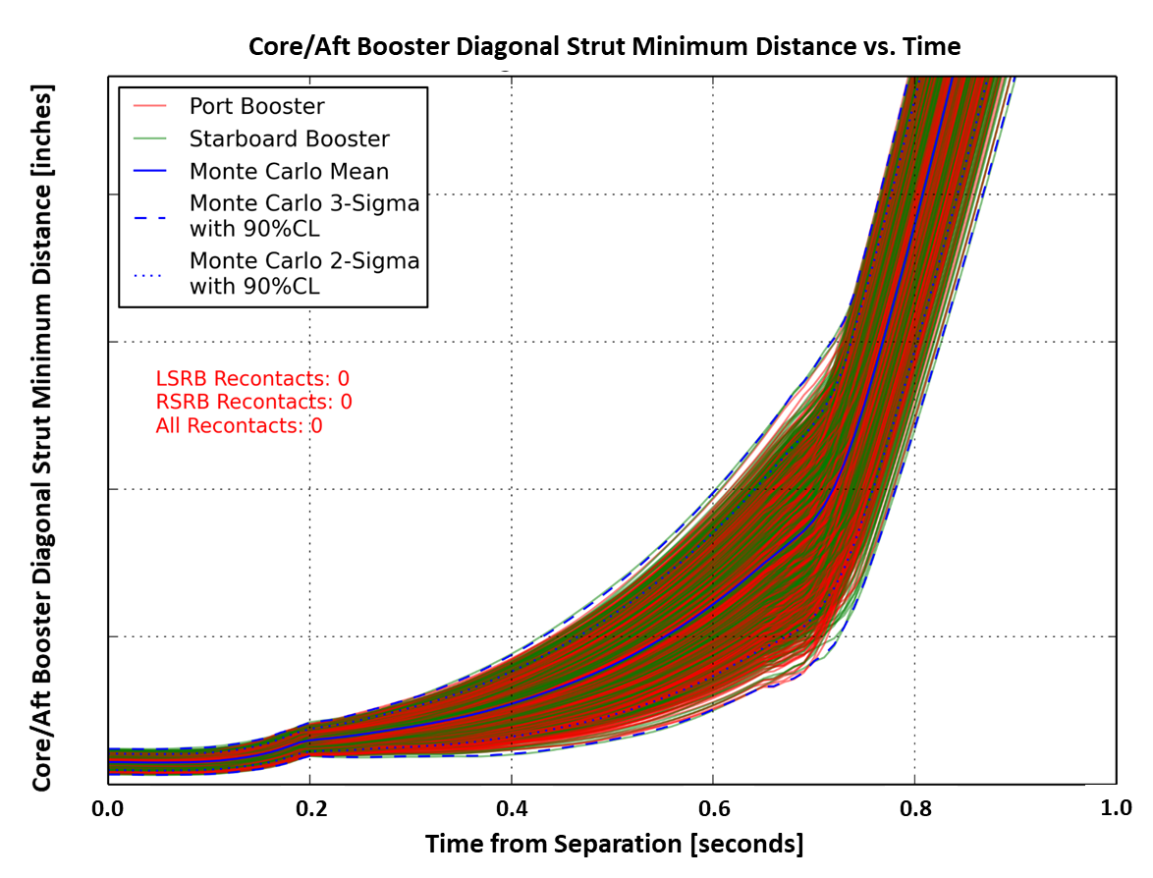
SLS Booster Separation Analysis Data Products
Similar to the liftoff analysis, the dispersed clearances are the primary product of the booster separation analysis.
  Focus is on the forward and aft attach hardware, as well as the overall macro clearances.
In addition to creating engineering-based realistic animations, TREE3D is used for assessing on-board camera placement, orientation, and field-of-view, to support post-flight reconstruction efforts.
Forward Attach Clearance
Aft Attach Clearance
Dispersed Aft Attach Clearances

Slide 7
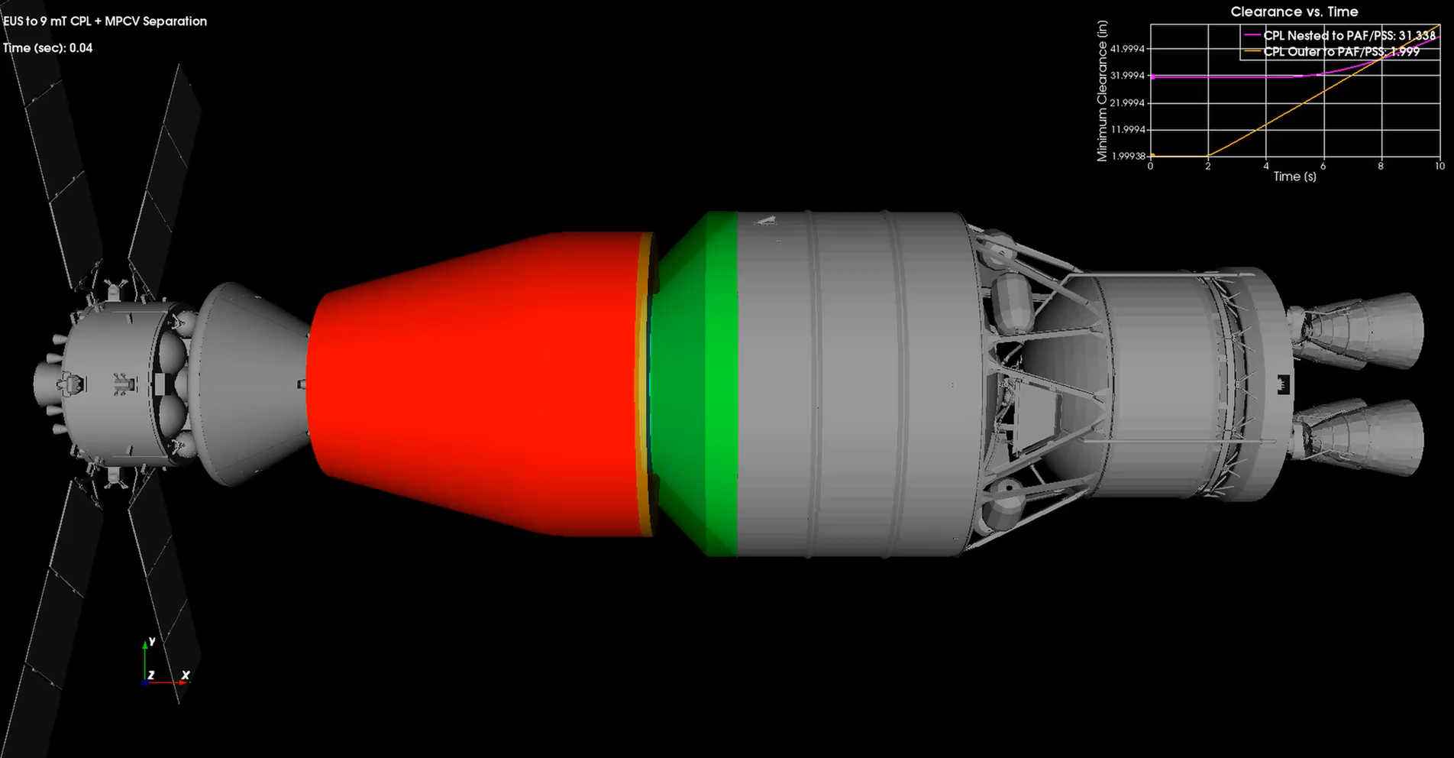
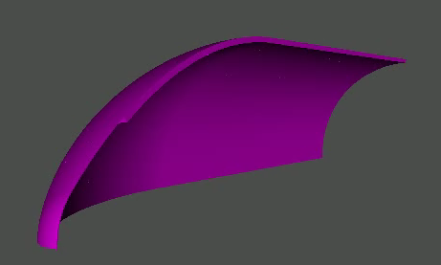
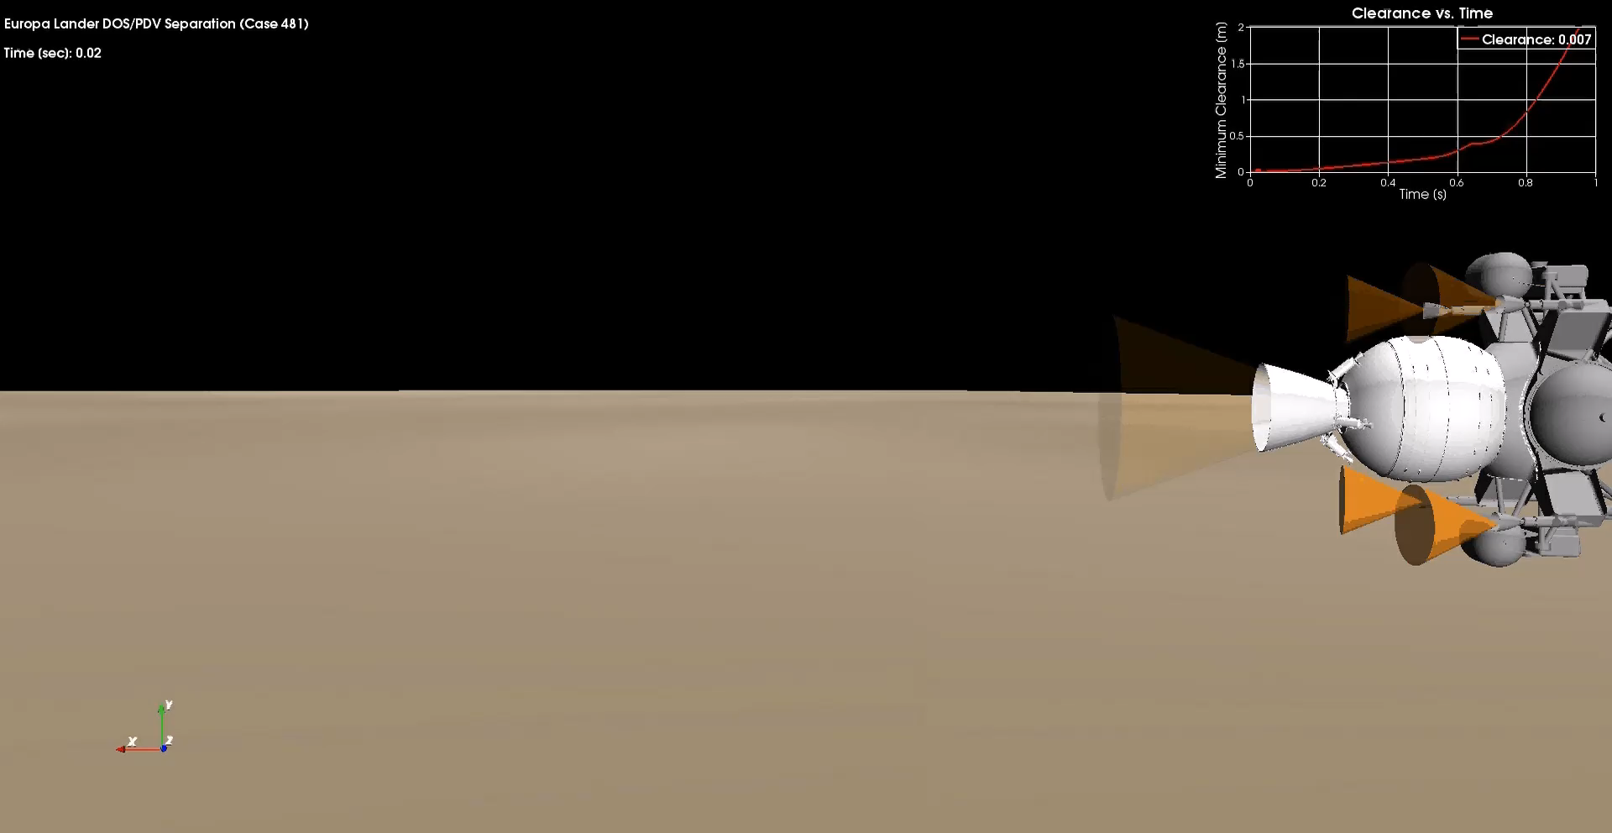
Broader Applications of the Tool Chain
The tool chain can also be applied to address other aerospace multi-body problems.
  It has been used to analyze other SLS separation events, including the Block-1B vehicle payload separation events and the payload fairing separation event.
    The payload fairing separation analysis highlights an innovative application where large CAD models can be automatically segmented into smaller pieces that get anchored to individual flex nodes. The Minimum Distance Tool includes these flex deflections and rotations with the rigid body states in calculating clearances.
  The tool chain has also been applied to non-SLS aerospace vehicles, including the Europa Lander De-Orbit Stage separation event.
The modular, data-driven, MVC architecture of CLVTOPS allows it to be efficiently tailored to address a broad range of aerospace analyses and applications.
SLS Block-1B Payload Separation
Payload Fairing Separation
Europa Lander Separation

Slide 8
Questions?
Contact info: ben.burger@nasa.gov

