Slide 1
Jeff Gramling
Director, Mars Sample Return Program
Mars Sample Return (MSR)
Presentation to the Planetary Advisory Committee
November 30th, 2020

Slide 2
MSR Recent Accomplishments
The MOU establishing the ESA/NASA MSR program partnership was signed by the NASA Administrator and the ESA Director General on October 5th
IRB Final Report Released 11/10/20
MCR completed 10/19/20
SMD DPMC conducted 11/23
APMC scheduled for 12/16/20
IRB and SRB both endorsed proceeding into Phase A

Slide 3

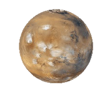
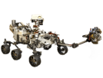













MSR Architectural Overview
Mars Sample Return Campaign Concept Review
Mars
Mars 2020
Tube Delivery
SRL
Mars Ascent
Vehicle
Tube Retrieval
Sample Fetch Rover
Tube Collection & Depot
Orbiting Sample
Retrieve OS
Relay Support
ERO
Break-the-Chain
Avoid Earth
Earth Entry Vehicle
Earth
Mars2020
Earth Return Orbiter
Sample Retrieval Lander
Sample Return and Science

Slide 4
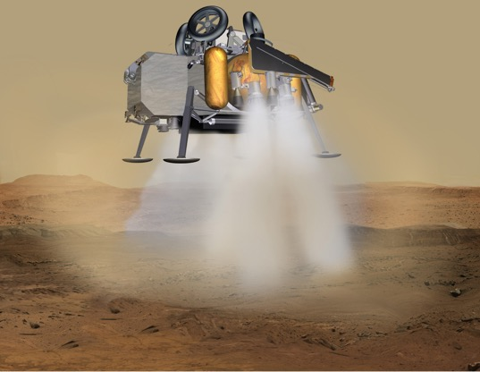
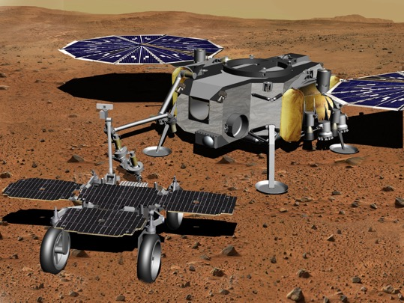
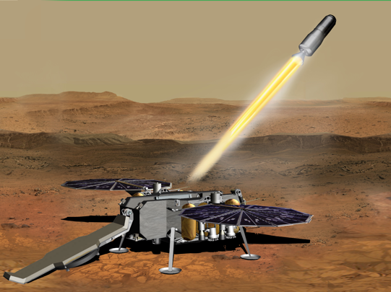
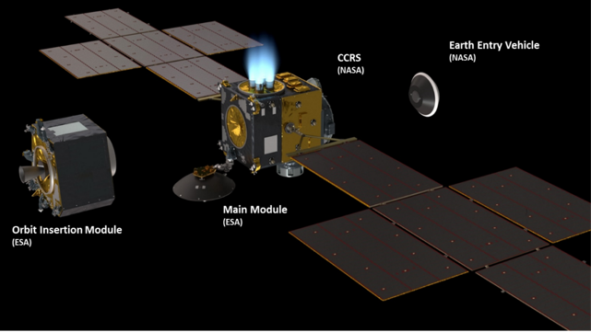
MSR Program Elements
Sample Retrieval Lander (SRL) Touchdown
Sample Transfer
Mars Ascent Vehicle (MAV) Launch
Earth Return Orbiter (ERO)

Slide 5
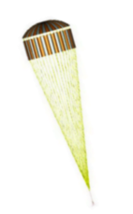

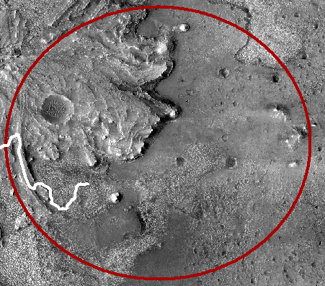
SRL EDL - Extended Divert
SRL will carry enough propellant to fly out the backshell separation ellipse (8 x 8 km) and land at a specific spot (~±20m accuracy)
Enables new capability of landing at a specific site scouted by Mars 2020
8 km Parachute Deploy Ellipse
Powered Descent
Landing Spot
5

Slide 6
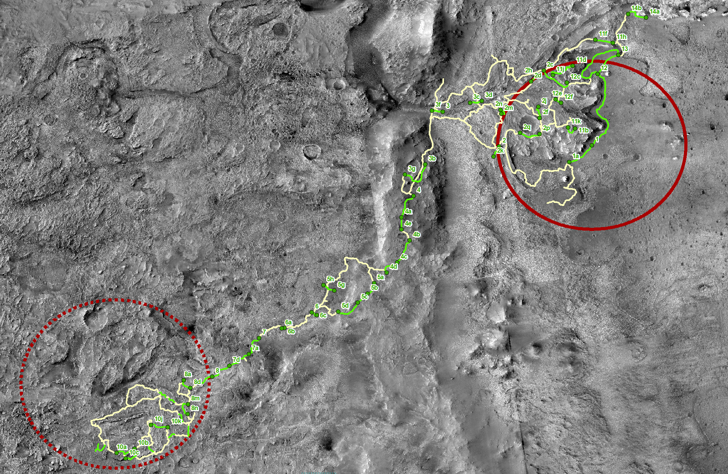
Overview of Green Pathways
Across Jezero-Midway Region
M2020 Reference Traverse Paths
Identified SFR Green Pathways
JEZ Landing Ellipse
MDW Reference Ellipse
10km
Pre-Decisional Information -- For planning and discussion purposes only.
6

Slide 7
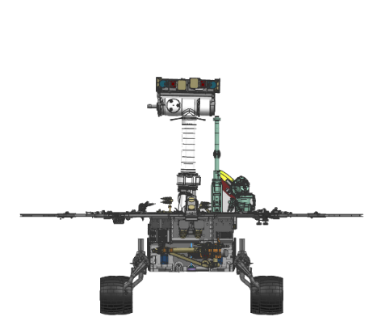
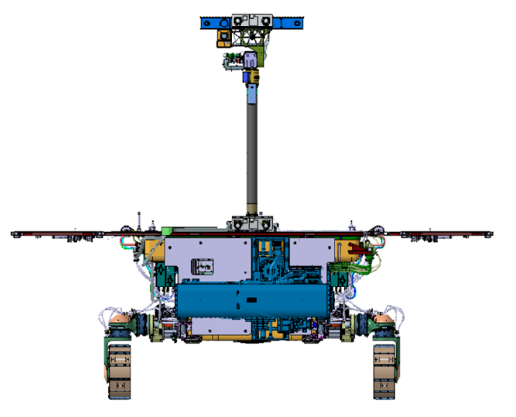
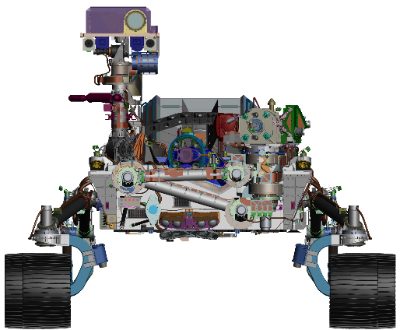
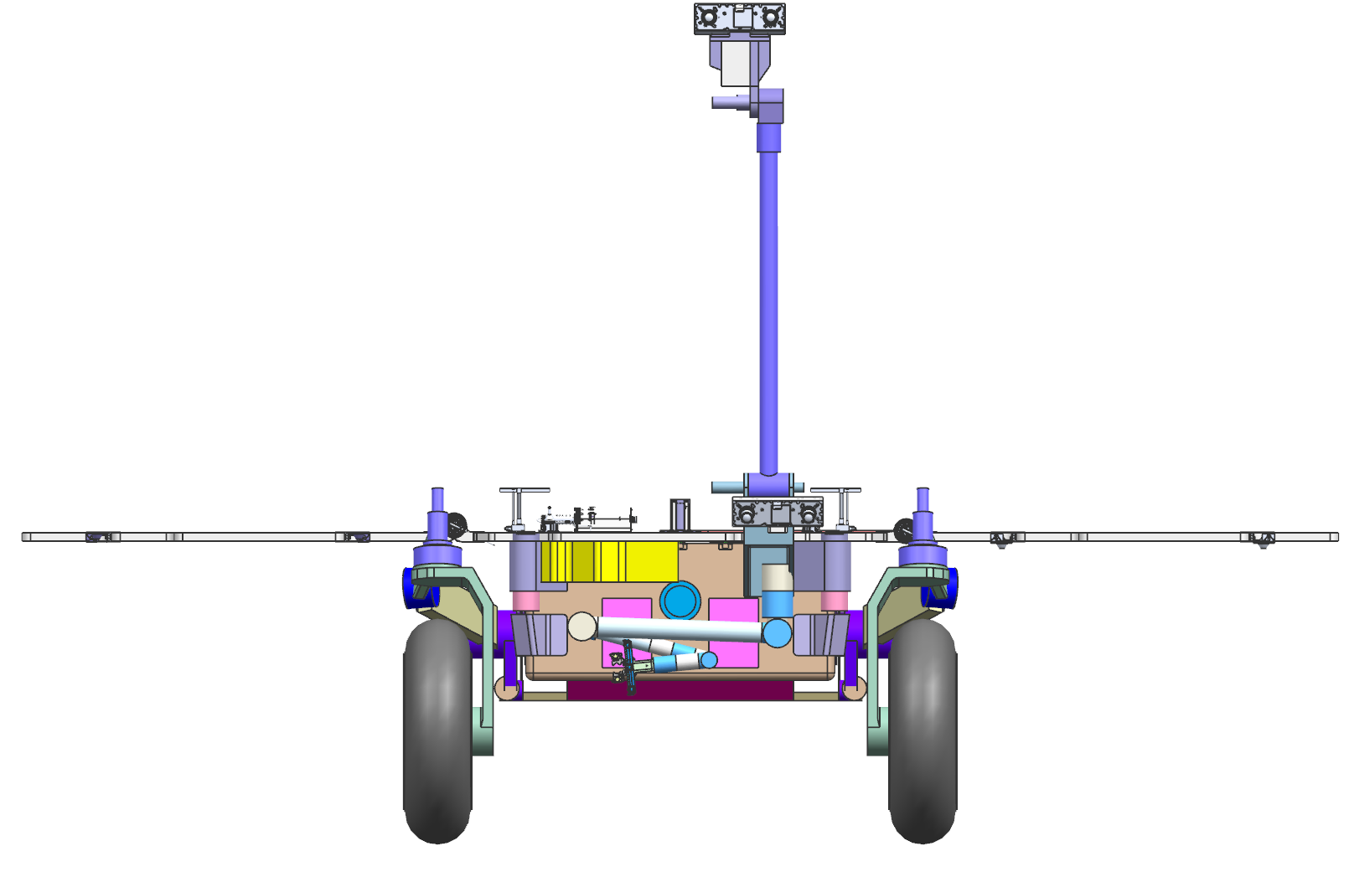
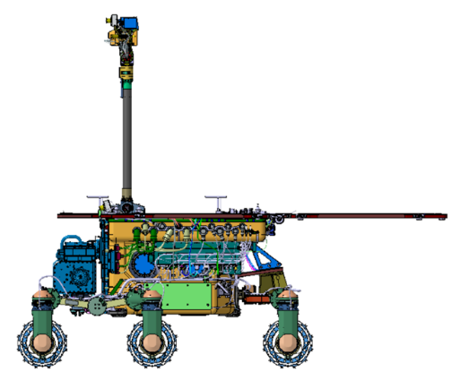
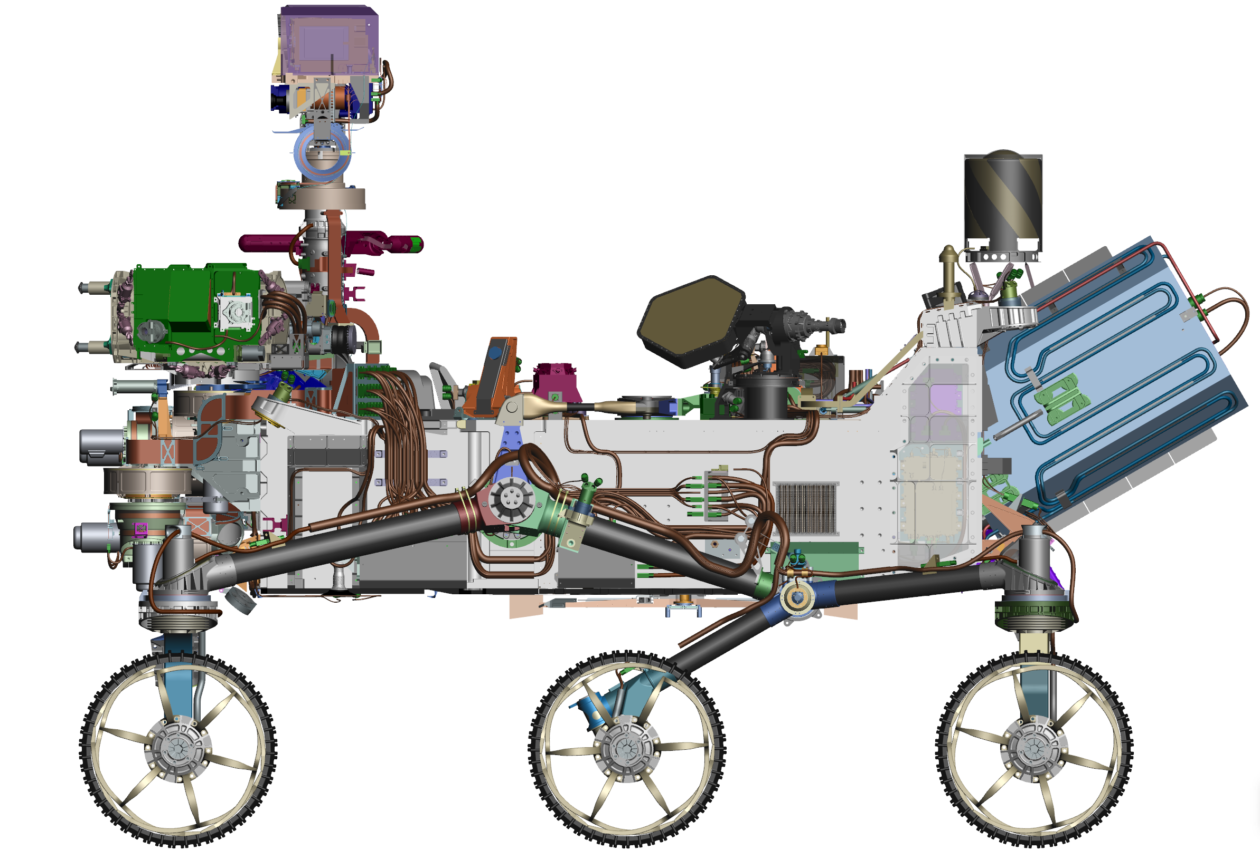
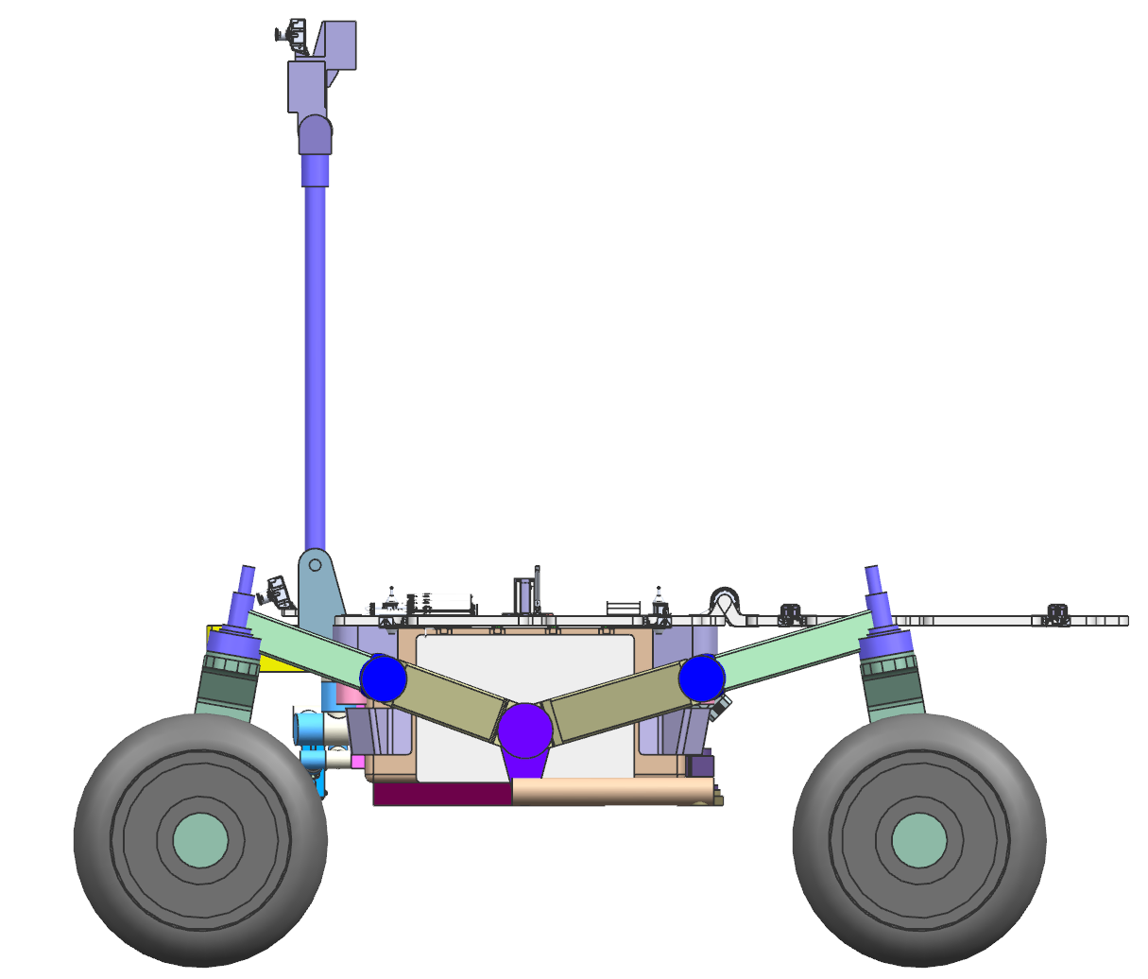
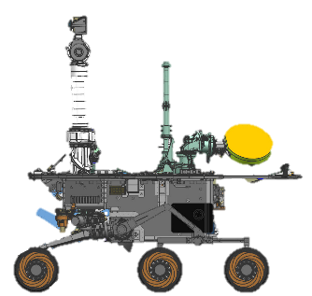
Rover Size Comparison
MER
ExoMars
M2020
SFR
Mass = 173 kg
Number of wheels = 6 Wheel Diameter = 230 mm Wheel Type = Rigid
Susp Type = Rocker-Bogie w/ internal diff
Ground Clearance = 300 mm
Mass = 310 kg
Number of wheels = 6 Wheel Diameter = 285 mm Wheel Type = Compliant
Wheelbase = 1260 mm
Susp Type = 3x Bogie
Ground Clearance = est 250 mm
Mass = 1030 kg
Number of wheels = 6 Wheel Diameter = 526 mm Wheel Type = Rigid
Wheelbase = 2260 mm
Susp Type = Rocker-Bogie w/ external diff
Ground Clearance = 584 mm
Mass = < 230 kg
Number of wheels = 4 Wheel Diameter = 550 mm Wheel Type = Compliant, Mesh
Wheelbase = 1550 mm
Susp Type = 4 wheel w/ external diff
Ground Clearance = 350 mm

Slide 8
Resiliency Decisions and Sample Safe States
Mars Sample Return Campaign Concept Review
Through architecture design, created numerous sample-safe states and decision events
  Sample(s) are designed to survive on the Mars surface for a minimum of 10 years
  Functionally redundant paths for delivering samples to SRL (M2020 and SFR)
  OS orbit is designed to be stable for a minimum of 10 years
  OS designed to be capable of returning as many as 30 samples
In Phase A, team will look carefully at each Phase for additional resiliency
MSR is using resiliency to guide decision making
  Testing and V&V programs will be detailed with focus on high risk areas
  Probabilistic risk assessment will be used as part of the SE&I function to quantify risk as part of the Program decision-making process

Slide 9
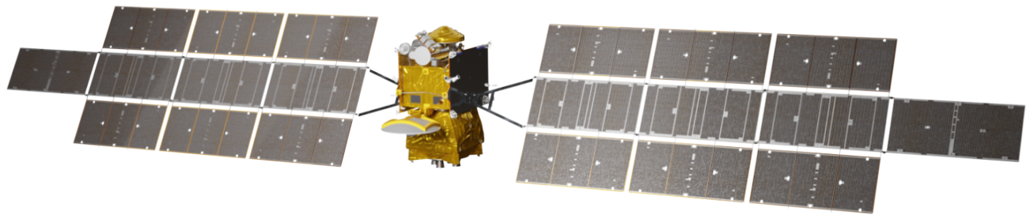

MSR Launch Opportunities
MSR Launch Opportunity Comparison
ERO
26/26/31 Reference Design
Slightly Worse than 26/26/31
Worse than 26/26/31
Much Worse than 26/26/31
2026
2027-28 2029-30
Primary 26/26/31
Return: 2031
Return: 2033
Favorable EDL Atmosphere Solar-Only SRL/SFR
Heavy SRL Launch Vehicle Relay: MRN
MAS Launch NOT Observed
Similar ERO Traj ERO: 6 years
M2020: 7 years Backup Requires Redesign
Return: 2037
Favorable EDL Atmosphere Solar-Only SRL/SFR
Heavy SRL Launch Vehicle Relay: MRN
MAS Launch NOT Observed
More Challenging ERO Traj ERO: 9 years
M2020: 7 years
Backup Does Not Require Redesign
Favorable EDL Atmosphere
Each opportunity is evaluated based upon SRL and ERO designed specifically for that opportunity
Solar-Only SRL/SFR
2026
Heavy SRL Launch Vehicle
Relay: ERO & MRN
MAS Launch Observed
Reference ERO Traj
ERO: 5 years
M2020: 7 years
MRN = Mars Relay Network
  MRO, MAVEN, TGO
Backup Does Not Require Redesign
Return: 2033
Favorable EDL Atmosphere Solar-Only SRL/SFR
Super Heavy SRL Launch Vehicle
Relay: ERO & MRN (+2 years)
MAS Launch Observed Easier ERO Traj ERO: 7 years
M2020: 9 years Backup Requires Redesign
Return: 2033
Return: 2037
Favorable EDL Atmosphere Solar-Only SRL/SFR
Super Heavy SRL Launch Vehicle
Relay: MRN (+2 years)
MAS Launch NOT Observed More Challenging ERO Traj ERO: 9 years
M2020: 9 years Backup Requires Redesign
Favorable EDL Atmosphere
Nomenclature: “28/27/33”
  SRL Launches in 2028
  ERO Launches in 2027
  ERO Returns in 2033
Solar-Only SRL/SFR
SRL
2028
Super Heavy SRL Launch Vehicle
Relay: ERO & MRN (+2 years)
MAS Launch Observed
Similar ERO Traj
ERO: 6 years
M2020: 9 years
"2027-28” covers the potential for ERO to launch one year earlier and use an Earth flyby prior to utilizing a 2028 Earth - Mars transfer. These options are architecturally similar.
Backup Requires Redesign
Return: 2037
Unfavorable EDL Atmosphere Nuclear SRL/SFR
Super Heavy SRL Launch Vehicle
Relay: ERO & MRN (+5 years) MAS Launch Observed Similar ERO Traj
ERO: 11 years
M2020: 12 years
Backup Does Not Require Redesign
Return: 2037
Unfavorable EDL Atmosphere Nuclear SRL/SFR
Super Heavy SRL Launch Vehicle
Relay: ERO & MRN (+5 years) MAS Launch Observed Similar ERO Traj
ERO: 10 years
M2020: 12 years Backup Requires Redesign
Return: 2037
Unfavorable EDL Atmosphere Nuclear SRL/SFR
Super Heavy SRL Launch Vehicle
Relay: ERO & MRN (+5 years) MAS Launch Observed
More Challenging ERO Traj ERO: 9 years
M2020: 12 years
Backup Does Not Require Redesign
Backup
2030
28/27/33
Pre-Decisi
on
al Information -- For plannin
g a
nd discussion purposes only.

Slide 10
Science Integration Across Programs
Science is working closely with system engineers on requirements and essential trade-offs.
NASA/ESA Mars Sample Return Sample Planning Group – Phase 2 (MSPG2) is addressing science and curation planning questions for analyzing returned samples, developing draft requirements for the Sample Receiving Facility.
  Terms of Reference signed in April 2020, reports expected in Spring 2021
COSPAR Sample Safety Assessment Protocol Working Group (SSAP) is developing a recommendation for determining when extraterrestrial samples are safe for distribution outside of containment.
  Report out in Jan/Feb 2021 at COSPAR Assembly
  NASA interests are represented through Planetary Protection, Mars Science, and US scientists
An open community workshop for a Perseverance/MSR Sample Caching Strategy Workshop planned Jan. 2021, informing the draft operations M2020/MSR MOU

Slide 11
Going Forward- Phase A
Mars Sample Return Campaign Concept Review
    Complete Architectural Trade Studies recommended by IRB
    Continue Technology and Engineering Development plans
    Continue to work Planetary Protection requirements
    Proceed with NEPA process
    Work to ensure MSR coordination with M2020 Phase E sampling operations
    Work to maintain 2026 schedule through PDR, per IRB and SRB recommendations

Slide 12


with us

