Slide 1
Jeff Gramling
Director, Mars Sample Return Program
Mars Sample Return (MSR)
Presentation to the International Mars Exploration Working Group
December 2nd, 2020

Slide 2

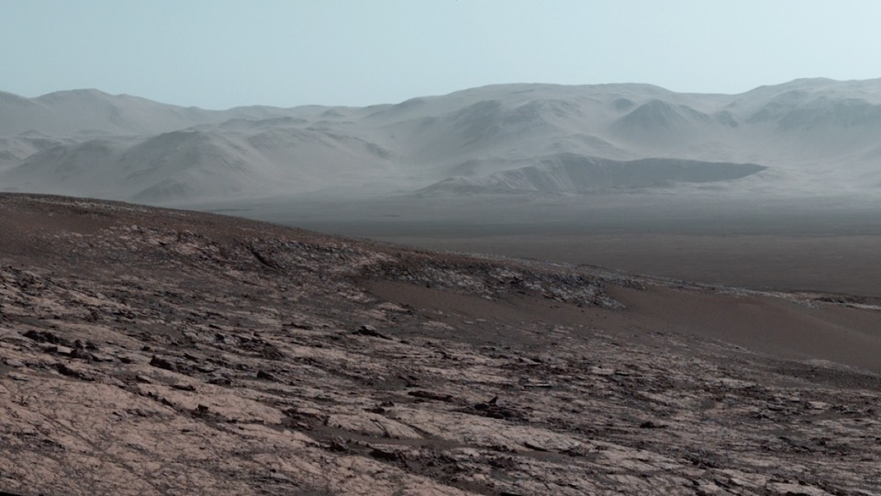
Mars Sample Return—
First Sample Return From Another Planet
A priority since 1980 and of two National Academy Decadal Surveys
A first-step “round-trip” in advance of humans to Mars
The oldest known life on Earth existed ~3.5 billion years ago,
a time when Mars was habitable. Today,
<<1% of the Earth’s surface is 3 billion years or older
    >50% of the Mars’ surface is 3 billion years or older
The first billion years and life’s beginning in the Solar System:
The record is on Mars

Slide 3
MSR Recent Accomplishments
The Memorandum of Understanding (MOU) establishing the ESA/NASA MSR program partnership was signed by the NASA Administrator and the ESA Director General on October 5th
Independent Review Board (IRB) Final Report Released 11/10/20
  https://www.nasa.gov/sites/default/files/atoms/files/nasa_esa_mars_sample_return_final_report_small.pdf
MSR Concept Review (MCR) completed 10/19/20
Science Mission Directorate (SMD) Directorate Program Management Council (DPMC) conducted 11/23
Agency Program Management Council (APMC) scheduled for 12/16/20
IRB and Standing Review Board (SRB) both endorsed proceeding into Phase A

Slide 4







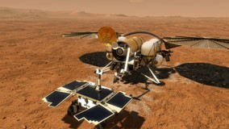
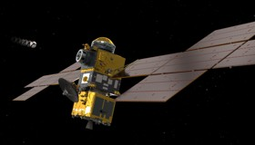
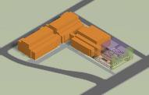
Mars Sample Return Campaign
Mars Sample Return Campaign Concept Review
Mars Sample Return Program
2 3
1
+ 1
Sample Caching Rover (Mars 2020) Operations
Sample acquisition/caching
Sample (subset) delivery
Mars Returned Sample Handling
Sample Receiving Facility
Curation
Sample science investigations
Sample Retrieval Lander
Fetch Rover
Orbiting Sample (OS) container
Mars Ascent Vehicle
Earth Return Orbiter
Capture/Containment System
Earth Return Vehicle
“Initiates the Campaign”
“New Element”
“New Element”
“New Element”
Ground Element
to be reviewed at a future date
The MSR Campaign spans three launches and one ground element
The MSR Program manages development and operations of elements 2 and 3 above and interfaces to elements 1 and 4; program concludes with recovery/containment of Orbiting Sample (OS) for transfer to Sample Receiving Facility (SRF)
The Mars Exploration Program (MEP) manages M2020 Phase E operations & will be the home of the future SRF Project

Slide 5

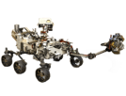













MSR Architectural Overview
Mars Sample Return Campaign Concept Review
Mars
Mars 2020
Tube Delivery
SRL
Mars Ascent
Vehicle
Tube Retrieval
Sample Fetch Rover (SFR)
Tube Collection & Depot
Orbiting Sample (OS)
Retrieve OS
Relay Support
ERO
Break-the-Chain
Avoid Earth
Earth Entry Vehicle
Earth
Mars2020
Earth Return Orbiter
Sample Retrieval Lander
Sample Return and Science

Slide 6
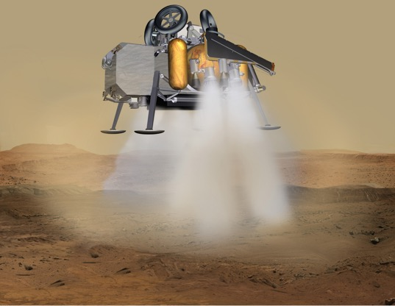
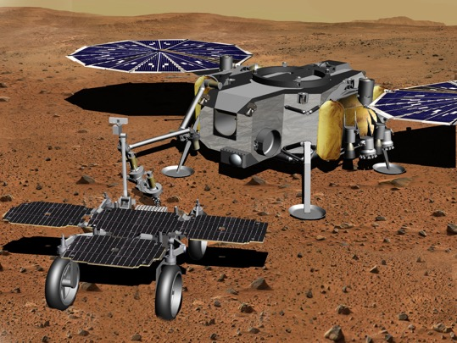
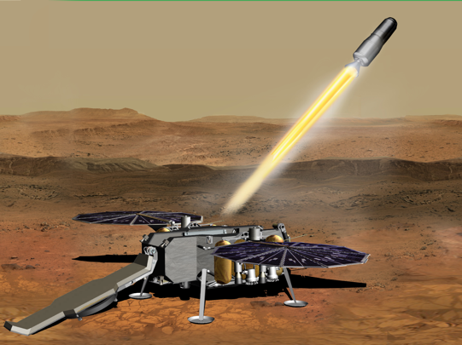
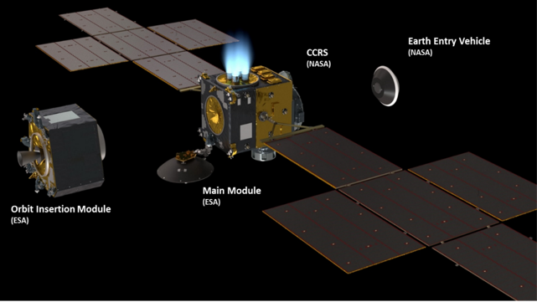
MSR Program Elements
Sample Retrieval Lander (SRL) Touchdown
Sample Transfer
Mars Ascent Vehicle (MAV) Launch
Earth Return Orbiter (ERO)

Slide 7
MSR Architecture Elements
Mars Sample Return Program Director (HQ)
System-Level Project and Program Office
Campaign Mgmt, SE, MA
Interface to Mars 2020 surface operations
Interface to Sample Handling Facility Project
PP and restricted Earth return
Mission system
Mars 2020
Future Sample Handling Facility Project
Sample Retrieval Lander Project
Earth Return Orbiter Project
Returnable Sample Tubes
Capture/Containment
& Return System Project
Curation and Global Distribution of Samples
Sample Fetch Rover
Sample Transfer System
Orbiting Sample
Mars Ascent Vehicle
Capture & Containment Module
Earth Return Module
STA
Legend:
ARC
GSFC
LaRC
NASA
GRC
JPL
MSFC
ESA
JSC
TBD

Slide 8


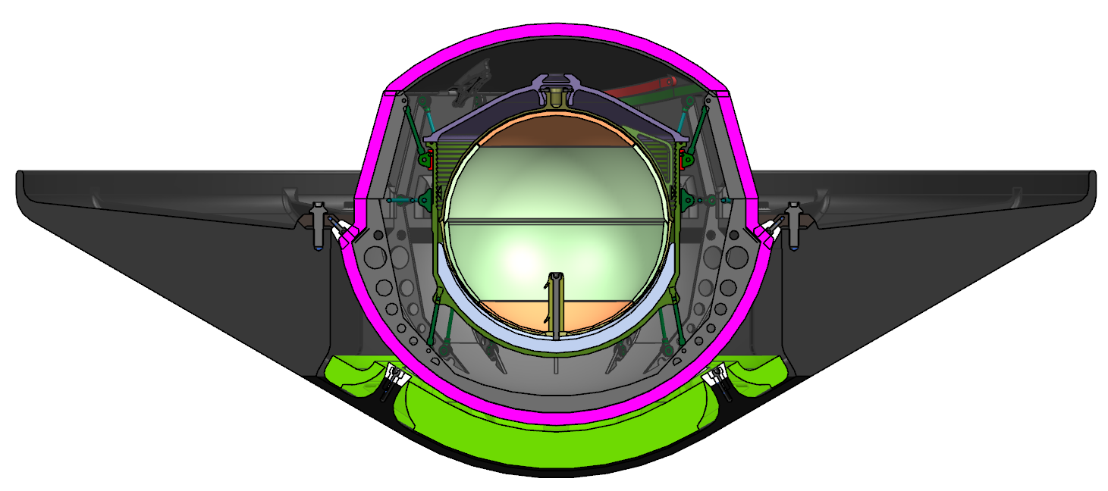



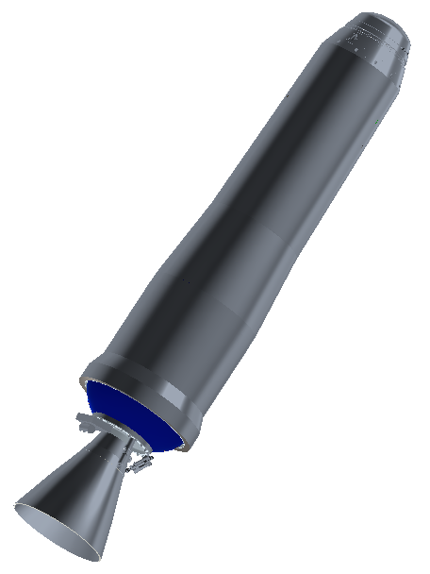
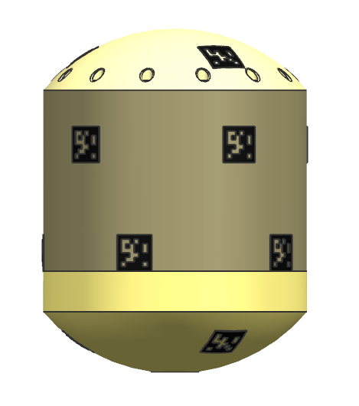



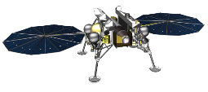
Campaign Timeline Overview
*Illustrates an example scenario
2026 |  |  |  |  |  |  |  |  |  |  |  | 2027 |  |  |  |  |  |  |  |  |  |  |  | 2028 |  |  |  |  |  |  |  |  |  |  |  | 2029 |  |  |  |  |  |  |  |  |  |  |  | 2030 |  |  |  |  |  |  |  |  |  |  |  | 2031
J | F | M | A | M | J | J | A | S | O | N | D | J | F | M | A | M | J | J | A | S | O | N | D | J | F | M | A | M | J | J | A | S | O | N | D | J | F | M | A | M | J | J | A | S | O | N | D | J | F | M | A | M | J | J | A | S | O | N | D | J | F | M | A | M | J | J | A | S | O | N | D
 |  |  |  |  |  |  |  |  |  |  |  |  |  |  |  |  |  |  |  | Reg. |  | Dust Storm Season |  |  |  |  |  |  |  | Reg. |  |  |  |  |  |  |  |  |  |  |  | Reg. |  | Dust Storm Season |  |  |  |  |  |  |  | Reg.
 |  |  |  |  |  |  |  |  |  |  |  |  |  |  |  |  |  |  |  |  |  |  |  | N Winter |  |  |  |  |  |  |  |  |  |  |  |  |  |  |  |  |  |  |  |  |  | N Winter
 |  |  |  |  |  |  |  | Earth to Mars |  |  |  |  |  |  |  |  |  |  |  |  |  | Spiral Down |  |  |  |  |  |  |  | Low Mars Orbit (Relay) |  |  |  |  |  |  |  |  |  |  |  |  |  | RDV and Contain |  |  | Spiral Up |  |  |  |  |  |  |  | Mars to Earth
 |  |  |  |  |  | Earth to Mars |  |  |  |  |  |  |  |  |  |  |  |  |  |  |  |  |  |  |  |  |  |  |  |  |  | Surface*
Conj
Conj
26-26-31
ERO
MOI
EES
EDL
M2020
MAV
OS
SRL
SFR
*See zoomed diagram for surface phases
26 – 26 – 31
SRL Launches in 2026
Samples are returned in 2031
ERO launches in 2026
Sample Retrieval Lander (SRL) avoids winter and global dust storm season, enabling all-solar SRL/SFR
SRL Entry, Descent and Landing (EDL) occurs in a favorable season, maximizing landed mass
ERO can provide all relay services needed for MSR (SRL, SFR, M2020, Mars Ascent Vehicle (MAV))
SRL and ERO fit on available launch vehicles and trajectories are feasible

Slide 9
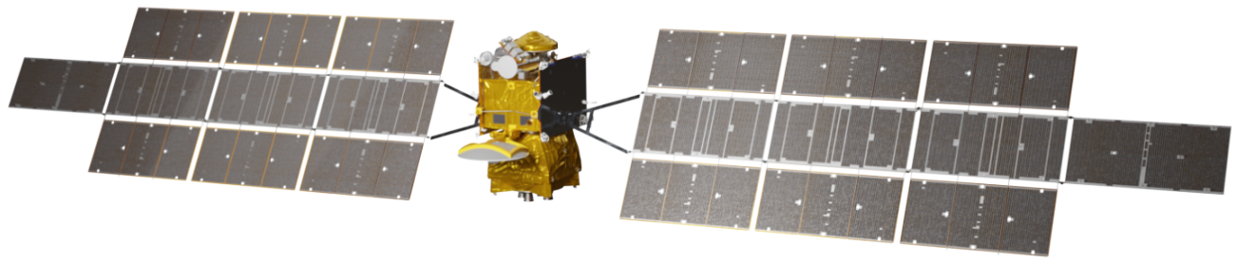

MSR Launch Opportunities
MSR Launch Opportunity Comparison
ERO
26/26/31 Reference Design
Slightly Worse than 26/26/31
Worse than 26/26/31
Much Worse than 26/26/31
2026
2027-28 2029-30
Primary 26/26/31
Return: 2031
Return: 2033
Favorable EDL Atmosphere Solar-Only SRL/SFR
Heavy SRL Launch Vehicle Relay: MRN
MAS Launch NOT Observed
Similar ERO Traj ERO: 6 years
M2020: 7 years Backup Requires Redesign
Return: 2037
Favorable EDL Atmosphere Solar-Only SRL/SFR
Heavy SRL Launch Vehicle Relay: MRN
MAS Launch NOT Observed
More Challenging ERO Traj ERO: 9 years
M2020: 7 years
Backup Does Not Require Redesign
Favorable EDL Atmosphere
Each opportunity is evaluated based upon SRL and ERO designed specifically for that opportunity
Solar-Only SRL/SFR
2026
Heavy SRL Launch Vehicle
Relay: ERO & MRN
MAS Launch Observed
Reference ERO Traj
ERO: 5 years
M2020: 7 years
MRN = Mars Relay Network
  MRO, MAVEN, TGO
Backup Does Not Require Redesign
Return: 2033
Favorable EDL Atmosphere Solar-Only SRL/SFR
Super Heavy SRL Launch Vehicle
Relay: ERO & MRN (+2 years)
MAS Launch Observed Easier ERO Traj ERO: 7 years
M2020: 9 years Backup Requires Redesign
Return: 2033
Return: 2037
Favorable EDL Atmosphere Solar-Only SRL/SFR
Super Heavy SRL Launch Vehicle
Relay: MRN (+2 years)
MAS Launch NOT Observed More Challenging ERO Traj ERO: 9 years
M2020: 9 years Backup Requires Redesign
Favorable EDL Atmosphere
Nomenclature: “28/27/33”
  SRL Launches in 2028
  ERO Launches in 2027
  ERO Returns in 2033
Solar-Only SRL/SFR
SRL
2028
Super Heavy SRL Launch Vehicle
Relay: ERO & MRN (+2 years)
MAS Launch Observed
Similar ERO Traj
ERO: 6 years
M2020: 9 years
"2027-28” covers the potential for ERO to launch one year earlier and use an Earth flyby prior to utilizing a 2028 Earth - Mars transfer. These options are architecturally similar.
Backup Requires Redesign
Return: 2037
Unfavorable EDL Atmosphere Nuclear SRL/SFR
Super Heavy SRL Launch Vehicle
Relay: ERO & MRN (+5 years) MAS Launch Observed Similar ERO Traj
ERO: 11 years
M2020: 12 years
Backup Does Not Require Redesign
Return: 2037
Unfavorable EDL Atmosphere Nuclear SRL/SFR
Super Heavy SRL Launch Vehicle
Relay: ERO & MRN (+5 years) MAS Launch Observed Similar ERO Traj
ERO: 10 years
M2020: 12 years Backup Requires Redesign
Return: 2037
Unfavorable EDL Atmosphere Nuclear SRL/SFR
Super Heavy SRL Launch Vehicle
Relay: ERO & MRN (+5 years) MAS Launch Observed
More Challenging ERO Traj ERO: 9 years
M2020: 12 years
Backup Does Not Require Redesign
Backup
2030
28/27/33
Pre-Decisi
on
al Information -- For plannin
g a
nd discussion purposes only.

Slide 10
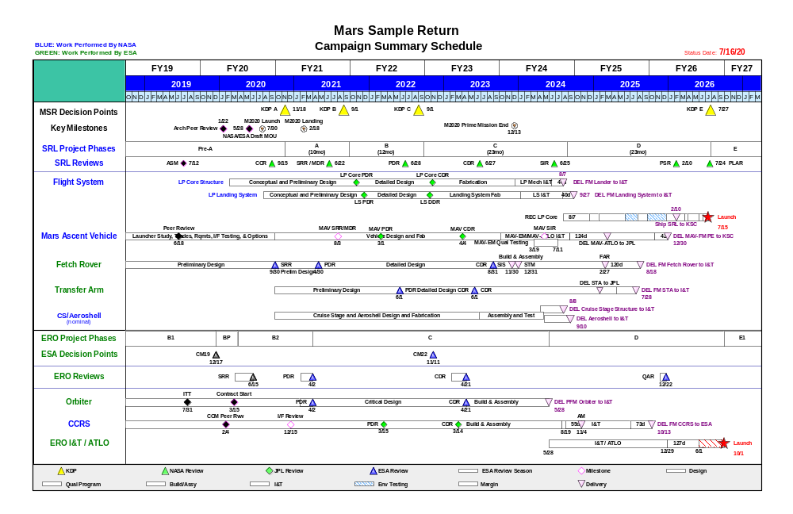
Mars Sample Return
Mission Summary Schedule
BLUE: Work Performed by NASA
GREEN: Work Performed by ESA
Status Date: 7/16/20

Slide 11
Science Integration Across Programs
Science is working closely with system engineers on requirements and essential trade-offs.
NASA/ESA Mars Sample Return Sample Planning Group – Phase 2 (MSPG2) is addressing science and curation planning questions for analyzing returned samples, developing draft requirements for the Sample Receiving Facility.
  Terms of Reference signed in April 2020, reports expected in Spring 2021
COSPAR Sample Safety Assessment Protocol Working Group (SSAP) is developing a recommendation for determining when extraterrestrial samples are safe for distribution outside of containment.
  Report out in Jan/Feb 2021 at COSPAR Assembly
  NASA interests are represented through Planetary Protection, Mars Science, and US scientists
An open community workshop for a Perseverance/MSR Sample Caching Strategy Workshop planned Jan. 2021, informing the draft operations M2020/MSR MOU

Slide 12
Going Forward- Phase A
Mars Sample Return Campaign Concept Review
    Complete Architectural Trade Studies recommended by IRB
    Continue Technology and Engineering Development plans
    Continue to work Planetary Protection requirements
    Proceed with NEPA process
    Work to ensure MSR coordination with M2020 Phase E sampling operations
    Work to maintain 2026 schedule through PDR, per IRB and SRB recommendations

Slide 13


with us

