Slide 1


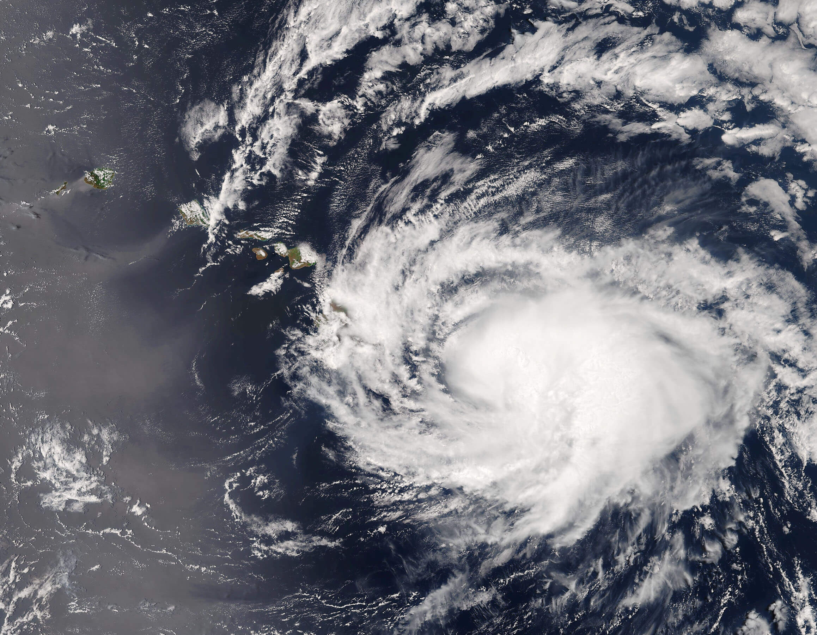




NASA’s Goddard Space Flight Center is a community ranging from all areas of expertise.
The Comm and Nav Community plays a vital role in enabling NASA’s mission and vision, empowering spacecraft to send data from extreme distances back to Earth. This data results in discoveries about our planet and the solar system, and have significant impact on humanity’s knowledge about the universe and our existence here on Earth.

Slide 2



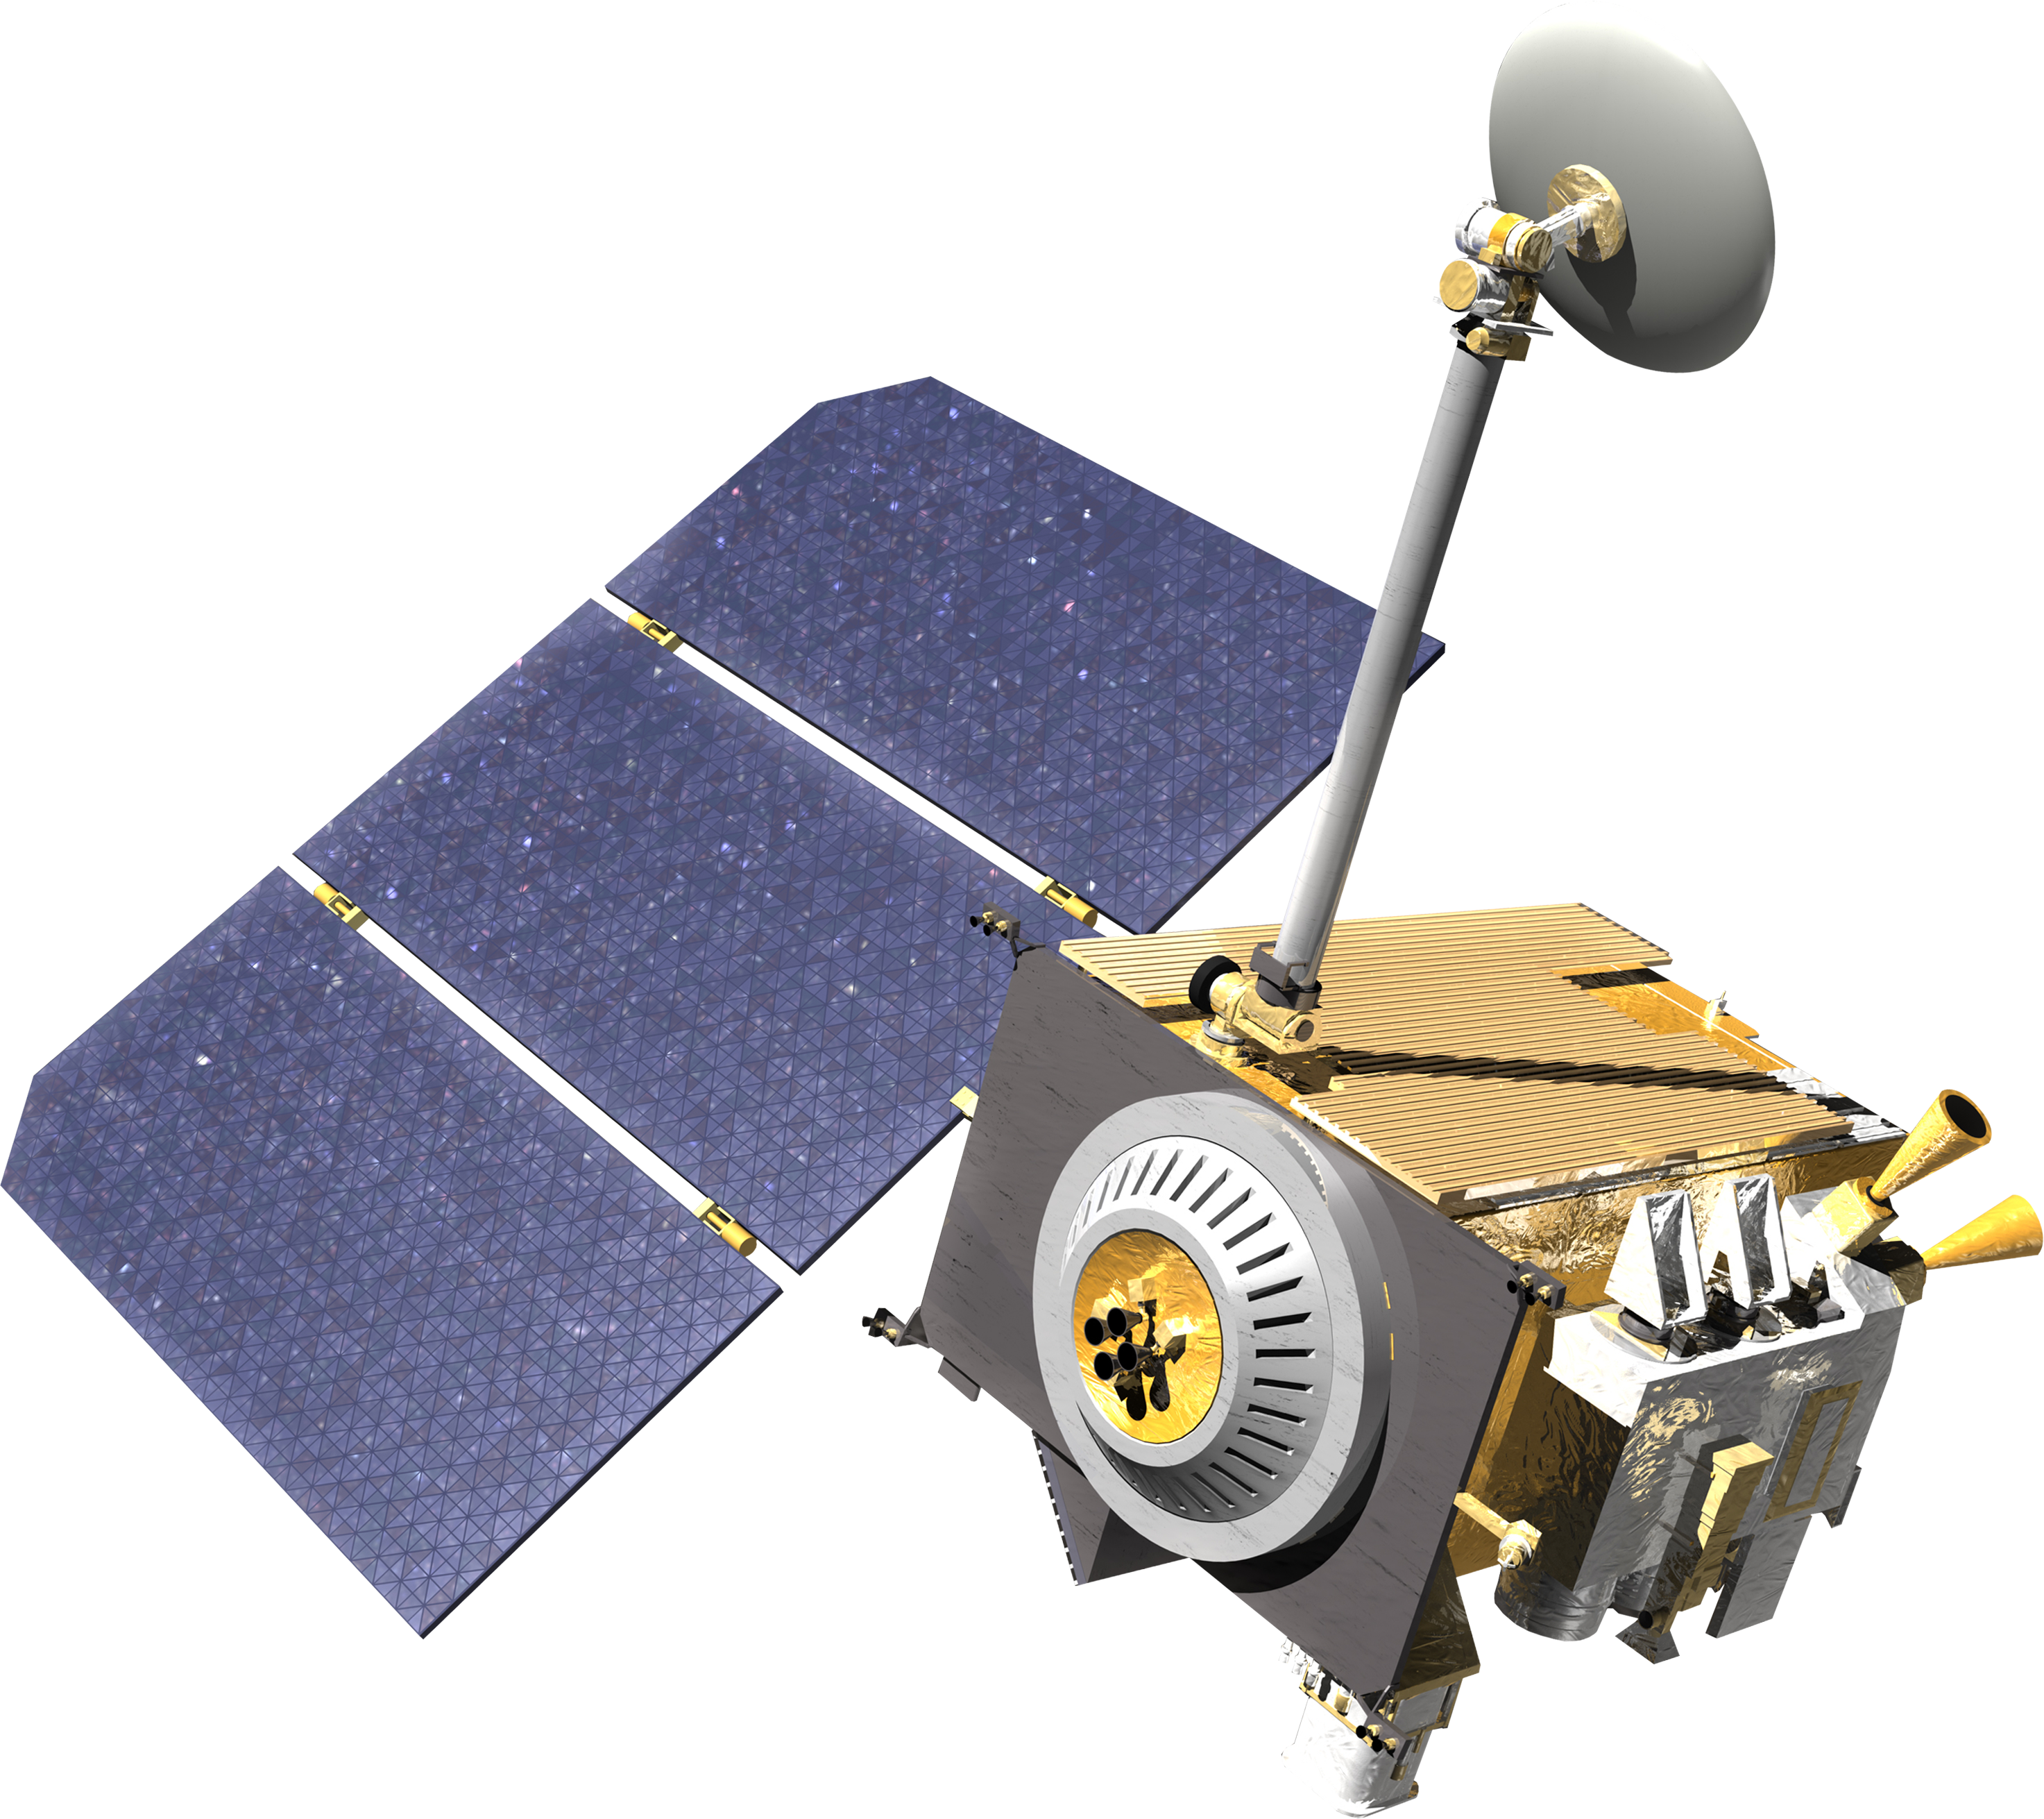
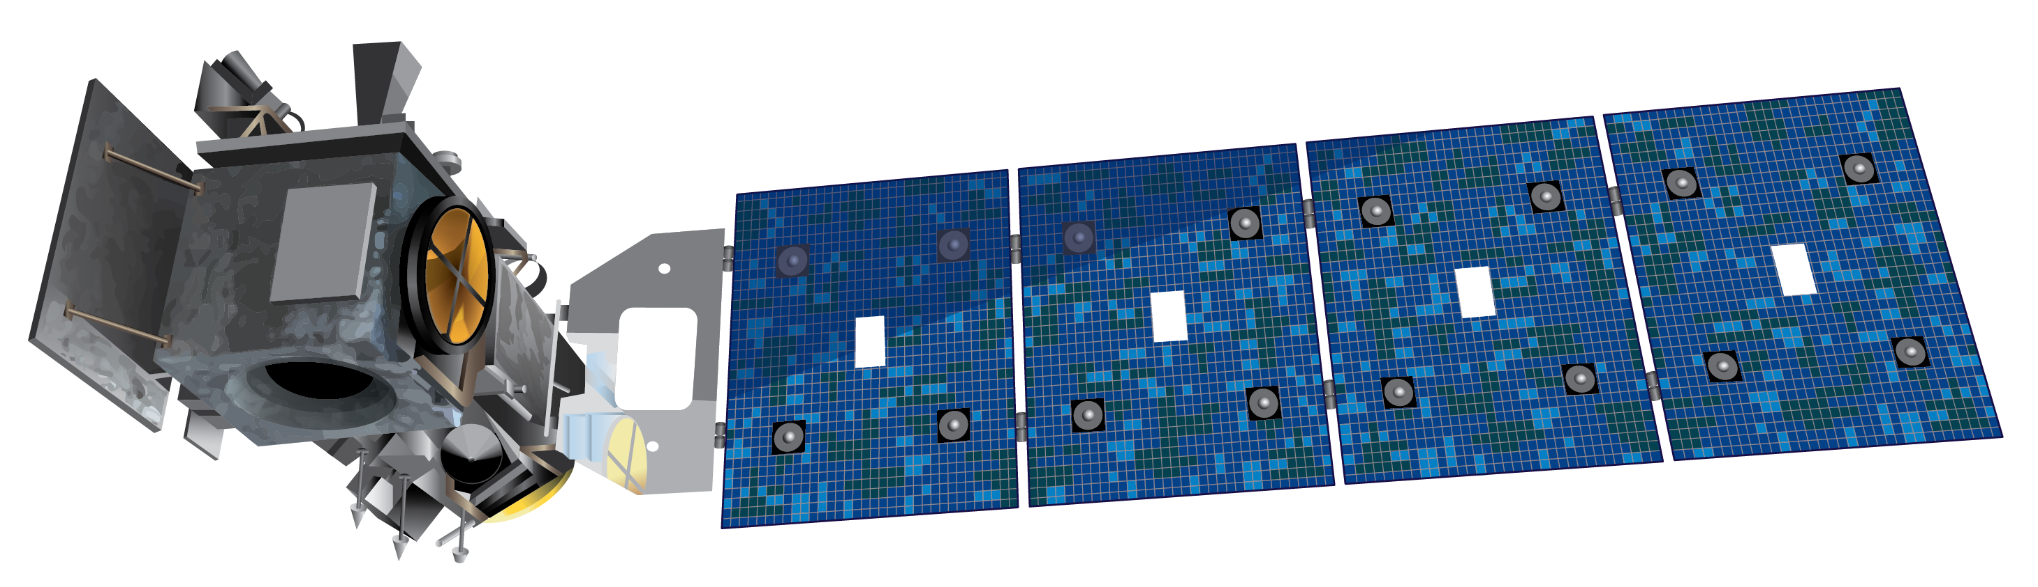

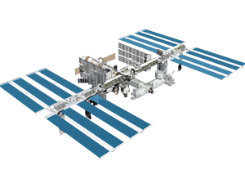
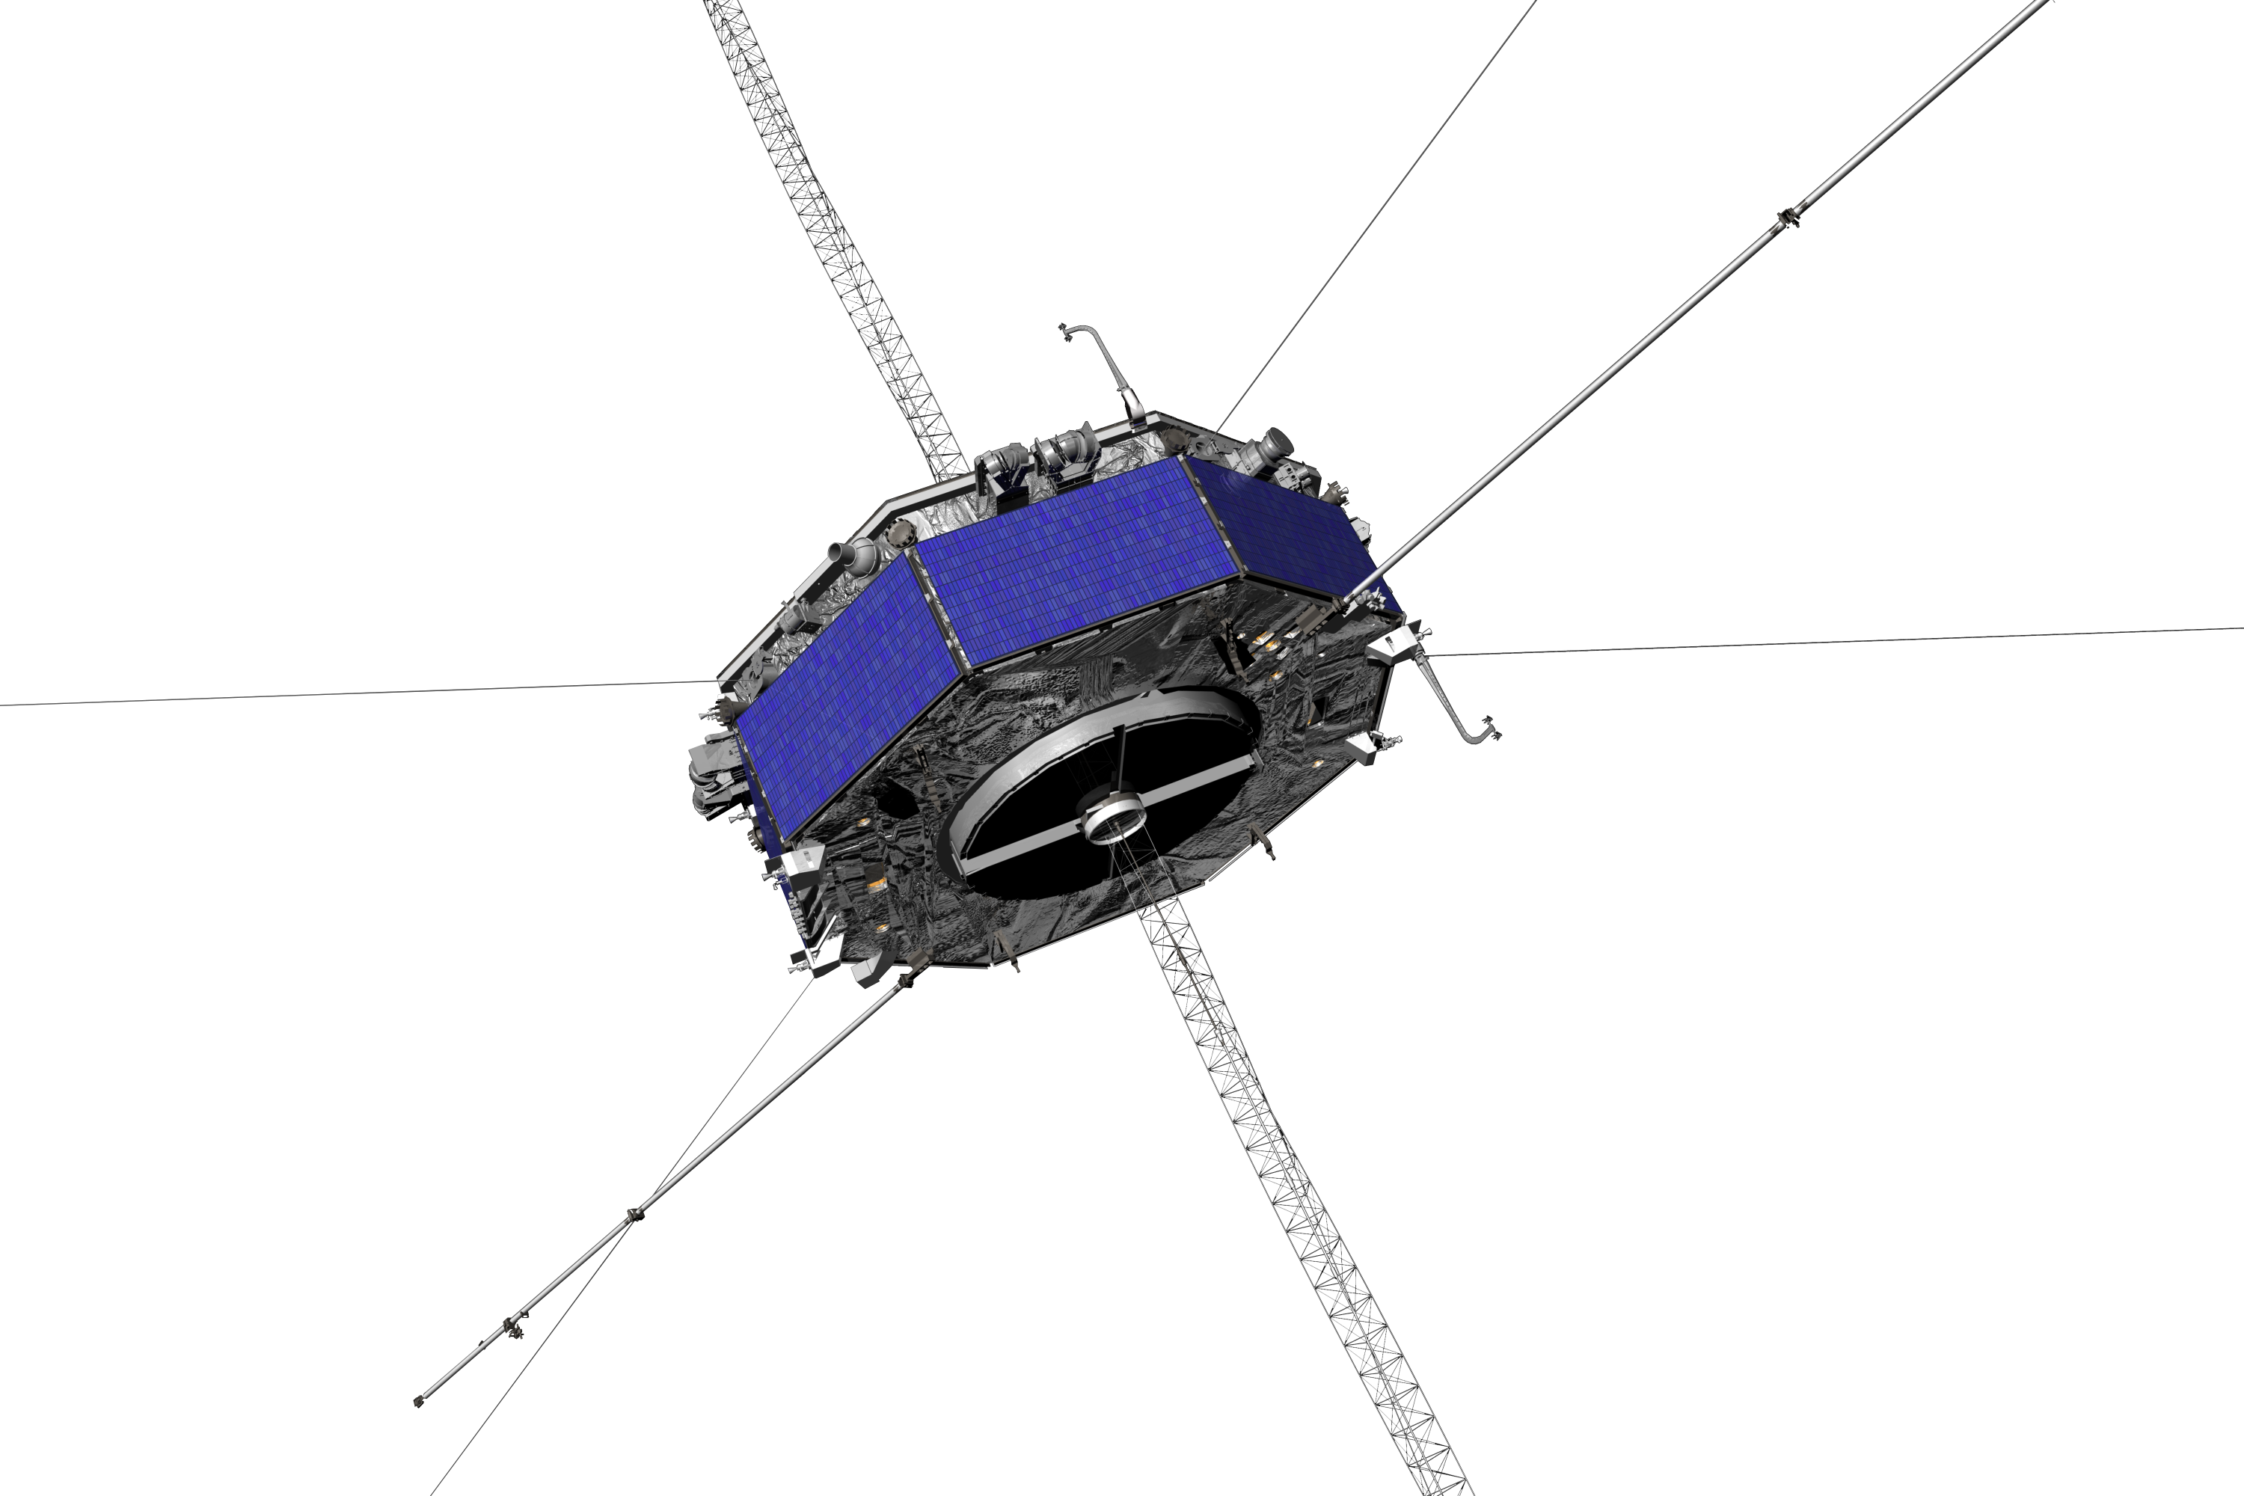
At Goddard Space Flight Center, we provide end-to-end telecommunications and navigation capabilities and services. This enables spacecraft to reach their destination and communicate critical data back to scientists on Earth.
Goddard will provide these critical communications and navigation services to the Artemis missions.
Notes:
Moon – LRO
Ice cap – ICESat-2
Far left – MMS (Magnetospheric Multiscale Mission)
Middle - ISS

Slide 3
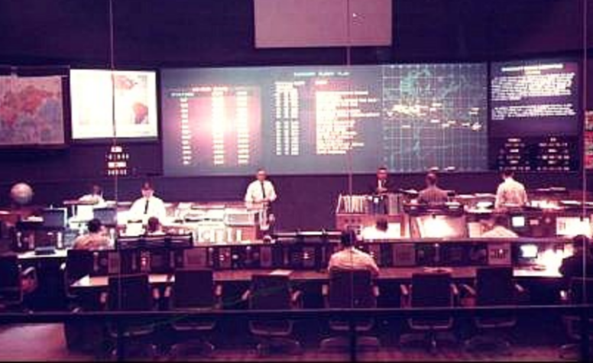
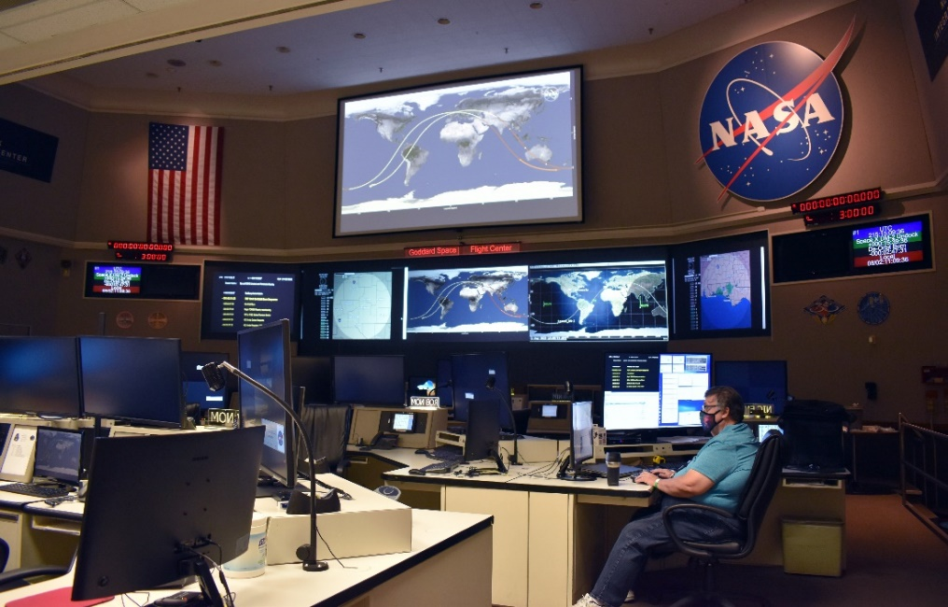
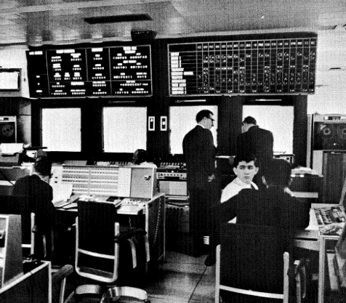
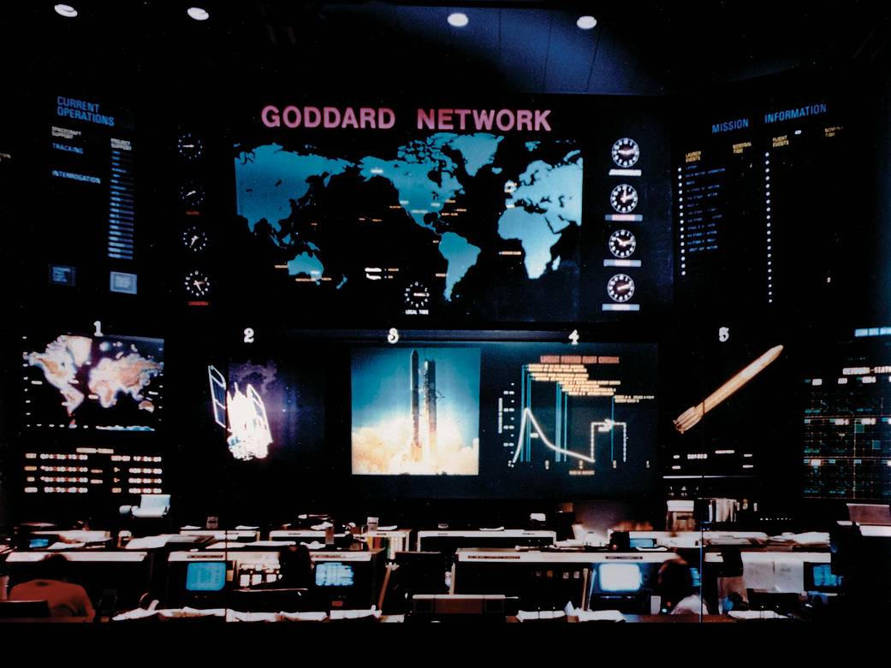
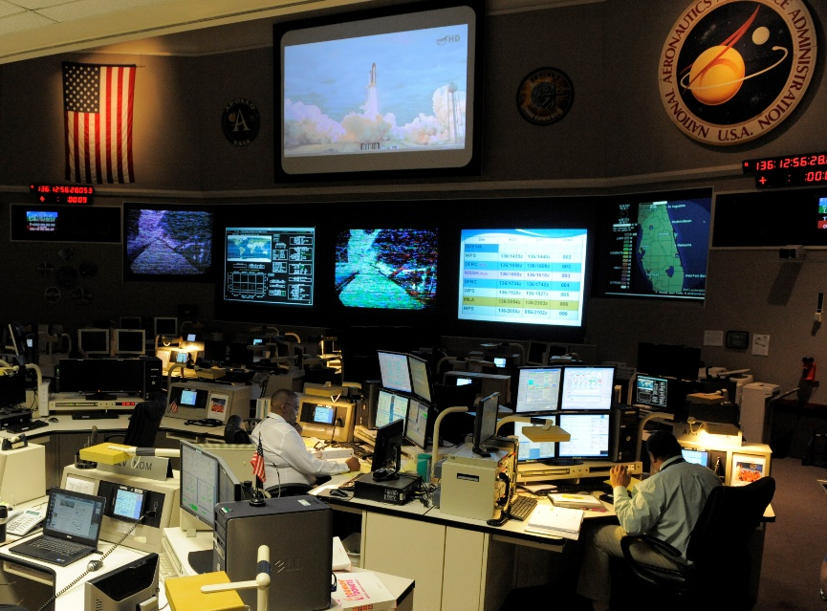
1968 - Manned Space Flight Network Operations Center
1987 - Network Control Center
2020’s - Near Space Network Operations Control Center
1959 - Mercury Computing Center
1970’s - Network Operations Control Center
2000’s - Network Integration Center for Near Earth Network and Space Network
Notes:
Since the inception of the agency, Goddard Space Flight Center has played a critical role in space communications and navigation. NASA organized its earliest networks — the global infrastructure that enabled Mercury, Gemini and Apollo — around the people and facilities at Goddard.
With the Artemis program, Goddard’s communications and navigation community will play the same critical role.
last bullet Today the Network support to over 50 missions currently which include NASA and non- NASA

Slide 4
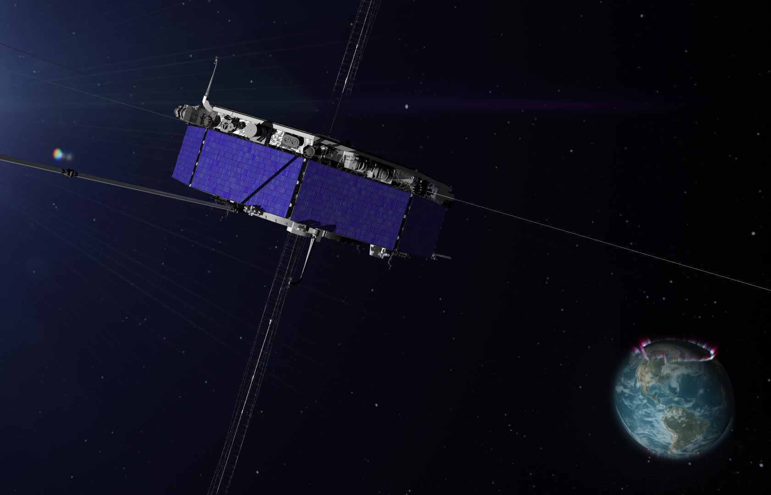

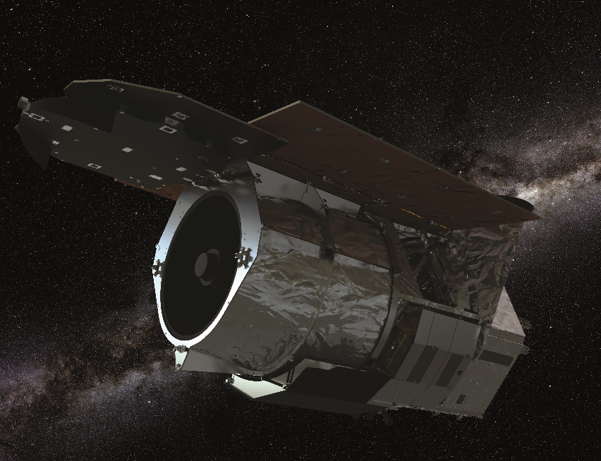
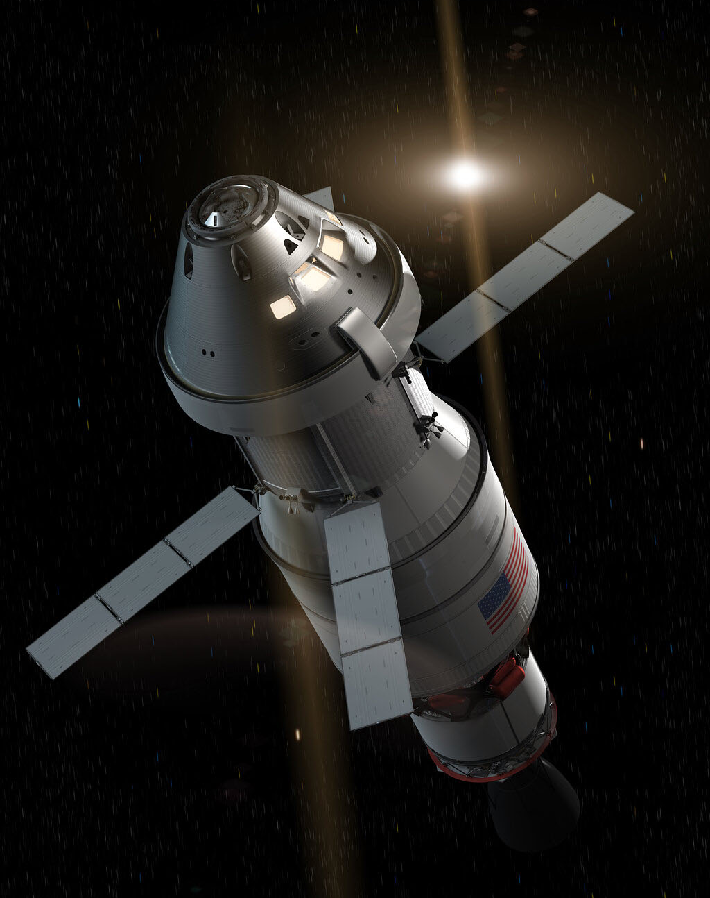
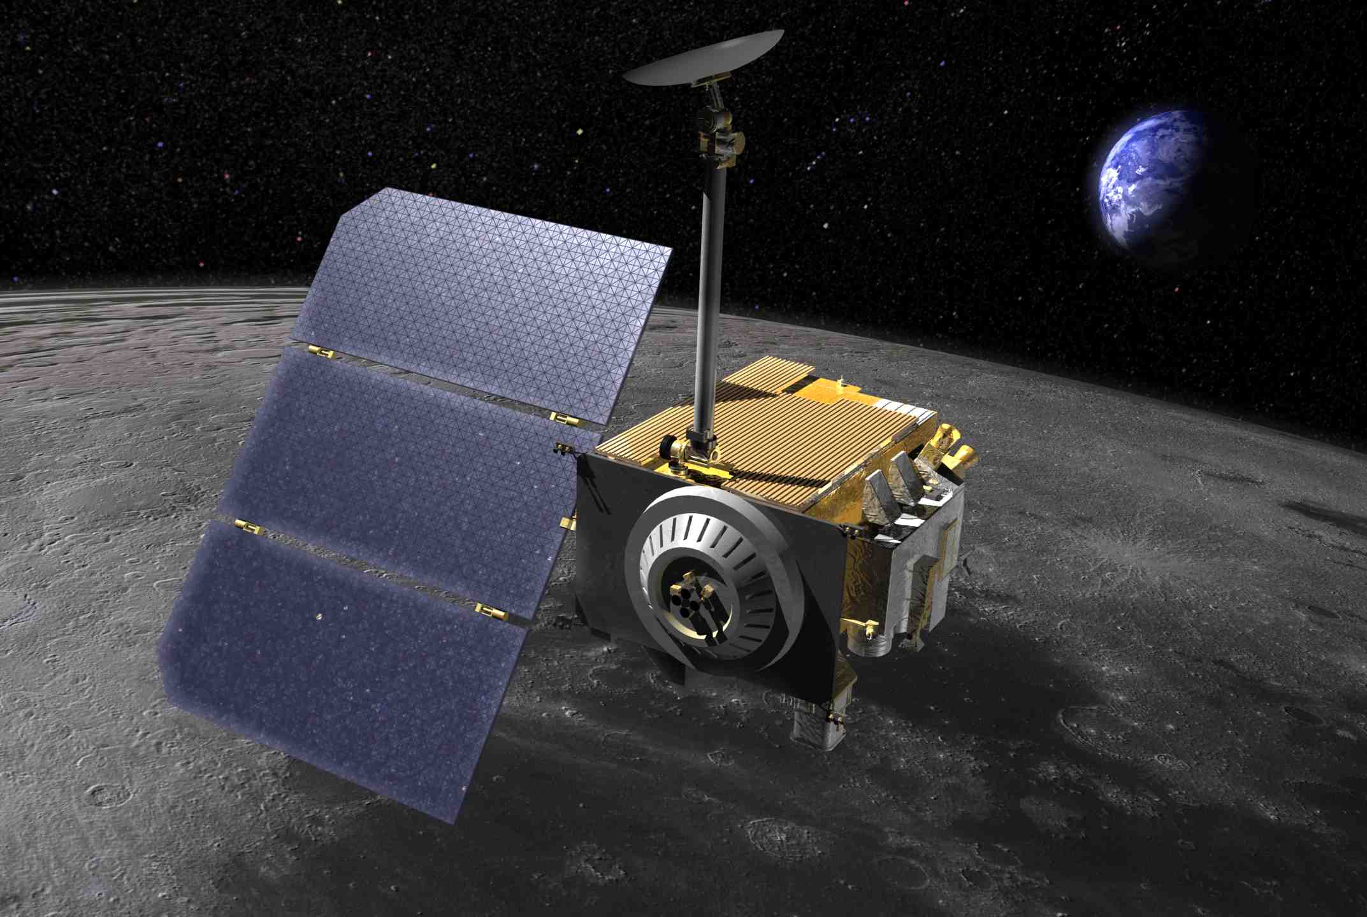
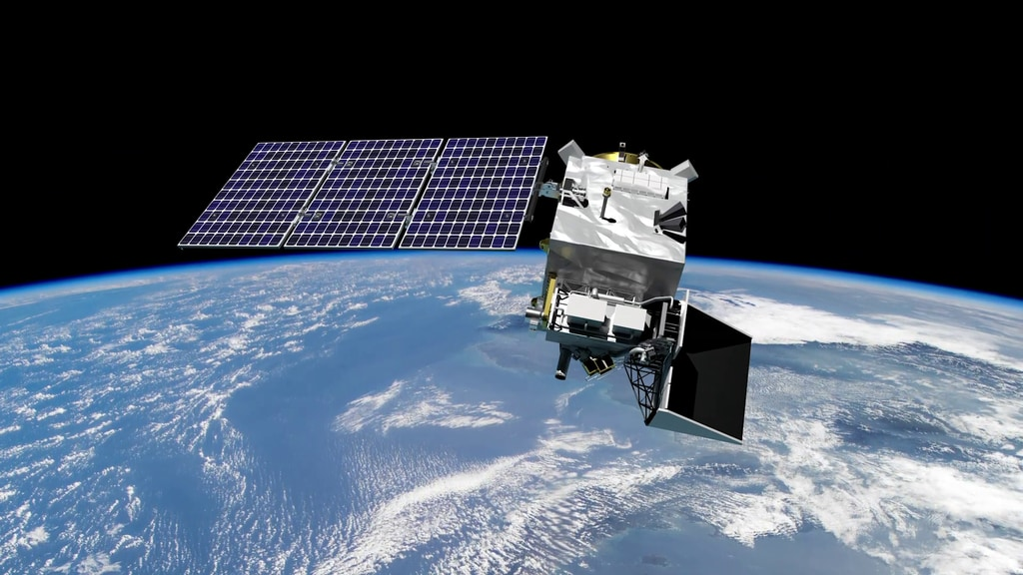
User Missions: The Goddard Comm & Nav Community has built and operated communications and navigation systems on multiple science and exploration missions
OPERATIONAL
IN DEVELOPMENT
Notes:
MMS
LRO
ISS
PACE
WFIRST
Artemis II – O2O

Slide 5
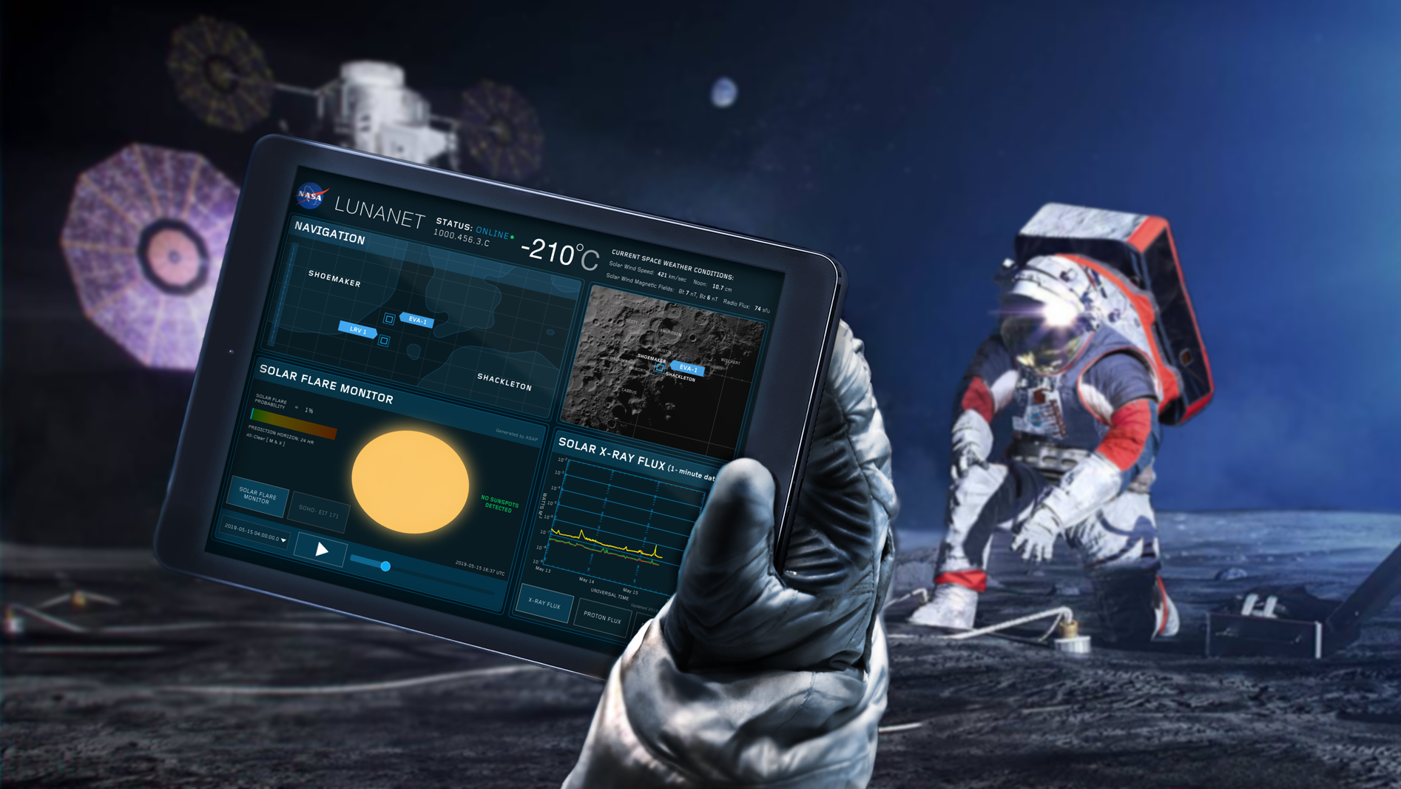


The LunaNet architectural approach is applicable to the Moon, any planetary body, and will enable the solar system internet.
Notes:
LunaNet is NASA’s planned communications and navigation architecture for the Moon. Leveraging Delay/Disruption Tolerant Networking, LunaNet will establish a terrestrial-like internet around the Moon, allowing rovers, orbiters, and astronauts to be connected to a larger network with a constant link back to Earth.

Slide 6


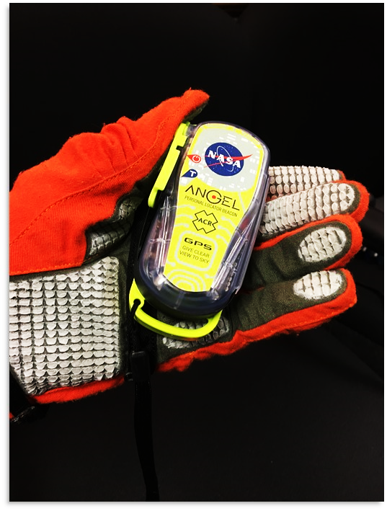
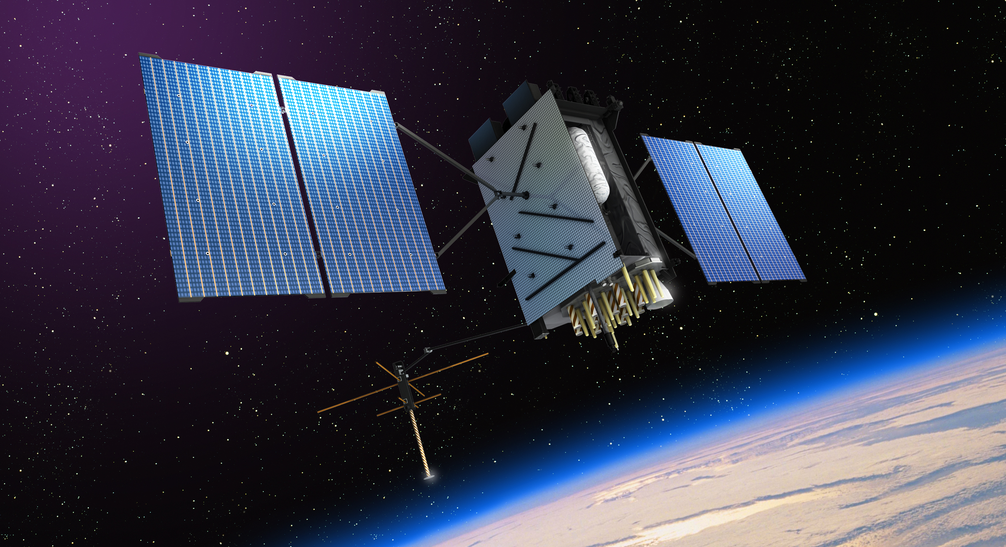
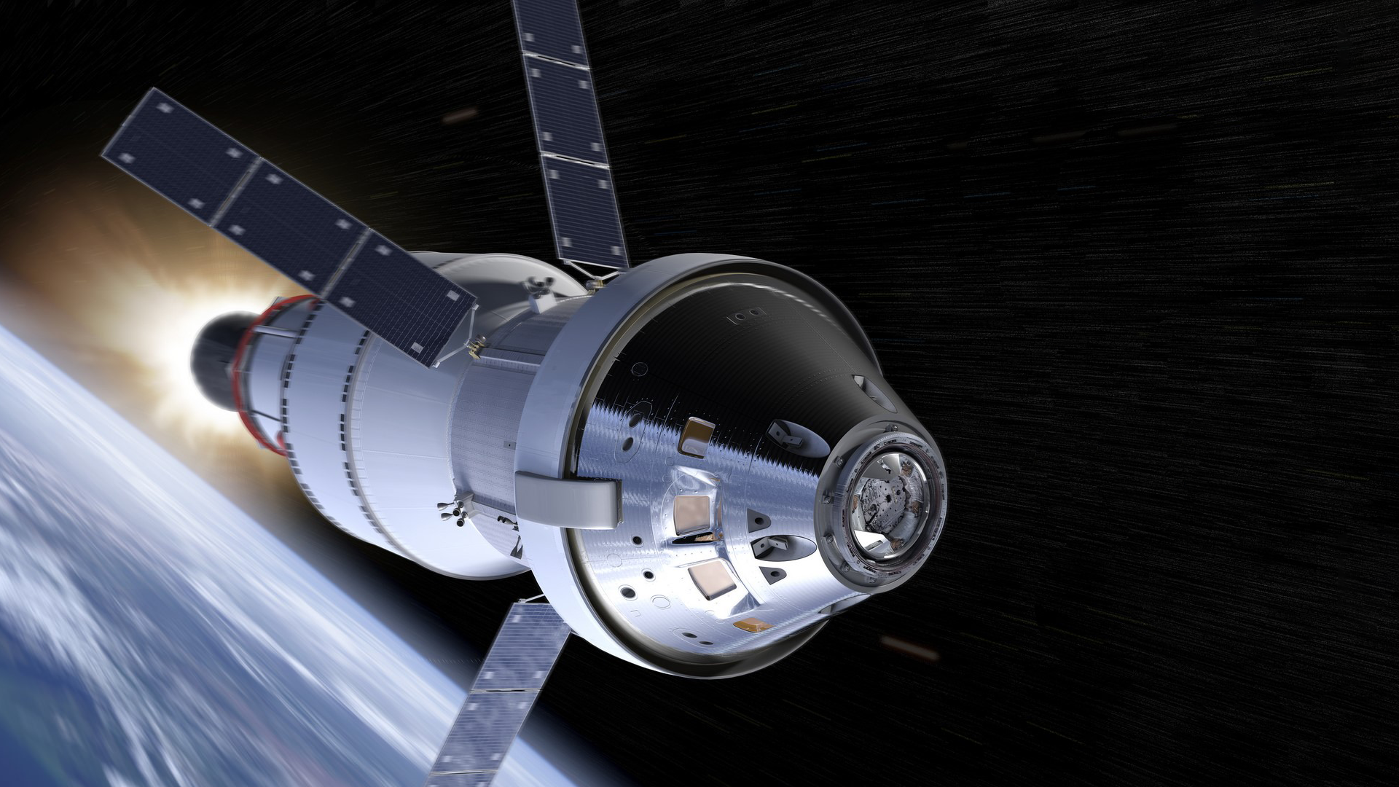
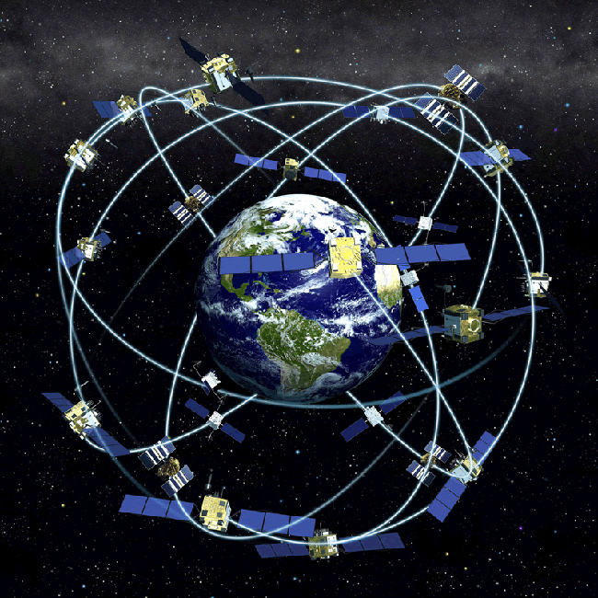

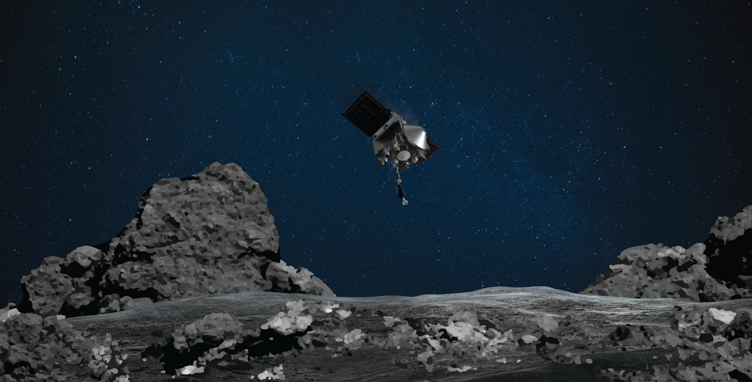
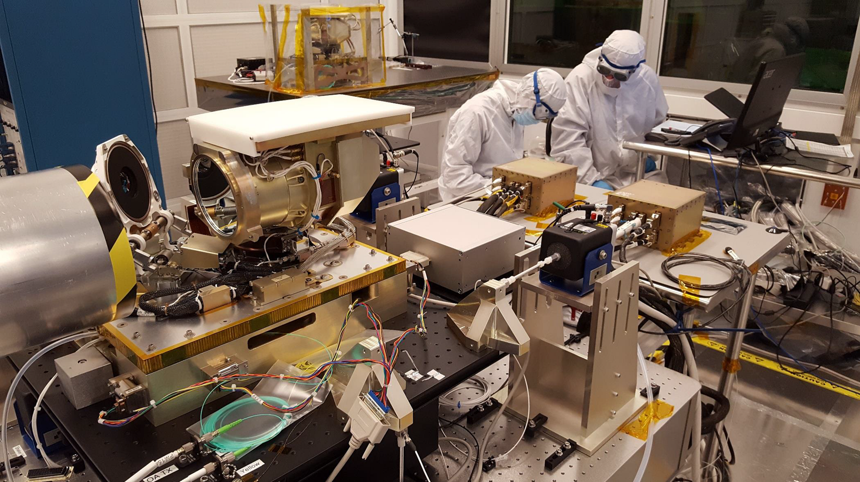
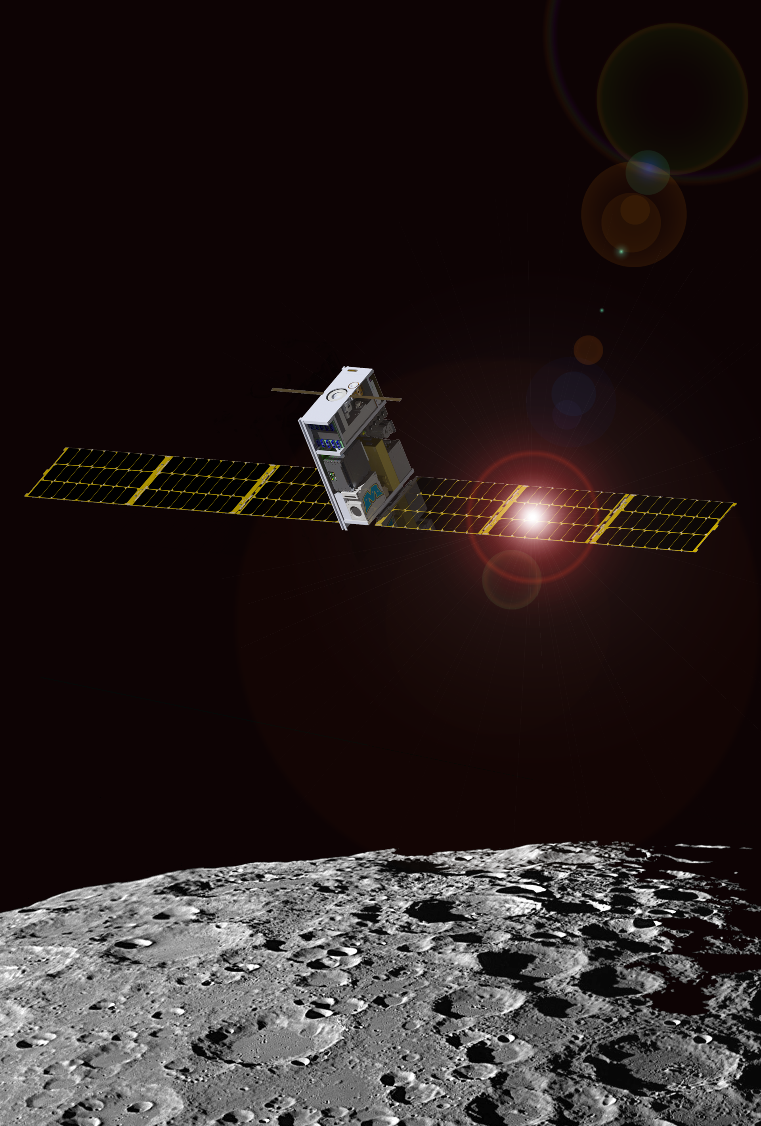
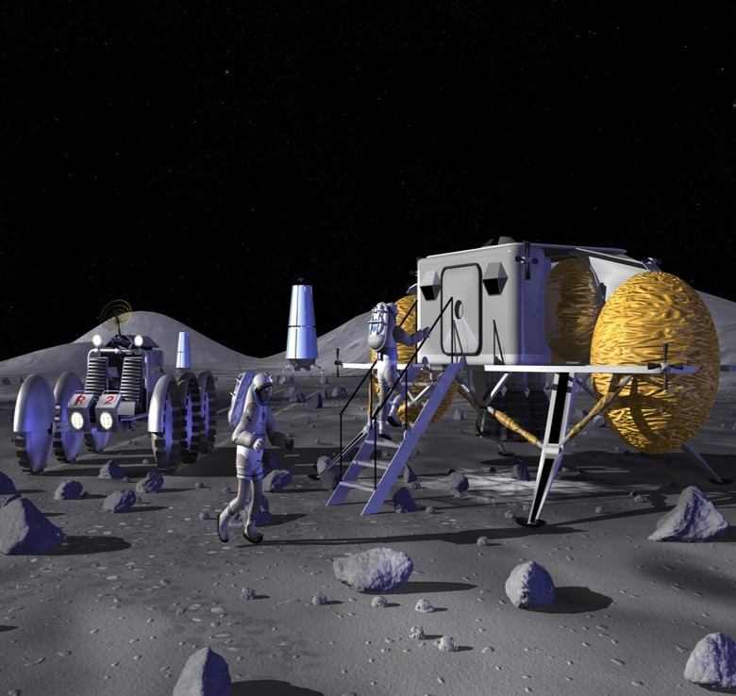
Tracking, Telemetry, and Command support to launches, on-orbit, and return.
Delay/Disruption Tolerant Networking
Optical Communications
High Altitude GPS
Launch Communications Segment
ANGEL beacons
Gateway Flight Software
Lunar Landers Support
Lunar IceCube Mission Instrument
Notes:
Highlights:
Recent:
Over FY20, the Comm and Nav community supported 16 launches.
The Goddard-developed Broadband Infrared Compact High Resolution Exploration Spectrometer (BIRCHES) was shipped to Morehead State University for integration into the Lunar IceCube spacecraft. Lunar IceCube will launch aboard the Artemis I mission in 2021, and study ice distribution on the Moon’s surface.
The Orion Artemis II Optical Communications System’s (O2O) first flight subsystem has completed testing and was delivered to our partner, the Massachusetts Institute of Technology - Lincoln Laboratory for additional testing and integration. O2O will fly aboard NASA’s second Artemis mission, enabling increased data capabilities for the astronauts onboard.
The OSIRIS-Rex mission made history, successfully “tagging” the surface of the asteroid Bennu. Position, Navigation, and Timing Policy Lead and Comm and Nav Community member Benjamin Ashman played a pivotal role in this milestone as a member of the OSIRIS-REx navigation team. Through this mission, the techniques learned give the community new knowledge on how to achieve similar techniques on the Moon and Mars.
Last year:
In 2019, the Launch Communications Segment (LCS) was unveiled at Kennedy Space Center’s Uplink Station. Over 115 people, including leadership from Goddard and Kennedy, celebrated the critical role LCS will play in NASA’s journey forward to the Moon, Mars and beyond. Kennedy’s center director renamed the entrance road “Robert H. Goddard Road” in recognition of the partnership between the two centers to develop the station.

Slide 7
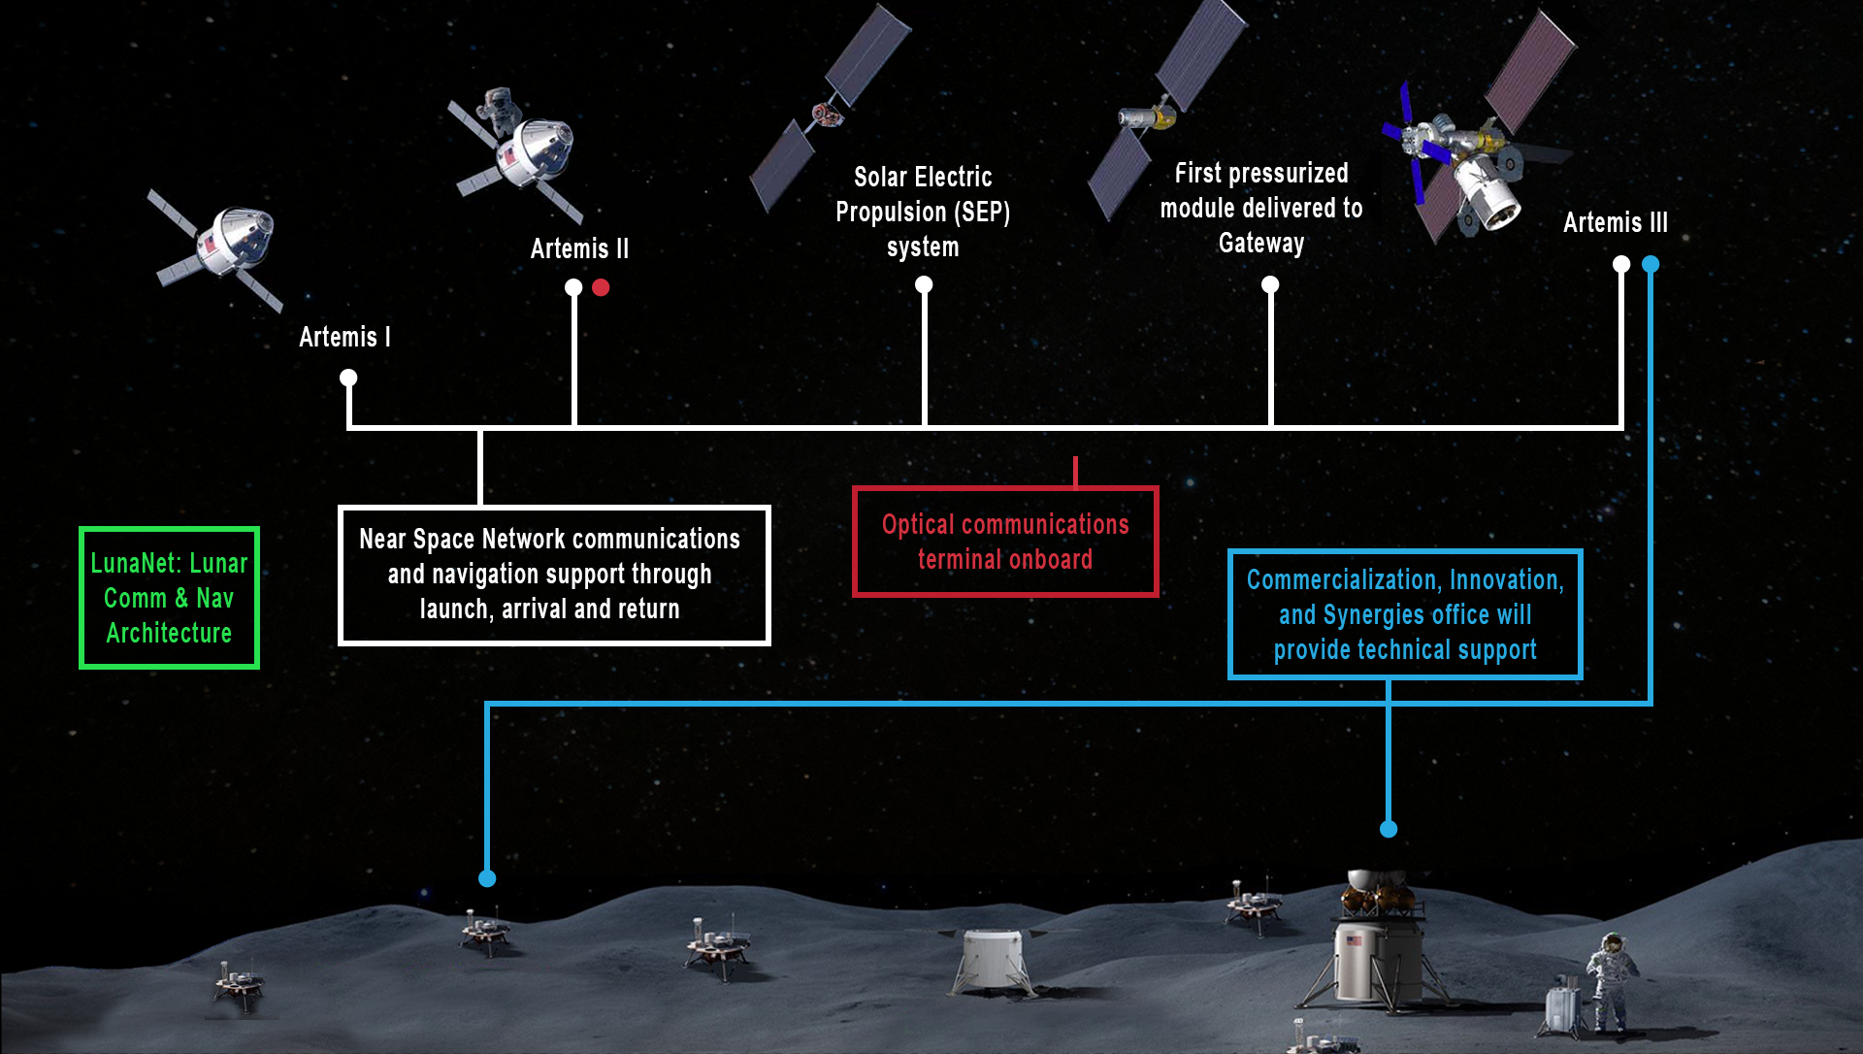
Snapshot:
Comm & Nav Contributions to Artemis
Notes:
Commercialization, Innovation, and Synergies office now oversees the Exploration Systems Project, which provides expertise to exploration initiatives.
They are currently contributing core Flight Software expertise to Gateway.
They are providing insight into the Human Landing System development with contractors
They are leading development of the BIRCHES instrument on Lunar IceCube

Slide 8


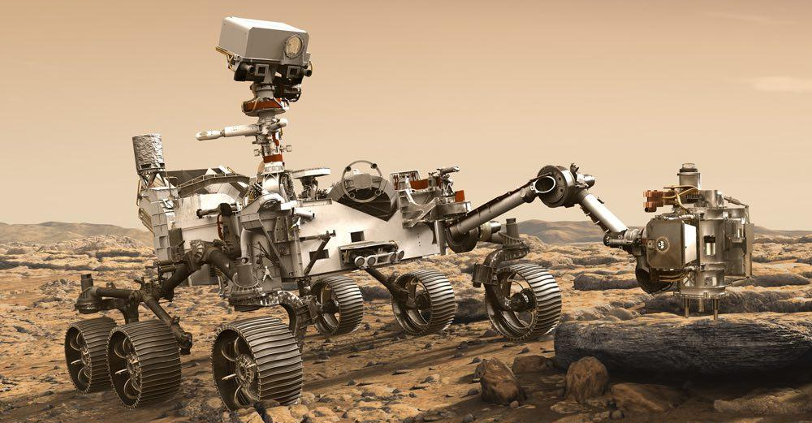
The knowledge we gain at the Moon will empower humanity’s journey to Mars.
Important things to consider for Mars:
  Oxygen, Water, Shelter, Touchdown, Spacesuits, Communications back to Earth, Surface Navigation, etc.
    LunaNet’s extensible architecture will also apply to Mars
NASA launched the Perseverance Rover in July 2020. Its research will help us learn more about the planet and how we can sustain life there.
  The GSFC Comm and Nav Community supported the launch of NASA’s Mars 2020 Perseverance rover.
Notes:
The Comm and Nav Community supported the launch of NASA’s Mars 2020 Perseverance rover. Our community supplied the Atlas V launch vehicle with essential communications and navigation services from our networks and the Flight Dynamics Facility. Once again, our community is a part of a monumental event, as this advanced robotic rover will look for signs of past or present life on the Martian landscape, demonstrate technology needed for future human missions, and collect soil samples for a future return mission to Earth.

Slide 9


In support of Artemis, Goddard’s Comm and Nav Community will partner with other NASA centers, private industry, other government agencies, international entities, and academia.
In this era of commercialization, partners can provide unique expertise and capabilities alongside Goddard’s Comm and Nav workforce to support Artemis.
Goddard’s newly establish Near Space Network and Commercialization, Innovation, and Synergies office are working to further infuse industry capabilities into our services.
These partnerships will create new capabilities and enhance user experiences, making a more robust space communications and navigation marketplace.

Slide 10


Slide 11
Back-up

Slide 12
COMM & NAV TECHNOLOGIES, CAPABILITIES, & CONTRIBUTIONS
Optical Communications
Search and Rescue for terrestrial and Moon
GPS satellites for high altitude GPS
Support to Lunar Lander and Lunar IceCube development
Launch Communications Segment support to SLS
Osiris-REx
Notes:
Highlights:
Recent:
Over FY20, the Comm and Nav community supported 16 launches.
The Goddard-developed Broadband Infrared Compact High Resolution Exploration Spectrometer (BIRCHES) was shipped to Morehead State University for integration into the Lunar IceCube spacecraft. Lunar IceCube will launch aboard the Artemis I mission in 2021, and study ice distribution on the Moon’s surface.
The Orion Artemis II Optical Communications System’s (O2O) first flight subsystem has completed testing and was delivered to our partner, the Massachusetts Institute of Technology - Lincoln Laboratory for additional testing and integration. O2O will fly aboard NASA’s second Artemis mission, enabling increased data capabilities for the astronauts onboard.
The OSIRIS-Rex mission made history, successfully “tagging” the surface of the asteroid Bennu. Position, Navigation, and Timing Policy Lead and Comm and Nav Community member Benjamin Ashman played a pivotal role in this milestone as a member of the OSIRIS-REx navigation team. Through this mission, the techniques learned give the community new knowledge on how to achieve similar techniques on the Moon and Mars.
Last year:
In 2019, the Launch Communications Segment (LCS) was unveiled at Kennedy Space Center’s Uplink Station. Over 115 people, including leadership from Goddard and Kennedy, celebrated the critical role LCS will play in NASA’s journey forward to the Moon, Mars and beyond. Kennedy’s center director renamed the entrance road “Robert H. Goddard Road” in recognition of the partnership between the two centers to develop the station.

