Slide 1
Particle Seeding Method for Small-Scale, High-Pressure Nozzles
Aditya S. Acharya, K. Todd Lowe, Wing F. Ng, Paul M. Danehy*
Virginia Tech, *NASA Langley Research Center
2021 AIAA SciTech Forum, January 11-21 2021
Copyright © 2020 by Virginia Polytechnic Institute and State University and the U.S.A, as represented by the Administrator of the National Aeronautics and Space and Administration. All rights reserved.
Published by the American Institute of Aeronautics and Astronautics, Inc., with permission.

Slide 2
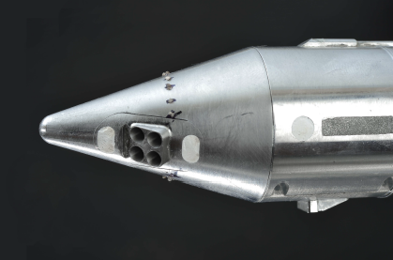
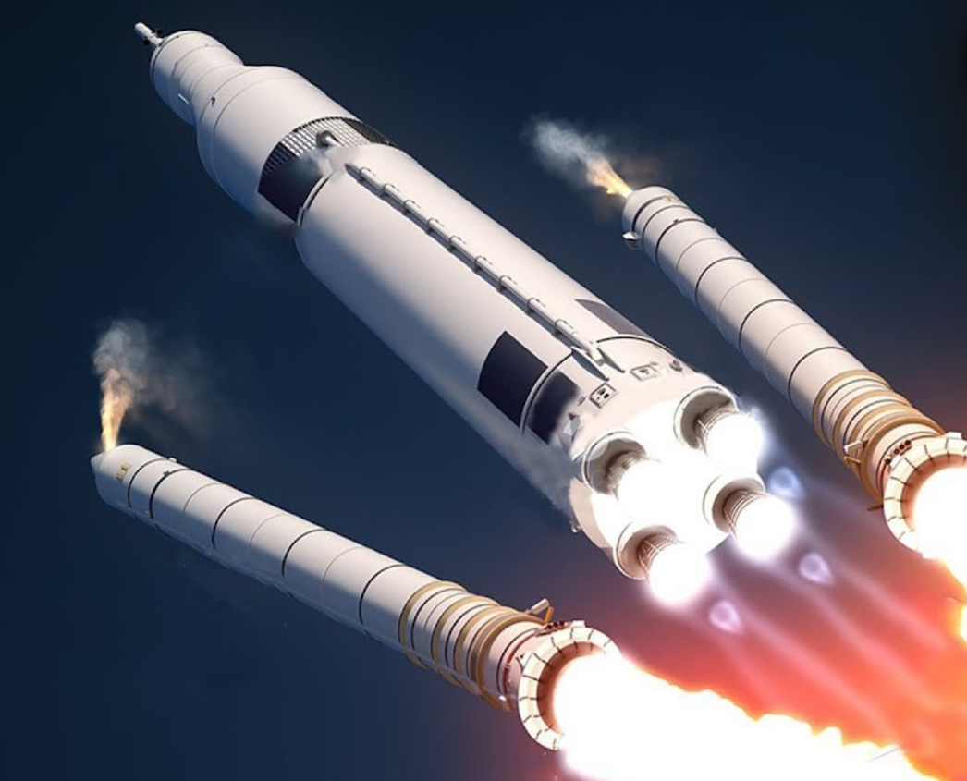
Motivation
Wind tunnel models simulate propulsion or reaction control
Small, high-pressure nozzles built into surfaces¹⁻³
Example: SLS models with booster separation motors (BSM)⁴

Slide 3
Motivation
Models studied with particle-based diagnostics
Seeded air can be displaced by unseeded plumes from BSMs
Scattered light intensity diminishes near plumes^{5,6}
Challenge:
Can we seed such small, high-pressure
nozzles?

Slide 4
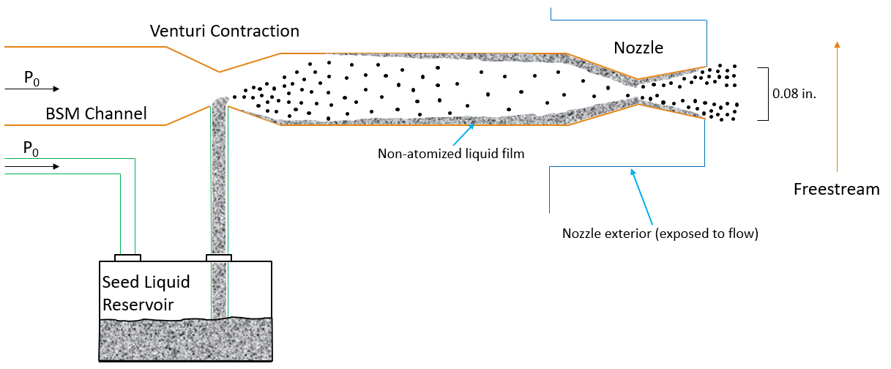
Experiment Design
Inspired by Laskin nozzles (shearing liquid into droplets)⁷

Slide 5
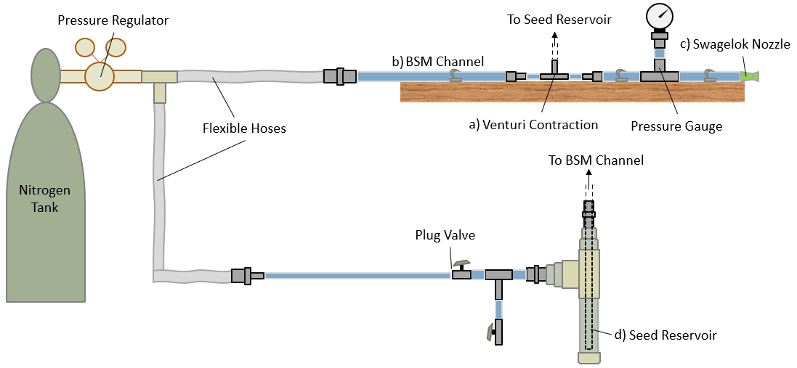
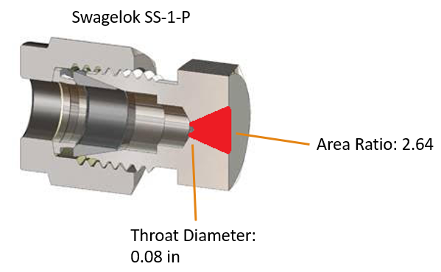
Experiment Design

Slide 6
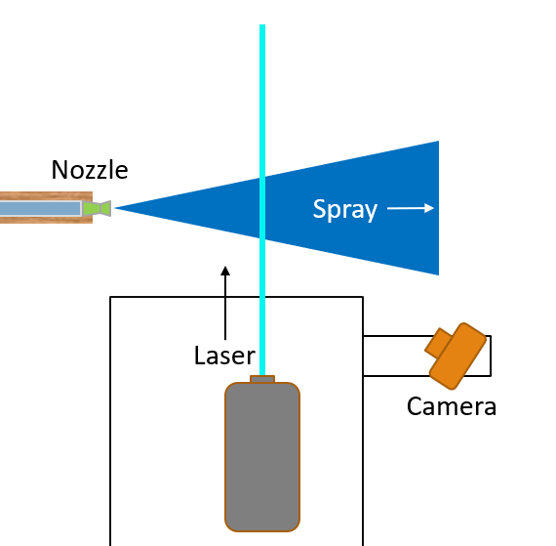
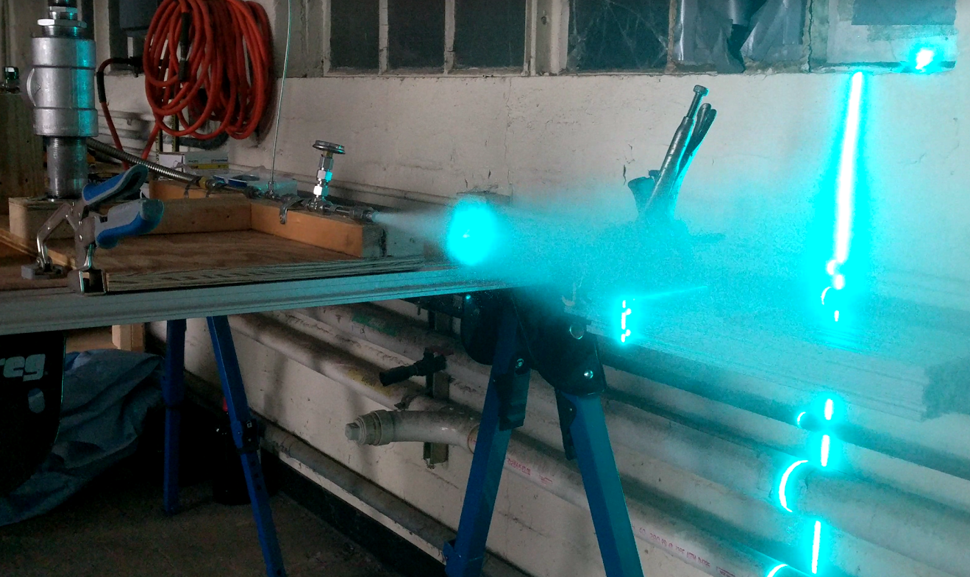
Experiment Design
Performed laser visualization study w/ DEHS – varied valve opening and pressure

Slide 7
Results
Spray achieved from 100 – 1500 psi
Seed flowrate controlled by varying valve position

Slide 8
Results
300 psi, mean images:
Valve State:
Open
90% Closed
90% Closed / Open
Mie Equation⁸ relates intensity (I) to particles per unit volume (c_{n}) and representative particle diameter (D):
$$I ∝ c_{n}D^{2}$$

Slide 9
Results
800 psi, mean images:
Valve State:
Open
90% Closed
90% Closed / Open
Mie Equation⁸ relates intensity (I) to particles per unit volume (c_{n}) and representative particle diameter (D):
$$I ∝ c_{n}D^{2}$$

Slide 10
Summary
Particle-based measurements in wind tunnels difficult near unseeded nozzle plumes
Developed Venturi contraction method to seed these small, high-pressure nozzles
Achieved spray and showed control of flow rate
NASA Langley to use for future plume-flow tests in Langley 4’ UPWT; will attempt more precise flow control

Slide 11
References
¹Berry, S. A., Rhode, M. N., Edquist, K. T., “Supersonic Retropropulsion Experimental Results from NASA Ames 9x7 Foot Supersonic Wind Tunnel”, Journal of Spacecraft and Rockets, Vol. 51, No. 3, 2014, pp. 724-734.
²Buck, G. M., Watkins, A. N., Danehy, P. M., Inman, J. A., Alderfer, D. W., Dyakonov, A. A., “Experimental Measurement of RCS Jet Interaction Effects on a Capsule Entry Vehicle”, 46th AIAA Aerospace Sciences Meeting and Exhibit, Reno, Nevada, 2008.
³Edquist, K. T., Korzun, A. M., Dyakonov, A. A., Studak, J. W., Kipp, D. M., Dupzyk, I. C., “Development of Supersonic Retropropulsion for Future Mars Entry, Descent, and Landing Systems”, Journal of Spacecraft and Rockets, Vol. 51, No. 3, 2014, pp. 650-663.
⁴Winski, C. S., Danehy, P. M., Watkins, A. N., Shea, P., Meeroff, J., Lowe, K. T., and Houlden, H., “Space Launch System Booster Separation Supersonic Powered Testing with Surface and Off-Body Measurements”, AIAA Aviation 2019 Forum, Dallas, Texas, 2019.
⁵Lowe, K. T., Byun, G., Shea, S., Boyda, M., and Winski, C. S., “Three-Velocity-Component Cross-Correlation Doppler Global Velocimetry for the Space Launch System Booster Separation Test in the NASA Langley Unitary Plan Wind Tunnel”, AIAA Aviation 2019 Forum, Dallas, Texas, 2019.
⁶Danehy, P. M., Wisser, B. M., Fahringer, T. W., Winski, C. S., Falman, B. E., Shea, S., Boyda, M., and Lowe, K. T., “Laser Light Sheet Flow Visualization of the Space Launch System Booster Separation Test”, AIAA Aviation 2019 Forum, Dallas, Texas, 2019.
⁷Echols, W.H., Young, J. A., “Studies of Portable Air-Operated Aerosol Generators”, NRL Report 5929, 1963.
⁸Bohren, C. F., and Huffman, D. R. Absorption and Scattering of Light by Small Particles, John Wiley & Sons, 2008.

Slide 13
Laskin Nozzle Seeder Concept
aerosol out
air in
Nozzle Detail
.
.
.
.
.
.
air flow
.
.
.
.
.
.
.
.
.
.
.
.
.
.
.
.
.
.
.
.
.
.
.
.
.
.
.
.
.
.
.
.
.
.
.
.
.
.
.
.
.
.
seed liquid
Redrawn from Melling, A., “Tracer Particles and Seeding for Particle Image Velocimetry”, Measurement Science and Technology, Vol. 8, No. 12, 1997, pp. 1406–1416.

