Slide 1





Deep Convolutional Neural Networks for Automated Dust Detection
Talha Khan^{1,2}, Nicholas Elmer^{2,4}, Muthukumaran Ramasubramanian³, Emily Berndt^{2,4}, Iksha Gurung³, Aaron Kaulfus³, Manil Maskey², Rahul Ramachandran²
¹University of Texas at San Antonio, ¹NASA Marshall Space Flight Center, ²University of Alabama in Huntsville, ³Short-term Prediction Research and Transition Center
Notes:
Hello everyone, My name is Talha Khan, and I’m excited to present to you all a work in collaboration with my colleagues at NASA, the SPORT (say it out), UAH, and the NASA Impact team called Deep Convolutional…

Slide 2
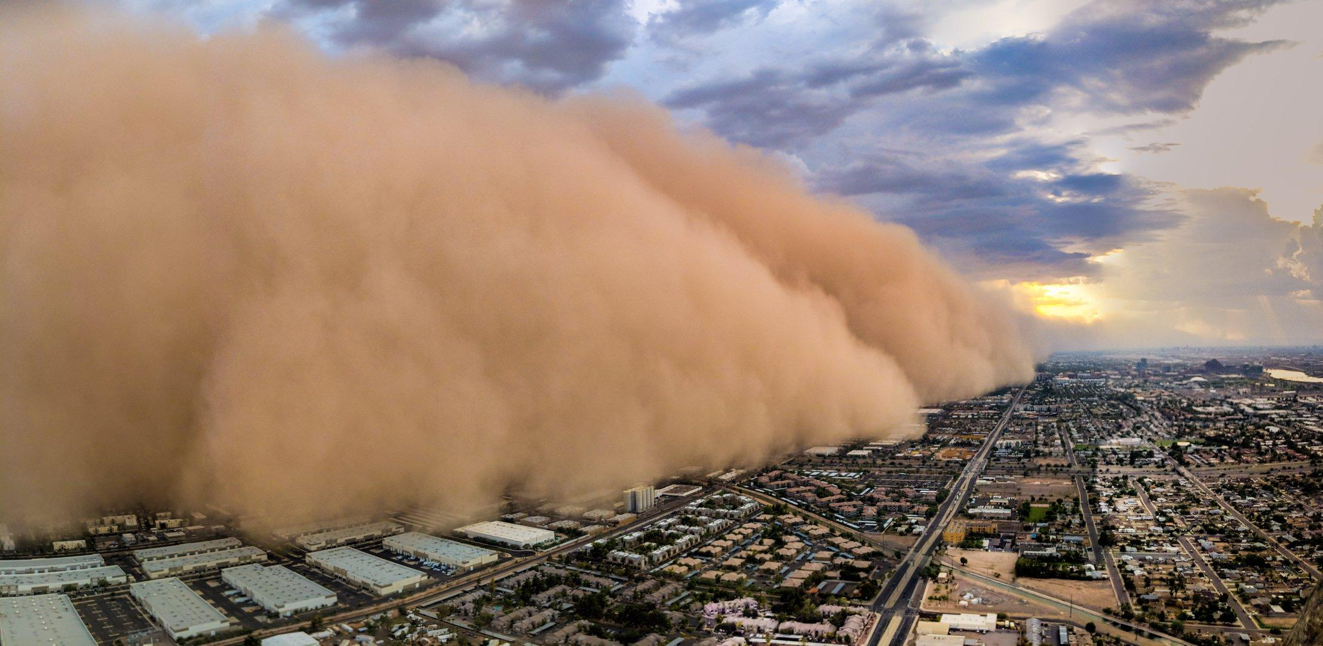
Dust Storms can have many harmful effects on the world
[6]
Notes:
Airborne dust, including dust storms and weaker dust traces, can have deleterious and hazardous effects on human health, agriculture, solar power generation, and aviation.

Slide 3
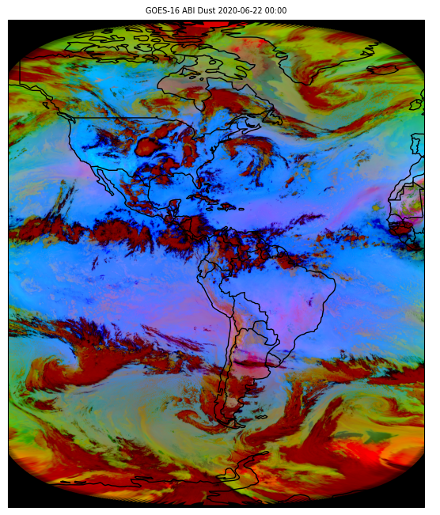
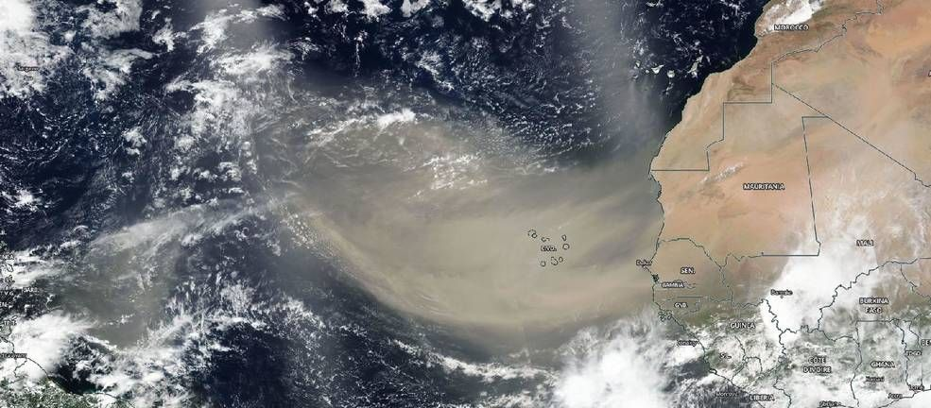
Detecting Dust Storms is both difficult and time consuming
[5]
Notes:
Earth Observing Satellites can be extremely useful for monitoring Dust within True color and infrared imagery, but limitations can come within True color imagery as you can see on the left in cases where clouds cover dust storms, smoke looking like dust, and more.
In order to combat this, Atmospheric Scientists have created False-color red-green-blue (RGB) composite imagery in order to enhance dust detection through combinations of infrared band imagery and band differences. In particular, the EUMETSAT Dust Composite was created using the GOES 16 IR bands 11, 13, and 15.… in order to identify Dust as magenta based on its spectral and radiative properties
Still difficult to detect dust at night even for experts due to radiative properties of the cooling, underlying surface mimicking those of dust.
On top of all this, it can be time consuming for experts to gather the data from the cloud and manually anayze all the images. In a sensitive situation Dust Storms, the faster we can identify them, the more prepared citizens and society can be for their onset, that of which could mitigate economic loss and even save lives.

Slide 4
Method
Deep Learning based semantic image segmentation model (UNET)
Six GOES-16 bands, with a focus on infrared and water vapor bands.
Automatically identifies airborne dust at night
Notes:
In order to combat all these inoptimalities, we created… Deep learning
Deep Learning in itself has the capability to detect subtle characteristics that cant be as easily detected by the human eye. Our previous work identifying dust with random forest models last year at AGU showed promising results but given the complexities of nightime detection, the granularity of Deep Learning can provide enhanced detections.
Before moving forward, we’er going to assume you know on a high level what Supervised Learning and AI are.
This work highlights dataset creation, model creation, and preliminary model validation
Ultimately, DL, can

Slide 5
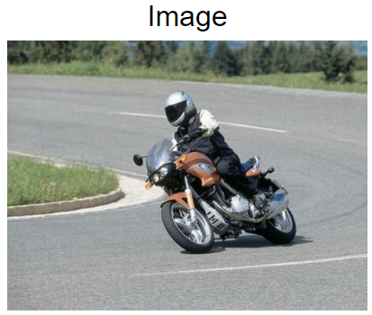
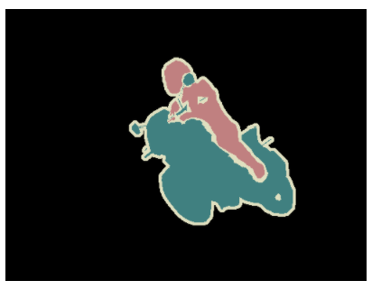
Deep Learning can be leveraged in order to segment out objects within an image (A.K.A. Semantic Segmentation)
Class Segmentations
Predict
[4].
Notes:
Deep Learning can be used to execute. Semantic Segmentation is a pixel based segmentation of objects in an image. Each pixel is carefully labeled with its respective class by a human expert and the AI model learns the pixels associated with each class. Once a DL model is trained on the right classes, you would be able to pass in the image on the left and the output would be the segmentation of the image as you can see on the right.

Slide 6
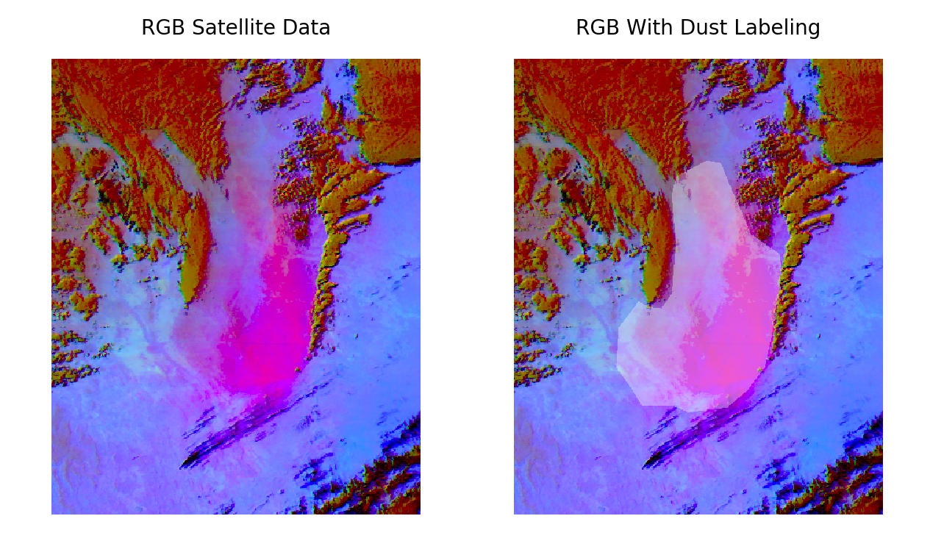
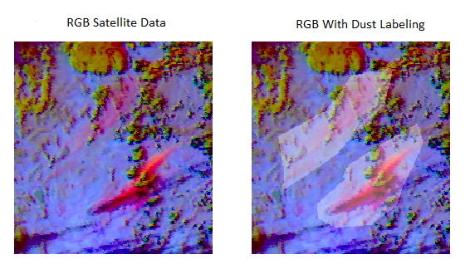
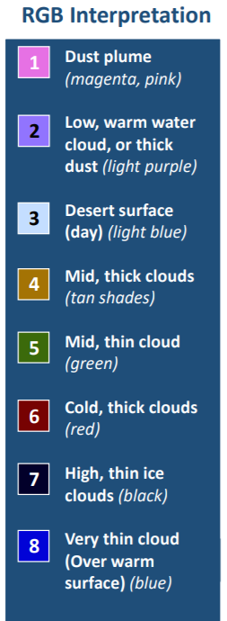
Dust Storm labels are handcrafted by experts and learned by the model
Notes:
So, with any supervised model, you have to … Like we mentioned before, … and in particular, if you look at the image on the far left, here is an example of the EUMETSAT Dust Composite coming straing from GOES. If you look at The image on the right of that, outlined in white are the labels crafted by our atmospheric Scientists specifying where the Dust Storms are within the image.
Images gathered from 2017-2020
Spring and Winter images
Night time Images
317 Total images
Training set: 191 Images
Data Augmentation
Validation set: 63 Images
Test set: 63 Images

Slide 7
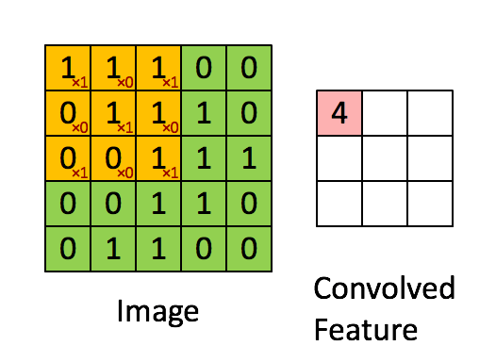
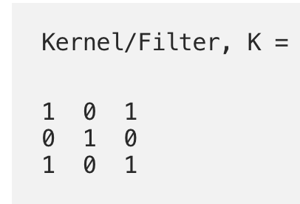
Convolutional Neural Networks can be leveraged to learn the features within an image irrespective of Spatial and temporal dependencies.
[7].
Notes:
A little bit of a background for the less experienced people in Deep Learning, an algorithm within deep learning called COnvolutional Neural Networks has gained a large amount of popularity for numerous tasks. CNN’s basically leverage Convolution in order to learn the low level features like lines and edges within an image. As you can see in the animation… a kernel/filter is created, and slid through the image of interest whether thats a training image or a testing image, creating a convolved feature map of the image. CNN’s leverage this concept, regardless of the number of image channels, and as you stack more and more convolutional layers, feature maps connect low level features to high level features, in our case, dust storms. Because of the notion of these sliding filters, CNN’s learn features irrespective of the spatial or temporal locations within an image, which makes them scalable for any detection task.

Slide 8
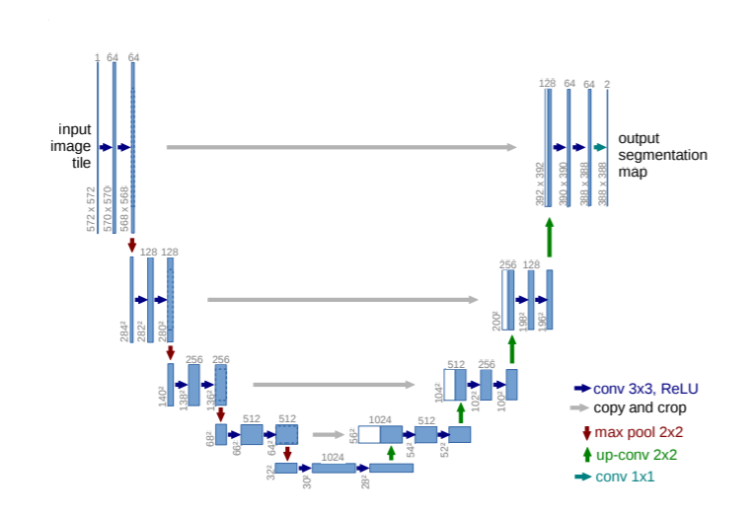
UNET Architecture
Convolutional Encoder-Decoder Network
Learns low level features using Convolution
Maps to high level (i.e. Dust Storms)
Scales image back and creates segmentation
Python, TensorFlow, Keras implementation.
[1].
Notes:
The UNET Architecture does exactly this! The UNET is a collection of several stacked Convolutional layers! In particular, the UNET is a Conv encode-decode net and on the left side of the image is the encoder side. The ecoder portions does what we mentioned before and maps low level features to high level features, but in a segmentation problem, we dont want the model to only output a 0 or 1 saying there is or isnt a dust storm. We want the model to scale the image back to its original size and create the segmentation map for the classes (in our case dust storms). The decoder portion on the right does exactly that! And scales the image back to its original size, producing our newly formed dust detection. All of this is done within P,T,K, and the final thing to note with the UNET is that the information from the encoder side is concatenated during the upscaling in order to retain the original information from the image. These concatenations as represented by the white lines and are one of the key components of the UNET architecture.
I am assuming that folks will be somewhat familiar with Convolutional neural Networks before reaching this slide. From there I will discuss the bullet points and some specifics of the model like the encoder side giving info to the Decoder side.
U-net architecture (example for 32x32 pixels in the lowest resolution). Each blue box corresponds to a multi-channel feature map. The number of channels is denoted on top of the box. The x-y size is provided at the lower left edge of the box. White boxes represent copied feature maps. The arrows denote the different operations.

Slide 9
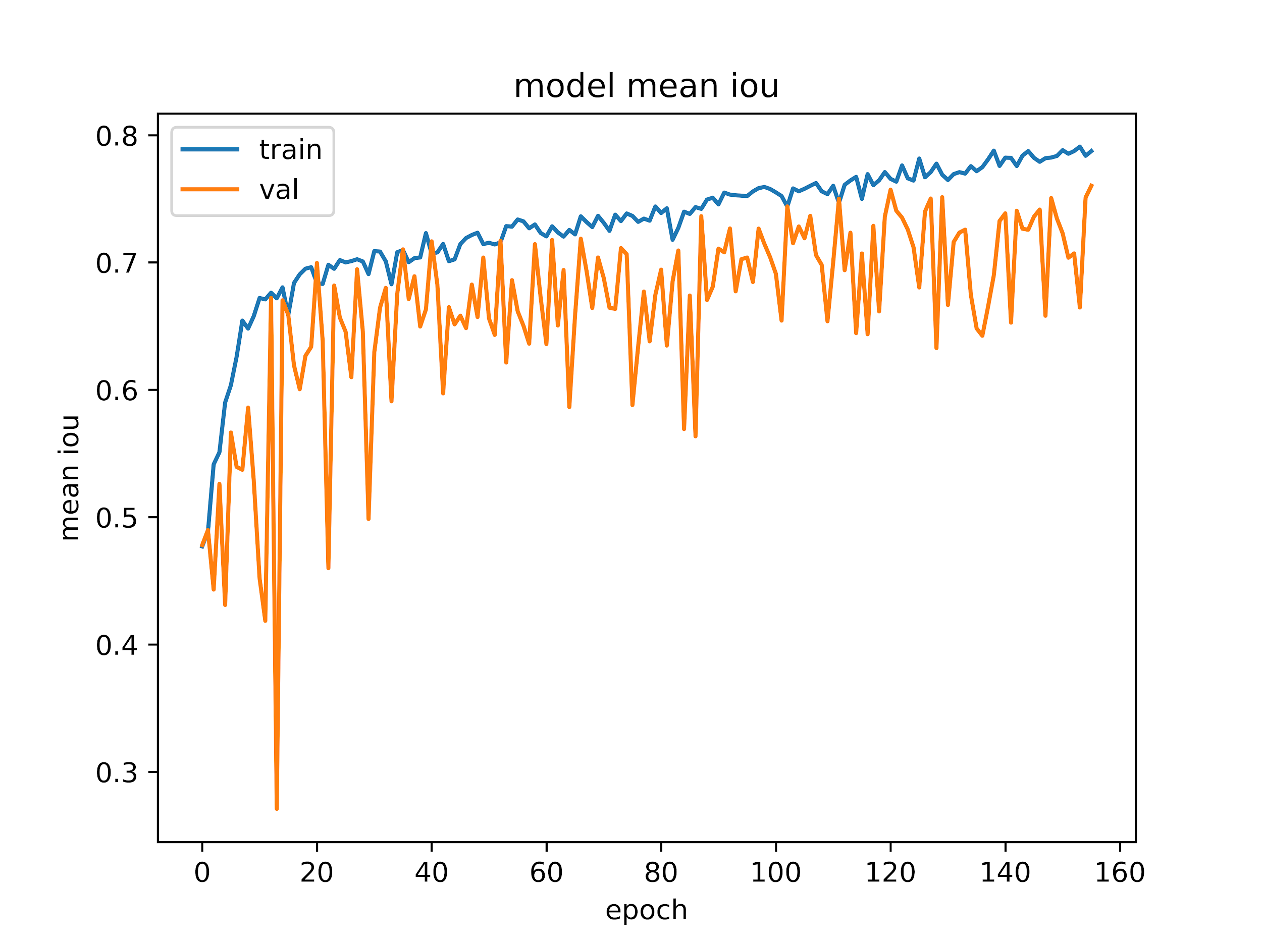
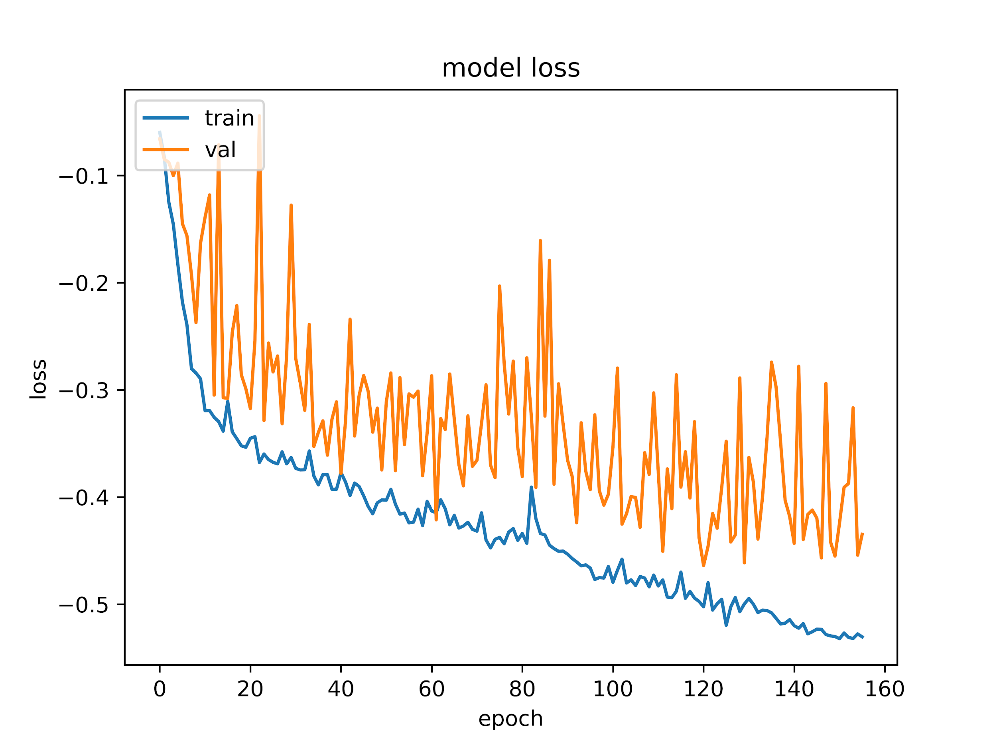
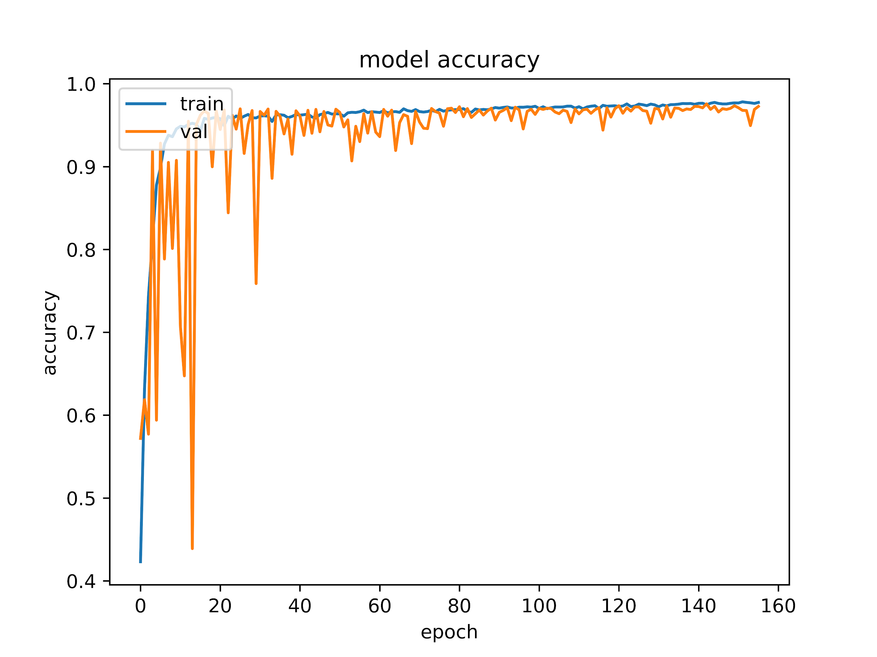
Training Results
Model IOU:
Important for Semantic
Segmentation.
Overlap of predictions to
Labels.
Higher IOU means closer
predictions to labels.
Model Loss:
Most important metric.
Want to minimize loss
So that the model learns.
Model Accuracy:
Number of Correct predictions
Out of total predictions.
Pixel level.
Want to get as close to 1 as
possible.
Notes:
Model IOU:
Important for Semantic
Segmentation.
Overlap of predictions to
Labels.
Higher IOU means closer
predictions to labels.
Model Loss:
Most important metric.
Want to minimize loss
So that the model learns.
Model Accuracy:
Number of Correct predictions
Out of total predictions.
Pixel level.
Want to get as close to 1 as
possible.

Slide 10
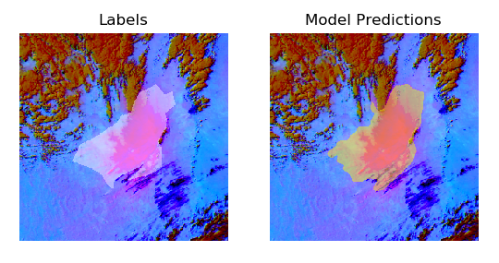
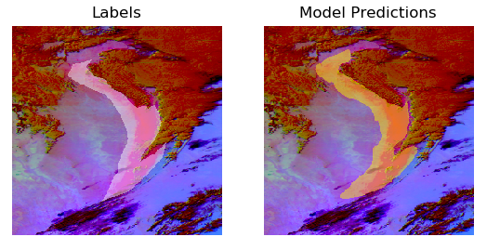
The UNET performed well for most cases
Notes:
Detections from the model compared to the labels from the dataset.

Slide 11
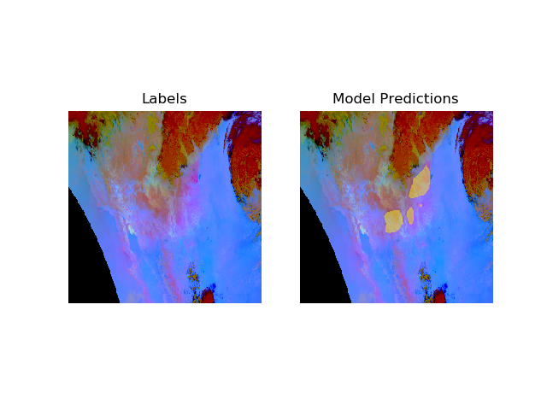
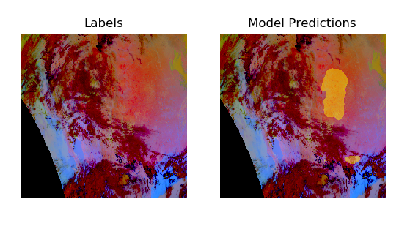
Some cases of poor predictions did arise
Model Predicts poorly in some cases. Left images do not have any dust; the predictions made are on the underlying surface that has similar IR characteristics as dust. Right Image has smoke and a similar underlying surface.

Slide 12
Test Metrics
High accuracy is good.
Precision shows signs of over classification
Mean IOU could improve.
Likely caused by noisy labelling and/or
Difficult cases to identify dust in.
Accuracy | 0.975
Precision | 0.729
F1_score | 0.747
Recall | 0.766
Mean IOU | 0.530
Roc Auc | 0.882
Notes:
Statistically across our test set, our model performed well for the most part.
Can be improved by expanding the dataset to include more edge cases.

Slide 13
Conclusion
With further model development, validation, and testing in a more representative context, Deep Learning based dust storm prediction could alert weather forecasters, emergency managers, and citizens to the location and extent of impending dust storms much quicker than before.
Dataset Creation
Semantic Segmentation
Statistical Validation
Automated Dust Detection
Feel Free to contact reach out below if there are any questions about our work!
Email: Talha0128@gmail.com
Notes:
Future Works
Create Benchmark models to compare to Unet Architecture
Gather Training data for Daytime Dust within Satellite Imagery
Train model on both Night-time and Daytime dataset to create full scale dust detection model

Slide 14
References
1. Ronneberger et al. (2015) “U-Net: Convolutional Networks for Biomedical Image Segmentation”
2. Fuell et al. (2016) “Next Generation Satellite RGB Dust Imagery Leads to Operational Changes at NWS Albuquerque”
3. Terradellas et al. (2015) “Airborne Dust: A Hazard to Human Health, Environment and Society”
4. Everingham et al. “The Visual Object Classes Challenge 2012 Results”:http://www.pascal-network.org/challenges/VOC/voc2012/workshop/index.html
5. Gohd, (2020), “Massive Saharan dust plume swirling across Atlantic Ocean spotted from space”:https://www.space.com/massive-sahara-desert-dust-plume-seen-from-space.html
6. Strange Sounds, (2018), “5,000 feet high WALL OF DUST engulfs Phoenix Area (videos and pictures)”:https://strangesounds.org/2018/08/wall-of-dust-monsoon-activity-kicks-dust-and-rain-into-phoenix-area-videos-and-pictures.html
7. Saha, (2018), “A Comprehensive Guide to Convolutional Neural Networks — the ELI5 way”:https://towardsdatascience.com/a-comprehensive-guide-to-convolutional-neural-networks-the-eli5-way-3bd2b1164a53

