Slide 1
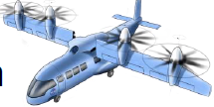

Enhancement of an Electrified Tilt-Wing Propulsion System using Turbine Electrified Energy Management
2021 AIAA SciTech Forum
Jonathan Kratz and Dennis Culley
NASA Glenn Research Center
January 14th, 2021
Notes:
Good morning. My name is Jonathan Kratz. My co-author is Dennis Culley. We are both from the NASA Glenn Research Center. I’ll be presenting a paper we wrote documenting the enhancement of an electrified tilt-wing propulsion system using a controls approach known as Turbine Electrified Energy Management.

Slide 2
Objectives
Investigate the applicability of Turbine Electrified Energy Management (TEEM) on a 15 passenger vertical lift concept vehicle
Differences from prior applications of TEEM
  Smaller turbomachinery
  Turboshaft vs. turbofan
  Power producing turbomachinery
  Single spool gas generator vs. dual spool turbofans
  Expanded propulsion system with propulsors outside of the engine
Questions?
  Is TEEM applicable to the smaller class vehicles?
  Is TEEM applicable to this propulsion system architecture?
Notes:
In the past, we have applied the Turbine Electrified Energy Management, or TEEM, control strategy to relatively large turbofan concepts and have shown significant benefits through simulation studies. Particularly when it comes to improving transient operability. However, we suspect some of the benefits could dwindle as the size of the turbomachinery shrinks. In this study we are applying TEEM to the propulsion system of a turboelectric tilt-wing concept. It has significantly smaller turbomachinery than the previously investigated turbofans and differs in a number of other ways, some of which are listed on this chart. Ultimately we want to determine whether or not TEEM is applicable to this smaller class of vehicle and its propulsion system architecture.

Slide 3
Background – TEEM
At its broadest level, TEEM is about managing energy in an electrified turbine engine propulsion system
  Goal: Improve operability of the turbomachinery → enable better performing engine designs and/or enhance aircraft capabilities
  The Means: electric machines (EMs) coupled to the engine shaft(s)
    EMs are new actuators that can alter engine operation
Transient operability (main focus of this effort)
  Supplement fuel flow to operate closer to steady-state design conditions
Power Turbine
Gas Generator EM
Compressor
Fuel
Power Turbine EM
Turbine
Burner
Gas Generator
Energy Storage Devices (ESDs)
Notes:
You might be wondering what TEEM is. TEEM is a controls approach to managing energy in an electrified propulsion system that includes turbomachinery. Its goal is to improve operability and ultimately enable a better performing, more efficient, and or lighter-weight propulsion system; or to otherwise enhance the capabilities of the aircraft through energy management.
The means of doing this is electric machines coupled to the engine shafts and energy storage that can supply or absorb power as needed. We treat the electric machines as new actuators that can be used to alter the operation of the engine and or the larger propulsion system. In the instance of the tilt-wing we will have an electric machine interfaced with the gas generator and power turbine of a turboshaft engine as shown in the picture here. In addition, we also have access to 4 electric machines interfaced with each of the vehicle’s rotors.
To date, emphasis has been on improving transient operability by using active control to command off-nominal electric machine torques that supplement the effects of the fuel. The goal is to keep the turbomachinery operating closer to its steady-state operating conditions, even as it experiences a change in engine power level. Tighter control of operability limits alleviates constraints on the engine design that could lead to better performing turbomachinery.

Slide 4
Background – The Tilt-Wing Vehicle
Mission Type: commercial transport
Architecture Type: Turbo-electric
Payload: 3000 lb (15 passengers + luggage)
Max Gross Weight: 13866lb
Max range: 400nm
Cruise speed: 200kts
Key Features: performance of fixed wing aircraft with vertical take-off and landing capabilities
Notes:
The Tilt-Wing application considered in this study is shown here. It is based upon a NASA concept with some minor deviations. It is a commercial transport with a turbo-electric propulsion system. It has 4 wing mounted rotors driven by electric motors that ultimately derive their power from the turboshaft engine. Some basic parameters about the concept are provided here. As the name implies it has a tilting wing that can vary its position from 90 degrees in the vertical position to 0 degrees in the horizontal position. This allows the aircraft to take-off vertically and fly relatively fast and efficiently compared to other vertical lift vehicles.

Slide 5
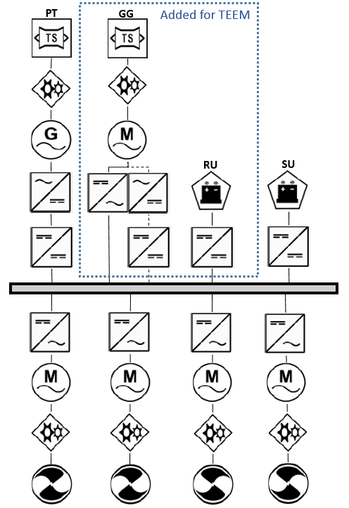
Background – The Tilt-Wing Propulsion System
Baseline System
Turboshaft engine (~4000 hp)
Generator connected to power turbine (PT)
Rectifier
DC-DC converter
4 inverters
4 motors
5 gearboxes (1 for each EM)
4 rotors
1 single-use battery
TEEM additions*
EM connected to the gas generator (GG)
1 gearbox
Re-usable energy storage
Inverter/rectifier pair
*May already be present for the purpose of engine starting
Notes:
The diagram on the right depicts the major components. The baseline concept includes a turboshaft engine with a free power turbine. A generator connects to the power turbine through a gearbox. Electrical power is transmitted from the generator through a rectifier and DC-DC converter before being put on a DC bus. Power is passed through inverters prior to being applied by electric machines that are connected to the rotors through gearboxes. A single-use battery is also present in the event of a turboshaft failure. To apply TEEM there are a few additions that might be required. This includes an electric machine interfaced with the gas generator through a gearbox, a small mount of re-usable energy storage, and power electronics for handling power flow between the electric machine and the DC bus. It should be noted that such components may already be present for the purpose of starting the engine.

Slide 6
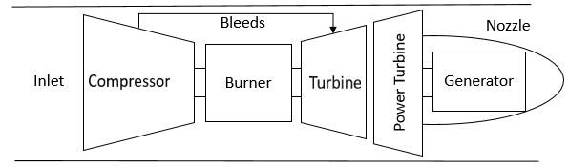
System Modeling
Turboshaft
Rotors
Hub
Blade
dr
Utilizes the Toolbox for Modeling and Analysis of Thermodynamic Systems (T-MATS)
  Combines bulk component level models to create an overall system model
    Inlet
    Compressor
    Burner
    Turbine
    Power Turbine
    Nozzle
    Bleeds
  Compressor and turbine performance is defined by performance maps
  Utilizes an iterative solver to satisfy conservation equations
0.1R
0.2R
…
0.7R
0.8R
0.9R
R
Zero Lift Line
Lift
Drag
Angle of Attack
Total Velocity
Axial
Velocity
Rotational Velocity
Techniques are based on theory used by the NASA Design and Analysis of RotorCraft (NDARC) software
  Power calculations are highly empirical
  Rotor forces are calculated using blade element theory
  Power and thrust calculations are coupled requiring iteration
  A solver is utilized to satisfy thrust and rotor flapping and coning equations
Notes:
The overall system model integrates several subsystem models. The turboshaft engine depicted on the left is modeled with the Toolbox for Modeling and Analysis of Thermodynamic Systems, also known as T-MATS. It combines bulk component level models to create an overall system model.
The rotors were modeled in order to provide realistic predictions of thrust and rotor shaft power when coupled with the rest of the propulsion system. Modeling techniques were based upon the theory used by the NASA Design and Analysis of RotorCraft software, otherwise known as NDARC. The shaft power calculations are highly empirical. Rotor forces are calculated using blade element theory.

Slide 7
System Modeling
Electric System and Gearboxes
Flight Dynamics
Simple model that applies efficiencies for each of the components
  Electric Machines – 97%
  Inverters/Rectifiers/Converters – 98.6%
  Gearboxes – 98%
0.7 kW-hr of re-usable energy storage was included
EM Sizes:
  Power Turbine EM: 3600 hp
  Rotor EMs: 800 hp
  Gas Generator EMs: 200 hp
*Only used to determine rotor shaft power requirements for transition
Simple aerodynamic models for aircraft components (wing, fuselage, horizontal tail, etc.)
Calculates forces and moments
Solves for trim conditions (thrust, velocity, cyclic pitch or horizontal tail angle) at different tilt-wing angles
Notes:
The electrical system and gearboxes are modeled simplistically. Gearboxes and electrical components apply constant efficiencies which are provided on the chart. The generic energy storage device and electric machine sizes are also listed here.
A simple flight dynamic model was also developed with guidance from the theory applied in NDARC. The flight dynamic model is only used to determined shaft power requirements for the rotorcraft as it transitions between hover and forward flight. It’s not part of the overall system model used in the dynamic simulations that will be discussed next. The model consists of simple aerodynamic equations to predict lift and drag for each major aircraft component. Forces and moments are used to determine trim conditions required at different tilt-wing angles in order to maintain steady-level flight.

Slide 8
Baseline Control
Gain schedule Linear Quadratic Regulator (LQR) with integral action for reference tracking
Control objectives
  Maintain power turbine speed of 8000 rpm
  Maintain rotors speed set-point (function of air speed)
  Achieve a desired rotor shaft power
Control Inputs
  Fuel flow rate
  Power turbine EM torque
  Collective pitch
Limit logic is applied to modify the shaft power set-point to prevent violation of operating limits
Notes:
The baseline controller is a gain scheduled linear quadratic regulator with integral action for reference tracking. It has multiple control objectives including maintenance of the power turbine speed and rotor speed as well as the delivery of the desired rotor shaft power as determined by a set-point schedule. The control inputs include the fuel flow rate, power turbine electric machine torque, and the collective pitch of the rotor blades.

Slide 9
TEEM Control
Augments the existing baseline controller
Transient Control Logic
  Designed independently from the baseline controller
  Controller commands off-nominal torques to closely match steady-state shaft speed conditions for the rotors, power turbine, and gas generator
  Proportional integral (PI) controllers
  Activated/de-activated based on the rotor shaft power error
Steady-state energy management
  Applies excess power gathered during transients to the rotors (temporarily decreases fuel consumption)
  Charges the ESDs as needed
Thrust augmentation
  Allows for additional energy from ESDs to be sent to the rotors – increase maximum thrust by ~7% at sea level static conditions
Notes:
The TEEM controller augments the existing baseline control and is designed independently from it. It consists of a transient controller that commands off-nominal torques for the electric machines with the objective to more closely match steady-state shaft speed conditions for their respective components. During steady-state there is the issue of recharging energy storage devices and dealing with excess energy gathered during transients. When the state of charge is above its desired value, the excess energy is applied to the rotors, allowing for a temporary decrease in fuel consumption. If the state of charge is below its desired value, a small amount of additional power is extracted from the power turbine until the desired state of charge is reached. A feature has also been added to take advantage of the presence of energy storage to temporarily increase the maximum thrust.

Slide 10
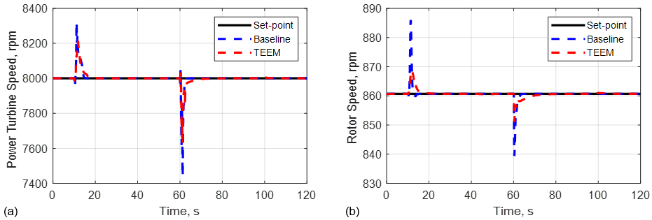
Simulation Results
Burst and chop transient at sea level static hover conditions
More tightly regulated rotor and power turbine speeds
Notes:
The results shown in this presentation are for power transients at sea level static conditions. The pilot command is expressed as a power level ranging from 0 to 100 where 100 corresponds to maximum power and 0 corresponds to idle. For the power command shown here, the power turbine and rotor speed responses are shown both with and without TEEM. The major takeaway here is that TEEM results in tighter speed regulation. This is beneficial because it helps prevent over-speeding, it alleviates pilot workload, and it keeps the turbine and rotor blades operating closer to their design incidence angles.

Slide 11
Simulation Results
Superior transient operability
  Improved minimum stall margin during acceleration
  Tighter control of operating point on the map
Notes:
Shown here is the compressor stall margin and the movement of the operating point on the compressor map. A significantly improved minimum stall margin is evident during the acceleration transient (as is shown here). On the map, the baseline operating point moves toward the stall line, while that excursion is suppressed with application of TEEM.

Slide 12
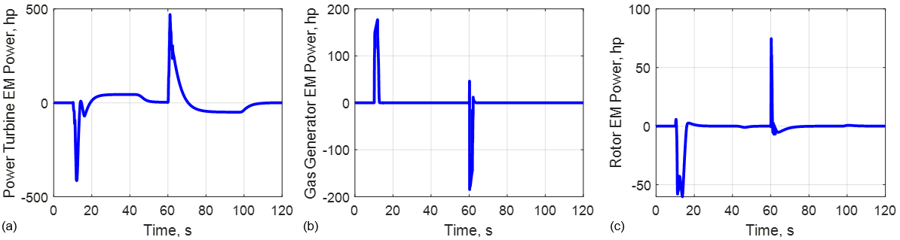
Simulation Results
Off-Nominal EM Power Inputs
Baseline Power turbine EM and rotor EMs should be sufficient to implement TEEM control
Need a gas generator EM with a peak power capability of ~175 hp
Off-nominal power inputs tend to offset each other → reduces energy storage needs
A 0.7 kW-hr energy storage device was sufficient
Brief periods of dissipating excess energy and charging
  Resulted in a net decrease in bulk fuel consumption (0.3%)
Notes:
The off-nominal power inputs of the electric machines are shown here. Major takeaways are: (1) the electric machine and energy storage sizes are capable of handling TEEM; (2) application of TEEM to the expanded propulsion system leads to power inputs that tend to offset each other. As shown some electric machines demand power while other extract power. This reduced the amount of energy storage required; The third observation was that post-transient energy dissipation and re-charging led to a net fuel burn benefit for this simulation scenario. Such fuel savings could add up over the course of numerous missions across an entire fleet of these vehicles.

Slide 13
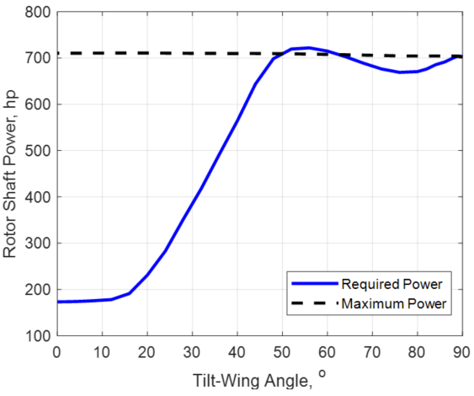
Simulation Results
Increased maximum thrust by ~7% while retaining operability benefits
Could be used to …
  Increase thrust during an emergency
  Increase take-off/landing weight and or altitude
  Address certain mission segments
Thrust Enhancement
Required Rotor Shaft Power
Notes:
Finally, shown here is thrust augmentation feature. The maximum thrust was increased by 7% while also retaining operability benefits for the turbomachinery that was demonstrated prior. This feature could be used to increase thrust in the case of an emergency. Or the maximum hover weight and or altitude could be increased. It could also be used to address specific mission segments. For instance, the flight dynamic model mentioned prior was used to determine the maximum rotor shaft power requirement during the transition between hover and forward flight. This analysis suggested that there was a segment of the transition in which the maximum power limit was exceeded (as can be seen in the figure to the right). Rather than increase the size of the turboshaft engine and the power turbine electric machine, electric thrust augmentation could be a solution, utilizing re-usable energy storage that is shared with the TEEM system.

Slide 14
Conclusions
Questions?
  Is TEEM applicable to the smaller class vehicles?
    Yes
  Is TEEM applicable to this propulsion system architecture?
    Yes
Notes:
The conclusion from these studies is that TEEM is applicable to this smaller class of vehicle and its propulsion system architecture. Not only that, TEEM appears to have increasing potential as the propulsion gets more distributed and electrified, with the caveat that turbomachinery is still at the core of the propulsion system.

Slide 15
Acknowledgements
Funded by the Transformational Tools and Technology (TTT) project under the Aerospace Research Mission Directorate (ARMD)
Special thanks to: Jeff Chapman, Mike Tong, and Chris Snyder from the NASA Glenn Research Center (GRC). Chris Silva and Wayne Johnson from the NASA Ames Research Center (ARC).
Questions/Discussion
Contact Information
Jonathan Kratz – jonathan.kratz@nasa.gov
Dennis Culley – dennis.e.culley@nasa.gov
Notes:
I want to acknowledge the projects and people who have contributed to this work whom are listed on this chart. With that, I thank you for your attention.

