Slide 1
Microwave Sintering Lunar Landing Pads & Horizontal Infrastructure
Moon Village Architecture Working Group Workshop
December 14, 2020
Michael Effinger*
Moon to Mars Planetary Autonomous Construction Technology’s (MMPACT)
Microwave Structure Construction Capability Element Lead
Special Thanks to these Contributors:
Lee Allen*, Curtis Bahr^{Ŧ}, Martin Barmatz**, Ralph Bruce***, Corky Clinton*, Jennifer Edmunson*, William Kaukler^{Ŧ}, Thomas Meek^{ȝ}, Savannah Metz*, Robert Mueller^{Ƚ}, Doug Rickman^{Ŧ}, Zack Roberts^{ʯ}, Holly Shulman^{ɸ}, Laurent Sibille^{Ƚ}
*Marshall Space Flight Center, **Jet Propulsion Laboratory, ***RW Bruce Associates, LLC, ^{Ŧ}Jacobs, ^{ȝ}The Crown College, ^{Ƚ}Kennedy Space Center, ^{ʯ}Radiance Technologies, ^{ɸ}Dr Holly Shulman Sole Proprietorship

Slide 2
Agenda
Overview
Technical Challenges
Current status
Forward Work
Summary

Slide 3
Microwave Structure Construction Capability (MSCC) Overview
Goals
Mature the technology and capability to emplace in-situ-based construction materials on the Moon to form infrastructure elements (horizontal infrastructure, e.g., landing pads, roads, etc.)
Develop and demonstrate microwave sintering of lunar simulants that can be used to form infrastructure on the Moon for a mid-sized payload (e.g., 2mT microwave paver vehicle)
Objectives
Develop microwave sintering protocols/processes and horn/applicator designs
Demonstrate microwave sintering construction of subscale structures

Slide 4
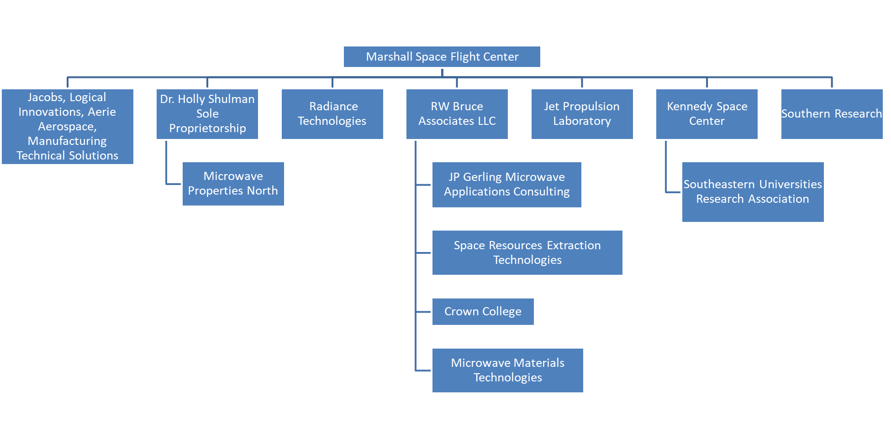
MSCC Team Partners

Slide 5
Technical Challenges
ConOps
Initial system concept of operations (ConOps) definition that have high specific area sintered/power in reasonable time with functional simplicity and robustness
Simulant & Synthetic Minerals
The number of variables in the lunar regolith that might affect microwave absorption characteristics & resulting ceramic properties is very large (e.g., distributions of particle size, shape, composition, etc.)
Simulants needed to perform the necessary tests are too limited in specifications and availability
Parameter space can not be explored directly and definitively via large scale experiments
Lack of lunar highland type and other simulants

Slide 6
Technical Challenges
Site Prep
Terrain surveying in high light contrast conditions
Lunar regolith typically compacts less than terrestrial simulants, with larger void ratios
Degree of uniformity of prepared regolith layers to meet microwave sintering requirements
Dust generation during site preparation may lead to navigation, positioning errors and consequently construction errors
Design
System that can survive lunar night
Accurate temperature dependence of lunar simulant permittivity and other physical parameters (thermal conductivity and specific heat)
Thermal management system for paver vehicle
Power available with respect to construction time
Design of a applicator that can work continuously in a lunar environment while exposed to an 1100C radiant surface and volatiles

Slide 7
Technical Challenges
Microwave Sintering
Regolith is a super insulator that prevents conduction of heat from the surface
Develop accurate method for determining temperature when sintering takes place for ground testing
Gain understanding of the heating profile and depth of penetration of the microwaves into the regolith
Development of procedures for applicator such that it can withstand the heat and volatile generation without significant degradation
Determine (and develop optimized energy efficient process) mass sintered simulant densified per hour with magnetron from -200C to sintering temperature, accounting for porosity, and mitigating thermal runaway

Slide 8
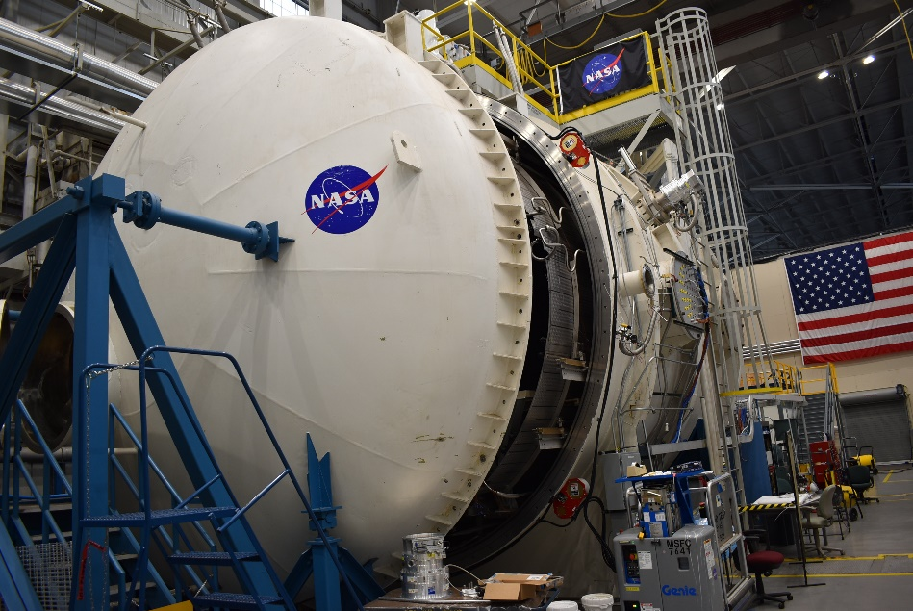
Technical Challenges
Testing
Obtaining vacuum capability for certain testing (e.g., thermal & mechanical properties)
Ancillary Instruments
Ceramic product verification with non-uniform porosity, thickness, and graded density
High temperature measurement of off-gas products from a sintering operation
(20 ft. diameter x 28 ft. long), Existing vacuum chamber system
Credit: NASA
2006 1kW microwave heater before vacuum chamber testing
Credit: NASA

Slide 9
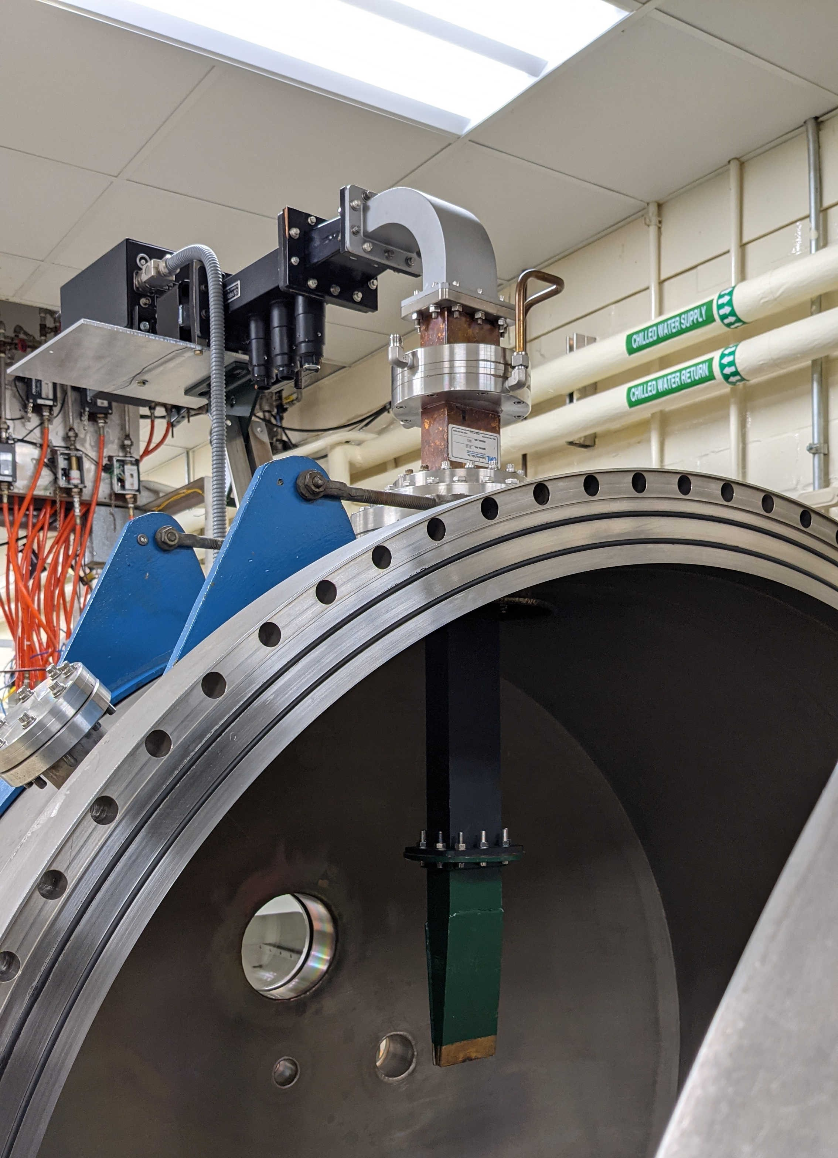
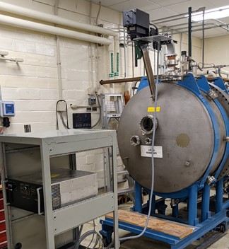
Current Status
Three contracts awarded
Building up and activating microwave sintering testing facilities at Alfred University, JPL, Radiance Technologies & MSFC
Initiated simulant heating modeling using HFSS and COMSOL (JPL, Space Resources Extraction Technologies, & MSFC)
Initiated microwave sintering vehicle conceptual design
4’ diameter TVAC chamber with microwave system
Credit NASA

Slide 10
Forward Work
Known Gaps
Generating process monitoring instrumentation
Forward leveraging planned
Flight site preparation vehicle (rock removal, leveling, etc.)
Tailor mass spectrometer and other existing flight volatile identification systems to MSCC needs
Tailor microwave radiometer and/or thermography for temperature measurements
Tailor terrain mapping and applicator positioning instruments
Solar power amplification and transmission to solar cells
Flight microwave sintering vehicle PDR, CDR, fabrication, assembly, testing, software, automation, con-ops, mobility system, guidance navigation and control, and delivery
Not required to complete paving job, but useful for increased lunar human sustainability
Integration of any volatile collecting systems from OTHER projects (likely on 2nd generation paver)
Apply principles to the beneficiation/extraction of minerals and other lunar resources
Apply principles to vertical structure fabrication

Slide 11
Summary
MSCC is a broad & deep industry, academia, and multi-NASA Center team with extensive microwave and site preparation experience that will enable TRL 6 achievement for process and hardware that will ultimately yield a microwave sintered landing pad on the Moon
MSCC has multiple design and testing paths to achieve optimal solution (i.e., competition within)
MSCC has two design and test cycles for multiple technologies (i.e., design, test, incorporate lessons learned in redesign)
MSCC is developing some ancillary technology necessary to enable landing pad fabrication (i.e., site preparation, volatile characterization on ground, & ceramic landing pad in-situ verification)

