Slide 1




Digital Flight Rules
Enabling the Era of Aerial Mobility in the National Airspace System
David Wing
Blue Sky Workshop
Langley Research Center
Dec 9, 2020

Slide 2
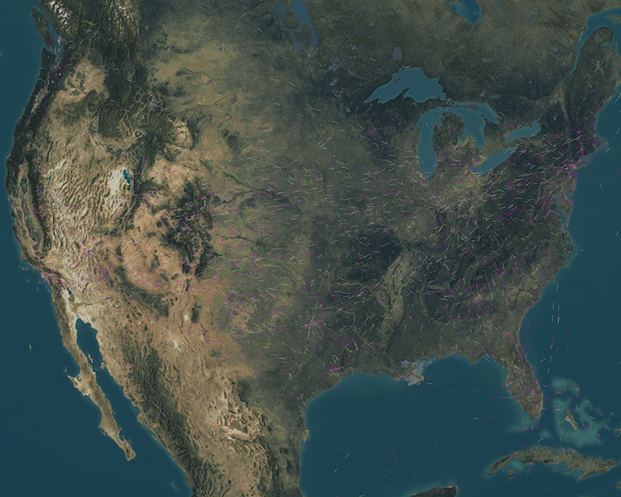
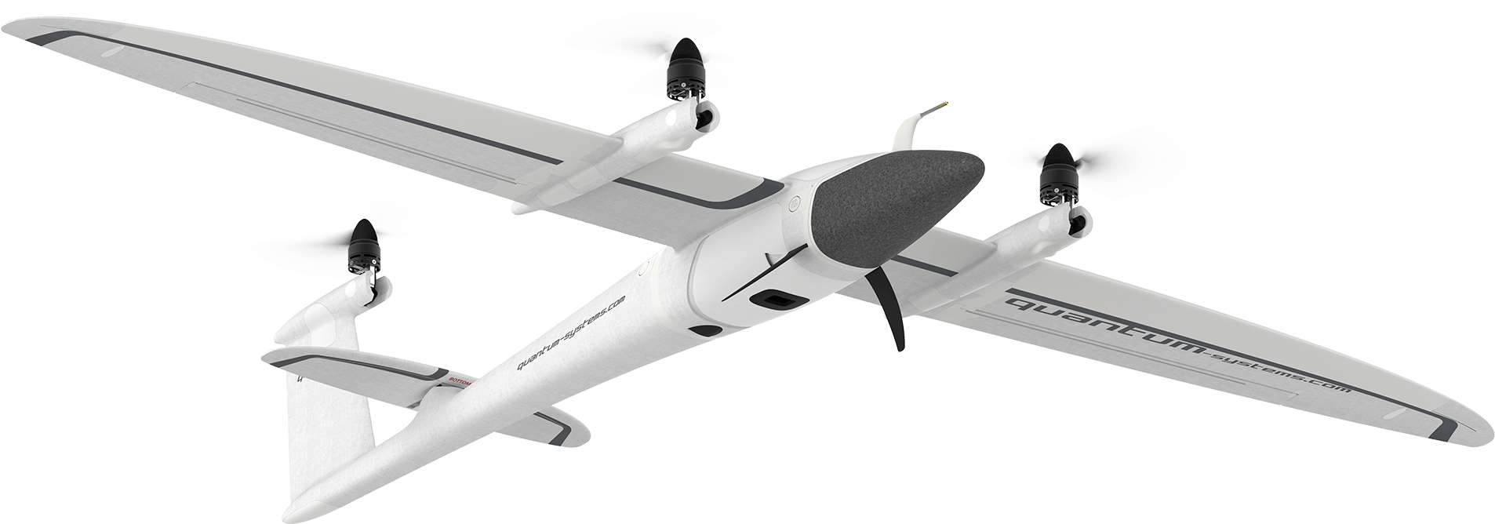
The Future of Aviation is Mobility
Authority to Act
Available to All
Easy to Fly
Operator in Charge
Freedom of Routing
Ubiquitous Access
Spontaneous Flight
Good Neighbor Aviator
Expedited Departure
All Weather Access
Preferred Routing
Consistent Procedures
Continually Optimizing
Uninhibited Flexibility
Connected and Informed
Proactively Managing the Flight
Self-Scaling Operations
Free from Airspace Structure
Anyone Anywhere Anytime
Empowered by Automation

Slide 3
Digital Flight Rules (DFR)
DFR
Greater than IFR Access
Greater than VFR Flexibility
VFR
Limited
Access
Significant Flexibility
IFR
Greater Access
Limited Flexibility
Mobility is the ability to move freely and easily
  Requires both access and flexibility
  VFR and IFR necessarily trade these two off
Digital Flight Rules will increase both access and flexibility
  Unifying rules available to all users
  Designed to meet the mobility needs of all emerging operations
  Putting the user fully in charge
Enabled by an increasingly complex and evolving digital layer
  Information-rich, digital communications, advanced computations
  Leverages evolving technology
A new, third set of
flight rules for the NAS

Slide 4
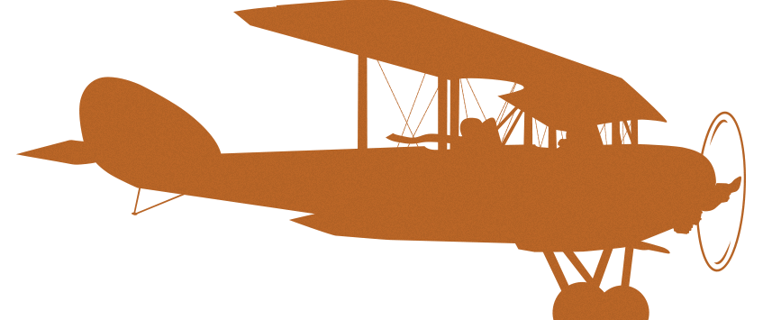

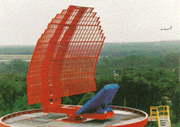
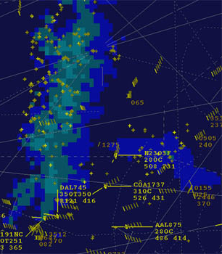
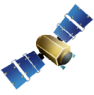

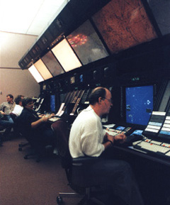
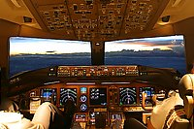
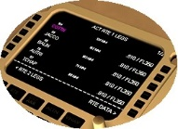
20th Century Evolution
Visual Separation
in VMC
A ∙ –
N – ∙
“Airways” Formed
N – ∙
A ∙ –
Into IMC w/
Radio Navigation
Increased Collision Risk
ATC Procedural Separation
ATC Radar
Separation
Radar Surveillance
Relayed Communications
10 minutes or
different altitudes
Direct Communications
ARINC
ATC
Precision
Navigation
Trajectory Based Operations
Advanced Avionics and ATM Automation
Mobility still limited by see-and-avoid (VFR) or ATC capacity (IFR)

Slide 5
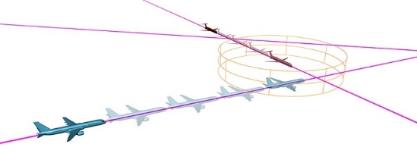
21st Century Digital Advancements
Communications – digital via Data Comm
Navigation – global access and precision
Surveillance – vehicle derived and broadcast
Information – detailed 4D weather and NAS status
Connectivity – broadband and the “connected aircraft”
Computing – onboard, cloud, and ground platforms
Prediction – advanced trajectory-based algorithms (conflict management, optimization, …)
Continuing and accelerating advancements (AI/ML, prognostics, …)
Opportunity for unprecedented mobility

Slide 6



A Logical Enhancement
Visual Flight Rules
  Couples the environment directly to human cognition through pilot’s visual interpretation
  Flight path responsibility → Pilot-in-Command (PIC)
Instrument Flight Rules
  Leverages instrumentation in the air and on the ground to measure the operating environment for use by human cognition
  Flight path responsibility → PIC and ATC (divided)
Digital Flight Rules
  Introduces a digital layer between the environment and human cognition to assist and/or relieve the human operator
  Flight path responsibility → Operator

Slide 7
A Convergence of Operating Concepts
UAS Traffic Management
  “Operator responsible for separation”
  Gain access to shared airspace
  above 400 ft
Urban Air Mobility
  “Operator responsible for separation”
  Outgrow segregated operations
  in UAM corridors
Digital Flight Rules
  Unified mechanism for all operators to achieve
  maximum aerial mobility
Personal Air Vehicles
  “Flying anyone, anywhere, anytime”
  Simplified operations enabled by responsible technology
Upper Class E Operations
  “Cooperative community-based separation”
  Enable optimal operational flexibility
  with few restrictions
General Aviation
  “Simplified Vehicle Operations”
  Reduced pilot skills & training
  so more people become pilots
Airline / Business Aviation
  “Reduced operating costs”
  Increased flexibility to optimize
  under dynamic conditions
Large UAS and
Autonomous Cargo
  “M:N operations”
  Lost link contingency management

Slide 8
Principles for Defining New Flight Rules
Preserve what
already works
Create mobility opportunity for all users
  Keep VFR and IFR unchanged
  Uniquely define new rules in parallel
Consolidate trajectory authority & responsibility
  Establish performance-based standards
  Remove flight visibility as a barrier
  Integrate digital layer as an
  essential element
Enable operations in
shared airspace
Promote scalability
and resilience
  Seek minimal to no segregation
  Promote early, gradual introduction
  Leverage distribution, automation, and connectivity

Slide 9
DFR Implementation
2020
2025
2030
2035
2040
2045
2050
Community
consensus on
Flight Rules
System &
performance requirements
Published
regulations
and standards
Industry
builds to
the standards
Certify and
approve first
operation
Reach first
steady state
maturity
2020
2025
2021
2022
2023
2024
Timeline could be significantly accelerated by large disruptive events such as community push for UAM
Getting Started
Generate a starting proposal for Digital Flight Rules
Demonstrate key elements via simulation and flight (NASA Centers, FAA research facilities)
Guide community working groups to refine DFR
Develop viable paths to DFR that provide early benefits under VFR & IFR

Slide 10
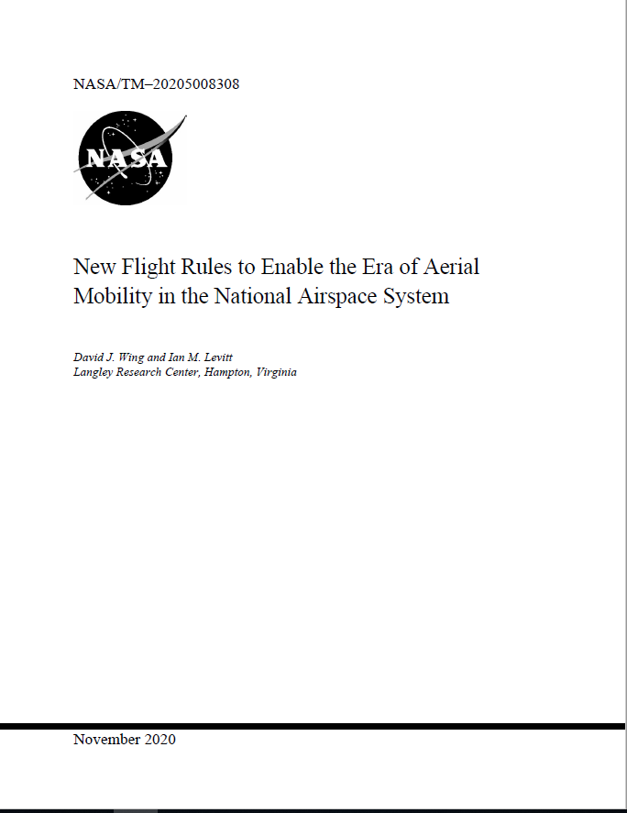
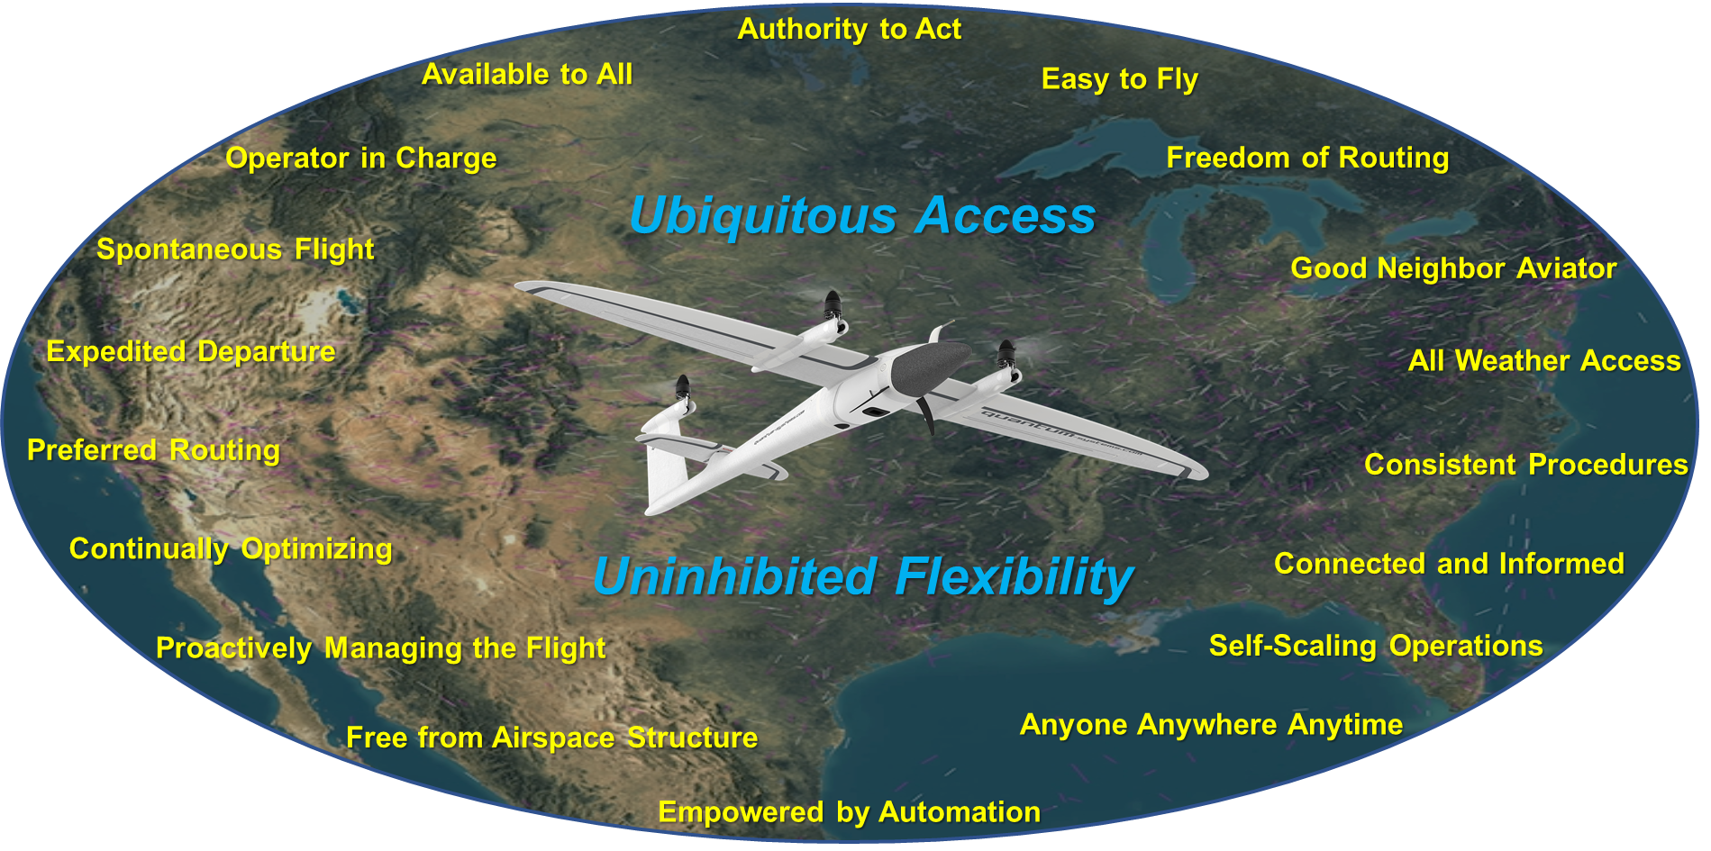
The Future of Aviation is Mobility
Available on NTRS
Search “Digital Flight Rules” or “DFR”

