Slide 1
Lunar Delivery Challenge Webinar https://www.herox.com/LunarDelivery
Tracy Gill/KSC - NASA
Paul Kessler/LaRC – NASA
Dec 10, 2020

Slide 2
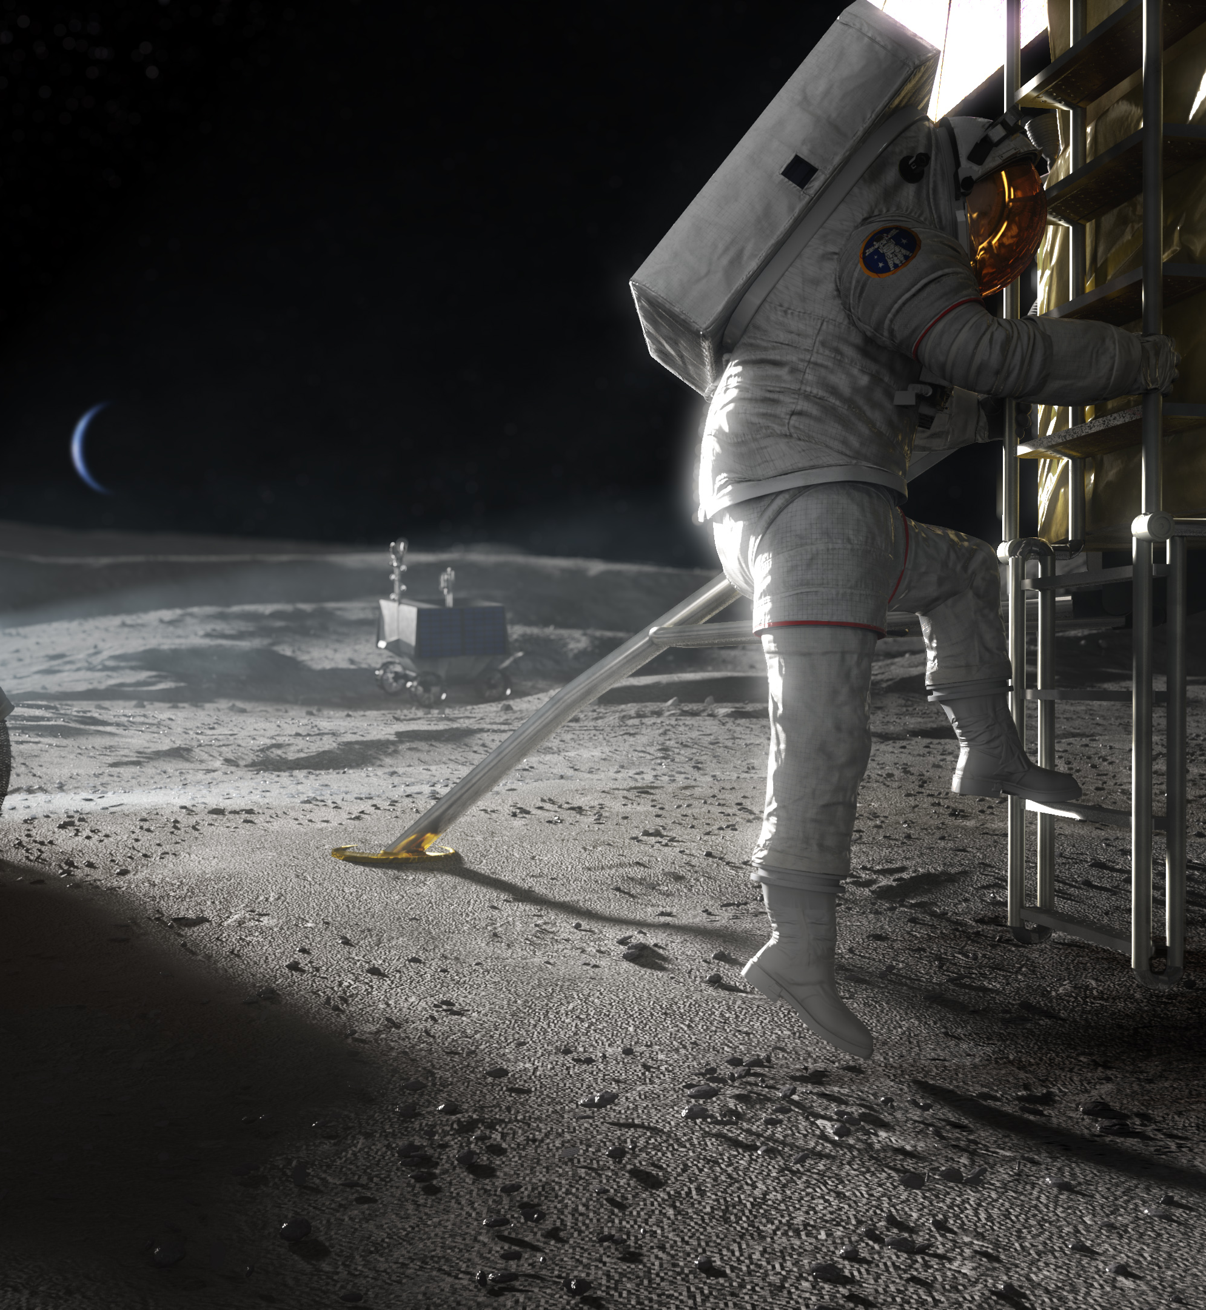
NASA’s Artemis Program
2024: Land first woman and next man on the moon
Prior to 2030: Create a sustainable base camp
Basecamp serves as a hub for scientific research and a base for Mars exploration

Slide 3
Artemis Delivery Needs
Cargo needs to be offloaded from a lander
Robust and reliable cargo-handling in lunar environment
Compatible with a broad array of lunar lander configurations

Slide 4
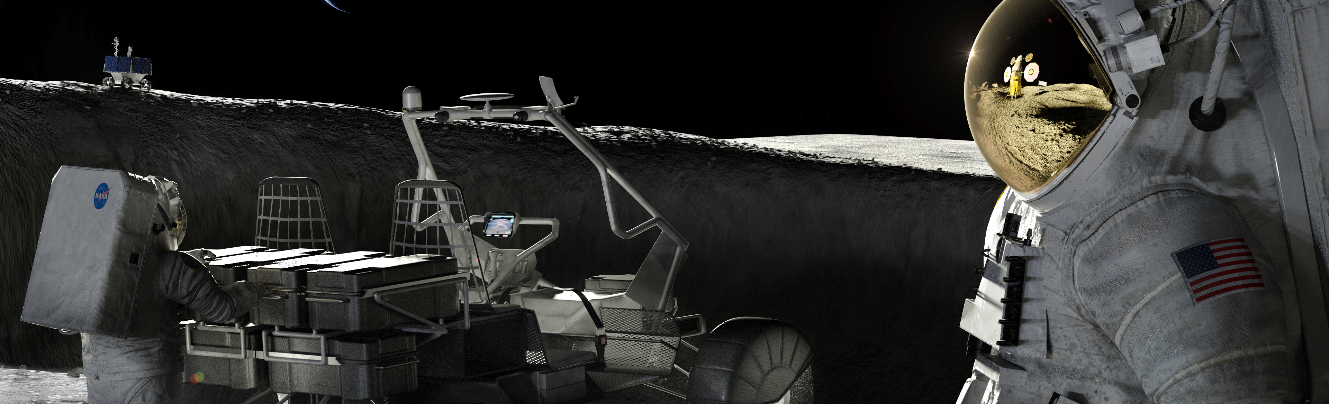
Context
NASA has developed some concepts and prototypes
These methods are effective at some operations
Concepts may not optimize cost, mass, and simplicity

Slide 5
The Ask
NASA is seeking ideas from the public to inform the direction of future development
Who can participate
Anyone age 18 or over from any background

Slide 6
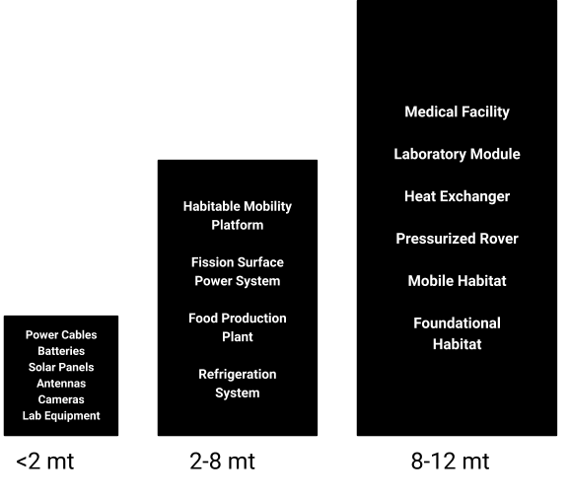
Payloads to be Offloaded
Example payloads
Lunar terrain vehicle or LTV, transports crew
Habitable mobility platform crew trips lasting up to 45 days
Lunar foundation surface habitat houses four crew members
NASA Outlines Lunar Surface Sustainability Concepts
Consider interfaces and standards for compatibility to variety of payloads and landers
Notes:
These are just examples of expected payloads
It’s a wide variety of shapes and sizes so we are interested in commonality for how it is packed or handled.
Also interested in the associated interfaces and standards to enable common approaches

Slide 7
Foundation Surface
Habitat
Habitable Mobility Platform
Lunar Terrain Vehicle
Notes:
HMP also known as pressurized rover
LTV is unpressurized rover
FSH could be mounted on lander (as pictured on top of notional descent stage) but likely to be offloaded to allow it to easily interface with other elements.

Slide 8
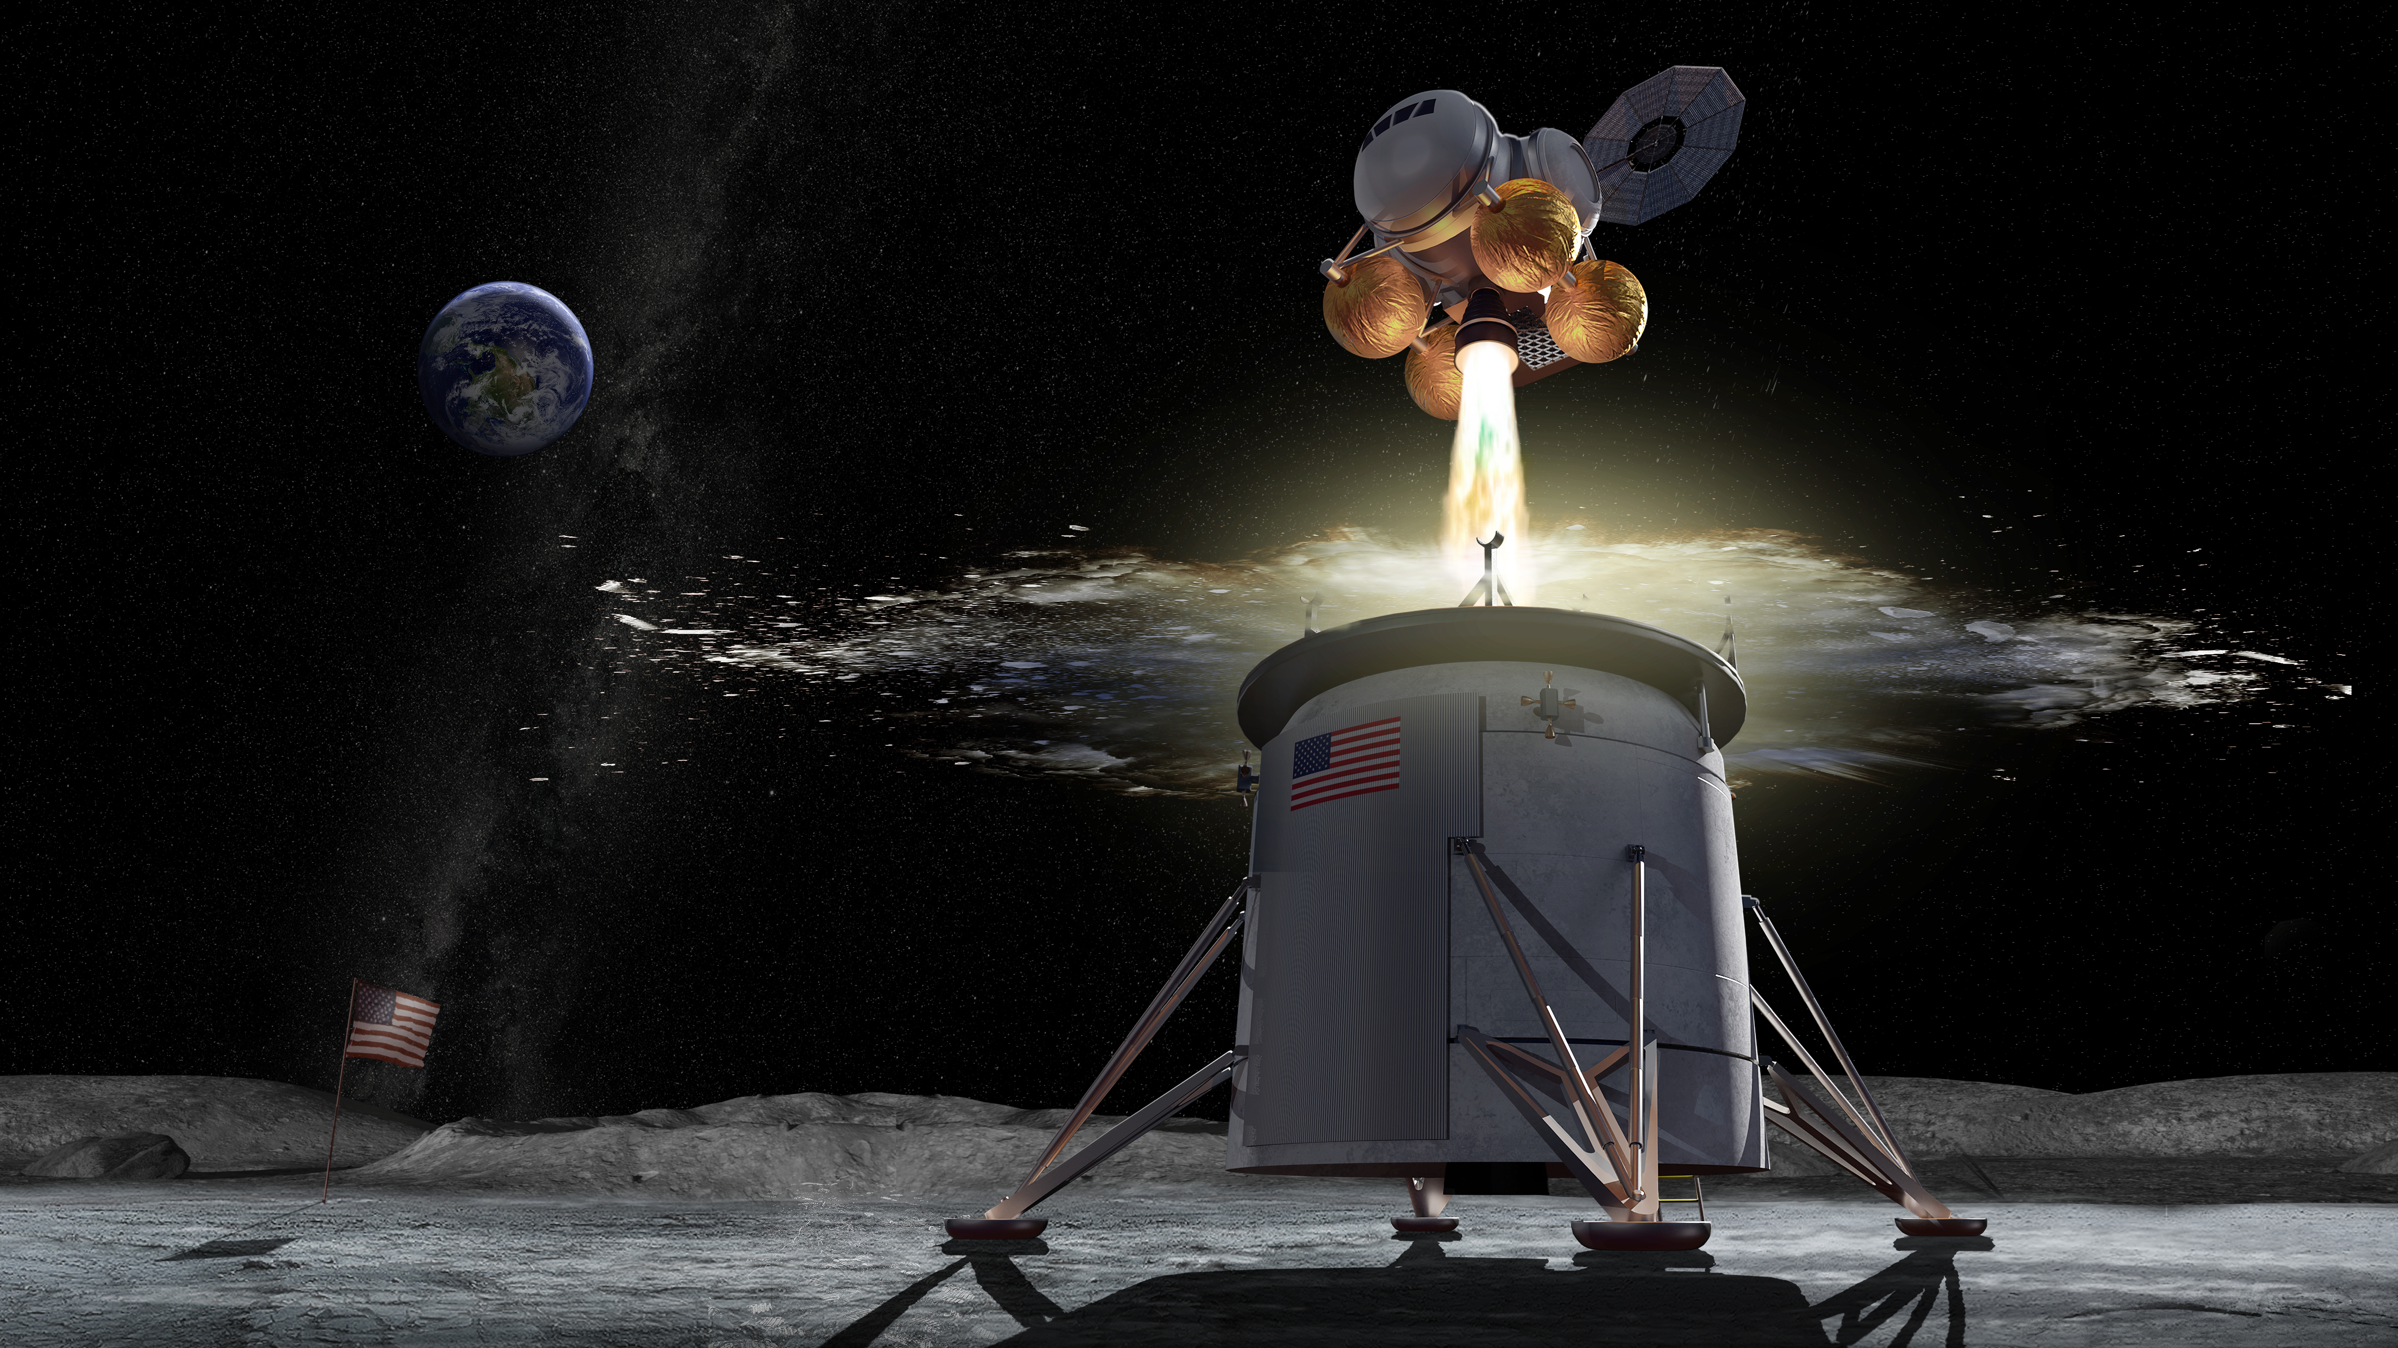
Lander Configurations
Consider the three height ranges of lunar landers
0-4 meters (0-12 ft.)
4-10 meters (12-30 ft.)
10 meter (30 ft.) or greater
Competitors should decide if solution will be limited to single height range or versatile
Notes:
Discuss low slung, medium elevation, and tall lander payload locations. Not required to be able to operate across all three.

Slide 9
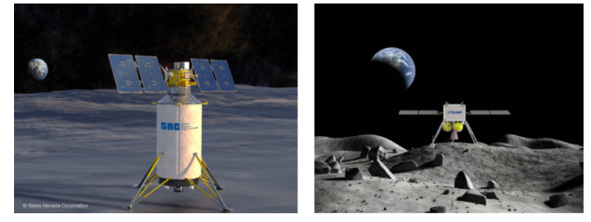
Commercial Lunar Payload Services
Fourteen qualified providers to deliver science and technology to the lunar surface
https://www.nasa.gov/content/commercial-lunar-payload-services
Notes:
Example pictures from some of the providers to convey the potential variety in types of future landers

Slide 10
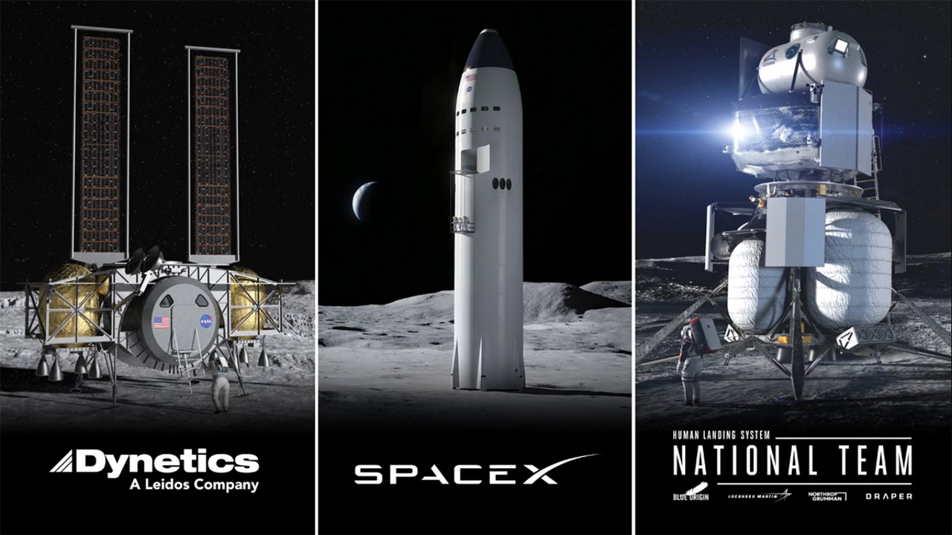
Human Landing System competitors
https://www.nasa.gov/feature/nasa-selects-blue-origin-dynetics-spacex-for-artemis-human-landers
Notes:
Mention pending down select around March. Mention that these fit into the 3 height categories mentioned earlier where primary payloads could be mounted. Payloads could be mounted on top, mounted underslung, or come out the side and lowered in the case of SpaceX.

Slide 11
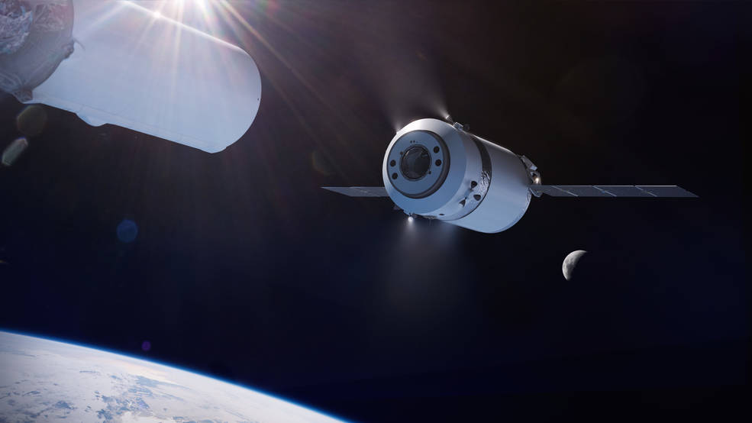
Gateway Logistics Services (GLS)
SpaceX selected as the first U.S. commercial provider under the Gateway Logistics Services contract to deliver cargo, experiments and other supplies to the agency’s Gateway in lunar orbit
Multiple supply missions planned
5 MT delivered cargo capability
Power to internal and external payloads
Trash removal
Automated RPOD (docking/undocking)
Firm-fixed price, indefinite delivery/indefinite quantity contract
Guaranteed two missions per logistics services provider with a maximum total value of $7 billion across all contracts as additional missions are needed
https://www.nasa.gov/press-release/nasa-awards-artemis-contract-for-gateway-logistics-services
Notes:
Part of Deep Space Logistics chain. Payloads could be at the Gateway and get transferred to a landerSpaceX as the first U.S. commercial provider under the Gateway Logistics contract to deliver cargo, experiments and other supplies.
NASA is planning multiple supply missions in which the cargo spacecraft will stay at the Gateway for six to 12 months at a time.
SpaceX will deliver critical pressurized and unpressurized cargo, science experiments and supplies to the Gateway, such as sample collection materials and other items the crew may need on the Gateway and during their expeditions on the lunar surface.

Slide 12
Other Considerations
Pros/cons landing capability for each payload or reusing across architecture with dedicated landing
Payload access location and elevation from surface
Could be a primary driver
Payload handling interfaces and standards
Mission specific lander configuration may drive design
Modularity and evolution paths may be considered in the design
Notes:
Giving a few thoughts of areas of emphasis

Slide 13
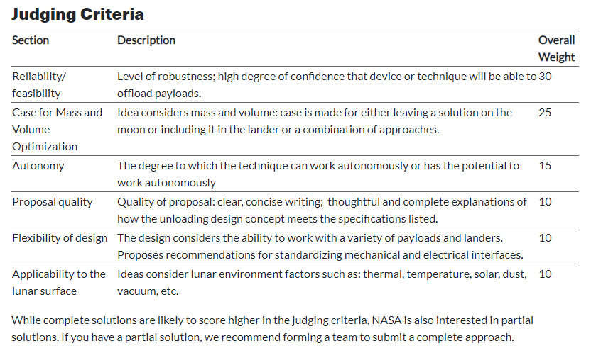
Judging Criteria
Notes:
Briefly touch on each line

Slide 14
Monetary Prizes
This challenge will award up to $25,000 in total prizes for up to 6 teams:
One 1st place winner: up to $10,000
Two 2nd place winners: up to $4,500 each
Three 3rd place winners: up to $2,000
Notes:
The challenge prizes are as seen above. We will have to work through virtual events when the time comes in March.

Slide 15
Other Prizes
Present concept to NASA engineers
Conference/virtual event for prize winners to present and interact with NASA (pending availability)
Publicity announcing the winners
Wide promotion of the winner on social media
Participation in a webinar showcasing winning solutions to public
*State Department restrictions may apply

Slide 16
Questions?
See https://www.herox.com/LunarDelivery for more details on guidelines, timeline, and the challenge forum.
Notes:
Take questions here and point back to the challenge site where there is more background and many questions have already been answered in the forum.

