Slide 1
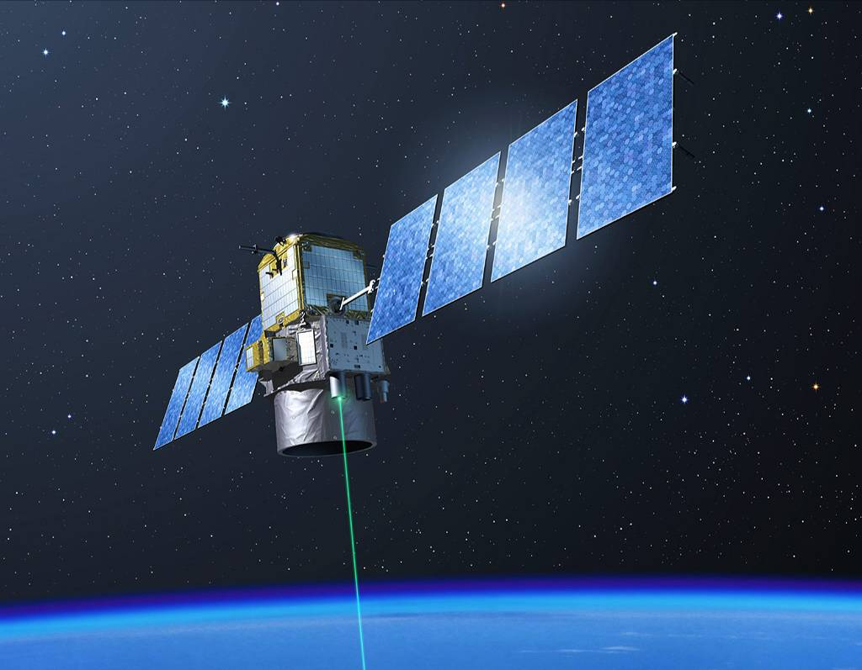
The First Decade of Global Lidar Observations
(summary)
Dave Winker
NASA LaRC
Hampton, Virginia
COSPAR, January 2020

Slide 2
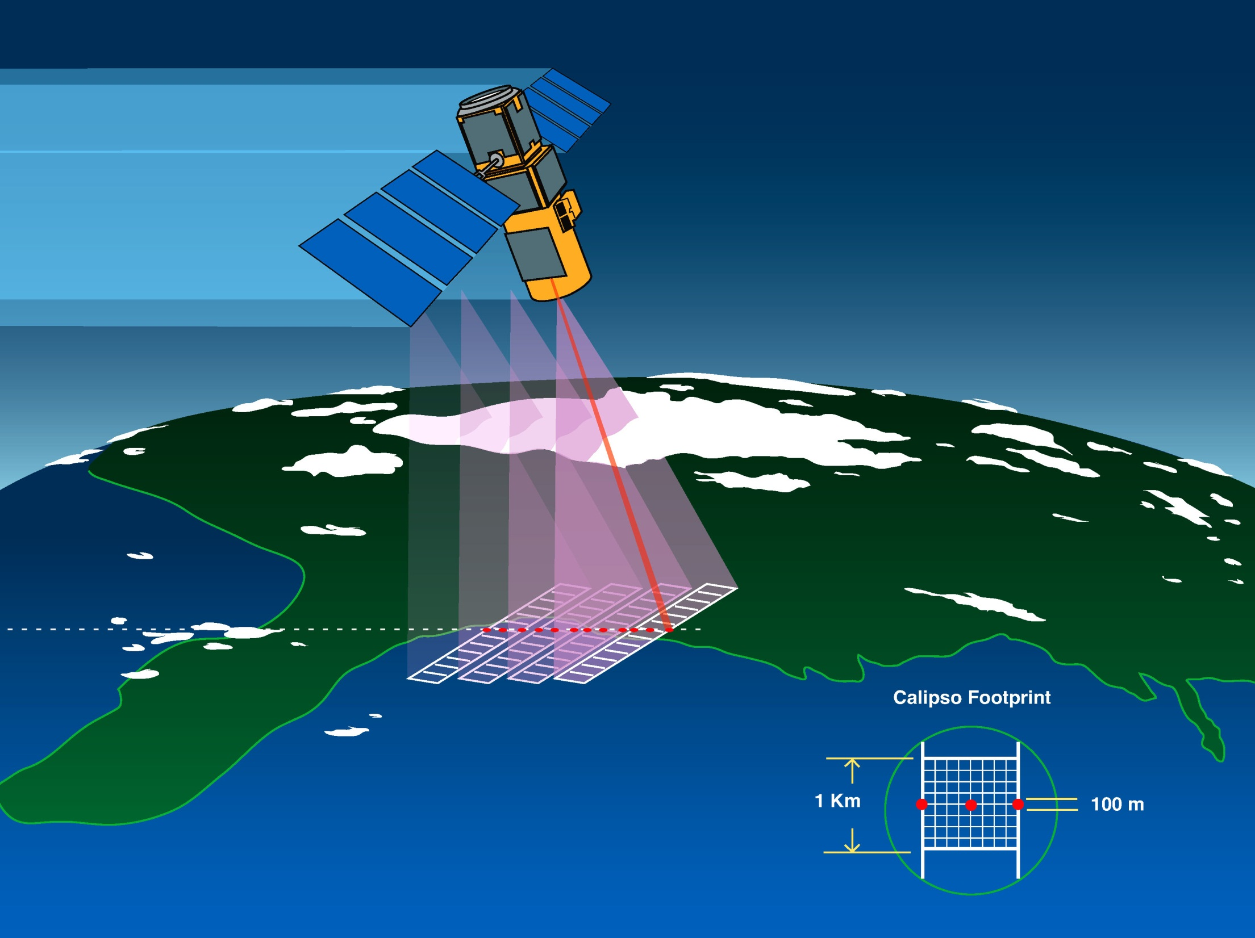
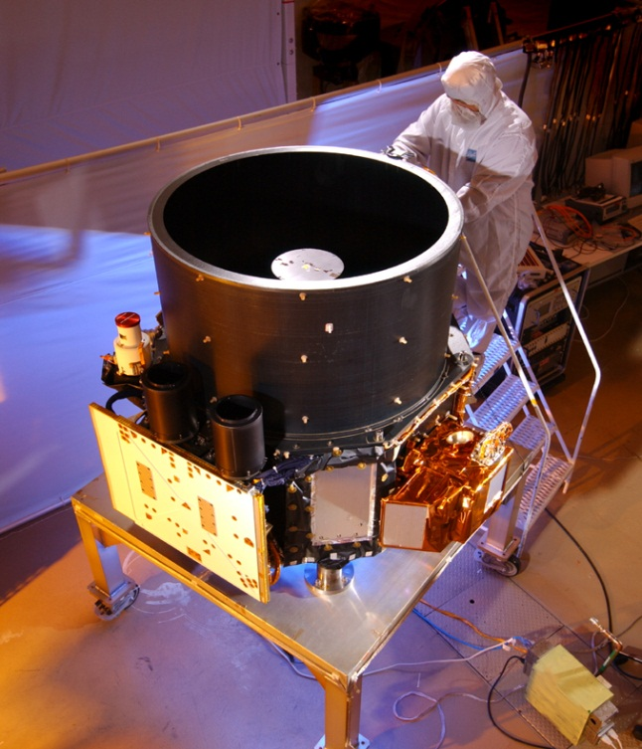
CALIPSO First Light: 7 June 2006
Three co-aligned instruments:
CALIOP: polarization lidar
  30 m vertical resolution
  90 m footprint
Imaging IR radiometer
  8.6, 10.5, 12.0 um
  60 km swath
Wide-Field Camera
  650 nm
  60 km swath

Slide 3



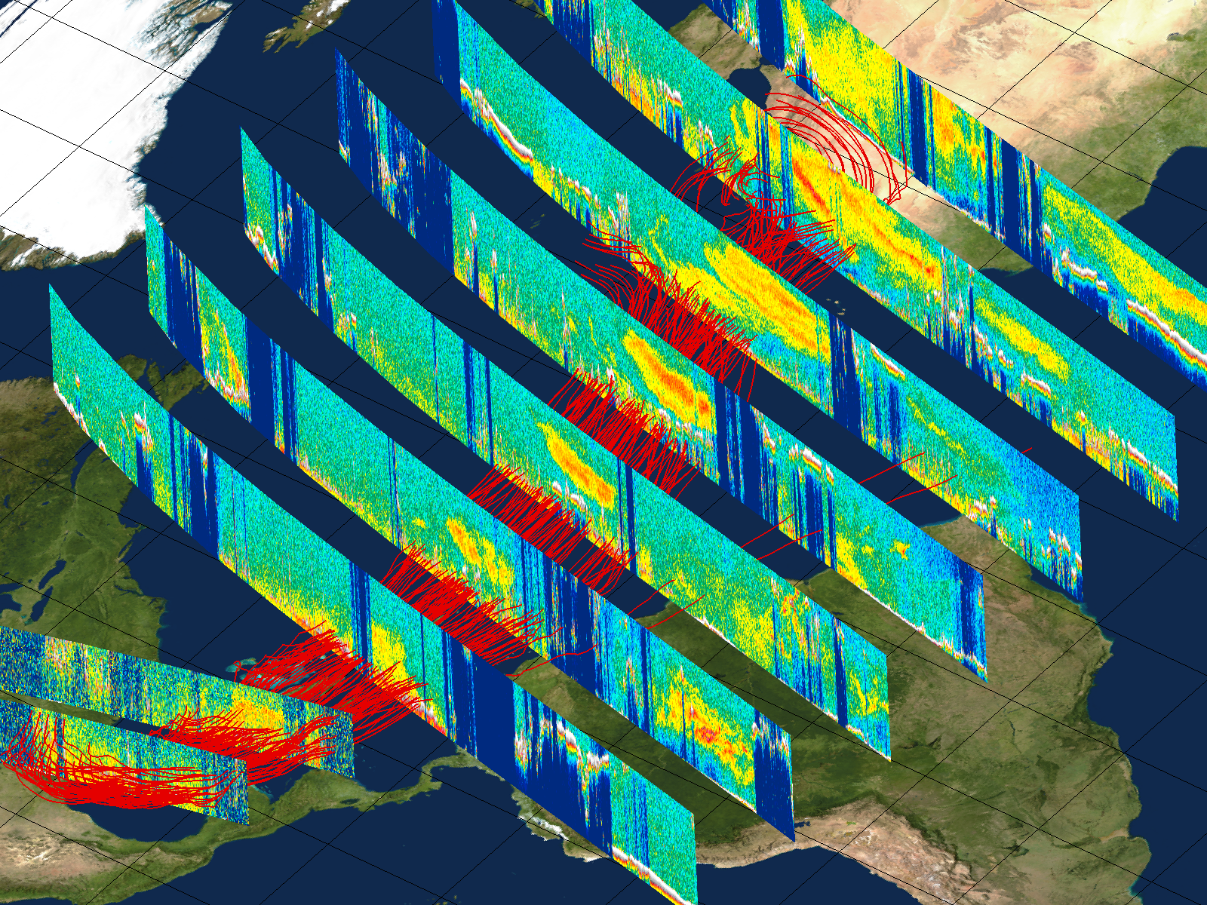
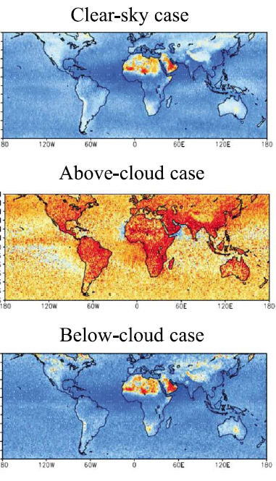
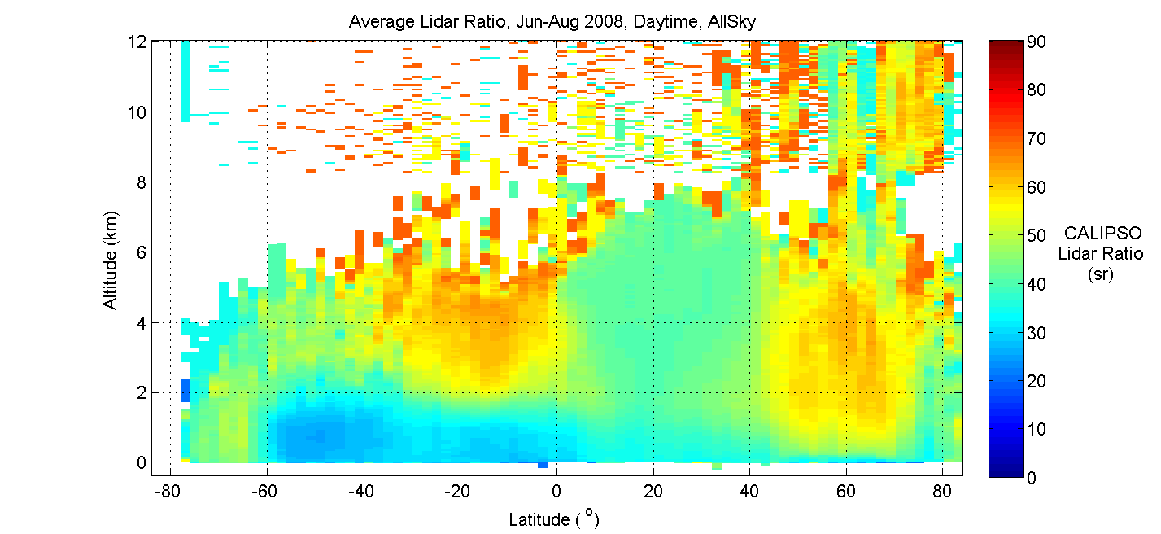
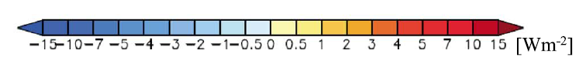
Unique Aerosol Capabilities
Aerosol Transport
Aerosol Radiative Effects
Sahara dust outbreak, Aug 2007
Liu et al, JGR, 2008
Aerosol Composition
dust
smoke
Zonal mean distribution of aerosol types, June through August
smoke
marine
SW DARF (Oikawa et al., JGR 2018)

Slide 4
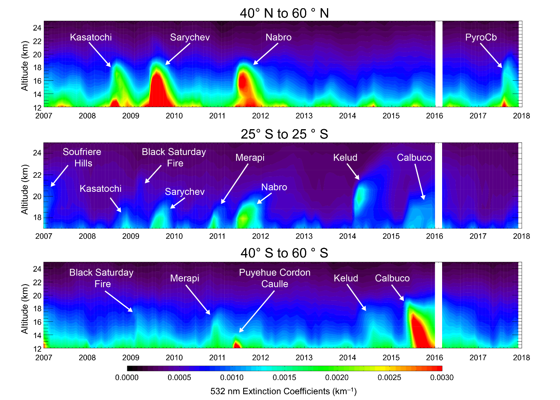
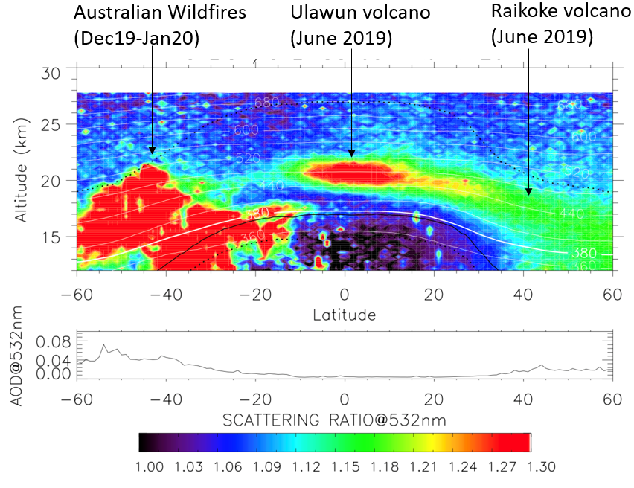
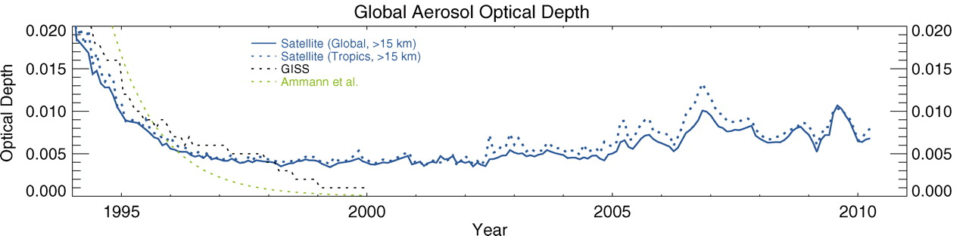
Monitoring the Stratosphere
Zonal mean upper atmosphere aerosol scattering ratio, 3-12 Jan 2020:
Time-height cross sections of CALIOP stratospheric aerosol extinction, 01/2007 – 12/2017 (Kar et al., AMT 2019)
SAGE II (1990–2005), GOMOS (2002–2009), and CALIOP (2006–2010) (Solomon et al., Science 2011)

Slide 5
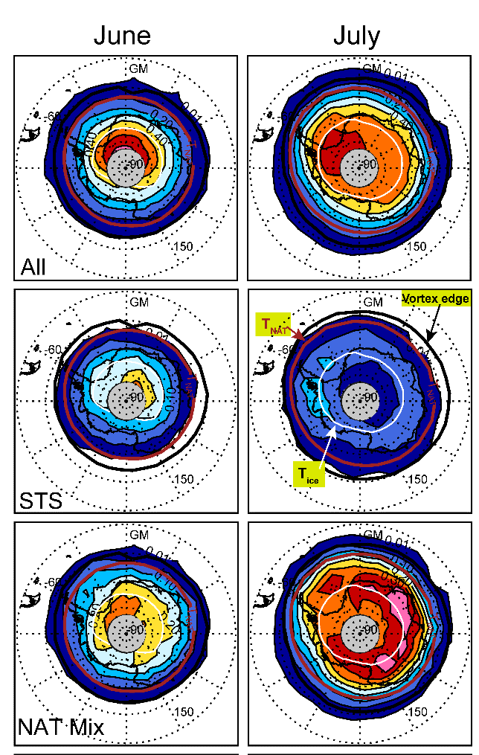
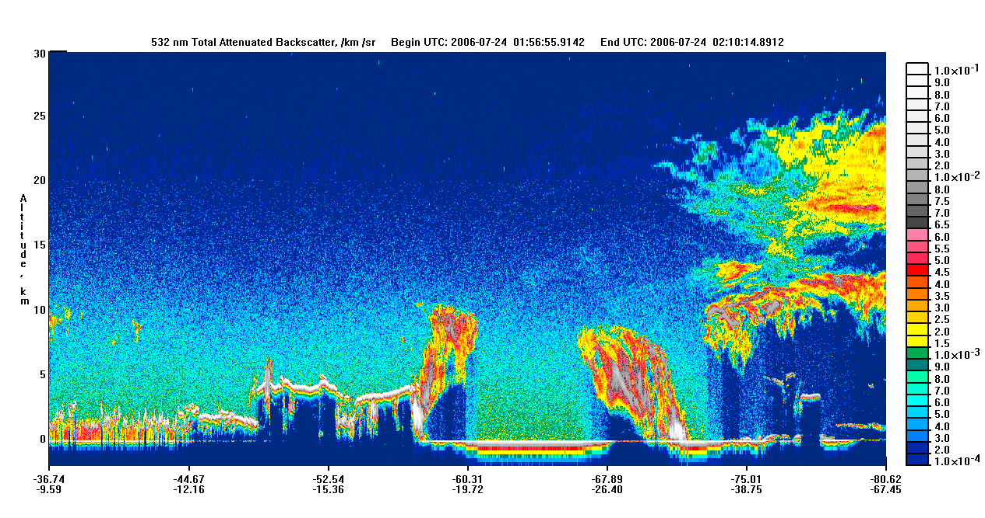
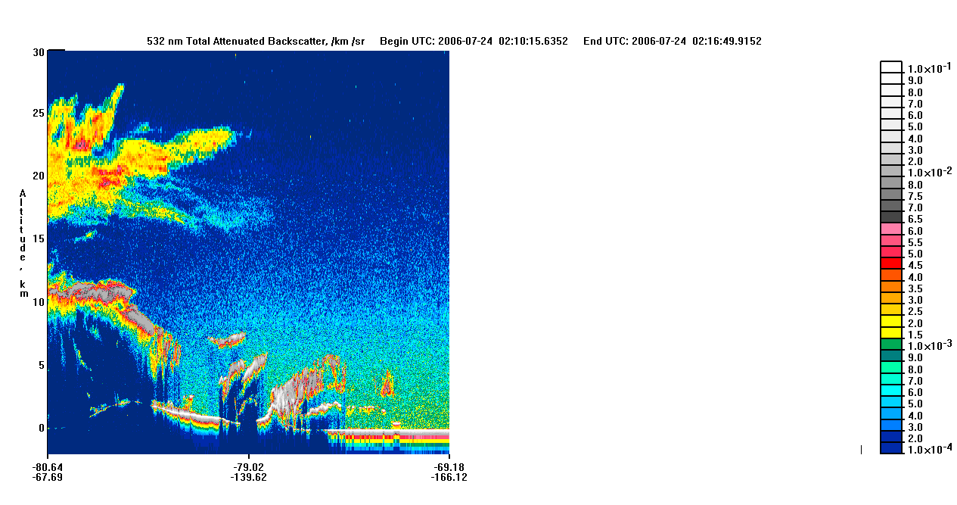
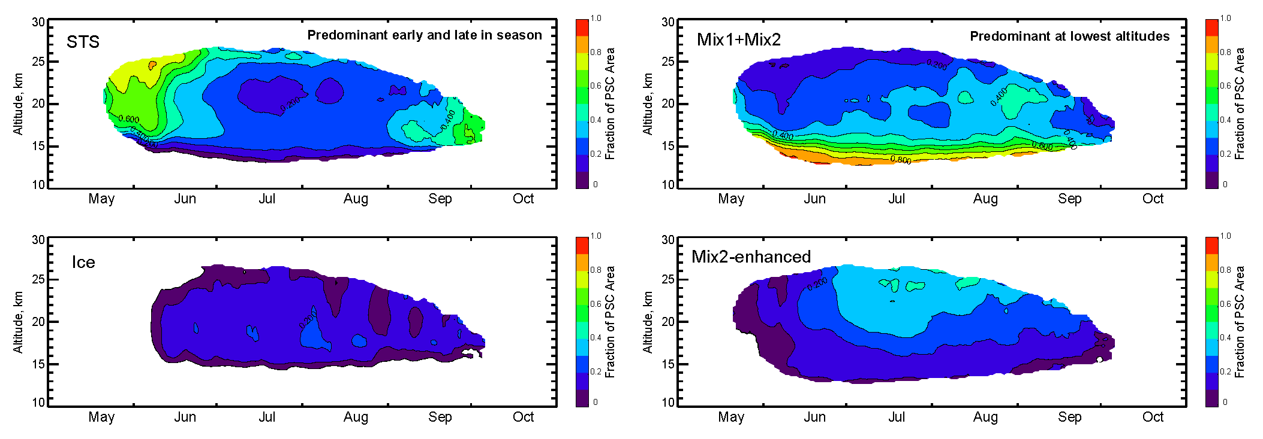
Polar Stratospheric Clouds (PSCs)
Polar Stratospheric Clouds play a key role in the chemistry of the polar stratosphere CALIOP has produced a 14-year climatology of PSCs distribution and properties
30
25
20
15
10
5
0
CALIOP profiles the vertical extent of PSCs throughout polar winter
Depolarization discriminates liquid and frozen particles
Altitude (km)
2006-2018: monthly mean maps of Antarctic PSC occurrence frequency at θ =500 K (~20 km) Updated from Pitts et al. (2018)
Evolution of Antarctic PSC area fraction partitioned by composition (2006-2014)
Top left: supercooled ternary solution (STS)
Top right: mixtures of STS with nitric acid trihydrate (NAT) particles
(Courtesy Mike Pitts, LaRC)

