Slide 1
Hypersonic Second-Mode Instability Response to Shaped Roughness
National Aeronautics and Space Administration
Andrew Leidy, Rudolph King, Meelan Choudhari, Pedro Paredes
NASA Langley Research Center
Hampton, VA 23681

Slide 2
Outline
Motivation
Experimental Setup
Computational Methods
Significant Findings
Discussion
Concluding Remarks

Slide 3
Motivation
Extending laminar flow allows for safer, lower cost, and more efficient high-speed flight
The second-mode instability is the dominant transition mechanism for cones in hypersonic flow at 0 deg pitch and yaw
A previous study looked at second-mode instability suppression using a set of 2-D roughness (Fong et al., 2015)
Can shaped roughness effectively reduce second-mode amplitudes and delay transition?
Fong, K. D., Wang, X., Huang, Y., Zhong, X., McKiernan, G. R., Fisher, R. A., and Schneider, S. P., “Second Mode Suppression in Hypersonic Boundary Layer by Roughness: Design and Experiments,” AIAA Journal, Vol. 53, No. 10, 2015, 3138–3144.

Slide 4
Experimental Methods
Tests were conducted in the LaRC 20-Inch Mach 6 Tunnel
The testbed was a 7 deg half-angle cone, instrumented with
PCBs® (11–1000 kHz)
Kulites® (<100 kHz)
Thermocouples
Model was injected at flow conditions and data were sampled for 3 seconds
Diagram of instrumented test article and relative position of roughness array.
VG array and downstream instrumentation near the 90 deg ray

Slide 5
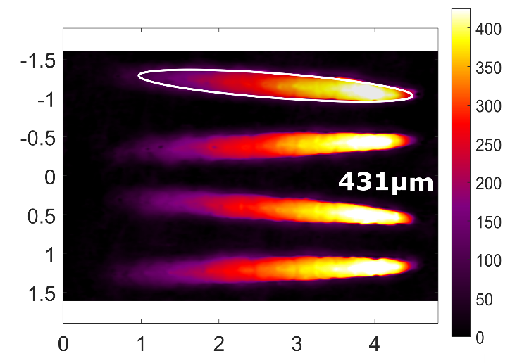
Roughness Array
Each wavelength consisted of an elliptical element pair
Azimuthal wavenumber was 112
The elements were designed based on lessons learned from Paredes et al. (2018)
Array was 3D printed as a single piece
VGs were centered at x = 229 mm on cone (≈2/3*x_{TR} at Re = 11.5 M/m)
Sketch of VG array segment
height [µm]
Distance [mm]
Paredes, P., Choudhari, M. M., and Li, F., "Transition Delay via Vortex Generators in a Hypersonic Boundary Layer at Flight Conditions," 2018 Fluid Dynamics Conference, AIAA Paper 2018-3217
Measured topographical map of VG elements

Slide 6
Computational Methods
The laminar boundary layer basic state for Re = 11.5 M/m was computed with a high-order WENO code
Linear, plane-marching PSE were used to predict linear amplification characteristics for Mack-mode and first-mode (which become streak) instabilities
The most unstable streak-instability mode corresponds to the azimuthally subharmonic mode, m=56
The N-factors are based on Mack’s energy norm
Predicted mean u-velocity contours for (a) 382 µm
and (b) 529 µm roughness heights (Re = 11.5 M/m)

Slide 7
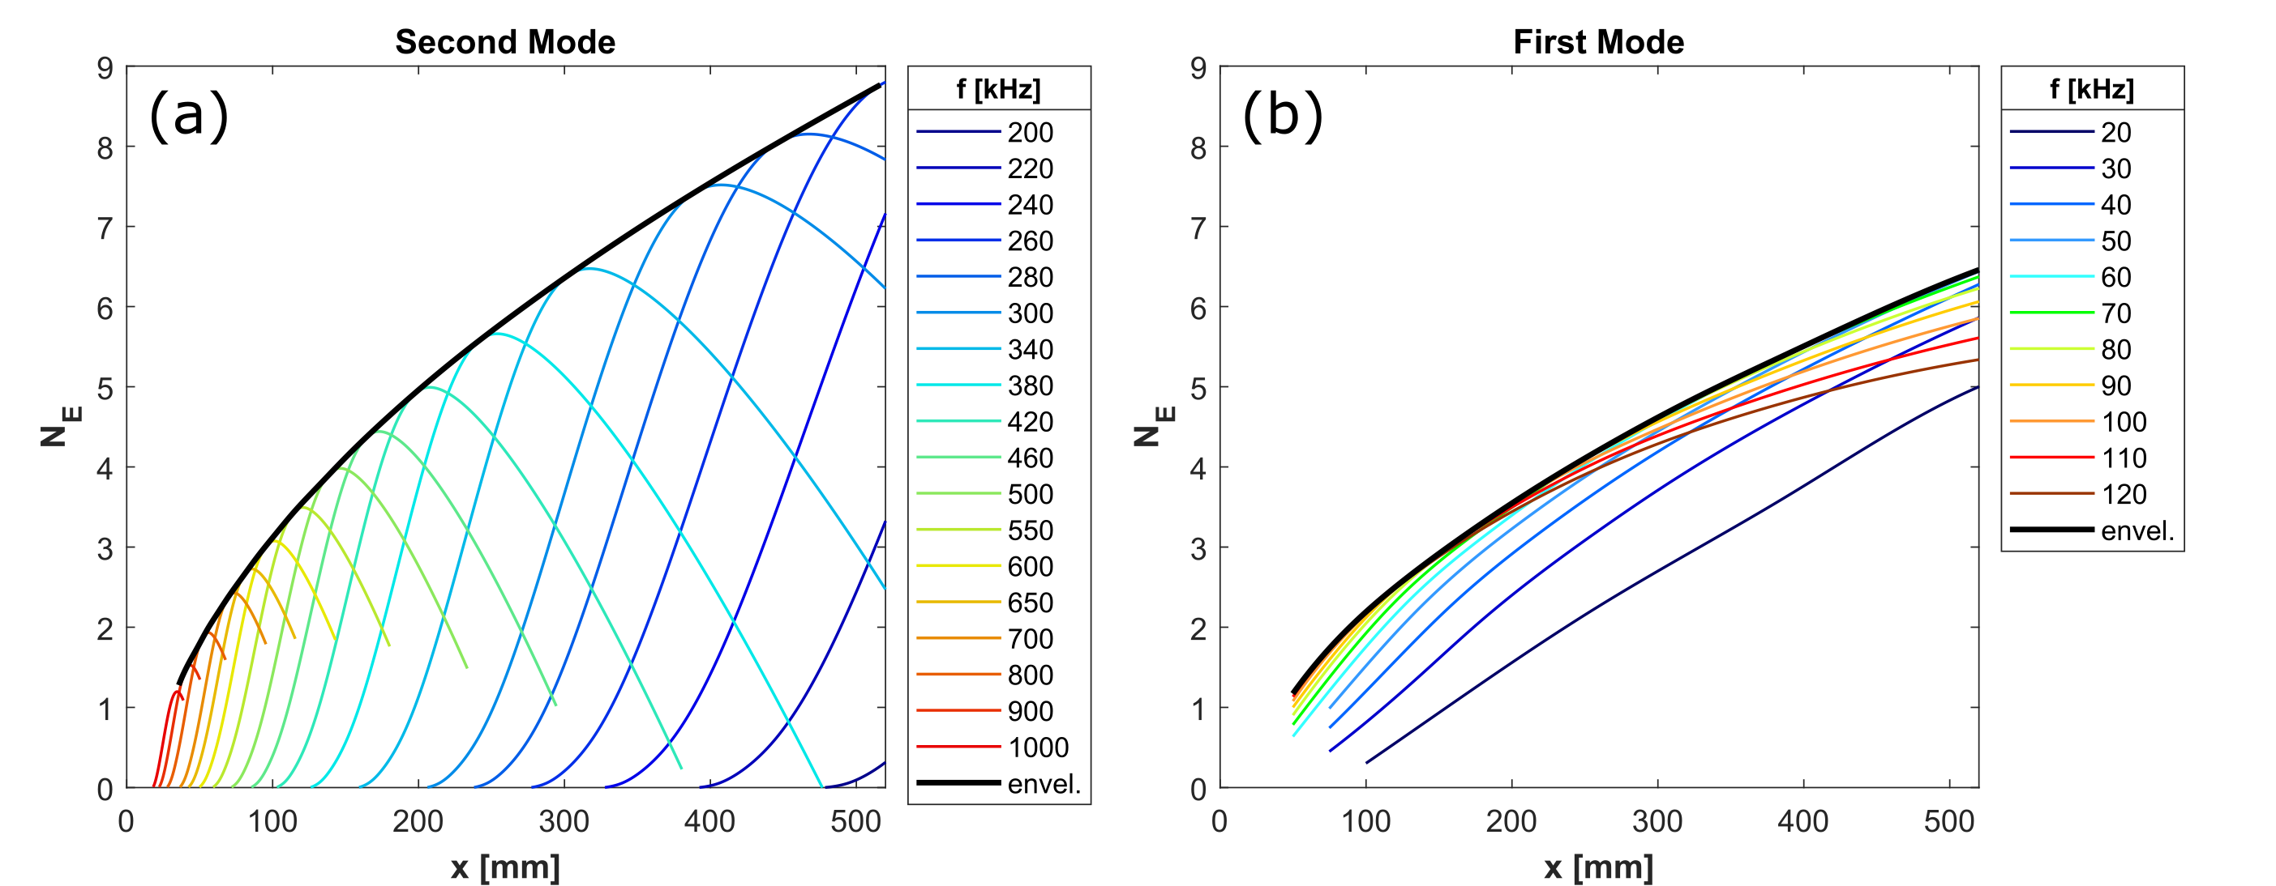
Baseline Results
Experimental (top) and computational (bottom) results are shown for the smooth cone at Re = 11.5 M/m
The onset of transition is near x = 350 mm
Initial rise in heat flux correlates with lower-frequency growth
Second-mode N-factor = 7 (320 kHz) at x_{TR}
First-mode N-factor = 5 at x_{TR}
Axial development of Stanton number
PSD pressure fluctuations
N-factor plots for (a) second-mode and (b) oblique first-mode envelopes for relevant azimuthal wavenumbers

Slide 8
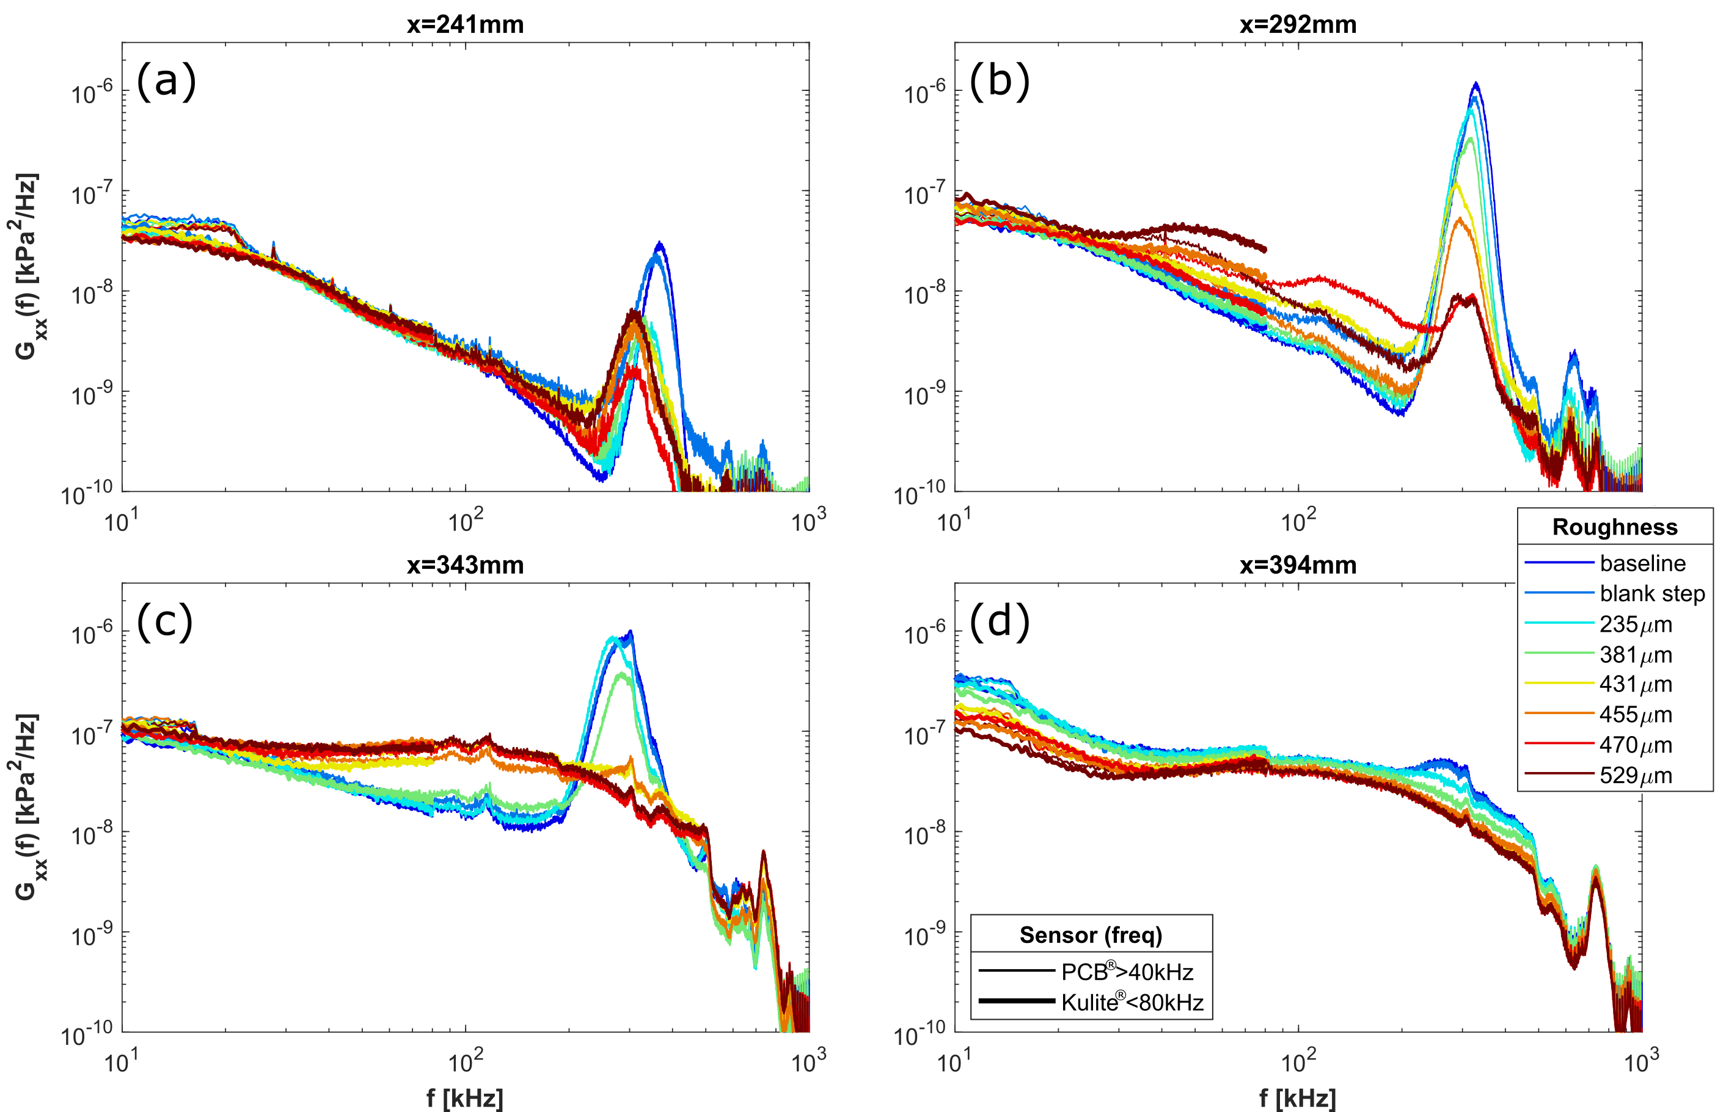
VG Spectra
Sensor locations for PSDs below
Second-mode amplitudes are initially reduced for all VG heights
Peaks are shifted to lower frequencies
Second mode recovers more for shorter VGs
Early transition occurs for taller VGs
There are signs of azimuthal variation in the forcing
Pressure fluctuation spectra for six roughness heights at Re = 11.5 M/m

Slide 9
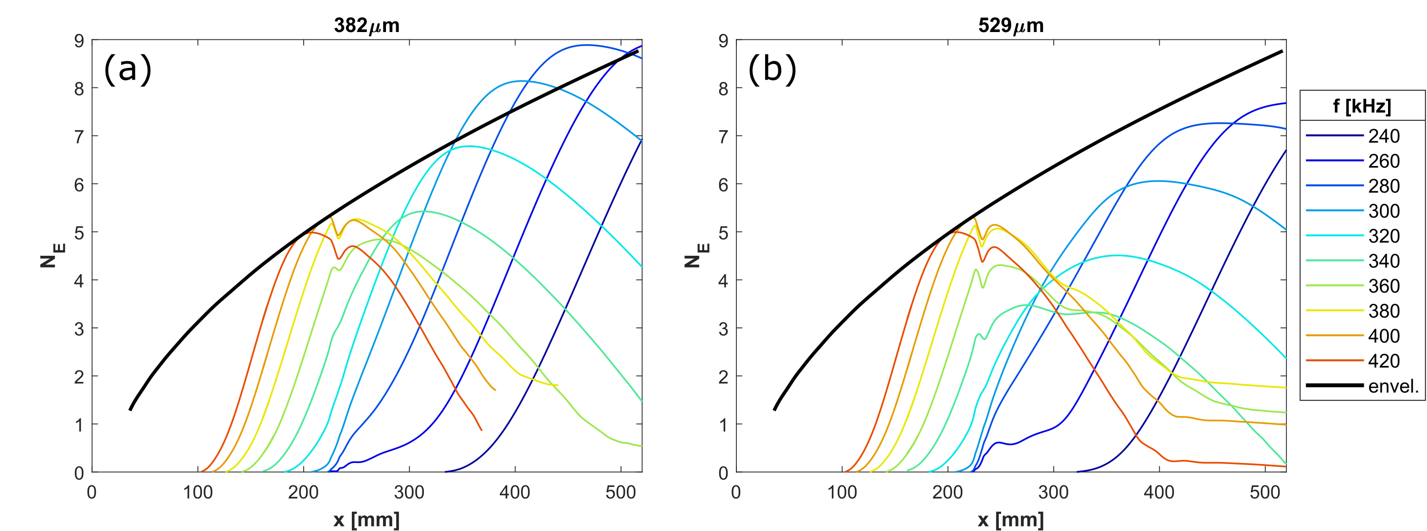
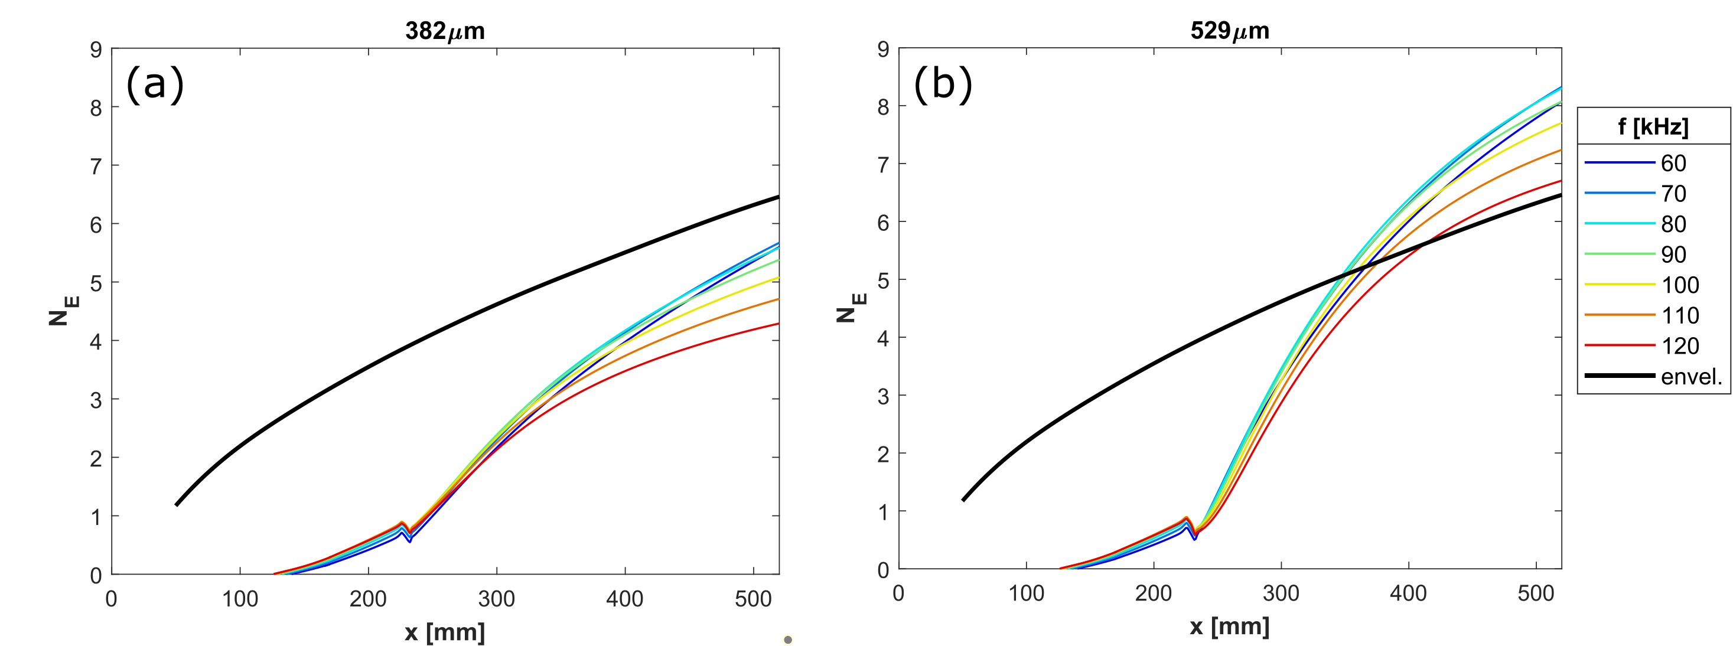
Significant Findings
Computations also show second-mode suppression and a shift to lower frequencies
The amplitude drop and frequency shift happen closer to the VGs in the experiment
Streak-instability amplitudes also drop across the VGs from the m=56 first-mode levels
Streak-instability N-factors exceed the first-mode envelope for 529 µm VGs, but farther downstream than observed in the spectra
PSDs from previous slide
Second-mode N-factors for (a) 382 µm and (b) 529 µm VGs
Streak-instability (m=56) N-factors for (a) 382 µm and (b) 529 µm VGs

Slide 10
Transition Delay?
Stanton number decreases across the VGs for the 235 µm and 381 µm cases at Re = 13.1 M/m
Lower-frequency content is reduced below the baseline levels
The 235 µm case shows a larger remnant of the second-mode instability peak than the baseline case
Axial development of Stanton number
Pressure fluctuation spectra for six roughness heights at Re = 11.5 M/m

Slide 11
Concluding Remarks
Increasing the VG height reduced second-mode amplitudes and shifted the spectral peak to lower frequencies
There was some evidence of transition delay for the 235 µm and 381 µm cases at Re = 13.1 M/m
Energy norm N-factors largely supported the experimental second-mode behavior
Streak-instability N-factors only surpassed the baseline first-mode envelope for the 529 µm VGs, suggesting that the freestream disturbances interacted with the streak instability to induce earlier transition
A similar experiment in a quiet facility may demonstrate delayed transition

Slide 12
Acknowledgements
AEDC White Oak Tunnel 9 personnel for allowing us to use the cone model and for support they provided
Funding was provided by the Hypersonics Technology Project
Computational resources were provided by the NASA High-End Computing (HEC) Program through the NASA Advanced Supercomputing (NAS) Division at Ames Research Center
Author Pedro Paredes was partially supported by the Air Force Office of Scientific Research under award number FA9550-20-1-0023

