Slide 1
Wind-Tunnel to Full-Scale Mapping of Winds and Loads for Launch-Vehicle Ground Wind Loads
Thomas G. Ivanco, Donald F. Keller, and Jennifer L. Pinkerton
National Aeronautics and Space Administration
Langley Research Center, Aeroelasticity Branch
AIAA SciTech, January 11-21, 2021
APA-41, Aerodynamic Testing
Copyright 2021 United States Government as represented by the Administrator of the National Aeronautics and Space Administration. No copyright is claimed in the United States under Title 17, U.S. Code. All Other Rights Reserved. Published by the American Institute of Aeronautics and Astronautics, Inc. with permission.

Slide 2
Outline
Introduction
Experimental Setup
Wind Speed Mapping Methodology
Component Load Mapping Methodology
Comparison Between Wind-Tunnel Derived and Full-Scale Measured Loads
Concluding Remarks

Slide 3
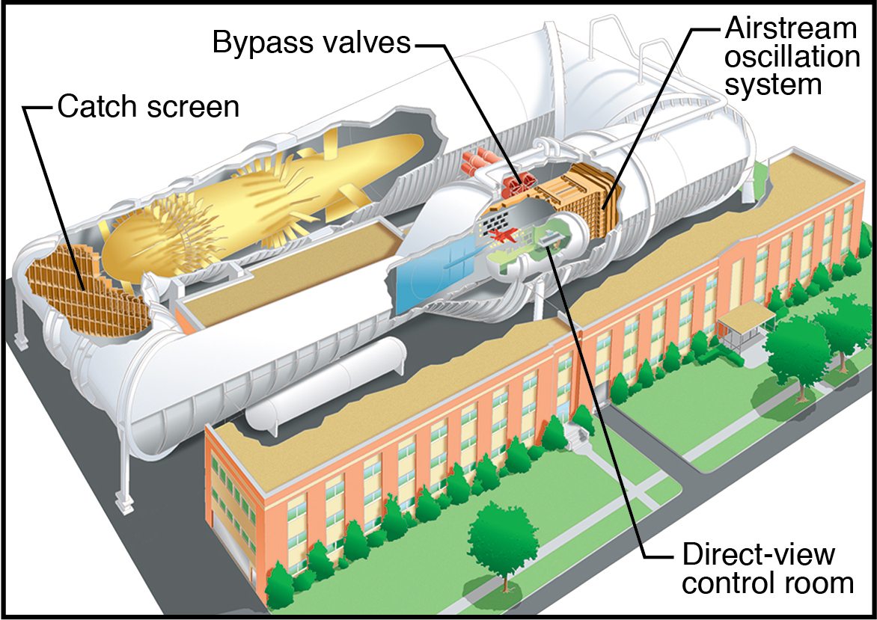
Introduction
Support ground wind loads (GWL) analysis/testing of launch vehicles
  Typically, primary interest is response due to vortex shedding
  Could result in nearly sinusoidal lift/drag forces
  Response can be resonant or nonresonant
Current objective:
  Define methodology for model-scale to full-scale mapping of winds and loads
NASA Langley Transonic Dynamics Tunnel (TDT)
  Unique aeroelastic test facility
  Used extensively in previous GWL problems
  Recently developed atmospheric boundary layer (ABL) simulation

Slide 4
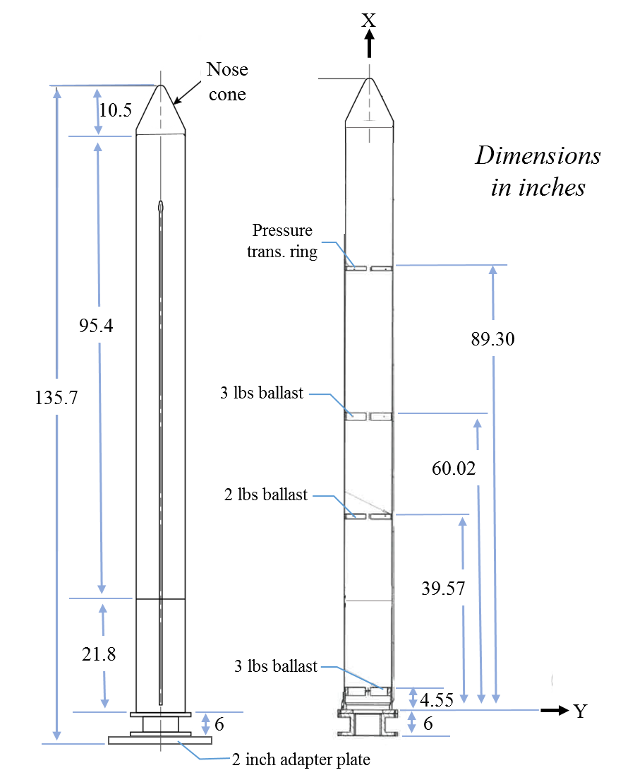
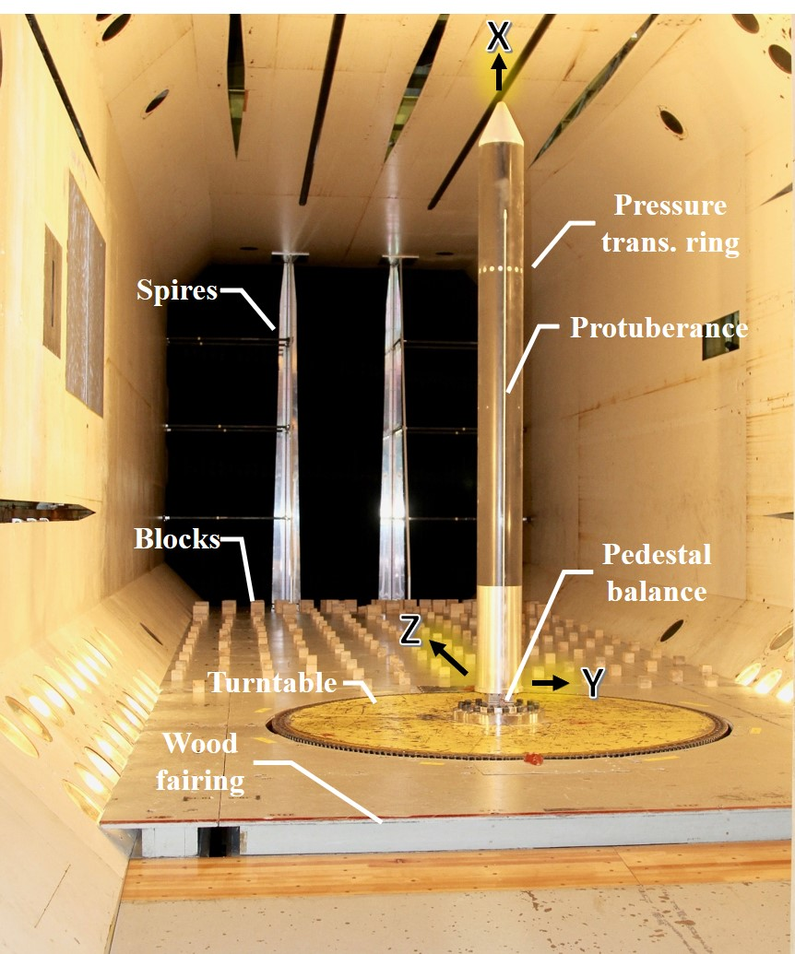
Experimental Setup - Research Model Description
Example model with basic geometry
Instrumentation
  Pedestal balance
  Unsteady pressures
  Accelerometers
9.7
View in TDT, looking upstream

Slide 5
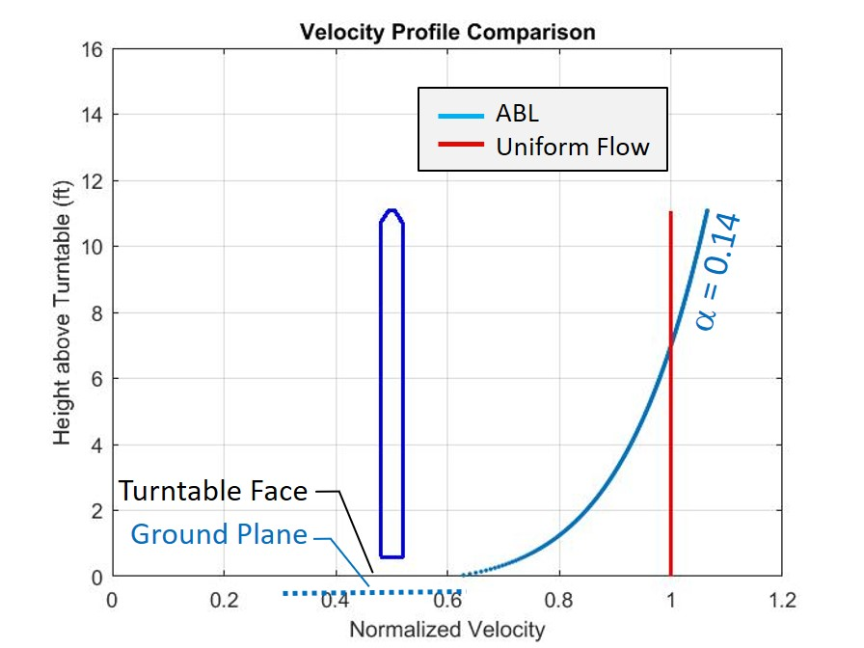
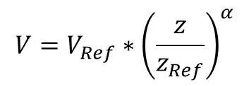
Wind Speed Mapping Methodology
What is the wind speed?
Six features to consider: profile, representative height, turbulence spectra, duration of measurement, anemometer performance, and lateral location of instrumentation
$$V=V_{Ref}∗{\left(\frac{z}{z_{Ref}}\right)}^{α}$$
where, V = local speed at elevation z, and V_{Ref} = reference speed at elevation z_{Ref}
[7] Ivanco, T. G.; Keller, D. F.; Pinkerton, J. L.; “Investigation of Atmospheric Boundary-Layer Effects on Launch-Vehicle Ground Wind Loads,” IEEE/AIAA Aerospace Conference, Big Sky Montana, March 2020.
Example velocity profile comparison, courtesy of [7]

Slide 6
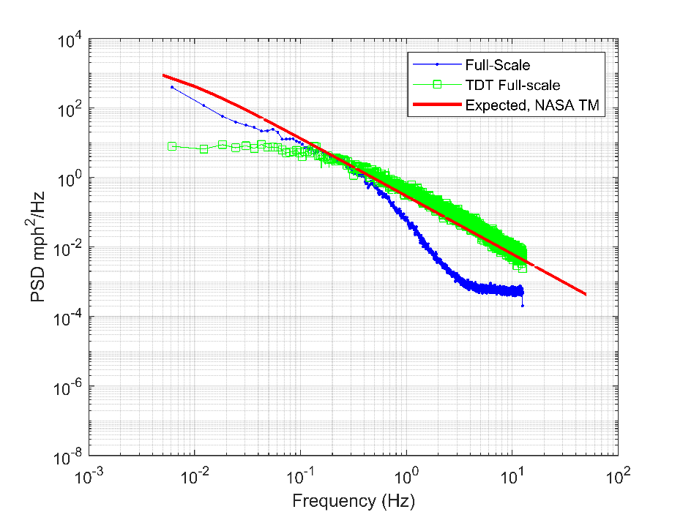
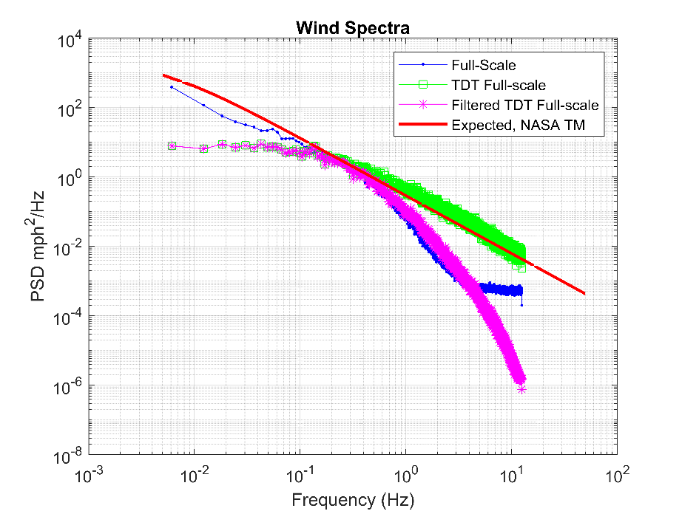
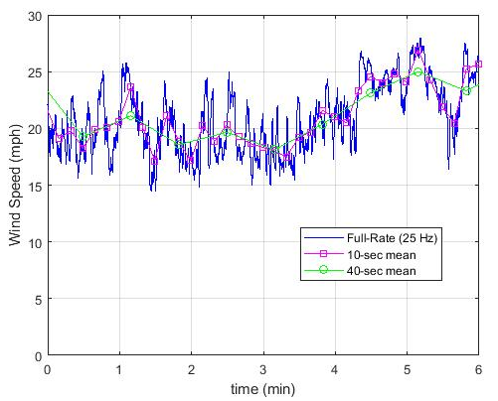
Wind Speed Mapping Methodology
Effect of anemometer performance
  Not fast-response
  Filtered TDT data to mimic performance
  10% difference in peak velocity
  (21% difference in peak Q)
  18% change in standard deviation
Effect of sample length
Comparison of Turbulence Spectra

Slide 7



Component Load Mapping Methodology
Conversion of Velocity and Loads
  Velocity mapping determined by reduced frequency (κ),
  where V is velocity, f is frequency, D is reference diameter, and subscripts FS and MS denote full- and model-scale, respectively
  Loads reduced into nondimensional coefficients, then converted to full-scale
  where BM is bending moment, Q is dynamic pressure, D is diameter, H is height, and L is reference length
$$κ=\frac{fD}{V}$$
$$\frac{V_{FS}}{V_{MS}}=\frac{f_{FS}}{f_{MS}}\frac{D_{FS}}{D_{MS}}$$
$$C_{BM}=\frac{BM}{QDHL}$$

Slide 8


Component Load Mapping Methodology
Corrections for damping
  Band-pass filters applied to isolate modes
  Scale factors applied to correct for difference between model and expected full-scale damping (by mode)
  Two correction factors depending upon direction of damping change:
  or
Correction for mass offset
  Displaced mass from wind-deflection adds to bending moment
  Effect is different between model-scale and full-scale
  On the order of 50% increase in loads for some cases
  Affects 1st bending modes only
$${\text{ζ}}_{cor}=\sqrt{\frac{{\text{ζ}}_{measured}}{{\text{ζ}}_{expected}}}$$
$${\text{ζ}}_{cor}=\left(\frac{{\text{ζ}}_{measured}}{{\text{ζ}}_{expected}}\right)$$
$${BM}_{\text{ζ}cor+LF}={BM}_{m1}∗{\text{ζ}}_{{cor}_{m1}}∗massLF+{BM}_{m2}∗{\text{ζ}}_{{cor}_{m2}}+{BM}_{mean}∗massLF$$

Slide 9
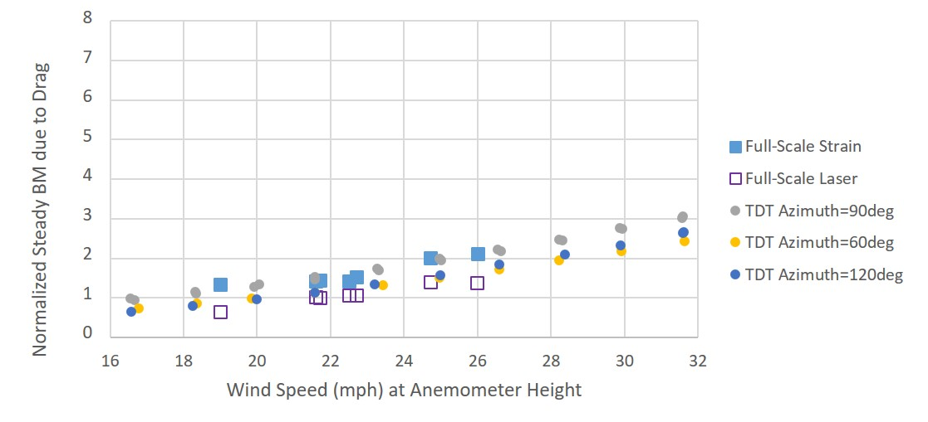
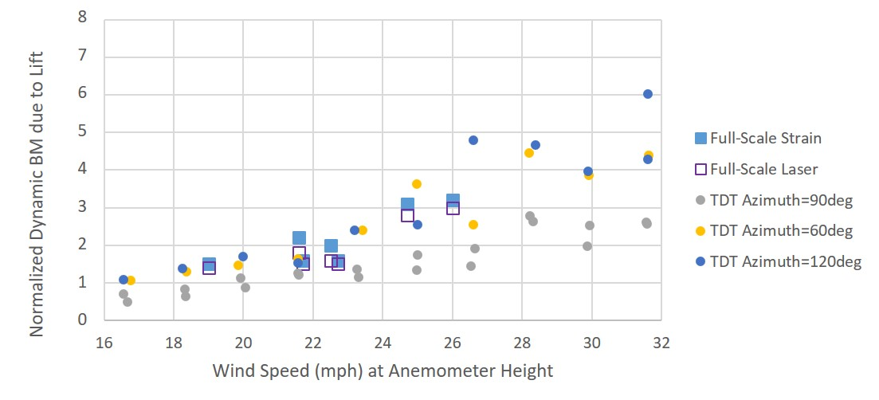
Comparison Between Wind-Tunnel and Full-Scale Loads
Full-scale event of interest acquired
  Detailed wind measurements
  Correlated load time histories
  Vehicle exposed to high winds for hours
Aeroelastically-scaled wind-tunnel model tested in ABL to investigate and compare
Mean Drag Comparison
Dynamic Lift Comparison

Slide 10
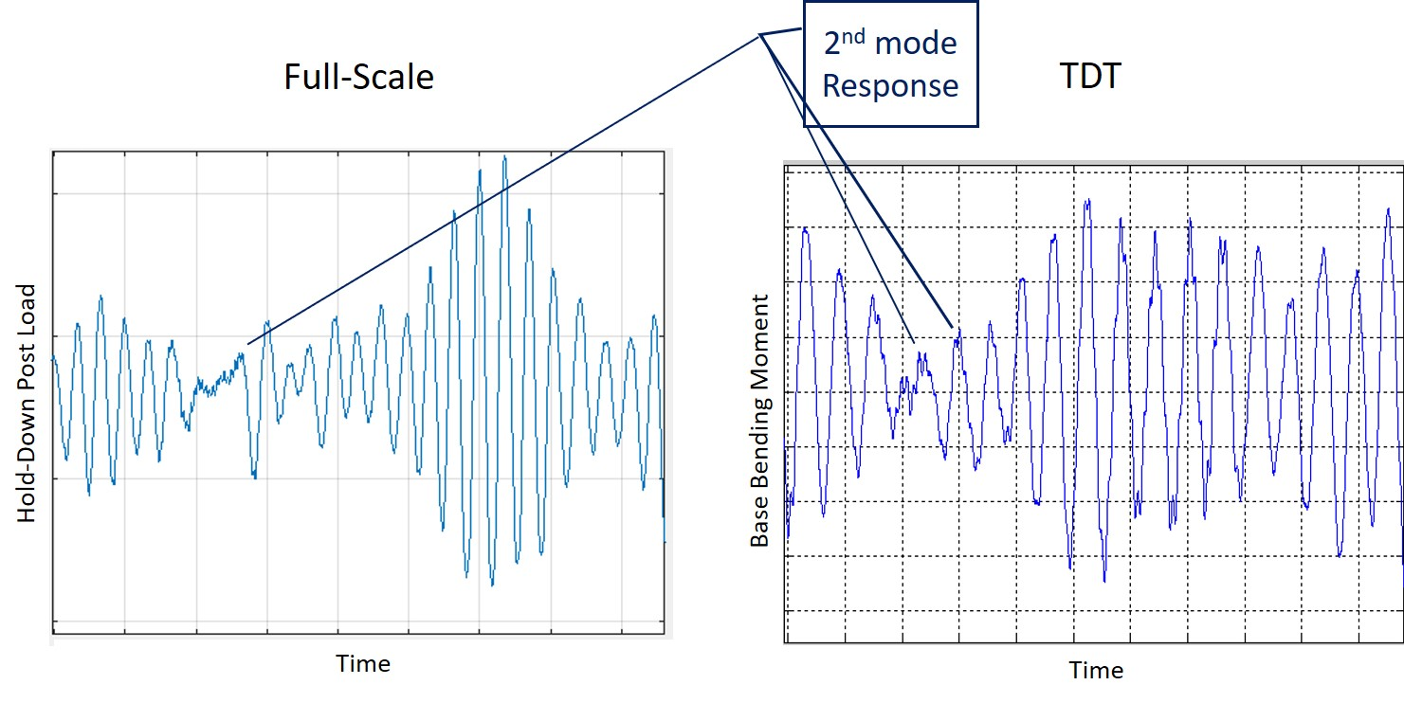
Comparison Between Wind-Tunnel and Full-Scale Loads
Qualitative comparison of mode dynamics

Slide 11
Concluding Remarks
Methodology developed to correlate wind-tunnel and full-scale winds
  Profile, elevation, anemometer performance and other parameters
Methodology developed to scale and correct wind-tunnel to full-scale loads
  Based upon nondimensional scaling parameters
  Converted to coefficient form
  Corrections for damping
  Corrections for mass offset
Comparison between wind-tunnel and full-scale response data presented
  Introduced methodology employed
  Loads agreed to within reasonable uncertainty when using methodology

Slide 12
Questions?
thomas.g.ivanco@nasa.gov
757-864-5092

Slide 13
References
Hanson, P. W.; and Jones, G. W.; “On the Use of Dynamic Models for Studying Launch Vehicle Buffet and Ground-Wind Loads,” NASA TM X 50548, September 1963.
Farmer, M. G.; and Jones, G. W.; “Summary of Langley Wind Tunnel Studies of Ground-Wind Loads on Launch Vehicles,” Compiled Papers from the 1966 Meeting on Ground Wind Load Problems in Relation to Launch Vehicles, NASA Langley Research Center, Hampton, VA, June 7-8, 1966.
Keller, D. K.; and Ivanco, T. G.; “Wind Tunnel Investigation of Ground Wind Loads for Ares Launch Vehicle,” 28th AIAA Applied Aerodynamics Conference, Chicago, IL, AIAA-2010-4371, June 2010.
NASA Space Vehicle Design Criteria, Prelaunch Ground Wind Loads, NASA SP-8008, November 1965.
Ivanco, T. G.; and Keller, D. K. “Investigation of Ground-Wind Loads for Ares Launch Vehicles,” Journal of Spacecraft and Rockets, Vol. 449, No. 4, July-August 2012.
Ivanco, T. G.; Keller, D. F.; Pinkerton, J. L.; “Development of an Atmospheric-Boundary-Layer Profile at the NASA Langley Transonic Dynamics Tunnel,” AIAA Space Forum, Orlando, FL, September 2018. AIAA 2018-5184. doi 10.2514/6.2018-5184
Ivanco, T. G.; Keller, D. F.; Pinkerton, J. L.; “Investigation of Atmospheric Boundary-Layer Effects on Launch-Vehicle Ground Wind Loads,” IEEE/AIAA Aerospace Conference, Big Sky Montana, March 2020.
Anton, P. S.; Gritton, E. C.; Mesic, R.; Steinberg, P.; Johnson, D.; Block, M.; Brown, M.; Drezner, J.; Dryden, J.; Hamilton, T.; Hogan, T.; Peetz, D.; Raman, R.; Strong, J.; Trimble, W.; “Wind Tunnel and Propulsion Test Facilities, an Assessment of NASA’s Capabilities to Serve National Needs,” The RAND Corporation, Santa Monica, CA, 2004.
Anton, P. S.; Johnson, D. J.; Block, M.; Brown, M.; Drezner, J.; Dryden, J.; Gritton, E. C.; Hamilton, T.; Hogan, T.; Mesic, R.; Peetz, D.; Raman, R.; Steinberg, P.; Strong, J.; Trimble, W.; “Wind Tunnel and Propulsion Test Facilities, Supporting Analyses to an Assessment of NASA’s Capabilities to Serve National Needs,” The RAND Corporation, Santa Monica, CA, 2004.

Slide 14
References
Anton, P. S.; Raman, R.; Osburg, J.; Kallimani, J. G.; “An Update of the Nation’s Long-Term Strategic Needs for NASA’s Aeronautics Test Facilities,” The RAND Corporation, Santa Monica, CA, 2009.
Ivanco, T. G.; “Unique Testing Capabilities of the NASA Langley Transonic Dynamics Tunnel, an Exercise in Aeroelastic Scaling,” AIAA 2013-2625; Ground Testing Conference; San Diego, CA; June 2013. doi: 10.2514/6.2013-2625
Ivanco, T. G.; Piatak, D. J.; Sekula, M. K.; Simmons, S. A.; Babel, W. C.; Collins, J. G.; Ramey, J. M.; Heald, D. M.; “A New High Channel-Count, High Scan-Rate, Data Acquisition System for the NASA Langley Transonic Dynamics Tunnel,” AIAA 2016-1149. doi: 10.2514/6.2016-1149
Jones, G. W.; Cincotta, J. J.; Walker, R. W.; “Aerodynamic Forces on a stationary and Oscillating Circular Cylinder at High Reynolds Numbers,” NASA TR R-300; February 1969.
Keller, D. K.; and Ivanco, T. G.; “Wind Tunnel Investigation of Ground Wind Loads for Ares Launch Vehicle,” 28th AIAA Applied Aerodynamics Conference, Chicago, IL, AIAA-2010-4371, June 2010.
Szechenyi, E., "Supercritical Reynolds Number Simulation for Two-Dimensional Flow Over Circular Cylinders.", Journal of Fluid Mechanics, Volume 70, part 3, 1975, pp. 529-542.
Ivanco, T. G.; “Aeroelastic Ground Wind Loads Analysis Tool for Launch Vehicles,” AIAA 2016-2047; San Diego, CA; January 2016. doi: 10.2514/6.2016-2047.
Johnson, D. L.; “Terrestrial Environment (Climatic) Criteria, Guidelines for Use in Aerospace Vehicle Development,” Marshal Space Flight Center, August 2000, NASA-HDBK-1001.

Slide 15
BACKUP

Slide 16
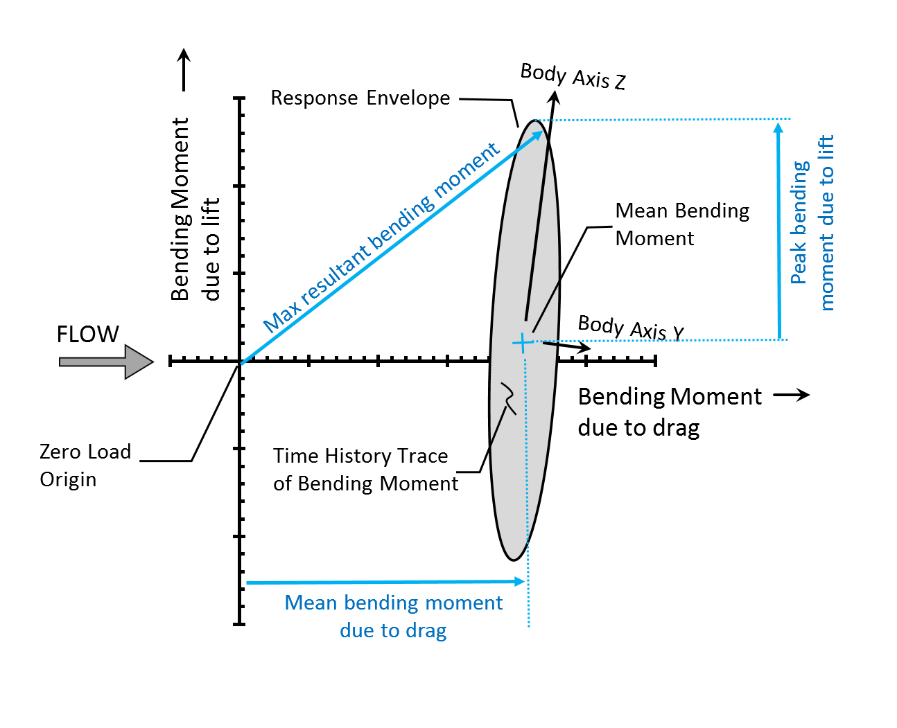
Component Load Mapping Methodology
Load Component Breakdown
  Consider time history trace of bending moment resolved in orthogonal wind axes
  Response typically approximates ellipse

