Slide 1


Enabling Advanced Air Mobility Operations through Appropriate Trust in Human-Autonomy Teaming: Foundational Research Approaches and Applications
Eric T. Chancey
Michael S. Politowicz
Lisa R. Le Vie
Copyright 2021 United States Government as represented by the Administrator of the National Aeronautics and Space Administration. No copyright is claimed in the United States under Title 17, U.S. Code. All Other Rights Reserved. Published by the American Institute of Aeronautics and Astronautics, Inc. with permission.

Slide 2

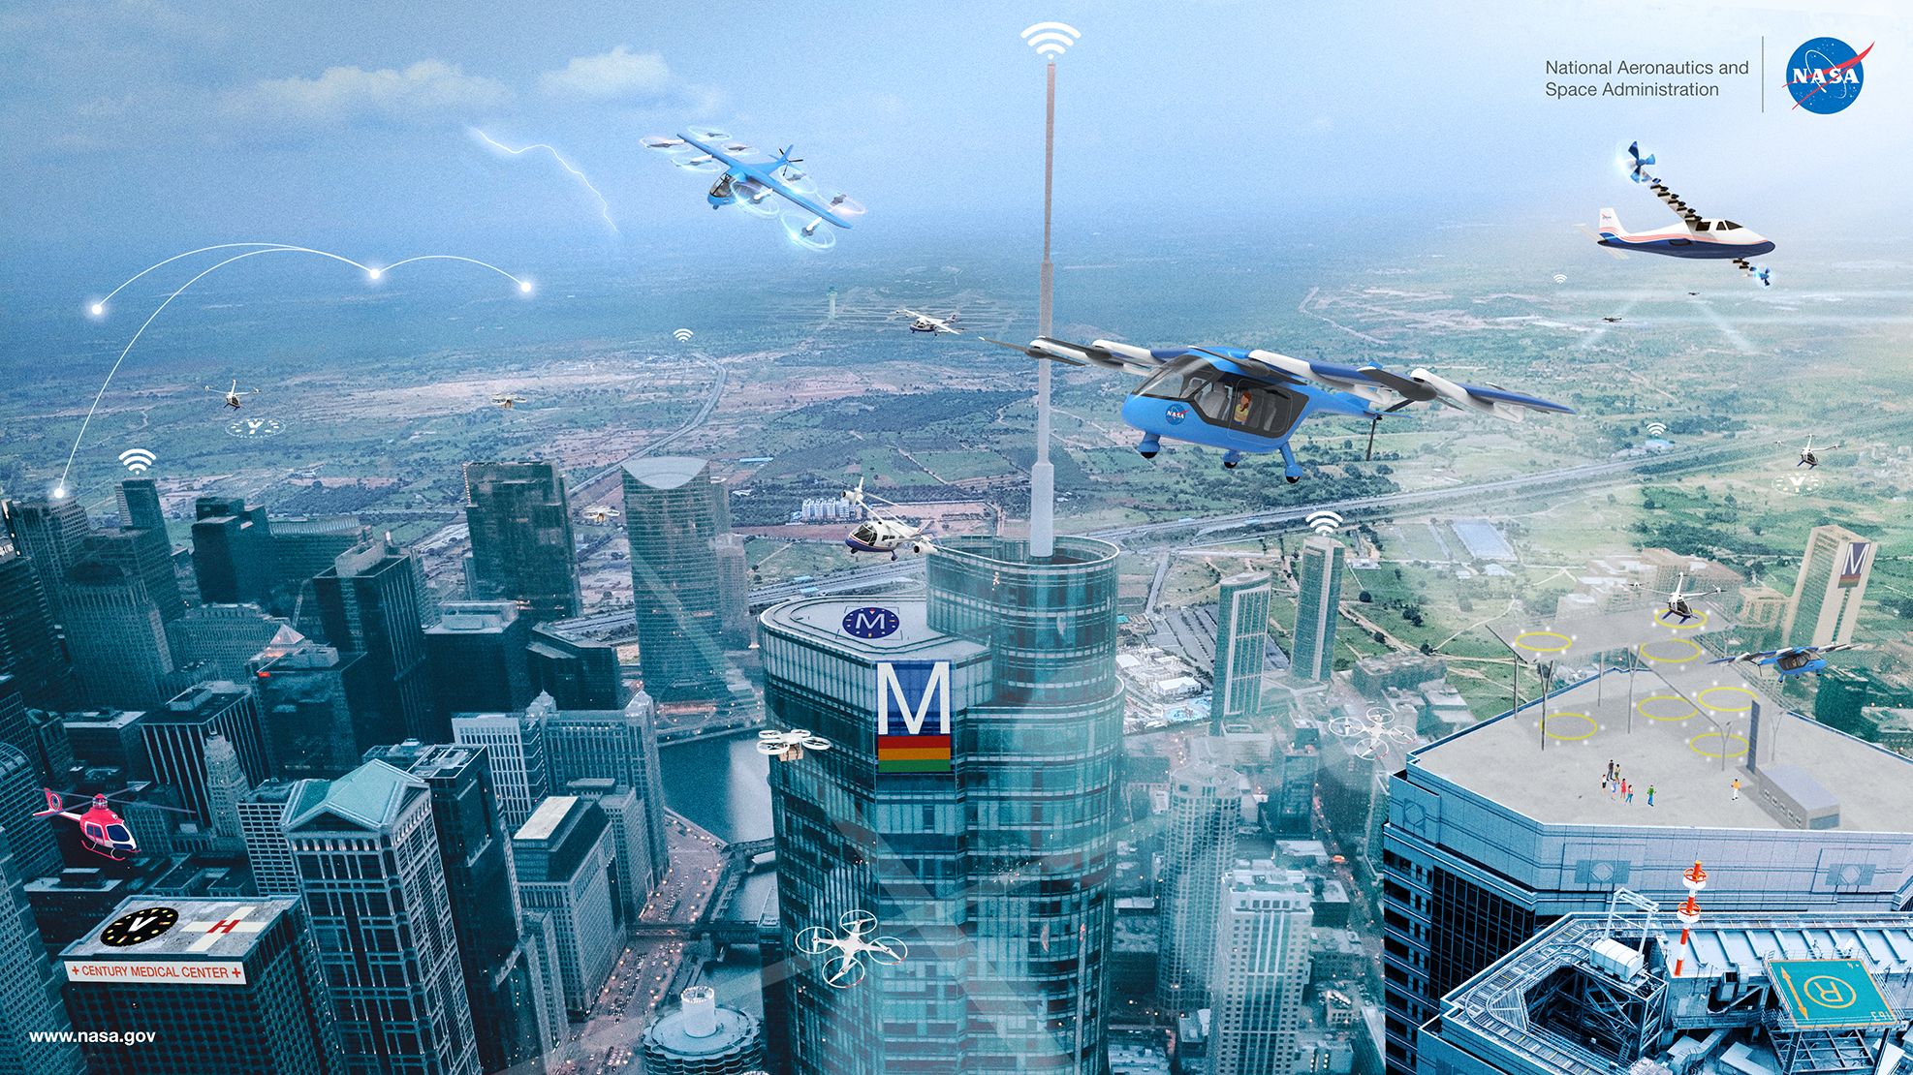
Advanced Air Mobility (AAM)

Slide 3
Research Scope and Approach
Human-Autonomy Teaming (HAT) Foundational Research Activity
  Goal: Identify capabilities and principles that facilitate humans and Increasingly Autonomous Systems working and thinking better together
  Approach: Provide basic research that advances the field of HAT through theory-development and controlled laboratory experiments
Pertinent HAT Constructs
Practical HAT Considerations
Trust calibration: How can inter-agent trust be appropriately built, calibrated, and leveraged to establish roles, authority, and transitions of control?
Performance measurement: How can human-machine team performance be measured and leveraged to enable ongoing system performance improvements?
Shared situation models: How can a common knowledge base and capability for intent inferencing between human and machine agents be established?
Contingency management: How can we ensure that human-machine teams retain or improve upon current capabilities to sustain operations under expected, uncertain, unanticipated, and unpredicted conditions?
Teaming models: What models of multi-agent interaction should be used, and how can we evaluate them?
Paths to operational approval: What are the viable paths to certification and operational approval of human-machine teaming concepts?
J. B. Holbrook et al., "Enabling Urban Air Mobility: Human-Autonomy Teaming research challenges and recommendations," in AIAA Aviation Forum, Virtual Meeting, 2020.

Slide 4
Research Scope and Approach
Human-Autonomy Teaming (HAT) Foundational Research Activity
  Goal: Identify capabilities and principles that facilitate humans and Increasingly Autonomous Systems working and thinking better together
  Approach: Provide basic research that advances the field of HAT through theory-development and controlled laboratory experiments
Pertinent HAT Constructs
Practical HAT Considerations
Trust calibration: How can inter-agent trust be appropriately built, calibrated, and leveraged to establish roles, authority, and transitions of control?
Performance measurement: How can human-machine team performance be measured and leveraged to enable ongoing system performance improvements?
Shared situation models: How can a common knowledge base and capability for intent inferencing between human and machine agents be established?
Contingency management: How can we ensure that human-machine teams retain or improve upon current capabilities to sustain operations under expected, uncertain, unanticipated, and unpredicted conditions?
Teaming models: What models of multi-agent interaction should be used, and how can we evaluate them?
Paths to operational approval: What are the viable paths to certification and operational approval of human-machine teaming concepts?
J. B. Holbrook et al., "Enabling Urban Air Mobility: Human-Autonomy Teaming research challenges and recommendations," in AIAA Aviation Forum, Virtual Meeting, 2020.

Slide 5
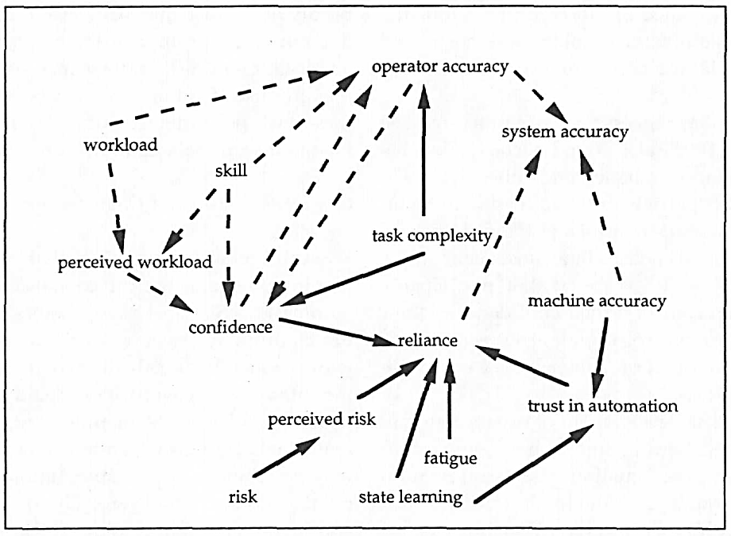
Non-Trust Factors Influence Human Behaviors
Parasuraman, R., & Riley, V. (1997). Humans and automation: Use, misuse, disuse, abuse. Human Factors, 39 (2), 230-253

Slide 6
HAT and Trust
HAT – humans and increasingly autonomous systems working and thinking better together (Holbrook et al., 2020)
  Team: a distinguishable set of two or more agents who interact, dynamically, interdependently, and adaptively toward a common and valued goal/objective/mission (Salas et al., 1992)
Trust is an inherent requirement in effective teams (Salas, Sims, & Burke, 2005)
  When team members (humans, automation) work interdependently they must be willing to accept a level of risk to rely upon each other to reach goals, contribute to team tasks, and cooperate confidently
  Without trust, team members tend to expend excessive time and effort crosschecking and inspecting each other, as opposed to collaborating toward an overall goal
Trust is an attitude that an agent will help achieve an individual’s goals in a situation characterized by uncertainty and vulnerability (Lee & See, 2004, p. 51)
  Perceived risk of vulnerability determines if trust translates into a behavioral response (Chancey, Bliss, Yamani, & Handley, 2017)
    trust < perceived risk → disused, ignored, disabled

Slide 7
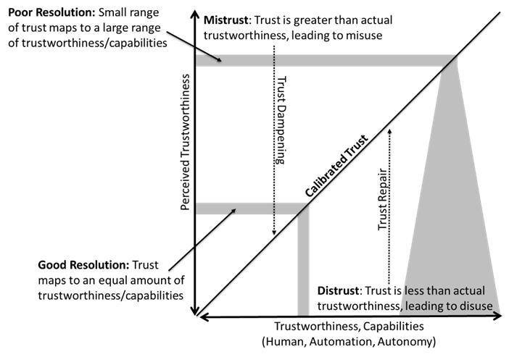
Trust Calibration
Trust Calibration – degree of appropriateness

Slide 8
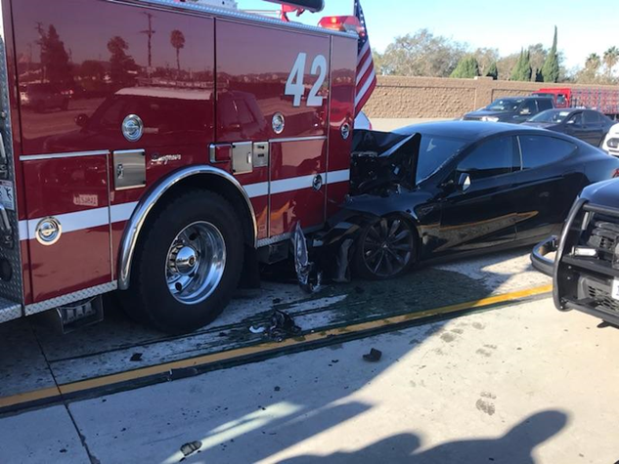
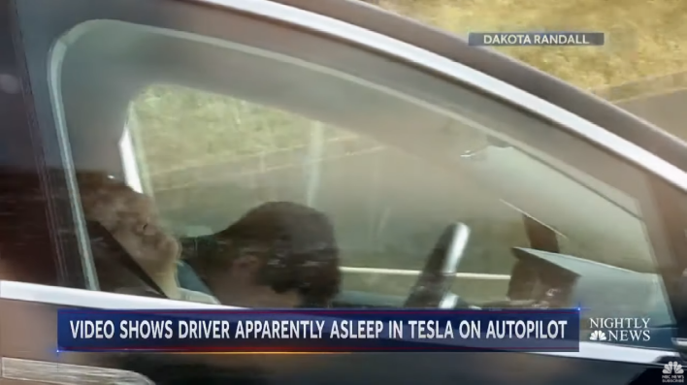
Trust Calibration
Trust Calibration – degree of appropriateness

Slide 9
Trust Calibration
Trust Calibration – degree of appropriateness
“Some military pilots I know admit to witnessing the removal of circuit breakers so as to disable flight warning systems” (Sorkin, 1988, p., 1107)
In a recent study on trust in the Automatic Ground Collision Avoidance System (Auto-GCAS), pilots conveyed accounts from other pilots of system failures resulting in crashes, even though Auto-GCAS had not been installed on the crashed aircraft in question (Ho, Sadler, Hoffmann, Lyons, & Johnson, 2017).

Slide 10
Trust Calibration
Trust Calibration – degree of appropriateness
Operationalizing Trust Calibration:
Probability Matching (Bliss et al., 1995; Manzey, Gerard, & Wiczorek, 2014; Wiegmann et al., 2001)
  Participants agree with a system at a rate comparable to the perceived reliability of it (e.g., agree with the system 80% of the time if perceived to be 80% reliable)
  Results seem to incentivize designing for over trust in automation
System Monitoring (Moray & Inagaki, 1999)
  Monitor the system at some “optimal”/ eutactic rate
  Complacent (over trust) vs. skeptical (under trust)
  Optimal needs to be operationally defined, which is difficult…
    Clever/contrived tasks (Bahner, Huper, & Manzey, 2008)
    Nyquist Sampling theorem (Moray, 2003)
    SEEV Model (Wickens & McCarely, 2008)
    Eye tracking (Karpinsky, Chancey, Palmer, & Yamani 2018; Karpinsky, Chancey, & Yamani, 2016ab)
Notes:
Salience, Effort, Expectancy, Value

Slide 11
Bases of Trust
Informs the trustor (human/automation) about the ability of the trustee (human/automation) to achieve the goal of the trustor
  Type of information/belief structures that describes the trustee (Lee & See, 2004; Lee &Moray, 1992,1994; Interpersonal Trust [Rempel et al., 1985; Mayer et al., 1995])
    Performance (What): Corresponds to the current and historical operation of the automation
    Process (How): Corresponds to the appropriateness algorithms in achieving goals
    Purpose (Why): Corresponds to how well the designer’s intent has been communicated
Belief structures supporting trust could be conceptualized as the mental models of the automation
  Mental representation so system processes humans use to reason, infer, and predict technology behaviors (Allen, 1997; Moray, 1998, 1999; Norman, 1983)
  Homomorphic approximations of the target system (not complete or accurate)
  Dynamically evolve through interactions with system and prior experience/knowledge
Trust Calibration – Appropriate mental models for what the automation is doing (Performance), how it is doing it (Process), or why it was developed (Purpose) will lead to well-calibrated trust in the automation

Slide 12
User Model vs. Design Model
User Model: User’s mental model of the automation
Design Model: Designer’s mental model of the automation
  Based on task and technical limitations of the automation
  Should be based on capabilities, limitations, attitudes, and behaviors of the human
  If Design Model and User Model are aligned, trust should be appropriately calibrated

Slide 13
System Image
User Model: User’s mental model of the automation
Design Model: Designer’s mental model of the automation
  Based on task and technical limitations of the automation
  Should be based on capabilities, limitations, attitudes, and behaviors of the human
  If Design Model and User Model are aligned, trust should be appropriately calibrated
System Image
Physical system (UI, Control), training, and instructional documentation
Design Model
Performance
Process
Purpose
User Model
Performance
Process
Purpose
Transparency

Slide 14
Transparency
Transparency is “… the communication of system-centered factors and human-centered factors that promote shared awareness and shared intent within a human-machine team” (Lyons, Clark, Wagner, & Schuelke, 2017, p. 41; Lyons, 2013)
  Task Model – information that allows the human to analyze the actions of the automation
  Analytical Model – information that allows the user to analyze how the automation is making decisions (calculations, algorithms, reasons for system errors)
  Intentional Model – Information that helps the user analyze way the automation was created and place actions in appropriate strategic context
A transparent System Image is a design and training technique that translates the Design Model into the User’s Model, with the particular purpose of calibrating human-automation trust to match automation capabilities (i.e., trustworthiness)

Slide 15
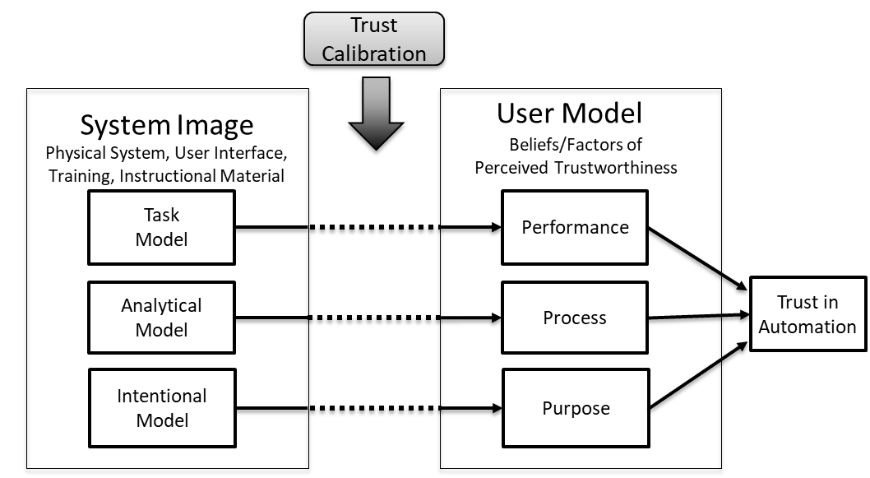
Trust Calibration

Slide 16
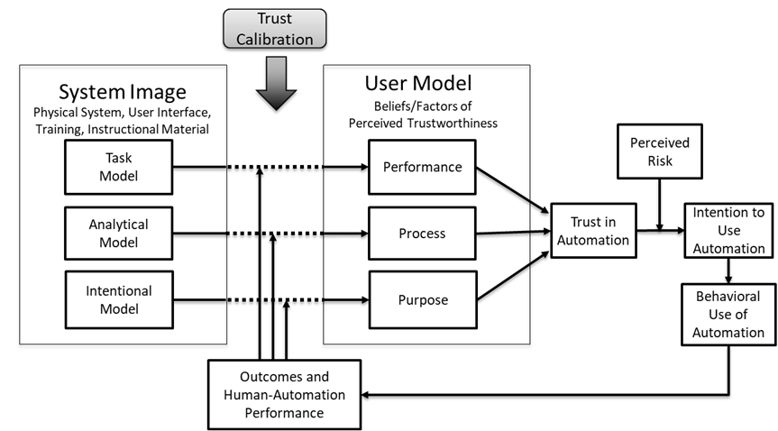
Fixed Design

Slide 17
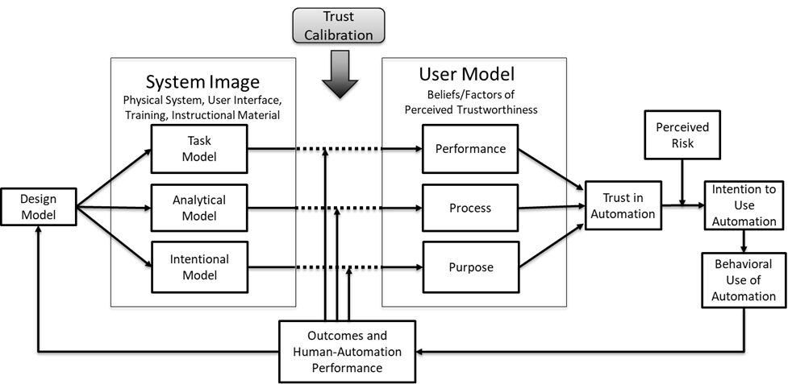
Iterative Design

Slide 18
Iterative Design
Lends itself to iterative experimentation
  Validation of theoretical concepts
  Operationalizing trust calibration (e.g., use of eye tracking for monitoring behaviors, operator response behaviors toward automation, physiological reactions during human-automation teaming sessions, validated theoretically-based trust questionnaires)
  Operationalizing and formalizing mental models (e.g., use of Lattice Theory Notation, Pathfinder Network Analysis, Conant Method of Expected Dependency)
  Correlation between mental models and trust
  Correlation between user model and designer model is mediated by system image (i.e., display, training)
  Match (mismatch) between user and design model leads to trust calibration (mis/discalibration)

Slide 19
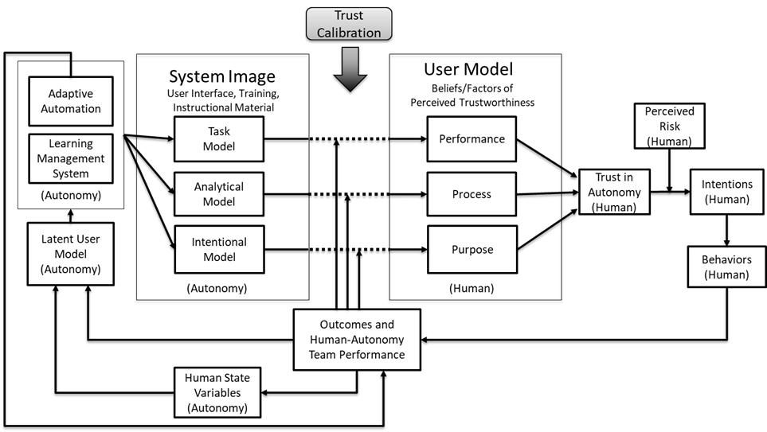
Adaptive Trust Calibration

Slide 20
Adaptive Trust Calibration
Closing the loop does not require iterative experiments
Baseline to establish current state of human (fatigue, workload, attentional tunneling), given physiological metrics available (Stephens et al., 2018)

Slide 21
Adaptive Trust Calibration
Closing the loop does not require iterative experiments
Dynamic analog to the Design Model – system constructs hypothesized User Model to anticipate potential mis/dis-calibration
Lattice Theory (Moray 1998; 1999)
Conant Method of Extended Dependency Analysis (Jamieson, 1996; Conant, 1976, 1996; Moray)
  Eye Tracking

Slide 22
Adaptive Trust Calibration
Closing the loop does not require iterative experiments
Dynamically reconfigure or add/remove informational elements in the display
Machine Learning: Houston, Barrows, Manuel, & Le Vie, 2018; Houston, Manuel, Gizzi, & Barrows, 2019; Houston & Le Vie, 2017
Bio-Cybernetic: Prinzel, Pope, & Freeman, 2002; Prinzel & Scerbo, 1995; Prinzel, Parasuraman, & Freeman, 2003 etc.

Slide 23
Adaptive Trust Calibration
Closing the loop does not require iterative experiments
Tailored training material
Blackboard®
USAF AI scheduling algorithms (Carlin, Ward, & Freeman, 2016)

Slide 24
Adaptive Trust Calibration

Slide 25
Conclusion

Slide 26
Questions?
Dr. Eric T. Chancey
NASA Langley Research Center
Crew Systems and Aviation Operations Branch
eric.t.chancey@nasa.gov
Mr. Michael S. Politowicz
NASA Langley Research Center
Crew Systems and Aviation Operations Branch
michael.s.politowicz@nasa.gov
Ms. Lisa R. Le Vie
NASA Langley Research Center
Autonomous Integrated Systems Research Branch
lisa.r.levie@nasa.gov

