Slide 1
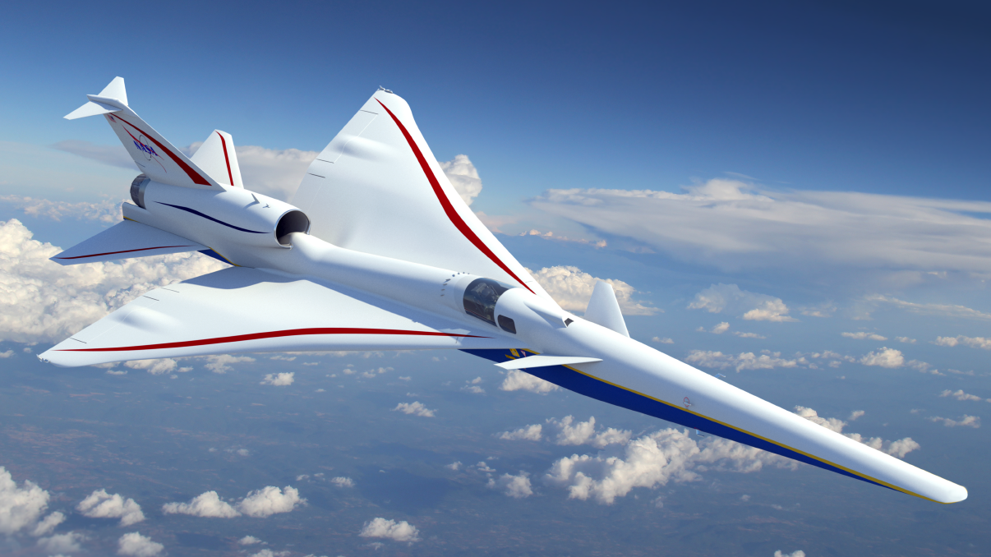

NearField Summary and Analysis of the Third AIAA Sonic Boom Workshop Shock-Plume Interaction Case
Melissa Carter &
Michael Park
NASA Langley Research Center
Copyright 2021 United States Government as represented by the Administrator of the National Aeronautics and Space Administration. No copyright is claimed in the United States under Title 17, U.S. Code. All Other Rights Reserved. Published by the American Institute of Aeronautics and Astronautics, Inc. with permission.

Slide 2
Workshop Objective
The objective of the Third Sonic Boom Prediction Workshop was to assess the state of the art for predicting nearfield signatures with Computational Fluid Dynamics (CFD) and propagation codes used to propagate nearfield signatures to the ground.

Slide 3
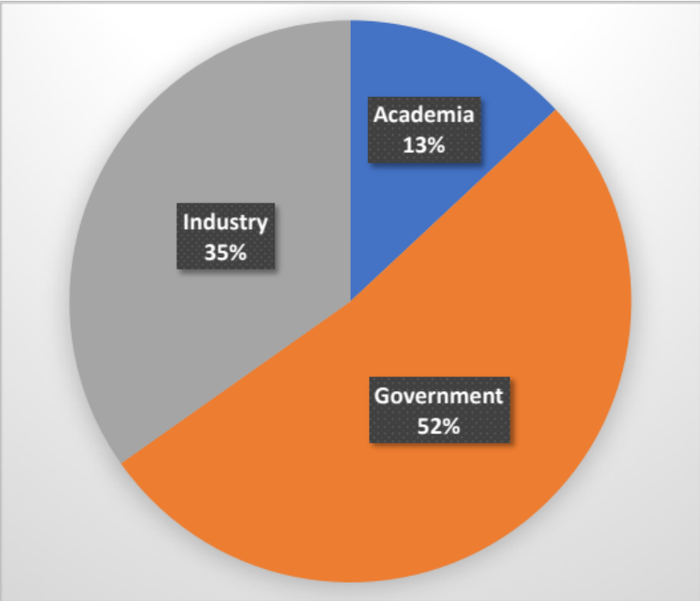
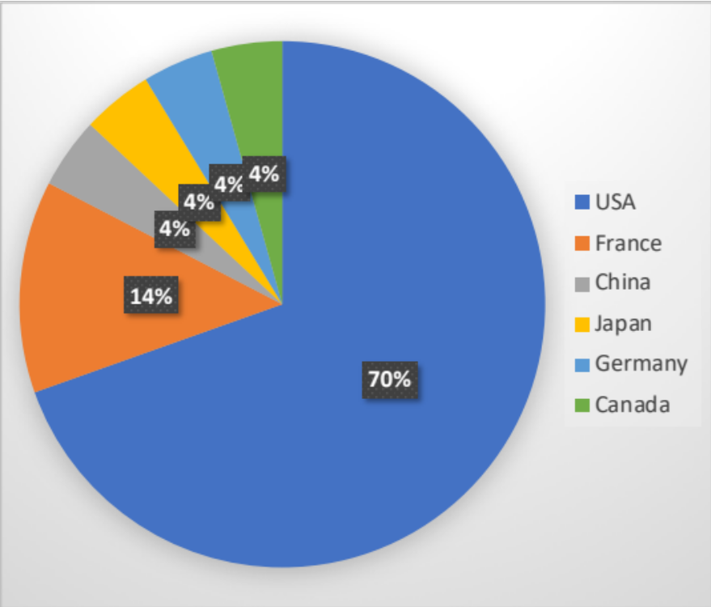
3rd Workshop: 23 participants
ANSYS
Boeing
Boom Aero
DASSAV
DLR
FAA
INRIA
JAXA
Lockheed Martin
Metacomp
NASA
Northwestern Polytech
ONERA
Penn State
Siemens
Texas A&M
Volpe

Slide 4
Workshop Culture
Adjectives such as good, bad, right, and wrong oversimplify issues and should be avoided
Focus on describing observed differences and communicate why things are different

Slide 5
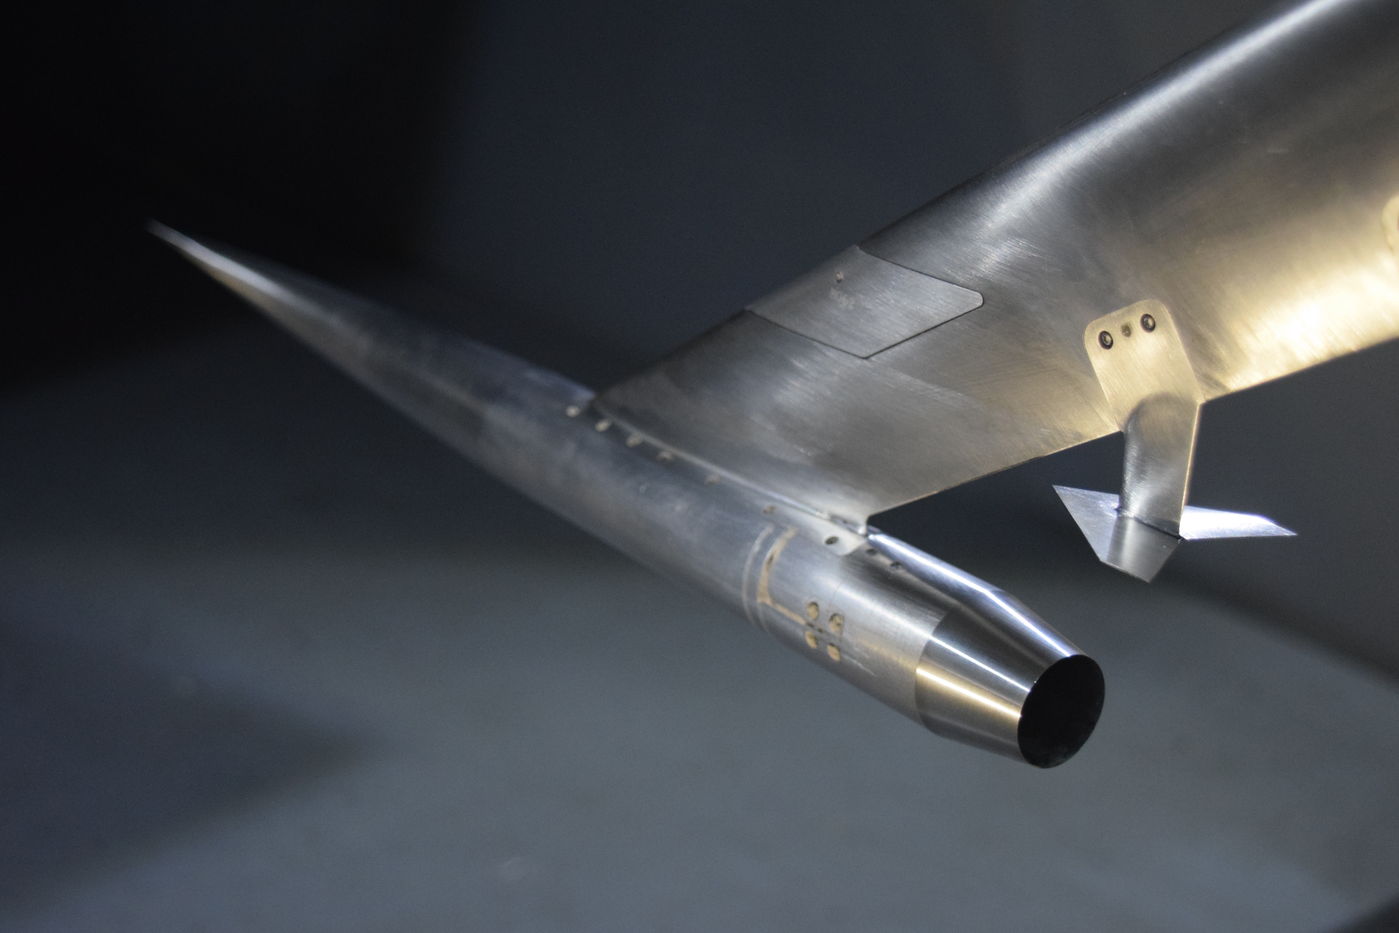
Models and Cases
Biconvex
Ames 9’x7’ UPWT Biconvex Plume-Shock Interaction Case
C608, an early X-59 Prototype
IGES and STEP geometry files along with workshop generated grids provided
C608

Slide 6
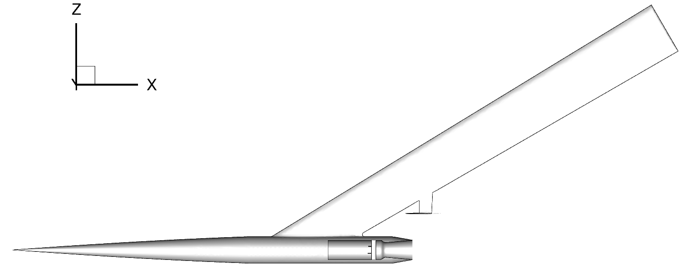
Biconvex computational model
Biconvex
Nozzle lip

Slide 7
Simulation Conditions
1.6 Mach
0.0$°$ angle of attack
0.0° angle of attack
Geometry and grid provided in correct orientation
374 degrees Rankine temperature
376,850 Reynolds number per inch
8.0 Engine plenum pressure ratio, P_{T}/P∞
1.768 Engine plenum temperature ratio, T_{T}/T∞
Data extracted at Z~15 inches, at 3 Phi angles
Phi angles of approx. 0$°$, 15$°$ and 30$°$
Phi angles of approx. 0°, 15° and 30°
7

Slide 8
Grid Details
Tetrahedral Grids
Scale | Nodes | Tetrahedral
1.57 | 846,227 | 4,785,786
1.28 | 1,576,352 | 8,977,516
1.00 | 3,286,221 | 18,815,990
Mixed-Element Grids
Scale | Nodes | Tetrahedral | Prisms | Pyramids
1.57 | 846,227 | 2,825,421 | 650,469 | 4479
1.28 | 1,576,352 | 5,984,989 | 993,489 | 6030
1.00 | 3,286,221 | 14,627,534 | 1,388,470 | 11523

Slide 9
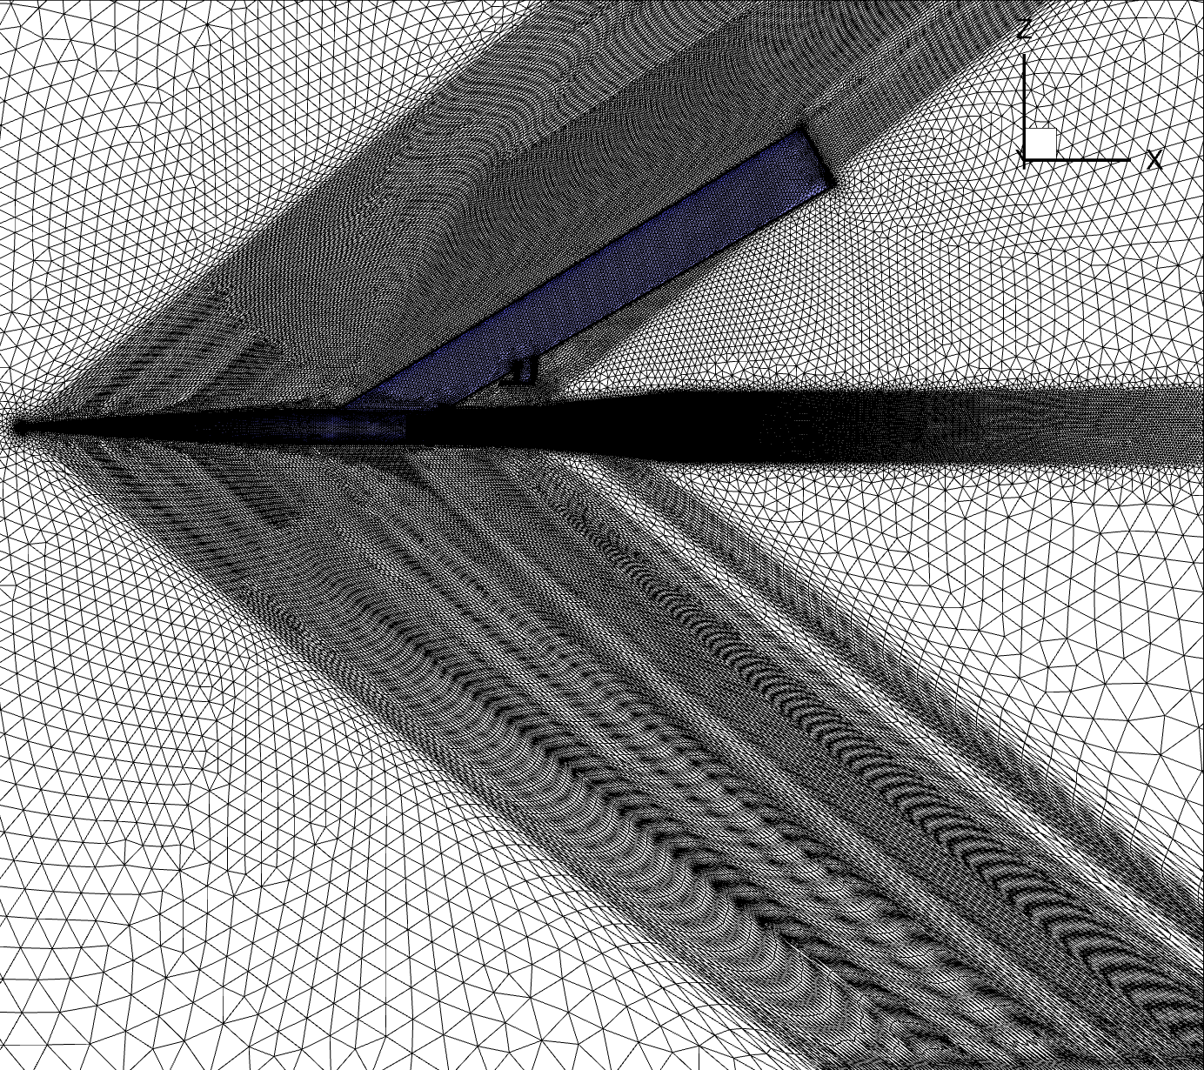
Grid 100 (fine grid) Tetrahedral
Signature is ~15” below the model

Slide 10
BiConvex Submissions

Slide 11
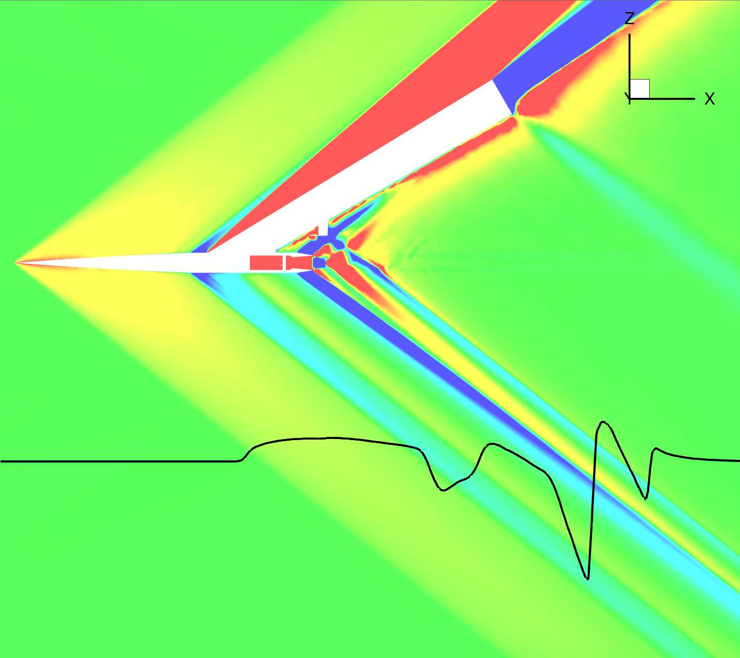
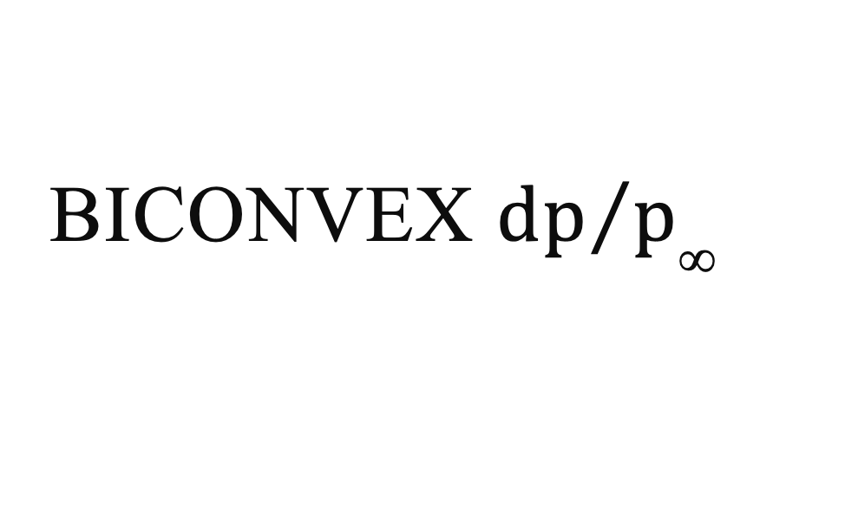
BiConvex ${dp}/{p_{\text{∞}}}$
Grid 100
Tetrahedral
USM3D
Production
code
dp/p∞ which is the pressure disturbance normalized by freestream pressure
~15"
Biconvex
shock
Nose
shock
Strut
shock
Nozzle
lip shock

Slide 12
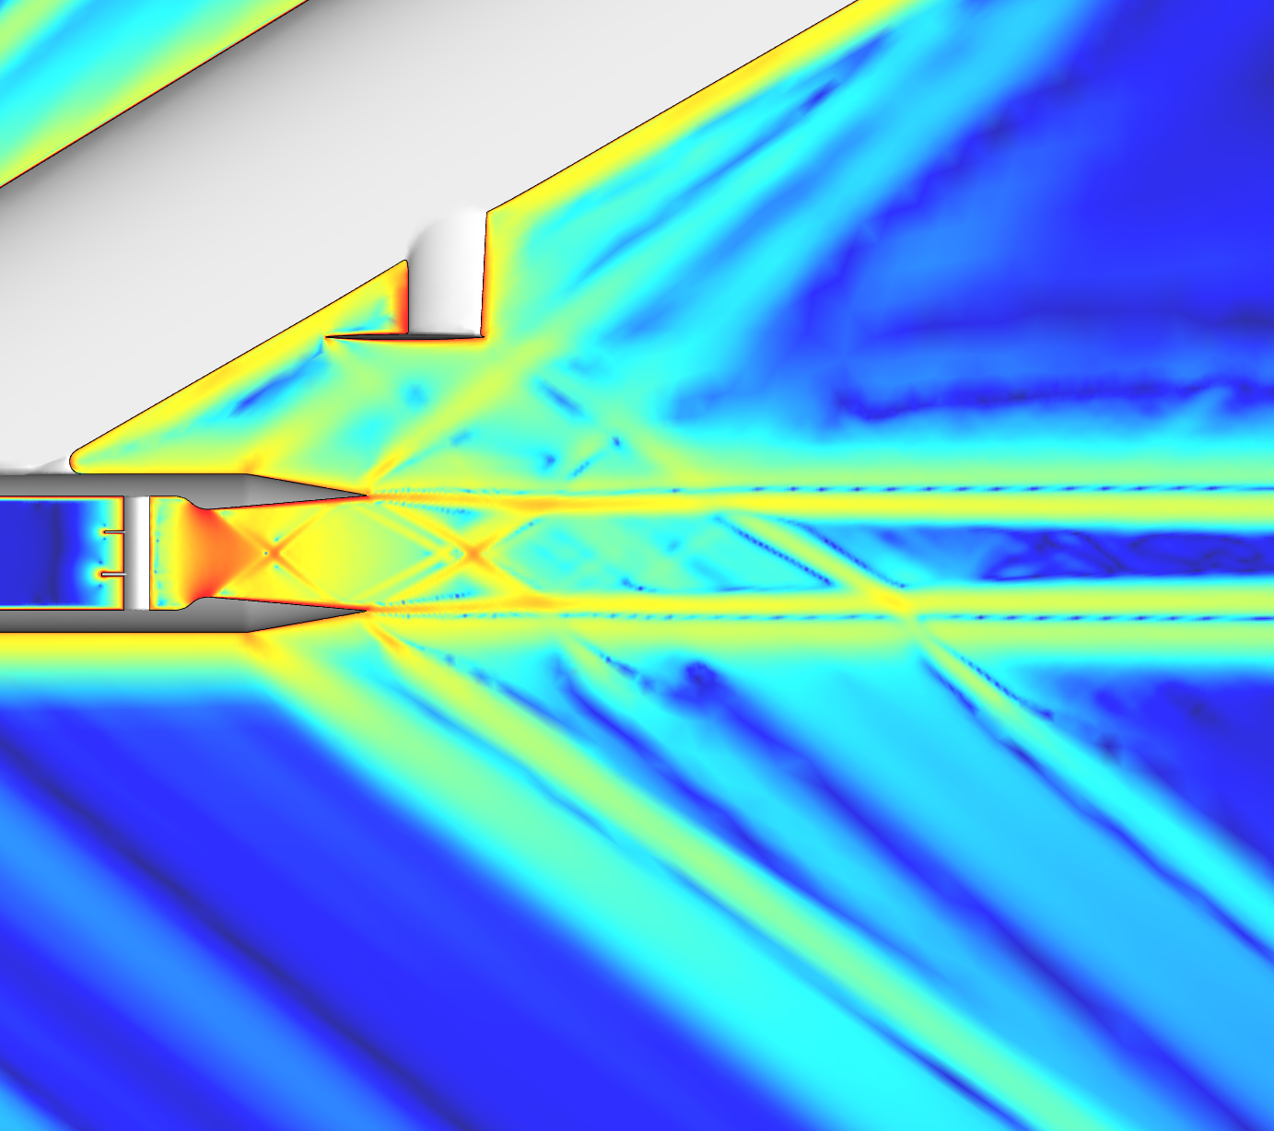
BiConvex density gradient
Grid 100
Tetrahedral
USM3D
Production
code
Density gradient

Slide 13
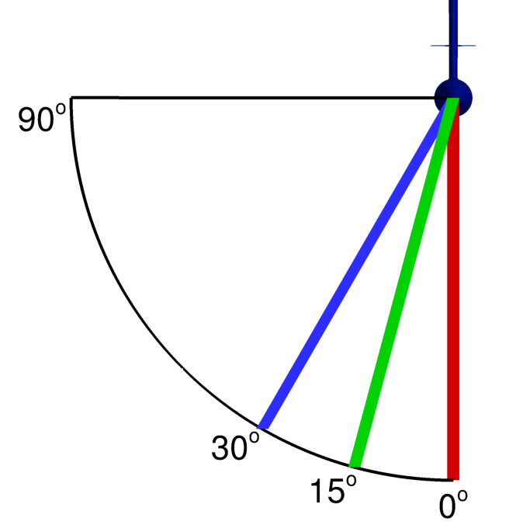
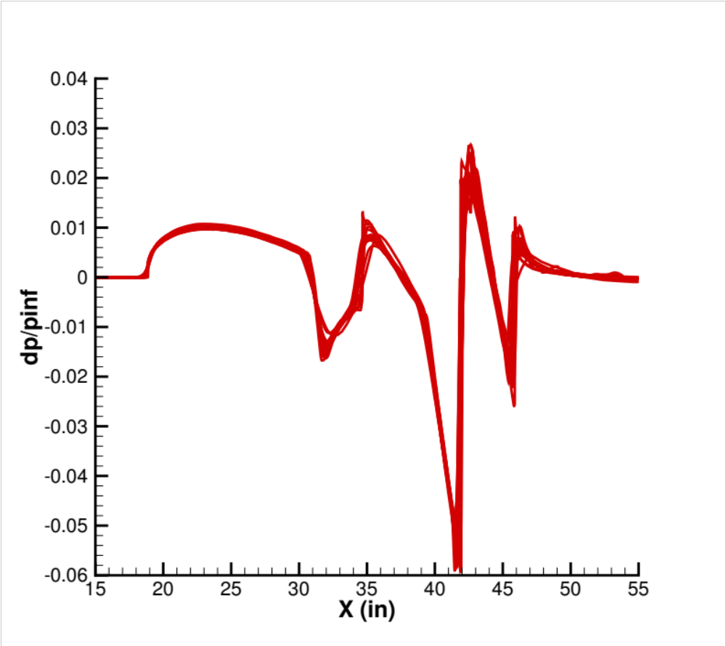
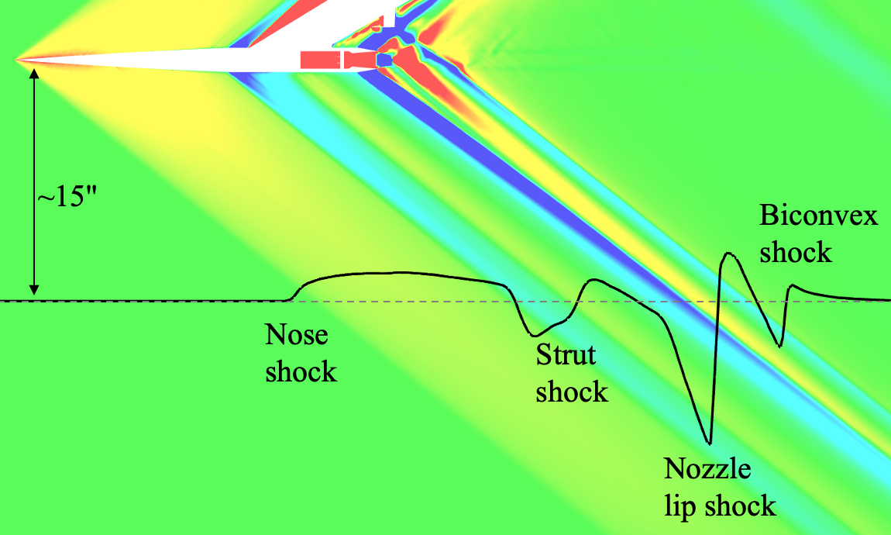
BiConvex Fine-Grid
PHI=0°
N=31
dp/p∞

Slide 14
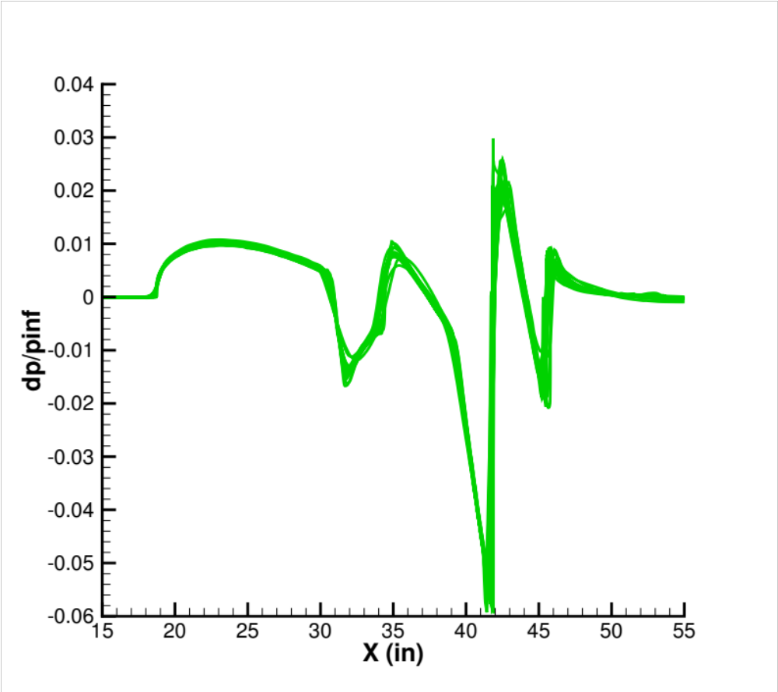
BiConvex Fine-Grid
PHI=15°
N=31
dp/p∞

Slide 15
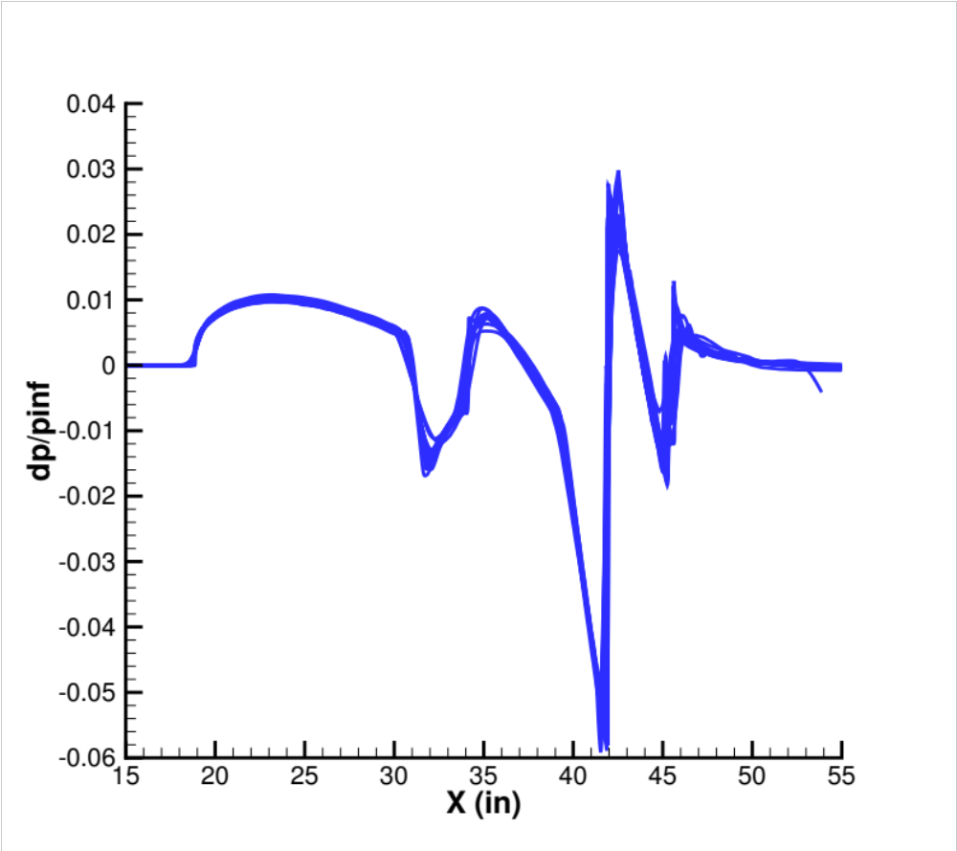
BiConvex Fine-Grid
PHI=30°
N=31
dp/p∞

Slide 16
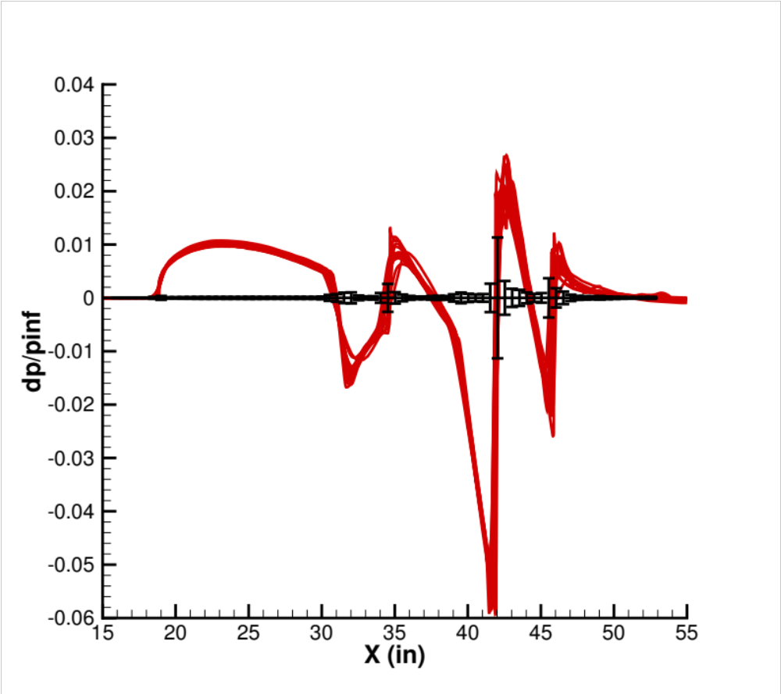
Biconvex Fine-Grid Ensemble With Standard Deviation
PHI=0°
N=31
dp/p∞

Slide 17
Identification of Outliers
Goal is to use an objective tool to identify and learn from differences in submissions
Previous workshop used box and whisker plots with an effective coverage factor of 2 (exceed 95% likelihood)
Coverage factor of 1 (exceed 68% likelihood) used here

Slide 18
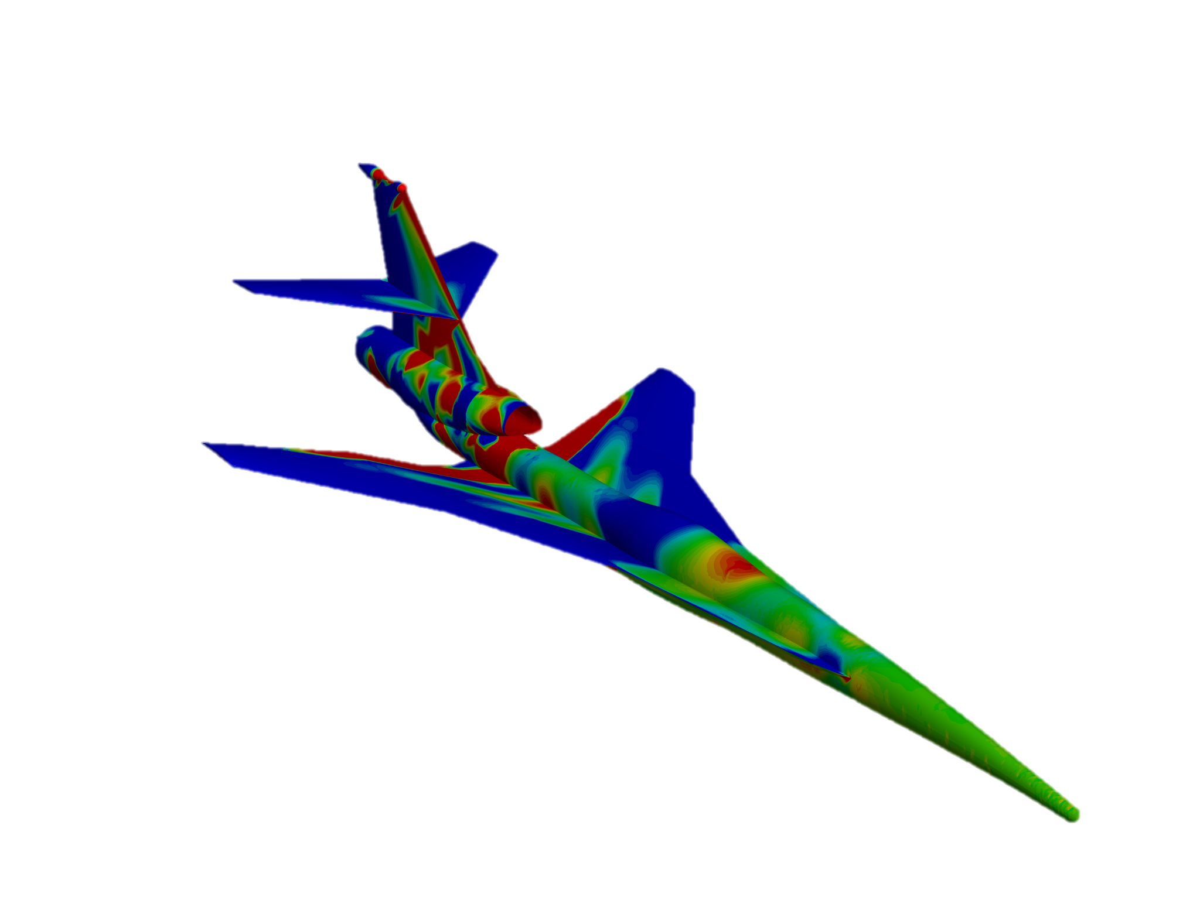
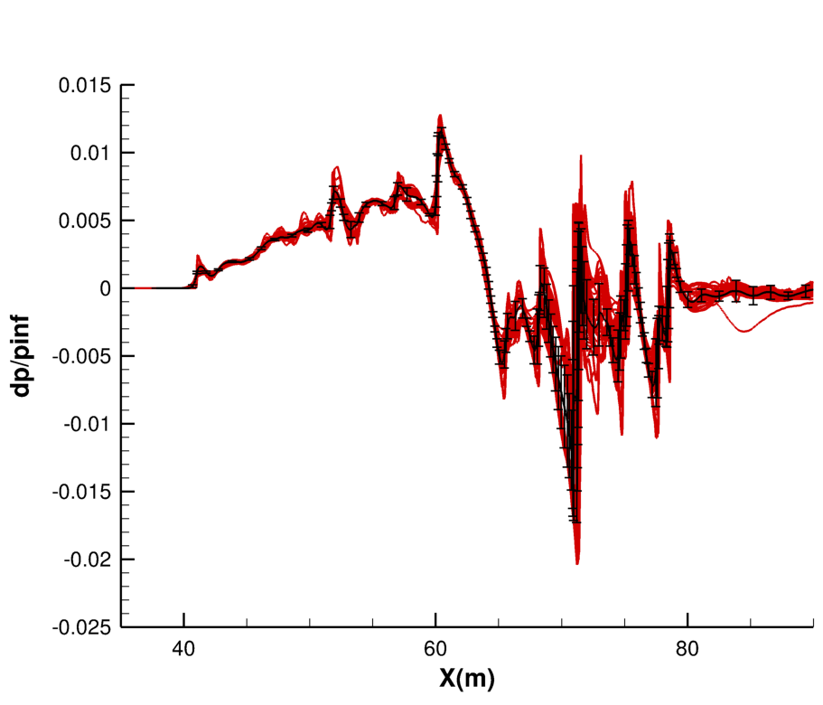
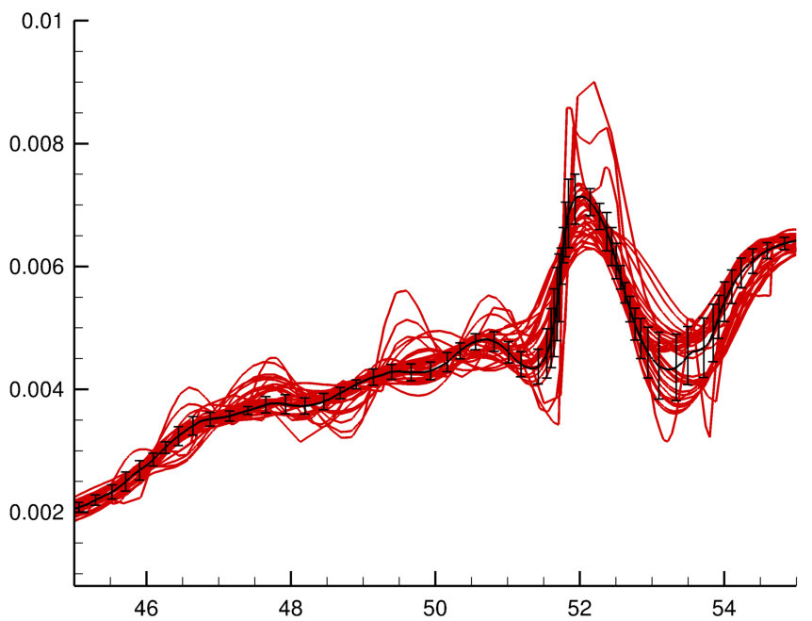
SBPW2 C25P Context
dp/p∞
PHI=0°
1 Body Length

Slide 19
Biconvex Fine-Grid Ensemble With Standard Deviation
PHI=0°
N=31
dp/p∞

Slide 20
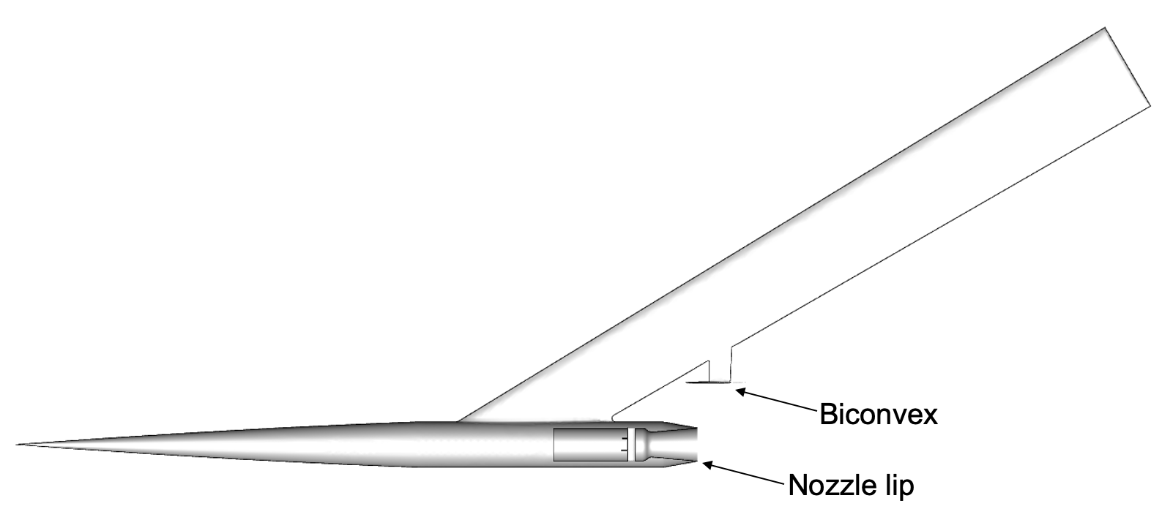
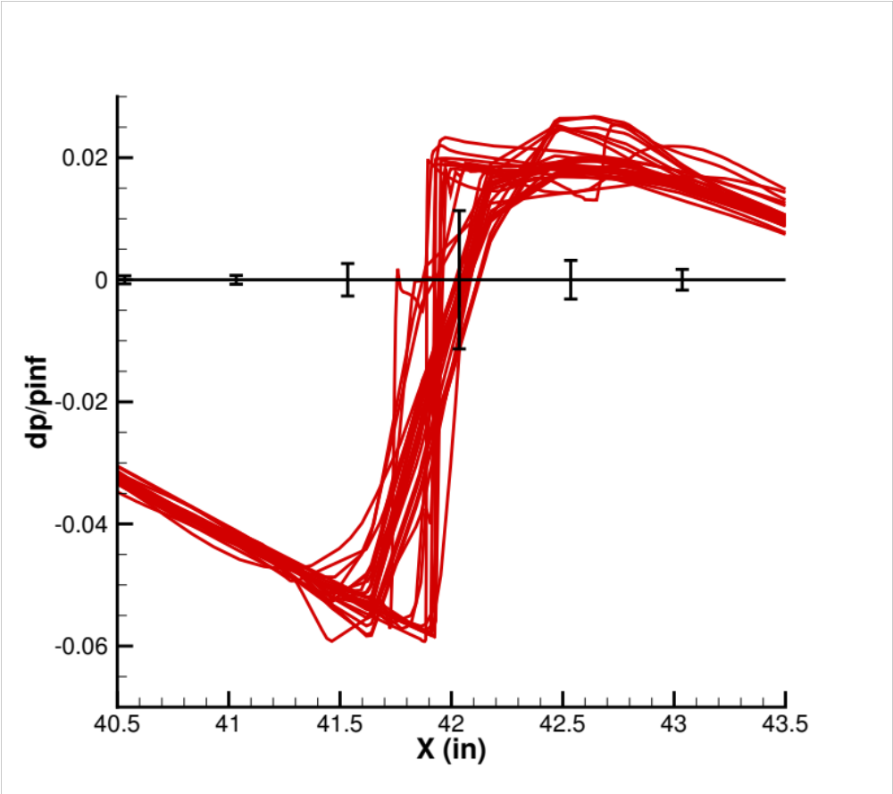
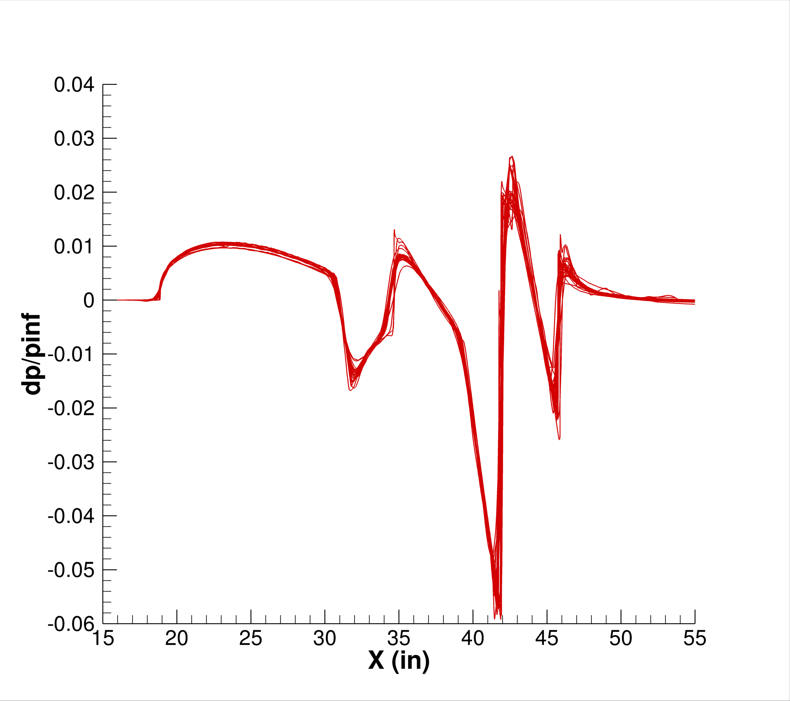
Nozzle Lip Shock
dp/p∞
dp/p∞
PHI=0°

Slide 21
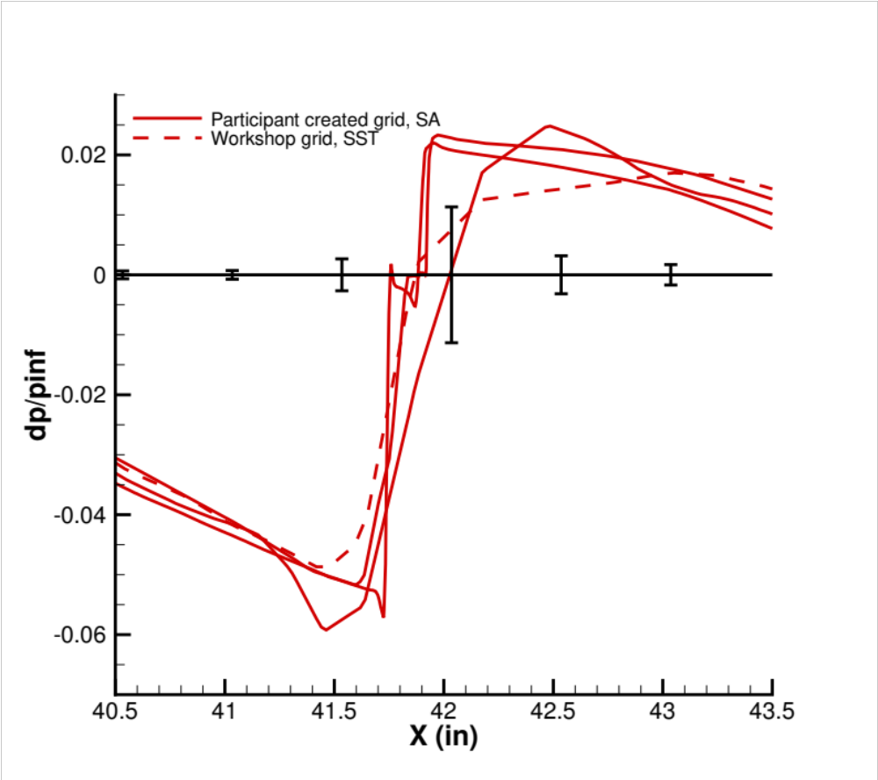
Nozzle Lip Shock Integral Outliers
dp/p∞
dp/p∞
PHI=0°

Slide 22
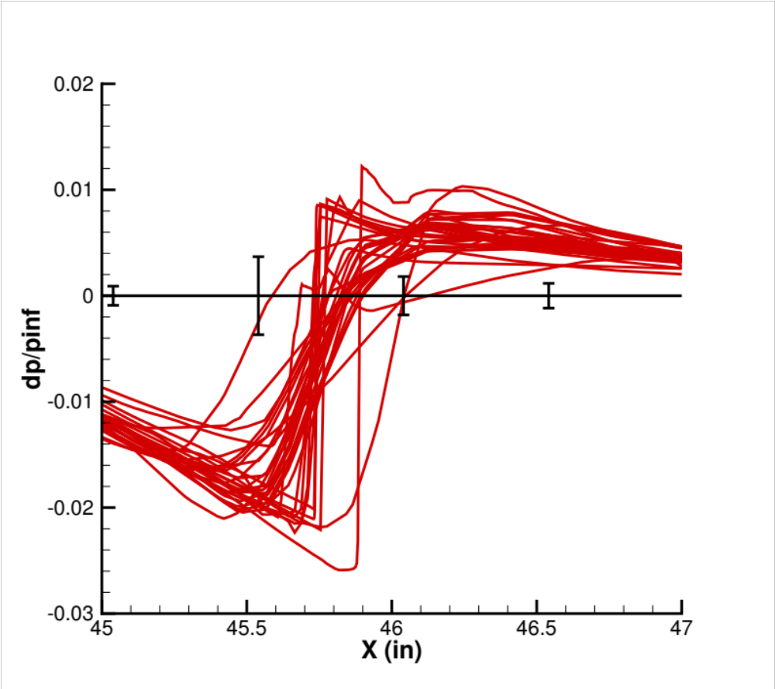
BiConvex Shock
dp/p∞
dp/p∞
PHI=0°

Slide 23
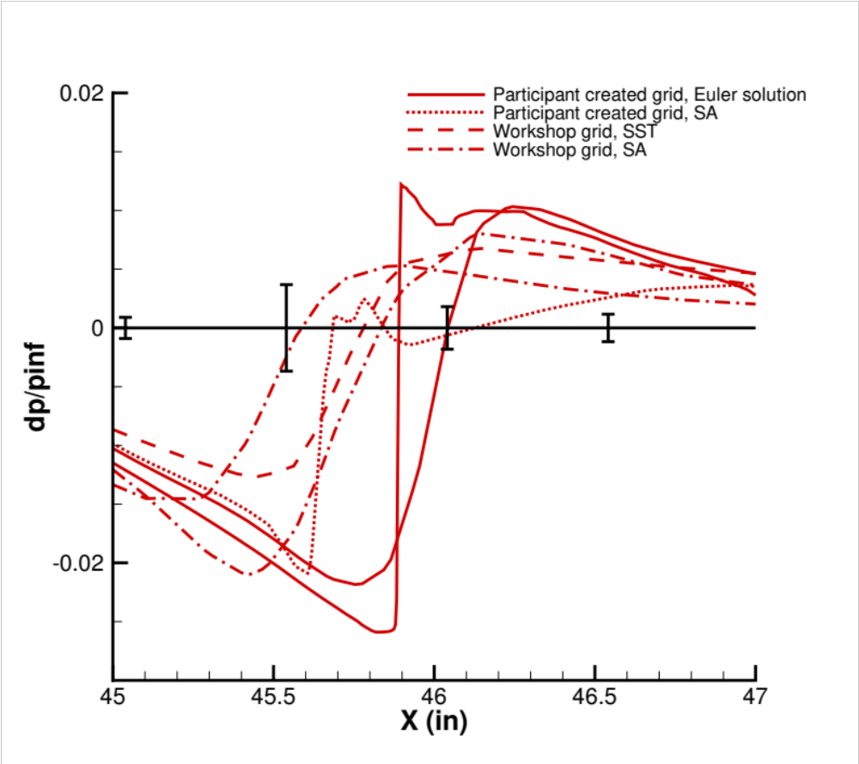
BiConvex Shock
Outliers
dp/p∞
dp/p∞
PHI=0°

Slide 24
Biconvex Summary
Participant submissions tightly grouped and strict criteria required to identify outliners
Outliers were identified in multiple regions:
  Majority of outliers from the nozzle lip shock were from participant created grids
  Three outliers from the biconvex shock solutions provide an opportunity to further investigate the cause of the slight differences

Slide 25
Conclusions
Sincere thank you to all the participants!
These cases included propulsion boundary conditions and realistic geometry making them the hardest attempted in the workshop series
The variation is lowest of SBPW, requiring a stricter criterion to identify outliers
  A coverage factor of one was used (outliers exceed 68% likelihood) via sample mean and standard deviation
  SBPW-2 coverage factor of two (outliers exceed 95% likelihood) via box and whisker plots

