Slide 1
Development of Buffet Forcing Functions using Frequency-Dependent Coherence Factors
J. Micheal Ramey, Martin K. Sekula, David J. Piatak,
Patrick S. Heaney, and Francesco Soranna
NASA Langley Research Center
Aeroelasticity Branch
Hampton, VA
AIAA SciTech Forum, 11-15 & 19-21 January 2021
Copyright 2021 United States Government as represented by the Administrator of the National Aeronautics and Space Administration. No copyright is claimed in the United States under Title 17, U.S. Code. All Other Rights Reserved. Published by the American Institute of Aeronautics and Astronautics, Inc. with permission.

Slide 2
Agenda
Background and Motivation
Methodology
  Current Methodology
  Updated Methodology
Results
  Buffet Verification Test (BVT) results
  Space Launch System (SLS) Block 1 Crew launch vehicle results
Applicable Conclusions

Slide 3
Launch Vehicle Buffet
Launch vehicle buffet environments
  Aerodynamic loads caused by fluctuating pressures on the surface of the vehicle
  Can excite both global and local vehicle structural responses
Typically modeled with buffet forcing functions (BFFs)
  Time histories of orthogonal forces acting on the centerline of the vehicle
  BFFs are developed using wind-tunnel data from rigid models highly-instrumented with unsteady pressure transducers
  Each transducer acts on a surface patch, which is assumed to be consistent throughout
To reduce over-conservatism, coherence-based factors are employed
This work proposes a new implementation to improve forcing functions

Slide 4
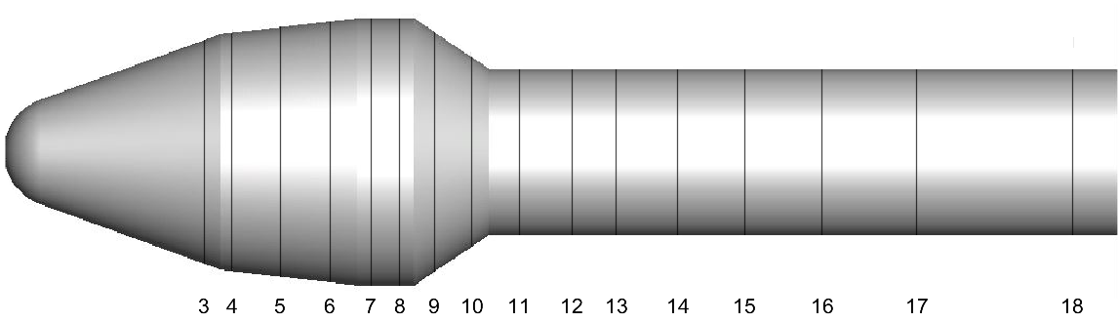
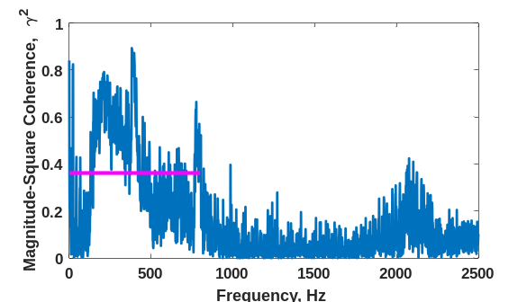
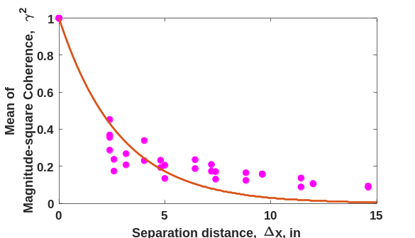
Current Approach – Longitudinal Coherence Factors
Aerodynamic Region ID
  Established based on major changes in the local aerodynamic environment
  Employ a coefficient of determination analysis to provide rigor to the selection of boundaries
Mean Longitudinal Coherence
  Calculate mean of magnitude-square coherence functions
  Plot the mean coherence as a function of separation distance
  Exponential fit using least squares method
  Determine coherence length
  Determine coherence factors
Region 1
Region 2
Region 3

Slide 5
Updated Approach – Frequency-Based Coherence Factors
Develop frequency-based coherence factors
  Calculate magnitude-square coherence functions across a set number of frequency bins rather than using the mean value
  Determine coherence factor for each bin
Apply frequency-based coherence factors
  Take Fast Fourier Transform (FFT) of each BFF
  Use a spline function to interpolate the coherence factors to each FFT frequency
  Multiply FFT coefficients by the interpolated coherence factors
  Apply inverse FFT to the adjusted values to produce new BFFs in the time domain
Challenge – How are user-defined aerodynamic regions selected?
  Aerodynamic regions could vary across the frequency spectrum, necessitating aero regions for each bin
  Impractical to define regions for each bin due to the user input needed

Slide 6
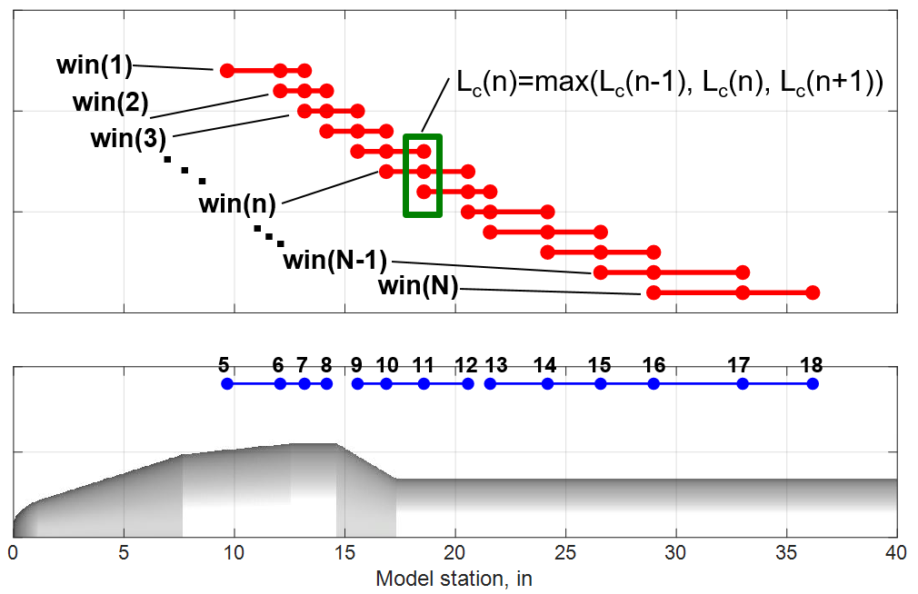
Updated Approach – Moving-Segment Aerodynamic Regions
Construction
  Eliminates the use of aerodynamic regions
  Series of overlapping, longitudinal segments
Implementation
  Calculate the coherence lengths for each segment
  At each station, select the maximum coherence value from the overlapping segments
Current Approach - Aerodynamic regions
1
2
3
Updated Approach - Moving segments

Slide 7
Analysis – Tests and Cases
Two tests will be examined
  Buffet Verification Test (BVT) – NASA Ames Research Unitary Plan Wind Tunnel 11x11 TWT
  SLS Block 1 Crew launch vehicle – NASA Langley Transonic Dynamics Tunnel
Four combinations of analysis examined for each test
  MCU – Mean Coherence User-defined
  MCM – Mean Coherence Moving-segment
  FCU – Frequency-dependent Coherence User-defined
  FCM – Frequency-dependent Coherence Moving-segment
Comparison Cases
  BVT Test: full integration of unsteady pressure sensitive paint (uPSP) pressures
  SLS Test: program-accepted BFFs (MCU, or baseline)

Slide 8
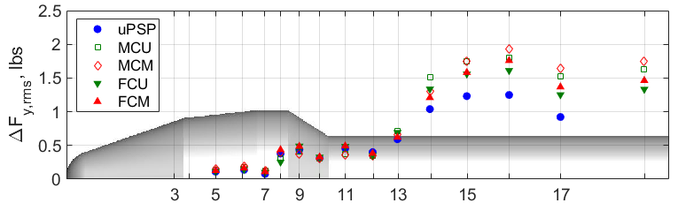
BFF rms Comparisons
BVT Test: M = 0.92, α = β = 0˚
In general, the different approaches follow the same trends
Where there are differences, the mean coherence approaches usually have the largest overprediction vs. the uPSP integration
The user-defined approaches compare well to the moving-segment approach counterparts
1
2
3

Slide 9
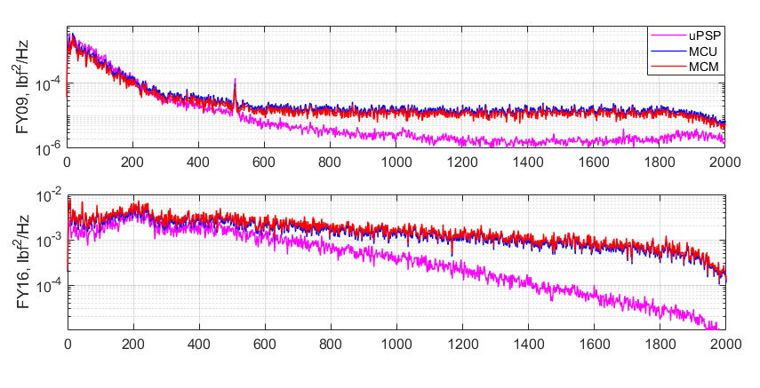


BFF PSD Comparisons
BVT Test: M = 0.92, α = β = 0˚
Mean approaches (MCU, MCM) overpredict uPSP at high frequencies; can underpredict at low frequencies
$$Φ_{y}^{F}$$
1
2
3
$$Φ_{y}^{F}$$
Frequency

Slide 10
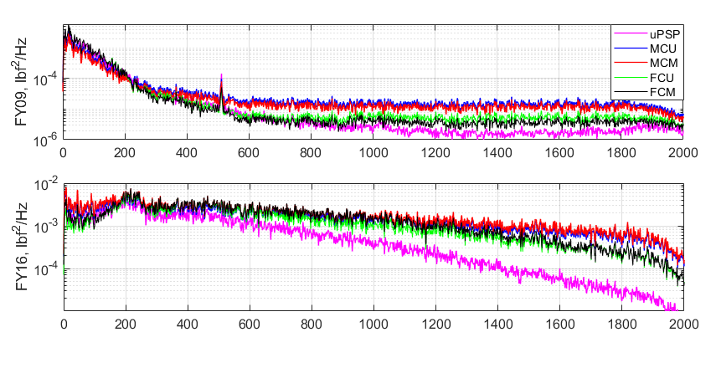
BFF PSD Comparisons
BVT Test: M = 0.92, α = β = 0˚
Mean approaches (MCU, MCM) overpredict uPSP at high frequencies; can underpredict at low frequencies
Frequency-dependent approaches (FCU, FCM) approximate uPSP better than mean approaches
$$Φ_{y}^{F}$$
1
2
3
$$Φ_{y}^{F}$$
Frequency

Slide 11
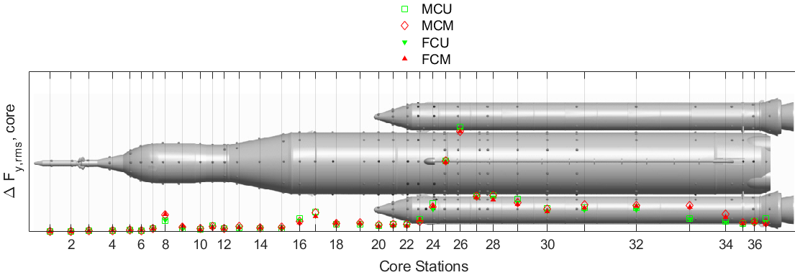
BFF rms Comparisons
SLS Test: M = 0.90, α = β = 0˚
In general, the rms levels for updated approaches match well
Moving-segment vs. user-defined approach had a larger influence on the differences in rms levels than frequency-dependent vs. mean coherence
1
2
3
4
5
6
7

Slide 12
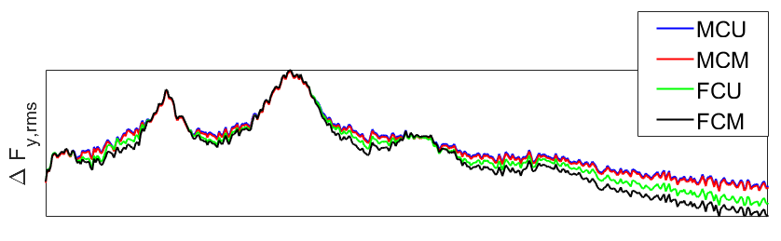
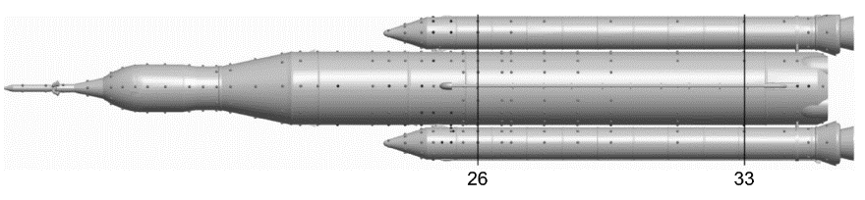
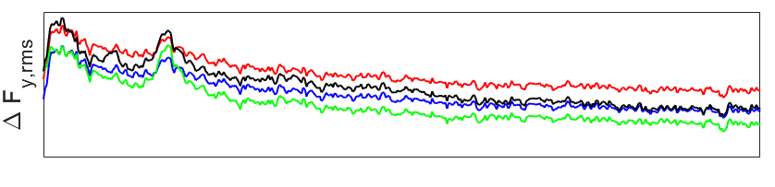


BFF PSD Comparisons
SLS Test: M = 0.90, α = β = 0˚
MCU and MCM result in higher predictions in between the peaks and at higher frequencies
FCU and FCM result in higher predictions near the peaks
User-defined approaches vs. the moving approaches can better be explained by looking at coherence individually
$$Φ_{y}^{F}$$
$$Φ_{y}^{F}$$
Frequency

Slide 13
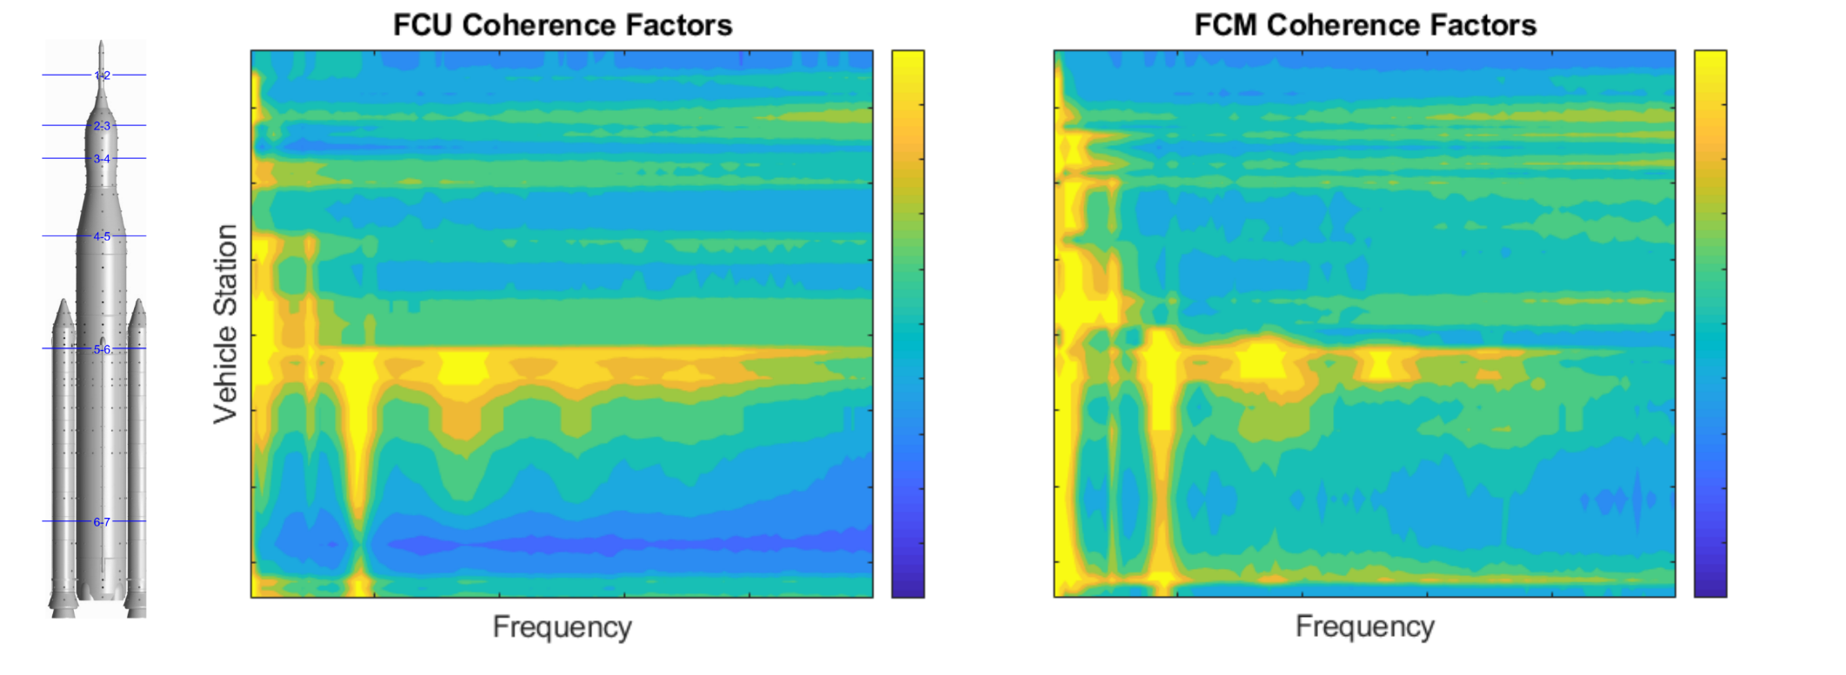
SLS Coherence Factor Comparison
SLS Test: M = 0.90, α = β = 0˚
Station 26 – Away from the harmonics, the FCM approach has lower coherence
Station 33 – FCU approach has lower coherence due to user-defined region boundary
FCU Coherence Factors
FCM Coherence Factors
max ζ_{c}
Vehicle Station
26
33
Frequency
Frequency
min ζ_{c}

Slide 14
Summary
Presented a methodology to incorporate frequency-dependent coherence factors in BFF development
  Use of FFT-inverse FFT approach to apply coherence factors to BFFs
  Implementation of a moving-segment analysis to develop longitudinally varying coherence factors
Validated new methods using uPSP on wind tunnel model of a notional vehicle
Examined impact of new methods on BFFs for SLS Block 1 Crew vehicle
The updated coherence factor approaches produce more intuitive predictions for buffet forcing functions when compared to the current-program accepted approach

