Slide 1

USM3D Simulations for the Third Sonic Boom Prediction Workshop (SBPW-3)
Alaa Elmiligui, Mohagna Pandya, and Melissa Carter
NASA Langley Research Center, Hampton VA 23681
Boris Diskin
National Institute of Aerospace, Hampton, VA 23666
Sudheer Nayani
Analytical Services & Materials, Inc., Hampton, VA 23666
2021 AIAA SciTech Forum and Exposition
Special Session: 3rd AIAA Sonic Boom Workshop Report-Out
January 12, 2021
Copyright 2021 United States Government as represented by the Administrator of the National Aeronautics and Space Administration. No copyright is claimed in the United States under Title 17, U.S. Code. All Other Rights Reserved. Published by the American Institute of Aeronautics and Astronautics, Inc. with permission.

Slide 2
Outline
Objectives
USM3D-Mixed Element Code
Workshop Test Cases
Numerical Results
Concluding Remarks

Slide 3
Objectives
Summarize USM3D-Mixed Element (USM3D-ME) contributions to the 3rd AIAA Sonic Boom Prediction Workshop (SBPW-3)
Compare USM3D-ME results from two different nonlinear iteration methods

Slide 4
USM3D-Mixed Element (USM3D-ME) Code
System of nonlinear equations, R(Q) = 0
Two different methods to solve for nonlinear iterations
  Preconditioner-Alone (PA) Method
    baseline technology with improved discretization and preconditioner
  Hierarchical Adaptive Nonlinear Iteration Method (HANIM)
    significant improvements over PA in robustness and iterative convergence
    enhanced solver for the system of nonlinear equations
    provides two additional hierarchies around the preconditioner of PA
    CFL adaptation used as a comprehensive tool

Slide 5
Preconditioner-Alone (PA) Method
Baseline technology with improved discretization and preconditioner
  first-order FDS scheme for mean flow approximate Jacobian
  point- or line-implicit scheme for solving preconditioner equations
  residual reduction targets for preconditioner
Nonlinear iteration
nonlinear residuals
pseudo time step
Preconditioner
Solved by
Preconditioner
Performed inside
Nonlinear Update
Nonlinear update
PA Flowchart
Notes:
A quick overview of PA method is presented here.
Some improvements to the baseline mixed-element USM3D’s discretization scheme and preconditioner are listed here.
For example, mean flow approximate Jacobian can use first-order FDS scheme for better approximation to the target second-order nonlinear operator that uses FDS scheme.
The PA method flowchart is shown on the right. The method has two main modules that are shown by rectangular boxes. The Precondition module solves this linear equation and computes solution updates, DQ. In this equation, delRcaret/DQ is approximate Jacobian. Nonlinear Update module advances the nonlinear solution as shown here.

Slide 6
Hierarchical Adaptive Nonlinear Iteration Method (HANIM)
nonlinear iteration
nonlinear residuals
pseudo time step
Failure Handler
Preconditioner
GCR Solver
failed
failed
Realizability Check
failed
Nonlinear Control
Nonlinear Update
HANIM Flowchart
Notes:
This is the flowchart of HANIM.
HANIM is implemented using six modules. The modules are Preconditioner, GCR Solver, Realizability Check, Nonlinear Control, Failure Handler, and Nonlinear Update.
For each nonlinear iteration, HANIM has an inner iteration loop that monitors and addresses the failure in any of these three modules. This inner iteration loop is terminated when all three modules report success, and the control is passed on to the Nonlinear Update module.
The Preconditioner module is the same as that in the PA method. Most of the HANIM modules are briefly described in the next slide.
The Preconditioner module generates a new search direction for the GCR Solver.
The GCR Solver module solves this linear equation for solution updates, DeltaQ, using a Generalized Conjugate Residual Method. The term delR/delQ represents an exact Jacobian. Instead of explicitly forming the Jacobian, this matrix-vector product is evaluated using Frechet derivative.
Realizability Check module uses the GCR Solver computed solution updates to check for the realizability of the nonlinear solution at cell centers. If solution realizability is violated, control is passed to the Failure Handler module, otherwise solution updates are passed to the Nonlinear Control module.
Nonlinear Control module reduces nonlinear residuals to a specified target. It finds an optimal under-relaxation parameter for the solution updates that were suggested by the GCR Solver module. A quadratic search is used for the under-relaxation parameter.

Slide 7
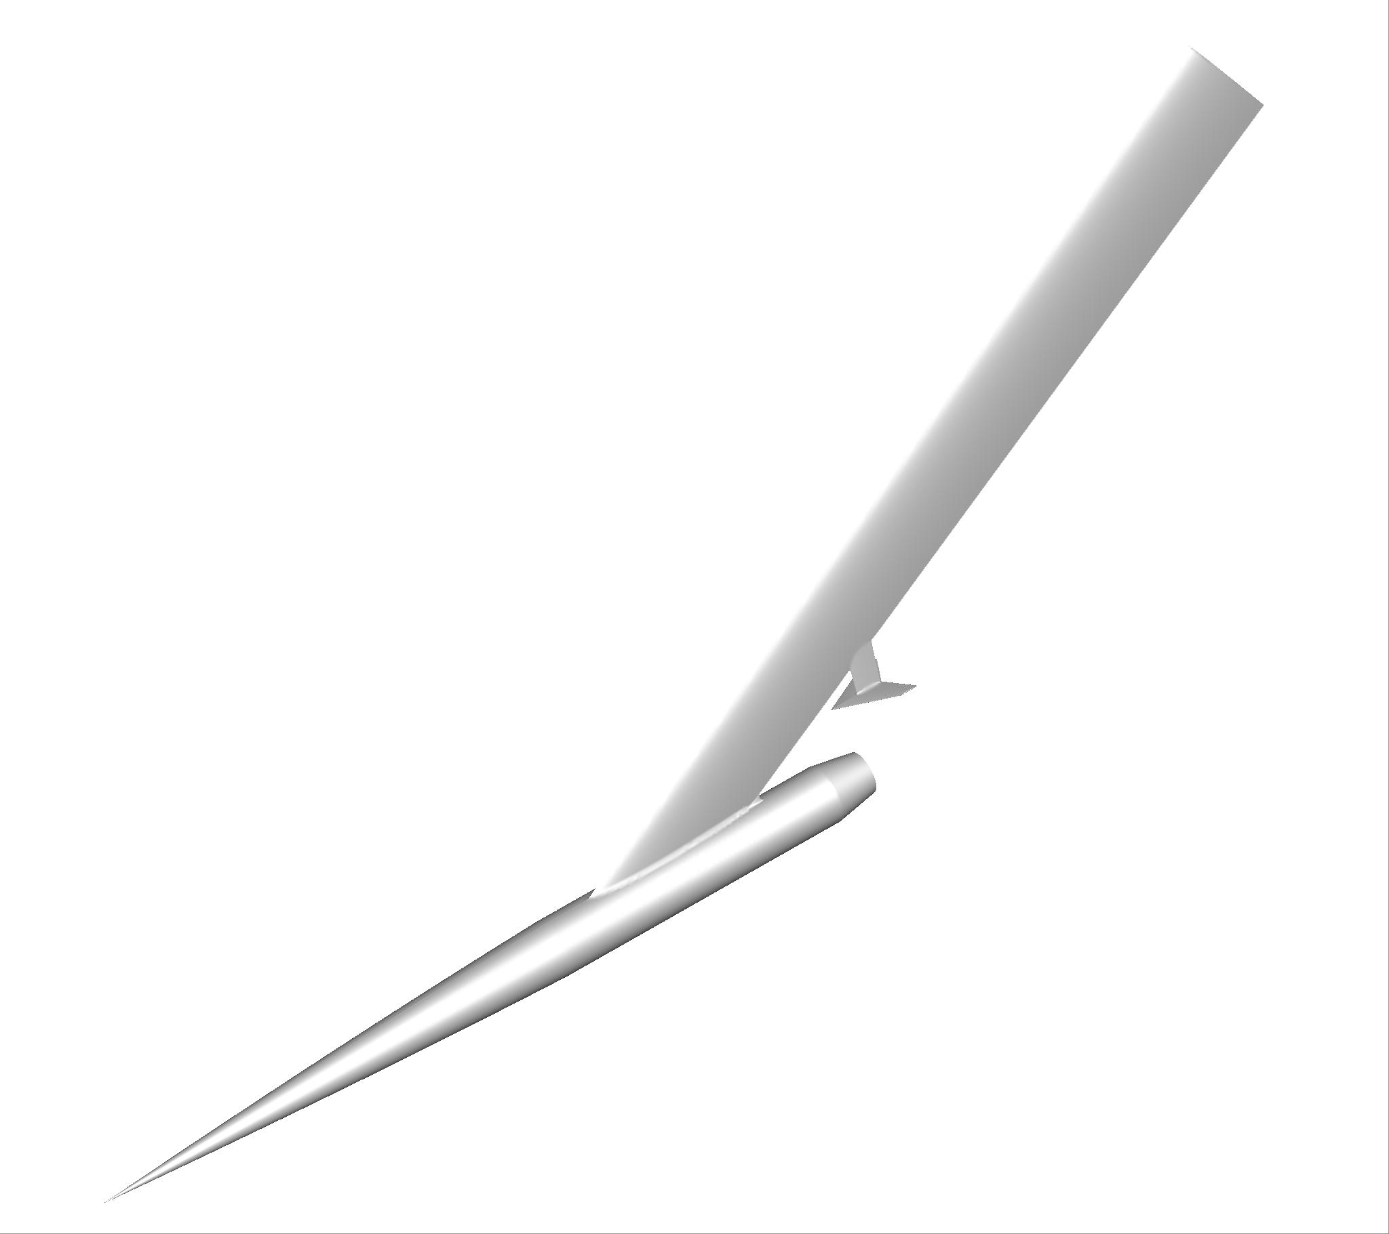
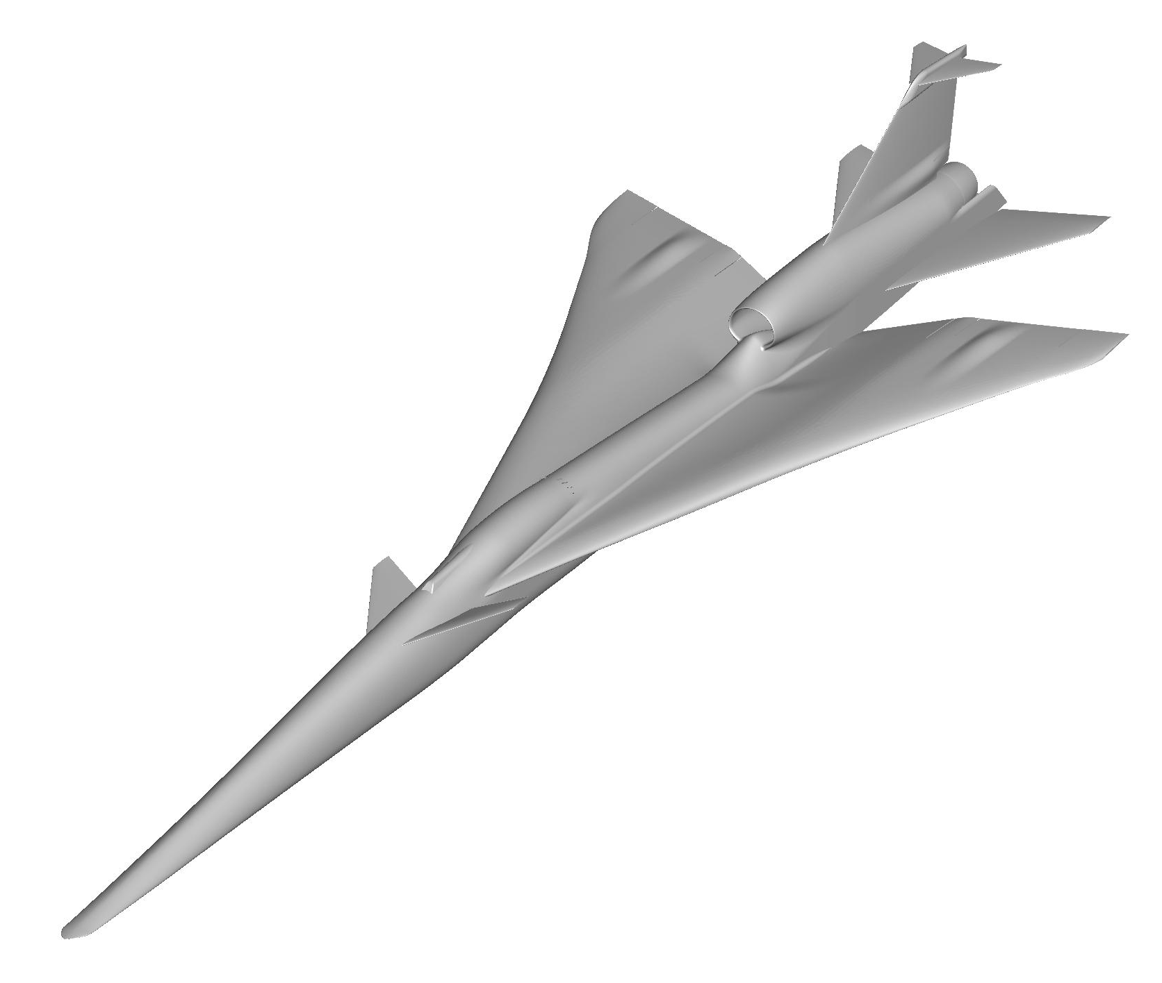
Test Cases for 3rd Sonic Boom Prediction Workshop
Focus of this presentation
Biconvex 9x7 Shock-Plume Interaction Model
C608 Low Boom Flight Demonstrator
Notes:
Axisymmetric Equivalent Area

Slide 8
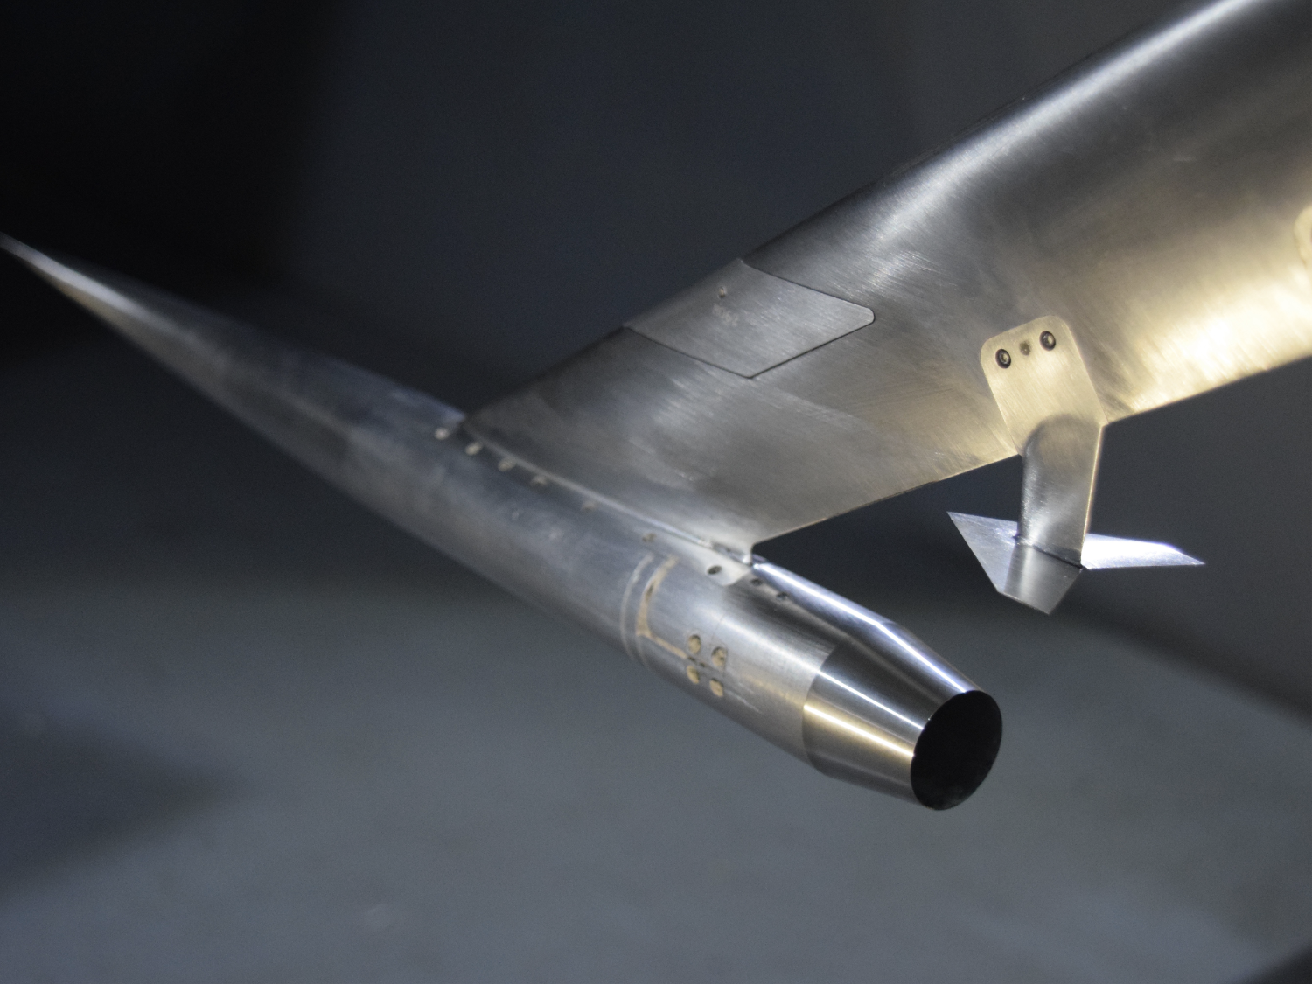
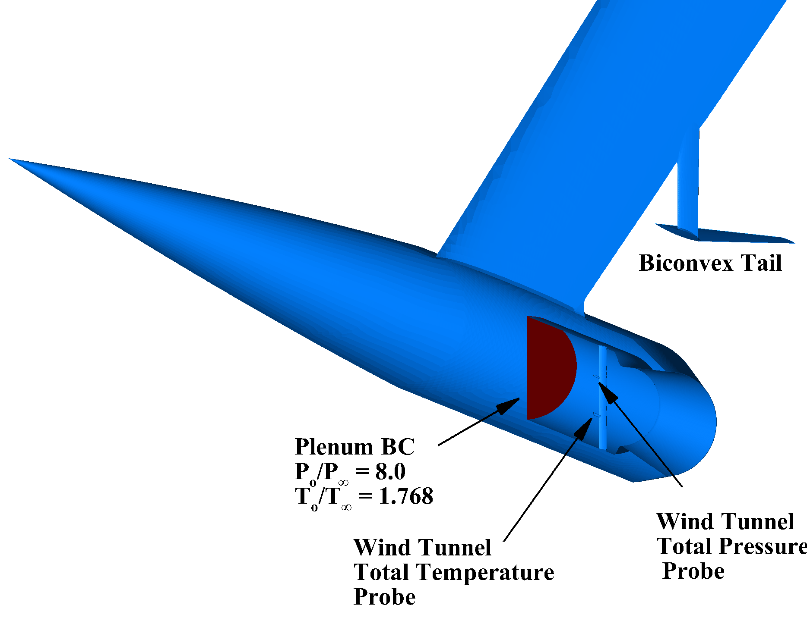
Biconvex 9x7 Shock-Plume Interaction Model
M∞ = 1.6, α = 0.0°, Re = 376,850 per inch
Experimental biconvex configuration
Computational biconvex configuration

Slide 9
Biconvex 9x7 Shock-Plume Interaction Model Grids
Grid Level | Scale Factor | Nodes (millions) | Mixed-Element Grids (millions) |  |  |  | Tetrahedral Grids (millions)
 |  |  | Tetrahedral | Pyramids | Prisms | Total | Total
Coarse | 1.57 | 0.846 | 2.825 | 0.004 | 0.650 | 3.480 | 4.785
Medium | 1.28 | 1.576 | 5.984 | 0.006 | 0.993 | 6.984 | 8.977
Fine | 1.00 | 3.286 | 14.627 | 0.012 | 1.388 | 16.027 | 18.815

Slide 10
Biconvex 9x7 Shock-Plume Interaction Model
HANIM Symmetry Plane Density Gradient Contours
M∞ = 1.6, α = 0.0°, Re = 376,850 per inch
15 inches
Nose shock
Biconvex TE shock
Nozzle boattail expansion
Nozzle lower lip shock

Slide 11

Biconvex 9x7 Shock-Plume Interaction Model
HANIM Symmetry Plane Density Gradient Contours
M∞ = 1.6, α = 0.0°, Re = 376,850 per inch
Biconvex TE shock
Shear layer
Nozzle boattail expansion

Slide 12
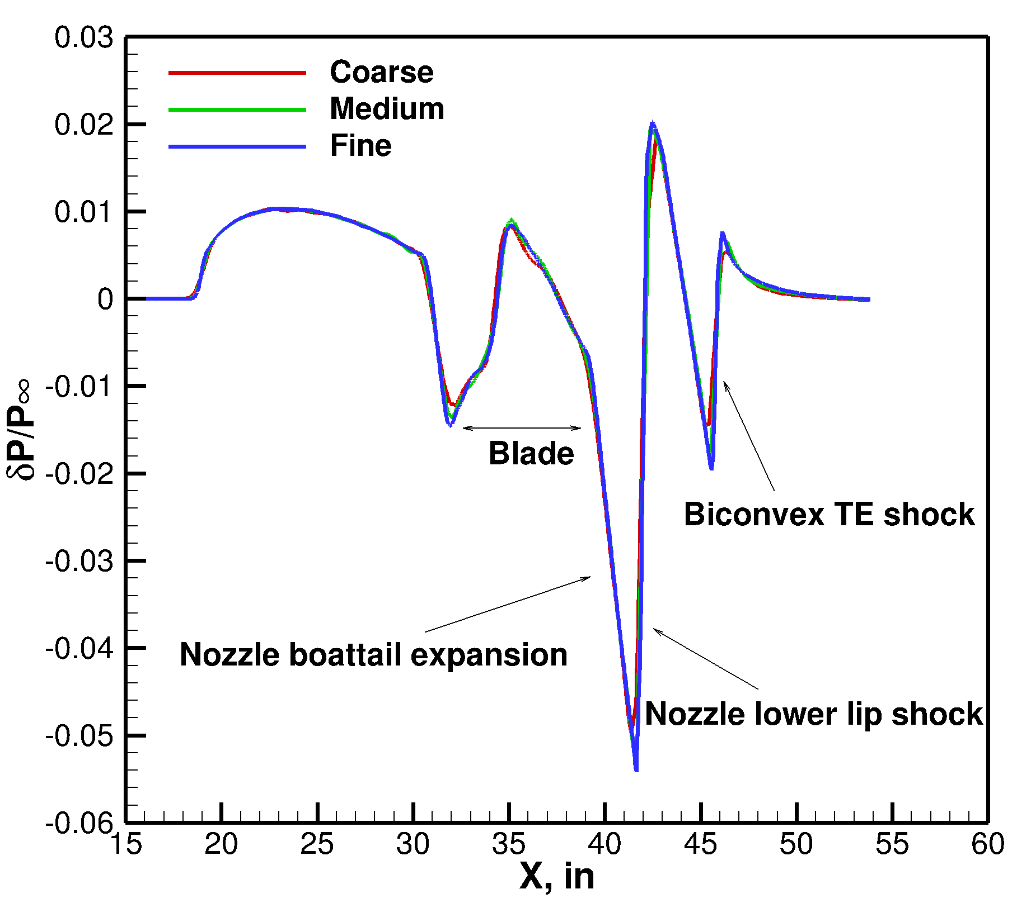
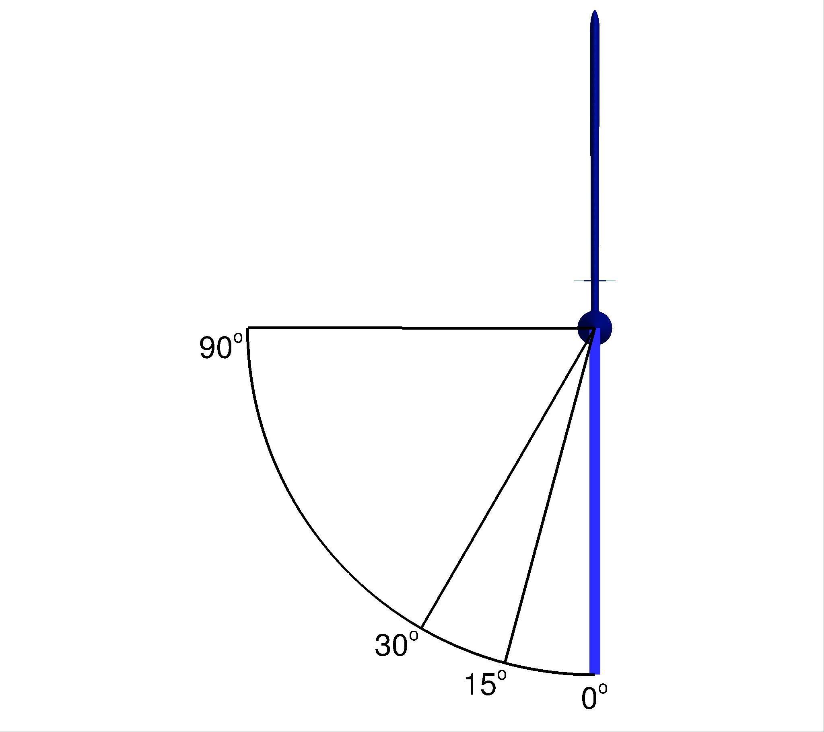
Biconvex 9x7 Shock-Plume Interaction Model
HANIM Grid Convergence on Tetrahedral Grids
M∞ = 1.6, α = 0.0°, Re = 376,850 per inch
Nearfield Pressure Signature, 𝜙 = 0°

Slide 13
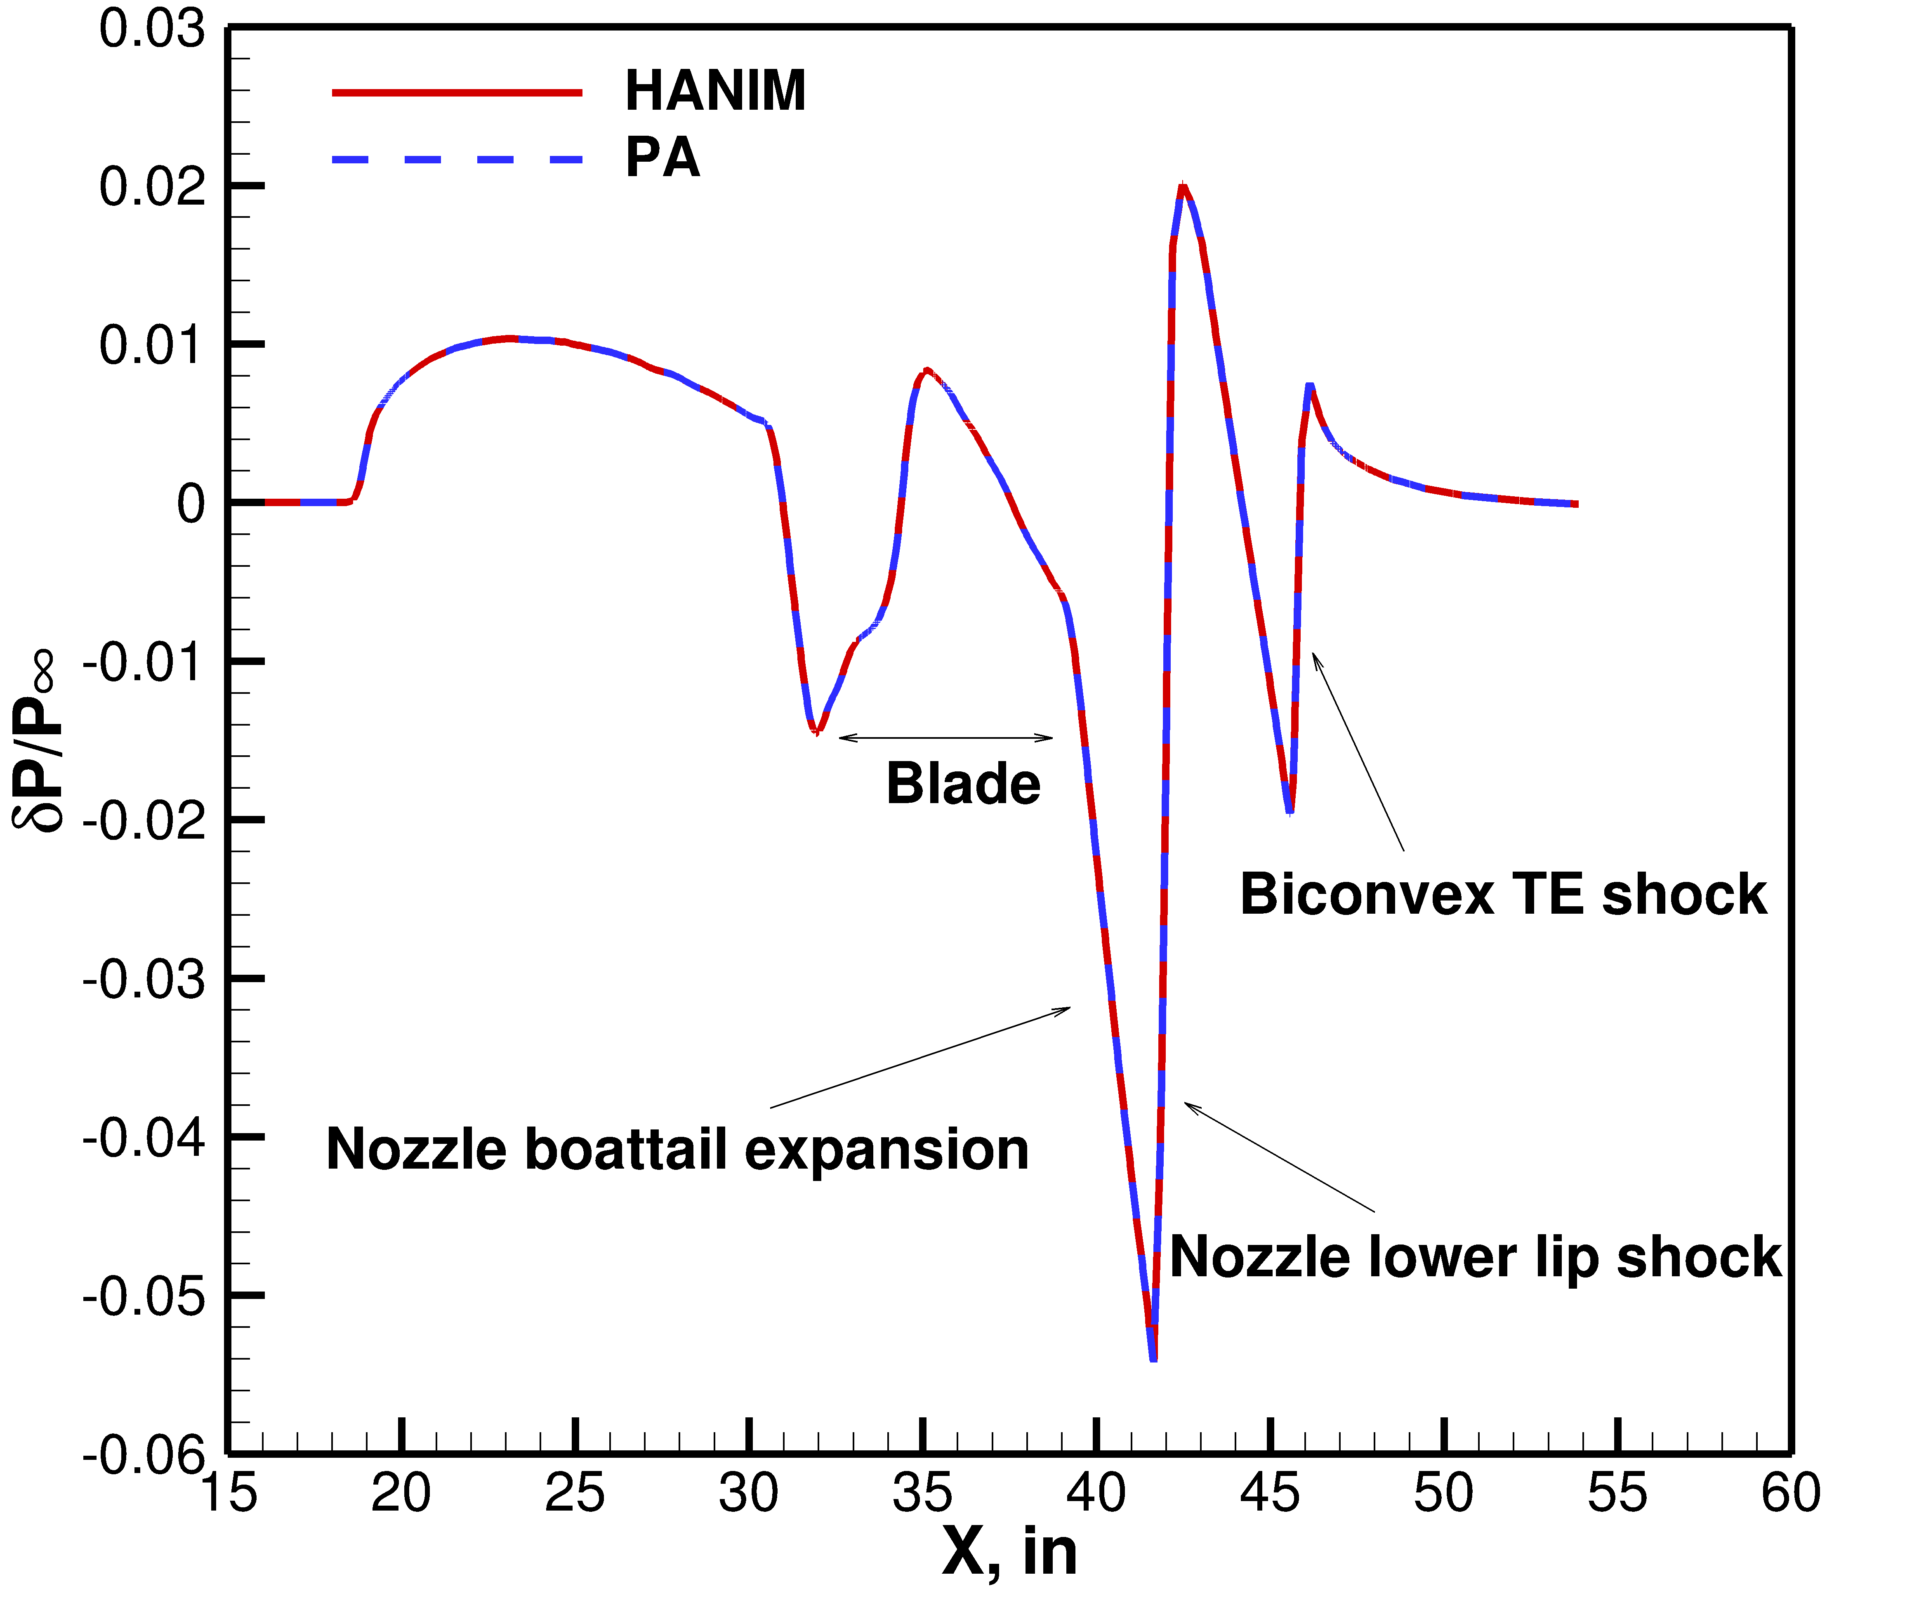
Biconvex 9x7 Shock-Plume Interaction Model
PA vs HANIM on Finest Mixed-Element Grid
M∞ = 1.6, α = 0.0°, Re = 376,850 per inch
Nearfield Pressure Signature, 𝜙 = 0°

Slide 14
Biconvex 9x7 Shock-Plume Interaction Model
HANIM Solutions on Mixed-Element and Tetrahedral Grids
M∞ = 1.6, α = 0.0°, Re = 376,850 per inch
Nearfield Pressure Signature, 𝜙 = 0°

Slide 15
Biconvex 9x7 Shock-Plume Interaction Model
Effect of Limiters on the Nearfield Pressure Signatures
M∞ = 1.6, α = 0.0°, Re = 376,850 per inch
Nearfield Pressure Signature, 𝜙 = 0°

Slide 16
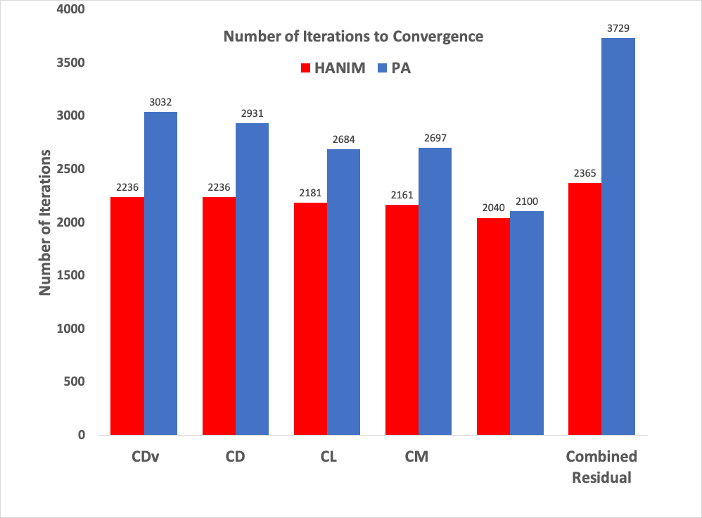
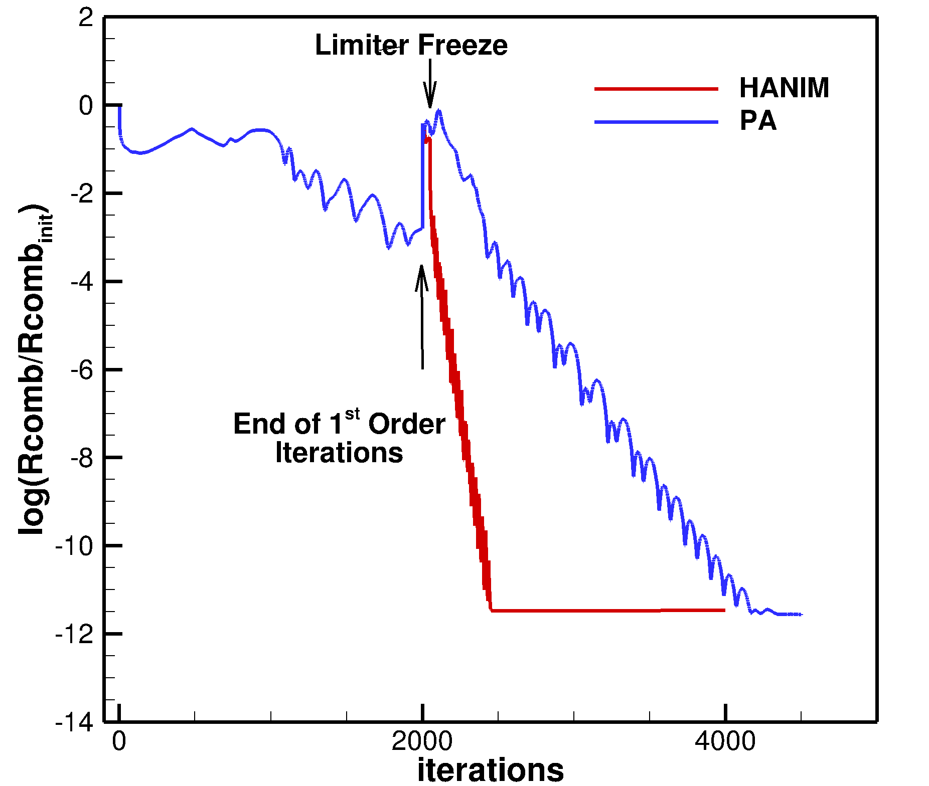

Biconvex 9x7 Shock-Plume Interaction Model
USM3D-(PA vs HANIM) Convergence History
M∞ = 1.6, α = 0.0°, Re = 376,850 per inch
$$δP/P_{∞}$$

Slide 17
Concluding Remarks
USM3D-ME results show:
  grid convergence on both the mixed-element and tetrahedral family of grids
  mixed-element grids and the tetrahedral grids are in excellent agreement
  grid topology has no effect on accuracy of solution
  PA and HANIM yield identical results
  limiters provided similar overall nearfield pressure distribution

Slide 18
Acknowledgement
This work was supported by the National Aeronautics and Space Administration (NASA) Commercial Supersonic Technology (CST) Project

Slide 19
Questions?

