Slide 1
Scalability of Cohesive Fatigue Analyses Using Explicit Solvers
Frank Leone, Carlos Dávila
NASA Langley Research Center, Hampton, Virginia
AIAA SciTech Forum
January 11–21, 2021
Notes:
My name is Frank Leone. I’m a researcher in the Damage Tolerance, Durability, and Reliability Branch at NASA Langley Research Center, and I’ll be presenting recent work on the Scalability of Cohesive Fatigue Analyses using Explicit Finite Element Solvers.

Slide 2
Outline
Review of Dávila’s Cohesive Fatigue Model
Implementation into an Explicit Material Model
Verification
  Traction-separation law
  Fatigue life
Validation
  Double cantilever beam (DCB) specimen
  Three-point bend doubler (3PB) specimen
Computational Scalability
Notes:
This work uses the cohesive fatigue model developed by my co-author Carlos Dávila. I will start off by reviewing the basic concepts of the cohesive fatigue model, before presenting our recent effort to integrate it into one of our in-house material models for use with explicit finite element solvers.
I will then present results from simple verification analyses to demonstrate the intended behavior and functionality of the model, before moving on to validation exercises involving material characterization specimens and simple structural details.
One motivating factor for adapting Carlos’ cohesive fatigue model for use in explicit analyses is the superior computational scalability that explicit solvers typically have over implicit solvers. I will present results demonstrating the scalability we achieved with the explicit implementation, comparing it to runs conducted with the original implicit fatigue model and high-fidelity progressive damage analyses for static loading from previous works.

Slide 3






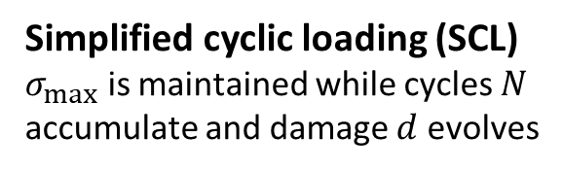









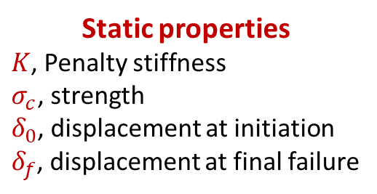
Cohesive Traction-Separation Law
$$σ$$
Static properties
$K$, Penalty stiffness
$σ_{c}$, strength
$δ_{0}$, displacement at initiation
$δ_{f}$, displacement at final failure
$$σ_{c}$$
$$K$$
Residual strength for given $λ$
Fatigue load history
$$σ$$
Fatigue
End of fatigue life, $N_{f}$
$$σ_{max}$$
Time
$$σ_{min}=Rσ_{max}$$
$$K\left(1−d\right)$$
Simplified cyclic loading (SCL)
$σ_{max}$ is maintained while cycles $N$ accumulate and damage $d$ evolves
$$δ$$
$$δ_{0}$$
$$λ$$
$$λ_{∗}$$
$$λ_{f}$$
$$δ_{f}$$
The rate of fatigue damage evolution, $\frac{∆d}{∆N}$, and fatigue life $N_{f}$, must then be defined
Notes:
Here we have a typical-traction separation law used by most cohesive elements. The initial stiffness is defined by the numerical penalty stiffness $K$. Loading monotonically upward, damage initiates upon reaching the strength $σ_{c}$ at a displacement of $δ_{0}$. If we continue loading monotonically, the element fully fails at an applied displacement of $δ_{f}$. If, rather than loading to final failure, the element were unloaded at some intermediate point, the unloading and reloading responses are affected by the cohesive damage variable d.
For fatigue loading, we consider a simple sinusoidal load history, with a maximum applied traction $σ_{max}$ and a minimum traction defined by the stress ratio $R$. In this approach, simplified cyclic loading is used to represent the accumulation of fatigue cycles while maintaining the maximum applied traction (or displacement) in the model.
At given damage $d$, the compliance of the material allows for $λ$ displacement at a peak traction $σ_{max}$. The damage variable used for static and fatigue modeling is the same. A residual strength and corresponding displacement $λ_{∗}$ can also be determined for a given damage $d$. As fatigue damage evolves, the unloading curve of the static traction-separation law is eventually intersected. This intersection occurs at the end of the fatigue life, $N_{f}$, for the given loading conditions.
Next, we’ll look at how the rate of fatigue damage evolution and fatigue life are defined…

Slide 4
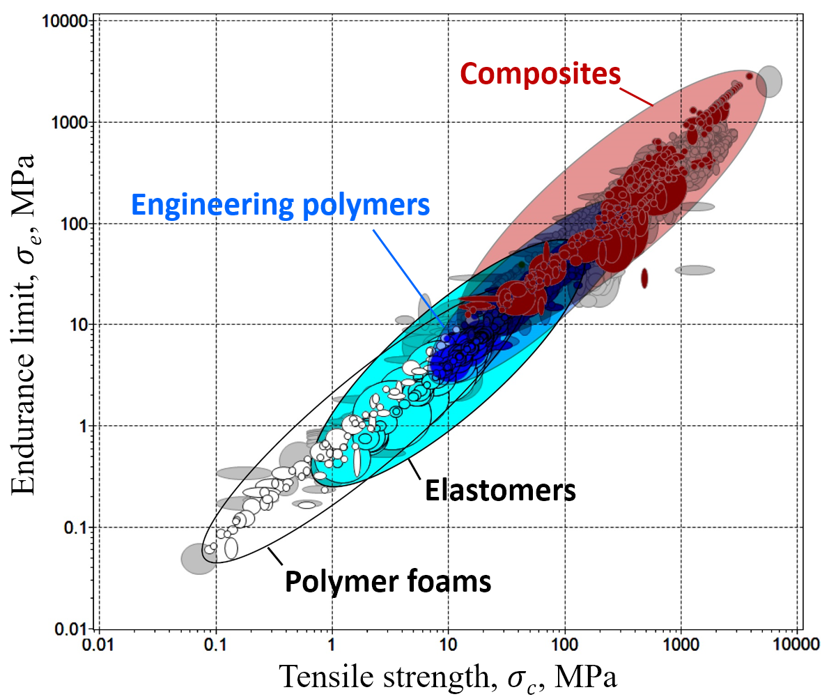
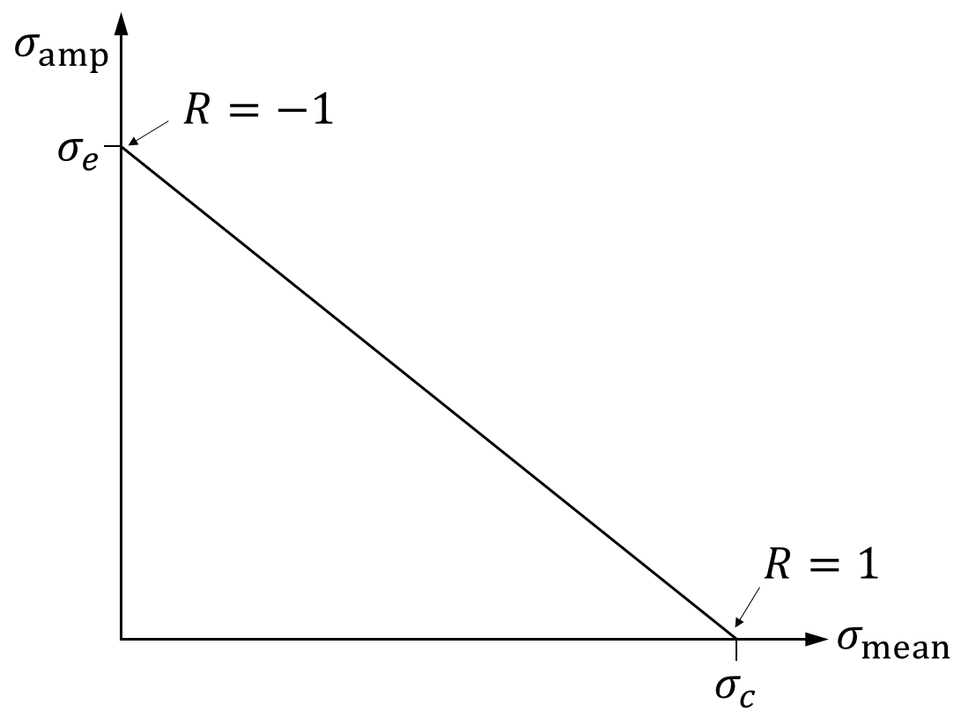
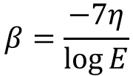
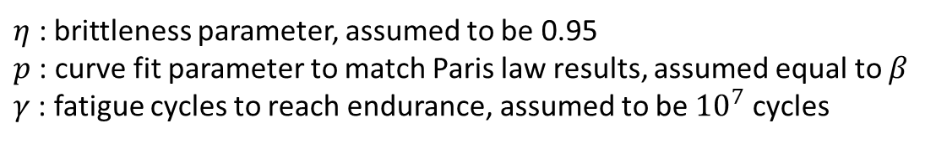
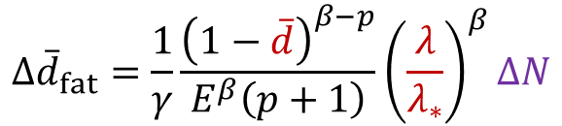
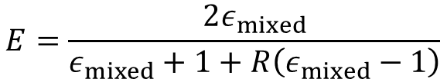
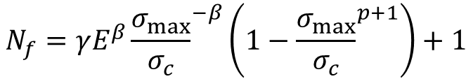

Incremental Fatigue Damage and Fatigue Life
Dávila’s CF20 fatigue damage function is based on engineering assumptions involving the endurance limit and the Goodman diagram
$$∆{\overline{d}}_{fat}=\frac{1}{γ}\frac{{\left(1−\overline{d}\right)}^{β−p}}{E^{β}\left(p+1\right)}{\left(\frac{λ}{λ_{∗}}\right)}^{β}∆N$$
$$β=\frac{−7η}{\log{E}}$$
, where
$η$ : brittleness parameter, assumed to be 0.95
$p$: curve fit parameter to match Paris law results, assumed equal to $β$
$γ$: fatigue cycles to reach endurance, assumed to be ${10}^{7}$ cycles
The relative endurance limit, $E$, accounts for $R$ and mode mixity, $B$
$$E=\frac{2ε_{mixed}}{ε_{mixed}+1+R\left(ε_{mixed}−1\right)}$$
Goodman diagram
$$ε_{mixed}=ε\left(1−0.42B\right)$$
$ε$ : ratio of endurance limit, $σ_{e}$, to tensile strength, $σ_{c}$, assumed to be 0.2
Integrating $∆{\overline{d}}_{fat}$ over the damage history yields the fatigue life $N_{f}$:
$$N_{f}=γE^{β}{\frac{σ_{max}}{σ_{c}}}^{−β}\left(1−{\frac{σ_{max}}{σ_{c}}}^{p+1}\right)+1$$
Notes:
Dávila’s CF20 fatigue damage function is used to control fatigue damage evolution. The approach is based on engineering assumptions involving the endurance limit and the Goodman diagram. We will not go into the details of the derivation of the incremental damage function here, but instead just note the dependencies of the incremental fatigue damage function. The lambda terms describe the current displacement-jump, $\overline{d}$ is the previous damage state, and $∆N$ is the number of fatigue cycles represented by the current solution increment. For constant traction conditions, the remaining terms remain constant.
The dependence of the rate fatigue damage growth on mode mixity is related to the E term here. E is the relative endurance limit, which modifies the nominal endurance limit $ε$ to account for differing mode mixities B and stress ratios R.
With this form of the incremental fatigue damage function, the fatigue life $N_{f}$ can be found by integrating $∆{\overline{d}}_{fat}$ over the damage history. We will use this relation in our following verification studies.

Slide 5
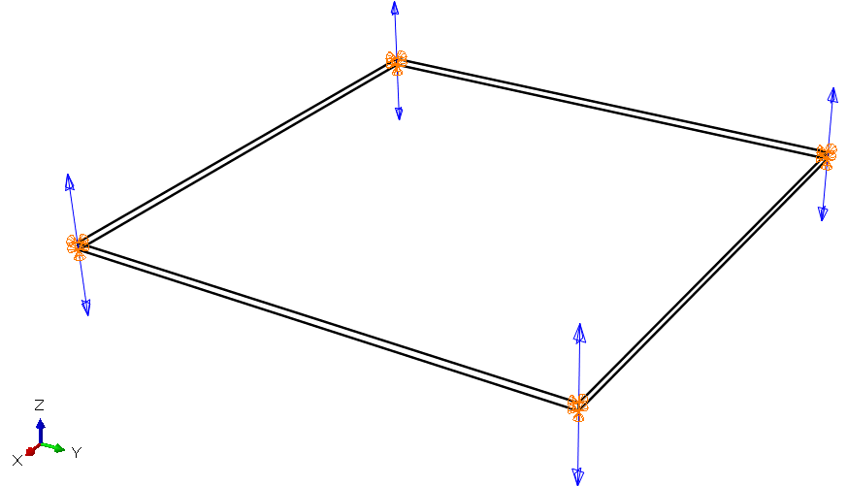
Implementation
UMAT material model for implicit analyses with Abaqus/Standard
  Minimum two analysis steps (one static, one fatigue)
  Fatigue analysis step pseudo-time represents fatigue cycles
  Good test/analysis correlation achieved with DCB and 3PB fatigue tests
Integrated into CompDam VUMAT material model for Abaqus/Explicit
  Open source (https://github.com/nasa/CompDam_DGD) continuum damage mechanics model
  Represents matrix cracks and delaminations with the same cohesive law
  Cohesive fatigue included in dev branch of repository, planned for inclusion in future 2.6.x release
Two key challenges in conducting explicit fatigue analyses:
  Maintaining quasi-static conditions throughout the fatigue analysis step
  Representing crack growth rate as a nonlinear function of fatigue cycles
Notes:
The CF20 cohesive fatigue model was originally implemented as a UMAT material subroutine for use with cohesive elements in Abaqus/Standard. In practice, a minimum of two analysis steps are required, one static and one fatigue, and pseudo-time in the fatigue analysis step represents fatigue cycles.
The explicit time increment is capped at the minimum stable time increment
The total solution increments is limited to avoid the accumulation of significant numerical error

Slide 6








Representation of Fatigue Cycles
The fatigue cycles per solution increment, ${ΔN}_{i}$, are independent of the step time
A numerical procedure allows ${ΔN}_{i}$ to change at each solution increment $i$ to keep $∆{\overline{d}}_{fat}$ bound between upper and lower limits, with changes to ${ΔN}_{i}$ written to a separate log file
$${∆\overline{d}}_{fat}≤{\left(∆{\overline{d}}_{fat}\right)}_{min}$$
$$∆{\overline{d}}_{fat}>{\left(∆{\overline{d}}_{fat}\right)}_{max}$$
$${\left(∆N_{i}\right)}_{max}$$
Cycles per Increment, $∆N_{i}$
$$1+{\left(∆N_{i}\right)}_{mod}$$
$${\left(∆N_{i}\right)}_{initial}$$
$${\left(∆N_{i}\right)}_{min}$$
Solution Increment, $i ×{10}^{3}$
Notes:
The fatigue cycles evolve as a function of the solution increments, and are independent of the step time.
A numerical procedure allows ${ΔN}_{i}$ to change at each solution increment $i$ to keep $∆{\overline{d}}_{fat}$ bound between upper and lower limits, with changes to ${ΔN}_{i}$ written to a separate log file. The relationship between step time, the output frames, and the fatigue cycles are then figured out by referring to the additional log file.
Six user-defined parameters control the evolution of ${ΔN}_{i}$, setting an initial, maximum, and minimum value for ${ΔN}_{i}$, upper and lower limits on incremental fatigue damage, and a percent change to ${ΔN}_{i}$ to apply when incremental fatigue damage is out of bounds. These parameters can set loosely to accommodate a wide range of fatigue lives. However, the parameters may need to be modified if fatigue damage growth causes deformations which violate the assumption of quasi-static conditions.
In a typical analysis, ${ΔN}_{i}$ starts small and increases every increment until either $∆{\overline{d}}_{fat}$ is in range or ${\left(∆N_{i}\right)}_{max}$ is reached. During the middle portion of the fatigue life, ${ΔN}_{i}$ intermittently increases (perhaps once per several thousand solution increments). Near the end of life, as the fatigue crack growth rate increases, ${ΔN}_{i}$ will start to decrease.
With the cohesive fatigue law implemented in our material model, and having a means of practically applying it within an explicit finite element framework, we sought to verify that our implementation was working as intended.

Slide 7
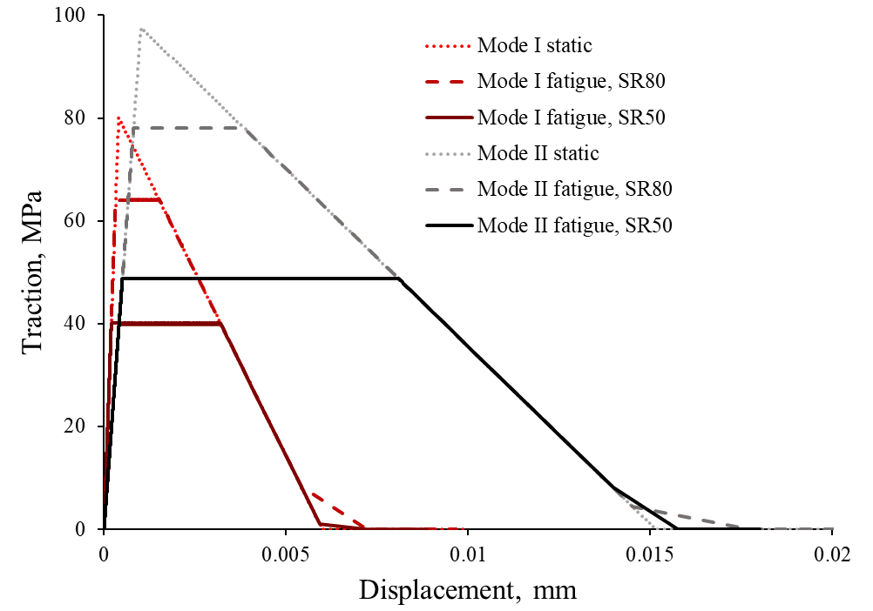
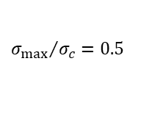
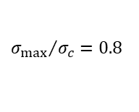
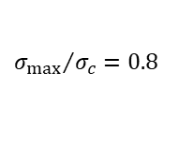
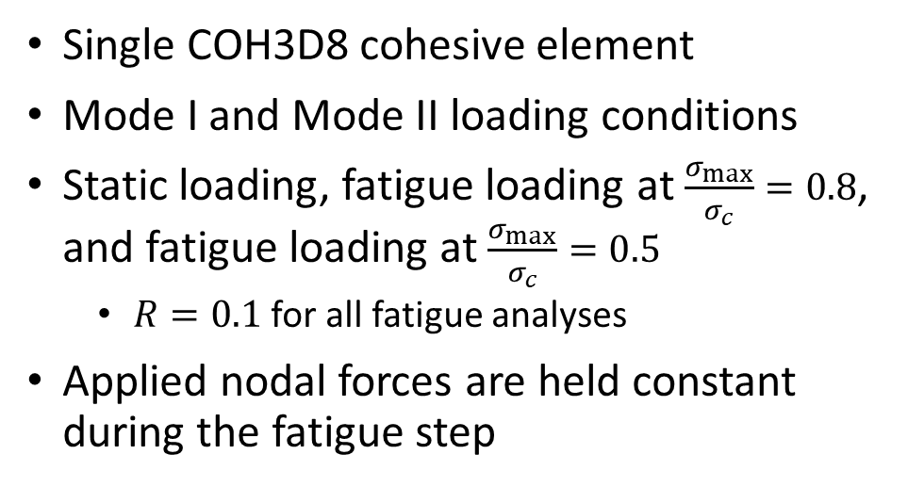
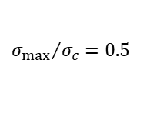
Verification of Traction-Separation Law
Single COH3D8 cohesive element
Mode I and Mode II loading conditions
Static loading, fatigue loading at $\frac{σ_{max}}{σ_{c}}=0.8$, and fatigue loading at $\frac{σ_{max}}{σ_{c}}=0.5$
  $R=0.1$ for all fatigue analyses
Applied nodal forces are held constant during the fatigue step
$${σ_{max}}/{σ_{c}=0.8}$$
$${σ_{max}}/{σ_{c}=0.5}$$
$${σ_{max}}/{σ_{c}=0.8}$$
$${σ_{max}}/{σ_{c}=0.5}$$
The designed traction-separation laws are perfectly reproduced for each verification case
The unloading portion of the fatigue analyses involves dynamic failure
Notes:
First, we sought to verify the designed traction-separation law could be produced using a single cohesive element model with prescribed nodal loads. Mode I and Mode II loading conditions were tested for both static and fatigue loading. For fatigue loading, we used two ratios of maximum applied stress to strength, 0.5 and 0.8.
The designed behavior is reproduced for each tested case. That is, the material compliance increases while under constant traction until the static unloading curve is intersected. Because these fatigue models have prescribed nodal forces, dynamic failure occurs upon reaching the static unloading curve.
While successfully, these verification tests do not assess predictions of fatigue life or how fatigue cycles accumulate in the model…

Slide 8
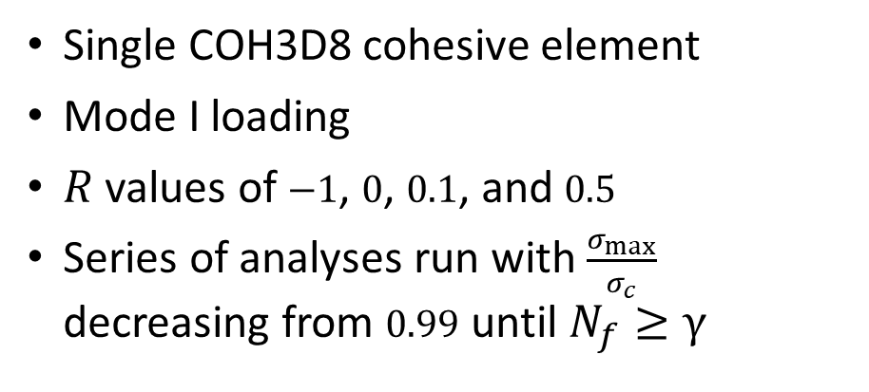
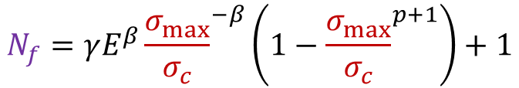

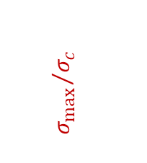

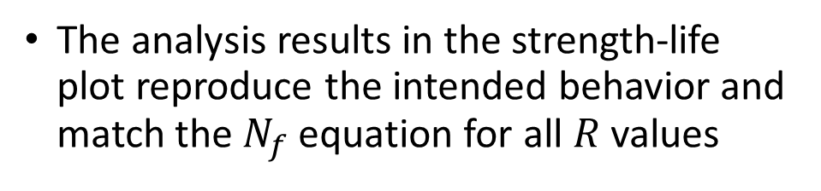
Verification of Fatigue Life
Single COH3D8 cohesive element
Mode I loading
$R$ values of $−1$, $0$, $0.1$, and $0.5$
Series of analyses run with $\frac{σ_{max}}{σ_{c}}$ decreasing from $0.99$ until $N_{f}≥γ$
$${σ_{max}}/{σ_{c}}$$
($γ,ε$)
The analysis results in the strength-life plot reproduce the intended behavior and match the $N_{f}$ equation for all $R$ values
Life, $N_{f}$, cycles
$$N_{f}=γE^{β}{\frac{σ_{max}}{σ_{c}}}^{−β}\left(1−{\frac{σ_{max}}{σ_{c}}}^{p+1}\right)+1$$
Notes:
To verify the model’s predictions of fatigue life, series of single element models were conducted for a variety of stress ratios $R$. For each value of R, analyses were conducted with a range of maximum applied stresses, starting at 99% of the tensile strength, and decreasing until the predicted fatigue life matched or exceeded ten million cycles, the $γ$ parameter. Here we have a plot of maximum applied fatigue stress divided by strength versus fatigue life. The analysis results (indicated by the markers) match the fatigue life equation which we derived from the incremental fatigue damage function (represented by the black lines) for each of the cases considered.
This study verifies that the total number of fatigue cycles required to increase the fatigue damage variable from zero to one is working as intended. How the damage variables evolve and how they perform as part of a fracture process zone is evaluated in the validation exercises.

Slide 9
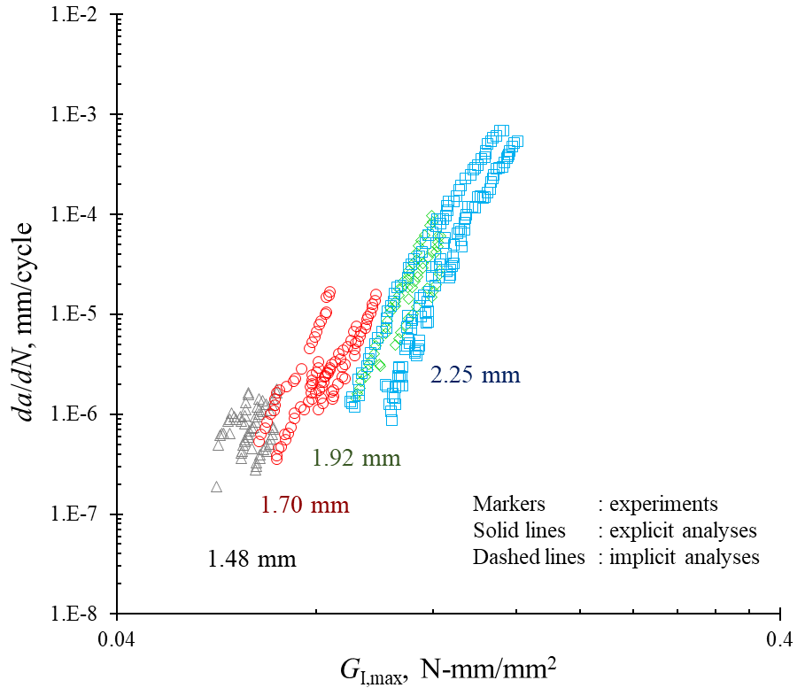
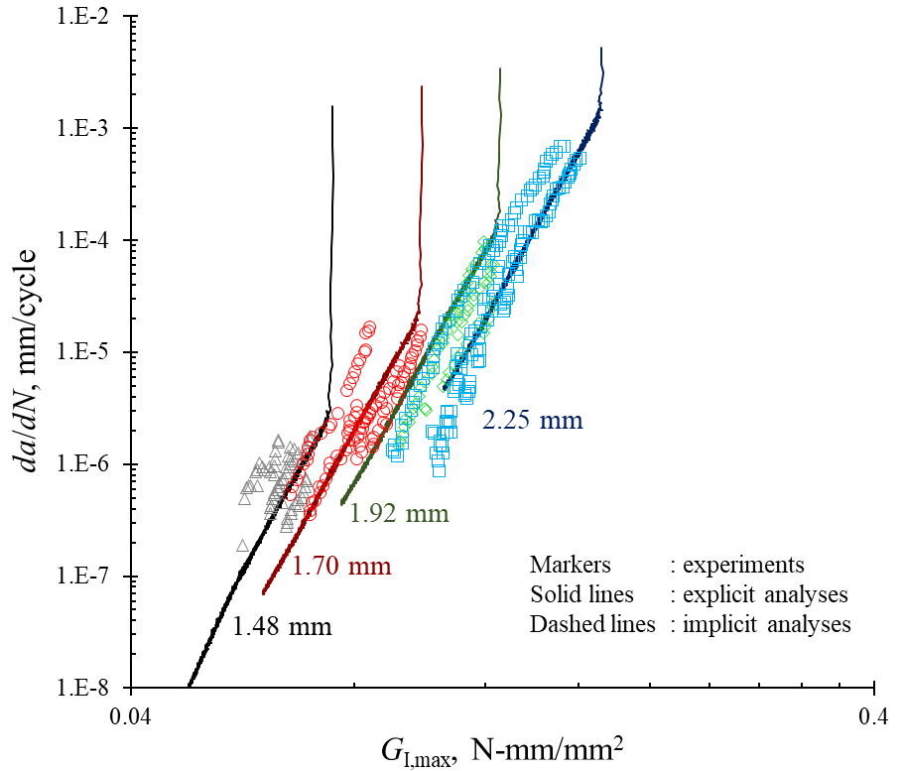
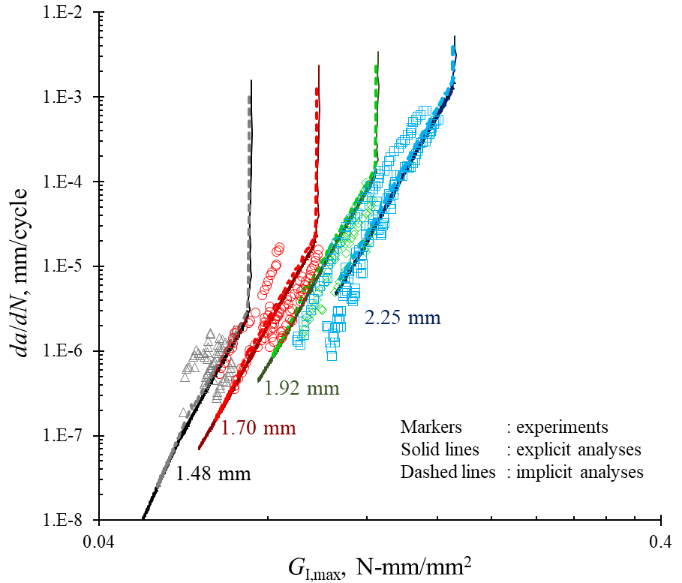
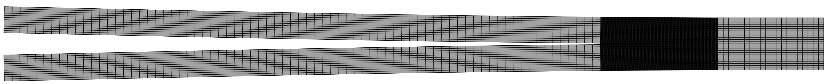
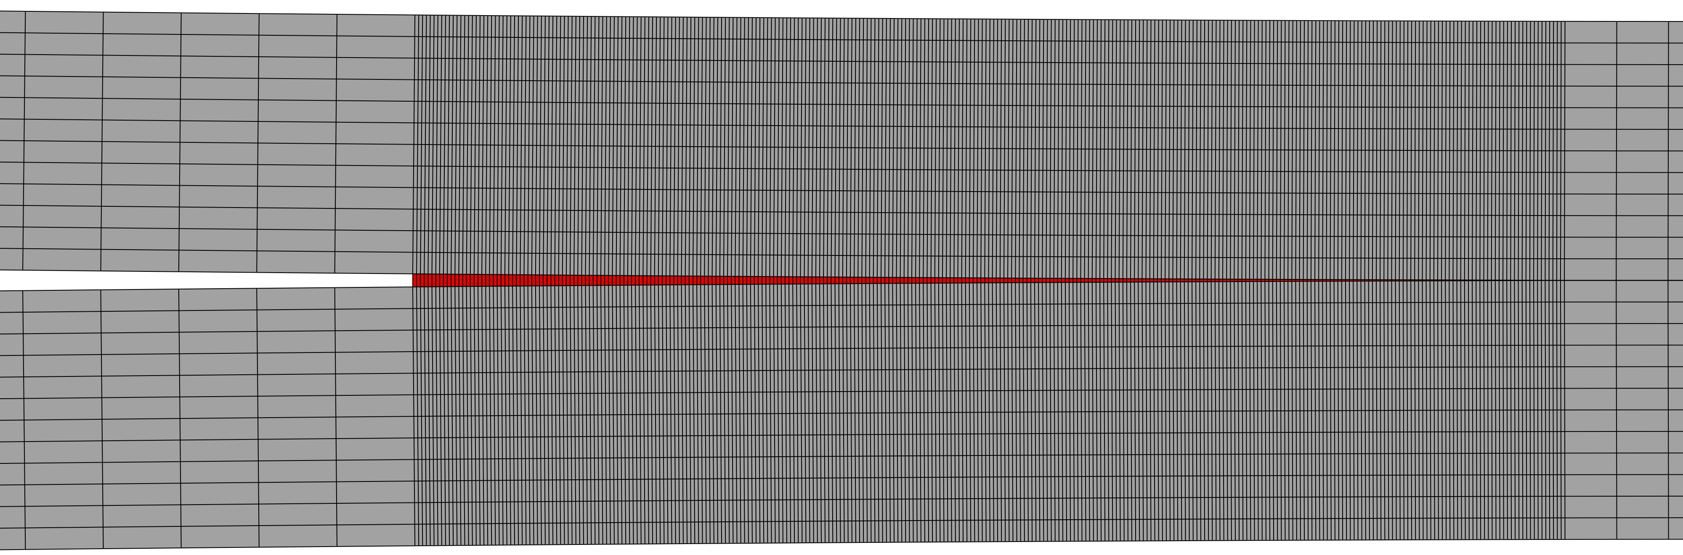


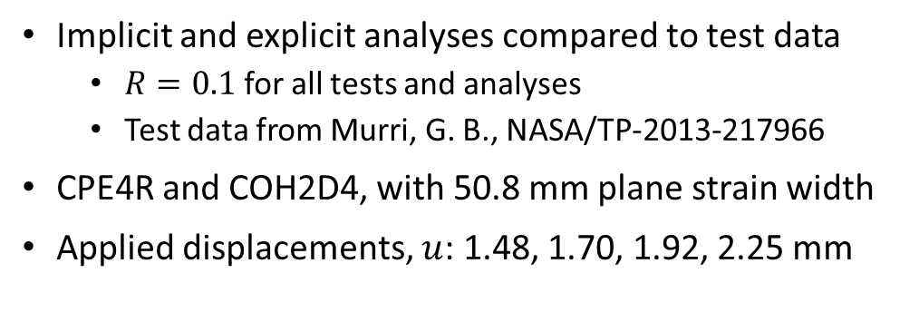




Double Cantilever Beam (DCB) Validation
Implicit and explicit analyses compared to test data
  $R=0.1$ for all tests and analyses
  Test data from Murri, G. B., NASA/TP-2013-217966
CPE4R and COH2D4, with 50.8 mm plane strain width
Applied displacements, $u$: 1.48, 1.70, 1.92, 2.25 mm
$$½u$$
$a_{0}=50.8$ mm
2.25 mm
1.92 mm
$$½u$$
1.70 mm
Markers : experiments
Solid lines : explicit analyses
Dashed lines : implicit analyses
$$y$$
$t_{arm}=2.25$ mm
1.48 mm
$$x$$
Notes:
The first validation exercise we consider here is a double cantilever beam specimen. Two-dimensional plane strain analyses of DCB specimens were used to evaluate fatigue crack growth rates in the analyses under Mode I loading. Specimens composed of IM7/8552 unidirectional tape with an initial crack length of 2 inches were used.
Experimental DCB data from Murri for fatigue tests conducted with four different peak applied displacements is used for these comparisons. The experimental results are plotted here in terms of crack growth rate versus G1_max.
Both explicit and implicit analyses were conducted using the same mesh, which is highly refined in the crack tip area. Differences between the implicit and explicit model input decks were limited to those required to maintain quasi-static conditions in the explicit model (e.g., mass scaling).
The explicit analysis results exhibit good correlation with the experimental results for the crack growth ranges in which the data exists. The explicit results appear somewhat jittery at some points in these curves, but these small oscillations are due to the numerical derivatives required to create the plotted outputs, not any significant vibrations in the model. Comparing the explicit results to the implicit results shows that very good correlation is realized throughout the fatigue histories for all values of the applied peak load. This again demonstrates that the explicit implementation can produce equivalent predictions to the implicit cohesive fatigue model.

Slide 10
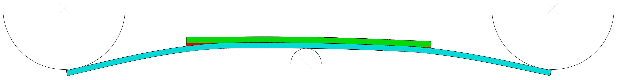
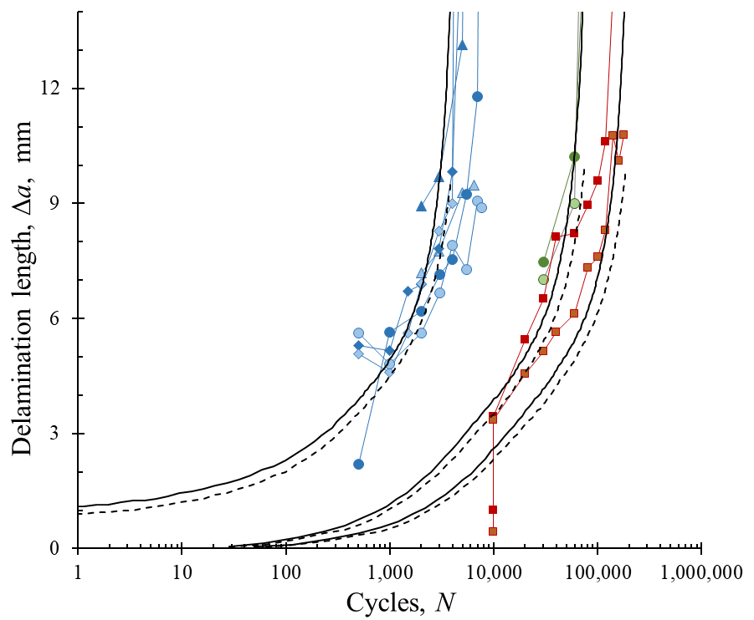
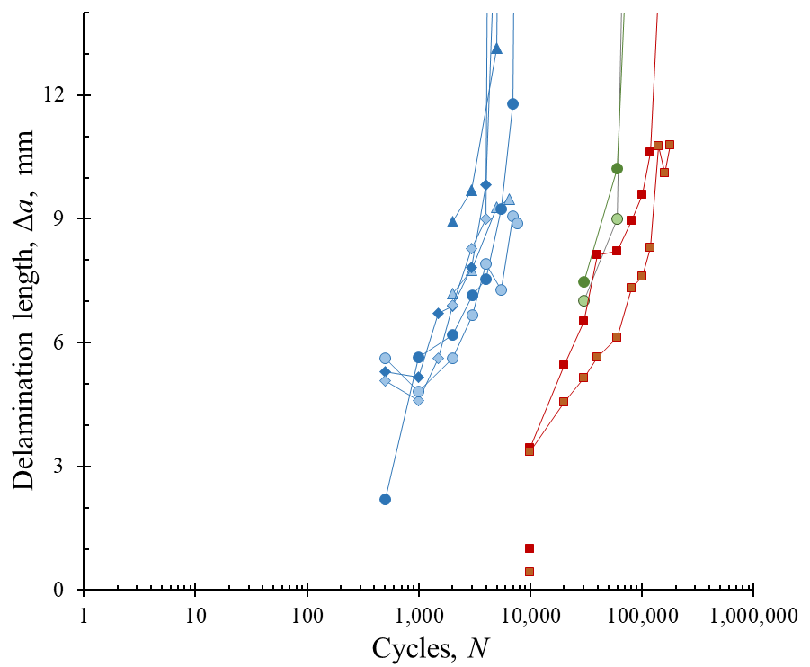
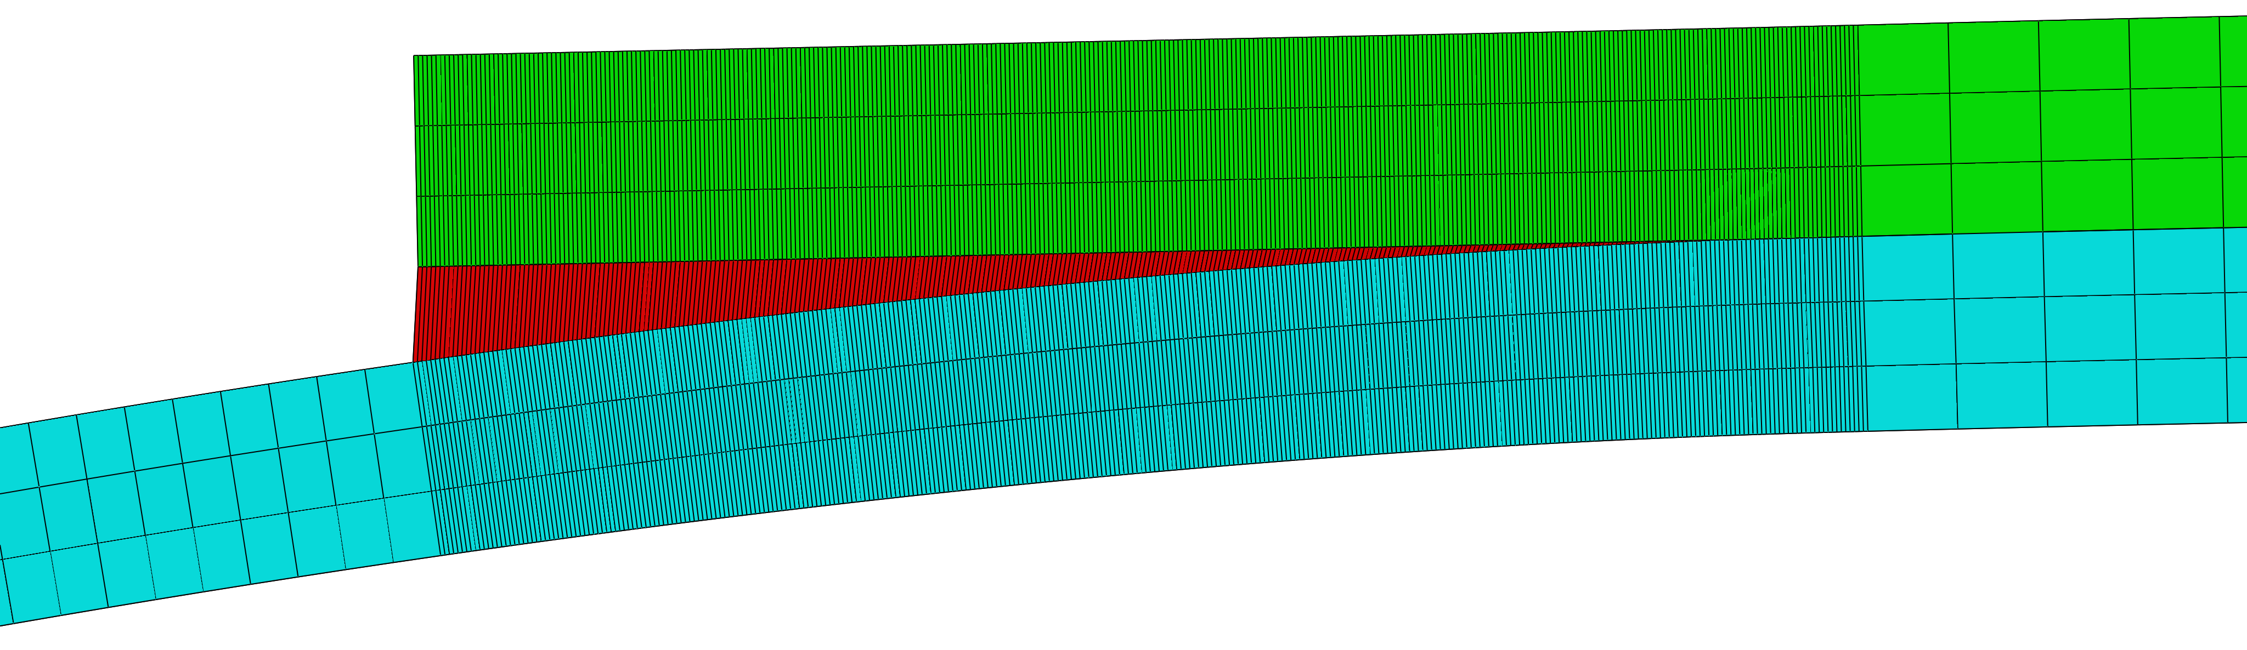







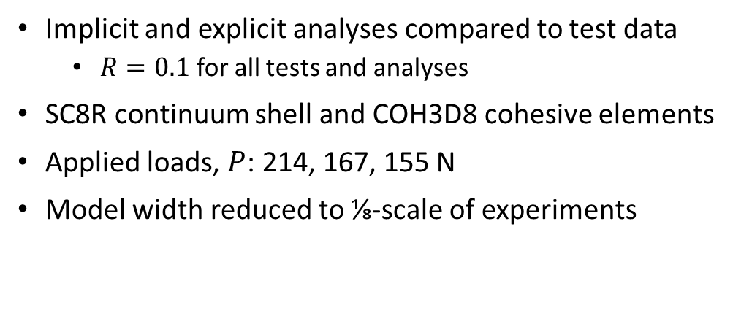


Three-Point Bend (3PB) Doubler Validation
$$P/2$$
$L_{loaders}=203.2$ mm
$$P/2$$
$L_{doubler}=101.6$ mm
214 N
167 N
155 N
$$P$$
Markers : experiments
Black lines : analyses
$$z$$
$t_{doubler}=2.38$ mm
$$x$$
$t_{skin}=2.20$ mm
Implicit and explicit analyses compared to test data
  $R=0.1$ for all tests and analyses
SC8R continuum shell and COH3D8 cohesive elements
Applied loads, $P$: 214, 167, 155 N
Model width reduced to ⅛-scale of experiments
Growth from left side
…right side
Notes:
The three-point bend doubler model was used in previous publications by Davila to demonstrate the implicit model’s ability to deal with non-uniform mixed-mode loading conditions. Load is introduced into the specimen via three rollers modeled as rigid analytical surfaces. The two outer rollers are separated by 8 inches, and a 4-inch-long fabric doubler is attached to the tape skin panel between them. The test specimens were 1-inch wide, but the model width was reduced to 1/8 scale to decrease the computational cost. The mesh is highly refined for 16.25 mm from either end of the doubler. In this region, the element size along the specimen length is 0.05 mm, and 0.15 mm across the specimen width.
Three applied peak fatigue loads are considered, indicated by the red, green, and blue markers. A stress ratio R of 0.1 was used for each case. Here, the experimental results are plotted in terms of crack length versus fatigue cycles. Crack length measurements were taken from both sides of the specimen during testing. Results from two specimens tested at 214 N are plotted here, along with one specimen tested at 167 N and one specimen tested at 155 N.
Adding the analysis results to the plot, we can see that the general shape of the da/dN curves match the experimental measurements, and that the test and analysis results agree for all three peak loads. For each load case, the solid and dashed black lines represent crack growth from opposite sides of the doubler. A slight eccentricity was introduced into the model to cause dominant crack growth to occur on the left side of the model. Only the explicit curves are plotted here, though the implicit and explicit results are indistinguishable for these three cases.

Slide 11
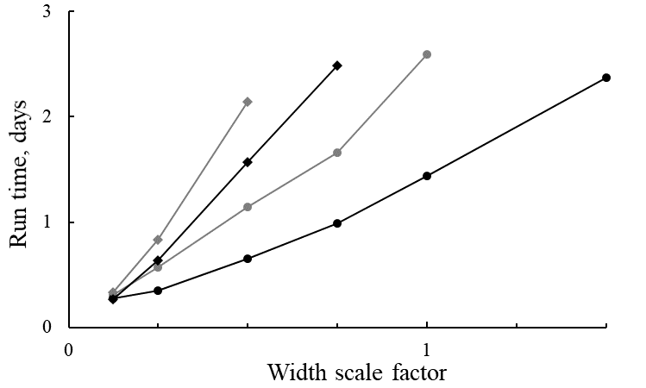
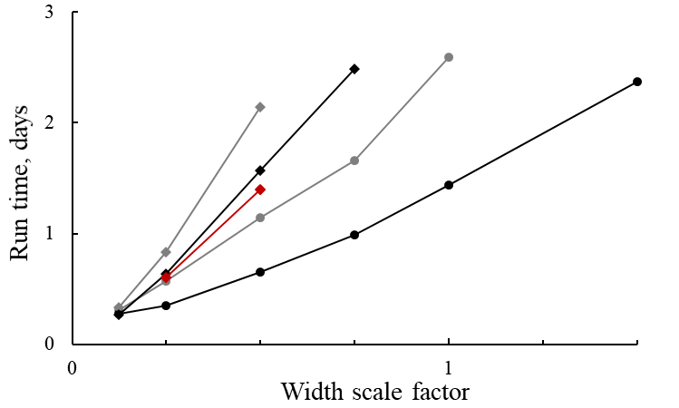
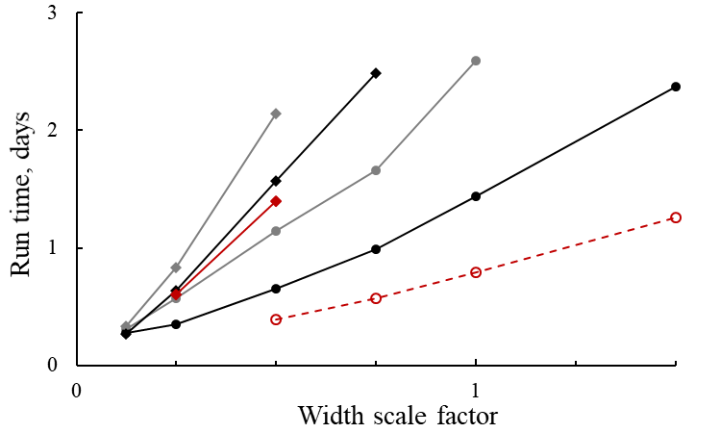
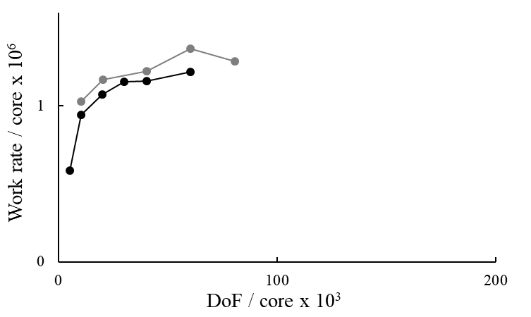
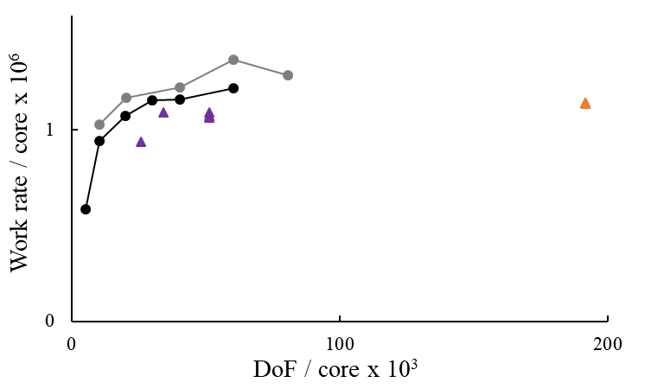
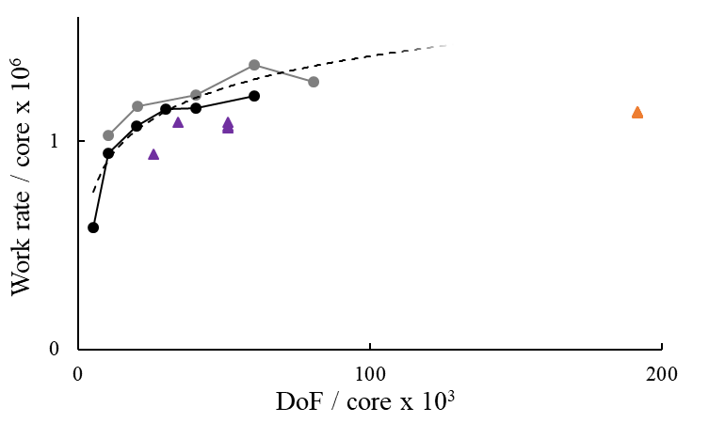
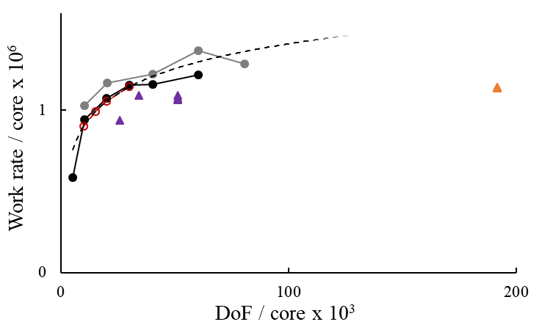
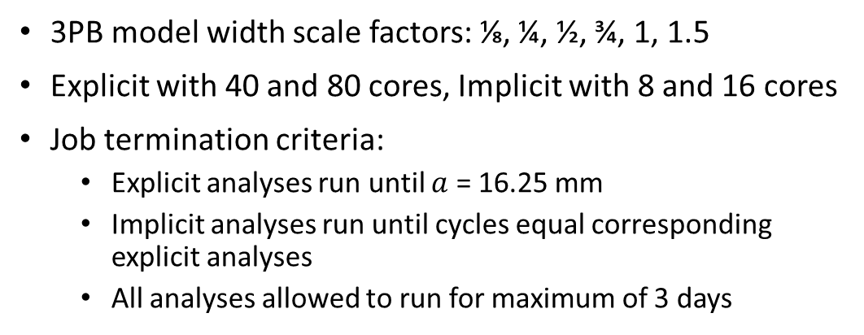
Computational Scalability of Explicit Fatigue
3PB model width scale factors: ⅛, ¼, ½, ¾, 1, 1.5
Explicit with 40 and 80 cores, Implicit with 8 and 16 cores
Job termination criteria:
  Explicit analyses run until $a$ = 16.25 mm
  Implicit analyses run until cycles equal corresponding explicit analyses
  All analyses allowed to run for maximum of 3 days
Implicit 16
Explicit 40
Explicit 80
Implicit 8
1.80x speed-up
1.37x speed-up
1.12x speed-up
1.82x speed-up
Explicit 160 (interpolation)
Implicit analyses scale far less efficiently than the explicit analyses
, with diminishing returns beyond 16 cores
Log. fit of 3PB fatigue results
40 cores
Explicit solvers progress through a solution at a predictable rate when mass scaling is used and updated regularly
Work rate = (solution increments) * DoF / time
Seven-point bend static PDA
3PB static PDA
80 cores
Notes:
To vary the computational cost of the analyses, the width scale factor was increased from the original 1/8 scale up to a maximum of 1.5x the experimental width. All analyses were conducted on the NASA Langley K cluster with Abaqus 2019. Explicit jobs were run with 40 and 80 cores, which corresponded to 1 and 2 nodes on the cluster. The maximum of 80 cores was set by Abaqus token limitations. Abaqus/Standard jobs were at first run with 8 and 16 cores based on prior experience of poor scaling beyond 16 cores. The explicit analyses were all run up to a crack growth of 16.25 mm, which was the length of the refined portion of the mesh. Implicit analyses were then run up to the same number of fatigue cycles as the explicit analyses. A maximum run time of 3 days was used for both cases.
The implicit analyses scale far less efficiently than the explicit analyses. With a doubling of the cores, the ideal, theoretical speed-up is 2.0. The best speed-up exhibited by the implicit analyses was 1.37 for the ½ width scale factor case. To ensure that the too few cores weren’t being used, two implicit analyses were conducted with 32 cores, which saw further diminishing efficiency.
Explicit solvers can progress through a solution at a nearly constant rate when mass scaling is used and updated regularly. As a result, we can attempt to forecast run times for analyses similar to those already conducted. Let’s define the computational “work” as the model degrees of freedom multiplied by solution increments, and the “work rate” as “work” divided by clock time. Plotting “work rate” per core versus model size per core reveals that computational work is completed in these analyses at a steady rate after initially ramping up from the condition that too many core are used in too small a problem. Adding in high-fidelity static PDA data from previous studies reinforces this observation.

Slide 12
Closing Remarks
An explicit implementation of a novel cohesive fatigue damage model is able to make equivalent predictions to an implicit implementation at scales from single elements up to simple structural details
When models sufficiently minimize dynamic effects and maintain quasi-static conditions, implicit and explicit analysis predictions agree in terms of load history, damage evolution, and remaining life
The explicit cohesive fatigue law exhibits the same favorable computational scalability of other explicit CDM methods, enabling fatigue analyses of structural problems otherwise intractable for implicit methods
Alternatively, the fidelity of fatigue damage analyses can be increased, e.g., modeling both mesoscale matrix cracks, delaminations, and their interactions
Notes:
An explicit implementation of a novel cohesive fatigue damage model is able to make equivalent predictions to an implicit implementation at scales from single elements up to simple structural details.
When models sufficiently minimize dynamic effects and maintain quasi-static conditions, implicit and explicit analysis predictions agree in terms of load history, damage evolution, and remaining life.
The explicit cohesive fatigue law exhibits the same favorable computational scalability of other explicit CDM methods, enabling fatigue analyses of structural problems otherwise intractable for implicit methods.
Alternatively, the fidelity of fatigue damage analyses can be increased, e.g., modeling both mesoscale matrix cracks, delaminations, and their interactions.

Slide 13
Effect of Width on 3PB Predictions

Slide 14






Goodman diagram
$$σ_{amp}$$
$$R=−1$$
$$σ_{e}$$
$$R=1$$
$$σ_{mean}$$
$$σ_{c}$$

Slide 15
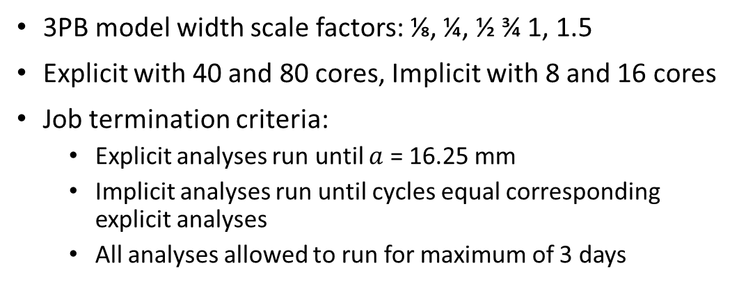
Computational Scalability of Explicit Fatigue
3PB model width scale factors: ⅛, ¼, ½ ¾ 1, 1.5
Explicit with 40 and 80 cores, Implicit with 8 and 16 cores
Job termination criteria:
  Explicit analyses run until $a$ = 16.25 mm
  Implicit analyses run until cycles equal corresponding explicit analyses
  All analyses allowed to run for maximum of 3 days
Implicit 16
Explicit 40
Explicit 80
Implicit 8
1.80x speed-up
1.37x speed-up
Explicit 160 (interpolation)
Explicit solvers progress through a solution at a predictable rate when mass scaling is used and updated regularly
Work rate = (solution increments) * DoF / time
Log. fit of 3PB fatigue results
40 cores
3PB static PDA
Seven-point bend static PDA
80 cores

