Slide 1




Implementing Geometric Surface Imperfections into Sandwich Composite Cylinder Finite Element Models
Cyrus Kosztowny
Structural Mechanics and Concepts Branch
NASA Langley Research Center
Hampton, VA
SciTech 2021 – AIAA Science and Technology Forum and Exposition
Virtual Event
January 11-15 and 19-21, 2021
Notes:
Good afternoon, I am presenting one method to implement geometric surface imperfections into sandwich composite cylinder finite element models.

Slide 2
Outline
Overview of the Shell Buckling Knockdown Factor (SBKF) project
Introduction to geometric surface imperfections
Composite Test Article 8.2B (CTA8.2B) as-manufactured surface data
Using the Python Tool for Implementing Geometric Imperfections in Reduced Structures (Py_TIGIRS) on CTA8.2B finite element models
Preliminary analysis results to reinforce significance of imperfect structures
Concluding remarks
Notes:
I will discuss one objective of the Shell Buckling Knockdown Factor project as well as briefly introduce the types of geometric surface imperfections for the thin cylindrical shell types of structures that are of interest in SBKF.
From there, I will show an example of the as-manufactured surface data collected from one of the project’s test articles, Composite Test Article 8.2B.
This data is used by a Python scripting tool I wrote in conjunction with a nominal geometry finite element model of CTA8.2B to generate a version with imperfections aimed at representing the as-manufactured geometry of the structure.
Lastly, I will reinforce why geometric imperfections are significant towards the SBKF objective by presenting preliminary analysis on the effect of imperfections in cylindrical shell structures loaded in axial compression and provide concluding remarks.

Slide 3
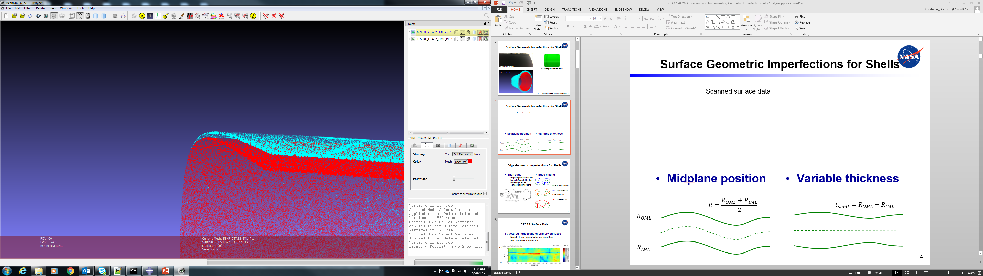




SBKF and Geometric Imperfections
SBKF Objective: Develop and validate analysis-based buckling knockdown factors for a select class of composite launch-vehicle structures
  Present objective: Demonstrate as-manufactured geometry can be accurately implemented into finite element models
Scanned cylindrical surface data
Outer Mold Line (OML) scan
Inner Mold Line (IML) scan
Midplane position
Thickness
$$R=\frac{R_{OML}+R_{IML}}{2}$$
$$t_{shell}=R_{OML}−R_{IML}$$
$$R_{OML}$$
$$R_{IML}$$
Notes:
One objective for the Shell buckling Knockdown Factor project is to develop and validate analysis-based buckling knockdown factors for a select class of composite launch-vehicle structures.
The SBKF project has been working on updating NASA’s SP-8007 guidelines for shell buckling knockdown factors for over 10 years. One important finding has been that accurate prediction of buckling load and initiation location can be obtained when analyzing the as-manufactured geometry of the structure. The objective of this work is to demonstrate a capability to accurately implement as-manufactured geometry into finite element models.
As-manufactured geometry can be collected in a variety of ways. The data discussed in this work was collected by the structured-light scanning technique. One outcome of this technique is the representation of a structure’s surface by many points in three-dimensional space, often referred to as point clouds. A partial view of the point clouds for a sandwich composite cylinder surface is shown in the first figure. The blue points are of the outer mold line, or OML, surface scan, and the red points are of the inner mold line, or IML, surface scan.
For the thin-walled structures considered in SBKF, geometric surface imperfections can conveniently be decomposed into two independent features.
A midplane radial position, given by averaging the OML and IML radial positions at a given location, can be calculated from the structured-light data.
Shell thickness, the difference between the OML and IML radial positions at a given location, can also be calculated from the data.

Slide 4
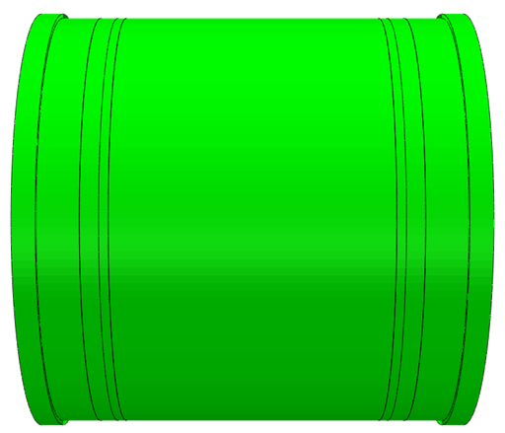
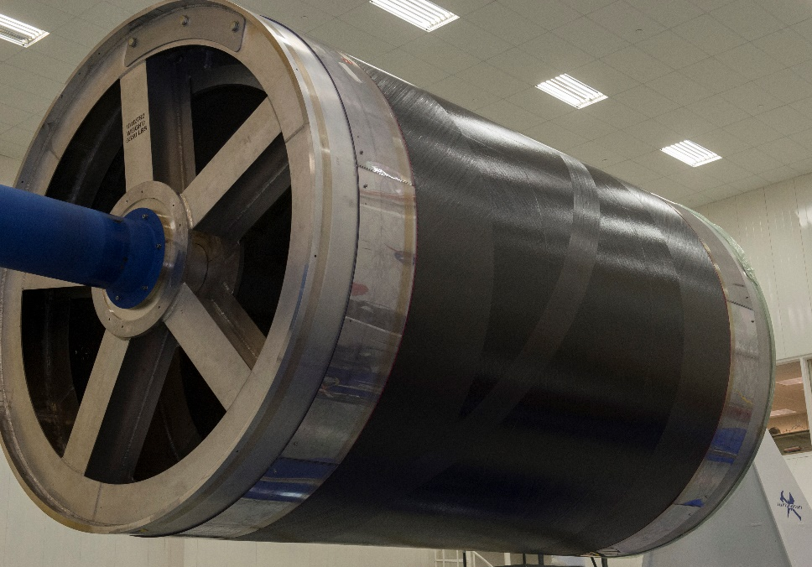
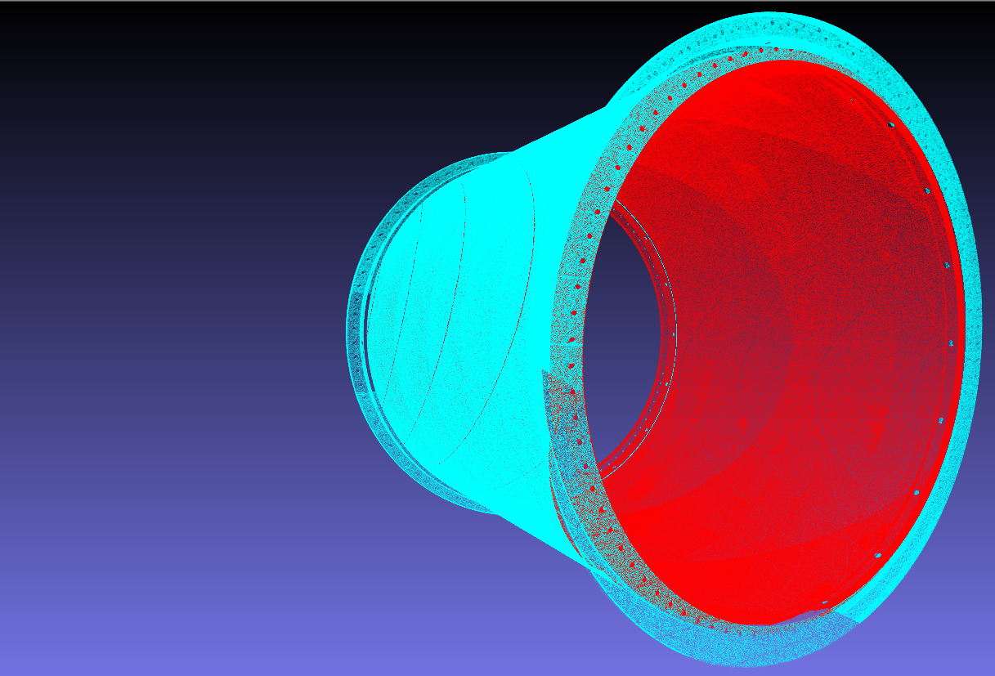
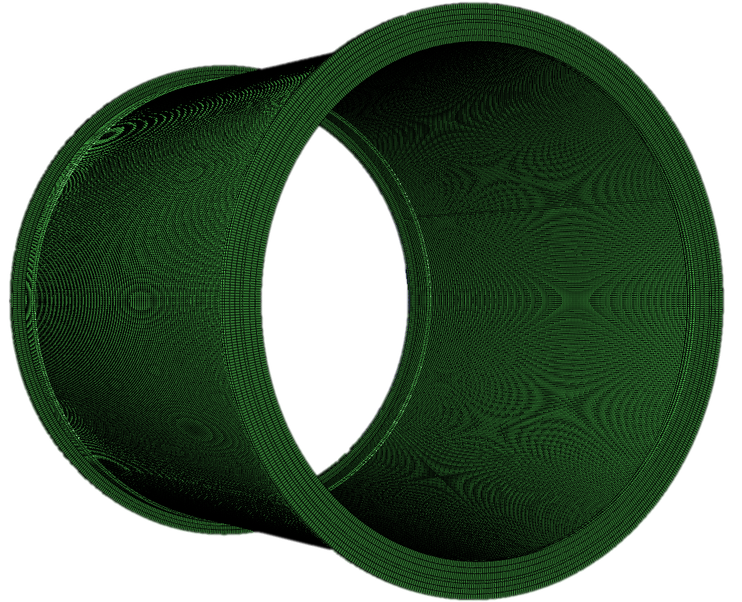
Geometric Imperfections in Practice
Nominal geometry model
?
Manufactured shell
Scanned surface data
OML scan
IML scan
?
Model with imperfections
Notes:
Manufacturing techniques for large-scale composite structures have improved over time, and an automated fiber placement machine at Marshall Space Flight Center was used to manufacture the test articles used in this work. The plies of the inner facesheet can be seen placed on a constant-diameter tool in the upper left image.
As mentioned previously, the structured-light scanning technique was used to collect data from the test article in the as-manufactured geometry and that data is shown in the lower left image.
Analysts often use nominal geometry models such as that shown in the upper right image. For cylindrical shells loaded in axial compression, however, many researchers have demonstrated that nominal analyses often overpredict experimentally-observed buckling loads. This phenomenon eventually led to the recommendation of shell buckling knockdown factors when designing shell structures for launch vehicles.
One of the largest challenges in shell buckling research has been to accurately predict buckling load and initiation locations. Correspondingly, analyzing the as-manufactured test article geometry has previously shown promise to address that challenge.
A significant challenge when working with imperfections, however, is implementing them into finite element analyses in an efficient and accurate way. The tool described later in this work was developed to specifically address this challenge, so that the analysis models and as-manufactured data could be combined into the figure shown in the lower right.

Slide 5
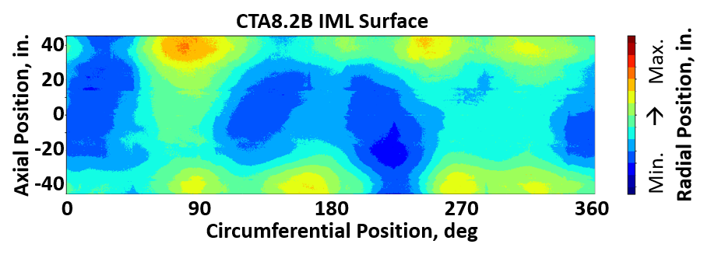
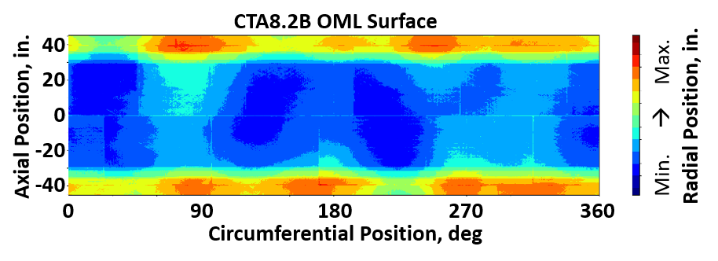
Geometric Surface Imperfections for Shells
Scanned surface data
Interpolated contours of cylindrical surfaces
Midplane position
Thickness
$$R=\frac{R_{OML}+R_{IML}}{2}$$
$$t_{shell}=R_{OML}−R_{IML}$$
$$R_{OML}$$
$$R_{IML}$$
Notes:
One of the first ways to investigate the as-manufactured geometry of a test article is to visually represent the geometry.
The IML and OML surfaces are shown in the first two figures. The cylinder has been split in the axial direction and unrolled for convenient viewing. The contours represent the radial position of the cylinder’s surface.
The IML and OML surfaces shown here can then be used to calculate the midplane and thicknesses that were previously discussed.

Slide 6
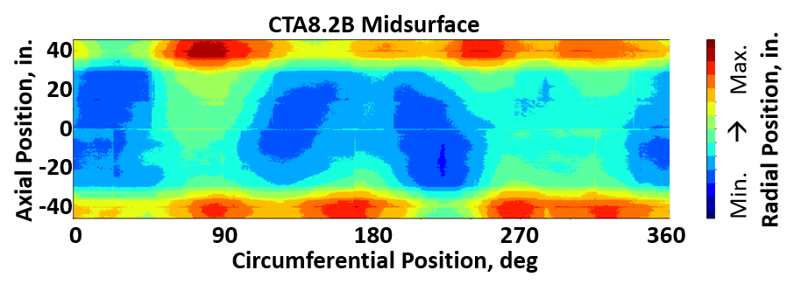
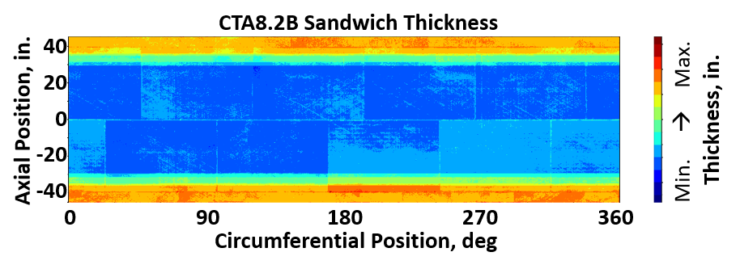
Geometric Surface Imperfections for Shells
Scanned surface data
Calculated contours of cylindrical surfaces
Midplane position
Thickness
$$R=\frac{R_{OML}+R_{IML}}{2}$$
$$t_{shell}=R_{OML}−R_{IML}$$
$$R_{OML}$$
$$R_{IML}$$
Notes:
The calculated representations of the test article’s midsurface and thickness are shown in the first two figures.
One may observe that the areas of larger- and smaller-radial position are well represented in the midsurface contour plot. The thickness contour plot, however, has little resemblance to the midsurface contour plot. This reinforces use of both midplane position and thickness as a way to represent the overall geometry of a shell structure.
The thicker regions of the cylinder near the top and bottom ends also indicate a design feature in the test article itself. At the ends of the test article, padup plies were added into the facesheet stacking sequence to aid with load introduction during compression.
These two contours are the data that Py_TIGIRS was developed to implement into the nominal geometry finite element model.

Slide 7
CTA Surface Imperfection Implementation
Py_TIGIRS description
  Highly automated set of scripts to process IML and OML data
  Update Abaqus* input file accordingly
  Developed in Python (open-source, active community, numerically efficient, parallel processing capable)
  Standalone from Abaqus scripting modules
*The mention of a company or product is not an endorsement by the National Aeronautics and Space Administration (NASA)
Notes:
Py_TIGIRS was previously introduced, but more detail is now provided about what it is, how it functions, and how well it implemented geometry from the structured-light data.
Py_TIGIRS is a highly automated set of Python scripts to process the IML and OML scanned data into midplane position and thickness values in a finite element model.
It then updates an Abaqus input file so the mesh and material layup sections reflect the as-manufactured geometry.
Py_TIGIRS was developed in Python to capitalize on the open source and active community and the numerically efficient capabilities of a scripting language.
Py_TIGIRS, though written to modify Abaqus input files, is a standalone script and not built into Abaqus thereby enabling future potential development for use with other finite element formats.

Slide 8
Py_TIGIRS Functionality
Import Abaqus input file data
  Nodal positions
  Element-node connectivity
  Shell section definitions
Calculate sandwich shell thickness and midplane for each node via scanned IML and OML data
Calculate element-based shell thicknesses and “bin” into similar groups for processing efficiency
Export Abaqus input file with updates to
  Nodal positions to reflect midplane position
  Assumption 1: Shell section definitions with altered core thicknesses
  Assumption 2: Each element is constant thickness
Notes:
Py_TIGIRS functions by importing relevant information from an Abaqus input file. Specifically, the nodal positions, element-node connectivity matrix, and shell-section definitions are imported for use and/or modification.
Py_TIGIRS then processes the structured-light scan IML and OML data to calculate the total shell thickness and midplane for each node.
Thicknesses are assigned at the element-level for shell elements in Abaqus, and if each element had a unique shell section definition, the preprocessing time required for an average-sized model would be outrageous. Therefore, elements with similar calculated thicknesses are grouped together into “bins” whereby each bin is assigned a unique shell section definition. This process significantly reduces preprocessing time for each analysis.
An updated Abaqus input file is written with changes to the nodal positions to reflect the midplane position and shell thickness.
There are two main assumptions is this process. The first is that the facesheet plies remain a constant thickness and that all thickness variation is implemented in the core layer. The second is that each element is constant thickness.

Slide 9
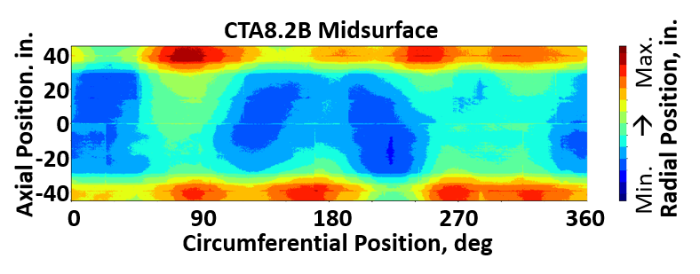
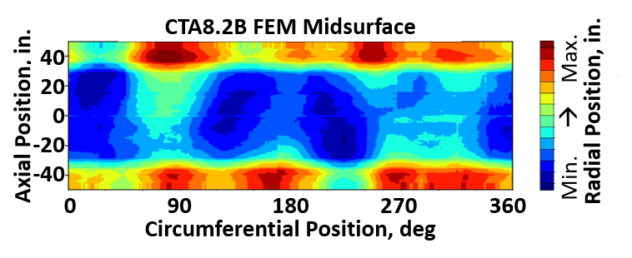
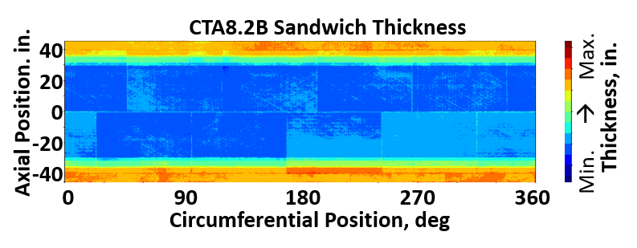
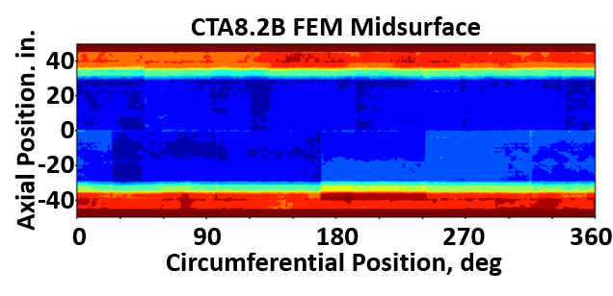
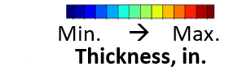
CTA8.2B Implemented Imperfections
As measured | As implemented
Notes:
So how does Py_TIGIRS perform compared to the input data?
On the left are the midsurface and thickness contours calculated from the as-manufactured data. The contours on the right are the extracted data from the Abaqus input file.
First looking at the midsurface contours, one can observe the overall features of high- and low- spots and their shapes are well captured.
Next looking at the thickness contours, one again observes the similarity in features and scales between the as-manufactured and the as-implemented geometry.
Overall excellent agreement is observed between the left and right pair of contours. This lends confidence that Py_TIGIRS is implementing the geometry accurately into the analysis model.

Slide 10
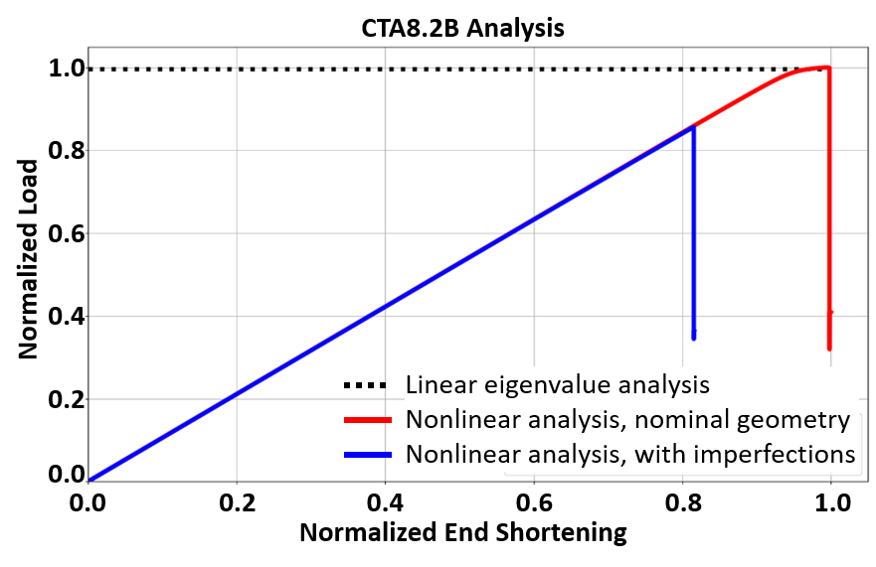
Motivation to Implement Imperfections
Linear eigenvalue and nonlinear transient dynamic analyses with nominal geometry are known to overpredict buckling loads
Implementing as-manufactured geometric imperfections lower the predicted preliminary buckling load for CTA8.2B by approximately 15%
Including as-manufactured geometry is one method to achieve an objective for SBKF
Notes:
So why is all this important, and why are imperfections, despite being tedious to work with, necessary?
Cylindrical shells in axial compression are well-known to be sensitive to many types of imperfections – geometric imperfections among them.
A linear eigenvalue analysis of a nominal geometry cylinder is a common analysis when first investigating a particular design and produces various predicted buckling loads and modes.
Enhancing the analysis to nonlinear transient dynamic analyses, but still with nominal geometry, can easily convince an analyst that the linear eigenvalue predictions are reasonable because the buckling loads are very close. This is highlighted by the black dashed line representing the linear eigenvalue predicted buckling load and the red line representing the nonlinear analysis.
Once as-manufactured imperfections are included in the nonlinear analysis, shown by the blue line, significantly lower buckling loads are predicted.
Various methods for including imperfections have been proposed in previous work, but implementing as-manufactured geometry into analyses is one method that has enabled the SBKF project to progress towards achieving its objective.

Slide 11
Concluding Remarks
The SBKF project is developing and validating analysis-based buckling knockdown factors for a select class of launch-vehicle structures
Geometric surface imperfections can significantly alter a cylinder’s response in axial compression
Py_TIGIRS was created and demonstrated to accurately implement geometric surface imperfections into finite element models
Implementing as-manufactured geometric surface imperfections is one method enabling the SBKF project to achieve its objective
Notes:
SBKF is developing analysis-based buckling knockdown factors for sandwich composite structures.
Geometric surface imperfections can alter the predicted buckling response of a cylindrical structure loaded in axial compression.
Py_TIGIRS was created to accurately implement geometric surface imperfections into finite element models and therefore enabling the SKBF project to make progress towards achieving one of its objectives.

Slide 12
Questions?
Notes:
This has been a brief overview of the work presented in the paper, and I am happy to answer any questions you may have.
Come discuss this topic with me afterwards during the session’s Q&A.
Thank you.

