Slide 1
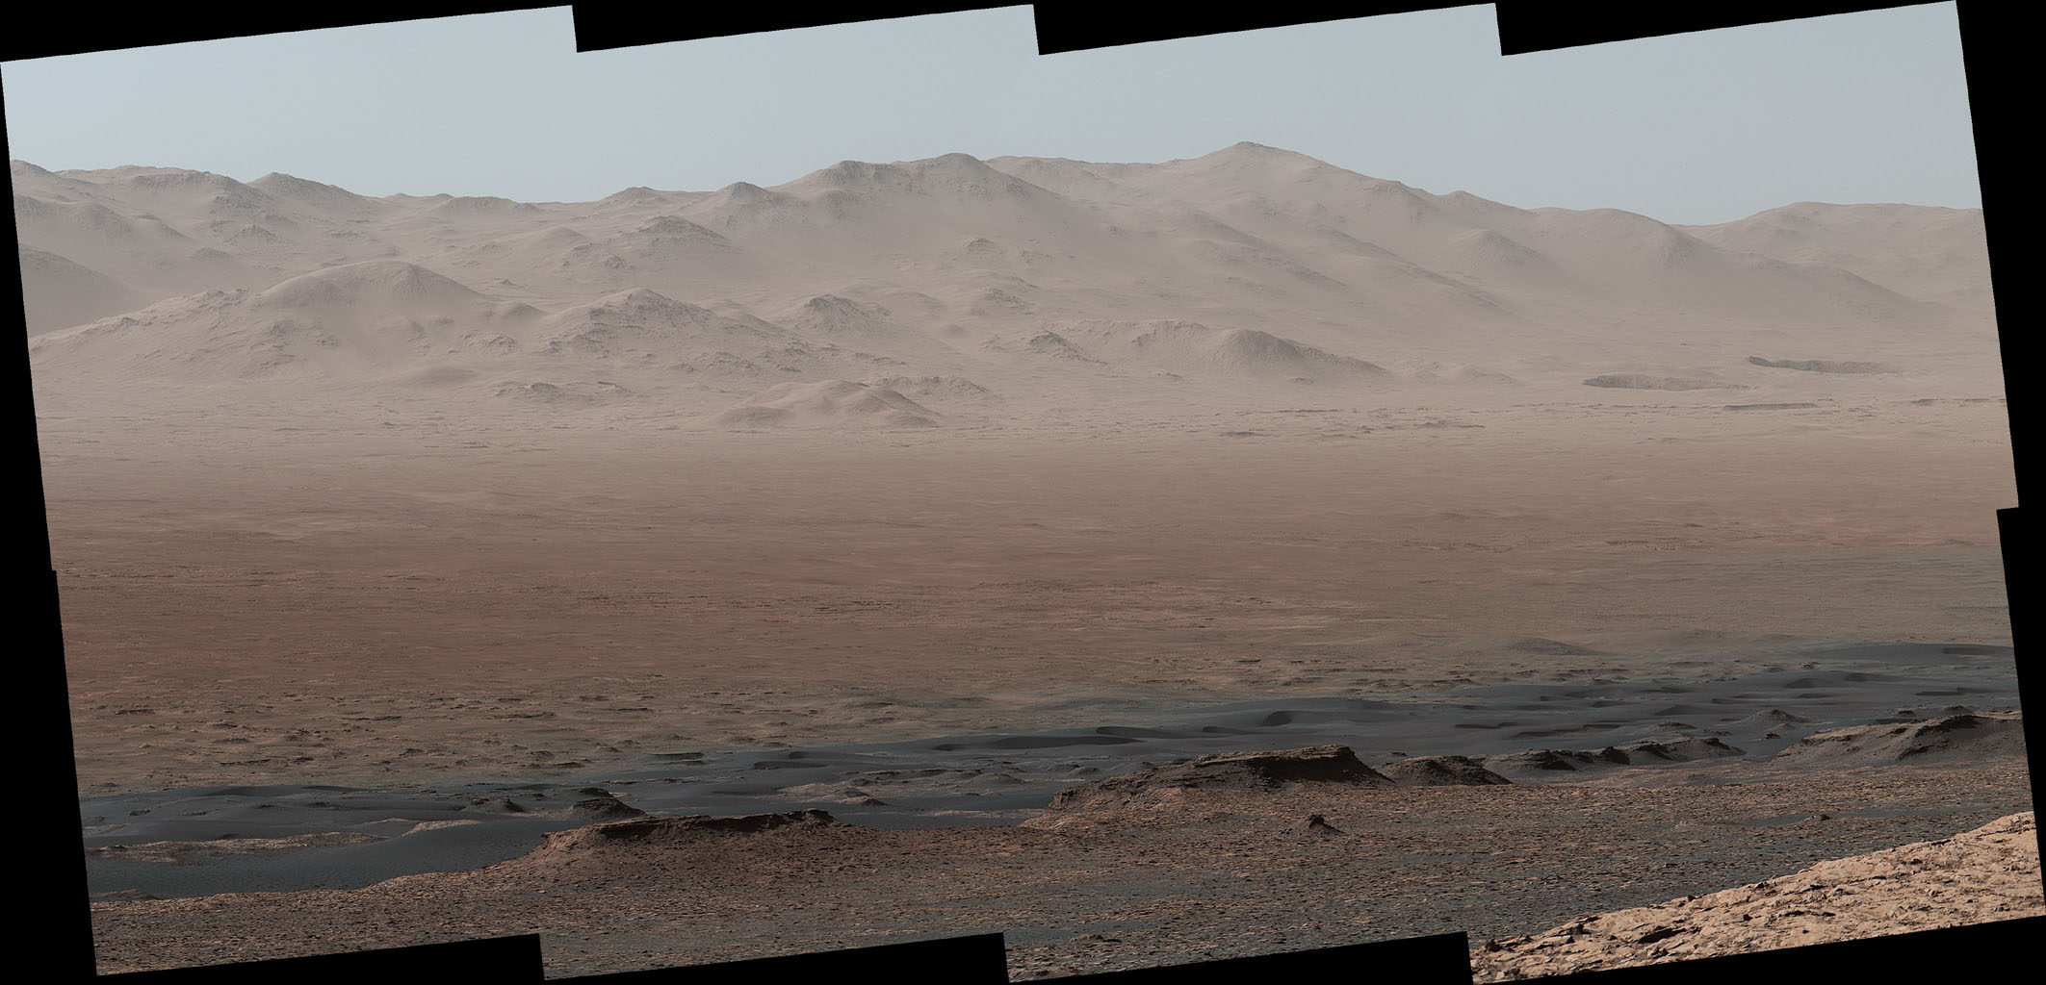

Ancient Martian Climate with ROCKE3D
Kostas Tsigaridis, Scott Guzewich, Michael Way, Igor Aleinov, Eric Wolf, Anthony Del Genio, Robin Wordsworth
AGU Fall Meeting
December 15, 2020
NASA/JPL-Caltech/MSSS

Slide 2
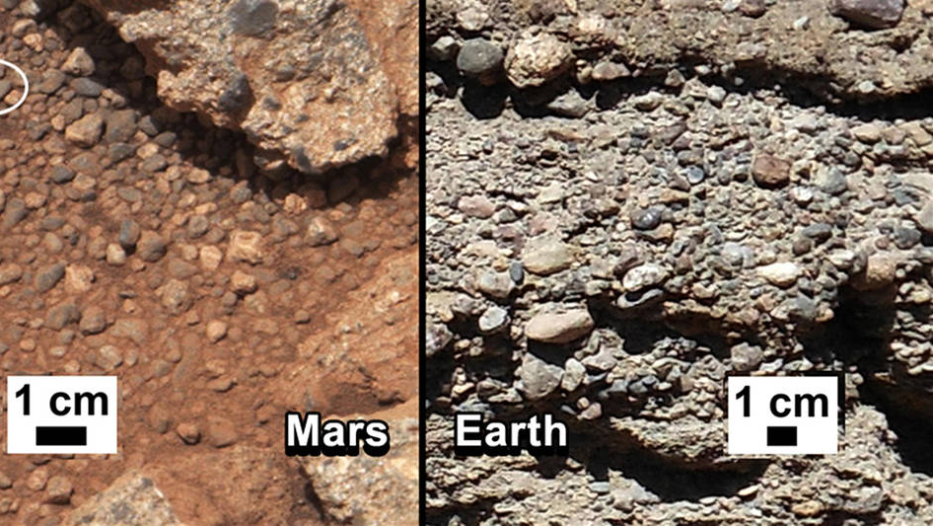
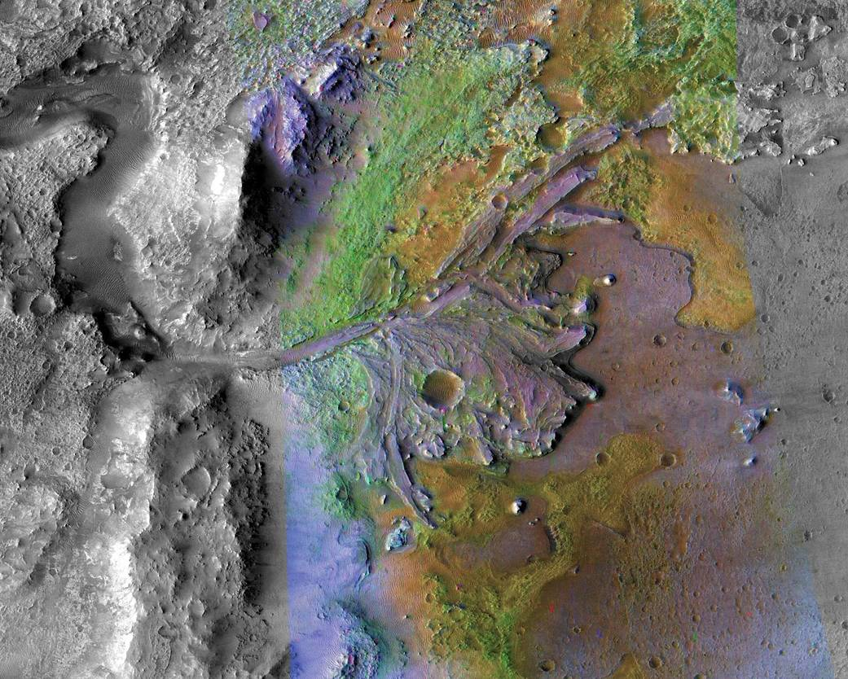
Motivation
Gale Crater conglomerate rocks: Williams et al., 2013
Jezero Crater delta: NASA/JPL-Caltech/ASU
Abundant evidence of ancient fluvial activity on Mars

Slide 3
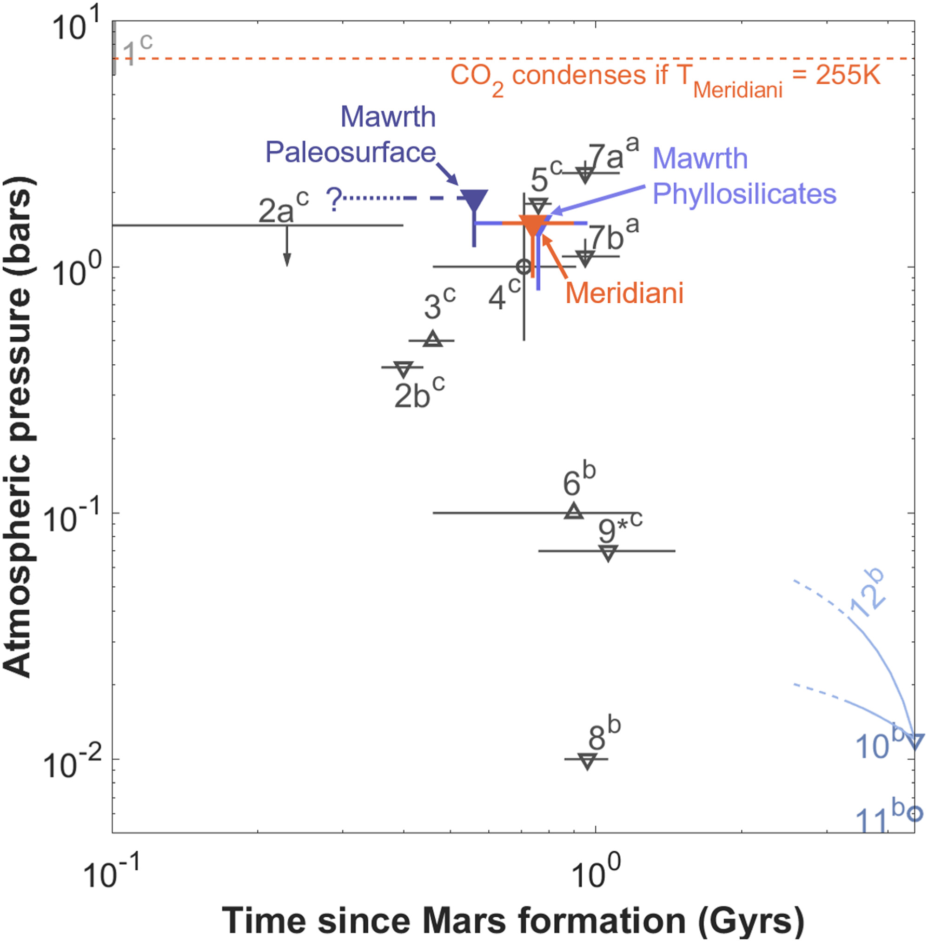
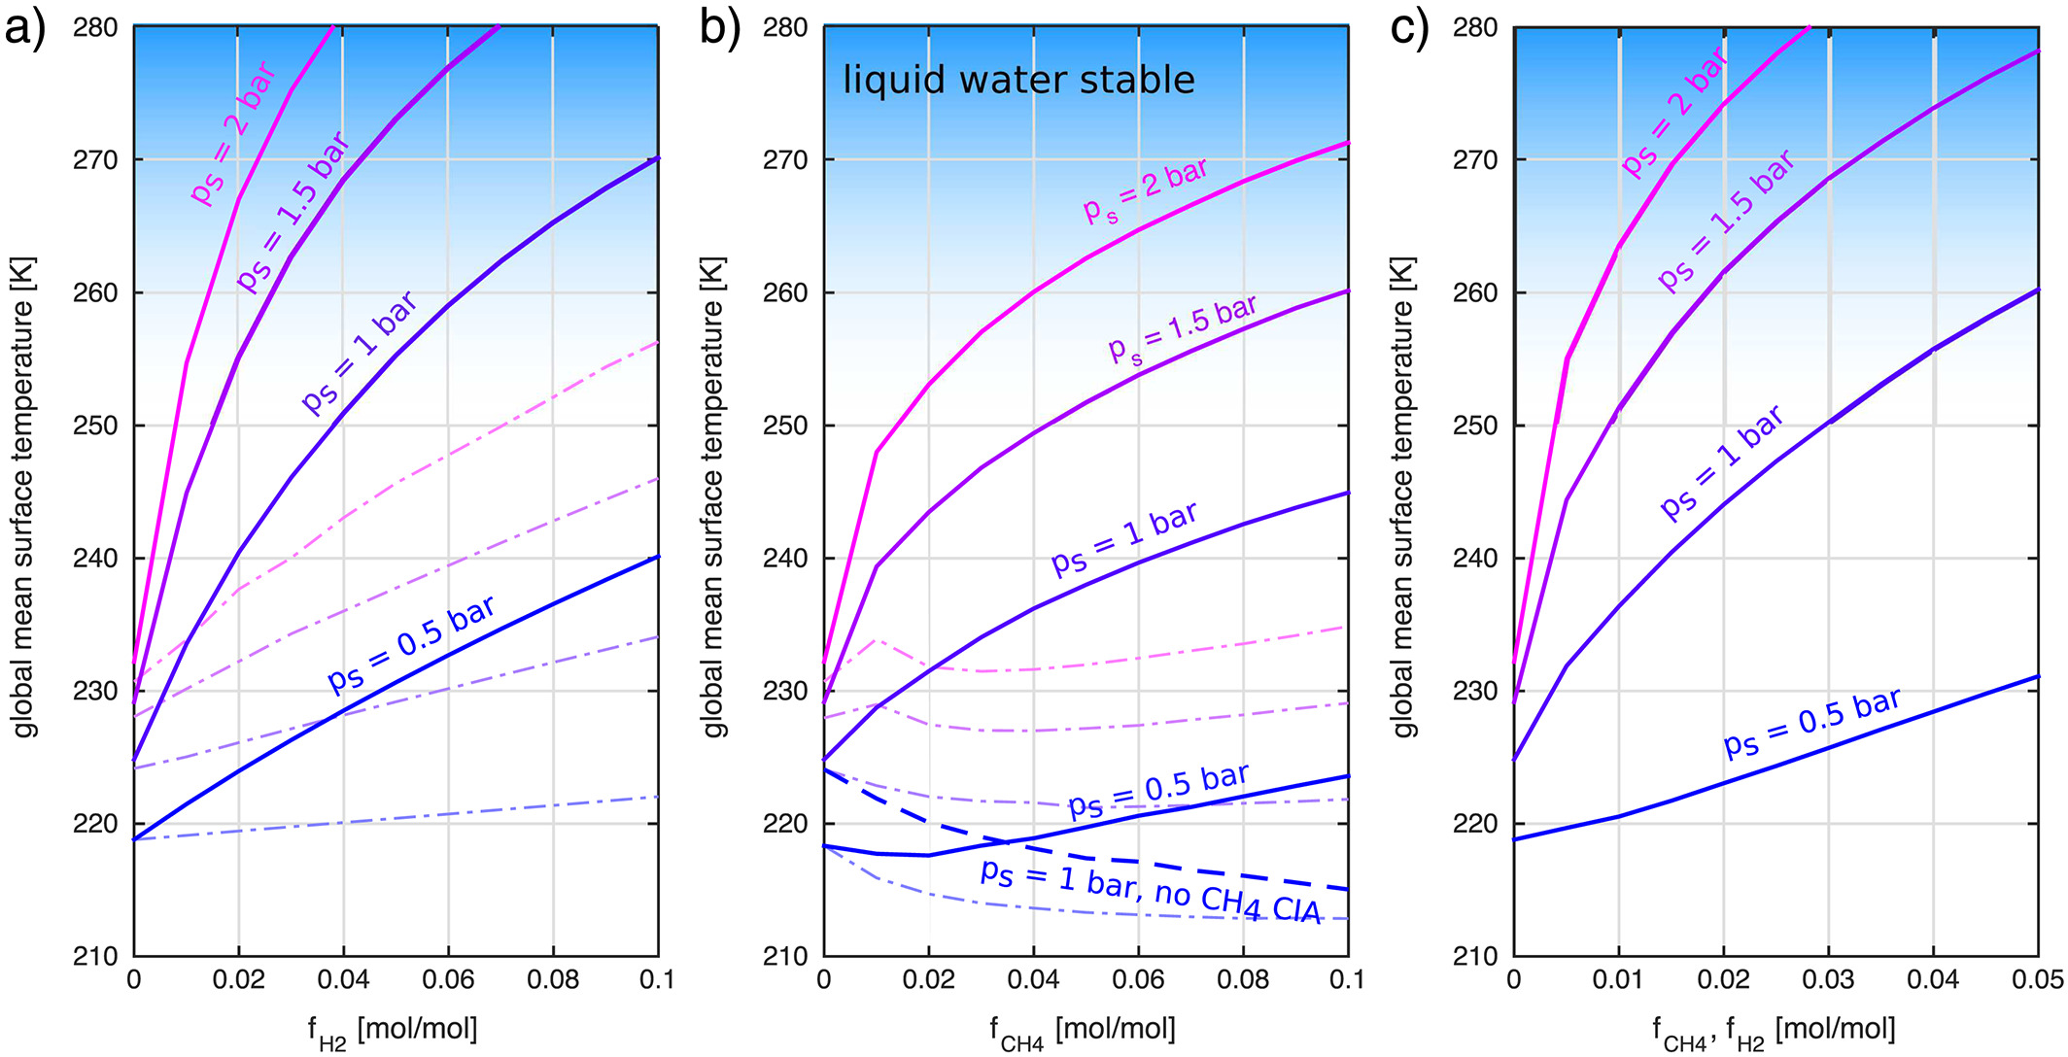
Motivation
Paleopressure constraints of ≤2 bar
(Kite et al., 2014; Warren et al., 2019)
Possibility of H₂ collision-induced absorption as a greenhouse warming agent
(Ramirez et al., 2014; Wordsworth et al., 2017)
Warren et al., 2019
Wordsworth et al., 2017

Slide 4
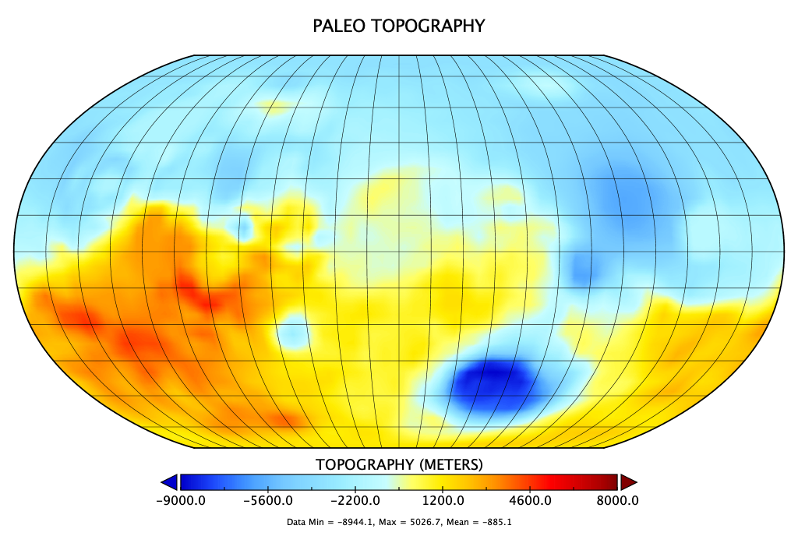
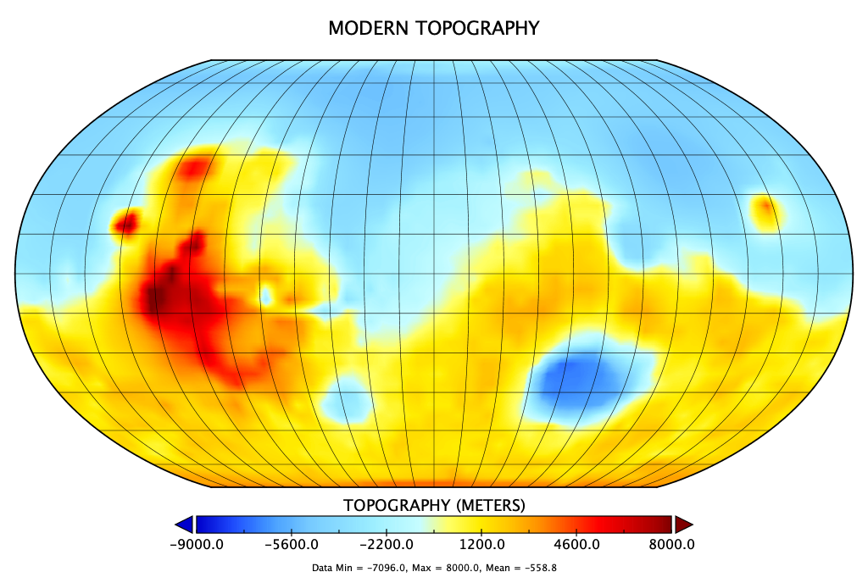
ROCKE3D Simulations
3.8 Gya Solar spectrum
Modern and paleo (pre-Tharsis and pre-True Polar Wander) topography (Bouley et al., 2016; Matsuyama and Manga, 2010)
0.5-2 bar CO₂ atmospheres with varying amounts of H₂ (0-10%), CH₄ (0-1%), and N₂ (0-10%)
Varying amounts of surface liquid water (0-500 m global equivalent layer) in “lakes” or fully-dynamic oceans
Modern (25°), 0°, or 45° obliquity

Slide 5
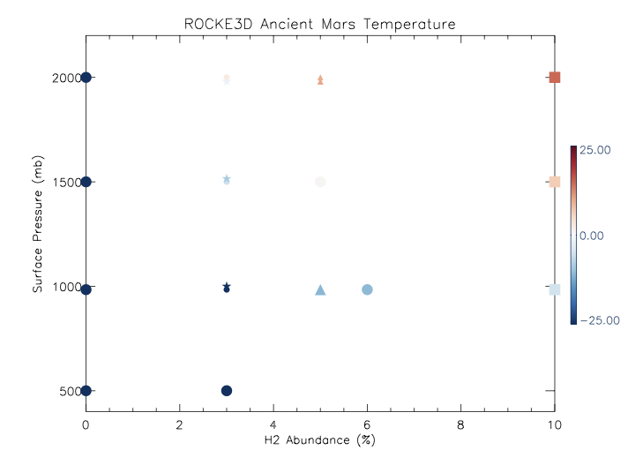
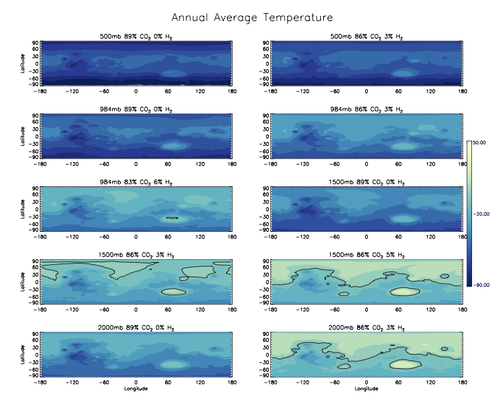
Seeking 273 K
For “dry” simulations, ≥3% H₂ and 1.5 bar is needed for global mean temperatures above freezing→Tharsis and southern highlands still cold
Global mean temperature above freezing
Global mean temperature below freezing

Slide 6
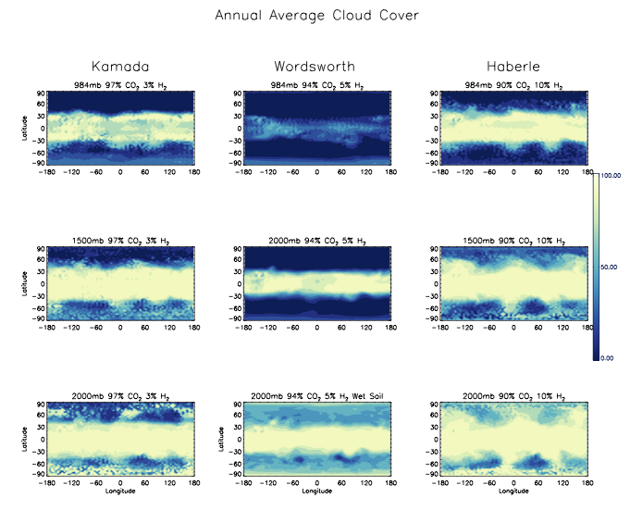
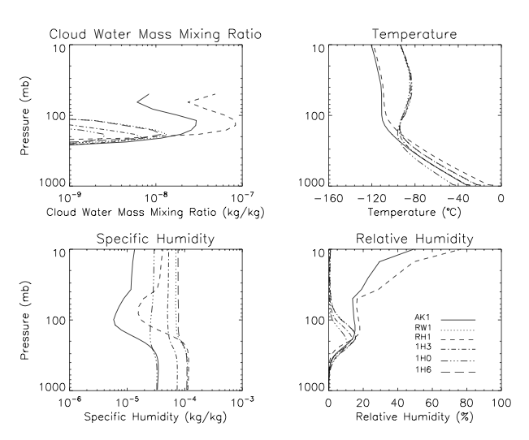
CH₄, Clouds, and Water Loss?
1% CH₄ produces a leaky stratosphere. Simulations without CH₄ (following Kamada et al. 2020 and Haberle et al. 2019) have cloud-induced hygropause.
With 1% CH₄
With 1% CH₄

Slide 7
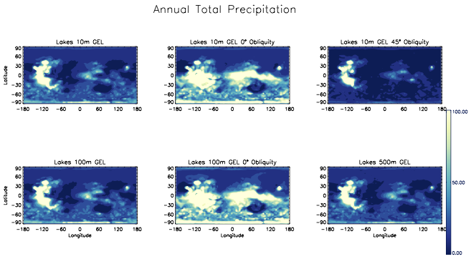
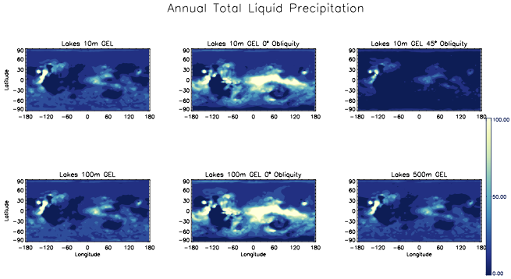
The Fate of Surface Liquid Water
With modern topography, water is cold-trapped on Tharsis. Regardless of initial water inventory.
0° obliquity produces much more precipitation, including rainfall. And over areas with valley network formations.
mm/year
Cold-trapping of water on Tharsis
0° obliquity rainfall near dichotomy boundary and southern highlands

Slide 8
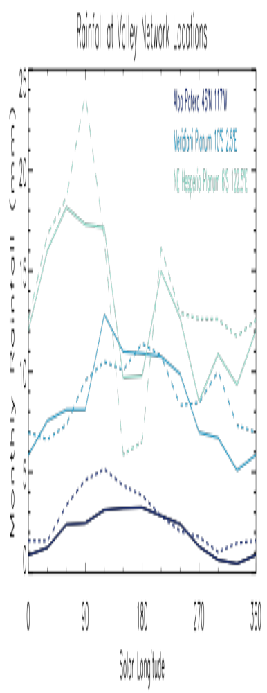
Rainfall at Valley Network Locations
0° obliquity produces much more precipitation, including rainfall. And over areas with valley network formations. Final rainfall is largely independent of initial 10m (solid line) or 100m (dashed line) of GEL water inventory.
Many, but not all VN locations (Hynek et al., 2010), see rainfall. E.g., southern Solis Planum sees very little rainfall in these simulations.

Slide 9
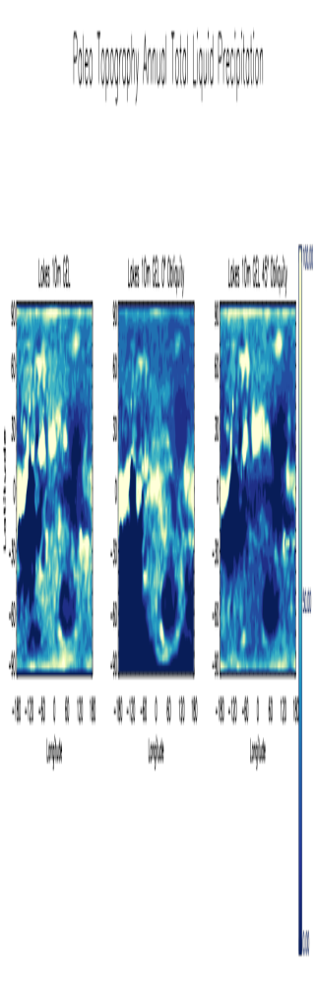
Rainfall before Tharsis Formation
Prior to Tharsis formation and True Polar Wander, areas with valley network formations fell around 24°S +/- 14° (Bouley et al., 2016).
0° and 25° obliquities favor rainfall in these areas. Again, high obliquity (45°) is not consistent with rainfall supporting valley networks.
  Simulations with higher water inventories ongoing

Slide 10
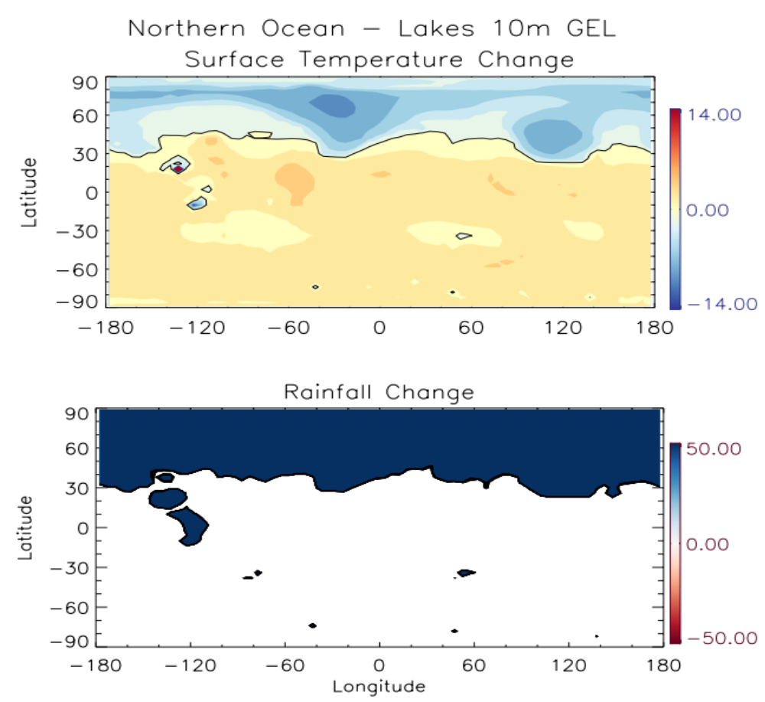
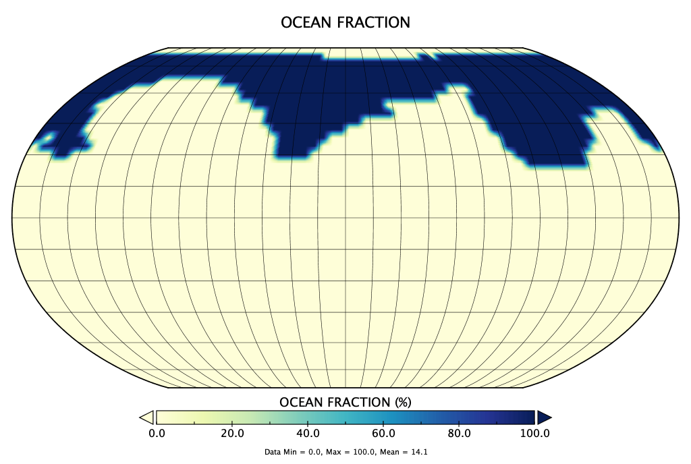
Role of Ancient Martian Oceans
Modern topography northern ocean with minimum 200 m depth
Planet is very slightly warmer on average
Rainfall is not increased in areas of open/closed lake basins or valley networks
Deep snow/ice cover over Tharsis remains

Slide 11
Ongoing Work
Lakes simulations with paleotopography
  Lack of Tharsis creates much longer simulation durations (2000+ years) to reach hydrologic equilibrium
Additional simulations with fully dynamic oceans
  Could ocean heat transport have helped maintain ancient habitable conditions?

