Slide 1
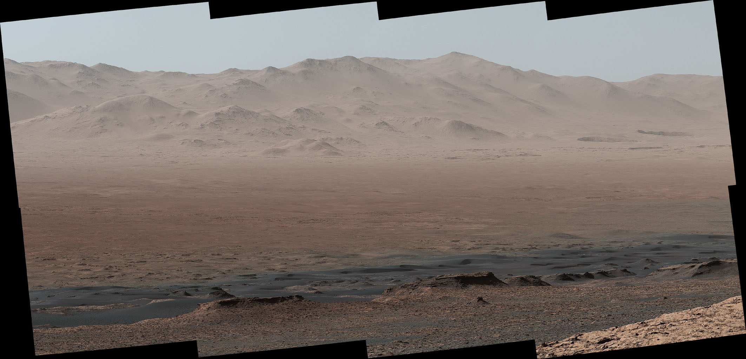

Gravity Wave Observations by the Mars Science Laboratory REMS Pressure Sensor and Comparison with Mesoscale Atmospheric Modeling with MarsWRF
Scott Guzewich, Manuel de la Torre-Juárez, Claire Newman, Emily Mason, Michael Smith, Nina Miller, Alain Khayat
AGU Fall Meeting
December 10, 2020
NASA/JPL-Caltech/MSSS

Slide 2
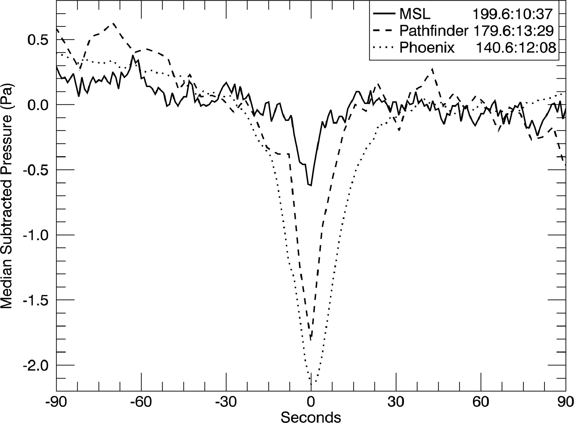
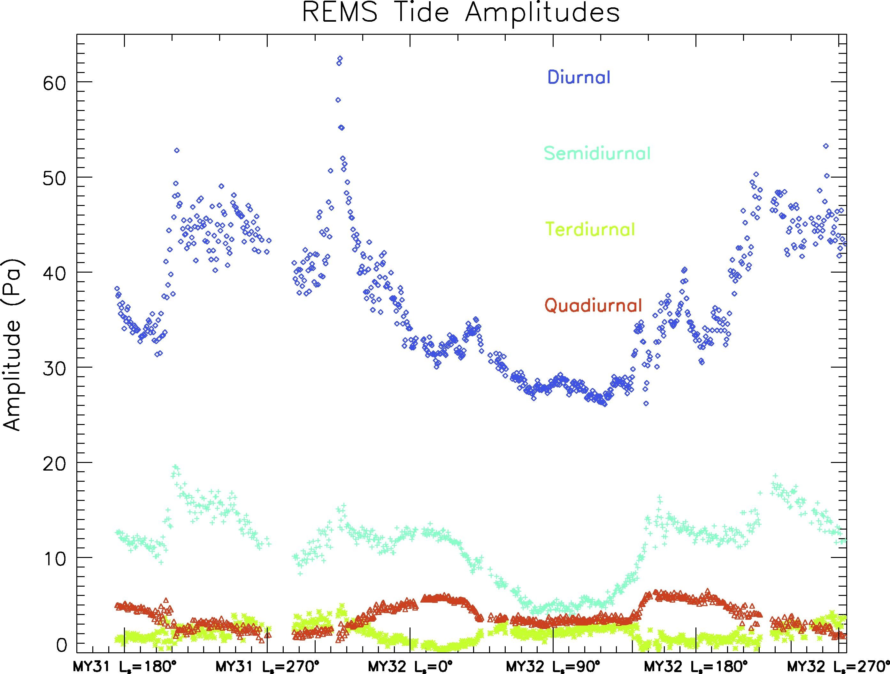
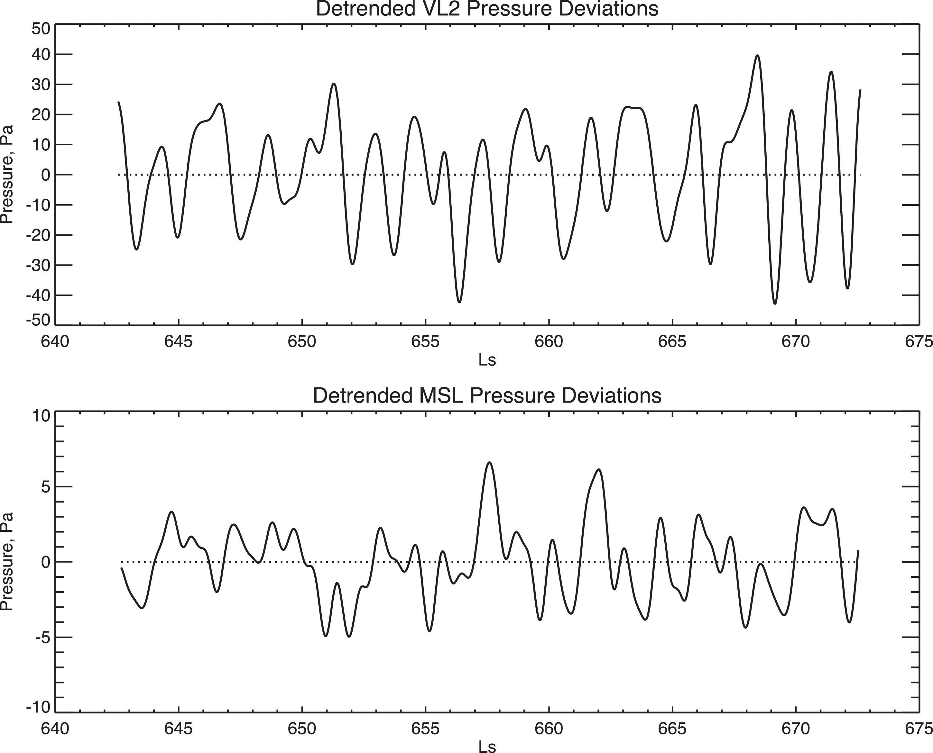
Motivation
Baroclinic/barotropic Traveling Waves
(e.g., Haberle et al., 2018)
Dust Devils and Pressure Vortices
(e.g., Steakley and Murphy, 2016)
Atmospheric Tides
(e.g., Guzewich et al., 2016)
Wave Period
Seconds
Minutes
Hours
Sols
Explore a missing area in the time phase space of atmospheric waves on Mars

Slide 3
Motivation
Waves with periods of tens of minutes to hours are not well characterized in surface pressure on Mars
Baroclinic/barotropic Traveling Waves
(e.g., Haberle et al., 2018)
Dust Devils and Pressure Vortices
(e.g., Steakley and Murphy, 2016)
Atmospheric Tides
(e.g., Guzewich et al., 2016)
Wave Period
Seconds
Minutes
Hours
Sols
Explore a missing area in the time phase space of atmospheric waves on Mars

Slide 4
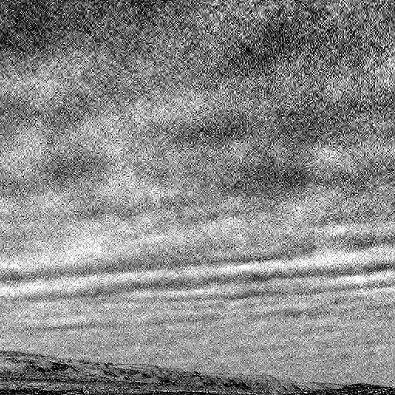
Motivation
Kloos et al., 2018
Determine if REMS can detect waves seen in cloud movies

Slide 5
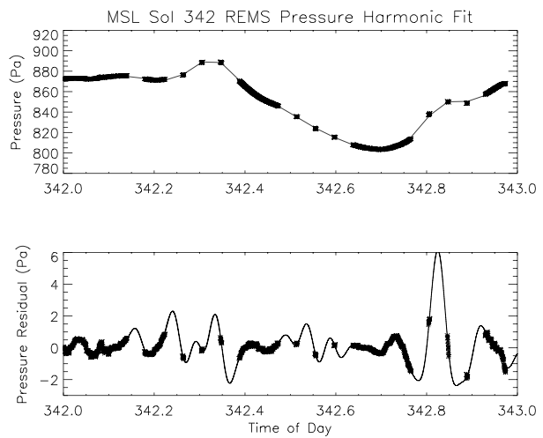
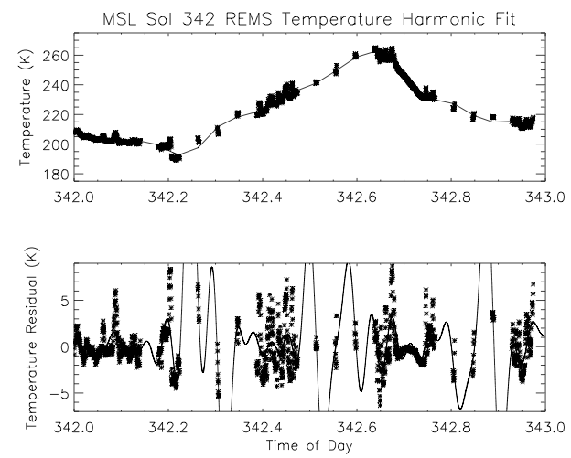
REMS Analysis Methods
Harmonic Fitting
Wavelet Analysis

Slide 6
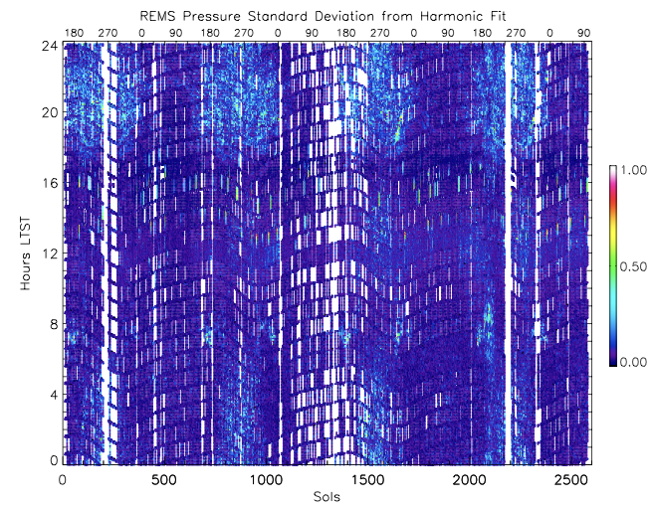
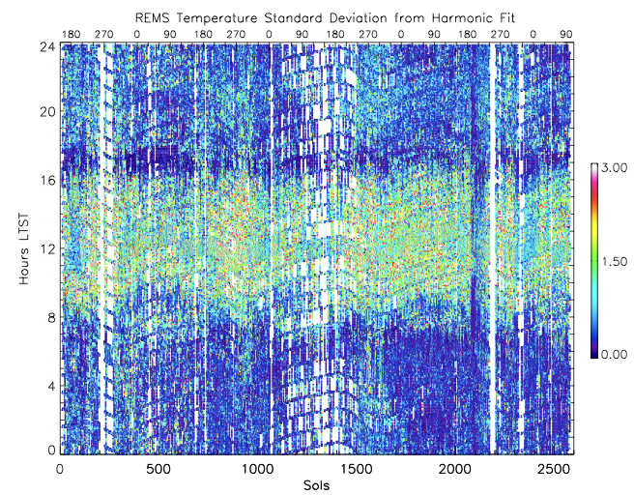
0th Order Analysis: Standard Deviation from Harmonic Fit
Pressure and temperature distinctly different: temperature driven by daytime turbulence
Pressure has a clearer seasonality (with most activity in southern spring and summer) and diurnal cycle (most activity after sunset and early morning)

Slide 7
0th Order Analysis: Standard Deviation from Harmonic Fit
“Quiet Period” near 1700-1800 LTST
  InSight sees this too and is the time when they are most sensitive to Marsquakes; Banfield and Spiga et al., 2020

Slide 8
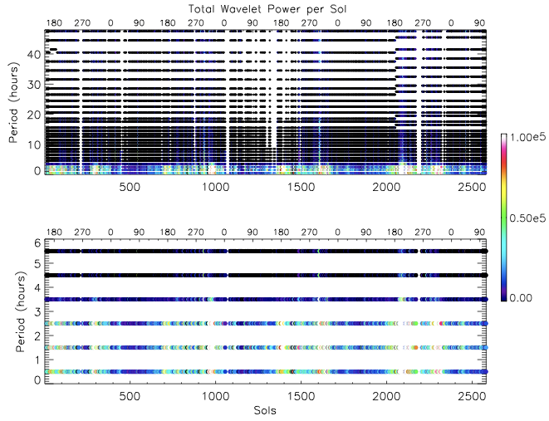
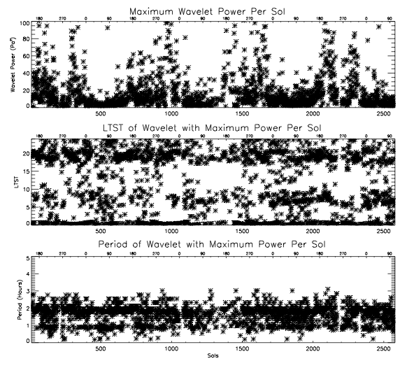
Wavelet Analysis of REMS Pressure
Flexible analysis method. We apply wavelet analysis to the residual pressure with an 8th order harmonic fit (for atmospheric tides) removed.
Seasonality and diurnal patterns like standard deviation
Strongest wavelets comparable to semidiurnal tide (~5-10 Pa)

Slide 9
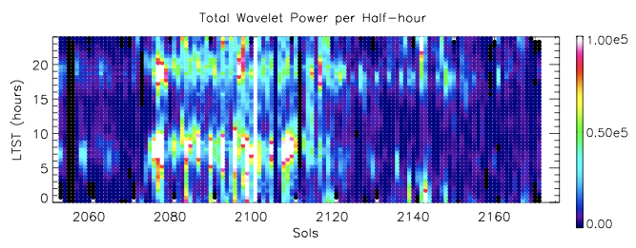
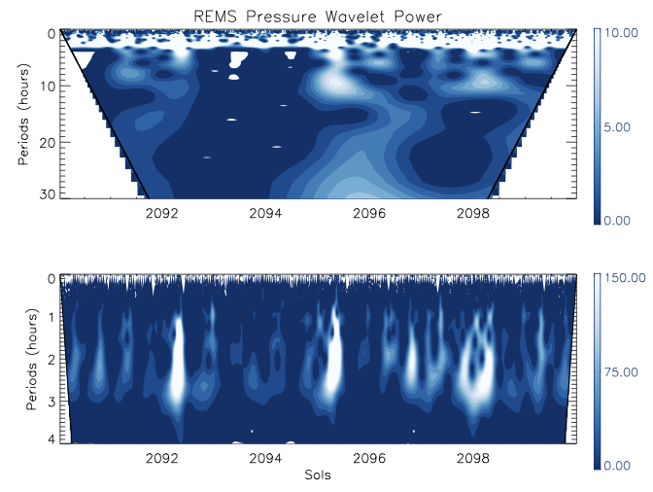
Mars Year 34 Global Dust Storm
Strongest wavelets of the entire mission occurred as opacity peaked near Sol 2080
Wavelet power also present
at long periods (10+ hours),
which is rare or absent for the
remainder of the mission

Slide 10
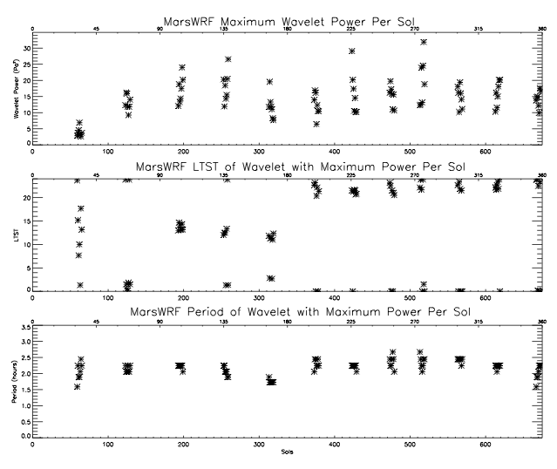
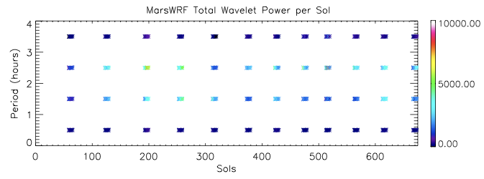
Compare with Mesoscale Modeling w/MarsWRF
High-resolution “nested” mesoscale simulation covering MSL and InSight landing sites. Prescribed dust climatology, no water ice clouds.
Wavelet analysis shows waves of comparable periods, but weaker (~20 Pa² vs. up to 80-100 Pa² w/REMS), and with muted seasonality.

Slide 11
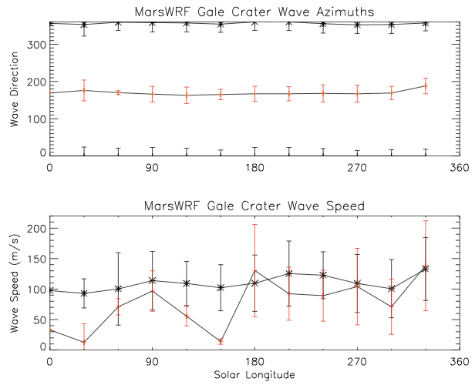
Compare with Mesoscale Modeling w/MarsWRF
Having model output across the full domain allows us to identify wave azimuths and speed.
Waves are predominantly from the north (black) with a second preference from the south (red).
Phase speeds are consistent with horizontal wavelengths of ~200-1500 km under shallow water assumption
  Comparable to gravity waves in Earth’s stratosphere and mesosphere

Slide 12
Conclusions
REMS pressure indicates non-tidal waves with periods of tens of minutes to hours are frequently present.
  Most common in late evening and early morning
  Seasonal cycle with strongest waves in southern spring and summer
Pressure waves distinct from temperature, which is dominated by higher-frequency/shorter-period turbulence
Mesoscale MarsWRF simulations reproduce the periods and some aspects of the diurnal cycle of these waves as seen by REMS.
  Directional azimuths and phase speeds imply topographically-generated inertia-gravity waves.

