Slide 1
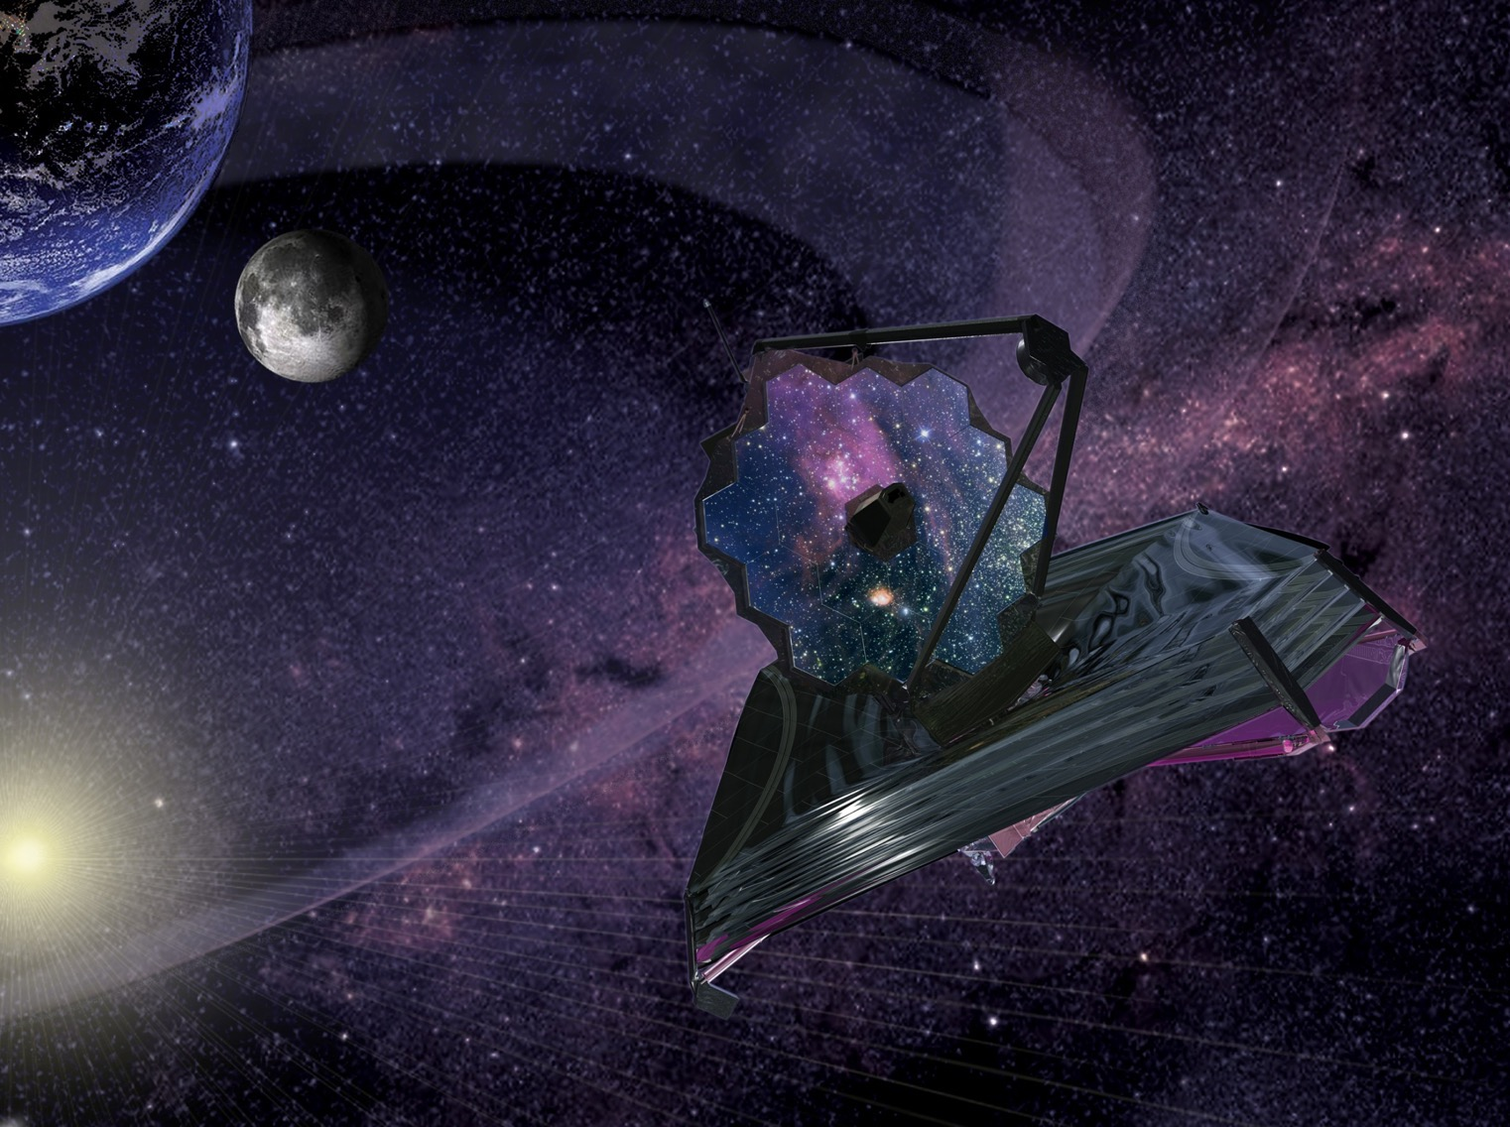

Preparing JWST for Science Operations
SPIE Meeting
December 2020
Erin Smith- NASA/GSFC
JWST Deputy Project Scientist
Notes:
Hi My name is Erin Smith, I am a Deputy project scientist for the James Webb Space telescope at NASA’s Goddard Space Flight Center. Today I will be talking about how we plan to prepare JWST for science during it’s on-orbit commissioning. The James Webb Space telescope is a 6.5 meter infrared optimized, open body telescope that will be launched in 2021. JWST will be placed in an L2 orbit, where it will be shielded from the sun by the tenis-court-size, 5 layer sunshield. JWST has four science instruments, NIRCAM, NIRSPEC, NIRSS and MIRI, and will deliver cutting edge science from .6-28 microns that will revolutionize our understanding of galaxy evolution, star formation and the origin of the universe and much more.

Slide 2
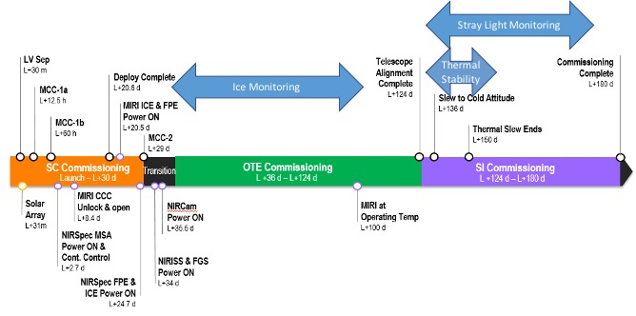
Commissioning At A Glance
Commissioning begins at launch and is ~ 180 days long marked by the following key events:
1. Launch and Ascent – power positive, safe attitude, and communications established
2. Mid Course Correction – MCC1 (a and b) corrects launcher dispersions for proper L2 trajectory
3. Deployments
4. Cool-Down/Cryo-Cooler Activation
5. Mirror segment deploy and wave-front control
6. Science Instrument calibrations and checkout
Launch and Deploy Phase
Cool-Down/OTIS Phase
OTE: Optical Telescope Element
Notes:
When launched, there are a series of activities whichi occur in the early stages of the observatory’s life. This includes the launch, ascent and mid-course correction, which places the observatory into its L2 orbit. During this time deployments, such as the deployment of the sunshield, secondary mirror and primary mirror wings occurs. The observatory is also cooling down throughout this time period, and the primary mirror segments are aligned.
Commissioning the Webb telescope is a carefully coordinated process, usually divided into three parts: Spacecraft commissioning, Optical Telescope Element commissioning, and science instrument commissioning. Observatory commissioning tasks are conducted throughout these phases.

Slide 3
OTE in Overall Commissioning
JWST Timeline: Optical Telescope Element (OTE) Commissioning
SCE Commissioning
OTE Commissioning
SI Commissioning
L +31 min – L+30 d
L +40 d – L+124 d
L +124 d – L+180 d
Notes:
After the spacecraft commissioning, when all deployments have been completed and the MCC burn is complete, the observatory enters OTE (or optical telescope element) commissioning. During this time the observatory is still cooling, but the primary activity centers on alignment of the mirror segments. Throughout this alignment process the NIRCam, and later NIRSpec instruments will be used to perform the Ice monitoring observatory commissioning activity.

Slide 4
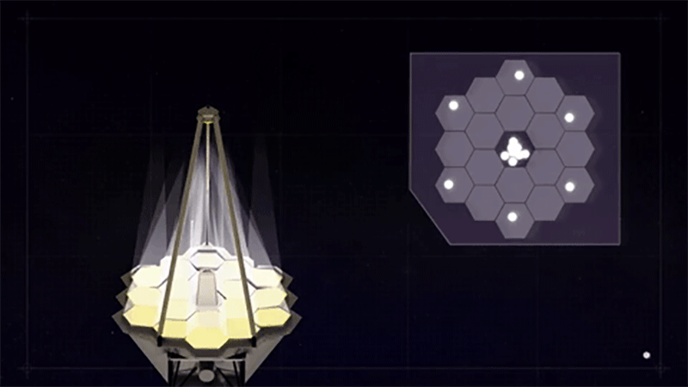
Mirror Segment alignment
https://www.nasa.gov/feature/goddard/2017/james-webb-space-telescope-s-laser-focused-sight
Notes:
The main activity during OTE comissioing is the alignment of JWST’s mirror segments. This is accomplished through systematic measurement wavefront errors, segment image stacking and image optimization. Please see Lee Feingerg’s talk for more information on this activity. Throughout this activity the NIRCAM instrument will be taking ice monitoring measurements, requiring close coordination between the teams to ensure the status of the telescope is well-understood.

Slide 5
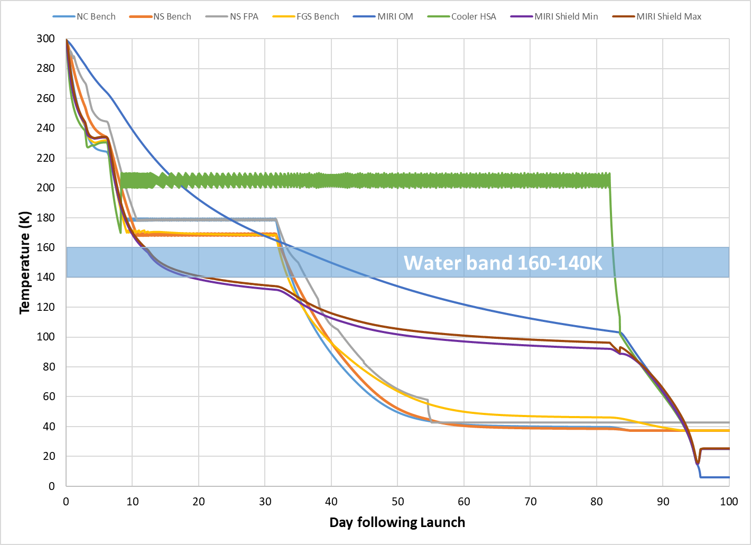


Cooldown Overview
Notes:
When launched, JWST begins to passively cool, yielding the low temperature backgrounds that enable the IR science JWST will pursue. However, this cooling must be controlled to protect sensitive optics from accumulating water ice. To accomplish this the sensitive optical components, such as the fine steering mirror, have heaters, which ensure that any ambient water ice will freeze out on non-sensitive surfaces by allowing them to pass through the water band first. Only then are the sensitive surfaces released to cool through the water band.

Slide 6
Water Contamination Risk
Instrument performance and thermal management performance is reduced if too much moisture settles on OTE or ISIM critical surfaces.
Critical surfaces include:
  Fine Steering Mirror
  Telescope optics
  SI optics and detectors
  NIRSpec microshutters
  MIRI thermal shield
  MIRI cryocooler lines
Sources of moisture could include:
  ISIM Structure
  Insulation
  Warm regions of the core (though unlikely)
Water ice deposition onto critical JWST components post-launch presents a risk to achieving full performance of ISIM science measurements .
Notes:
Because JWST is an IR telescope water ice deposition could have an adverse effect on performance. This is especially true if this water ice were to settle on surfaces such as the FSM, SI optics, or the MIRI cryocooler lines. Water ice is not expected, but could result from trapped moisture in the ISIM structure or insulation, etc.

Slide 7
Ice Contamination Risk Mitigation
In general, the approach on-orbit to mitigate this risk is to
  Ensure that the cooldown is as controlled as possible and all sensitive surfaces remain warm until water-desorbing surfaces (composites and blankets) cool below water-freeze out temperatures (140K)
    Keep FSM warm until ice contamination has been precluded
  Ensure that the NIR SIs cool completely to operating temperature and take early measurements evaluating the amount of ice collected in the NIR SI optic train and in the telescope optics. If the ice found is within an acceptable range and not increasing, it will be safe to drop the MIRI to its operating temperature and open the MIRI Contamination Control Cover (CCC).
The best mitigation plan to minimize ice contamination is prevention, since SI decontamination warm-up would lead to only partial results, could make the contamination state worse, could carry unknown and untested risks, and would be a time-intensive operation
Notes:
As mentioned, the main mitigation against ice is in keeping sensitive optics warm until any potential ice contamination is frozen out on non-sensitive areas. This is especially important in the case of the Fine steering mirror, or FSM. Technically, a way to ‘decontaminate’ a surface would be to heat it up, releasing the ice, to deposit elsewhere. However, there are two issues with this: 1st the FSM heater cannot be re-activated once it has been turned off. As the FSM feeds all instruments any heating of other surfaces would have limited effect. This means that ensuring the FSM is not contaminated before turning off the heater is essential to preventing ice contamination. The second issue is that any heating of ISIM, regardless of the FSM status is very time consuming, and, since the FSM would remain cold, might not adequately clear contamination anyway. Finally, since there is additional cooling for MIRI using a cryocooler, it is important to ensure there is no ongoing ice contamination before dropping MIRI to operating temperature and opening its contamination control cover
This is the reason for the carefully controlled cooldown. It is also why we will conduct a series of measurements to a certain if there is any ice contamination before the FSM heater is turned off, throughout the cooldown of the instruments, and before MIRI’s CCC is opened.

Slide 8

Ice Monitoring
NIRCam Ice Monitoring Measurements 1-5
Because FSM cannot be decontaminated:
Mitigate FSM contamination risk by taking ice measurements before the FSM gets cold.
Monitor for any ice accumulation throughout cooldown
NIRCam & NIRSpec Ice Monitoring Measurement
NIRCam & NIRSpec Ice Monitoring Measurement
NIRCam Ice Monitoring Measurements
6 & 7
Notes:
The Ice Monitoring activity includes 9 total measurements of the 3.1 water ice spectral feature: 1 NIRCAM measurement before the FSM heater is turned off, 6 NIRCAm measurements for rate monitoring, and two NIRCAM and NIRSPEC measurements before the MIRI cover is opened and the cryocooler reaches state 4. Because these measurements will occur during OTE commissioning, some will be performed with a partially unstacked primary, meaning some may not have flux from all mirror segments. In particular the first measurement will be done using course guiding with only one segment, as this measurement needs to be done with the FSM warm, but fine guiding and alignment cannot be done with a warm FSM. This means that this measurement must be done as early and as efficiently as possible. The following NIRCAM measurements will be used to determine if there is any ongoing contamination by measuring any rate of increase in water absorption. The NIRSPEC measurements will check that the NIRSpec optics are clear of contamination, or that any measured contamination is consistent with NIRCAM measurements, meaning any contamination is upstream of the ISIM.

Slide 9
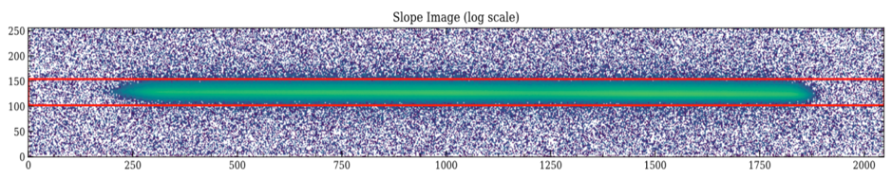
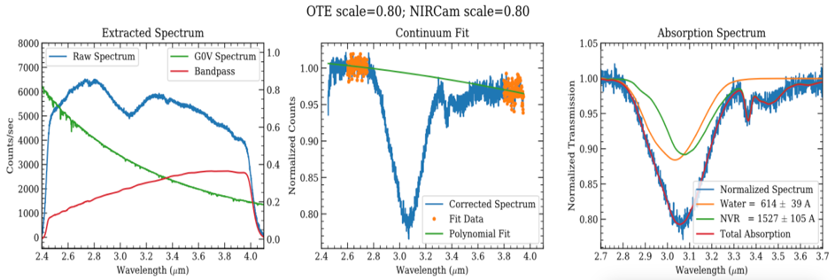
Ice Monitoring: Data analysis
Notes:
The first ice measurement is critical to both ensuring there is no ice contamination on the FSM and must be done as quickly and efficiently as possible to allow committioning to continue, we have run rehearsals with simulated data for this measurement. The Top image is a Simulated NIRCam longwave grism spectral trace for the warm FSM, unphased telescope with solar-type star target. To the Stellar spectrum water ice and hydrocarbon features have been added. On the bottom is the NIRCAM team analysis of the simulated NIRCam spectrum. Ice contamination levels were measured using the Equivalent Width of the broad ice feature at 3.1 microns. Using optical models we were able to estimate the amount of ice contamination to be below the threshold, so the FSM heater could be turned off. For ice contamination our threshold is the EOL contamination threshold. This is because any contamination is expected to occur during the cooldown.

Slide 10
Science Instruments in Overall Commissioning
JWST Timeline: Science Instrument (SI) Commissioning
SCE Commissioning
OTE Commissioning
SI Commissioning
L +31 min – L+30 d
L +40 d – L+124 d
L +124 d – L+180 d
Notes:
Once the telescope segments are fully aligned, JWST will enter Science instrument commissioning, where science instruments will check observing modes, functionality and performance. At the observatory level, we will be looking at two global aspects of JWST: the fidelity of the background model predictions through the Stray Light Monitoring activity, and the Thermal behavior of the observatory through the thermal stability characterization Activity.

Slide 11
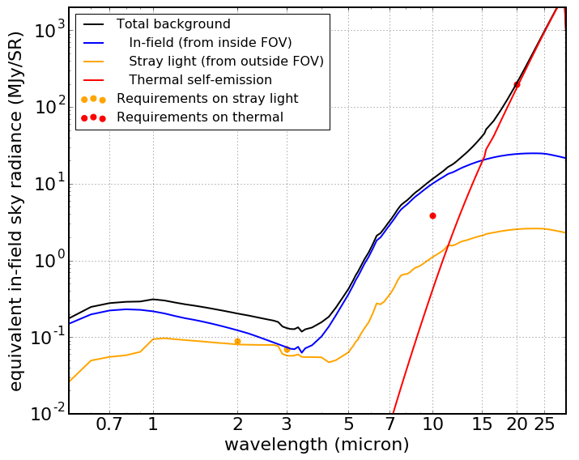
Background Characterization
In many modes (NIR broadband imaging, long wavelength MIRI), the background contributors are dominant over the detector noise terms --hence, an important part of commissioning is assessing the various contributors to the background
Figure at right from STScI’s JDox pages shows the nominal contributions to the background from the various terms (J. Rigby fit to P. Lightsey models)
From https://jwst-docs.stsci.edu/jwst-observatory-functionality/jwst-background-model
Notes:
Because JWST is an open infrared telescope, understanding the backgrounds seen by the science instruments is of particular importance. The predicted backgrounds for JWST have been carefilly modeled, and have been incorporated into timing claculators (such as the ETC). These models have also been used in development of the JWST background tool, which is available in Jdox as a python module. The JWST background tool breaks the observed backgrounds into several major components: The In-field backgrounds, (including the zodiacal and galactic sky), the out-of field stray light background, and Thermal Self-emission.

Slide 12
Background Characterization
Use on-sky observations to characterize the stray light behavior, which will be used to 1) evaluate the JWST Backgrounds Tool for systematic offsets or anomalies and 2) trend any evolution to the stray light behavior.
During commissioning, we will use pointed observations at important fields and attitudes, using a compliment of filters with broad wavelength coverage.
NIRCam + MIRI measurements at 8 selected fields, including stressing cases chosen to evaluate the extremes of the background model and key scientific fields.
MIRI measurements at extremes of the field of regard (“hot attitude” and “cold attitude”) to characterize the thermal background performance of the Observatory
Contingency commissioning observations could include additional pointed observations or a request for expanded filter imaging following planned science instrument commissioning activities.
Notes:
To measure the actual backgrounds vs the modeled backgrounds we will use a series of pointed observations and compare them to the outputs of the JWST background tool. For Observatory Commissioning we have selected 8 fields, including stressing cases and key science fields for NIRCam and MIRI parallel observations. MIRI will additionally observe fields in the hot and cold attitude to characterize the thermal background performance. Any deviation from the predicted backgrounds will be investigated further.

Slide 13
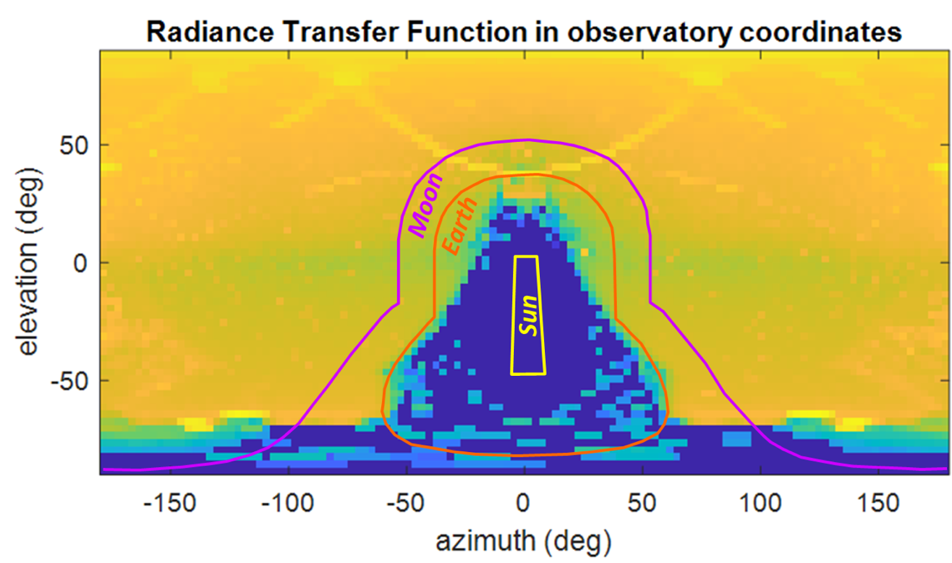
Background Characterization
The out-of-field sky background scattered into the JWST beam is characterized by the Radiance Transfer Function (see Lightsey and Bowers, Proc. SPIE 10398, 103980L, 2017)
The predicted scatter contribution to the background is the convolution of the sky background (zodi + Milky Way) with this susceptibility map; the telescope line of sight is at (azimuth, elevation) = (0,90) on this plot
Notes:
The reason we need to check multiple stressing cases is that the JWST backgrounds depend not only on the target, but also the specific geometry of the observation. The sky background that scatters into the JWST beam is captured by the radiance transper function, which has a graphical representation below, . often refered to as the susceptibility map.

Slide 14
Pointings
ID | FIELD NAME | Background | Rationale
1 | HUDF (offset) | Low NIR background | Key field
2 | Ext Groth Strip (offset) | Low NIR background | Key field
3 | HDF-S | Low NIR background | Key field
4 | 1.2 min zody | High NIR background | Requirement Benchmark
5 | Galactic Center | High NIR & MIR background | Stressing NIR/MIR case
6 | Mid-Range Background | Moderate NIR & MIR background | Moderate background field
7 | CVZ-S | High MIR background | Monitoring
8 | High Zodi, Low non-Zodi | High MIR background | Stressing MIR case
Notes:
To get a good base measurement of the backgrounds we selected 8 pointings, three of these are key deep field pointings, which are expected to be observed for long timescales in the cycle 1 science program. While these observations obviously will not go nearly as deep as science observations, they should give us an indication if there are any deviations in the background models which should be addressed. We also will observe the 1.2 min Zdo benchmark. For stressing cases we will look at the galactic center, a moderate background target and a position selected to have High zodiacal contributions. We will also observe in the Continuous Viewing Zone in order to set a baseline background measurement, as the CVZ will be revisited regularly throughout the life of the observatory giving the opportunity to monitoring changes to background with respect to this baseline. While the near-infrared observations are not predicted to change substantially throughout the life of the mission, the mid-infrared backgrounds are predicted to increase as the sunshield and optics degrade due to micrometeoroid impacts.

Slide 15
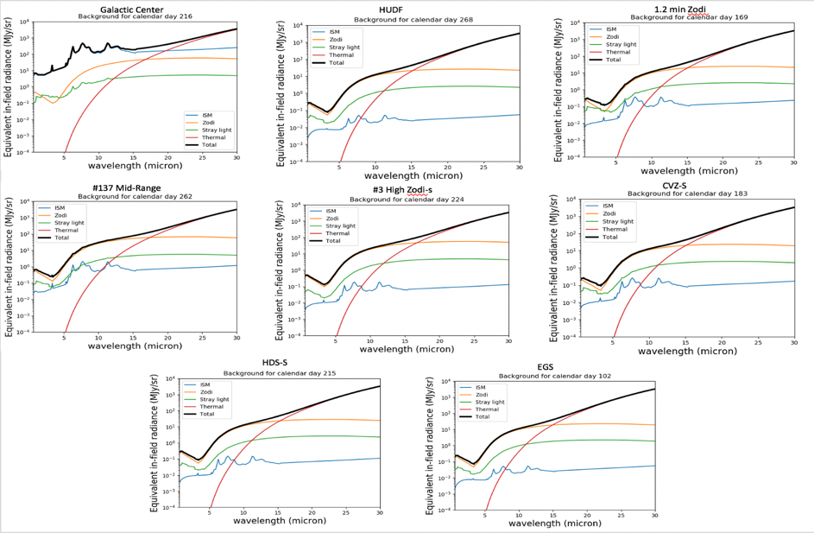
Background Characterization
HDF-S
Notes:
Here are the JWST background tool generated background models for all eight pointings. They represent widely varying backgrounds, as illustrated by the difference between the Galaceic center field and the Hubble ultra deep field.

Slide 16

Proposed Filter Usage
Pointed Stray Light filter usage
 | Science Instrument | Filter
1 | NIRCam | F070W
2 | NIRCam | F115W
3 | NIRCam | F150W
4 | NIRCam | F220W
5 | NIRCam | F277W
6 | NIRCam | F322W2
7 | NIRCam | F356W
8 | NIRCam | F444W
9 | MIRI | F560W
10 | MIRI | F770W
11 | MIRI | F1000W
12 | MIRI | F1280W
Thermally-dependent MIR background measurement filter usage
 | Science Instrument | Filter
1 | MIRI | F770W
2 | MIRI | F1280W
3 | MIRI | F1500W
4 | MIRI | F1800W
5 | MIRI | F2100W
6 | MIRI | F2500W
Notes:
These eight pointings will be observed in Four parallel NIRCAM MIRI observations. This will cover four MIRI filters, 4 Shortwave channel NIRCAM filters and 4 longwave NIRCam filters, allowing full exploration of model performance. The MIRI instrument will perform an addition check of background model performance by measuring backgrounds at the hot, then cold attitudes, and will measure the thermal self-emission in 6 MIRI filters. On the left is the filter list for both sets of observations, on the right are the filter bands marked on a JWST Backgorund prediction

Slide 17
Sensitivity Expected Outcomes & Contingencies
Throughput
  Expectation is that we will simply update our planning tools (e.g., Exposure Time Calculator [ETC]), as standard star fluxes are known more accurately than our current throughput uncertainty from ground measurements
  There is an early throughput contingency regarding unexpected levels of ice accumulation. Unlikely to have remedial actions available at the time we’re taking standard star measurements.
Backgrounds
  Expectation again is that we may need to update our planning tools – JWST Background Model, ETC – for deviations from current predictions
  Current predictions are thought to be conservative; e.g., predicted Beginning-of-Life temperatures are somewhat cooler than what is used in current tools
  Monitoring of background over the commissioning program could potentially reveal an issue with higher background near the edge of the Field of Regard – again, NOT expected, but in principle could impose operational restrictions
Notes:
We do not expect any major differences between the measured and predicted backgrounds, but should there be major deviations in the background measurements, or in throughput models, adjustments could be made to planning tools such as the ETC. One reason this is unexpected is that the current models are very conservative—most assume end-of-life performance, for example. if monitoring shows issues with high backgrounds near the edge of the field of regard, there may be operational mitigations put into place. However, this is very unlikely

Slide 18
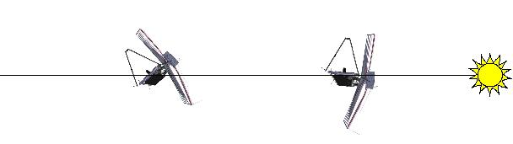
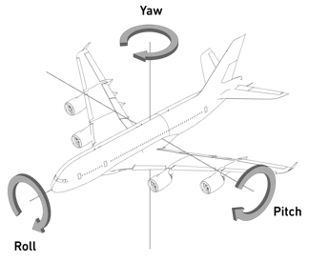
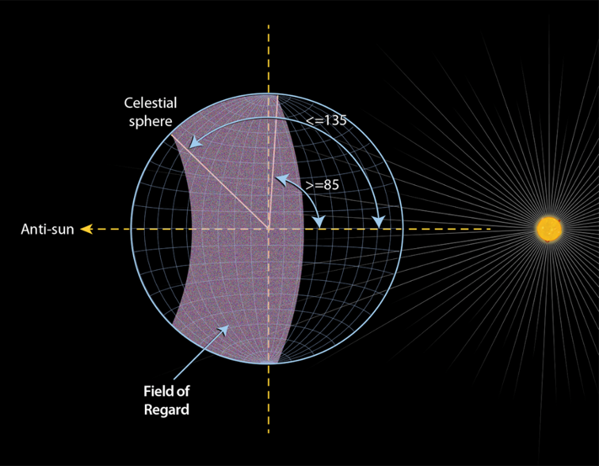
Thermal State Dependance on Pointing
-45° : cold pitch
+5°: hot pitch
The JWST science field of regard is +5 to -45 degrees in pitch and +/- 5 degrees in roll.
  Normal science observations will be carried out at various pointings within the field of regard (FOR), smoothing over the thermal state extremes to some extent.
Momentum unloads (MUs) are nominally executed at a pitch of 0 and -44 degrees and station keeping maneuvers (SK) are at pitches between 0 and -53 degrees.
  MU and SK can be carried out at either the hot or cold attitudes.
https://jwst-docs.stsci.edu/
Notes:
JWST observes a field of regard from +5 to -45 degrees in pitch and +/- 5 degrees in roll—the thermal backgrounds change slightly within this field of regard, with the +5 pitch being the ‘hot attitude and the -45 degrees pitch being the cold attitude, based on the orientation of the telescope with reference to the sun, the continuous viewing zones are at the hot pitch, but as science targets are expected to be widely distributed, the thermal state is expected to more or less average out. Changes in thermal state will subtly affect the telescope as it adjusts to the new thermal environment. This adjustment is expected to occur slowly over the course of a few days.

Slide 19
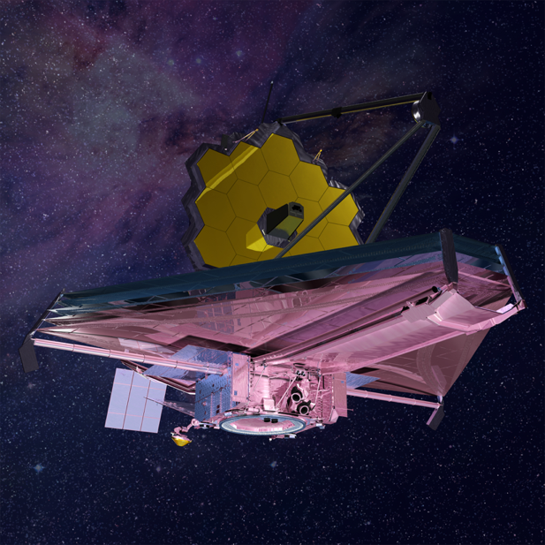
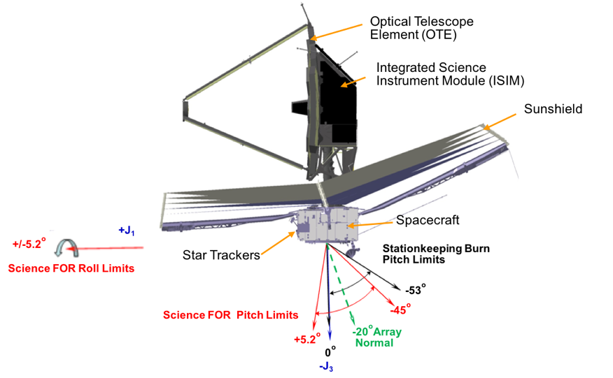

Thermal Slew: Star Tracker Thermal Response
Star Trackers in shade
Star Trackers in sun
Notes:
In addition to the thermal stability of the telescope itself, the star tracker is affected by changes in attitude. The star tracker sits on the end of a lever arm which sees a different thermal environment than the instruments, as illustrated in this animation.. As the star tracker thermally distorts, it changes the boresight between the star tracker and the telescope. These translations are sensed and corrected by the fine guidance system, but there is a small residual roll about the boresight that is uncompensated.

Slide 20
Known Optical Drifts from Thermal Changes
Design drifts: When a large slew in pitch (i.e., toward or away from the sun) is made, thermal changes on the spacecraft and OTE contribute to optical stability changes.
  Pointing stability: from thermal changes to the star tracker assembly and OTE which affect the relative coordinates, resulting in a roll about the boresight (i.e., not sensed or corrected by the fine guidance sensor loop).
  OTE thermal distortion: from structural displacements to the OTE backplane and secondary mirror motion, resulting in a change in the wavefront error.
As-built drifts: During cryovacuum testing, three additional instabilities were observed.
  IEC cyclic wavefront drifts: from the IEC radiator panel heater turn on/off which coupled into the backplane through the harness, much of which was attributed to the GSE IEC support. This is not reliant on a thermal slew.
  Frill & PMSA close-out thermal distortion: from frill and PMSA installations that did not have the requisite slack to operate across the OTE temperature range without imparting forces on the backplane. Inspections and rework completed to add slack to much of the frill and PMSA close-outs, reducing the expected drifts in flight.
  PMSA tilt events: unpredictable tilt events, likely due to backplane stress relief from the structural cooldown to operational temperatures. Several events were identified during OTIS cryo-stable but had plausible non-flight contributors. Data monitors have been developed to detect tilt events during observations (e.g., with FGS) or at the 2-day WF monitoring observations. They are not expected to be induced by the small temperature changes from a thermal slew.
Notes:
The pointing stability drift due to the star tracker and the telescope thermal distortion are two of the major expected optical drifts due to thermal changes. Additional drifts found during testing include drifts due to the frill and Primary mirror segment closeouts—these cut down on stray light, but did not have adequate slack, so induced drifts when the thermal state was changed. This has since been repaired by adding adequate slack, which should reduce these distortions, but this has not been tested. Other potential sources of drifts are cyclic wavefront drifts driven by the IEC (which do not result from thermal shifts), and primary mirror segment tilt events, which were observed in cooldown testing, but are unlikely to occur during the small thermal changes during science operations.

Slide 21
Thermal Stability Characterization
After the Observatory reaches operational temperatures, there are several activities where the hot and the cold pointings have been grouped together to provide:
  A stable hot period
  A single slew to coldest pointing
  A stable period in the cold pointing
In these periods, we will characterize the flight optical stability performance by measuring:
  Pointing stability
  OTE Thermal Distortion
  cyclic wavefront drifts
  Frill and Primary Mirror Segment Assembly (PMSA) closeout thermal distortion
  Check for unknown drifts for the as-flown Observatory over critical science timescales prior to critical science instrument commissioning measurements
Notes:
In order to measure JWST drifts, especially those that could be induced during the attitude changes in normal science operations, the observatory will conduct a commissioning activity called the Thermal Stability Characterization. This activity will be executed after the observatory has reached operational temperatures. To begin the activity, the observatory will go to a ‘hot’ attitude and stabilize there. Then the telescope will be slewed to a cold attitude, where it will make stability measurements for 14 days. Following this, the telescope will slew back to the hot attitude. During this activity the pointing stability, telescope thermal distortion, and distortion from the Frill and PMSA closeouts will be measured, any cyclic wavefront drifts will also be measured. The purpose of these measurements is to characterize the as-flown observatory over science-like timescales—especially where observations in the colder attitudes might directly follow observations in the hot attitude.

Slide 22
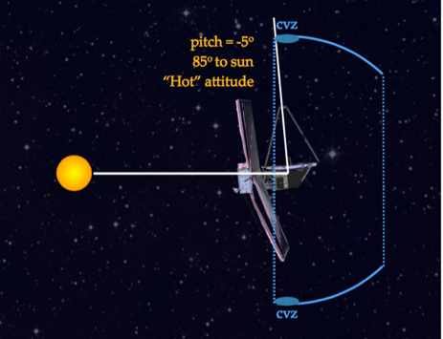
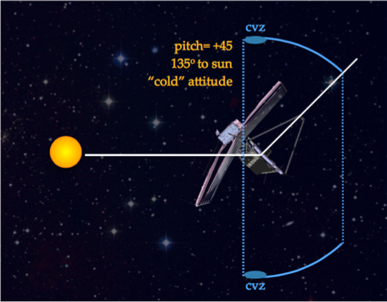
Thermal Stability: Pointing & Distortion Effects
Objectives: Measure and characterize the JWST thermal profile to 1) validate observatory thermal models and 2) determine WFSC update expectations.
All thermal stability measurements take ~4.6 days over a 20 day time period (WF monitoring activities have been absorbed in the new measurement). The additional time is filled with other commissioning activities on a non-thermal interference basis.
Stabilize at Hot attitude
Assess IEC cyclic wavefront or other short timescale drifts and establish warm stable baseline performance for pointing and wavefront stability.
Slew to Cold attitude
Assess frill/PMSA/OTE wavefront drifts and pointing stability over 14 days.
Return to Hot attitude
Verify consistency with prior hot to cold pointing stability
  Observables: telemetry data from the observatory, heater sensors, image quality evolution, transient behaviors
Notes:
This is a more visual representation of the Thermal Stabilization Characterization Activity. We will be measuring JWST performance over multiple timescales in order to fully understand the observatory’s as-flown thermal profile. This will help validate thermal models, and will also set performance expectations, and potentially determine adjustments to the cadence of wavefront control activities needed to keep the telescope in phase. The observatory will first stabilize at the hot attitude, then will perform a series of measurements to measure short timescale drifts. Measurements will also be taken for a pointing stability base line. The observatory will be slewed to the cold attitude, where it will spend 14 days to determine pointing stability drifts from the star trackers, any frill/PMSA induced drifts, and the telescope thermal distortion drifts. Finally, the observatory will return to the hot attitude, where more drift measurements will be obtained to verify and compare to the cold attitude measurements. In total the duration of the dedicated drift measurements will take 4.6 days, over a 20 day period. The ‘unused’ time in this period will be used for other SI commissioning tasks that do not interfere with the activity (for example, tasks that can be done at the cold attitude…)

Slide 23
Thermal Stability Characterization Flow
L+132 to L+137 (~4 days thermal settling + ~0.75 days of activities)
CAR 819
Hot
Attitude
0 +/- 5 deg. pitch
819-1 Slew to Hot and Thermally Stabilize
Executing other CARs!
> 4 days
819-2 Wavefront Maintenance
NIRCam Single-Field Monitor
2.8 hours
819-3 Pointing stability baseline NO DITHERS!
NIRCam | NIRISS
3 hours (6.5 min samp)
819-4 IEC cyclic drifts
NIRCam fast weak lens
2 hours (8.6 s samp)
819-5 OTE TD
NIRCam Internal Phase Retrieval (IPR) – HOT
0.9 hours
819-6 OTE TD
NIRCam Multi-Field Monitor + LOS Monitor
12 hours
Slew to Cold Attitude
-40 +/- 5 deg pitch
CP/CAM to Cold Attitude
Executing other CARs!
2 hours
Complete Analysis and CP Preparation
Executing other CARs!
6 hours
L+138 to L+152 (~4 days of activities)
CAR 811 Cold Attitude (-40 +/- 5 deg pitch)
811-1 Frill/PMSA/OTE TD & Pointing Stability NO DITHERS!
Frill: Continuous NIRCam SW weak lenses with +/- 8 waves only (15 min samp) Roll Stability: NIRCam LW
3 hours
811-2 Frill/PMSA/OTE TD NO DITHERS!
Frill & PMSA: Continuous NIRCam SW weak lens sequences with full WL suite (25 min samp) Roll Stability: NIRCam LW
21 hours
811-3.1 OTE TD
NIRCam Multi-Field + LOS Monitor
12 hours
Wait 12 hrs
811-4.[1-9] OTE TD
NIRCam Single-Field + LOS Monitor
1.4 hours
811-3.2 OTE TD
NIRCam Multi-Field Monitor + LOS Monitor
12 hours
Wait 24 hrs
811-4.[10-13] OTE TD
NIRCam Single-Field + LOS Monitor
1.4 hours
811-5 OTE TD
NIRCam IPR – COLD
0.9 hours
811-3.3 OTE TD
NIRCam Multi-Field Monitor + LOS Monitor
12 hours
repeat 5 days
repeat 4 days
Slew to Hot Attitude
(0 +/- 5 deg pitch)
CP/CAM to Hot Attitude
Executing other CARs!
2 hours
Complete Analysis and CP Preparation
Executing other CARs!
6 hours
L+152 (0.1 days)
CAR 819
Hot
Attitude
0 +/- 5 deg. pitch
819-7 Pointing Stability NO DITHERS!
NIRCam | NIRISS
3 hours (6.5 min samp)
Contingency 819-8b Frill/PMSA/OTE TD & Pointing Stability
Frill: Continuous NIRCam SW weak lenses with +/- 8 waves only (15 min samp) Roll Stability: NIRCam LW NO DITHERS!
3 hours
Analysis & Preparation
Executing other CARs!
End Thermal Slew
Executing other CARs!
OR
Notes:
As the Thermal stability characterization activity is attempting to measure drifts from a variety of sources, there are a large number of groups of measurements, each using a different method of because of the different timescales of each drift. In this flowchart, the hot attitude activities are in the pink rectangle at the top and bottom, while the cold attitude activities are in the light blue rectangle in the middle. The observatory starts at the hot attitude, and stabilizes there—other activities may be conducted, so long as they are in the hot attitude. Once stabilized, the observatory does a series of measurements to align the telescope, it will then measure a baseline for the star tracker pointing stability, conduct measurements of the IEC cyclic drifts, then execute a series of wavefront retrievals before slewing to the cold attitude.
Once at the cold attitude, the observatory immediately measures any frill, OTE or PMSA-induced distortion and any pointing stability errors from the star trackers for 3 hours continously. For the rest of the first day at the cold attitude, the Frill, OTE and PNSA distortions are observed continuously. During this first day at the cold attitudes, not dithers are executed. After the first day and a half, the OTE thermal distortion is measured at a regular cadence, every 12 hours for 5 days, and every 24 hours for the remaining days up to the 14th day at the cold attidude, with specialized observations occurring intermittently. During the pauses between these measurements other commissioning activities can be conducted, so long as they do not move out of the cold attitude, or require a re-alignment of the telescope.
After 14 days at the cold attitude, the observatory is returned to the hot attitude, where again the pointing stability is measured for 3 hours immediately after the completion of the slew. If necessary frill/PMSA measurements can be conducted here as well, since the slew from cold to hot also induces a thermal shift. Once completed, the observatory can return to normal commissioning activities.

Slide 24
Summary and Conclusions
JWST Commissioning is a careful process designed to optimize observatory performance and science operations
Spacecraft, OTE and SI commissioning build on one another for an iterative process
Observatory Commissioning captures activities involving coordination of multiple systems:
Ice Monitoring
  Ensures sensitive optical surfaces are free from water ice
    Starts before FSM heater turns off, continues throughout OTE commissioning
    Carefully coordinated with wavefront team
Stray Light
  Assesses Stray Light and Background models
  Includes stressing pointings, regions of interest and benchmark locations
Thermal Stability Characterization
  Assesses the thermal and pointing stability of the telescope during and after a large change in thermal profile
  4 Days stabilization at Hot attitude, slew 45 degrees to cold attitude, remains 14 days at ‘cold’ attitude, returns to hot attitude
Notes:
The JWST commissioning process is optimized to carefully measure and maximize observatory performance. The observatory commissioning activities incluse activites throughout OTE and Science instrument comissioing. Durin Ice monitoring activities NIRCam and later NIRSpec will be used to ensure that sensitive optical surfaces are not contaminated with water ice. This is especially essential in the first measurement, when the FSM heater has not yet been turned off, and is carefully coordinated with the telescope and wavefront teams.
The stray light and Background activities will characterize the backgrounds seen by the as-flown observatory, and compare them with the JWST background models.
The thermal stability characterization activity will asses the thermal and pointing stability of the observatory before, during and after a slew between the hot and cold attitudes. This will be used to asses JWST thermal models.
We are entering very exciting times here on the JWST team, as JWST is quickly approaching its launch date. Look for even more exciting things to come!
Thank you so much for your time an attention.

