Slide 1
Stereo Camera Simulation for Lunar Surface Photogrammetry
Ryan J. Thompson
University of Virginia and NASA Langley Research Center
SciTech Forum, 11-15 & 19-21 January 2021
Copyright 2021 by the University of Virginia and the United States Government as represented by the Administrator of the National Aeronautics and Space Administration. No copyright is claimed in the United States under Title 17, U.S. Code. All Other Rights Reserved.
Published by the American Institute of Aeronautics and Astronautics, Inc., with permission.

Slide 2
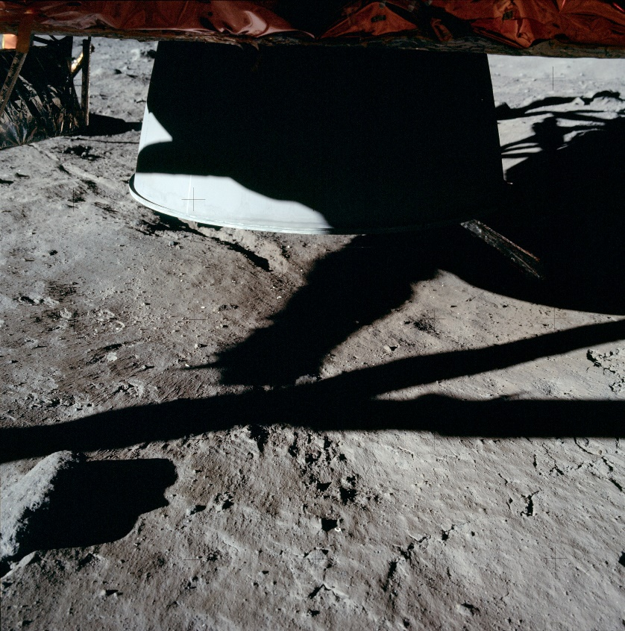
Background: Plume-Surface Interaction (PSI)
During descent, engine ejects regolith and forms a small crater
Ejected material poses a risk to lander and nearby objects
PSI is not well-understood
To date, no dedicated studies of extraterrestrial PSI
Apollo 11

Slide 3
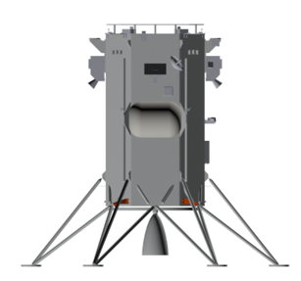
Background: SCALPSS
Stereo Cameras for Lunar Plume-Surface Studies
Science package to fly on the Intuitive Machines Nova-C lander
Equipped with four cameras for monitoring PSI
Cameras

Slide 4
Background: SCALPSS
Stereo Cameras for Lunar Plume-Surface Studies
Science package to fly on the Intuitive Machines Nova-C lander
Equipped with four cameras for monitoring PSI
Will conduct photogrammetric measurement of plume-induced crater
Cameras
Lunar surface
Descent engine crater

Slide 5
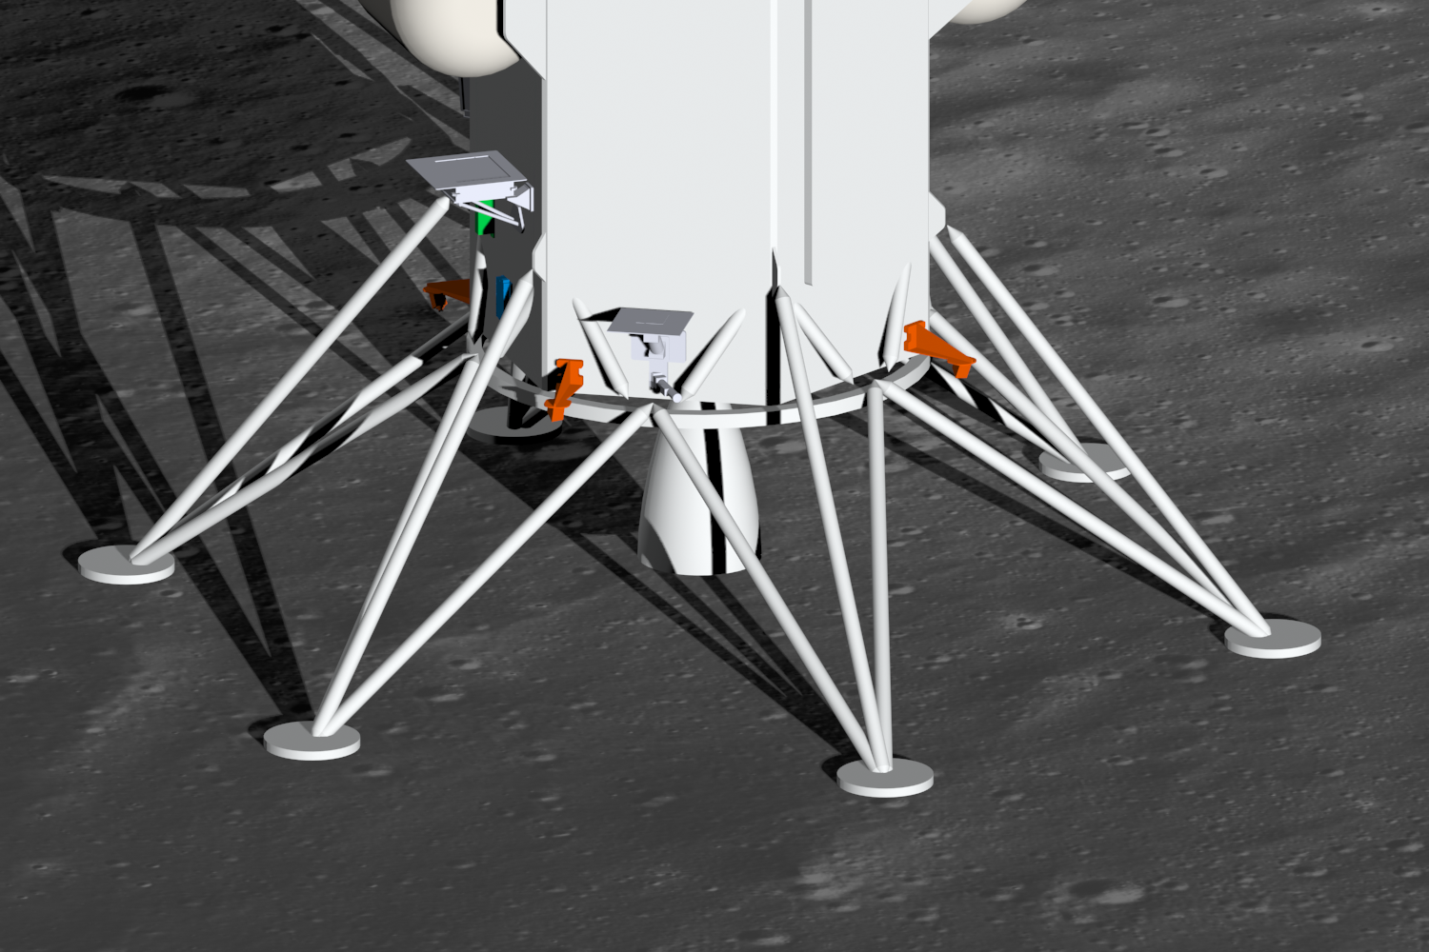
Simulation Environment
Shaded by lander
3D environment simulated in computer graphics software
Simulated camera views, sunlight/shadow
Simulated lunar surface

Slide 6
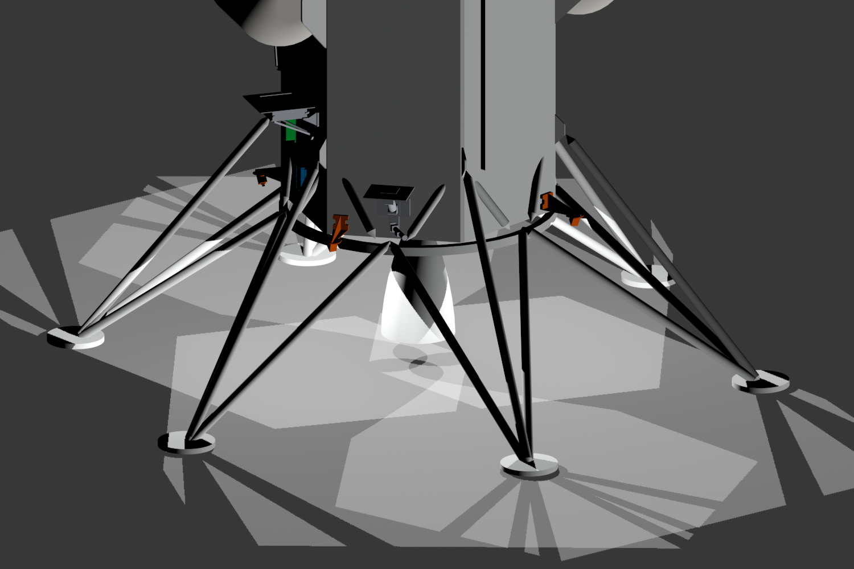
Simulation Environment
Not visible to cameras
3D environment simulated in computer graphics software
Simulated camera views, sunlight/shadow
Camera views projected on ground
Used to minimize obstruction of cameras by lander structure
Visible to cameras

Slide 7

Stereo Coverage Mapping
Snapshot of projected camera views taken for analysis
Brightness in image corresponds to visibility by cameras
footpads

Slide 8
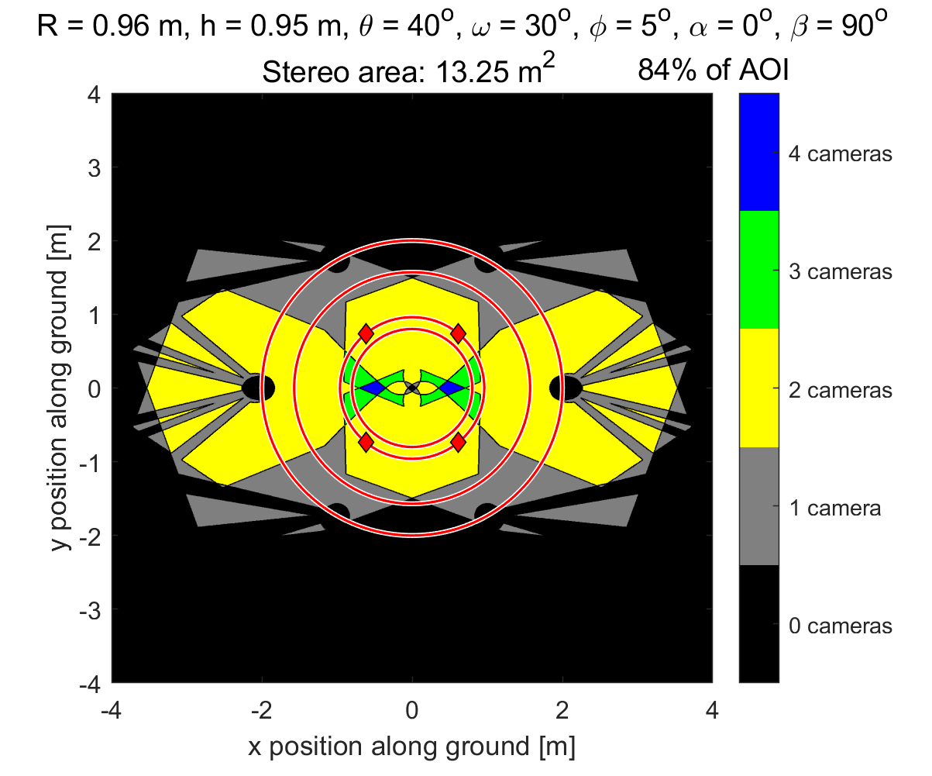
Stereo Coverage Mapping
Snapshot of projected camera views taken for analysis
Brightness in image corresponds to visibility by cameras
Apply physical scale
Sum stereo coverage area
Calculate percent of area of interest that falls within coverage

Slide 9
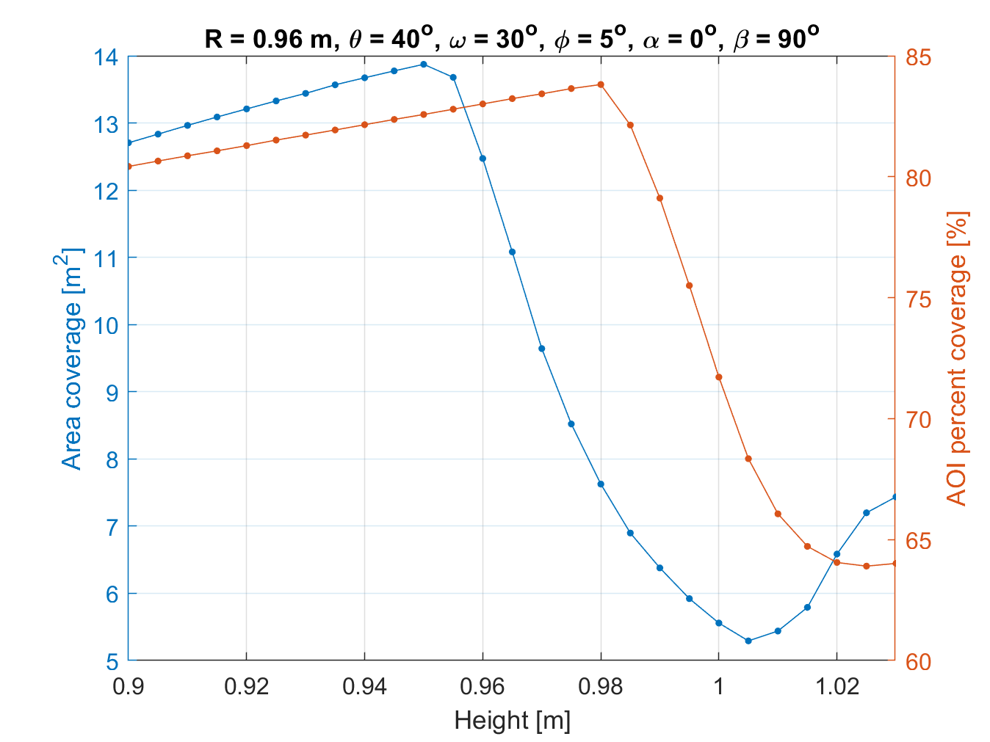
Design Optimization Studies
Enables fast simulation of many different camera system designs
Determine optimal design within a given test matrix

Slide 10
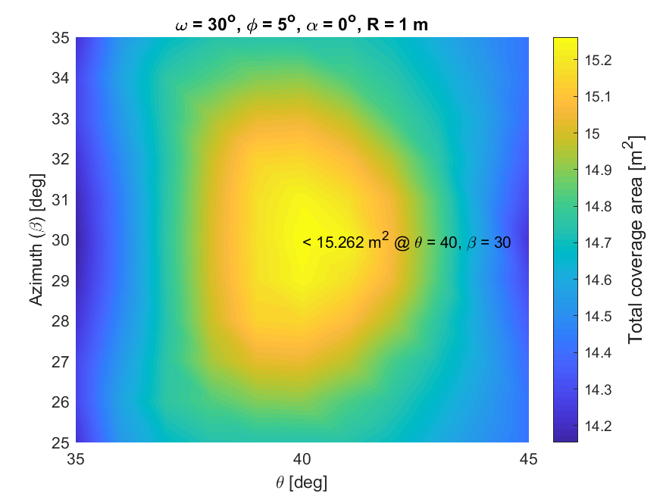
Design Optimization Studies
Enables fast simulation of many different camera system designs
Determine optimal design within a given test matrix
Maximize coverage area with respect to multiple variables simultaneously

Slide 11
Final Configuration Decision
Provides 13.25 m² of coverage area
84% of AOI is covered
Performance of system maximized given constraints

Slide 12
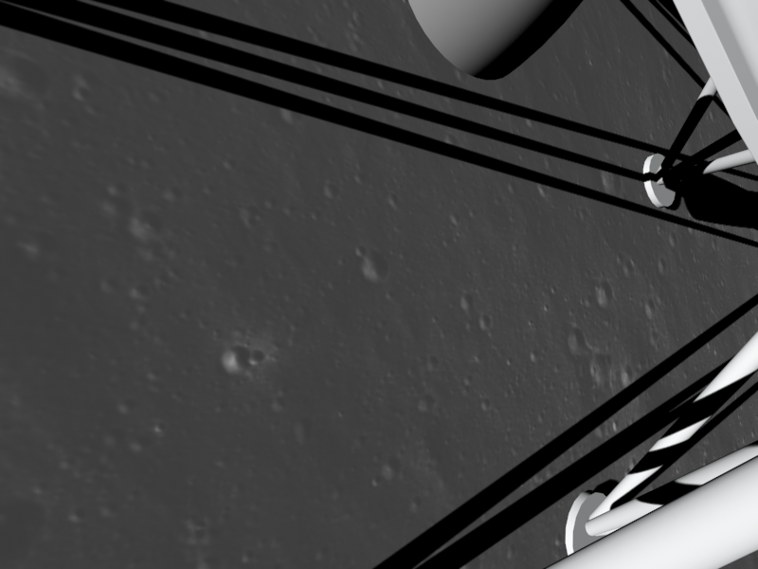
Final Configuration Decision
Simulated camera view
Provides 13.25 m² of coverage area
84% of AOI is covered
Performance of system maximized given constraints
Camera views of footpads, engine bell, and lander body

Slide 13
References
  Immer, C., Lane, J., Metzger, P., and Clements, S., “Apollo video photogrammetry estimation of plume impingement effects,” Icarus, Vol. 214, No. 1, pp. 46-52, 2011.
  Mehta, M., Sengupta, A., Renno, N.O., Van Norman, J.W., Huseman, P.G., Gulick, D.S., and Pokora, M., “Thruster Plume Surface Interactions: Applications for Spacecraft Landings on Planetary Bodies,” AIAA Journal, Vol. 51, No. 12, 2013.
  Metzger, P.T., Immer, C.D., Donahue, C.M., Vu, B.T., Latta III, R.C., and Deyo-Svendsen, M., “Jet-Induced Cratering of a Granular Surface With Application to Lunar Spaceports,” J. Aerosp. Eng., 22(1), pp. 24-32, 2009.
Acknowledgements
The SCALPSS Project was funded by the NASA Science Mission Directorate (SMD) through the NASA Provided Lunar Payload (NPLP) Development Program. The authors would like to thank Intuitive Machines for providing 3D models of the Nova-C lander and contributing to valuable discussions regarding the design and operation of the SCALPSS camera system.

